Slide 1
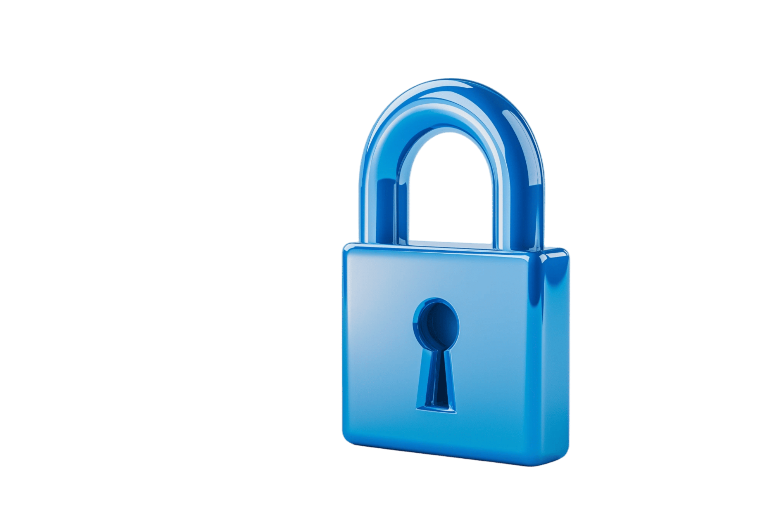

Empirical Security & Privacy, for Humans
UPenn CIS 7000-010
10/28/2025
Privacy and Human Behavior in the Age of Information

Slide 2
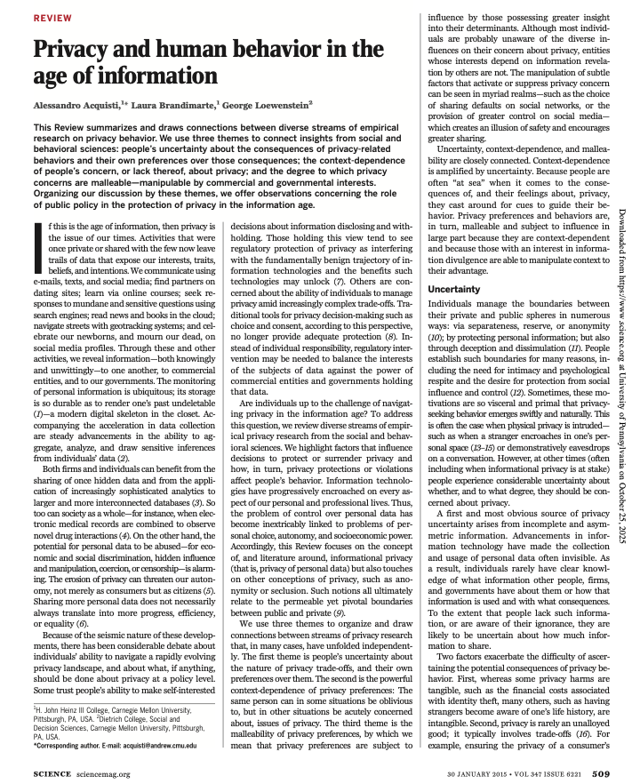
Reading

Slide 3
Alan Westin Privacy Segmentation Index (1995)
Questions: How strongly do you agree or disagree?
PC?
1 = Strongly Disagree, 2 = Somewhat Disagree, 3 = Somewhat Agree, 4 = Strongly Agree
Consumers have lost all control over how personal information is collected and used by companies.
Most businesses handle the personal information they collect about consumers in a proper and confidential way.
Existing laws and organizational practices provide a reasonable level of protection for consumer privacy today.
3,4
1,2
1,2

Slide 4
Alan Westin Privacy Segmentation Index (1995)
Questions: How strongly do you agree or disagree?
PC?
1996Res
Segment
Consumers have lost all control over how personal information is collected and used by companies.
Most businesses handle the personal information they collect about consumers in a proper and confidential way.
Existing laws and organizational practices provide a reasonable level of protection for consumer privacy today.
Privacy Fundamentalists: Participants who give privacy concerned responses to all questions;
Privacy Unconcerned: Participants who give privacy concerned responses to no questions;
Privacy Pragmatists: All other participants
3,4
25%
1,2
16%
1,2
59%
1 = Strongly Disagree, 2 = Somewhat Disagree, 3 = Somewhat Agree, 4 = Strongly Agree

Slide 5
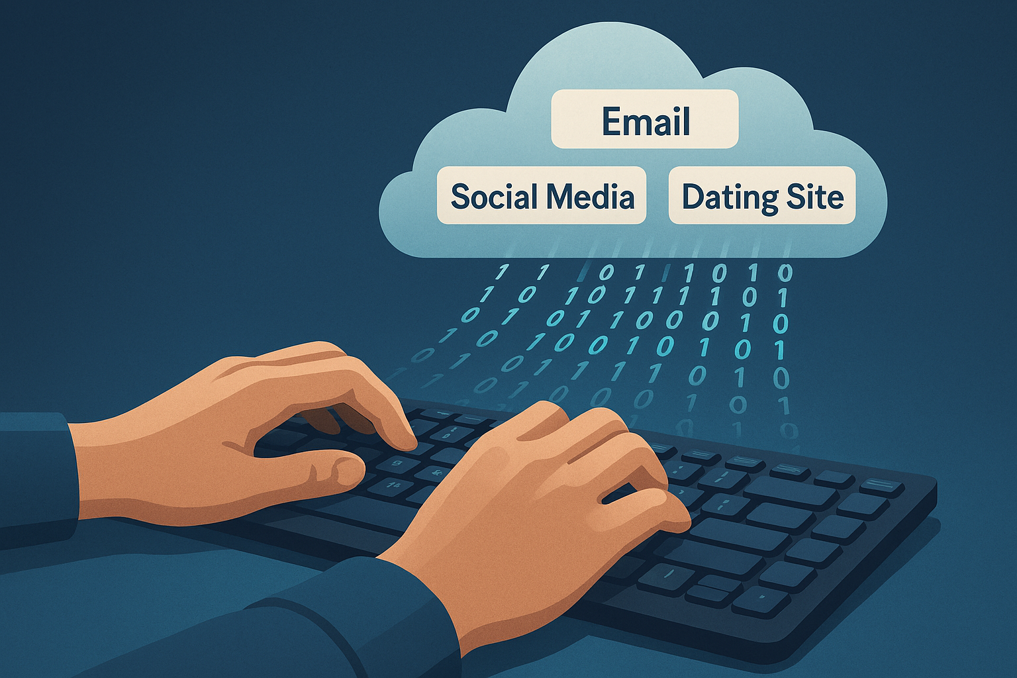
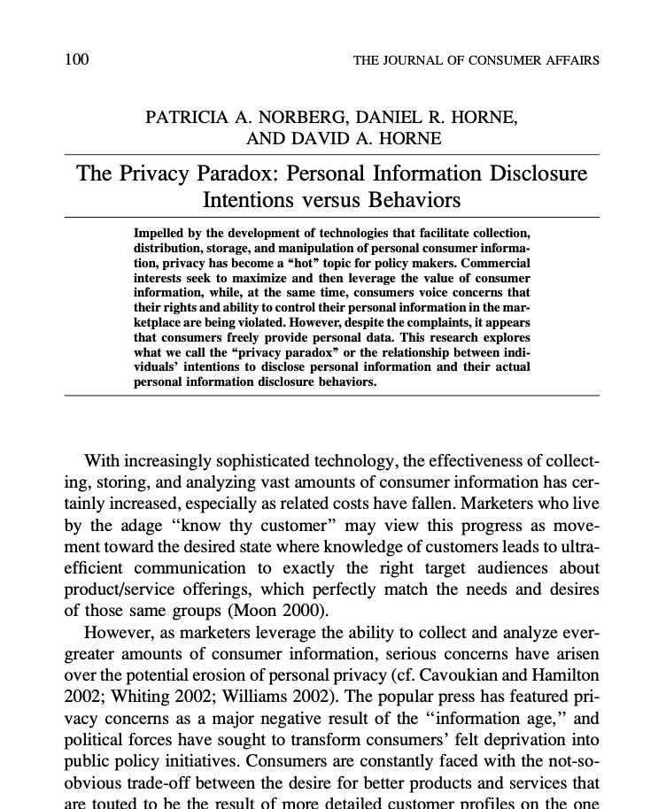
The Privacy Paradox
(2007)
People say they care about privacy.
So why do they share so much?
Those who bucket as Westin’s fundamentalists regularly share sensitive data for small rewards
Notes:
Example: 48% who said strangers shouldn't know their sexual orientation... publicly revealed it on social media

Slide 6
The Privacy Paradox
People say they care about privacy.
So why do they share so much?
Benefits
Personalization
Convenience
Social connection
But also risks
Discrimination
Manipulation
Loss of autonomy

Slide 7
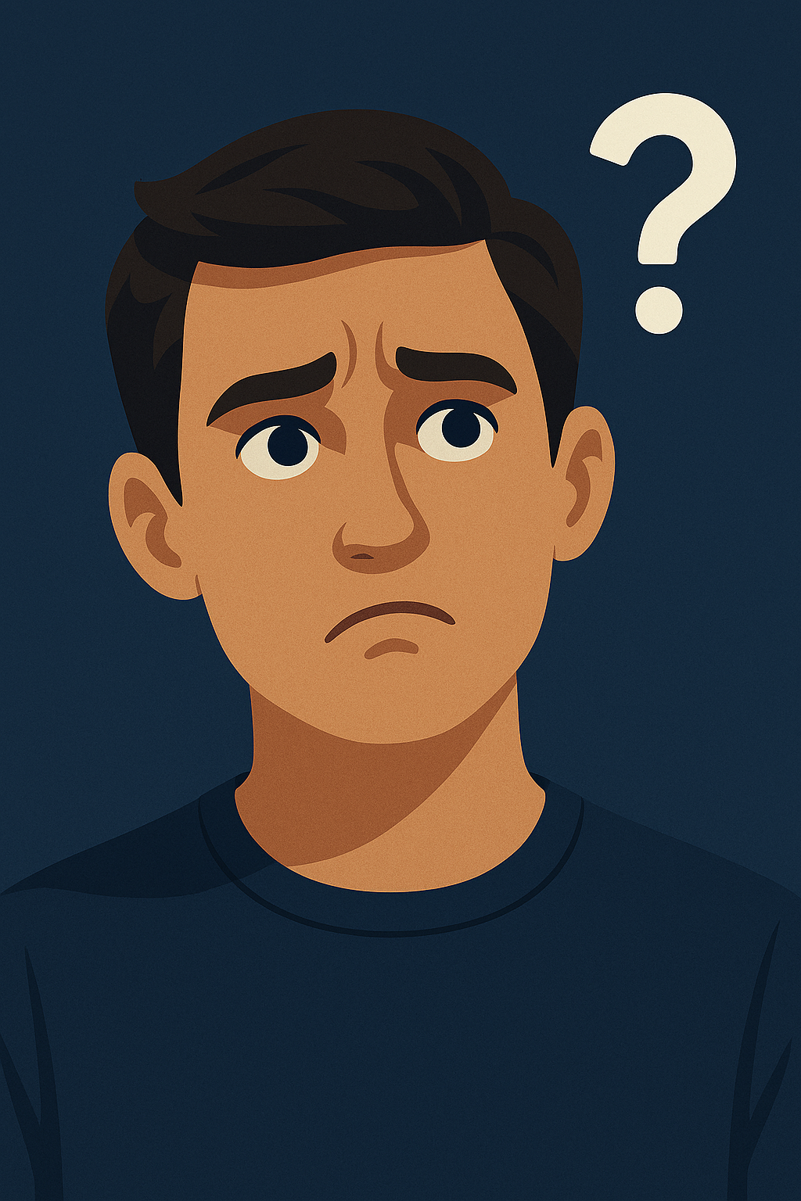

Why? Answer in three themes
Uncertainty
Malleability
Privacy preferences can be manipulated
Those who profit from data sharing can exploit psychological processes
Don’t know consequences of sharing
Don’t know own preferences
Context-dependence
Can be privacy-obsessed or careless; depends on situation
Environmental cues a strong influence on behavior

Slide 8
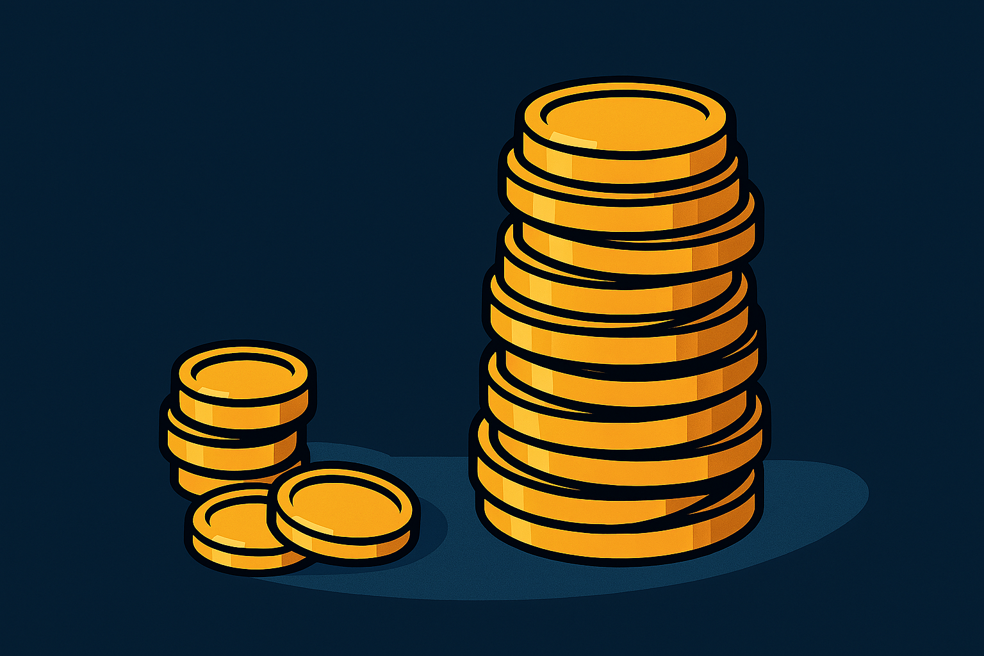
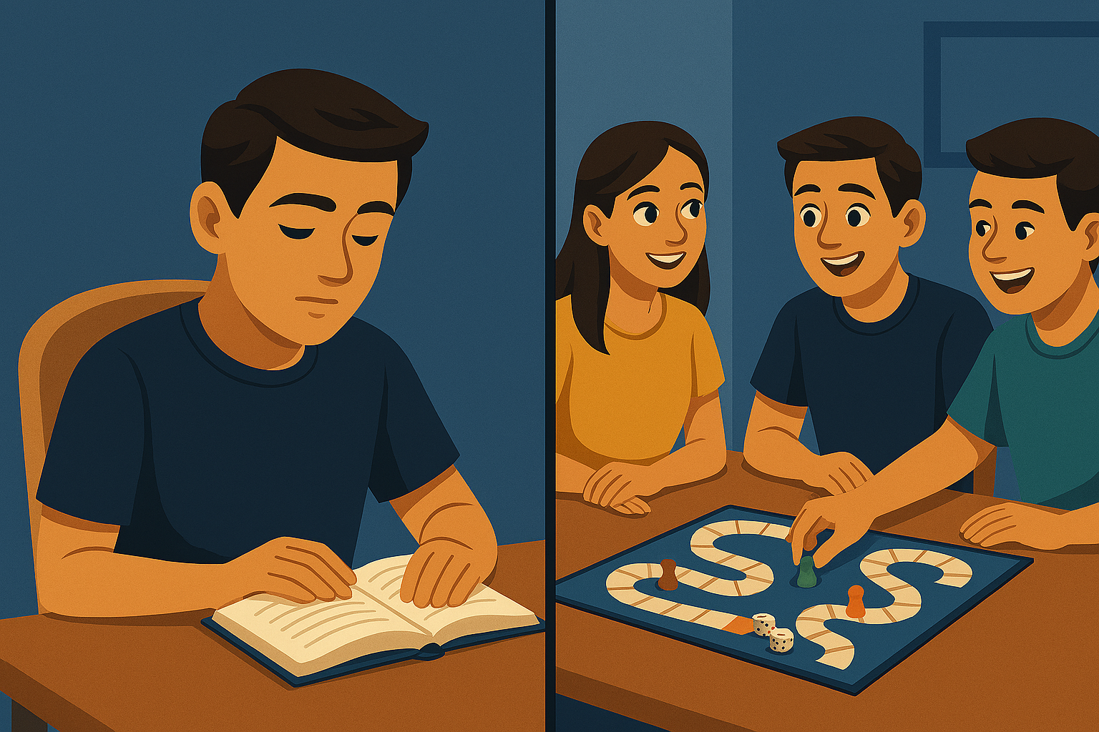
Uncertainty
Don’t know consequences of sharing
Don’t know own preferences
When consequences are tangible and clear, people act on privacy concerns
But:
Immediate gratification > delayed consequences
Misperceptions of atual costs & benefits
Mental shortcuts, emotional factors
Fundamental tension: Need for privacy vs. desire to share and connect
Notes:
Click 1: The Search Engine Experiment:
Participants bought batteries or sex toys online
Condition 1: Just price comparison → most ignored privacy policies, chose cheapest
Condition 2: Privacy info made salient → majority paid ~5% premium for privacy-protecting merchants
Click 2:
- Endowment effect: People value privacy 5x more when they have it than when they don’t
- Gift card experiment: 52.1% kept $10 anonymous card vs. 9.7% who kept it when starting with $12 trackable card
Click 3:
Humans are social animals:
Self-disclosure builds relationships (social penetration theory)
Sharing provides psychological and physical health benefits
Builds social capital and self-esteem
Even activates reward mechanisms in the brain (fMRI studies)
The Fundamental Tension:
Need for privacy vs. desire to share and connect
Privacy provides foundation for intimate disclosure
Social media provides unprecedented opportunities for both

Slide 9
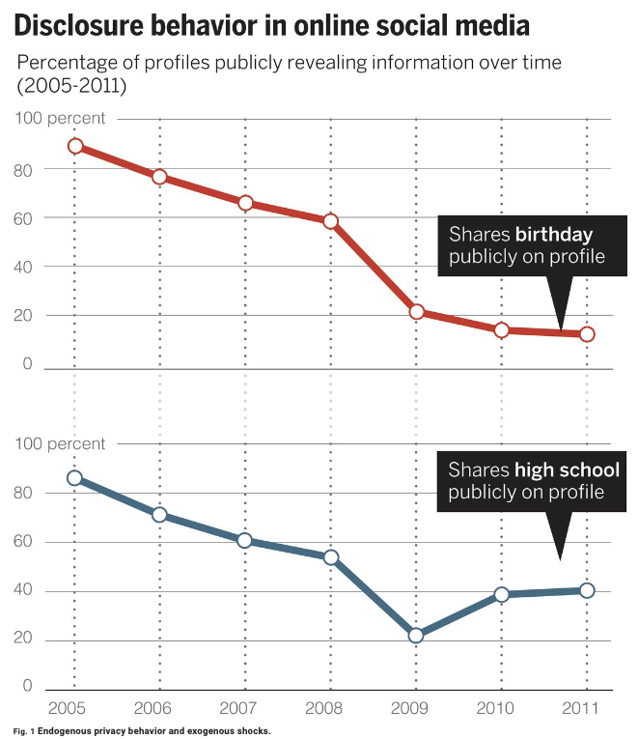
Context-dependence
Can be privacy-obsessed or careless; depends on situation
Notes:
Boundaries between public and private are murky
Rules for managing privacy are learned, cultural, situational
Click:
Steady decrease over time, as privacy awareness grew: The percentage of members in the Carnegie Mellon University Facebook network who chose to publicly reveal personal information decreased dramatically. For instance, over 80% of profiles publicly revealed their birthday in 2005, but less than 20% in 2011.
Context: platform change led to uptick:
The decreasing trend is not uniform, however. After decreasing for several years, the percentage of profiles that publicly revealed their high school roughly doubled between 2009 and 2010—after Facebook changed the default visibility settings for various fields on its profiles, including high school (bottom), but not birthday (top)

Slide 10
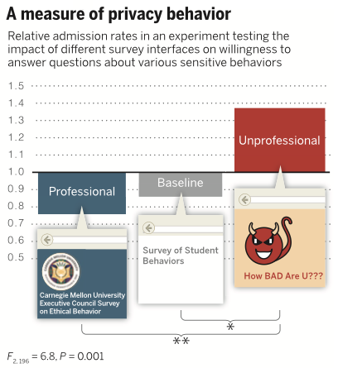
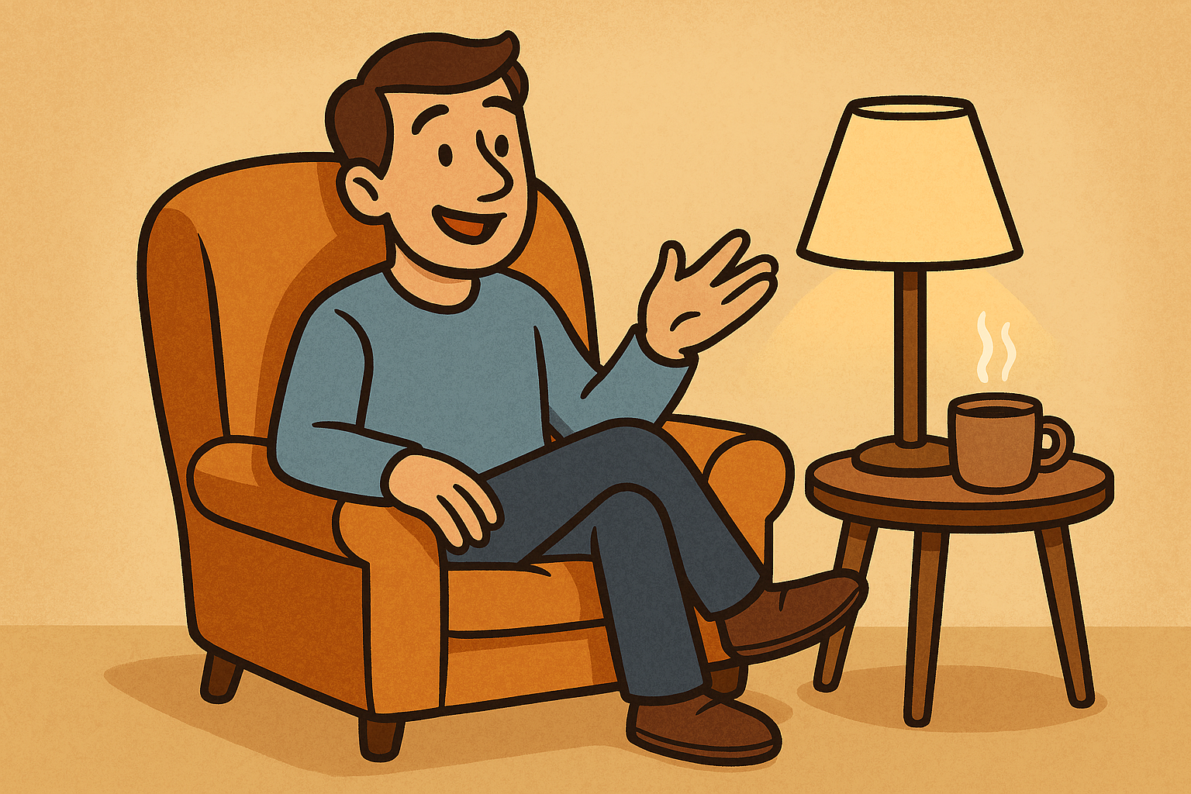
Context-dependence
Can be privacy-obsessed or careless; depends on situation
Environmental cues are a strong influence
Notes:
Cues influence disclosure:
Warm, comfortable rooms with soft lighting → more intimate disclosure
Cold rooms with fluorescent lights → less disclosure
Click:
In an online experiment (47), individuals were asked a series of intrusive questions about their behaviors, such as “Have you ever tried to peek at someone else’s e-mail without them knowing?”
Across conditions, the interface of the questionnaire was manipulated to look more or less professional.
The y axis captures the mean affirmative admission rates (AARs) to questions that were rated as intrusive (the proportion of questions answered affirmatively) normed, question by question, on the overall average AAR for the question.
Cues can be unrelated or even opposite to rational privacy protection
Subjects revealed more personal and even incriminating information on the website with a more casual design, even though the site with the formal interface was judged by other respondents to be much safer. The study illustrates how cues can influence privacy behavior in a fashion that is unrelated, or even negatively related, to normative bases of decision-making.
--

Slide 11
Context-dependence: Other factors
Social cues
Imitation (“majority admitted this behavior”)
Reciprocity
Adaptation over time
Surveillance (“breaking ice” effect)
Change activates concern; stability dulls it
On-line setting: Context confusion
Boundaries are blurry
Privacy management both more complex and more consequential
Notes:
Social Cues and Norms
Descriptive norms (imitation):
Observing others reveal information increases your likelihood of revealing
Survey experiment: Told "majority admitted this behavior" → increased admission of other sensitive behaviors
Reciprocity:
People reveal more to computer agents that "share" about themselves
Information sharing makes others "co-owners" with responsibility to protect
Privacy turbulence:
When co-owners mismanage shared info → anger, mistrust, boundary restrictions
Adaptation Over Time
We get used to surveillance:
Helsinki household monitoring experiment
Initially changed behavior (conversations, nudity, sex)
"Breaking the ice" effect when accidentally doing monitored activity
Became inured to technology presence over time
Change activates concern, stability dulls it:
Introduction of camera → discomfort, reduced productivity
Continued presence → adaptation
Privacy concern is reactive, not proactive
Context Confusion Online
Online boundaries are blurrier:
Who's reading our posts? Unclear spatial boundaries
Social groups mixing (coworkers + family + friends)
Difficult to separate online/offline identities
Hard to meet multiple audiences' privacy expectations
The result:
People simultaneously increase sharing to friends AND decrease sharing to strangers
Context collapse makes privacy management more complex and consequential

Slide 12
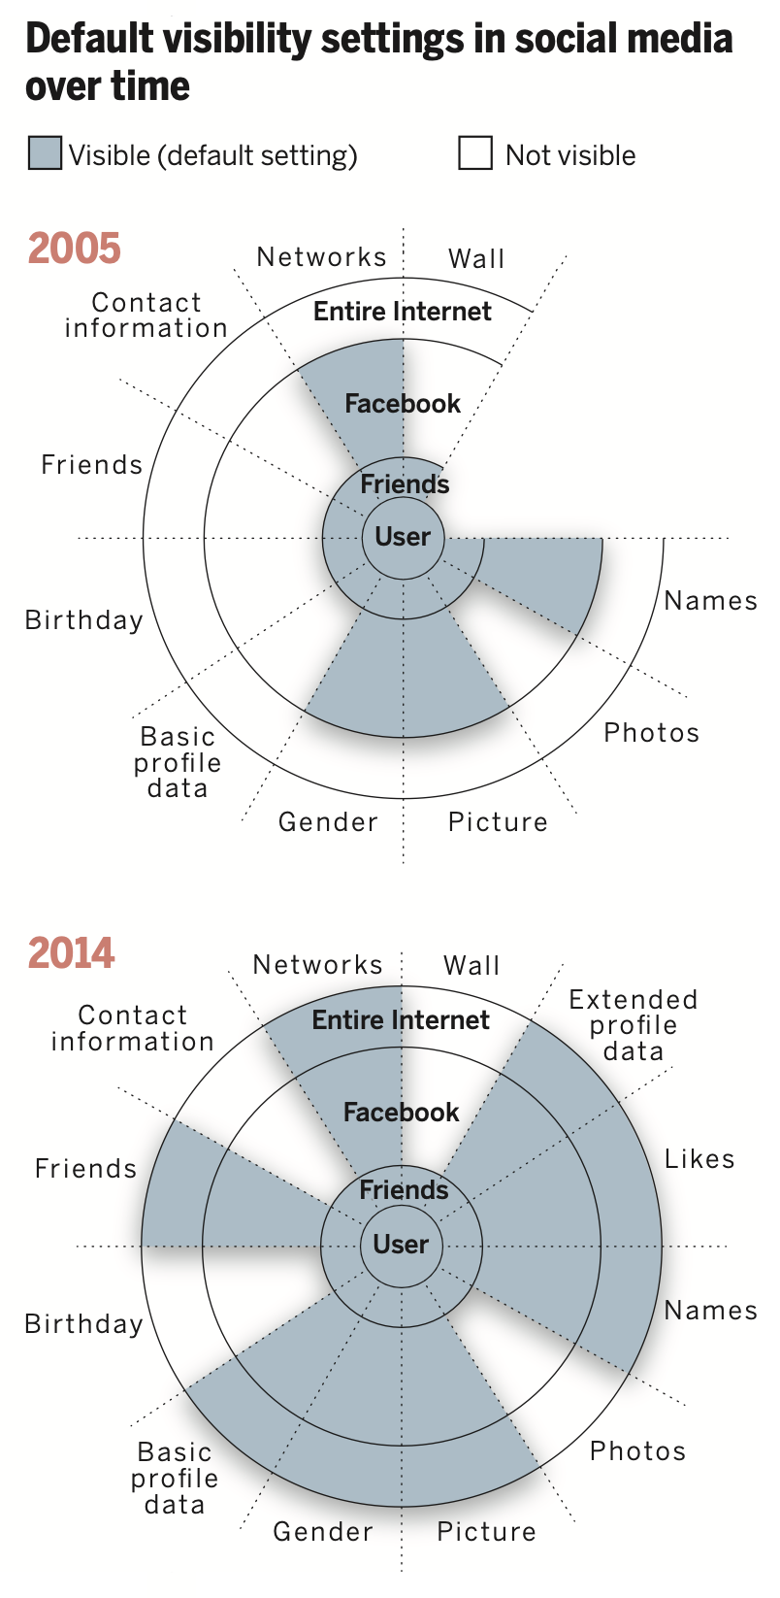
Malleability
Privacy preferences can be manipulated
Those who profit from data sharing can exploit psychological processes
Notes:
Power of defaults:
Over time, Facebook profiles included an increasing amount of fields and, therefore, types of data. In addition, default visibility settings became more revelatory between 2005 (top) and 2014 (bottom), disclosing more personal information to larger audiences, unless the user manually overrode the defaults
In general:
opt-in vs. opt-out (default assumed to be ‘recommended’ version, and safe)
Defaults become increasingly revelatory (Helsinki effect)
Malicious interface design
Too much precision rings alarm bells (too precise ads)
Make change of settings difficult to understand
Collect data invisibly while keeping users comfortable

Slide 13
Malleability: Other factors
The paradox of trust and control
Simply posting unread privacy policy → misplaced feelings of protection
Greater control over disclosure → reduced concern → more sharing
Privacy policies
Most people don’t read them – if they did, est. $781B prod. cost/year !
Transparency requires comprehensibility, accessibility, actionability
Not all malleability is sinister
Monitoring, good defaults, simple cues can increase prosocial behavior
Anonymity can increase truthful responses but also enable cheating and dishonesty
Notes:
Trust and Control (Paradoxical Effects)
Trust reduces concern:
62% believe privacy policy means site CAN'T share info without permission (incorrect!)
Simply posting unread policy → misplaced feelings of protection
Control can backfire:
Greater control over disclosure → reduced concern → more sharing
Experiment: Participants given explicit control shared MORE sensitive info with broader audience
Opposite of intended purpose!
The illusion of safety encourages risk-taking
Transparency Theater
Privacy policies don't work:
Overwhelming majority don't read them
Half written beyond grasp of most users
Estimated cost if everyone read them: $781 billion/year
Transparency requires:
Not just availability of information
Comprehensibility, accessibility, actionability
Current implementations fail on all counts
Monitoring and Accountability
Not all malleability is sinister:
Monitoring can reduce productivity BUT also increase prosocial behavior
Feeling observed → adherence to social norms
Simple cues (three dots in face configuration) can heighten prosocial behavior
Anonymity is complex:
Can increase truthful survey responses (beneficial)
Can enable cheating and dishonesty (disinhibition effect)
With religiosity priming → increases prosocial sharing
Context determines whether manipulation is beneficial or harmful

Slide 14


Policy implications
People cannot adequately self-protect
So individual empowerment is insufficient
Need baseline protection framework
Fair information principles and practices
Protection that doesn't require constant informed decision-making
Accommodate real humans: "naïve, uncertain, and vulnerable"
Goal: Equity of power
Notes:
People cannot self-protect adequately:
Uncertainty → can't make informed decisions
Context-dependence → behavior is inconsistent and influenced by irrelevant cues
Malleability → vulnerable to manipulation by sophisticated actors
Individual empowerment is insufficient:
"Notice and consent" model assumes rational, informed decision-making
Transparency and control can backfire
Uneven playing field between individuals and data holders

Slide 15
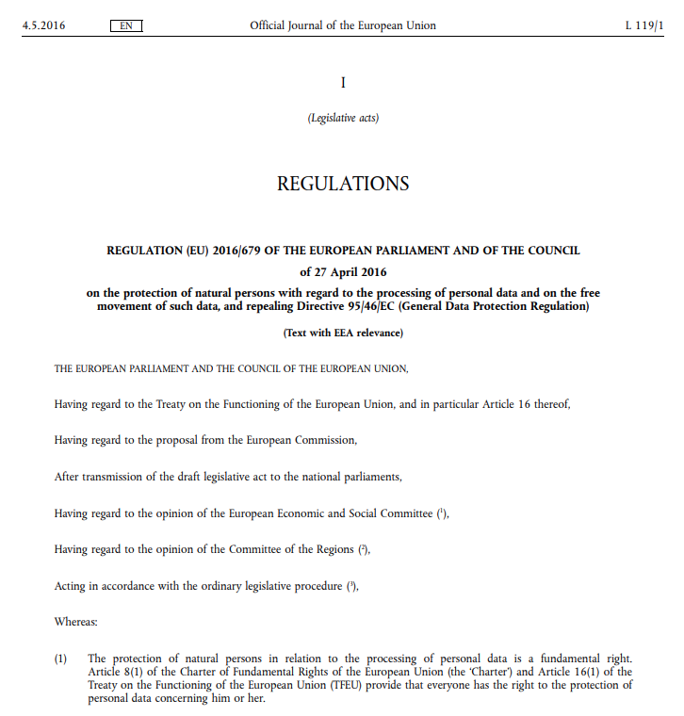
General Data Protection Regulation (GDPR)
Regulates and protects the processing of personal information (of EU citizens)
Companies must be transparent about the personal data they handle and have a legitimate purpose for using it
Notes:
GDPR concept first proposed in 2012
Passed 14 April 2016
25 May 2018 Implementation date
(This paper published in 2015)

Slide 16
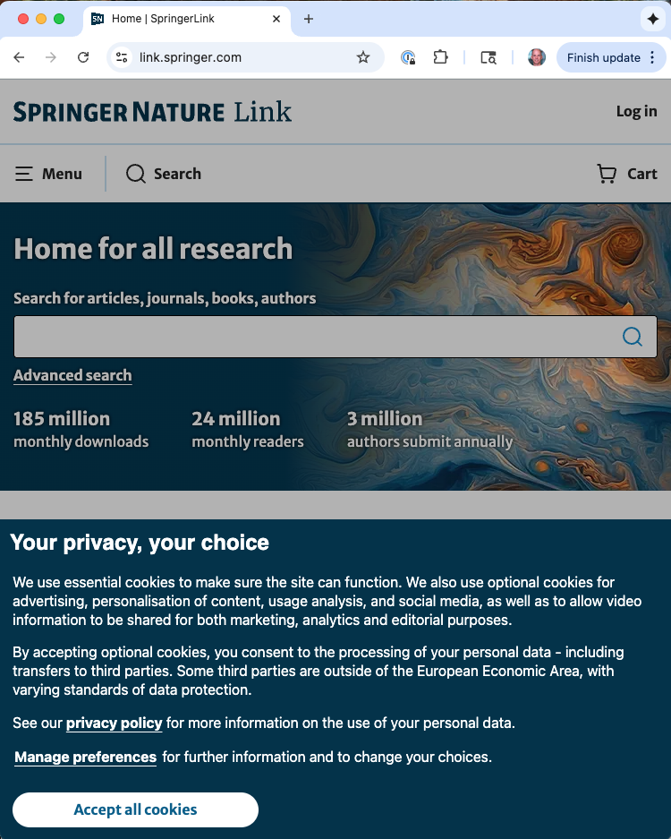
GDPR: Personal rights
Data subjects have a Right
to be Informed
of Access
to Rectification
to Erasure
to Restrict Processing
to Data Portability
to Object
to not to be subject to a decision based solely on automated processing (with exceptions)
Notes:
GDPR passed 14 April 2016
25 May 2018 Implementation date
(This paper published in 2015)
https://www.itgovernance.eu/blog/en/the-gdpr-consumer-rights-for-your-personal-data

Slide 17
GDPR and context-dependence, malleability
Context dependence
Malleability
Habituation: Repeated consent warnings cause fatigue, leading to surveillance acquiescence
Control: Fine-grained data controls encouraged by the law, but paradoxically discourage privacy
Consent: Using "pre-ticked boxes" or convoluted consent forms that aren't freely given
Transparency: Making privacy policies overly complex or hard to find, despite GDPR requiring transparency
Law does not force companies to reveal uncertain benefits and consequences, nor require them to nudge people toward the former

Slide 18
Key takeaways
The privacy paradox is real → people say one thing, do another
Three interconnected themes explain the paradox:
Uncertainty amplifies context-dependence
Context-dependence enables malleability
Malleability creates power imbalances
Our instincts are inadequate for navigating information age privacy
Policy must protect vulnerable humans, not assume rational actors
Baseline protections are necessary, not just individual choice

Slide 19
Discussion questions
Do you recognize these patterns in your own privacy behavior?
What examples of "malicious design" have you encountered?
Should there be stronger regulations on default settings?
How do we balance innovation benefits with privacy protection?
Is the "notice and consent" model salvageable, or do we need a completely different approach?

