Slide 1


Secure Systems Engineering and Management
A Data-driven Approach
Michael Hicks
Intrusion Detection
and
Security Operations
UPenn CIS 7000-003
Spring 2026

Slide 2
Roadmap
Security incident lifecycle (overview)
Detection: history, tools, challenges
Suricata and Zeek in depth
Security Operations Centers (SOCs)
Notes:
This lecture focuses on what happens after software is deployed. Once systems are live, organizations must detect, contain, eradicate, and recover from attacks. We’ll briefly frame the NIST incident lifecycle, then dive deep into detection — particularly intrusion detection systems — and the people and processes that operate them (SOCs). We’ll close with the project, which has you using Zeek and Suricata hands-on.

Slide 3
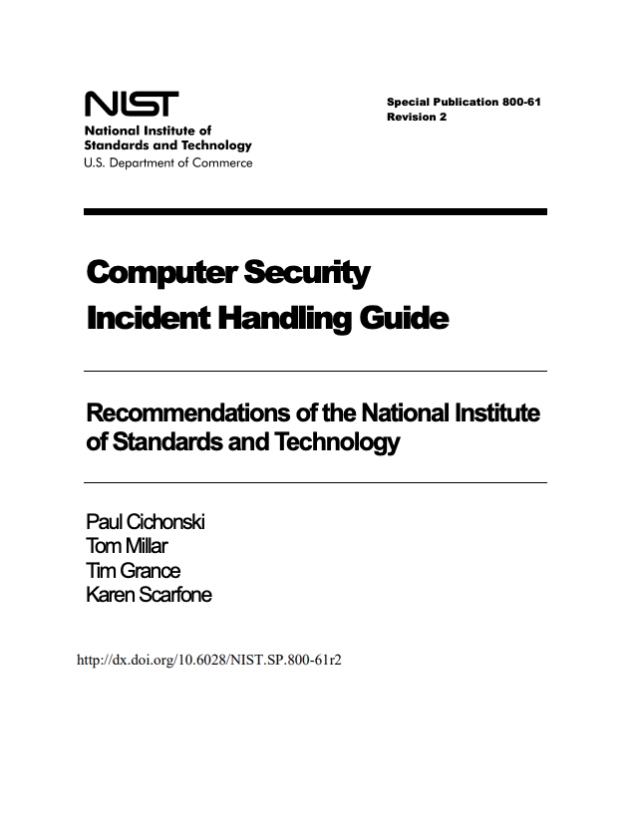
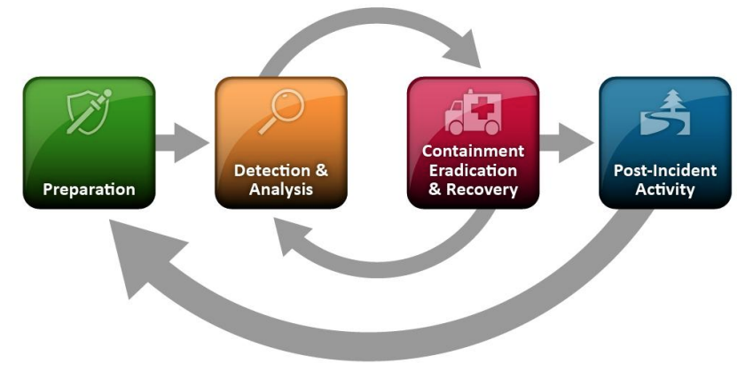
The Incident Lifecycle (NIST SP 800-61)
Notes:
[FIGURE: Circular diagram showing six phases: Preparation → Detection & Analysis → Containment → Eradication → Recovery → Lessons Learned, with arrows connecting each phase in a cycle and a feedback arrow from Lessons Learned back to Preparation.]
The NIST Computer Security Incident Handling Guide (SP 800-61) defines the standard framework for incident response. It has six phases forming a cycle. This is the framework used by most organizations and referenced in certifications like CISSP and GCIH.

Slide 4
The Six NIST Phases
Phase | Goal
Preparation | Tools, plans, trained staff, baselines
Detection & Analysis | Identify and validate malicious activity
Containment | Stop the spread; short-term and long-term
Eradication | Remove the threat from the environment
Recovery | Restore systems to normal operations
Post-incident activity | Lessons learned; feed improvements back
Today’s focus: Detection & Analysis
Notes:
Preparation is everything you do before an incident: deploying IDS sensors, writing runbooks, training analysts, establishing baselines of normal activity. Detection & Analysis is identifying that something malicious is happening and understanding its scope — this is the bulk of today’s lecture. Containment stops the bleeding (isolate a host, block an IP). Eradication removes the root cause (patch the vulnerability, remove the malware). Recovery restores normal operations. Lessons Learned closes the loop: what did we miss, what can we improve? The SOC section of this lecture will touch on all six phases, but our deep dive is on detection.

Slide 5
Why Detection is Hard
“Attackers need to find one vulnerability.
Defenders need to protect everything.”
Asymmetric advantage for attackers
Massive volume of normal activity to sift through
Sophisticated attackers blend in with legitimate traffic
Detection must be fast, accurate, and actionable
Notes:
This framing helps understand why detection is not a solved problem despite decades of research. The defender’s dilemma is fundamental: you must monitor everything, while the attacker only needs one way in. We’ll see throughout this lecture how this asymmetry shapes tool design, SOC operations, and the challenges that persist.

Slide 6
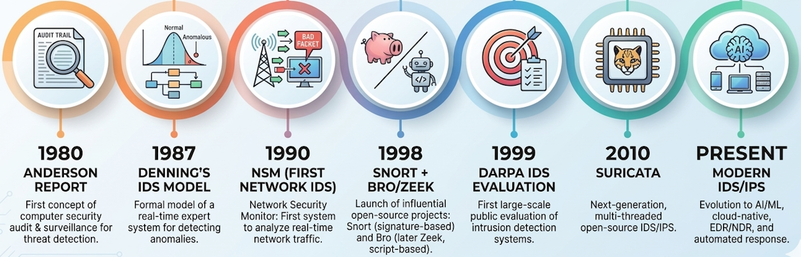
Automating Attack Detection: A Brief History
Notes:
The concept of monitoring audit trails for intrusions dates to a 1980 report by James Anderson for the US Air Force.
Anderson’s 1980 report “Computer Security Threat Monitoring and Surveillance” was commissioned by the US Air Force. It identified that the primary threat to computer systems was not outsiders breaking in, but authorized insiders misusing their access. He proposed that this could be detected by monitoring audit trails — the records of who did what on the system. This was a novel idea: audit logs existed for accounting purposes, but Anderson was the first to propose using them for security. Denning’s model, seven years later, formalized Anderson’s concept into a rigorous framework.
Dorothy Denning formalized the first general IDS model in 1987. Todd Heberlein built the first network-based IDS (NSM) in 1990. Snort and Bro (now Zeek) appeared in 1998, taking very different approaches. The 1998-99 DARPA evaluation attempted to rigorously test IDS systems but was later criticized for methodological flaws. Suricata emerged in 2010 with multi-threaded performance. Each milestone shaped the field we work with today.

Slide 7
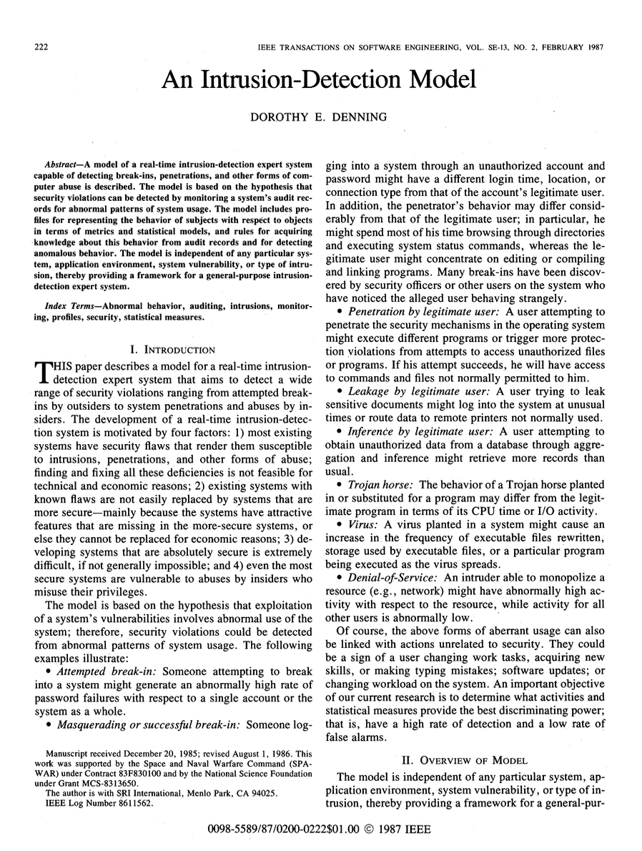
Denning’s Intrusion Detection Model (1987)
The foundational paper for the entire IDS field
Core thesis: intrusions can be detected in real time by monitoring audit records for abnormal patterns of system usage
Key contribution: a general-purpose, system-independent model
Notes:
Dorothy Denning’s 1987 paper “An Intrusion-Detection Model” in IEEE Transactions on Software Engineering formalized Anderson’s ideas into a complete model. She proposed that any system producing audit records could be monitored for intrusions using statistical profiling. The model is independent of any specific system, application, or type of intrusion. Nearly every IDS built since traces its conceptual lineage to this work. We’ll walk through its components because they map directly onto concepts in modern tools like Zeek and Suricata.
Reference: D. Denning, “An Intrusion-Detection Model,” IEEE TSE, Vol. SE-13, No. 2, Feb 1987.

Slide 8
Denning’s Model: Six Components
Subjects — who initiates activity (users, processes)
Objects — targets of activity (files, programs, resources)
Audit Records — <Subject, Action, Object, Exception, Resource-Usage, Timestamp>
Activity Profiles — statistical models of “normal” behavior
Anomaly Records — generated when behavior deviates from profile
Activity Rules — what to do when anomalies are detected
Notes:
The model’s power is its generality. Audit records are the raw data — in modern terms, these are log entries, and you can see a direct line from Denning’s audit record format to Zeek’s conn.log (which records subject/source, object/destination, action/protocol, timestamps, and resource usage like bytes transferred). Activity profiles are the heart of anomaly detection — this concept persists in modern UEBA (User and Entity Behavior Analytics) systems, though it’s largely fallen out of favor for network IDS in favor of signature matching (as we’ll see in Suricata). Activity rules map to what we now call detection rules or SIEM correlation rules.

Slide 9
Denning’s Statistical Approaches
Method | Idea | Modern echo
Event Counter | Count occurrences per time unit | Suricata threshold keyword
Mean + Std Dev | Flag activity >d std devs from mean | UEBA behavioral baselines
Multivariate | Correlate multiple metrics | SIEM correlation rules
Markov Process | Model command sequences as state transitions | Largely fallen out of favor for IDS
Time Series | Predict next observation, flag deviations | ML anomaly detection research
Notes:
Denning laid out specific statistical approaches that still echo through modern tools. Event counting is alive and well — Suricata’s threshold keyword does exactly this (e.g., alert if more than 10 similar requests in 60 seconds). Mean/standard deviation approaches are what UEBA systems do, though they’ve proven difficult for network IDS due to the base-rate problem we’ll discuss shortly. The Markov and time series approaches have largely been explored in academic ML-for-IDS research but have not achieved widespread operational deployment — Sommer and Paxson’s 2010 paper explains why.

Slide 10
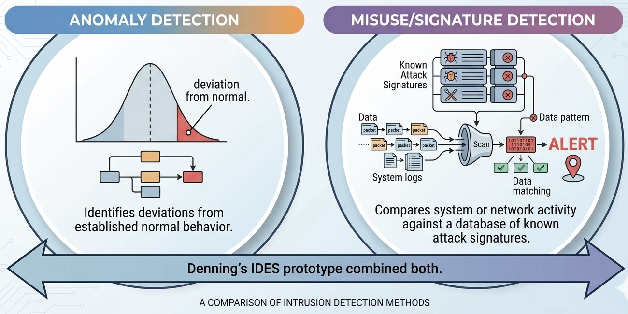
Denning: Two Detection Paradigms
Denning’s focus
Suricata (primarily)
Zeek
Notes:
Denning’s prototype IDES (Intrusion Detection Expert System) at SRI International combined both statistical anomaly detection and a rule-based expert system for known attack signatures. This hybrid approach became the standard architecture. In practice, the field has evolved: signature-based detection (Suricata, Snort) dominates operational deployment because it’s fast, explainable, and actionable. Anomaly-based approaches remain largely in the research domain. Zeek occupies an interesting middle ground — it doesn’t do anomaly detection natively, but its rich logs and scripting language let analysts build custom behavioral analysis.
Anomaly detection: Denning’s focus; flag deviations from “normal”
Misuse/signature detection: match against known attack patterns
Modern IDS: Suricata uses primarily signatures; Zeek enables both

Slide 11
Denning identified challenges still unsolved
Base-rate fallacy
even low FP rates produce many false alarms at scale
Training poisoning
if attacker present during training, malicious behavior becomes “normal”
Slow evasion
attackers gradually shift behavior to train the profile
Notes:
Remarkably, the challenges Denning identified in 1987 are still central challenges of IDS. The base-rate problem is mathematical — we’ll see Sommer and Paxson formalize this in 2010 and Alahmadi et al. confirm it operationally in 2022. Training poisoning and slow evasion are adversarial challenges that any statistical approach faces. The fact that these are still open problems after nearly 40 years speaks to the fundamental difficulty of intrusion detection.

Slide 12
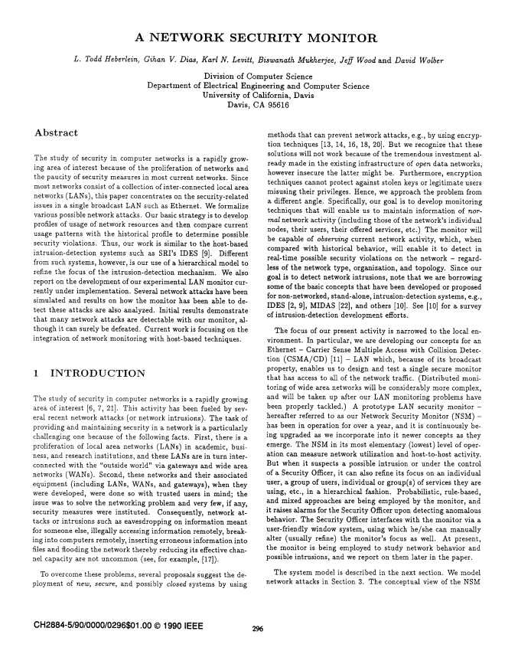
Network Security Monitor (1990)
Todd Heberlein at UC Davis built the first network-based IDS
Shifted IDS from host audit trails to network traffic
Monitored network packets rather than system logs
Demonstrated that network traffic analysis could detect attacks
Notes:
Denning’s model focused on host audit trails — log entries from individual computers. Heberlein’s Network Security Monitor (NSM), described in his 1990 paper “A Network Security Monitor,” was the first system to apply intrusion detection to network traffic. This was a fundamental shift: instead of monitoring what’s happening on each individual host, you monitor the traffic flowing between hosts. This provides a different vantage point — you can see lateral movement, C2 communication, and exfiltration that no single host would see. Every network IDS today, including Zeek and Suricata, descends from this idea.
Reference: T. Heberlein et al., “A Network Security Monitor,” IEEE S&P, 1990.

Slide 13
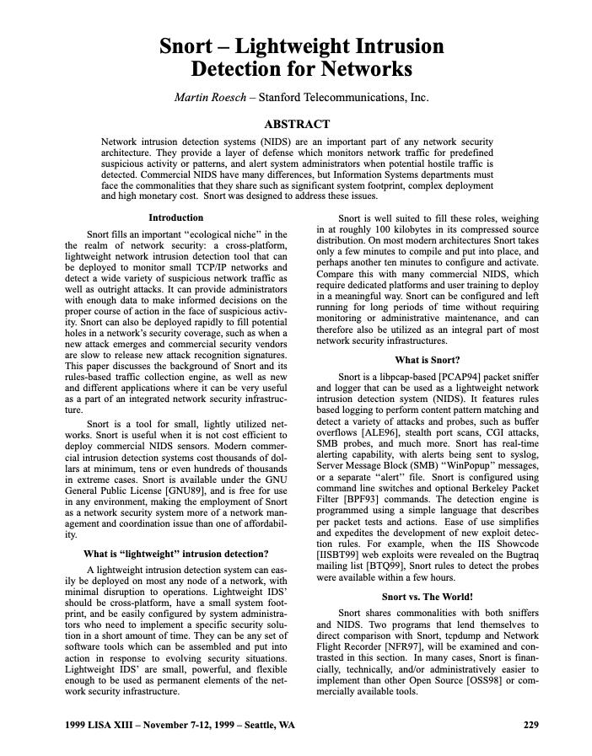
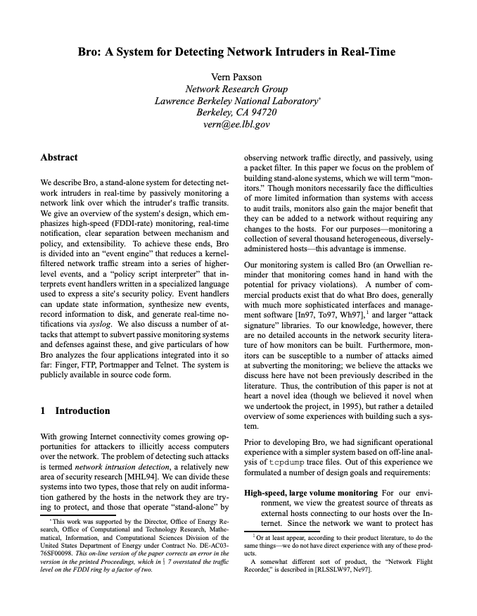
Snort and Bro (1998): Two Philosophies
As in “Big Bro” from 1984
(later: Zeek)

Slide 14
Snort and Bro (1998): Two Philosophies
 | Snort | Bro (Zeek)
Creator | Martin Roesch | Vern Paxson
Philosophy | Fast signature matching | Deep protocol analysis + scripting
Output | Alerts on known attacks | Rich logs of all network activity
Approach | “Does this match a known bad pattern?” | “What is happening on this network?”
Both open-source, both transformative, both still in use today
Notes:
1998 saw two landmark network IDS tools emerge with fundamentally different philosophies. Snort made signature-based network IDS accessible and affordable — its rule language became an industry standard. Bro (renamed Zeek in 2018) took a different path: rather than just alerting on known attacks, it produced comprehensive logs of all network activity and provided a scripting language for custom analysis. These two philosophies — signature matching vs. network visibility — remain the fundamental divide in network security monitoring. Suricata (2010) later combined elements of both: Snort-compatible signatures with Zeek-style protocol logging.

Slide 15
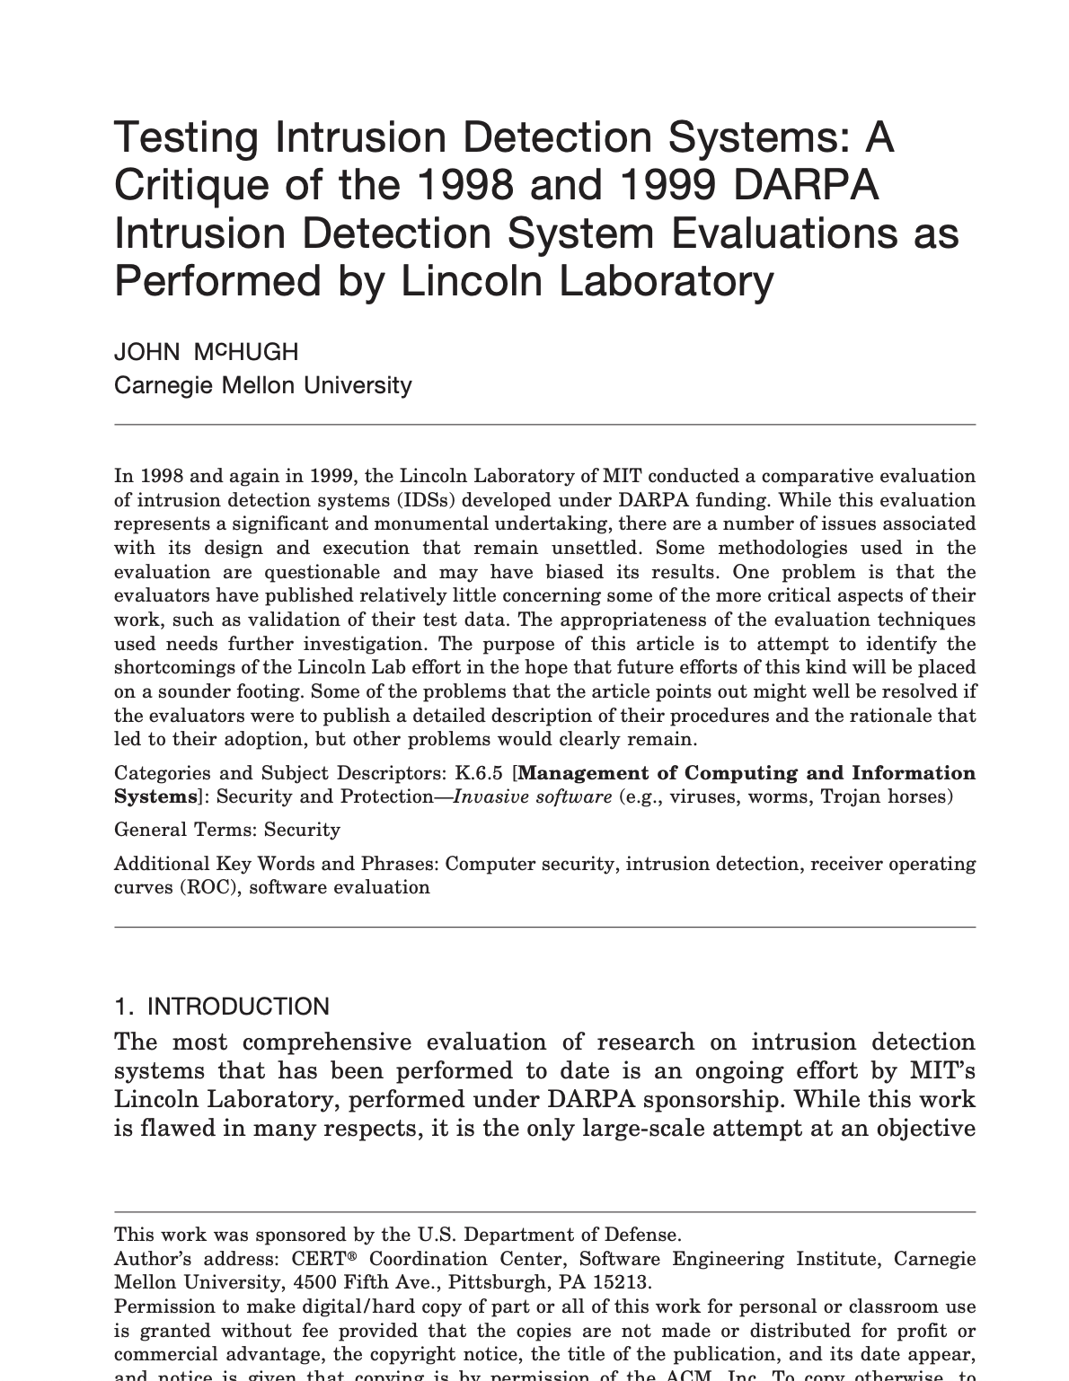
The DARPA IDS Evaluation (1998–99)
Lincoln Labs created a simulated network with injected attacks
First attempt at rigorous, standardized IDS testing
Most research papers used this dataset for over a decade
Shown to have serious methodological flaws (McHugh’00)
Synthetic traffic not representative of real networks
Attack/normal ratio unrealistic
Became a cautionary tale about evaluation methodology
Notes:
The 1998-99 DARPA Intrusion Detection Evaluation, conducted by MIT Lincoln Labs, was a well-intentioned effort to create a standard benchmark for IDS testing. They built a simulated Air Force network, generated background traffic, and injected known attacks. Most IDS papers from 1999 through the 2010s used this dataset (or the derived KDD Cup 1999 dataset) for evaluation. However, John McHugh’s 2000 critique demonstrated serious problems: the synthetic traffic didn’t resemble real network traffic, the attack-to-normal ratio was unrealistic, and results on this dataset didn’t predict real-world performance. This dataset’s flaws are directly cited by Sommer and Paxson in their 2010 critique of ML-based IDS. The lesson: evaluation methodology matters as much as the detection algorithm.
Reference: J. McHugh, “Testing Intrusion Detection Systems: A Critique of the 1998 and 1999 DARPA Intrusion Detection System Evaluations,” ACM TISSEC, 2000.

Slide 16
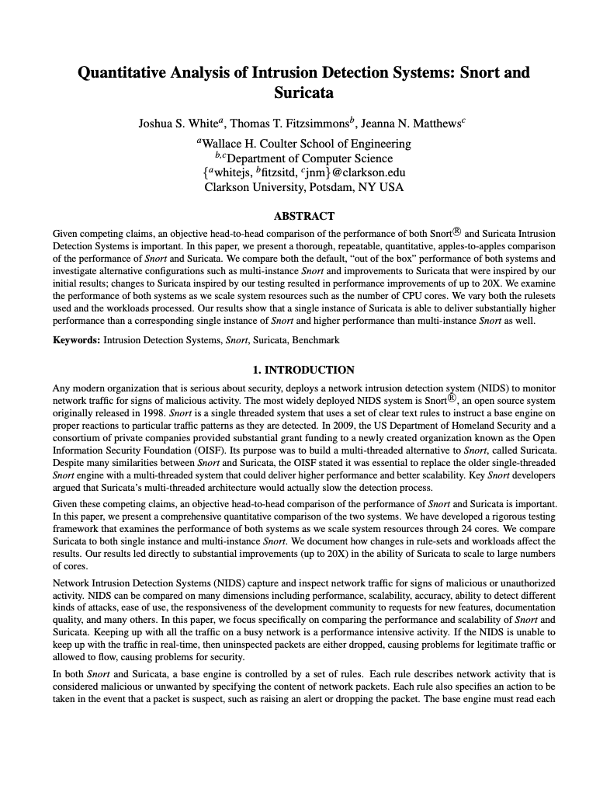
Suricata (2010)
Written by Open Information Security Foundation (OISF) in 2009
  OISF founded by DHS and others
Inspired by but improved on Snort
  Added multithreading support
  OISF development model prevents commercial capture
  Snort-compatible rule syntax — easy migration path
NB. In 2023, Snort added multithreading …

Slide 17
Detecting Attacks Today

Slide 18
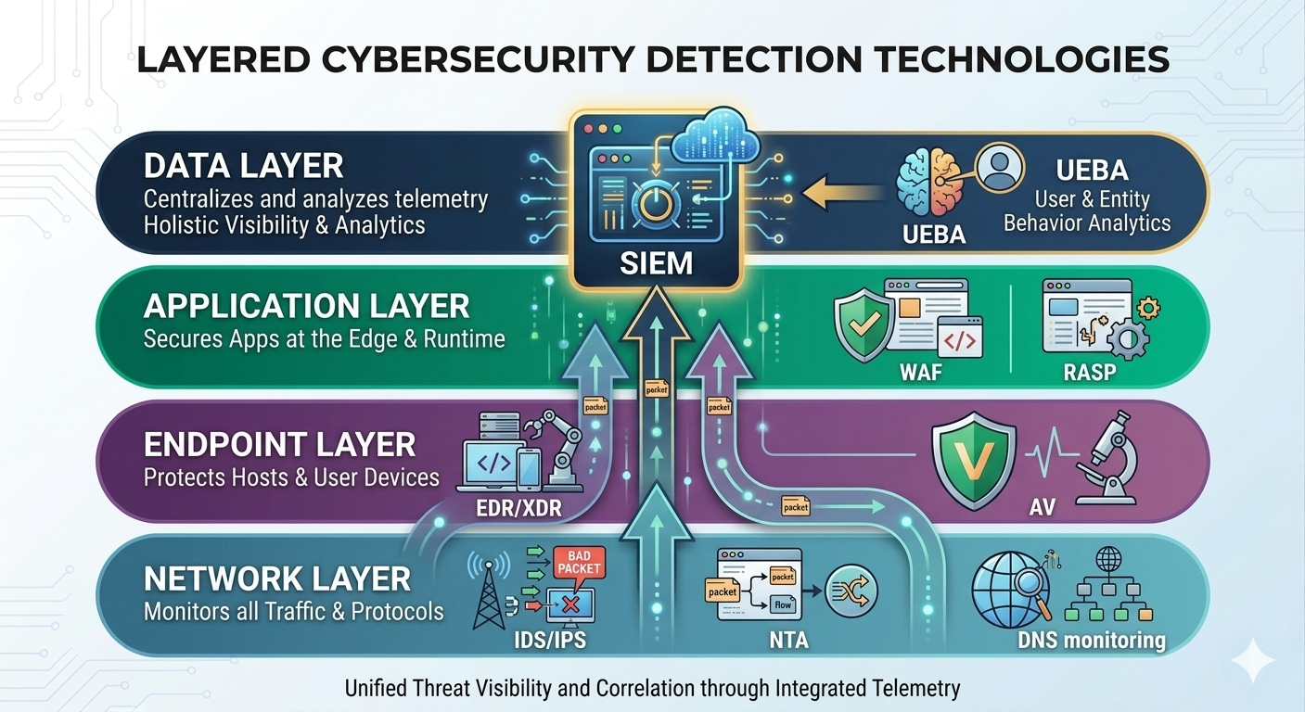
Notes:
Detection is not a single tool but a layered defense. Each layer provides different visibility. Network tools see traffic patterns. Endpoint tools see process behavior. Application tools see request-level activity. SIEMs aggregate and correlate across all layers. We’ll touch on each, then go deep on network-based detection with Zeek and Suricata.

Slide 19
Logging and SIEM
SIEM = Security Information and Event Management
Aggregate logs from endpoints, servers, network, cloud
Normalize, correlate, detect
Platforms: Splunk, Microsoft Sentinel, Elastic Security, IBM QRadar
Notes:
SIEMs are the central nervous system of security operations. They ingest logs from everywhere — endpoint agents, network devices, cloud APIs, applications — normalize them into a common format, and apply correlation rules to detect threats. A single suspicious login might not be noteworthy, but a failed login followed by a successful login from a different country followed by privilege escalation is a pattern the SIEM can catch. Note how Denning’s concept of correlating multiple metrics across subjects and objects is exactly what SIEM correlation rules do.

Slide 20
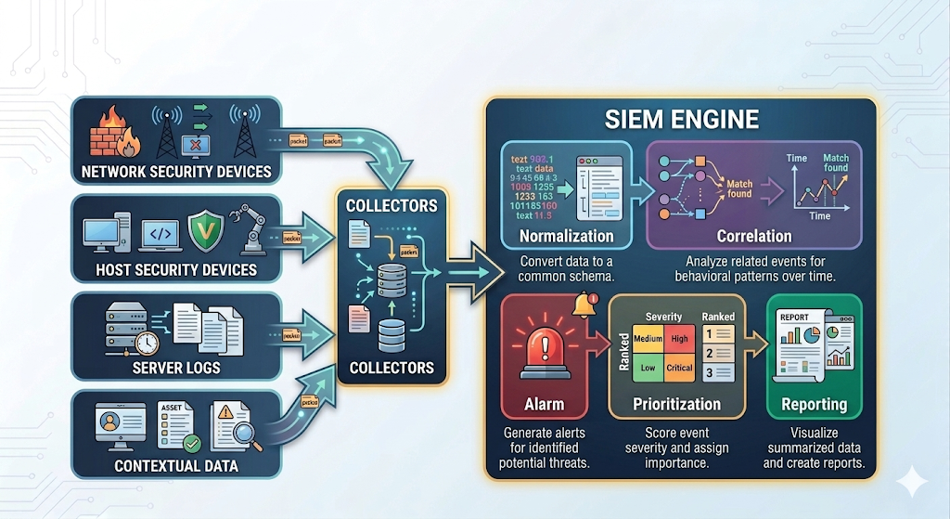
SIEM Architecture
Notes:
[FIGURE: Diagram showing data flow. Left side: four source boxes (Network Security Devices, Host Security Devices, Server Logs, Contextual Data) each with arrows pointing to “Collectors” in the middle. Collectors feed into SIEM Engine on the right, which performs Normalization → Correlation → Alarm → Prioritization → Reporting.]
Data sources feed into collectors, which gather and forward logs. The SIEM engine normalizes logs into a common schema, applies correlation rules to link related events, generates alarms, prioritizes them based on severity and context, and provides reporting dashboards. The quality of correlation rules is critical — poorly written rules generate noise, well-crafted rules surface real threats.

Slide 21
What to Log
Authentication events (logins, failures, MFA)
Privilege escalation
Process execution (especially unusual binaries)
Network connections (especially outbound)
File changes (especially on sensitive files)
DNS queries
Cloud API calls
Notes:
The decision of what to log involves a trade-off between visibility and volume/cost. Logging everything is expensive and creates noise. Logging too little means missing attacks. These categories represent the minimum that most security teams consider essential. DNS queries are particularly valuable because almost all malware needs DNS to reach command-and-control servers, and DNS tunneling is a common exfiltration technique.

Slide 22



Endpoint Detection and Response (EDR)
Continuous monitoring of endpoint activity
Process trees, file operations, registry changes, network connections
Behavioral detection: suspicious patterns, not just known signatures
Telemetry recording for forensic investigation
Response: isolate host, kill process, quarantine file
Notes:
EDR represents Denning’s anomaly detection concept applied to endpoints, though modern EDR uses more sophisticated behavioral models than her original statistical approaches.
EDR moves beyond traditional antivirus by monitoring behavior rather than just matching file signatures. If a Word document spawns PowerShell which downloads a binary from the internet and creates a scheduled task — that behavioral chain is suspicious regardless of whether any individual component matches a known malware signature. EDR also records detailed telemetry, which is invaluable for post-incident investigation.

Slide 23
XDR: Extending Beyond Endpoints
Extended Detection and Response
Correlates across endpoints, network, email, identity, cloud
Unified view of an incident across multiple attack surfaces
Reduces alert fatigue through automated correlation
Comparing XDR with SIEM:
SIEM is a correlation bus for heterogeneous, already-processed data.
XDR is a unified detection platform over raw, cross-domain telemetry from an integrated collection stack.
Notes:
XDR is the evolution of EDR. Where EDR sees one endpoint at a time, XDR correlates across the whole environment. A phishing email (email telemetry) delivers a malicious attachment (endpoint telemetry) that connects to a C2 server (network telemetry) and moves laterally (identity + endpoint telemetry). XDR links these into a single incident rather than five separate alerts.
A SIEM correlates alerts from heterogeneous tools that were built independently and don't share data models.
XDR, at least in its idealized form, correlates raw telemetry from an integrated suite where the data models are designed to work together.
XDR vs. SIEM is partly a build-vs-buy tension. A mature organization with diverse best-of-breed tools (separate endpoint, network, email, cloud security vendors) may need a SIEM to aggregate across them

Slide 24
Network-Based Detection: Overview
Approach | What It Does | Examples
Signature IDS/IPS | Match known attack patterns | Suricata, Snort
Network Traffic Analysis | Detect anomalous traffic patterns | Zeek, Darktrace
DNS Monitoring | Detect tunneling, DGA, malicious domains | Passive DNS sensors
Notes:
Network-based detection provides visibility that endpoint tools can’t. It sees lateral movement between machines, command-and-control beaconing, data exfiltration, and network reconnaissance. Signature-based tools match known patterns quickly. Traffic analysis tools look at metadata and behavior. DNS monitoring is particularly effective because DNS is used by virtually all network communication and is often overlooked by attackers. We’ll go into Zeek and Suricata in detail shortly.

Slide 25
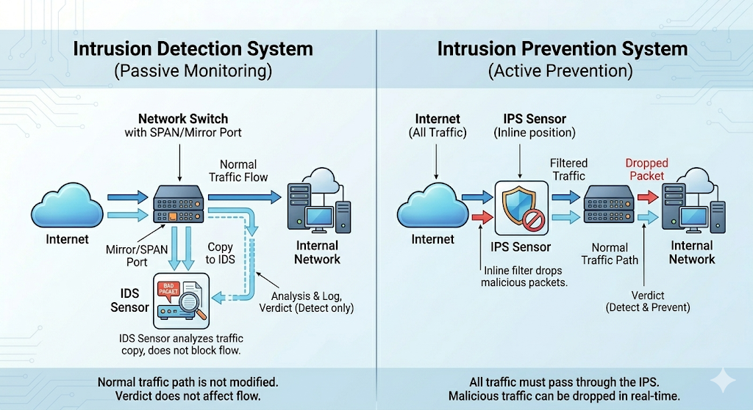
Notes:
[FIGURE: Two side-by-side network diagrams. Left: IDS — a switch with a mirror/span port sending a copy of traffic to the IDS sensor; traffic flows normally regardless of IDS verdict. Right: IPS — sensor sits inline between the switch and the rest of the network; traffic must pass through the IPS, which can drop malicious packets.]
Comparison in terms of Position Action Latency Risk
IDS and IPS represent different trade-offs. IDS is passive — it sees a copy of traffic and generates alerts but cannot stop attacks in real time. IPS sits inline and can actively block malicious traffic, but this introduces the risk of blocking legitimate traffic (false positives become service outages). Many organizations run both: IDS for broad monitoring, IPS at critical choke points with high-confidence rules.

Slide 26
Vulnerability Scanning and AV
Vulnerability scanners (Nessus, Qualys, OpenVAS)
  Authenticated and unauthenticated scanning
  Integration with patch management
Anti-virus / Anti-malware
  Traditional signature-based detection
  Increasingly subsumed by EDR
Cloud Security Posture Management (CSPM)
  Detect misconfigurations (public S3 buckets, overly permissive IAM)
  Tools: Prisma Cloud, AWS Security Hub, Wiz
Notes:
Vulnerability scanning is proactive detection — finding weaknesses before attackers do, which maps to the Preparation phase of the NIST lifecycle. Traditional AV is increasingly seen as a baseline rather than sufficient protection. CSPM addresses a growing problem: cloud misconfigurations are a leading cause of breaches.

Slide 27
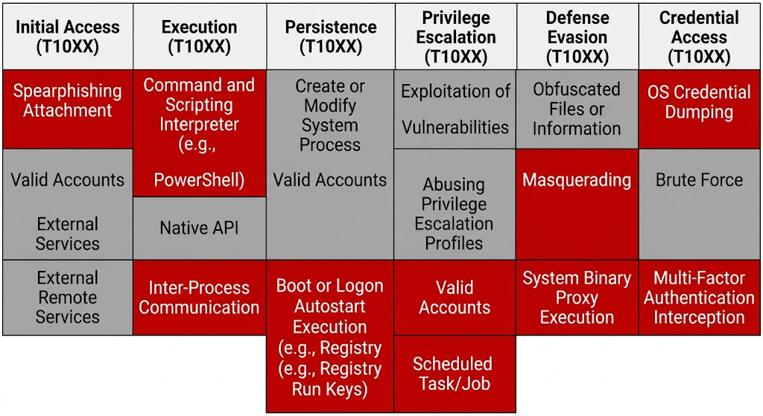
Threat Intelligence
Threat feeds: STIX/TAXII, MISP
MITRE ATT&CK: framework mapping attacker techniques
Use intelligence to prioritize detection engineering
MITRE ATT&CK
Notes:
[FIGURE: Diagram showing MITRE ATT&CK matrix snippet — a grid with Tactics as columns (Initial Access, Execution, Persistence, Privilege Escalation, …) and Techniques as rows under each. Some cells are highlighted in red to show “coverage” and some in gray for “gaps.”]
Threat intelligence provides context: who is attacking, how, and what to look for. STIX (Structured Threat Information eXpression) and TAXII (Trusted Automated eXchange of Intelligence Information) are standards for sharing indicators of compromise. MITRE ATT&CK is a knowledge base of adversary tactics and techniques that has become the standard framework for evaluating detection coverage. Organizations map their detections to ATT&CK to identify gaps.

Slide 28
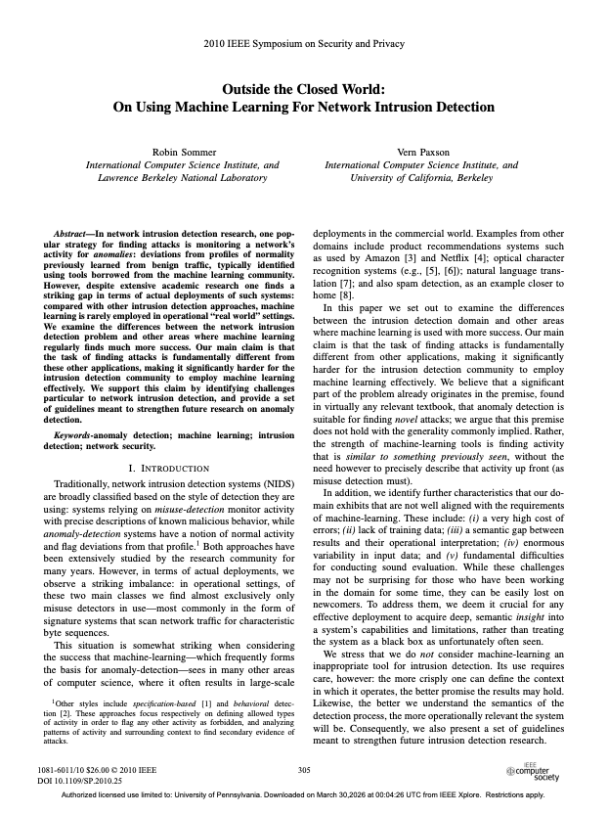
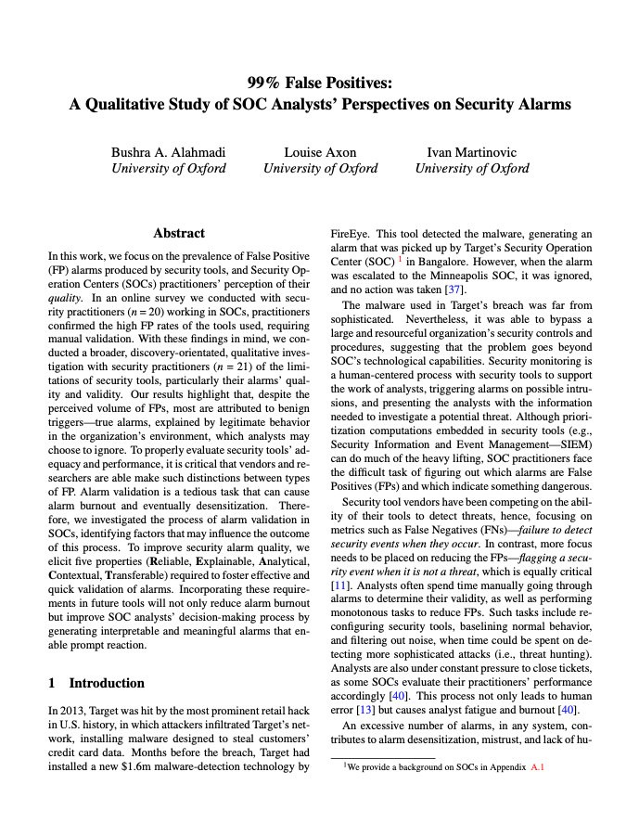
Challenges of IDS: Theory Meets Reality
with some insights from:
Notes:
We’ll discuss these two papers together because they tell a connected story. Sommer and Paxson (Paxson is the creator of Zeek) wrote a devastating 2010 critique explaining why ML had failed to gain traction in operational IDS despite 20+ years of academic research. Twelve years later, Alahmadi et al. interviewed real SOC analysts and found the same fundamental problems persisting. Where Sommer & Paxson provide the theoretical framework, Alahmadi et al. provide the ground truth from practitioners. Together, they paint a comprehensive picture of why intrusion detection remains so hard.
References:
- R. Sommer and V. Paxson, “Outside the Closed World: On Using Machine Learning for Network Intrusion Detection,” IEEE S&P, 2010.
- B. Alahmadi, L. Axon, I. Martinovic, “99% False Positives: A Qualitative Study of SOC Analysts’ Perspectives on Security Alarms,” USENIX Security, 2022.

Slide 29
Challenge 1: The Base-Rate Fallacy
Even with 99.9% true positive and 0.1% false positive rates:
If attacks are 0.001% of traffic →
For every 1 true alert, ~100 false alerts
Notes:
Sommer & Paxson (2010) formalized this as the core mathematical challenge. When the base rate of attacks is extremely low (which it is in real traffic), even tiny false positive rates produce overwhelming numbers of false alarms. This cannot be solved by algorithmic improvement alone — it’s a fundamental property of rare-event detection. Denning flagged this same issue in 1987.

Slide 30
2022 Confirmation: “99% False Positives”
“We know 99% of the alarms we generate are false positives, but we still have to look at them.” — SOC Analyst B3
45% of analysts receive <5K alerts daily; some receive >100K
One analyst: 1 in 100 alerts investigated is an actual threat
Another: 50 in every 200 are legitimate (but benign)
The base-rate problem isn’t theoretical — it’s daily reality
Notes:
Alahmadi et al.’s 2022 interviews confirm that the base-rate problem Sommer & Paxson identified theoretically is exactly what analysts experience in practice. The numbers are staggering: some SOCs receive over 100,000 alerts daily. The paper also reveals an important nuance we’ll explore next: most of what analysts call “false positives” aren’t actually false in the traditional sense.

Slide 31
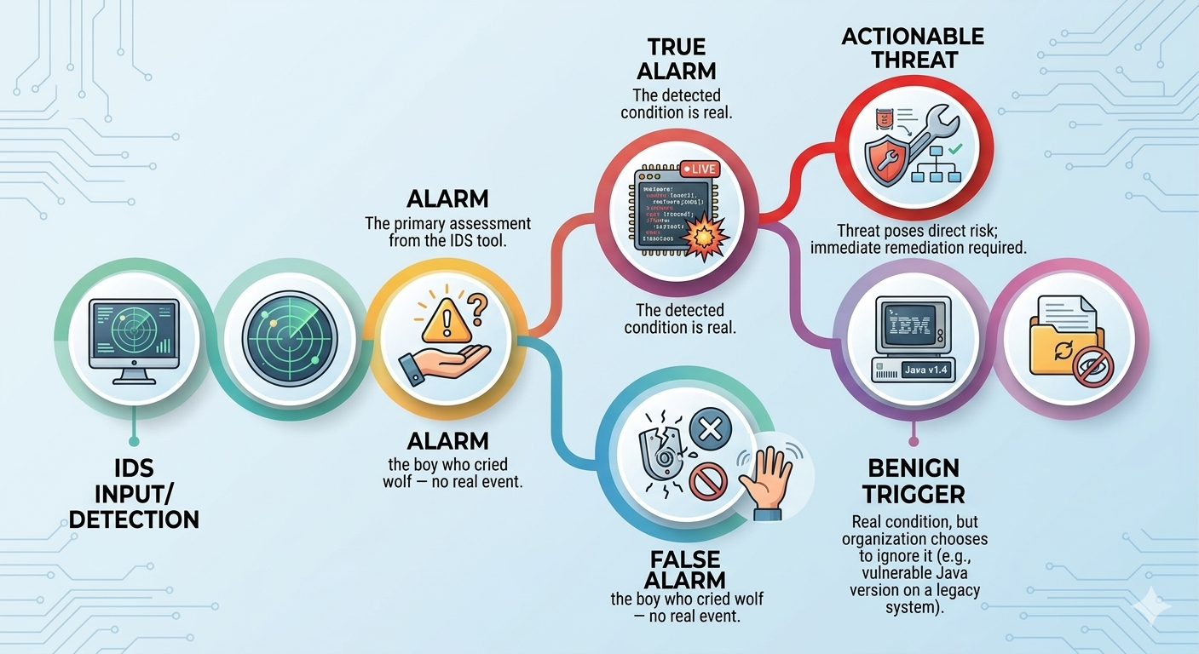
False Alarms vs. Benign Triggers
Notes:
[FIGURE: Decision tree diagram. An “Alarm” branches into “True alarm” (the detected condition is real) and “False alarm” (the boy who cried wolf — no real event). “True alarm” further branches into “Actionable threat” and “Benign trigger” (real condition, but organization chooses to ignore it, e.g., vulnerable Java version on legacy system).]
A crucial distinction from Alahmadi et al.: most of what analysts call “false positives” are actually benign triggers — the tool correctly identified a real condition (e.g., an outdated Java version), but the organization knowingly accepts that risk. One analyst explained: “Snort signatures, we have particularly noisy ones — they’re always identifying vulnerable versions of Java, but a lot of companies have a lot of vulnerable versions of Java, so we get a massive influx of it.” The signature fires correctly, but the alarm is noise. This distinction matters for evaluating tool quality — the technology isn’t wrong, but it lacks organizational context.

Slide 32
Challenge 2: The Semantic Gap
ML system: “This flow is anomalous”
Signature IDS: “This is CVE-2024-1234 exploiting a buffer overflow in OpenSSH 8.9”
Operators need to know what the alert means and what to do
Notes:
Sommer & Paxson (2010) identified the semantic gap as a fundamental problem: the difference between statistical deviation and actionable security information. An ML system can tell you something is unusual, but not why it matters or what to do about it.

Slide 33
2022 Confirmation: “Black Box” Tools
Analysts describe commercial security tools as:
“Untrustworthy”, “unuseful”, “poor”
“Sometimes it’s a generic filter… you don’t know what logic they put inside”
“If you don’t tell me the reason you fire, you’re not ready to open up”
Only 10% of surveyed SOCs use ML-based tools
Notes:
Alahmadi et al. found that twelve years after Sommer & Paxson’s warning, the semantic gap is alive and well. Analysts want to understand WHY an alarm fired, not just that it did. Black-box tools that produce unexplainable alerts lose analyst trust. The paper’s survey found that only 10% of SOCs use ML-based security tools — confirming Sommer & Paxson’s observation about zero operational adoption, now extended to 2022. Analysts gave specific reasons: skepticism of ML (B4), lack of accreditation for government networks (A1), no historical training data (E7), and the expectation that ML would produce even more false positives (B4): “Machine learning itself would learn what normal is but humans aren’t exactly going to be normal and do the same stuff every day.”

Slide 34
Challenge 3: Adversarial Adaptation and Drift
Attackers craft traffic to evade ML models
Concept drift: “normal” changes constantly (new apps, users, configs)
No clean training data: real networks always have some compromise
Alahmadi et al. (2022) —
Change management failures generate false alarms
“We were seeing a huge amount of ICMP traffic… the networking team deployed a new tool and nobody told us”
Notes:
Sommer & Paxson described these as theoretical challenges for ML-based detection.
Alahmadi et al. found the same problems in practice, even with traditional signature-based tools. The concept drift problem manifests as undocumented network changes: a new tool gets deployed, traffic patterns shift, and the IDS generates a flood of alarms because the baseline has changed. This isn’t an ML-specific problem — it affects any detection system that depends on understanding what “normal” looks like. The adversarial challenge remains: attackers actively study detection tools and craft evasion techniques.

Slide 35
Challenge 4: Evaluation Methodology
Most papers use synthetic/outdated datasets
(KDD Cup 1999, DARPA eval)
No operational testing — lab results don’t transfer to deployment
Cherry-picked metrics that obscure the base-rate problem
No comparison with simple baselines —
is ML actually better than rules?
The DARPA evaluation flaws we discussed earlier: still being repeated
Notes:
Sommer & Paxson showed that the academic community had been evaluating ML-IDS on the same flawed DARPA/KDD datasets for over a decade. Papers reported impressive-looking numbers in controlled settings that had no relation to real-world performance. They recommended evaluating on realistic traffic, reporting operationally meaningful metrics (including base-rate-adjusted precision), and comparing against simple baselines. Some progress has been made since 2010 — better datasets exist now — but many papers still fall short.

Slide 36
Sommer & Paxson: Recommendations
Evaluate on realistic, modern traffic
Report operationally meaningful metrics (not just ROC curves)
Provide semantic context with alerts
Consider the adversarial setting explicitly
Focus ML on well-scoped sub-problems
Compare against simple baselines
Deploy and test in real environments
Notes:
These recommendations remain highly relevant. The recommendation to focus ML on well-scoped sub-problems is particularly important: ML can work well for clustering similar alerts, prioritizing alerts, or detecting specific protocol anomalies, even if “detect all attacks” remains out of reach. Alahmadi et al.’s findings twelve years later suggest the community still has significant work to do.

Slide 37

Suricata: Next-Gen Network IDS/IPS

Slide 38
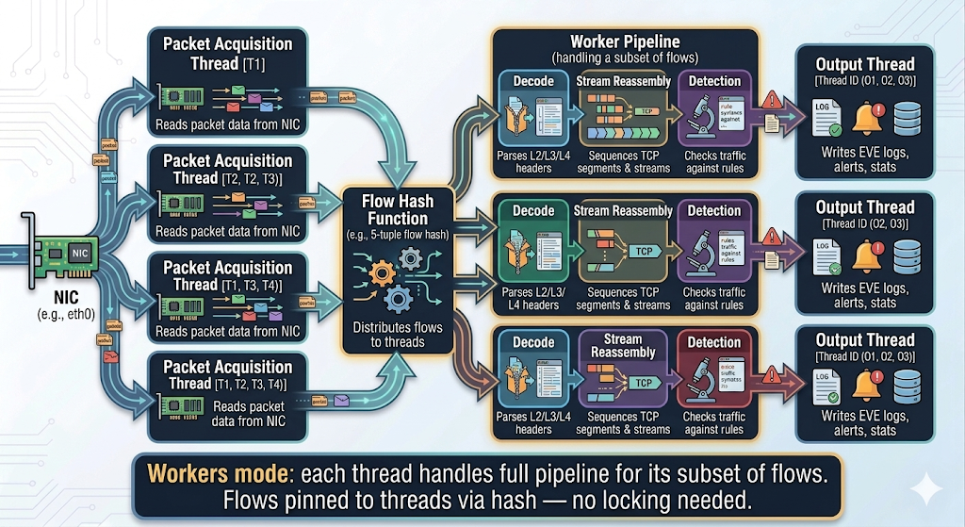
Suricata Multi-Threading Architecture
Notes:
Suricata’s multi-threading is its headline feature. In the default “workers” mode, each thread handles the complete processing pipeline for its share of flows. Flows are pinned to threads via a hash function, so each flow is always processed by the same thread, eliminating the need for locks on flow state. This scales nearly linearly with CPU cores. By contrast, classic Snort processes everything in a single thread, limiting it to about 1 Gbps.

Slide 39
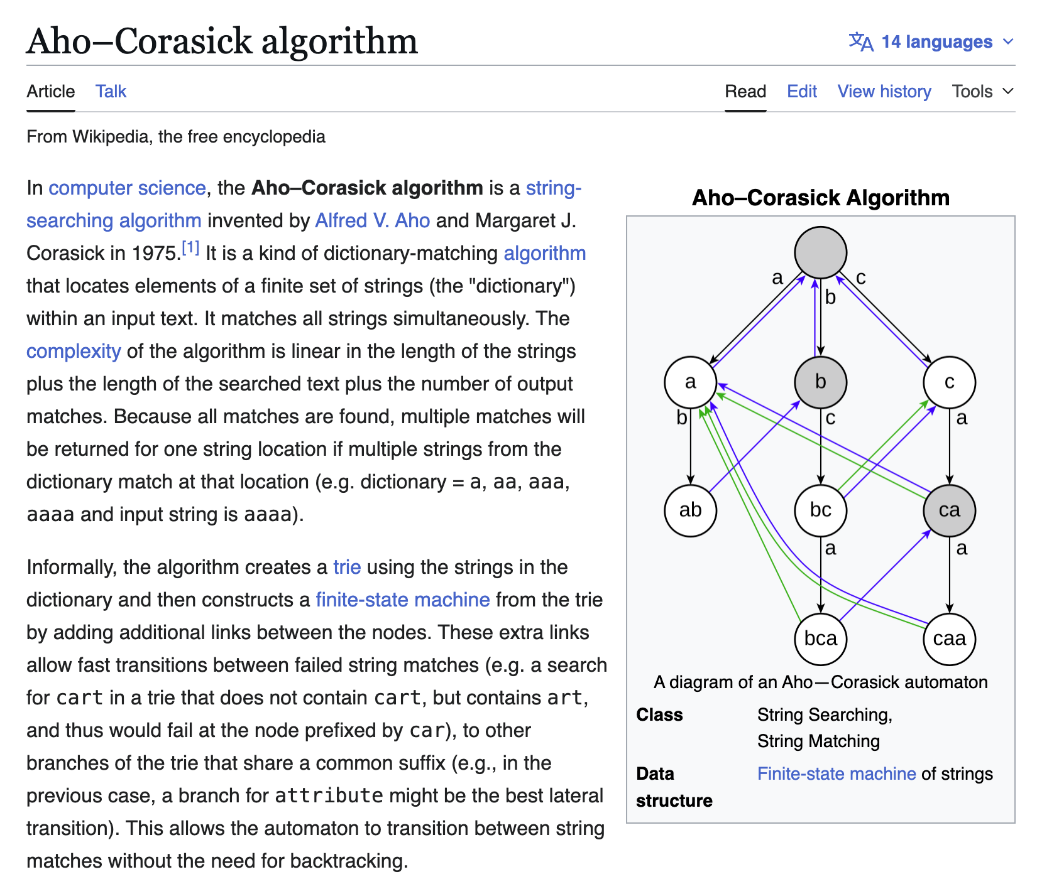
Suricata Detection Engine
Multi-Pattern Matcher (MPM) using Aho-Corasick algorithm:
All content strings from all rules compiled into one automaton
Scan payload once against all patterns simultaneously
Only rules whose content matched proceed to full evaluation
Also: 20+ protocol parsers (HTTP, TLS, DNS, SMB, SSH, …) run independently of rules
Notes:
The detection engine is designed for efficiency. Instead of checking each rule against each packet, Suricata compiles all the content patterns from all loaded rules into a single Aho-Corasick automaton. When a packet arrives, a single pass through the automaton identifies which rules might match. Only those candidate rules go through full evaluation (checking flow direction, protocol fields, etc.). On hardware that supports it, Suricata can use Intel’s Hyperscan library for even faster matching.

Slide 40
Suricata Rule Anatomy
alert http $HOME_NET any -> $EXTERNAL_NET any (
msg:"Possible malicious download";
flow:established,to_server;
content:"GET"; http_method;
content:"/malware.exe"; http_uri;
sid:2001001; rev:1;
)
Notes:
A Suricata rule has a header and options. This rule alerts on HTTP GET requests from the internal network to external servers where the URI contains “/malware.exe”.
The header specifies:
action (alert),
protocol (http),
source and destination addresses/ports, and
direction.
The options (in parentheses) specify: what to match and metadata.
You might expect http_method to be an argument to content, written as content:"GET", http_method;. But it's not — it's a separate semicolon-terminated statement that modifies the preceding content option. This is Suricata's "sticky buffer" system. http_method isn't an argument to content:"GET" — it's a standalone keyword that says "the previous content match should be applied specifically to the HTTP method field, not to the raw packet bytes." It "sticks" to whatever content check came before it.
sid:2001001; rev:1; the rule's unique ID is 2001001, revision 1 (used for tracking and updating rules over time).

Slide 41
Rule Header: Actions
Action | Behavior
alert | Generate an alert
pass | Stop evaluation, allow packet
drop | Drop packet + alert (IPS mode only)
reject | Send TCP RST or ICMP unreachable + drop
Notes:
The action determines what happens when the rule matches. In IDS mode, only alert and pass are meaningful — the sensor is passive and can’t block traffic. In IPS mode, drop and reject become available. Pass is useful for creating exceptions to broader rules. Reject is more aggressive than drop: it actively tells the sender that the connection was refused, which can help terminate malicious sessions faster but also reveals the presence of the IPS.

Slide 42
Rule Header: Protocols and Addresses
Protocols: tcp, udp, icmp, ip + application-layer: http, tls, dns, ftp, ssh, smtp, smb, …
Addresses: IPs, CIDRs, variables ($HOME_NET), groups, negation
Direction: -> (unidirectional), <> (bidirectional)
alert dns $HOME_NET any -> any any (
msg:"DNS query for suspicious TLD";
dns_query; content:".xyz"; endswith;
sid:2001002; rev:1;
)
Notes:
Using application-layer protocols (like dns, http, tls) means the rule only fires when Suricata’s protocol parser has identified the flow as that protocol, regardless of port. This is important: malware often uses non-standard ports, and Suricata can still identify the protocol through deep packet inspection. The $HOME_NET and $EXTERNAL_NET variables are defined in suricata.yaml and typically represent your internal network and everything else.

Slide 43
Rule Options: Content Matching
content:"pattern" — match bytes (text or |hex|)
nocase — case-insensitive
depth, offset, distance, within — positional constraints
pcre:"/regex/" — Perl-compatible regex
Sticky buffers (protocol-aware):
  http_uri, http_host, http_user_agent, http_header
  dns_query, tls_sni, ja3.hash
  file_data (file content)
Notes:
Content matching is the core of Suricata rules. Simple content strings are fast because they go through the MPM. PCRE is more flexible but slower because it can’t use the Aho-Corasick prefilter. Sticky buffers are Suricata’s protocol-aware matching: instead of matching raw bytes anywhere in the packet, you match against a specific parsed field. This reduces false positives and is faster because the matching scope is narrower. For the project, you’ll write rules using these keywords.
Ordering depends on option type:
Purely metadata — order doesn't matter at all. msg, sid, and rev
flow:established,to_server can technically appear anywhere. But Suricata evaluates options roughly in the order they appear, but better for performance to appear early
The relative order of your content checks matters because Suricata's fast-pattern matcher picks one content keyword to use as a pre-filter

Slide 44
Rule Options: Flow and State
# Match only on established connections, client to server
flow:established,to_server;
# Stateful detection across packets with flowbits
alert http any any -> any any (
msg:"S1: suspicious beacon";
content:"/beacon"; http_uri;
flowbits:set,beacon_detected;
sid:2001003;
)
alert http any any -> any any (
msg:"S2: data exfil after beacon";
flowbits:isset,beacon_detected;
content:"POST"; http_method;
content:"/upload"; http_uri;
sid:2001004;
)
Notes:
Flow keywords let you specify connection state and direction. Flowbits enable stateful detection across multiple packets or even multiple connections in the same flow. In this example, the first rule detects a C2 beacon and sets a flag. The second rule only fires if that flag was previously set, catching exfiltration that follows beaconing. This multi-stage detection is much more precise than single-packet rules and reduces false positives. This is reminiscent of Denning’s Markov process approach — modeling sequences of events rather than individual events.
Other primitives:
xbits go further — they can persist beyond a single flow and can be keyed on IP addresses, so you can say "if host A did X in any flow, set a flag, and fire if host A later does Y in a different flow." They support timeouts, so the flag expires after a configurable interval.
flowint lets you maintain integer counters per flow — you can increment a counter each time something is seen and fire when it exceeds a threshold.

Slide 45
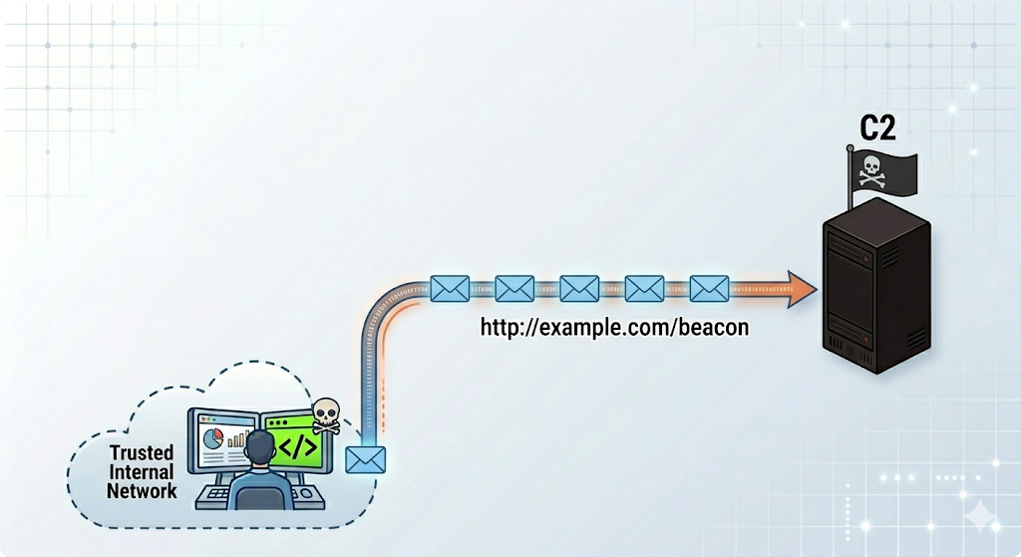
Example: Malware C2 Beaconing
Notes:
Let’s write some sample rules!
When writing rules, think about what makes malicious traffic distinctive: unusual protocols, regular timing, long encoded values, connections to known-bad infrastructure. Use Zeek’s logs to identify the suspicious traffic patterns first, then write Suricata rules to detect them.

Slide 46
Malware C2 Beaconing: Sample Rule
# Detect C2 beaconing by interval regularity
alert http $HOME_NET any -> $EXTERNAL_NET any (
msg:"Possible C2 beacon - regular interval";
flow:established,to_server;
content:"GET"; http_method;
threshold:type threshold, track by_src,
count 10, seconds 60;
sid:9000001; rev:1;
)
Notes:
C2 beaconing often shows regular intervals — a threshold rule can detect a host making many similar requests in a short window (recall Denning’s event counter approach).

Slide 47
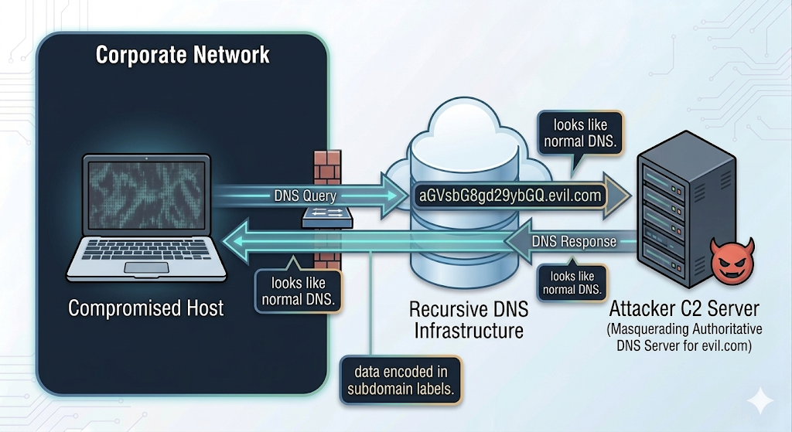
Example: DNS Tunneling

Slide 48
DNS Tunneling: Sample Rule
# Detect DNS tunneling by query length
alert dns $HOME_NET any -> any any (
msg:"Possible DNS tunneling - long query";
dns_query; content:"|00|";
byte_test:1,>,50,0,relative;
sid:9000002; rev:1;
)
Notes:
DNS tunneling encodes data in DNS queries, producing unusually long query names.
content:"|00|"; -- matches the ending nul terminator
byte_test:1,>,50,0,relative; -- after finding the null terminator, check that some length value exceeds 50
But according to Claude this is not a great thing to do -- in a well-formed DNS query, there isn't a useful single length byte to read.
Better: something like using dsize to check the total packet size, or using isdataat to verify data exists at a long offset
This rule is a good example of the precision/recall problem

Slide 49
EVE JSON: Suricata’s Output
Single JSON log file where each line is a self-contained event:
alert — signature match with rule metadata and payload
http — full HTTP transaction logs
dns — query and answer records
tls — SNI, certificate info, JA3/JA4 hashes
flow — connection metadata, byte/packet counts
fileinfo — extracted file metadata and hashes
Notes:
EVE (Extensible Event Format) is Suricata’s primary output — one JSON file where each line is an event. This format is designed for SIEM ingestion via Elasticsearch/Logstash, Splunk, or similar. Even without any alert rules firing, Suricata produces rich protocol metadata in EVE — HTTP transactions, DNS queries, TLS handshakes — making it useful as a network security monitor, not just an IDS. For the project, you’ll analyze EVE JSON output to understand what Suricata detected.

Slide 50
Running Suricata
# IDS mode on interface
suricata -c /etc/suricata/suricata.yaml -i eth0
# IPS mode via NFQUEUE
suricata -c /etc/suricata/suricata.yaml -q 0
# Offline PCAP analysis
suricata -c /etc/suricata/suricata.yaml -r capture.pcap
# Rule management
suricata-update # Download/update rulesets
Notes:
For the project, you’ll use the -r flag to analyze PCAP files offline. The -c flag points to the configuration file (suricata.yaml), which defines HOME_NET, rule locations, output settings, and threading. The suricata-update tool manages rule downloads from sources like Emerging Threats (ET Open), which is a free community ruleset. ET Pro is the paid version with additional rules.

Slide 51
Suricata Configuration Highlights
Key sections in suricata.yaml:
vars: define $HOME_NET, $EXTERNAL_NET
default-rule-path + rule-files: where rules live
af-packet / pcap: capture method
threading: number of worker threads
detect-engine: MPM algorithm (Aho-Corasick, Hyperscan)
app-layer: enable/disable protocol parsers
outputs: configure EVE JSON, fast.log, file extraction
Notes:
Getting suricata.yaml right is critical for effective deployment. The HOME_NET variable should accurately reflect your internal network — rules depend on it. The threading configuration should match your hardware. The app-layer section lets you enable or disable protocol parsers and tune their settings. For the project, the main thing you’ll configure is HOME_NET and ensure the default ET Open rules are loaded.

Slide 52
Suricata: Summary
Suricata gives you fast, signature-based detection:
Matches packets against thousands of rules efficiently
Produces alerts when known attack patterns are found
Also logs protocol metadata (EVE JSON)
What Suricata doesn’t do well: answer “what else happened?”
If it alerts on a C2 beacon, what other connections did that host make?
What DNS queries preceded the alert? What files were transferred?
For that, we need Zeek
Notes:
This is the transition to Zeek. Suricata excels at telling you “something bad matched a known pattern.” But investigation requires broader context. An analyst who gets a Suricata alert needs to understand the full picture: what happened before, during, and after the detected event. This is precisely what Zeek provides. Recall that the Alahmadi et al. study found one of the key limitations of IDS alarms is lack of context — Zeek helps fill that gap.

Slide 53
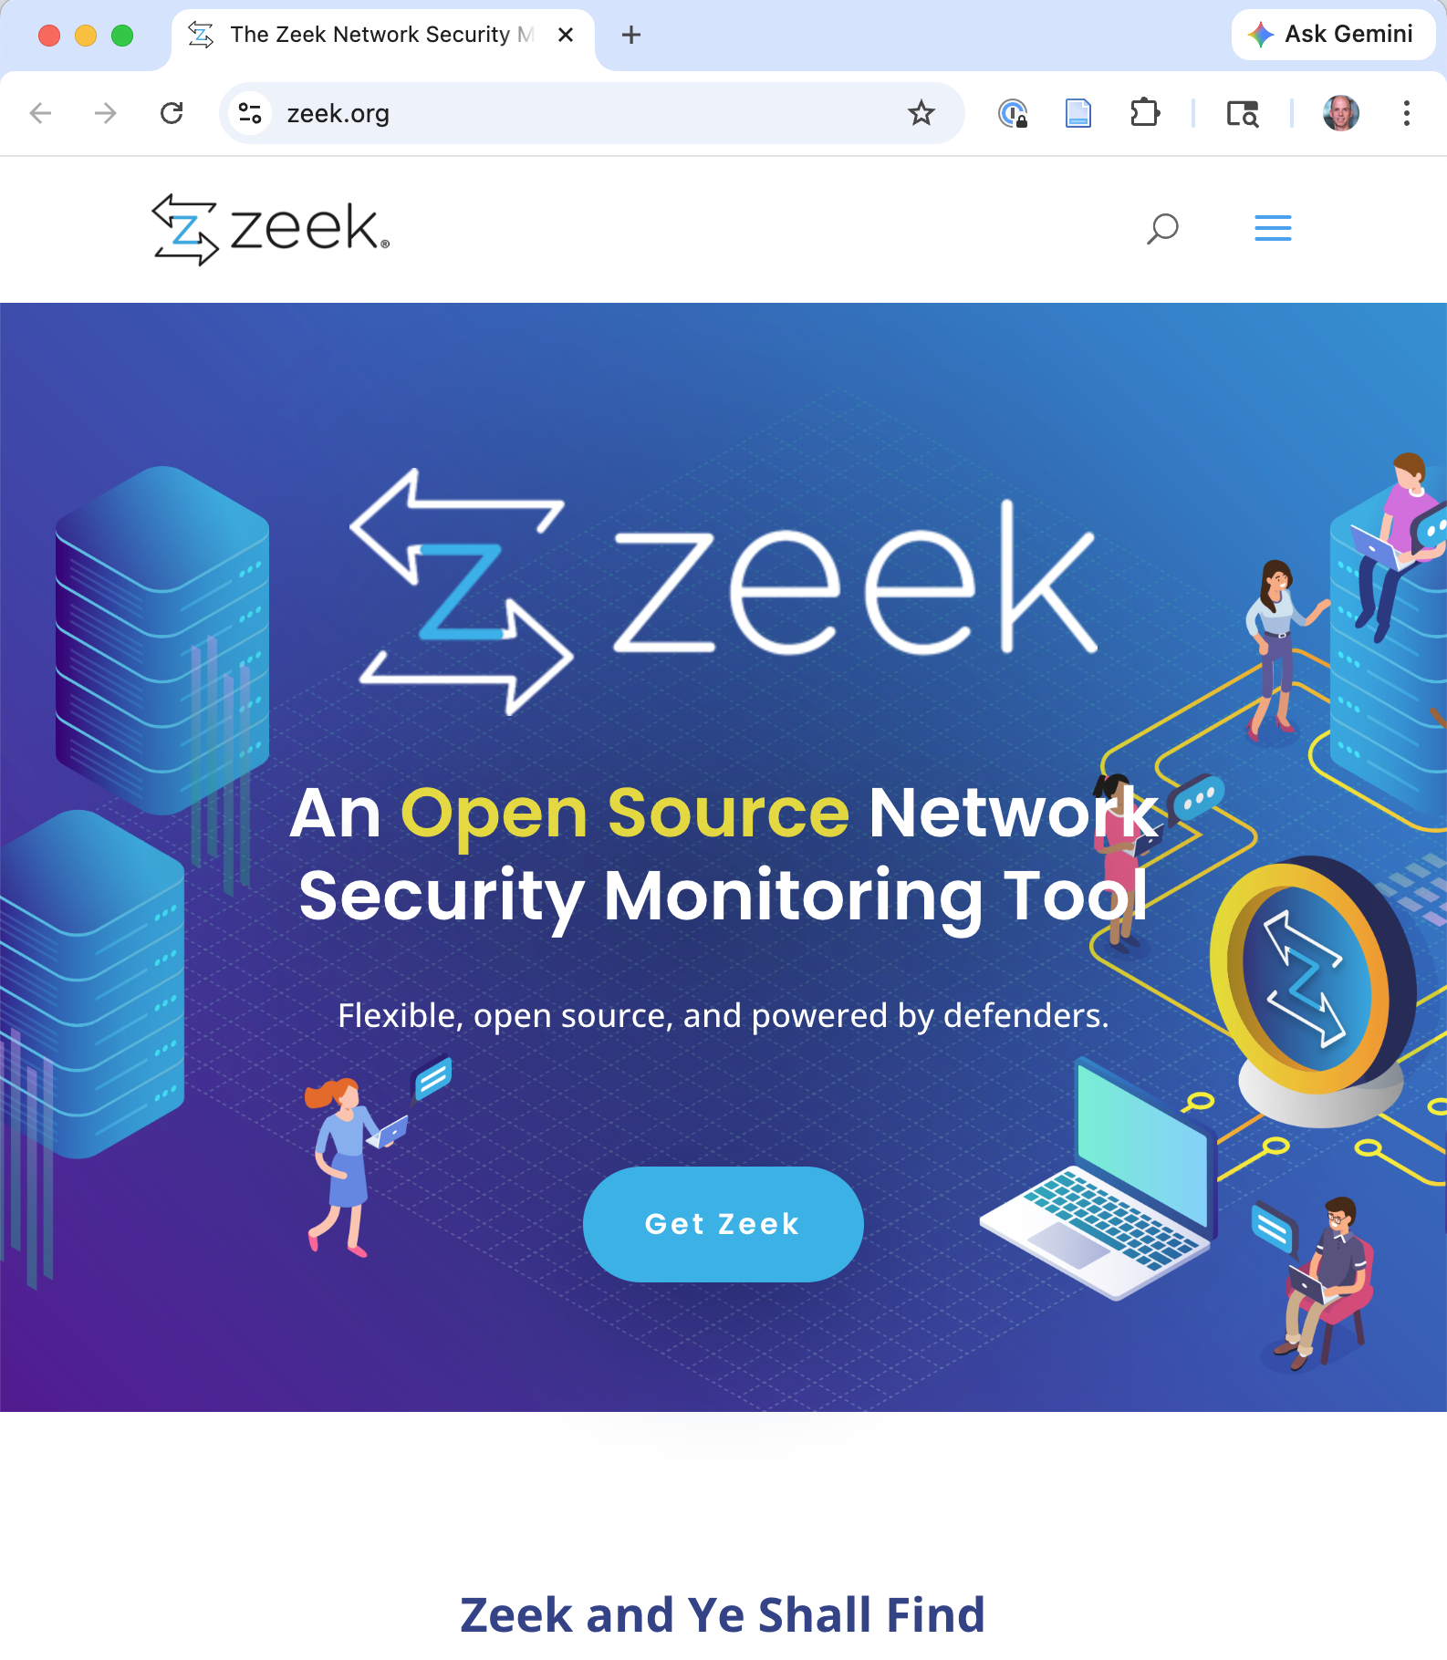
Zeek: Network Security Monitor

Slide 54
What is Zeek?
A fundamentally different philosophy from Suricata/Snort:
 | Suricata | Zeek
Question | “Does this match a known bad pattern?” | “What is happening on this network?”
Output | Alerts when rules match | Structured logs of all activity
Detection | Signature-based (fast, specific) | Scriptable (flexible, open-ended)
Forensics | Limited to alert context | Complete network audit trail
Notes:
Where Suricata implements Denning’s signature/misuse detection paradigm, Zeek implements something closer to her audit record concept. Zeek doesn’t primarily look for known bad patterns — it logs everything and gives you the tools to analyze it. Created by Vern Paxson in the mid-1990s (originally called “Bro,” renamed 2018), Zeek generates comprehensive logs of every connection, DNS query, HTTP request, TLS handshake, and file transfer. This makes it invaluable for the investigation that follows a Suricata alert, for threat hunting (looking for things no signature covers), and for forensic analysis.

Slide 55
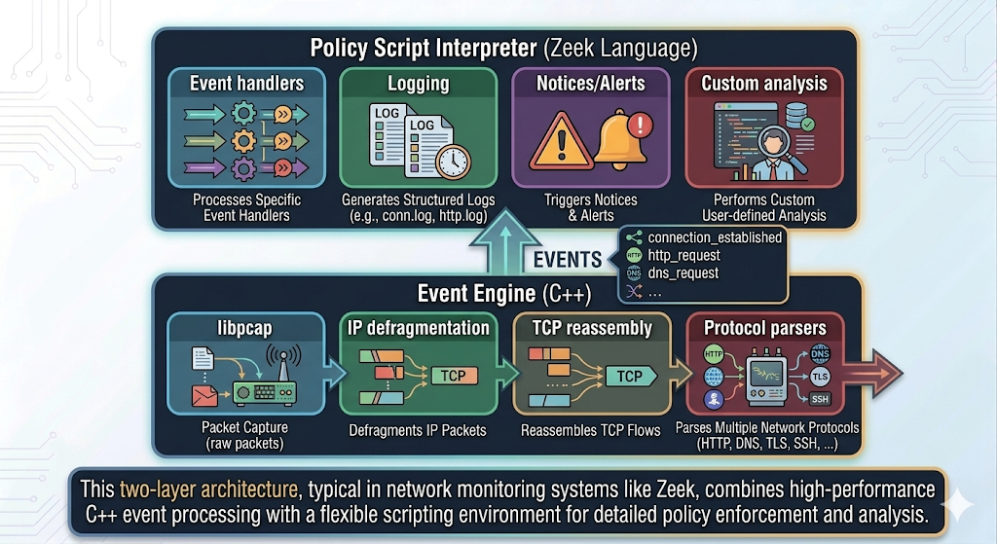
Zeek Architecture
Notes:
Zeek’s architecture cleanly separates mechanism from policy. The C++ event engine handles the hard work of packet capture, stream reassembly, and protocol parsing. It generates semantic events like “an HTTP request was made” or “a DNS query was observed.” The scripting layer then decides what to DO with those events: log them, alert on them, correlate them, or ignore them. This separation is powerful because you can change the policy without touching the packet processing code. Compare this to Suricata, where the detection engine and the rules are more tightly coupled.

Slide 56
Zeek Log Types
Log File | Contents
conn.log | Every connection: IPs, ports, protocol, duration, bytes
dns.log | DNS queries and responses
http.log | HTTP method, URI, host, user-agent, status code
ssl.log | TLS SNI, certificate info, cipher suite, JA3 hashes
files.log | Files transferred: MIME type, size, MD5/SHA256
weird.log | Unusual protocol events
notice.log | Alerts raised by Zeek scripts
Anomaly signal
Judgment output
Notes:
Zeek’s default scripts produce logs for every major protocol it parses.
There are around 50 logs in a default Zeek installation.
The conn.log is the foundation — it records every network connection with a unique ID (uid) that can be used to correlate across other logs. For example, you can trace a uid from conn.log to http.log to see what URL was requested, then to files.log to see what file was downloaded and its hash. These are Denning’s audit records, realized for networks: Subject, Action, Object, Timestamp, Resource-Usage all have direct analogs in Zeek’s fields.
Other logs not shown:
ftp.log, smtp.log, ssh.log, rdp.log, sip.log, snmp.log
x509.log — every TLS certificate observed
pe.log — metadata extracted from Windows PE (executable) files observed in transit.
Weird.log captures protocol violations and anomalies that Zeek's protocol parsers detect — things that are technically malformed or that don't conform to the relevant RFC. Examples:
A TCP connection where the data flow doesn't match the expected state machine
An HTTP response with a malformed Content-Length header
DNS packets with invalid structure
SSL/TLS negotiation that violates the spec
capture_loss.log — records when Zeek detects it has missed packets,

Slide 57
The Zeek uid: Linking Everything Together
# conn.log
ts uid id.orig_h id.resp_h id.resp_p
1609459200 CYwp7n1a2gkHQ 10.0.0.5 93.184.216.34 80
# http.log
ts uid method host uri
1609459200 CYwp7n1a2gkHQ GET example.com /malware.exe
# files.log
ts uid mime_type md5
1609459200 CYwp7n1a2gkHQ application/exe d41d8cd98f00b204...
Notes:
This example shows how the uid ties everything together.
A single connection shows up in conn.log with basic metadata.
The same uid appears in http.log with the HTTP details — we can see the host and URI.
It appears again in files.log with the file MIME type and hash.
An analyst can follow this chain to trace an entire malicious file download from the initial connection through to the exact file that was transferred, including its hash for lookups in threat intelligence databases.
This is exactly the kind of context that Alahmadi et al. found analysts need but often lack.

Slide 58
Zeek Scripting Language
event http_request(c: connection, method: string,
original_URI: string,
unescaped_URI: string, version: string)
{
if ( /\.exe$/ in original_URI )
NOTICE([$note=HTTP::Suspicious_Download,
$msg=fmt("EXE download: %s%s",
c$http$host, original_URI),
$conn=c]);
}
Notes:
The Zeek scripting language is purpose-built for network analysis.
Events are generated by the engine and scripts register handlers.
This example watches for HTTP requests where the URI ends in .exe and generates a notice.

Slide 59
Zeek Scripting Language
Domain-specific, event-driven language
  All relevant handlers for an event will run, and there can be many events that match a packet (can be prioritized)
Strongly typed: addr, port, subnet, time, interval, pattern, … all strictly checked
Rich data structures: Tables, sets, records
redef keyword for customization without modifying base scripts (for constants, variables, some record types)
Notes:
The language has network-oriented types (addr for IP addresses, subnet for CIDR ranges) and the redef mechanism lets you customize behavior without editing the base scripts. For the project, you’ll mainly work with Zeek’s default scripts and analyze the logs they produce.

Slide 60
More sophisticated state than Suricata
# A table mapping IP addresses to a count of connections
global connection_counts: table[addr] of count;
event new_connection(c: connection)
{
local src = c$id$orig_h;
if ( src in connection_counts )
connection_counts[src] += 1;
else
connection_counts[src] = 1;
}
Also supports: sets, records
Notes:
The language has network-oriented types (addr for IP addresses, subnet for CIDR ranges) and the redef mechanism lets you customize behavior without editing the base scripts. For the project, you’ll mainly work with Zeek’s default scripts and analyze the logs they produce.

Slide 61
Many built-in event types
Connection lifecycle
new_connection(c: connection) — fires when any new connection is first seen
connection_established(c: connection) — TCP handshake completed
connection_finished(c: connection) — connection closed cleanly
connection_rejected(c: connection) — RST received
connection_timeout(c: connection) — connection expired without closing
DNS
dns_request(c, msg, query, qtype, qclass) — any DNS query
dns_A_reply(c, msg, ans) — A record response specifically
dns_AAAA_reply(...), dns_MX_reply(...), dns_TXT_reply(...) — per record type
TLS/SSL
ssl_client_hello(...), ssl_server_hello(...)
x509_certificate(f, cert, chain) — certificate observed
Define your own starting from these

Slide 62
Running Zeek
# Analyze a PCAP file (logs into current directory)
zeek -r capture.pcap
# Live capture on an interface
zeek -i eth0
# Enable JSON output
zeek -r capture.pcap LogAscii::use_json=T
# Extract specific fields with zeek-cut
cat conn.log | zeek-cut id.orig_h id.resp_h id.resp_p duration
Notes:
For the project, you’ll primarily use zeek -r to analyze PCAP files offline. This reads the capture and produces all the default log files in the current directory. The zeek-cut utility is handy for extracting specific fields from the tab-separated log format. Enabling JSON output makes logs easier to ingest into tools like jq or Elasticsearch. In production, Zeek is deployed with ZeekControl (zeekctl) for cluster management across multiple worker nodes.

Slide 63
The Scaling Problem
Both Suricata and Zeek must consume and process all traffic
But modern networks run at 100+ Gbps — and the tools can’t keep up on commodity hosts:
Organizations must deploy clusters of sensors or sample traffic
(and risk missing attacks)
Tool | Single-core throughput
Snort | ~1 Gbps
Zeek | ~5 Gbps
Suricata | ~49 Gbps
Notes:
Now that we understand how Suricata and Zeek work, we can see the scaling challenge. Both tools need to inspect traffic in depth: Suricata runs every packet through its pattern matcher, Zeek reassembles and parses every protocol. This is computationally expensive. Network speeds have grown to 100+ Gbps, but the tools haven’t kept pace. Zeek is natively single-threaded and achieves about 5 Gbps. Suricata’s multi-threading helps but tops out around 49 Gbps. Prior work estimates Zeek needs 100+ CPU cores for 100 Gbps. These numbers come from the Retina paper (Wan et al., SIGCOMM 2022).
Reference: G. Wan, F. Gong, T. Barbette, Z. Durumeric, “Retina: Analyzing 100 GbE Traffic on Commodity Hardware,” SIGCOMM, 2022.

Slide 64
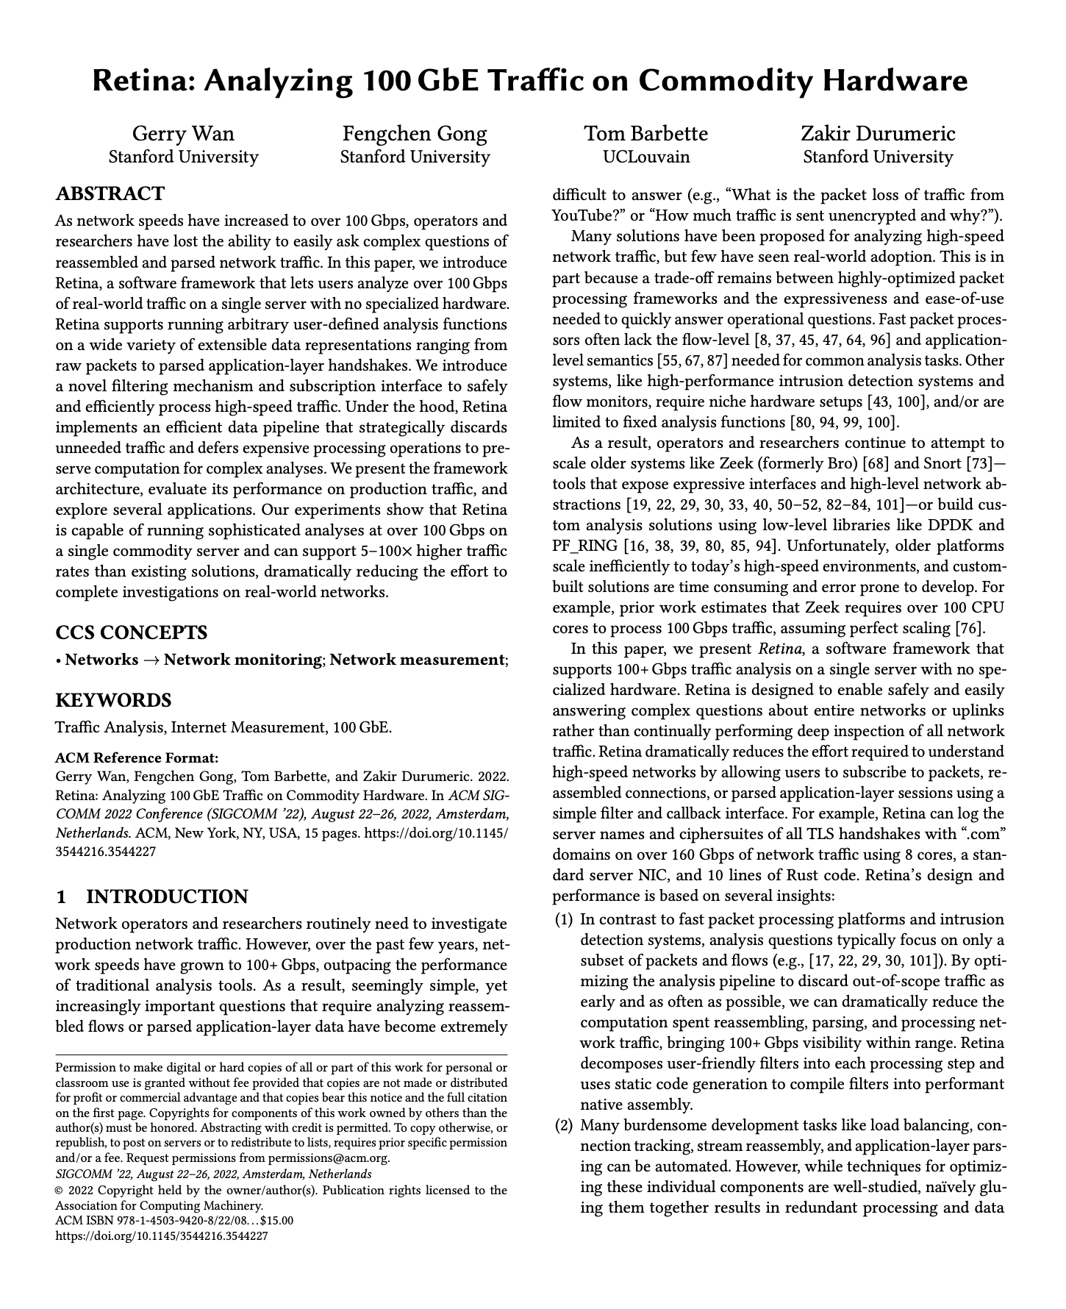
Retina: Filtering Early for Speed
Insight: most analyses only need a subset of traffic
Retina achieves 5-100x higher throughput by:
Letting users subscribe to specific traffic via filters
Discarding irrelevant traffic at each processing stage (hardware → software → connection → session)
Lazily reconstructing only the streams that match
Result: on a 100 Gbps link, only 0.000188% of packets reach the user’s analysis code
Notes:
Retina takes a fundamentally different approach from Zeek and Suricata. Instead of trying to analyze everything, users specify what they want to see using a filter and a Rust callback. The system decomposes filters into multiple layers and discards out-of-scope traffic as early as possible — even at the NIC hardware level. For example, 65% of TCP connections on their university network were single unanswered SYN packets (from scanning), which Zeek and Suricata track but which Retina can drop immediately. This is a research system, not production-ready, but it points toward how future IDS tools might handle 100+ Gbps networks. For your project, you’ll work with PCAP files, so throughput isn’t a constraint.

Slide 65
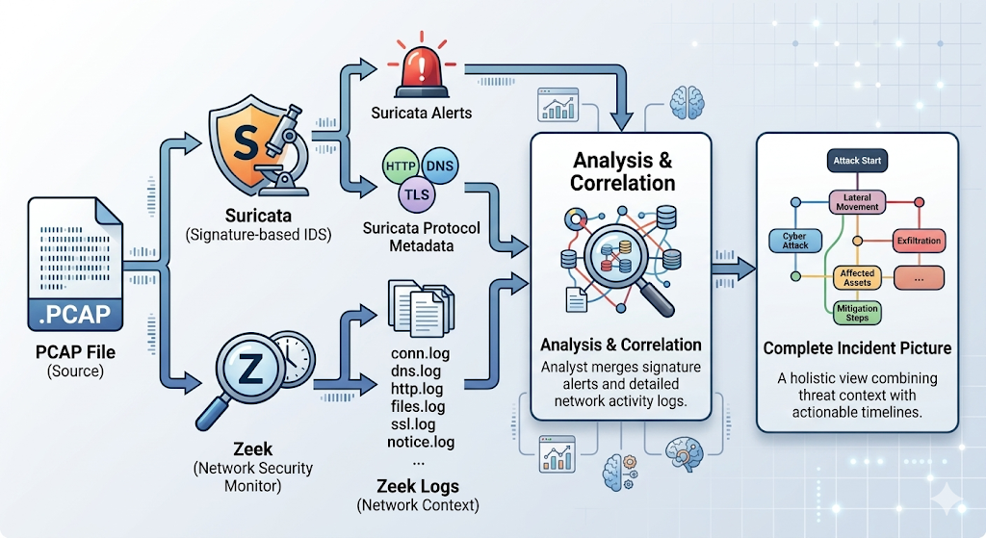
Suricata + Zeek: Better Together
Suricata tells you “something bad happened”
Zeek tells you “here’s everything that happened before, during, and after”
zeek-cut useful for extracting specific fields from Zeek's tab-separated logs
Notes:
Suricata and Zeek are complementary. Suricata quickly identifies known attack patterns with its signature engine.
Zeek provides the rich network context needed to investigate: what other connections did the compromised host make? What DNS queries preceded the attack? What files were transferred? Together, they give you both the alert and the full context.

Slide 66
Suricata + Zeek: Better Together
Why not Zeek for everything?
  Too slow: If you tried to express Suricata's 30,000-rule Emerging Threats ruleset as Zeek scripts checking payload bytes, you would almost certainly fall behind line rate on a busy network.
  Related: Would fight against script language design of higher level abstractions to match individual packets (quickly)
  Zeek is purely passive: Because it operates by building up multi-packet abstractions it is only designed for detection, not prevention (by dropping packets inline)
Notes:
Suricata and Zeek are complementary. Suricata quickly identifies known attack patterns with its signature engine.
Zeek provides the rich network context needed to investigate: what other connections did the compromised host make? What DNS queries preceded the attack? What files were transferred? Together, they give you both the alert and the full context.

Slide 67

Security
Operations
Centers

Slide 68
What a SOC Does
The organizational unit that staffs and operates the tools we’ve discussed
Continuously monitors the IT environment
Detects and triages alerts
Investigates and contains incidents
Coordinates eradication and recovery
Alahmadi et al. interviewed practitioners across 7 SOCs —
their findings ground this section
Notes:
The SOC is where detection technology meets human judgment. Everything we’ve discussed — SIEM, EDR, IDS, Zeek, Suricata — is deployed and operated by SOC staff. SOCs range from a single part-time analyst at a small company to 24/7 global operations with hundreds of staff at large enterprises. The Alahmadi et al. study interviewed 21 practitioners from 7 SOCs of various types (internal, MSSP) across multiple sectors, giving us a grounded view of how SOCs actually work.

Slide 69
SOC Staffing Models
Model | Trade-offs
In-house | Full control and org knowledge; expensive 24/7 staffing
MSSP / MDR | 24/7 coverage without headcount; less organizational context
Hybrid | Vendor handles Tier 1 and off-hours; in-house handles escalations
Alahmadi et al. found that MSSP analysts face pressure to over-report:
“Being analysts, most of them are afraid not to raise them to the customer… they do tend to raise quite a lot of alarms”
Notes:
Not every organization can afford an in-house SOC. MSSPs and MDR providers offer 24/7 monitoring, but the Alahmadi study revealed an important trade-off: MSSP analysts often lack deep organizational context and face pressure to report everything to avoid liability. In-house analysts understand the business better but may lack 24/7 coverage. Hybrid models try to balance both. The type of SOC directly impacts how analysts make decisions about alert triage — a point often overlooked when evaluating detection tools.

Slide 70
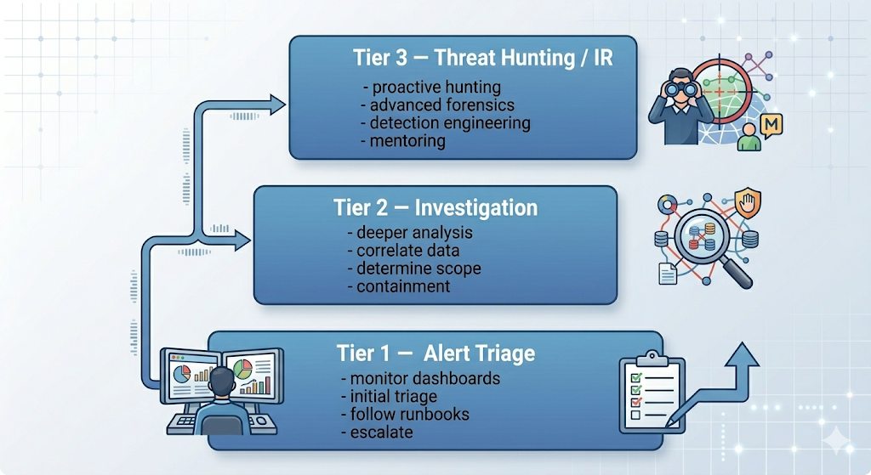
Tiered Analyst Structure
Notes:
[FIGURE: Pyramid diagram with three tiers. Bottom (widest): “Tier 1 — Alert Triage” with keywords: monitor dashboards, initial triage, follow runbooks, escalate. Middle: “Tier 2 — Investigation” with keywords: deeper analysis, correlate data, determine scope, containment. Top (narrowest): “Tier 3 — Threat Hunting / IR” with keywords: proactive hunting, advanced forensics, detection engineering, mentoring.]
Most SOCs use a tiered model. Tier 1 analysts monitor alert queues, perform initial triage (true positive? false positive? benign trigger?), and follow documented runbooks. Tier 2 analysts handle escalated alerts, conducting deeper investigation and correlation. Tier 3 are the senior experts who proactively hunt for threats, develop new detection rules, and mentor junior analysts. Alahmadi et al. found that alarm validation at every tier is fundamentally human-centered — analysts use pattern matching, association, reasoning, and tacit knowledge built through experience.

Slide 71
The Target Breach: Detection Without Response
2013: Target deployed $1.6M FireEye malware detection system
FireEye detected the malware and generated an alert
Alert picked up by SOC in Bangalore
Escalated to Minneapolis SOC — ignored, no action taken
Result: 40 million credit card numbers stolen
Likely: Alert fatigue
The central operational challenge for SOCs:
Analysts may see thousands to 100K+ alerts per day (Alahmadi et al.)
Consequences: alerts ignored, real attacks missed, analyst burnout
Why?
Notes:
The Target breach, which Alahmadi et al. use to open their paper, is the canonical example of detection without effective response. The technology worked — it detected the malware. But the organizational processes failed. The Bangalore SOC escalated the alert, but the Minneapolis team ignored it. Why? Alert fatigue, lack of context, organizational dysfunction. Target had even disabled the automatic response capability of their FireEye system due to fear of false positives disrupting business. This illustrates that Detection & Analysis (NIST phase 2) is necessary but not sufficient — without effective Containment (phase 3), detection is pointless.

Slide 72
Four Limitations of Security Alarms
Limitation | Problem
Unreliable | Signatures use volatile features (IPs, domain names); loosely written
Unexplainable | Black-box tools; short/generic descriptions
Lack context | No awareness of network topology, business function, asset criticality
Not transferable | Each environment is unique; one-size-fits-all fails
Notes:
From Alahmadi et al.’s qualitative interviews, four categories of alarm quality problems emerged. These map closely to Sommer & Paxson’s theoretical challenges but ground them in specific practitioner experiences. Unreliable: “A lot of the network-based stuff I don’t find very reliable because a lot of the IOCs are based on IP addresses which change, based on domains which get shut down.” Lack of context: analysts need to know network topology, business function, and asset criticality to triage effectively — an alarm for a Linux exploit on a Windows server is noise, but the tool doesn’t know the OS.

Slide 73
The REACT Model for Better Alarms
Alarms should be:
Reliable — use stable features; incorporate analyst feedback
Explainable — communicate reasoning, not just “anomalous”
Analytical — support human reasoning and hypothesis testing
Contextual — incorporate network, business, and environmental context
Transferable — adapt to different environments via transfer learning
Notes:
This is Alahmadi et al.’s constructive contribution: five properties that address both Sommer & Paxson’s theoretical challenges and the practitioner pain points. Reliable addresses the base-rate problem by using stable features and incorporating feedback. Explainable addresses the semantic gap. Contextual addresses the concept drift and environmental knowledge problems. Transferable addresses the fact that every network is different. These properties should guide the design of next-generation security tools and provide a framework for evaluating existing ones.

Slide 74
Other Alert Fatigue Mitigations
Strategies:
Tuning: refine rules to reduce noise (Alahmadi: “the tedious part is FPs that we deal with”)
Enrichment: add context automatically (asset criticality, threat intel)
SOAR automation: auto-close known FP patterns, auto-escalate high-confidence alerts
Detection quality metrics: track FP rate per rule; retire noisy rules
Notes:
Alert fatigue is the base-rate fallacy made real. The Alahmadi study found that most tuning falls on the analysts themselves — a tedious, never-ending task. SOAR (Security Orchestration, Automation, and Response) platforms like Palo Alto XSOAR or Splunk SOAR help by automating repetitive triage steps: auto-querying threat intel, auto-enriching alerts with asset context, and auto-closing known FP patterns. This frees analysts to focus on the cases that require human judgment. Key SOC metrics include MTTD (mean time to detect), MTTA (mean time to acknowledge), and MTTR (mean time to respond).

Slide 75
The Human Element in SOC Operations
Alahmadi et al.’s key findings:
55% of analysts rely on tacit knowledge and intuition
58% process alerts based on knowledge of regular network activity
Alarm validation requires understanding the business, not just the network
  “It’s not just about what you see in the tools, it’s about what you know of the customer and the customer’s nature — business nature”
Threat hunting (Tier 3): proactive, hypothesis-driven search for threats that evade automated detection
Notes:
The Alahmadi study powerfully demonstrates that security monitoring is a human-centered process, not just a technology problem. Analysts’ effectiveness depends on deep knowledge of the environment they’re protecting. One participant described filtering an FP by knowing a customer’s working hours: “I use open-source intelligence to build up a view of the customer first… if they are in Dubai… they might not be doing the same working hours.” This organizational knowledge is not something tools can easily replace. Threat hunting is the most proactive expression of this human element: forming hypotheses about attacker behavior and searching for evidence, using MITRE ATT&CK as a framework for identifying detection gaps.

Slide 76

Key Takeaways
The NIST incident lifecycle (six phases) frames how organizations handle security events
IDS concepts trace from Anderson (1980) through Denning (1987) to modern tools
The base-rate fallacy and semantic gap remain fundamental challenges (Sommer & Paxson, confirmed by Alahmadi et al.)
Zeek provides network visibility; Suricata provides fast signature matching — use both
SOCs are where technology meets human judgment
Alert fatigue is the central operational challenge; alarms should be REACT
Notes:
These are the themes that tie the lecture together. The NIST lifecycle provides the organizational framework. The historical progression from Anderson through Denning to modern tools shows how concepts evolved. The challenges identified in 1987, formalized in 2010, and confirmed in 2022 show how persistent the fundamental problems are. Tools complement each other. Scaling remains an open problem. And ultimately, the human element is critical: the best detection technology is useless if analysts are overwhelmed, undertrained, or lack organizational context.

Slide 77
References
Anderson, J. “Computer Security Threat Monitoring and Surveillance.” Technical report, 1980.
Denning, D. “An Intrusion-Detection Model.” IEEE TSE, 1987.
Heberlein, T. et al. “A Network Security Monitor.” IEEE S&P, 1990.
McHugh, J. “Testing Intrusion Detection Systems.” ACM TISSEC, 2000.
Sommer, R. and Paxson, V. “Outside the Closed World: On Using Machine Learning for Network Intrusion Detection.” IEEE S&P, 2010.
Alahmadi, B., Axon, L., and Martinovic, I. “99% False Positives: A Qualitative Study of SOC Analysts’ Perspectives on Security Alarms.” USENIX Security, 2022.
Wan, G., Gong, F., Barbette, T., and Durumeric, Z. “Retina: Analyzing 100 GbE Traffic on Commodity Hardware.” SIGCOMM, 2022.
Zeek Documentation: docs.zeek.org
Suricata Documentation: docs.suricata.io

