Slide 1


Secure Software Engineering and Management .
UPenn CIS 7000-010
Michael Hicks
Cybersecurity Regulation and Compliance

Slide 2
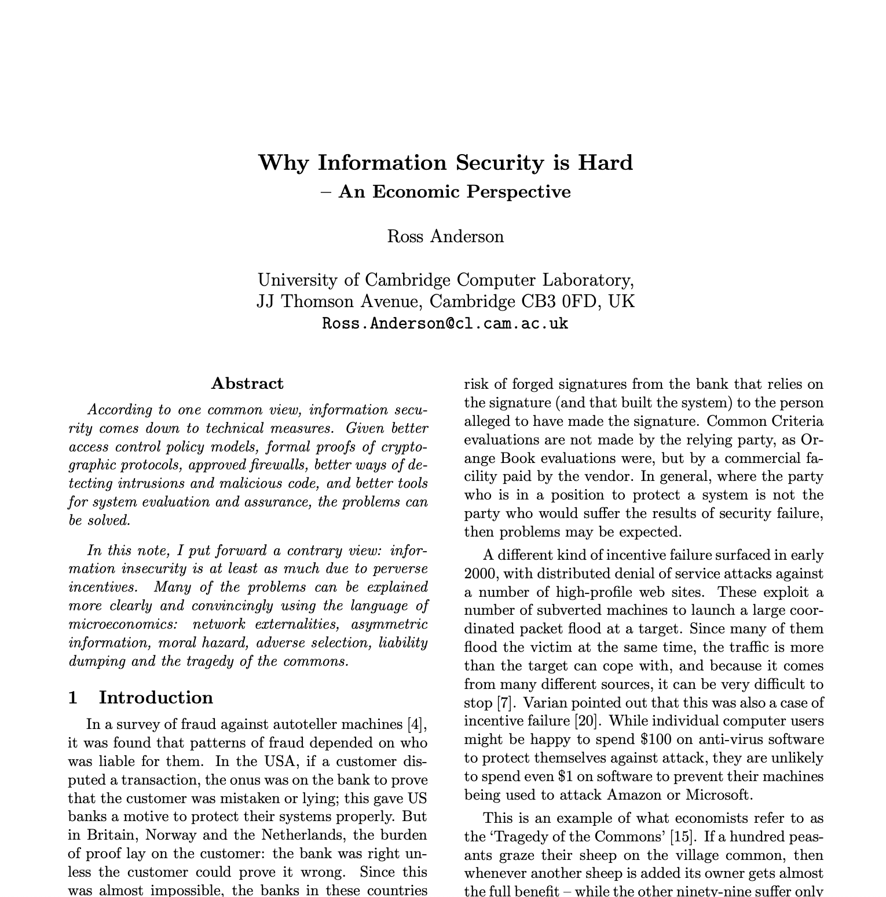
Misaligned Incentives
Recall from Anderson:
Markets systematically under-supply security
Incentives are misaligned — externalities, information asymmetry
The party that pays for security isn’t always the one that suffers its absence
Regulation is the classical response to market failure.
Today: does cyber regulation actually align the incentives?
Notes:
This connects directly to Anderson’s economics lecture: if markets under-supply security because of externalities and misaligned incentives, regulation is the classical response. But we’ll see that the regulation itself has trouble doing what it sets out to do — for some of the same reasons risk management is hard (measurement), and some new ones (process vs. outcomes, compliance theater, enforcement asymmetries).

Slide 3
The Big Question Today
If I am building a cloud-hosted service with valuable customer data:
What does the law require me to do?
Does doing it make me more secure?
And if not — why not, and what would work better?
Notes:
Frame the lecture as a continuation of last time’s scenario. Same SaaS company, same CISO. Last time we asked how to allocate a finite security budget. Today we ask: how much of that budget is already spoken for by legal and regulatory obligations, and what do we get for it? The uncomfortable possibility — foreshadowed by Grigg’s silver bullets argument — is that compliance spending crowds out risk-reducing spending, substituting the appearance of security for the real thing.

Slide 4
Outline
Case study: Equifax and FTC enforcement
Compliance ≠ security: the debate
The US regulatory toolkit
The EU approach: horizontal regulation
Incident reporting and the Cyber NTSB
Notes:
Roughly 15 + 20 + 20 + 15 + 4 + 15 + 5 minutes (94 min total including buffer). The arc: Part 1 grounds the whole lecture in a single incident (Equifax) and shows how the FTC’s Section 5 authority converts into enforcement. Part 2 steps back to ask the broader question Equifax raises — does compliance actually equal security? Part 3 surveys the toolkit US regulators actually use (prescription, disclosure, learning) and the case law that constrains each. Part 4 contrasts the EU’s horizontal approach. Part 5 is a compact 2-slide pass showing how every debate replays in AI regulation (full detail in Appendix if discussion opens up). Part 6 zooms out to the institutional learning gap (Cyber NTSB). Part 7 previews insurance as yet another attempted mechanism.

Slide 5

Part 1: Case Study

Slide 6
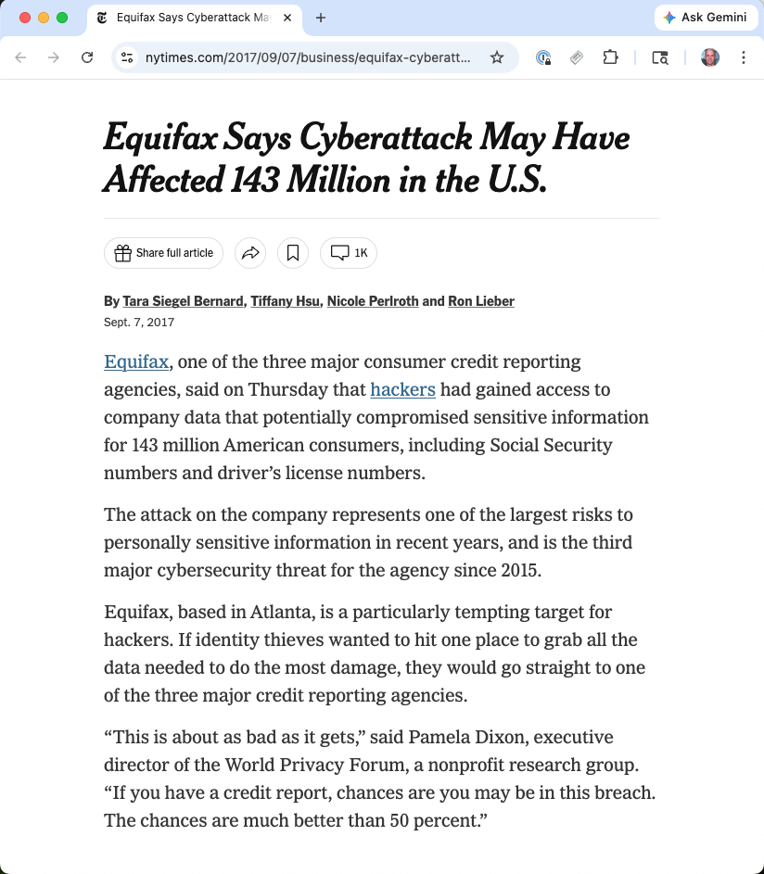
Notes:
IMAGE: A simple Equifax logo or a screenshot of one of the 2017 news headlines (“Equifax says cyberattack may have affected 143 million in the U.S.”) works well here.

Slide 7
Equifax 2017: A “Compliant” Company
Credit bureau holding data on ~200M US consumers.
Credentials at the time of breach:
PCI DSS Level 1 — annual on-site QSA audit
SOC 1 Type II — financial controls audited annually
Internal security org + CISO + $250M+ annual security budget
By every standard of the time: a compliant organization.
Notes:
The point of opening this way is to load the compliance-vs-security tension up front. If compliance-driven security worked, it should have worked at Equifax. They were large, well-resourced, heavily regulated, and had passed multiple external audits.
They were audited under PCI DSS as a Level 1 merchant, under SOC 1 Type II for their financial reporting controls, and were subject to GLBA Safeguards as a non-bank financial institution under FTC jurisdiction. Internally they had a CISO, a dedicated security organization, and a security budget reported at ~$250M/year in 2017.
The breach is therefore a natural experiment: all the compliance tools we’d recognize were in place. What failed? We’ll see the specific operational gaps on the next slide — and we’ll use Equifax as a running benchmark throughout the lecture (“would this regulation have prevented this breach?”). The deeper question — whether compliance of this kind can ever prevent a determined adversary — is what Part 2 takes up.

Slide 8
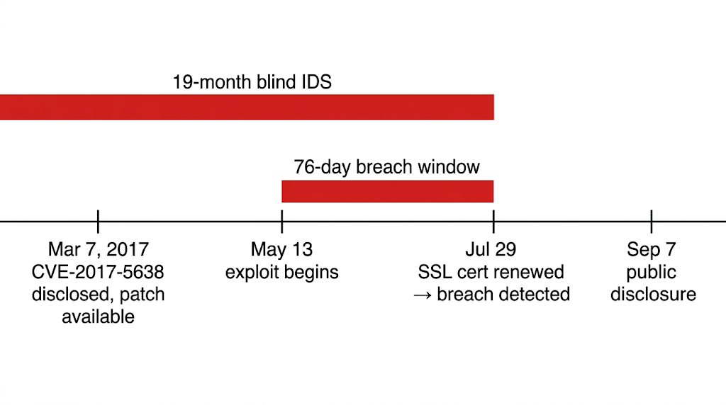
Timeline of the Breach
Every one of these sat inside controls that were documented, audited, and certified.
Notes:
March 7, 2017: Apache Struts CVE-2017-5638 disclosed; patch available same day
>2 months: Equifax fails to patch; scanning tools miss the vulnerable instance
May 13: Attackers exploit; access data for 76 days
SSL cert on traffic-inspection tool expired 19 months prior — blind IDS
July 29: cert renewed → suspicious traffic immediately detected
Every one of these sat inside controls that were documented, audited, and certified.
This is a case where the technical failures are embarrassingly basic: a critical vulnerability went unpatched for months, internal scanning tools missed the vulnerable Struts instance because of a hostname/scanner coverage gap, and when intrusion detection could have caught the ongoing exfiltration, the IDS was effectively blind because its SSL-inspection certificate had expired 19 months earlier and nobody had renewed it.
Ask the class: which of these is a “compliance” failure in the formal sense? Equifax had a patching policy. Equifax had an IDS. The policies existed; the operational follow-through did not. This is the core theme: compliance frameworks measure the presence of controls, not whether they work continuously.
Source: US-GAO, “Actions Taken by Equifax and Federal Agencies in Response to the 2017 Breach,” GAO-18-559 (Aug 2018).

Slide 9
The Breach
147.9 million US consumers affected
Exposed: SSNs, birth dates, addresses, ~209,000 credit card numbers

Slide 10
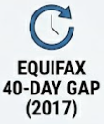
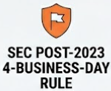
The Breach
40 days
147.9 million US consumers affected
Exposed: SSNs, birth dates, addresses, ~209,000 credit card numbers
Breach discovered, Jul 29
Public disclosure
Sep 7
4 days
CIO Jun Ying sold ~$950K in stock before disclosure → 4 months federal prison
Incident determined material
Public disclosure
Notes:
The 40-day disclosure gap is important for the SEC story later: it motivated the 2023 cyber disclosure rules requiring public companies to disclose material incidents within 4 business days. The insider-trading conviction is a reminder that individual accountability does exist — it just tends to attach to stock transactions, not security decisions.
The data categories are worth pausing on: SSNs and birthdates are essentially permanent identifiers. Unlike credit card numbers, they cannot be “rotated” by the consumer. The externality is nearly unbounded in time.

Slide 11
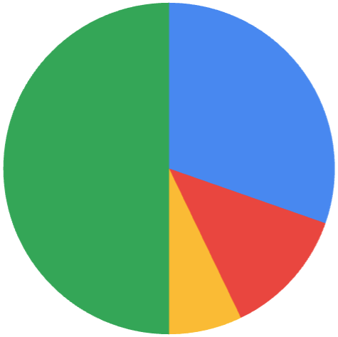
The Fallout: $1.4B by 2019
50-state AG coordinated action
Congressional hearings (4 committees, Oct 2017)
July 2019: FTC settlement of $700M
$425M consumer restitution
$175M to states
$100M CFPB civil penalty
Plus ~$700M incident response, tech, data security upgrades, investigations, lawsuits, …
Notes:
The existing regulatory tools were not toothless: they produced $1.4B+ in consequences. The FTC’s Section 5 authority, backed by Wyndham, proved effective for after-the-fact enforcement. The alleged violations were specific: unpatched known vulnerability, unencrypted sensitive data, inadequate network segmentation, expired SSL cert on monitoring tool. These map cleanly onto what we now see as the Equifax failure pattern.
What was missing in 2017 was proactive infrastructure: mandatory disclosure timelines (Equifax waited 40 days), mandatory incident reporting to a central authority, and institutional learning from incidents. The rest of the lecture examines whether subsequent regulation filled these gaps.

Slide 12
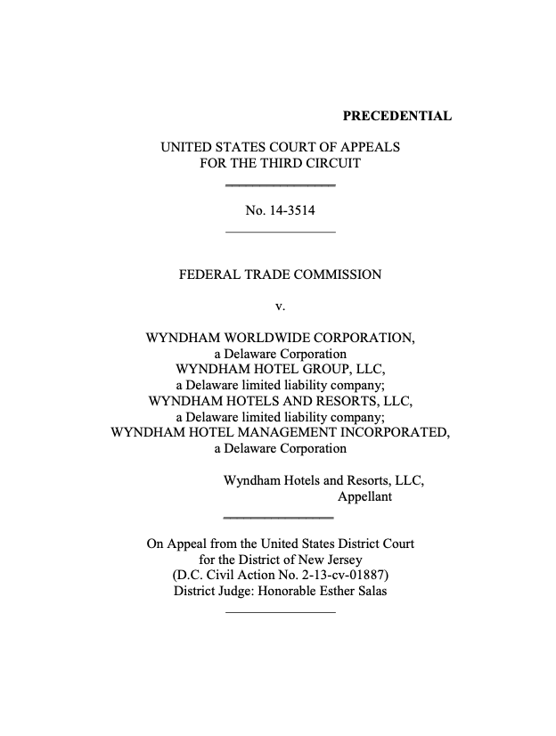
Remedy Foundation: FTC v. Wyndham (2015)
The question: does the FTC have authority to regulate cybersecurity at all?
Wyndham’s argument: no — Congress never passed a specific cybersecurity statute. Section 5 “unfairness” doesn’t reach data-security practices. Holding us liable without explicit rules violates due process.
Notes:
This is the legal foundation for the entire US approach to cybersecurity regulation. If Wyndham had won, the FTC’s ability to enforce cybersecurity standards under Section 5 would have been gutted, and Congress would have had to act to restore it (it hasn’t).
The Wyndham facts are egregious: three breaches in under two years (2008–2009), hackers pivoted from hotel property management systems into the Wyndham corporate network, 619,000+ payment cards exposed, many exported to a Russian domain, $10.6M in fraud losses — and Wyndham failed to fix vulnerabilities after the first breach, getting hit again the same way. Security failures included storing credit card data in clear text, easily guessed passwords, and no firewalls between hotel and corporate networks.

Slide 13
The Ruling
Third Circuit, August 2015:
Section 5 unfairness does encompass data security
FTC does not need to issue formal cybersecurity regulations first
Prior consent decrees + published guidance + complaints gave fair notice
Wyndham’s failures were so basic (cleartext credit cards, no firewalls) that fair notice was easily satisfied
Settlement: 20-year consent order, annual PCI DSS audits, franchisee network safeguards
Notes:
The company argued that by adopting targeted data security legislation, such as the Fair Credit Reporting Act, the Gramm-Leach-Bliley Act, the Children’s Online Privacy Protection Act, and the Health Insurance Portability and Accountability Act, Congress has settled on “a less extensive regulatory scheme.”
The reasoning is important. The court framed Section 5 unfairness as a cost-benefit analysis: practices that cause substantial consumer harm, not reasonably avoidable by consumers, and not outweighed by benefits. That’s the general standard from the FTC Act itself; the court held it’s sufficiently specific when applied to egregious security failures.
Quote from the opinion: a company that “publishes a privacy policy to attract customers who are concerned about data privacy, [then] fails to make good on that promise by investing inadequate resources in cybersecurity, [and] exposes its unsuspecting customers to substantial financial injury” engages in conduct the FTC may challenge as unfair.
The FTC Commission voted 4-0 to accept the settlement. Wyndham’s 20-year consent order effectively locked in a comprehensive security program.
What’s a consent order? A negotiated settlement between the FTC and the defendant that resolves the enforcement action without the defendant admitting liability. It binds the defendant to specific obligations — typically a comprehensive security program, recordkeeping, reporting, and external audits — and violations expose the defendant to civil penalties (~$51K per violation, indexed). The FTC standardized on 20-year terms for data-security consent orders as a long-duration compliance lever. No money changes hands for the underlying violation (FTC can’t get civil penalties for first-time Section 5 violations), but the order is enforceable in federal court, and the threat of per-violation penalties is real.
What about the PCI audits? Annual is actually the baseline PCI DSS cadence for large merchants, then and now. Wyndham was a Level 1 merchant (>6M Visa transactions/year), which requires an annual on-site assessment by a Qualified Security Assessor (Report on Compliance), plus quarterly external vulnerability scans. Smaller merchants (Levels 2–4) do annual Self-Assessment Questionnaires instead of on-site audits. So “annual PCI audits” in the consent order wasn’t elevated cadence — it was the normal Level 1 obligation, now owed to the FTC (court-enforceable) rather than only to the card brands. PCI DSS 4.0 (effective March 2024) keeps annual assessment for Level 1 and adds more continuous controls between audits.

Slide 14
Why Wyndham Matters
US (still) has no economy-wide cybersecurity statute
Wyndham gave the FTC de facto cybersecurity authority via Section 5
Standards built case by case through enforcement
Distinctly American: regulator accretes doctrine rather than Congress legislating
Every subsequent FTC cyber case sits on top of Wyndham
Notes:
This is the teachable takeaway. The US and EU diverge fundamentally here: the EU passes horizontal laws (GDPR, CRA), the US relies on a patchwork of sector-specific statutes plus agency common-law accretion. Each has pathologies, which we’ll see today.
The strength of the US approach: it’s adaptive — the FTC can pursue new kinds of harms without waiting for new legislation. The weakness: it’s unpredictable — companies don’t know what “reasonable security” means until they’re sued, and courts can reject the FTC’s position as too vague (we’ll see LabMD in a few slides).

Slide 15
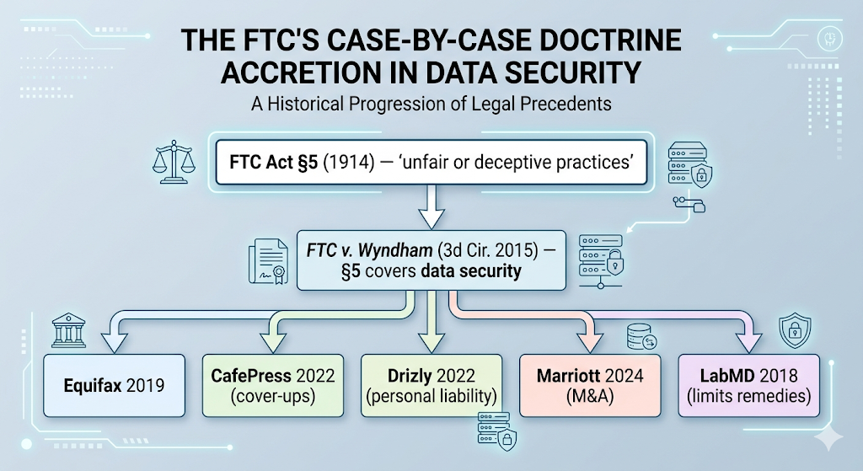
Notes:
This is the teachable takeaway. The US and EU diverge fundamentally here: the EU passes horizontal laws (GDPR, CRA), the US relies on a patchwork of sector-specific statutes plus agency common-law accretion. Each has pathologies, which we’ll see today.
The strength of the US approach: it’s adaptive — the FTC can pursue new kinds of harms without waiting for new legislation. The weakness: it’s unpredictable — companies don’t know what “reasonable security” means until they’re sued, and courts can reject the FTC’s position as too vague (we’ll see LabMD in a few slides).

Slide 16
FTC as Cyber Enforcer: A Pattern
Case | Year | Violation | Enforcement
Wyndham | 2015 | 619K cards, 3 breaches | 20-yr consent order; PCI audits
Equifax | 2019 | 147M records | $700M settlement (FTC + states + CFPB)
CafePress | 2022 | 22M accounts | $500K penalty; first cover-up case
Drizly | 2022 | 2.5M consumers | CEO bound 10 yrs at any future firm
Marriott | 2024 | 344M guest records, 3 breaches | 20-yr program of indep. security reviews; $52M multistate settlement
State AGs active too: Capital One ($190M, 2021), T-Mobile ($31.5M, 2024), Home Depot ($17.5M, 2020).
Notes:
Brief background on each case that students haven’t seen yet:
CafePress (2019 breach → FTC settlement March 2022, finalized June 2022): Custom-merchandise e-commerce platform. Attackers exfiltrated ~22M customer records — emails, security Q&A answers, partial credit card numbers, and ~180K unencrypted SSNs. Passwords were stored with a weak hash. After discovery, CafePress forced a password reset but framed it as a routine “policy update” and did not notify consumers of the breach for months. The FTC’s complaint was notable because it alleged both the underlying security failures and the cover-up — the first time the FTC treated breach concealment as a distinct Section 5 violation. Consent order against Residual Pumpkin Entity LLC (former owner) and PlanetArt LLC (2020 acquirer); $500K to compensate small-business victims; 20-year comprehensive security program required. Entities only — no named individual.
Drizly (FTC settlement October 2022): Uber-owned alcohol delivery marketplace. 2020 breach exposed ~2.5M consumers’ data (emails, geolocation, device info, some hashed passwords). The FTC’s complaint emphasized that CEO James Cory Rellas had known about a 2018 security incident (a GitHub credential leak) and failed to act. The consent order is the landmark individual-liability case: it binds both Drizly and Rellas personally. For 10 years, Rellas must implement an information-security program at any future employer that collects data on 25,000+ consumers. This is the order that “follows the CEO to his next job” — a deliberate FTC response to the “fine the LLC, executives move on” pattern.
Marriott / Starwood (FTC + state AG settlement October 2024): Three breaches from 2014–2020 cumulatively exposed data on 383M guests. The most damaging — the Starwood breach — had been ongoing since 2014 before Marriott acquired Starwood in 2016. Marriott did not detect it in due diligence. $52M multistate settlement; 20-year FTC consent order requiring comprehensive security program, data minimization (retention limits), and a mechanism for consumers to request deletion. Important M&A lesson: acquire a company, inherit its breach and its liability.
Two themes to pull out in discussion:
The FTC has begun imposing personal liability on executives. Drizly is the leading example; the consent order follows Rellas to any future company. This is a deliberate response to the “fine the LLC and the executives move on” problem. CafePress extended a different innovation — penalizing cover-ups as a distinct violation.
State AGs are increasingly the real cyber enforcers — faster, more aggressive, and with 50 jurisdictions they can coordinate around recalcitrant defendants. The Capital One and T-Mobile settlements are meaningful dollars.
The aggregate message: post-Wyndham, failing to have basic security is expensive. This is the single strongest counterargument to the “compliance theater” critique we’ll meet shortly — Section 5 accountability is not theater, it’s teeth.

Slide 17
Two Pillars of FTC Cyber Authority
Wyndham established the general pillar. A sector-specific pillar existed.
Wyndham (hotel chain) tested Pillar 1.
Equifax (credit bureau) was caught by both — and the $700M settlement invoked Section 5 and GLBA Safeguards violations together.
Pillar | Source | Scope | Standard
General | FTC Act §5 + Wyndham | All commerce | Case-by-case “unfairness”
Sector-specific | GLBA Safeguards Rule (2003) | Non-bank financial institutions | “Reasonable” security program
GLBA = 1999 Gramm-Leach-Bliley Act (aka the Financial Services Modernization Act)
Notes:
This slide makes explicit what’s been implicit so far: FTC cybersecurity enforcement authority rests on two independent pillars, not one.
Pillar 1 (Section 5 unfairness) is general, cross-sector, and case-law-driven. Wyndham’s story is entirely about this pillar — because Wyndham was a hotel chain, GLBA didn’t apply, and the legal question was purely whether §5 unfairness reached cybersecurity at all. The 3rd Circuit said yes in 2015.
Pillar 2 (GLBA Safeguards Rule) was already in force when Wyndham was litigated. Issued in 2003 under the Gramm-Leach-Bliley Act (1999), it gives the FTC a specific statutory basis for cyber enforcement over non-bank financial institutions. GLBA’s definition of “financial institution” is surprisingly broad: credit bureaus (like Equifax), mortgage brokers, auto-finance dealers, payday lenders, tax preparers, and debt collectors all qualify. Banks themselves have parallel rules under their banking regulators.
GLBA in brief: Gramm-Leach-Bliley Act, signed 1999, named after its three Republican sponsors. Primarily a deregulatory law — it repealed parts of the 1933 Glass-Steagall Act, allowing commercial banks, investment banks, and insurance companies to merge. But Title V contains the Financial Privacy Rule and the Safeguards Rule (cybersecurity obligations), plus “pretexting” prohibitions. The cybersecurity piece is what we focus on.
GLBA gives enforcement power to different agencies. For the FTC, it is non-bank, non-securities financial institutions (credit bureaus, mortgage brokers, auto-finance, etc.)
Equifax sat in both pillars — a credit bureau doing commerce with US consumers — so the FTC could pursue both theories in a single enforcement action. That’s exactly what happened: the 2019 settlement rested on Section 5 unfairness and GLBA Safeguards Rule violations together. Belt-and-suspenders: no need to pick one theory.
The dual structure also matters for Part 3’s case law: LabMD (Pillar 1, Section 5 vagueness problem) constrains the general pillar. The 2023 GLBA Safeguards revision (Pillar 2’s upgrade to prescriptive controls) is designed to avoid the LabMD vagueness trap within the financial sector specifically.

Slide 18
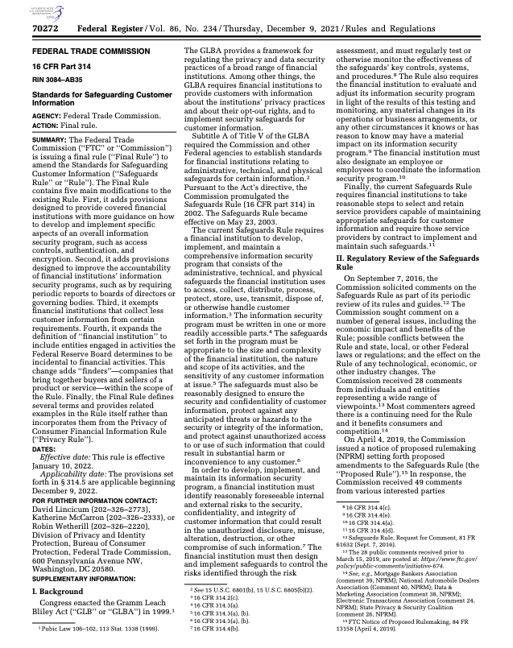
GLBA Safeguards Revision: Rules Strengthened
2021 rule, effective June 2023. Major shift: principles → prescriptive.
Mandatory encryption in transit and at rest
MFA for customer data access
Designated Qualified Individual (personal accountability)
Written incident response plans
Periodic pen testing and vulnerability assessments
Annual compliance reporting to boards
Notes:
Recall the Two-Pillars framing. The GLBA Safeguards Rule is the sector-specific pillar (Pillar 2). The 2021 revision (effective June 2023) upgrades that pillar from principles-based to prescriptive --- a direct response to the Equifax failure pattern. The old rule just required "reasonable" security --- which, as we'll see with LabMD in Part 3, is hard for a court to enforce concretely. The revised rule names specific controls. An auditor can answer "do you encrypt?" yes or no.
Importantly, this upgrade happens inside the *sector-specific* pillar. The *general* pillar (Section 5) is still stuck with "unfairness" / "reasonableness" and still runs into the LabMD vagueness problem for non-financial firms. That's why the FTC has different enforcement patterns for financial vs. non-financial firms --- and why sectoral-specific statutes remain so load-bearing in the US patchwork.
Ask the class: which specific Equifax failures would the new rule have caught?
Expired SSL cert on IDS? Indirectly — covered by “pen testing and vuln assessments,” which should test monitoring coverage.
Unpatched Struts? Covered by vuln assessments.
Cleartext sensitive data? Directly prohibited now.
Missing network segmentation? Addressed in safeguards program requirements.
The catch: the rule mandates controls exist. Verifying they work continuously is a different problem, and it’s where compliance audits tend to break down.
Primary sources (in case a student asks):
Final rule as adopted: Standards for Safeguarding Customer Information, 86 Fed. Reg. 70272 (Dec. 9, 2021)
Current codified text: 16 CFR Part 314
FTC hub (includes May 2024 breach-notification amendment — 30-day reporting for incidents affecting 500+ consumers): FTC Safeguards Rule
Calendar note: the rule was published Dec 2021 with most provisions set for Dec 2022. The FTC delayed the core technical requirements (MFA, access controls, encryption, incident response plan, Qualified Individual) to June 9, 2023 via a November 2022 rulemaking — that’s why we say “effective June 2023.”

Slide 19
Part 2: Compliance ≠ Security — The Debate

Slide 20
Stepping Back
Equifax
held multiple certifications
had a CISO
spent nine figures on security
And was breached through a patching failure and an expired certificate.
Post-Equifax, regulators tightened specific rules. But:
Does compliance actually equal security? And if not, why not?
Notes:
Explicit signpost into the new theme. Part 1 was grounded in a single incident and the FTC’s response to it — specific failures, specific enforcement. Part 2 steps back to examine the deeper question Equifax raises: is compliance-driven security ever enough, and where does it systematically fail?
We’ll see the critique sharpened in Kelly’s “Compliance Theatre,” counter-evidence from GDPR and Thaw, and the measurement problem that sits underneath all of it. Part 3 then turns to the regulatory toolkit: what mechanisms do US regulators actually have, and what limits their use?

Slide 21

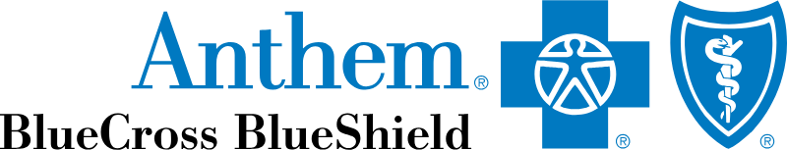





Equifax Is Not an Anomaly

Slide 22
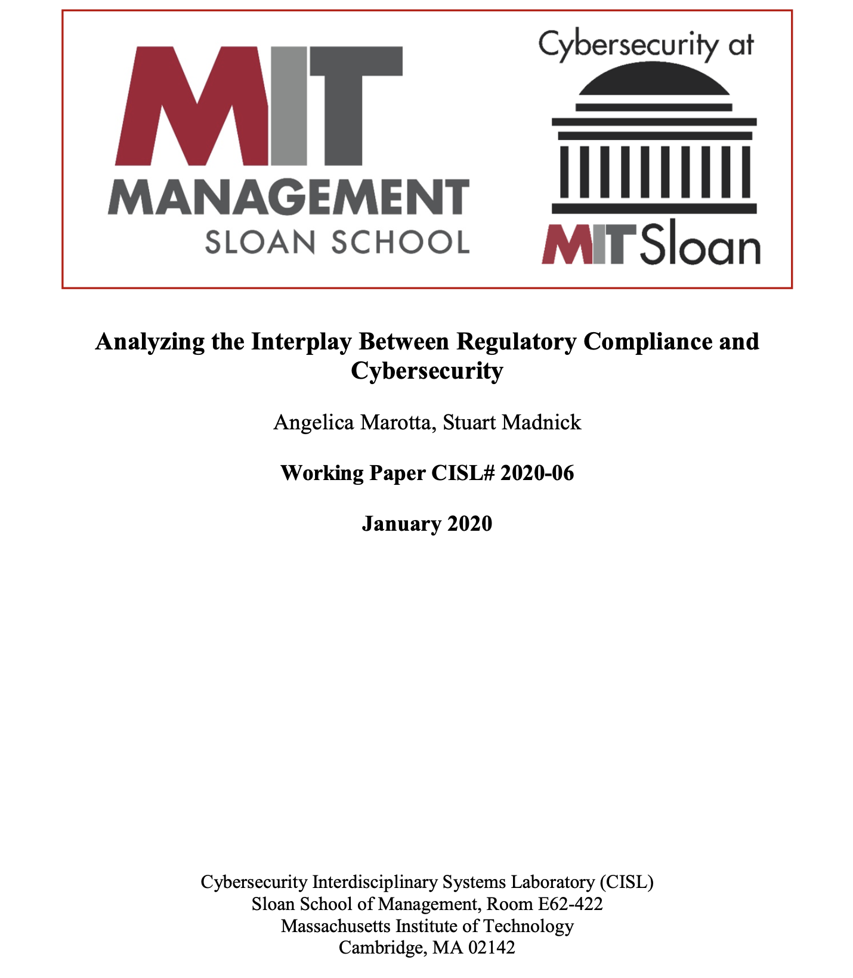
Equifax Is Not an Anomaly
Target (2013):
Was PCI-DSS certified when breached
Attackers entered via HVAC vendor
FireEye alerts ignored
40M cards + 70M customer records
Cost: $290M+
Heartland Payment Systems (2008), Anthem (2015), Marriott (2018): all certified compliant at time of breach.
8 case studies across 5 industries
Notes:
Target is the canonical example because it had passed a PCI-DSS compliance audit shortly before the breach. The attackers got in via Fazio Mechanical Services (the HVAC vendor), used stolen credentials to reach Target’s internal network, deployed POS malware, and exfiltrated 40M card numbers. FireEye alerts fired during the attack, but no one acted on them.
The pattern is structural: compliance frameworks measure whether you have controls, not whether you operate them effectively. An alert that fires into a queue no one reads satisfies “you have intrusion detection.” It does not satisfy “you detect intrusions.”
Reference: Marotta & Madnick, “Analyzing the Interplay Between Regulatory Compliance and Cybersecurity” (MIT CISL, 2020) — 8 case studies across 5 industries, found compliant orgs routinely had significant gaps.

Slide 23

Compliance Can Substitute for Security
Notes:
A visual metaphor for “compliance as theater / facade.” A Potemkin village sketch — the classic historical image of a painted front with nothing behind it — or a modern version: a building facade propped up with 2×4s, with “ISO 27001 CERTIFIED” emblazoned on the front and visible scaffolding/emptiness behind. Makes the “ceiling, not floor” metaphor physical and sticky.

Slide 24
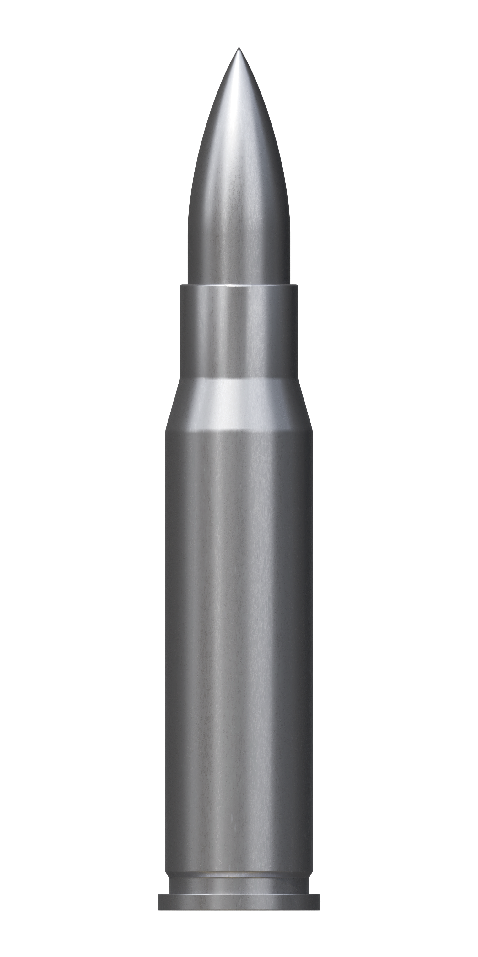
Compliance Can Substitute for Security
Optimizing for audit passage ≠ reducing risk.
Compliance becomes a ceiling, not a floor
“Paper security”: documentation substitutes for operation
Budget crowded out: compliance work is expensive, visible, measurable
Grigg’s silver bullets, redux: compliance certifications signal “doing security”
Notes:
This is the central framing of Part 2. We’re setting up the critique; in the next 5-6 slides we’ll hear it articulated more sharply by Nick Kelly. The “crowding out” argument is specific and testable: if compliance consumes X dollars that would otherwise be spent on risk-reducing activities, compliance increases risk at the margin even if each individual compliance activity is weakly positive.
Remind students of Grigg’s argument from the economics unit: markets reward the appearance of security because buyers can observe the signal (ISO 27001 certification, SOC 2 Type II report) but cannot observe the underlying quality. Compliance is the institutional version of this: regulators and customers can observe that you passed the audit, but neither can easily observe whether your security actually works.

Slide 25
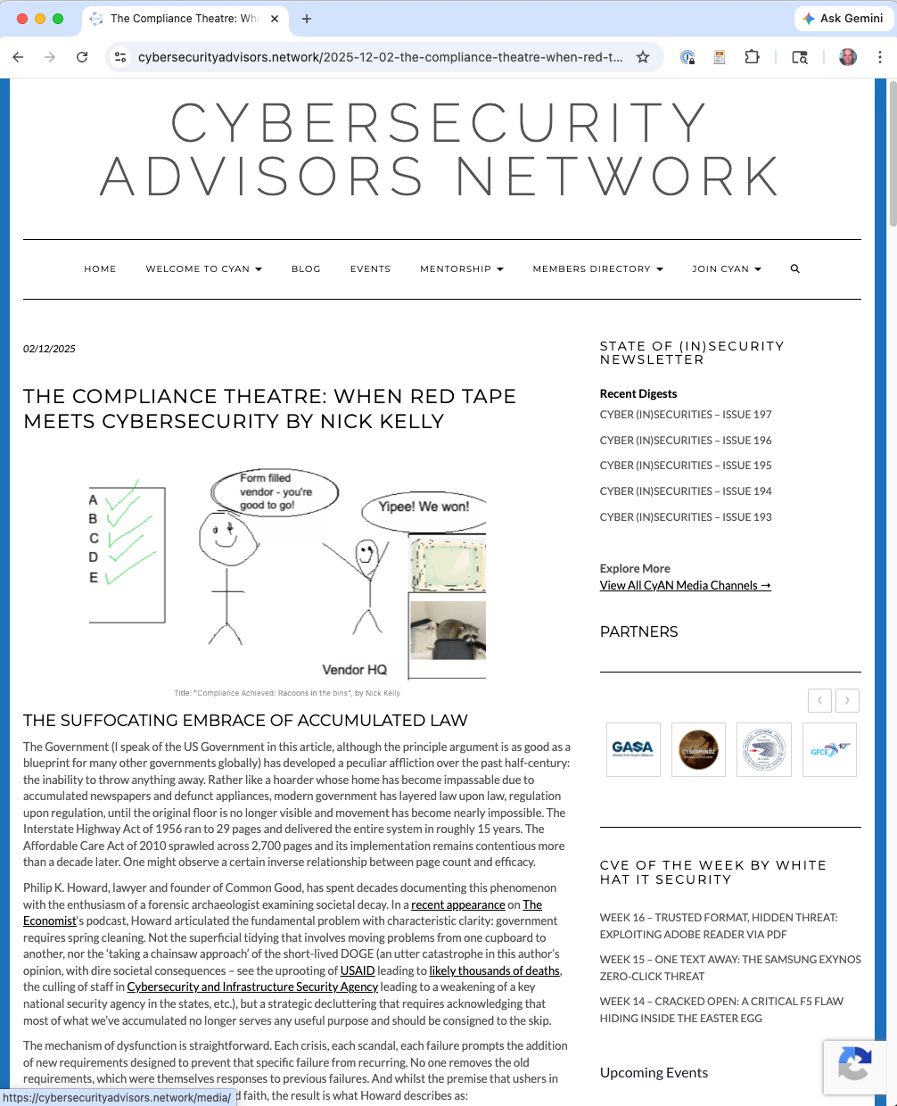
The Compliance Theater
Thesis: cybersecurity compliance has become bureaucratic theater that prioritizes documentation and procedural adherence over actual security outcomes.
“A compliance framework measures the presence of security controls and the quality of documentation. It does not directly measure security.”
--Nick Kelly, SecureFlag, 2025
Notes:
Nick Kelly’s piece (Cybersecurity Advisors Network, Dec 2025) articulates the strongest form of the “compliance is theater” argument. We’ll spend the next few slides unpacking his specific claims. The goal is not to fully endorse Kelly — we’ll hear the counterargument too — but to state the critique precisely enough to engage with it.

Slide 26

1: The Checkbox Illusion
Compliance questionnaires measure whether firms know the right answers
They don’t measure whether implementations work
Certified organizations get breached routinely
Heartland Payment Systems
Anthem
Telemessage (2025, federally approved)
Perfect compliance ≠ adequate security.
Notes:
Kelly’s point is that the signal compliance provides is miscalibrated. It is possible to achieve a perfect compliance score with mediocre security, and it is possible to have strong security without full compliance. Audits measure inputs and documentation, not operational reality — and the frameworks have become increasingly decoupled from what actually prevents intrusions.
Telemessage is a useful recent example because it was federally approved for sensitive government communications and was breached in 2025 anyway — a clean case of government-endorsed compliance failing to predict security.

Slide 27
2: Perverse Incentives
What CISOs are rewarded for:
✅ FedRAMP authorization
✅ ISO 27001 certification
✅ Clean SOC 2 Type II
Notes:
The perverse-incentive argument is a standard public choice observation applied to security. Rational CISOs respond to the compensation system they face. If bonuses, board approval, and career advancement track compliance milestones, that’s what gets prioritized. If they tracked breaches averted, we’d see different behavior — but averted breaches are counterfactual and unverifiable, so they don’t feed the compensation loop.
This is deeply parallel to the Lecture 1 forecasting argument: calibrated probability estimates reward you only if someone tracks the outcomes, which almost nobody does.

Slide 28

2: Perverse Incentives
What they are not rewarded for:
❓ Breaches that never happened
❓ Tail-risk mitigation with no visible output
❓ Reducing the attack surface of legacy systems
What CISOs are rewarded for:
✅ FedRAMP authorization
✅ ISO 27001 certification
✅ Clean SOC 2 Type II
Notes:
The perverse-incentive argument is a standard public choice observation applied to security. Rational CISOs respond to the compensation system they face. If bonuses, board approval, and career advancement track compliance milestones, that’s what gets prioritized. If they tracked breaches averted, we’d see different behavior — but averted breaches are counterfactual and unverifiable, so they don’t feed the compensation loop.
This is deeply parallel to the Lecture 1 forecasting argument: calibrated probability estimates reward you only if someone tracks the outcomes, which almost nobody does.

Slide 29

3: The Compliance Industrial Complex
Regulated firm
Who benefits from complex compliance regimes?
Auditors (Big 4 + specialty firms)
Consultants (implementation, remediation)
Tool vendors (Governance, Risk & Compliance platforms, evidence collection)
Certification bodies
FedRAMP alone: 18–24 months, $2–5M initial, $500K–$1M/year to maintain.
Big 4 auditors
Consultants
GRC vendors
Certification bodies
Notes:
Kelly describes this as “an ecosystem of auditors, consultants, and certifications… largely decoupled from the provision of actual security.” The structural observation: compliance has become a mature industry with $10B+ annual revenue that has strong economic incentives to add new frameworks and preserve existing ones. Nobody in that industry wants to simplify.
Big 4 auditors:
1. Deloitte (Deloitte Touche Tohmatsu)
2. PwC (PricewaterhouseCoopers)
3. EY (Ernst & Young)
4. KPMG (Klynveld Peat Marwick Goerdeler)
FedRAMP is his canonical example. The costs are real and are widely discussed in cloud-vendor circles. The question is not whether FedRAMP makes cloud services more secure — it probably does, at the margin — but whether it makes them $2M-per-vendor more secure, and whether the $2M is best spent that way.
Connect to Anderson’s economics lecture: this is a textbook case of regulatory capture where the regulated industry (the “we build compliance programs” industry) captures the content of the regulation.

Slide 30
Aside: What Is FedRAMP?
Federal Risk and Authorization Management Program (2011; codified in statute 2022)
Standardized security authorization for cloud services sold to federal agencies. Authorize once, use many times.
Baseline: NIST SP 800-53 controls (~325 for Moderate; ~425 for High)
Paths: JAB Provisional ATO or Agency ATO (single sponsor)
Kelly’s point: pure Category 1 prescription — concrete controls, auditable — with incumbent concentration as a side effect.
Notes:
Aside slide. Not essential to the Kelly argument but lets me pause on one concrete compliance regime so “$2-5M” doesn’t feel abstract. Skip if time tight.
What problem FedRAMP solves: before 2011, every federal agency buying a cloud service did its own NIST SP 800-53 authorization — AWS would get authorized by Agency A, then re-authorized by B, then C. Redundant assessments, inconsistent standards. FedRAMP centralized the work: one authorization package, any agency adopts it by issuing a simple ATO letter referencing the existing package.
Structure:
Impact levels (based on FIPS 199 categorization): Low (~125 controls), Moderate (~325), High (~425), plus a lightweight Li-SaaS tier for simpler offerings
Authorization paths: Joint Authorization Board (JAB: DoD + DHS + GSA CIOs) Provisional ATO — higher bar, broader reach; or Agency ATO — single sponsoring agency, now the more common path
Process: cloud provider hires a 3PAO (Third Party Assessment Organization, A2LA-accredited) to assess controls → System Security Plan + Security Assessment Report → authorization decision → continuous-monitoring reports forever after
The Big 4 angle: Deloitte, PwC, EY, and KPMG all have 3PAO practices, competing with specialty firms like Coalfire, Schellman, A-LIGN, and Kratos. Many large vendors hire one Big-4 arm to consult on control design, then pay a different firm (or a different engagement from the same firm with an “ethics wall”) to do the 3PAO assessment.
Reform: FedRAMP 20x (announced 2024) aims to shift toward automation, shorter cycles, and continuous authorization rather than point-in-time snapshots. Response to years of complaints about cost and duration. Early signs are modest.
Why it matters for this lecture: FedRAMP is the cleanest case of Category 1 prescription in US cyber regulation. The controls are concrete, the cost is traceable, and the market-concentration effect is measurable — federal cloud spend is dominated by AWS GovCloud, Azure Government, Google Cloud Assured Workloads, and Oracle FedRAMP High, with smaller vendors either partnering through a sponsor or simply skipping the federal market. Whether FedRAMP produces security uplift proportional to its cost is a live debate; whether it makes the market less competitive is empirically settled (yes).
References: - FedRAMP Marketplace - FedRAMP Authorization Act (FY2023 NDAA) - FedRAMP 20x announcement

Slide 31
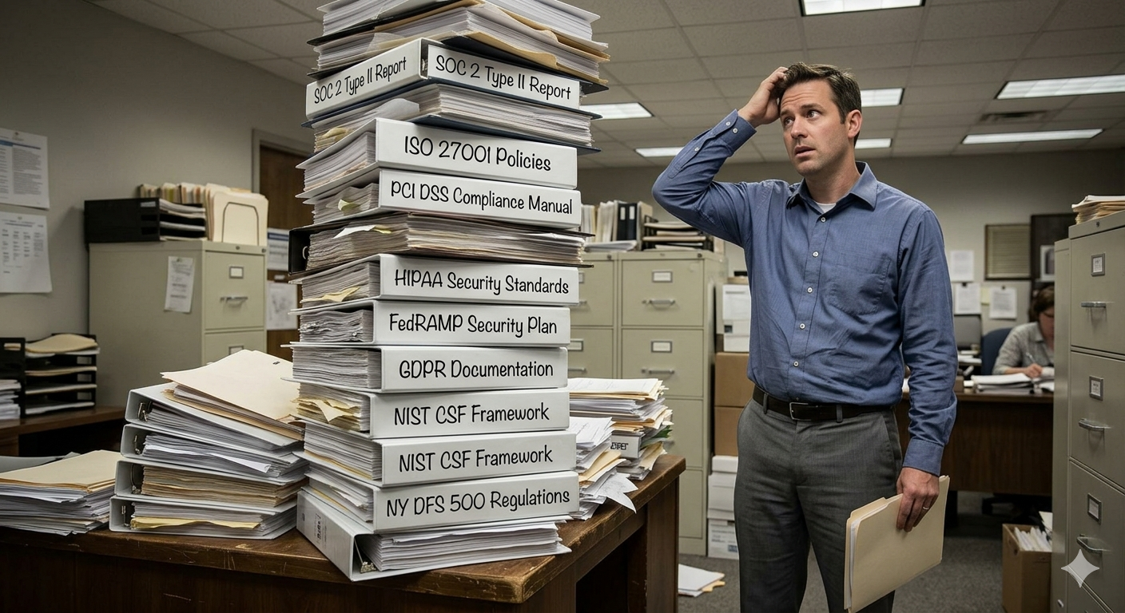
4: Regulatory Accumulation
New frameworks pile on top of old ones. Nothing gets removed.
Large orgs often maintain:
SOC 2 Type II
ISO 27001 / 27701
PCI DSS
HIPAA
FedRAMP
GDPR, …
Each requires separate evidence, audits, attestations.
Notes:
This is the “harmonization” problem GAO documented in GAO-25-108436 (2025):
industry spends tens of millions of dollars on overlapping, sometimes contradictory compliance work.
Wolff’s “Harmonizing U.S. Cybersecurity Regulations” (2024) catalogs the specific discrepancies.
Kelly’s framing: cybersecurity regulation inherits a design pathology from government more generally — new regulations get added when there’s political will, but old regulations are never removed because removing them politically looks like “weakening security.” The result is an ever-growing stack. He calls for a “spring cleaning” of accumulated requirements.
Ask the class: what would a well-designed “sunset clause” for a cybersecurity regulation look like? This is a genuinely open question.

Slide 32

Kelly’s Proposed Alternative: A Hybrid Model
Outcomes-focused frameworks: what must be achieved, not precisely how
Judgment and character assessed alongside control verification (aviation analogy)
Spring cleaning: remove obsolete requirements
Trust in expertise within accountability
Less checklist. More professional judgment.
Notes:
Kelly uses US Airways Flight 1549 floating on the Hudson River as his central metaphor for “judgment over procedure” — make it literal on the slide. Photos are widely available (AP, Reuters) but usage-licensed; the Coast Guard’s image is public domain.
Kelly’s proposal is aspirational, and its aviation analogy is double-edged. He cites Sully Sullenberger’s Hudson ditching as an example of judgment mattering more than procedure — but the reason Sullenberger was able to exercise judgment well is that aviation has decades of standardized training, certification, and accumulated institutional knowledge that we discussed in Lecture 1 (Downer’s aviation paradox). Cyber does not yet have that foundation.
So: Kelly is right that outcome-focused regulation is more meaningful, but the practical path to outcome-focused regulation depends on the measurement infrastructure we don’t have. We’ll come back to this in the CSRB section.
Reference: Kelly, “The Compliance Theatre: When Red Tape Meets Cybersecurity,” Cybersecurity Advisors Network, December 2, 2025. https://cybersecurityadvisors.network/2025-12-02-the-compliance-theatre-when-red-tape-meets-cybersecurity-by-nick-kelly/

Slide 33
But Is Compliance All Theater?
Kelly’s critique is sharp. But there’s a strong counterargument:
Post-Wyndham FTC accountability has real teeth
Some regulation has improved measured outcomes
Industry-informed regulation has outperformed pure checklists
Let’s steelman the pro-regulation case.
Notes:
This is the turn. We spent 4-5 slides on the anti-compliance critique; now we spend 4-5 slides on the best empirical defense of cybersecurity regulation. I want students to see this as a genuine tension, not a settled question.

Slide 34
Pro-Regulation Evidence: FTC Teeth
Equifax’s reported breach cost: ~$1.4B total (net of insurance recoveries).
At least half of that was the regulatory settlement: $700M to FTC + states + CFPB. Enabled by Wyndham, GLBA.
Without regulation, that $700M doesn’t exist.
Notes:
Being careful with the numbers here. The ~$1.4B is Equifax’s own disclosed cumulative breach-related cost through 2019 in its 10-K filings — net of insurance recoveries. That total already includes private litigation (consumer class actions settled for ~$380M), forensics, notification, credit monitoring, legal fees, and the regulatory settlements. It is not additive to those things.
What’s distinctive about the regulatory piece:
It wouldn’t exist without FTC Section 5 authority. Private plaintiffs have standing to sue for their own harms; they don’t collect consumer restitution on behalf of the broader public. The $425M consumer restitution fund was a creature of FTC/state enforcement, not private litigation.
It’s largely uninsurable. Cyber insurance policies typically exclude civil penalties and fines outright (the $100M CFPB penalty is the clean case). They sometimes cover consumer restitution or regulatory settlements subject to policy limits and negotiation, but much of the $700M is not going to be recovered from insurers — it’s a real out-of-pocket cost to the firm.
It’s priced against the firm, not against the security team’s budget. That shifts who has to care.
So the argument is narrower than “the $1.4B disproves Romanosky.” It’s: Romanosky’s baseline reflects what firms historically bore without strong regulatory teeth. For firms under meaningful FTC/state exposure (publicly-traded, consumer data, 50-state reach), the expected cost is now materially higher, and the regulatory slice is the part that can’t be smoothed by insurance markets.
This isn’t compliance theater. It’s tort-style enforcement after the fact, with specific factual claims about specific failures. The regulatory tool is not “did you have a checkbox?” but “did you act reasonably?” — closer to what Kelly actually argues for. Even inside the “compliance is theater” frame, there’s a live question of which regulatory mechanisms are theater (prescriptive checklists, audit regimes) and which are not (case-by-case enforcement tied to actual harms).
CafePress, Drizly (personal liability), and Marriott/Starwood all produced ongoing consent orders that are expensive to comply with for decades — another form of regulatory cost not captured by insurance.

Slide 35
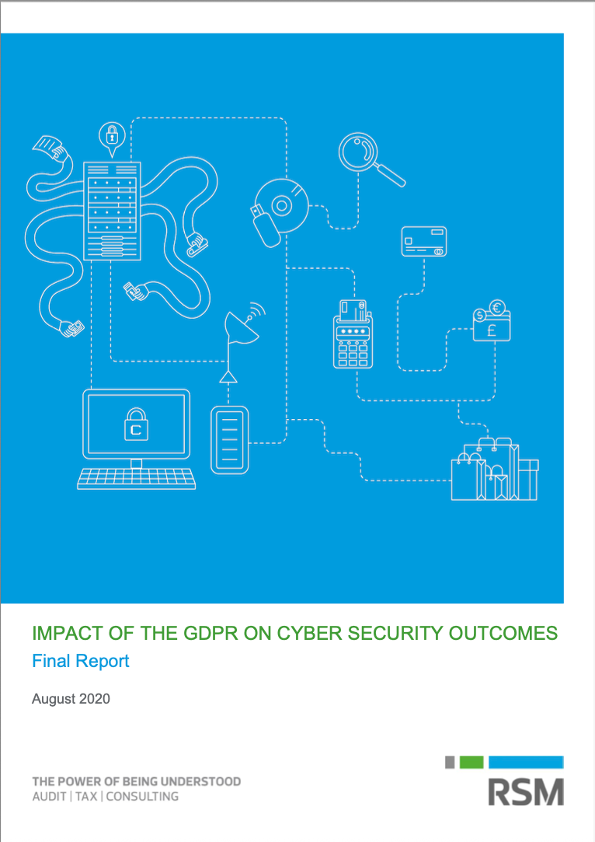
Pro-Regulation Evidence: GDPR Did Improve Security
1,348 UK businesses surveyed:
Measurable improvements in:
Governance: board-level cyber responsibility up
Risk management: risk registers more widespread
Data security practices: encryption, access control
Weaker improvements in: procurement, supply chain
Notes:
Report: “Impact of the GDPR on Cyber Security Outcomes,” UK Department for Digital, Culture, Media and Sport, July 2020.
This is an important counterweight to Kelly. GDPR is the big test case for horizontal regulation in the modern era — broad, ambitious, heavily criticized. The DCMS study is government-commissioned, large-sample, and finds real improvements in governance and risk management practices. Not security outcomes directly (the measurement problem again), but organizational behaviors that are plausibly upstream of outcomes.
The caveat: this is behavior change, not outcome measurement. We don’t know how much GDPR reduced breach frequency or severity in the UK. But it’s the strongest empirical evidence available that modern cybersecurity regulation changes what firms actually do.

Slide 36
Pro-Regulation Evidence: GLBA Rewritten
We saw the revised GLBA Safeguards Rule earlier.
Replaced “reasonable” with specific technical mandates
Direct response to Equifax-class failures
Regulators can and do learn from big incidents
This is exactly what Kelly asks for — except it was more rules, not fewer.
Notes:
The GLBA revision is the counter to Kelly’s “regulatory accumulation” point. Rather than adding another framework, the FTC rewrote an existing one in response to a clear pattern of failures. It’s not a spring cleaning — the rule got more complex — but it’s evidence that regulators can respond to lessons from incidents.
That said: the GLBA revision only applies to non-bank financial institutions. Healthcare, retail, tech, and manufacturing all have their own sector regimes (or none). The US patchwork problem persists even when individual sectors update their rules.

Slide 37
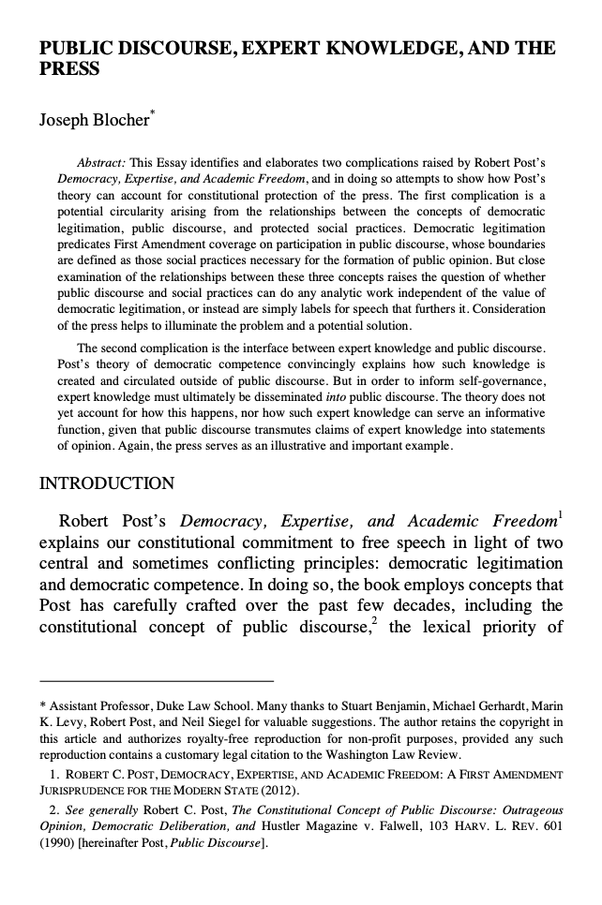
Pro-Regulation Evidence: Enlightened Capture
Thaw, “Enlightened Regulatory Capture” (Wash. L. Rev., 2014):
Compares healthcare (HIPAA) to traditionally-regulated industries
Industry-informed, adaptive regulation produced practices:
~4x more effective than prescriptive checklists
Key ingredient: collaborative, not just rule-imposing
Industry involvement isn’t always capture-in-the-bad-sense.
Notes:
Thaw’s empirical finding is striking: in healthcare, regulation that was developed with industry input and allowed flexibility in implementation produced security practices about 4x more effective than pure prescriptive models. He calls this “enlightened regulatory capture” — an unusual term, chosen to engage with Anderson’s capture framing from the economics lecture while arguing the effect can be positive.
The mechanism: industry experts know what’s feasible and what’s security-relevant; regulators know what to demand. When they collaborate rather than adversarially negotiate, the resulting rules are better calibrated.
“while possessing the power to advance selfish goals, NCVHS members [from private industry] instead acted like “Roman Senators,” using their procedural capture to advance the public interest, contrary to classic expectations about procedural capture. “
Connect to Kelly: Thaw’s finding supports Kelly’s claim that prescriptive checklists underperform; but it also supports the opposite of Kelly’s cynicism about regulation. The right lesson is about which kind of regulation works, not whether regulation works at all.
See also Thaw, “The Efficacy of Cybersecurity Regulation” (Ga. St. U. L. Rev., 2014) — more detailed empirical treatment, arguing directly that prescriptive checklists underperform adaptive, collaborative regulatory models (papers/The Efficacy of Cybersecurity Regulation.pdf)

Slide 38
The Measurement Problem, Resurfaced
As you know: we can’t reliably measure security outcomes.
So regulation mostly measures inputs:
The regulatory paradox: the most important goals are the least measurable. Challenges Thaw’s “let experts do their thing” idea.
Measurable | Not measurable
Did you patch? | Are you actually hard to breach?
Do you have a policy? | Do your controls work?
Did you pass the audit? | Is the residual risk acceptable?
Notes:
This connects directly to Lecture 1’s core data problem. Regulators default toward process mandates because processes are auditable — you can verify that a policy exists, that an MFA configuration is enabled, that a penetration test was conducted. Outcome measurement would require the actuarial infrastructure we established does not exist for cyber.
So the compliance-is-theater critique is partly a downstream consequence of the measurement problem. It’s not that regulators are lazy or captured (though sometimes they are); it’s that the available measurement tools push them toward process rules.
This is the Lecture 1 insight rephrased: if we cannot measure security, we will inevitably regulate a proxy. Whether the proxy is useful is an empirical question — and the evidence suggests “sometimes yes, sometimes no.”

Slide 39
Part 3: The US Regulatory Toolkit

Slide 40
The US Regulatory Landscape
What existed in 2017:
What later emerges:
GLBA Safeguards Rule — principles-based (“reasonable” security)
FTC Act Section 5 — unfair/deceptive practices
State breach notification laws (47 states, varying)
SEC securities fraud rules
CIRCIA (2022) — no federal incident reporting
SEC cyber disclosure rule (2023)
CSRB (2022) — no post-incident learning
Comprehensive federal breach notification law
Federal privacy law; GDPR not yet in force
Notes:
This is the pre-Equifax baseline. The important question is whether the post-2017 additions would have changed the outcome — we’ll apply each one as an “Equifax test” later in the lecture.
Note that GLBA, FTC Section 5, and state notification laws all did apply to Equifax. The absence of additional federal rules is sometimes cited as a failure of the pre-2017 regime, but the more interesting question is whether the existing rules were applied well, and whether the new rules actually plug real gaps or add paperwork.

Slide 41
Three Categories of Approach, Post-Equifax
GLBA 2023 revision
CIRCIA 2022 SEC 2023
CSRB 2022 (now dormant)
regulation
approach
Prescription
Institutional Learning
Disclosure
diagnosis
Not enough rules
Information asymmetry
No systematic knowledge
What failed at Equifax?
Notes:
Prescriptive mandates — specific required controls
Disclosure / reporting mandates — force information out
Institutional learning — systematically study incidents
Framing for all of Part 3: these are the three distinct things regulators have tried since 2017. Part 2 asked whether any of them can work in principle; Part 3 asks how each actually plays out, what court rulings have constrained them, and which would have prevented the precipitating incident.
The differences matter: - Prescriptive says “the failure was not enough rules; here are more” - Disclosure says “the failure was information asymmetry; force it open” - Institutional learning says “the failure was lack of systematic knowledge; build the knowledge base”
These can all be true at once, but they suggest very different policy designs and have very different failure modes.

Slide 42
Category 1: Prescription
Specify the controls. Audit them. Enforce them.
Canonical example: GLBA Safeguards revision (2023) — MFA, encryption, Qualified Individual, pen testing (covered in Part 1).
Two cases reveal how far prescription can actually reach in court:
LabMD (2018) — vagueness of “reasonable security”
D-Link (2017) — unfairness needs concrete harm
Notes:
Signpost slide. We’ve already seen Category 1 instantiated — the 2023 GLBA Safeguards revision in Part 1 was the strongest post-Equifax prescriptive response, replacing “reasonable” security with named technical controls. The natural next question: when the FTC tries to enforce prescriptive rules, what do courts actually permit?
Two cases are worth dwelling on. LabMD set an inward limit: if the prescribed standard is vague (“implement reasonable security”), the resulting order is unenforceable for vagueness. D-Link set an outward limit: absent actual or likely harm, the FTC can’t reach cyber failures under Section 5 “unfairness” at all. Together they tell us what prescriptive regulation can do and what it can’t.

Slide 43
LabMD v. FTC (11th Cir., 2018)
When: complaint 2013 → FTC reversal 2016 → 11th Cir. 2018
At stake: small cancer lab; LimeWire installed on work computer exposed 9,300 patients’ SSNs/insurance data via P2P
Outcome: FTC’s cease-and-desist order vacated for vagueness
Impact: Section 5 authority preserved (Wyndham stands) — but “implement reasonable security” is too vague to enforce as an injunction
Notes:
The LabMD facts are worth telling because they illustrate how enforcement can go wrong even with the right legal theory:
A billing-department employee installed LimeWire on a work computer, exposing a 1,718-page insurance aging file (“the 1718 File”) over a peer-to-peer network
The file was obtained by Tiversa, a cybersecurity firm that then solicited LabMD for remediation services
When LabMD refused, Tiversa reported LabMD to the FTC
The FTC Administrative Law Judge dismissed the case in 2015, finding no proof of actual or likely consumer injury
The FTC Commission reversed in 2016, ordering LabMD to implement a “reasonable” security program
The 11th Circuit vacated the order in 2018 for vagueness — not lack of authority, but lack of enforceable specifics
LabMD went out of business during the litigation
Tiversa’s key witness, Richard Wallace, was later discredited as a whistleblower
Teaching takeaway: Wyndham said the FTC can regulate cybersecurity under Section 5. LabMD said “reasonable security” is too vague to enforce as an order — the FTC needs to specify controls. This is why the 2023 GLBA revision went prescriptive: to have orders a court will actually enforce.
Reference: LabMD, Inc. v. FTC, 894 F.3d 1221 (11th Cir. 2018).

Slide 44
FTC v. D-Link (N.D. Cal., 2017)
When: complaint Jan 2017 → motion-to-dismiss ruling Sep 2017 → settlement 2019
At stake: IoT vendor marketing “EASY to secure” with hard-coded credentials, command-injection bugs, exposed signing key — no known breach
Outcome: unfairness claim dismissed (no concrete harm); deception claims survive; 20-year consent order, no fine
Impact: FTC must show actual or likely injury — hard to do pre-breach
Notes:
D-Link is the foil to Wyndham from the opposite direction. Wyndham had actual harm (619K cards, Russian exfiltration). D-Link had potential harm (vulnerable devices, no documented exploitation). The court said: potential harm is not likelihood of harm for Section 5 “unfairness” purposes.
What survived: the deception counts. The FTC’s strongest claim was that D-Link marketed its products as secure — “EASY to secure,” “ADVANCED NETWORK SECURITY” — while the products had catastrophic flaws. That’s a false-advertising theory, and false advertising requires no showing of consumer harm. The settlement in 2019 required a comprehensive software-security program, secure SDLC, and biennial third-party assessments, all for 20 years — but no monetary penalty.
Teaching takeaway: for IoT pre-breach, the FTC’s strongest lever is to police the claims, not the code. This also explains why IoT security regulation has largely moved to the states (California SB-327, 2020) and Congress (IoT Cybersecurity Improvement Act, 2020, federal-procurement only).
Reference: FTC v. D-Link Systems, Inc., No. 3:17-cv-00039-JD (N.D. Cal.), order on motion to dismiss Sep 19, 2017; stipulated order July 2, 2019.

Slide 45
Category 2: Disclosure
Force information out. Let markets, investors, and regulators price it.
Two main examples:
SEC Cyber Rules (2023) — investor-facing
CIRCIA (2022) — government-facing
One major case has tested (and narrowed) the limits: SEC v. SolarWinds / Brown.
Notes:
Signpost slide for Category 2. Disclosure regulation is fundamentally different from prescription: it doesn’t try to prevent breaches, it tries to ensure breaches are disclosed quickly and that information accumulates for others to act on. Different goal, different failure modes.
The two tools we look at serve different audiences. SEC rules are investor-facing, aimed at protecting capital markets from material undisclosed risk. CIRCIA is government-facing, aimed at giving CISA situational awareness across critical infrastructure. Both converge on the same tactic — mandatory reporting — but they generate different data flowing to different agencies for different purposes.
The SolarWinds case, which we’ll cover as the Category 2 limit, tested whether disclosure enforcement could extend to pre-breach security representations (not just post-breach disclosure). The answer turned out to be largely no.

Slide 46
SEC Cyber Rules (2023)
Public companies must disclose material incidents within 4 business days on Form 8-K
Board oversight + risk-management processes in annual filings
Conceptual shift: cyber risk as investor-relevant financial risk
Would have closed the 40-day Equifax gap
Notes:
The SEC rule is a direct response to the Equifax disclosure gap. July 29 discovery → September 7 public disclosure = 40 days of trading during which non-public information could be exploited (CIO Jun Ying did so). A 4-business-day 8-K requirement compresses that window to ~1 week.
The “material” qualifier is load-bearing and contested. Companies push back on what counts as material; the SEC has settled enforcement actions against firms that materially delayed disclosure. The materiality standard imports the classic securities-law test: would a reasonable investor consider the information important to their investment decision?
Open question: does mandatory disclosure incentivize better security (because breaches now become public faster and hurt more), or does it just add reporting overhead?

Slide 47
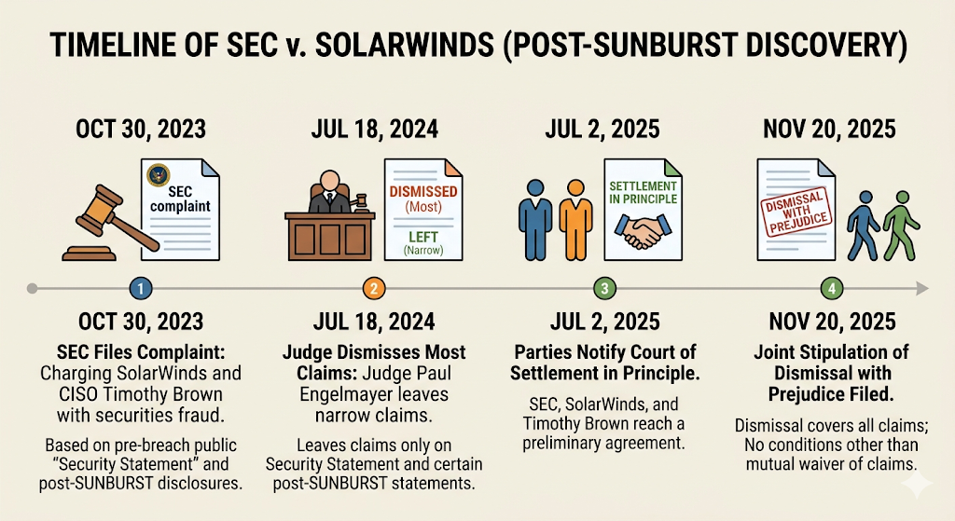
SEC v. SolarWinds / Brown — The Disclosure Limit
Notes:
This is a big case, and the outcome as of late 2025 was surprising. Timeline:
Oct 30, 2023: SEC files complaint, charging SolarWinds and CISO Timothy Brown with securities fraud based on the company’s pre-breach public “Security Statement” and its post-SUNBURST disclosures
Jul 18, 2024: Judge Paul Engelmayer dismisses most claims; leaves narrow claims about the Security Statement and certain post-SUNBURST statements. Ruling states the SEC relied on "hindsight and speculation" rather than facts available at the time.
Jul 2, 2025: SEC, SolarWinds, Brown notify court of settlement in principle
Nov 20, 2025: Joint stipulation of dismissal with prejudice filed — no settlement conditions other than mutual waiver of claims

Slide 48
SEC v. SolarWinds / Brown — The Disclosure Limit
At stake: SEC sued SolarWinds and its CISO personally for securities fraud based on pre-breach security representations
Outcome: joint stipulation of dismissal, with prejudice, no settlement terms
Impact: disclosure enforcement works prospectively (incident reporting). Retroactive fraud claims about security statements are hard to sustain (but SEC will nevertheless consider them). First cyber-fraud case against a sitting CISO is a defeat for the SEC.
Notes:
The SEC dropped the case. As of the Harvard Law School Forum analysis (Tannenbaum & Rudawski, Dec 2025), this is widely read as the SEC retreating from individual CISO fraud liability based on general security representations.
The asymmetry this teaches: the FTC’s Wyndham/Equifax approach enforces against having bad security. The SEC’s SolarWinds approach tried to enforce against misrepresenting security. The first has a richer factual basis (look at the controls) and clearer remedies (change the controls). The second requires proving intent-to-deceive, which courts reliably find hard. But: SEC intends to continue bringing cases against companies and individuals where it sees gaps between internal cybersecurity awareness and external statements to investors.
So: the 2023 SEC disclosure rule is a live enforcement lever when a company delays post-breach disclosure — that’s survivable doctrine. But extending disclosure law to police pre-breach statements about security posture has now failed in court. Disclosure regulation’s reach is narrower than the SEC’s original ambition.
Reference: Tannenbaum & Rudawski, “SolarWinds Dismissed: What the SEC’s U-turn Signals for Cyber Enforcement,” Harvard Law School Forum on Corporate Governance, Dec 7, 2025.

Slide 49
CIRCIA (2022)
Cyber Incident Reporting for Critical Infrastructure Act — signed March 2022.
First broad federal incident reporting mandate for critical infrastructure
72 hours for incidents, 24 hours for ransomware payments
~300,000 covered entities across 16 sectors
Reports shielded from civil discovery — but not anonymous
Final rules: delayed to May 2026
Notes:
CIRCIA is the Cyber Incident Reporting for Critical Infrastructure Act of 2022. It’s a significant expansion of mandatory federal reporting, but the rules have been delayed multiple times — final rules are now targeting May 2026.
The liability protections are real but limited: reports can’t be subject to civil discovery, but they can be shared with DOJ/FBI, and underlying incident liability is not shielded. Compare to aviation’s ASRS (which we’ll see in Part 6): anonymous and administered by NASA separately from the FAA, with legal protection against enforcement use.
References: https://www.cisa.gov/topics/cyber-threats-and-advisories/information-sharing/cyber-incident-reporting-critical-infrastructure-act-2022-circia ; Stransky, “The 2022 Cyber Incident Reporting Law: Key Issues to Watch,” Lawfare, 2022.

Slide 50
CIRCIA: Will It Generate the Right Data?
Aviation’s learning model depends on near-misses, not just incidents.
CIRCIA focuses on incidents only.
No institution yet analyzes the reports (CSRB now dormant)
Reports are not anonymous — chilling effect?
Reports go to an agency with enforcement relationships
Reporting ≠ learning. Data piled up is not data understood.
Notes:
This is the aviation paradox applied to CIRCIA. The aviation safety system works because it collects near-miss data through ASRS (Aviation Safety Reporting System), which is anonymous, non-punitive, and administered by an independent agency (NASA, not the FAA).
CIRCIA has none of these properties. It’s:
- Incident-only (not near-miss)
- Not anonymous (CISA knows who reported)
- Adjacent to enforcement (CISA can share with DOJ/FBI)
- Not analyzed by an independent body (CSRB dormant)
These design choices are not accidents — they reflect the political compromises that got CIRCIA passed. But they mean CIRCIA is likely to produce a regulatory compliance artifact rather than actuarial-quality data.
We’ll return to this in Part 6 when we discuss what a Cyber NTSB would actually need.

Slide 51
Category 3: Institutional Learning
Systematically study incidents. Publish lessons. Build cross-industry knowledge.
Cyber Safety Review Board (CSRB) — constituted 2021 → dormant since January 2025.
The most structurally broken of the three approaches today — and arguably the most important.
Full treatment later in the lecture
Notes:
Signpost slide. Category 3 is the one we’ll spend the most time on when we get to Part 6, because it’s where US regulation is furthest from the aviation-model institutional learning Lecture 1 argued is what actually produces safety.
Why defer? The CSRB/cyber-NTSB discussion depends on the incident-reporting machinery we’ve just introduced (CIRCIA), and it pairs naturally with the public-health analogy and the Knake/Shostack/Wheeler recommendations. Rather than cram that into Part 3, we’ll return to it as its own topic after the EU discussion.
For now, the key point is: a complete US regulatory toolkit for cybersecurity should have a working Category 3. It doesn’t.

Slide 52
Case Law: What Have We Learned?
Case | Lesson
Wyndham (2015) | FTC can regulate cyber under Section 5
LabMD (2018) | Remedies must be specific, not “reasonable”
D-Link (2017) | Unfairness requires concrete harm; deception is the reliable lane
SolarWinds (2025) | CISO personal fraud liability is hard to sustain
Case-by-case accretion is slow. It also has clear limits.
Notes:
This is the summary slide. Pull it together: US cybersecurity law is a common-law-like doctrine built out of specific enforcement actions. That’s adaptive but it’s also slow, and each case can narrow doctrine as much as it expands it.
Compare to the EU approach in Part 4, which tries to codify rules proactively through legislation.
Discussion prompt: given the US patchwork, if you were a CISO, which regulator would you fear most? (Answer: usually state AGs, because they’re numerous, fast, and can coordinate.) How does that shape behavior?

Slide 53
How Would Reforms Have Affected the Breach?
Reform | Effect on Equifax specifically
GLBA revision (2023) | Might have prevented: encryption, pen testing, Qualified Individual
SEC disclosure (2023) | Compressed the 40-day gap to ~1 week
CIRCIA (2022) | CISA would have had a report — situational awareness
CSRB (2021, now dormant) | Cross-industry learning from a published post-incident report
GDPR (2018, EU) | Out of jurisdiction; would have lifted data-governance practices
Notes:
Were they all precipitated by Equifax? Mostly no.
GLBA revision (2023): yes — the FTC’s rulemaking notice explicitly invoked Equifax-class failures (unpatched vulnerabilities, unencrypted data, inadequate monitoring) as motivation for moving from “reasonable security” to prescriptive controls.
SEC disclosure rules (2023): partly — Equifax’s 40-day gap and the Jun Ying insider-trading conviction were canonical examples in the rulemaking; SolarWinds and T-Mobile contributed as well.
GDPR (May 2018): no — adopted by the EU in April 2016; the legislative process began years earlier in response to Snowden-era privacy concerns. Its effective date falling after Equifax is coincidental.
CIRCIA (March 2022): no — driven by SolarWinds (2020) and Colonial Pipeline (2021). Equifax was in the broader regulatory mood but wasn’t the trigger.
CSRB (May 2021): no — direct response to SolarWinds; recommended by the Cyberspace Solarium Commission.
Substantive point: only Category 1 (prescription) plausibly changes the breach outcome. The rest are valuable for different reasons (transparency, market discipline, ecosystem learning) — but they aren’t prevention tools. This isn’t an indictment of regulation; different tools serve different purposes. It should temper expectations that new regulations “after the next Equifax” will prevent the next one.
Discussion: if prevention is primarily a function of prescriptive controls, and prescriptive controls have all the Kelly “compliance theater” pathologies, is there a way out? (Hint: Part 6 will argue that institutional learning — Category 3 — is the missing piece.)

Slide 54
Part 4: The EU Approach — Horizontal Regulation

Slide 55
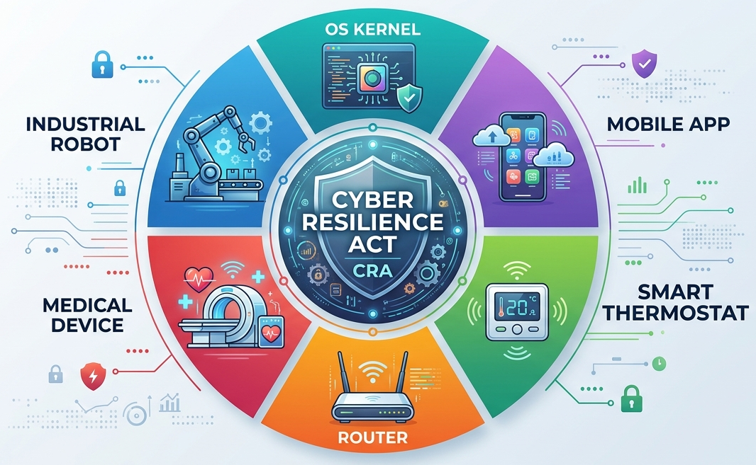
The Cyber Resilience Act (Regulation 2024/2847)
First EU law imposing mandatory cybersecurity on all products with digital elements
Applies regardless of manufacturer origin (market-access based)
In force December 2024; reporting: September 2026; full compliance: December 2027
Notes:
The CRA is ambitious in a way no previous cybersecurity regulation has been. It takes the EU’s product-safety model and extends it across digital products. The regulatory architecture is:
- CE marking for compliance (CE is Conformité Européenne)
- Third-party conformity assessment for high-risk categories
- National market surveillance authorities
- Fines up to €15M or 2.5% of worldwide turnover

Slide 56
CRA Key Requirements
Secure by design across entire product lifecycle
Vulnerability handling and patching
24-hour vulnerability reporting to national CSIRT + ENISA
72-hour update; 14-day final report
CE marking; third-party assessment for high-risk products
Fines up to €15M or 2.5% of worldwide turnover
Notes:
The compliance architecture looks familiar from GDPR: harmonized standards (CEN, CENELEC, ETSI drafting 41 of them as of 2025), CE marking, national enforcement. The content is more prescriptive than GDPR was — specific technical standards for product classes rather than broad principles.
Timeline reminder: in force now (Dec 2024), but enforcement ramps up through 2027.
Reference: https://digital-strategy.ec.europa.eu/en/policies/cyber-resilience-act

Slide 57
US vs. EU: Different Philosophies
 | US | EU
Approach | Sectoral + common-law | Horizontal + prescriptive
Primary lever | FTC Section 5 enforcement | Comprehensive statutes
Scope | Financial, health, etc. | Economy-wide
Flexibility | Case-by-case | Codified rules
Pace | Slow via litigation | Slow via legislation
The EU treats cybersecurity as product safety.
Notes:
"Horizontal" means the regulation cuts across all sectors of the economy applying the same rules everywhere, as opposed to "vertical" / "sectoral" regulation
that targets one industry at a time.
Frame the Part 4 transition. This is not “EU good, US bad” or vice versa — both systems have pathologies. It’s about what each emphasizes and what each sacrifices.
The EU’s “product safety” analogy is load-bearing. In Europe, products from toys to medical devices to industrial machinery are subject to horizontal safety regulation. Extending this to “products with digital elements” is a natural philosophical move for EU regulators — but cybersecurity has peculiarities (adversaries, rapid change) that product safety law wasn’t designed for.

Slide 58
GDPR as an Inspirational Test Case
General Data Protection Regulation (GDPR, May 2018):
Primarily privacy, but with security implications.
Old enough that we have evidence.
Has it improved security outcomes?
Has it caused unintended harms?
What does the track record tell us about the CRA?
Notes:
GDPR is now 8 years old. It’s the largest horizontal regulation we can study for CRA-style effects. The picture is mixed, and the balance of good vs. bad effects is genuinely contested.
Students may have opinions formed entirely from clicking “Accept all” on cookie banners. Part of the goal of this section is to show them the serious policy research on GDPR’s effects.

Slide 59
GDPR: The Good
UK DCMS study (2020):
Governance, risk management, data security practices improved
Board-level cyber responsibility up
Encryption and access control more widespread
Real evidence that ambitious horizontal regulation can shift firm behavior.
Notes:
We already introduced this in the pro-regulation evidence section. The UK DCMS study (longitudinal, qualitative) is the strongest single piece of empirical evidence that GDPR produced behavioral improvements in cybersecurity practices.
One caveat: the improvements measured are largely process-level (do you have a risk register, a DPO, board oversight). The study does not measure breach frequency or severity. So we know GDPR changed what firms do; we don’t know how much that reduced actual cyber harm.

Slide 60
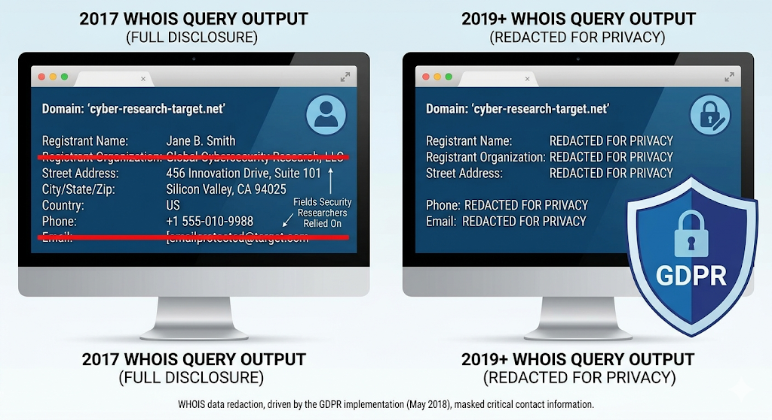
GDPR: Unintended Consequences for Security
Notes:
This is the sharpest unintended-consequence story for GDPR. WHOIS is the directory of domain registrants. Security researchers and law enforcement used it heavily to investigate phishing, malware hosting, and fraud. After GDPR, ICANN had to redact most of the data because registrant contact info is personal data.

Slide 61
GDPR: Unintended Consequences for Security
WHOIS restrictions
ICANN required to redact registrant data (GDPR = personal data)
APWG (2019): domain-abuse investigations slowed dramatically
Registrar response times: minutes → weeks
Privacy protected — at the expense of cybercrime investigation
Notes:
This is the sharpest unintended-consequence story for GDPR. WHOIS is the directory of domain registrants. Security researchers and law enforcement used it heavily to investigate phishing, malware hosting, and fraud. After GDPR, ICANN had to redact most of the data because registrant contact info is personal data.
The Anti-Phishing Working Group and EUROPOL both documented significant operational degradation in abuse investigations. This is a direct case where one security-relevant regulation (privacy) hurt another security activity (abuse response).
The general point: security and privacy can be in tension. A good regulatory design has to acknowledge the tension and choose; GDPR’s drafters did not fully anticipate this one.
Reference: APWG GDPR and WHOIS Use Survey, 2019.

Slide 62
GDPR: Threat Intelligence Chilled
ENISA (2019):
Legal uncertainty around sharing IoCs: IP addresses, email addresses = personal data?
ISACs reported reduced sharing volumes initially
Forced expensive legal review before routine intel operations
Privacy rules designed for consumer protection can block cross-border threat intel.
Notes:
ISACs (Information Sharing and Analysis Centers) are the peer-to-peer threat intelligence infrastructure. They share indicators of compromise: IP addresses, domains, email addresses. Many of these are personal data under GDPR.
ISACs went through legal reviews, identified appropriate bases under GDPR Article 6 (legitimate interest, usually), and largely adapted — but the early post-GDPR period saw a measurable reduction in intel flow. Small organizations without legal teams disproportionately sat out.
This is a concrete example of regulation producing its own compliance theater: orgs with budget built legal review processes; orgs without budget just stopped sharing. Neither is what GDPR’s drafters intended.

Slide 63
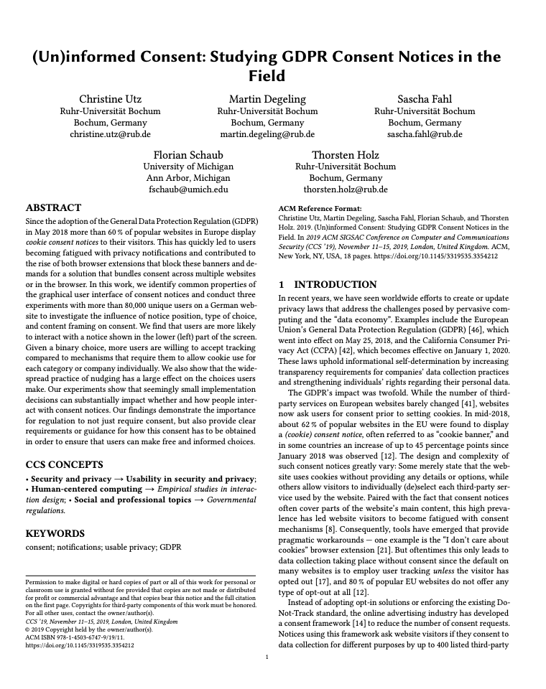
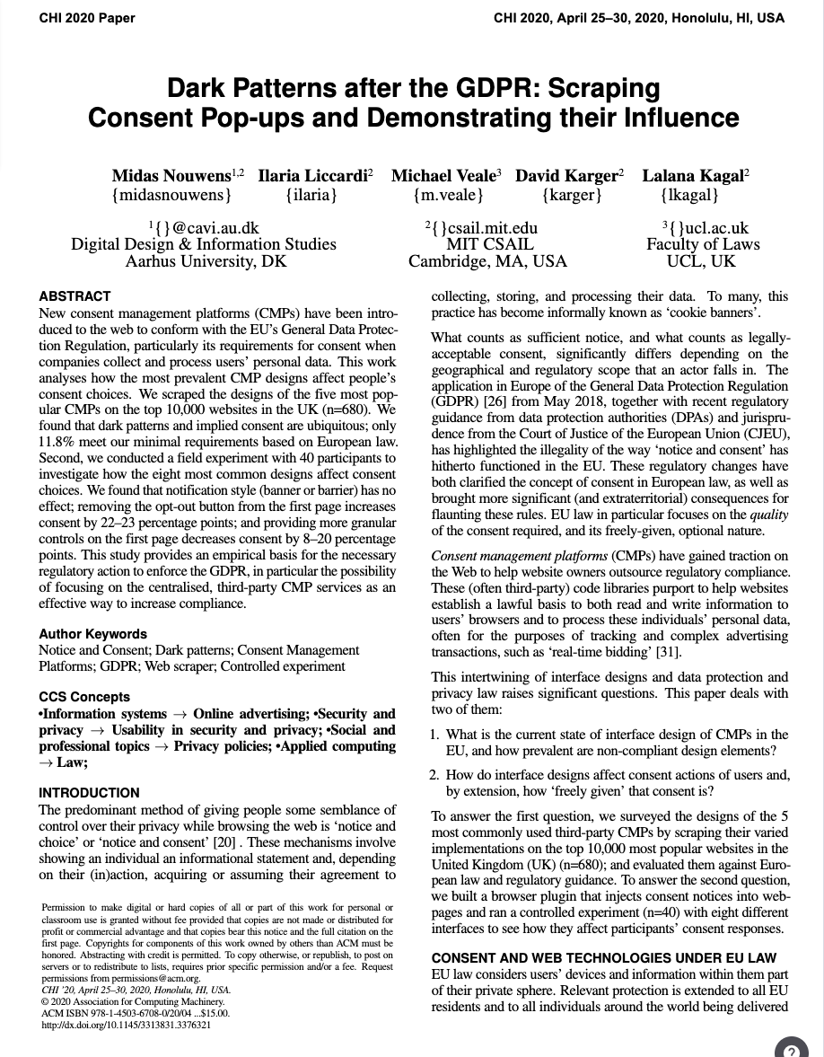
GDPR: Cookie Consent Theater
Utz et al. (CCS 2020): >90% of users just click “accept all”
Nouwens et al. (CHI 2020): only 11.8% of UK cookie consent implementations met GDPR minimum requirements
Ritual compliance, not informed choice
A literal case of compliance theater — by design.
Notes:
This is where GDPR gets the most direct criticism for producing compliance theater at scale. The consent mechanism has become a universal ritual that few users engage with and few sites implement correctly. The underlying privacy goal — informed consent to data processing — has not been achieved.
The question for the CRA: does a similar compliance-theater dynamic await “products with digital elements”? CE marking for cybersecurity has the same structural features as cookie consent banners: a visible signal that compliance exists, with unclear connection to actual security.
Connect to Kelly’s Compliance Theatre: this is exactly the pattern he warned about — bureaucratic ritual substituting for the goal the regulation was meant to achieve.

Slide 64
Post-GDPR: Compliance Costs and Competition
vendor concentration (favor Google, FB)
+17%
EU VC investment in tech
Goldberg, Johnson & Shriver (2022)
Johnson, Shriver & Goldberg (2022)
Jia, Jin & Wagman (2020)
Enforcement concentrated in France (CNIL), Ireland (DPC); Ireland criticized for slow Big Tech action
-12%
-26%
Recorded pageviews (and revenue) for EU users
Regulation has real costs --- and can entrench incumbents.
Notes:
Two separate Goldberg/Johnson/Shriver papers
1. **Goldberg, Johnson & Shriver**, "Regulating Privacy Online: An Economic Evaluation of the GDPR" (SSRN 3421731, Nov 2022): 1,084 websites via Adobe Analytics; **~12% drop in recorded pageviews and e-commerce revenue** for EU users post-GDPR. Distinguishes *recording* effects (users withholding consent → unmeasured activity) from *real* economic effects; both contribute.
2. **Johnson, Shriver & Goldberg**, "Privacy & market concentration: Intended & unintended consequences of the GDPR" (SSRN 3477686, Nov 2022): 27,000+ websites, panel of web-technology vendor relationships. **15% drop in vendor use** week-of-enforcement, **17% rise in aggregate vendor concentration**. Increased concentration predominantly arises among vendors that process personal data, and from the **increased relative shares of Facebook and Google-owned vendors** --- not from consent-request differences. Advertising category had the sharpest concentration increase (+25.3% short-run, +6.3% persistent through end of 2018).
The entrenchment story is specifically the **Johnson/Shriver/Goldberg** paper, not the pageviews/revenue paper. Google's share gain is real but specifically in *web-technology vendor relationships*, not in Google's overall ad-tech revenue (which is confounded by many things).
This is the economics-of-regulation view: GDPR imposed fixed compliance costs that large incumbents could absorb but that disproportionately burdened SMEs. Net effect across both papers: measurable declines in recorded economic activity *and* measurable increases in market concentration favoring the largest incumbents.
The Ireland enforcement point is politically charged. Ireland hosts most US tech firms' EU headquarters (for tax reasons); GDPR enforcement against those firms falls to the Irish DPC, which has been criticized for slow action. The result is uneven enforcement --- light on big firms in Ireland, heavy on smaller firms elsewhere.
None of this makes GDPR "bad" on net --- that's a values question --- but it's clear that the distributional consequences matter and are non-obvious.

Slide 65
Lesson for CRA
GDPR shows horizontal regulation:
✅ Can shift firm behavior (governance, practices)
⚠️ Creates unintended security harms (WHOIS, threat intel)
⚠️ Produces compliance theater at scale (consent banners)
⚠️ Imposes costs unevenly (SMEs, incumbents)
⚠️ Enforcement concentrates (and fails unevenly)
CRA’s scope is larger. Each of these risks is larger too.
Notes:
The framing for the CRA discussion. If GDPR had these problems at its scope (data processing), the CRA — which covers every product with digital elements, a vastly wider scope — will plausibly have larger versions of the same problems.
This is not an argument against CRA — it’s an argument for specifically designing CRA implementation to avoid known GDPR pathologies. Several EU commentators have made this point.

Slide 66
Back to CRA: What It Doesn’t Do Well
“Secure by design” is vague until harmonized standards exist
Technical standards (CEN, CENELEC, ETSI) still being drafted (slated for Oct 2026)
Monitoring every connected product is impossible
Expected pattern: enforcement-by-exception after big incidents — like GDPR
A law without its standards is a promise, not a requirement.
Notes:
This is the sharpest implementation concern. The EU Commission formally requested standards development in February 2025 — 41 harmonized standards across the product categories. These won’t all be ready by the December 2027 full-compliance date.
So CRA’s substantive requirements are currently placeholders. “Secure by design” is vague until the standards define what it means for each product class. Between now and when standards are finalized, companies will be preparing for requirements that don’t yet exist in final form.
Students from the secure design lectures can bring their knowledge here: what would a rigorous “secure by design” standard for, say, a smart thermostat actually require? The answer is non-obvious and would shape CRA compliance for years.

Slide 67
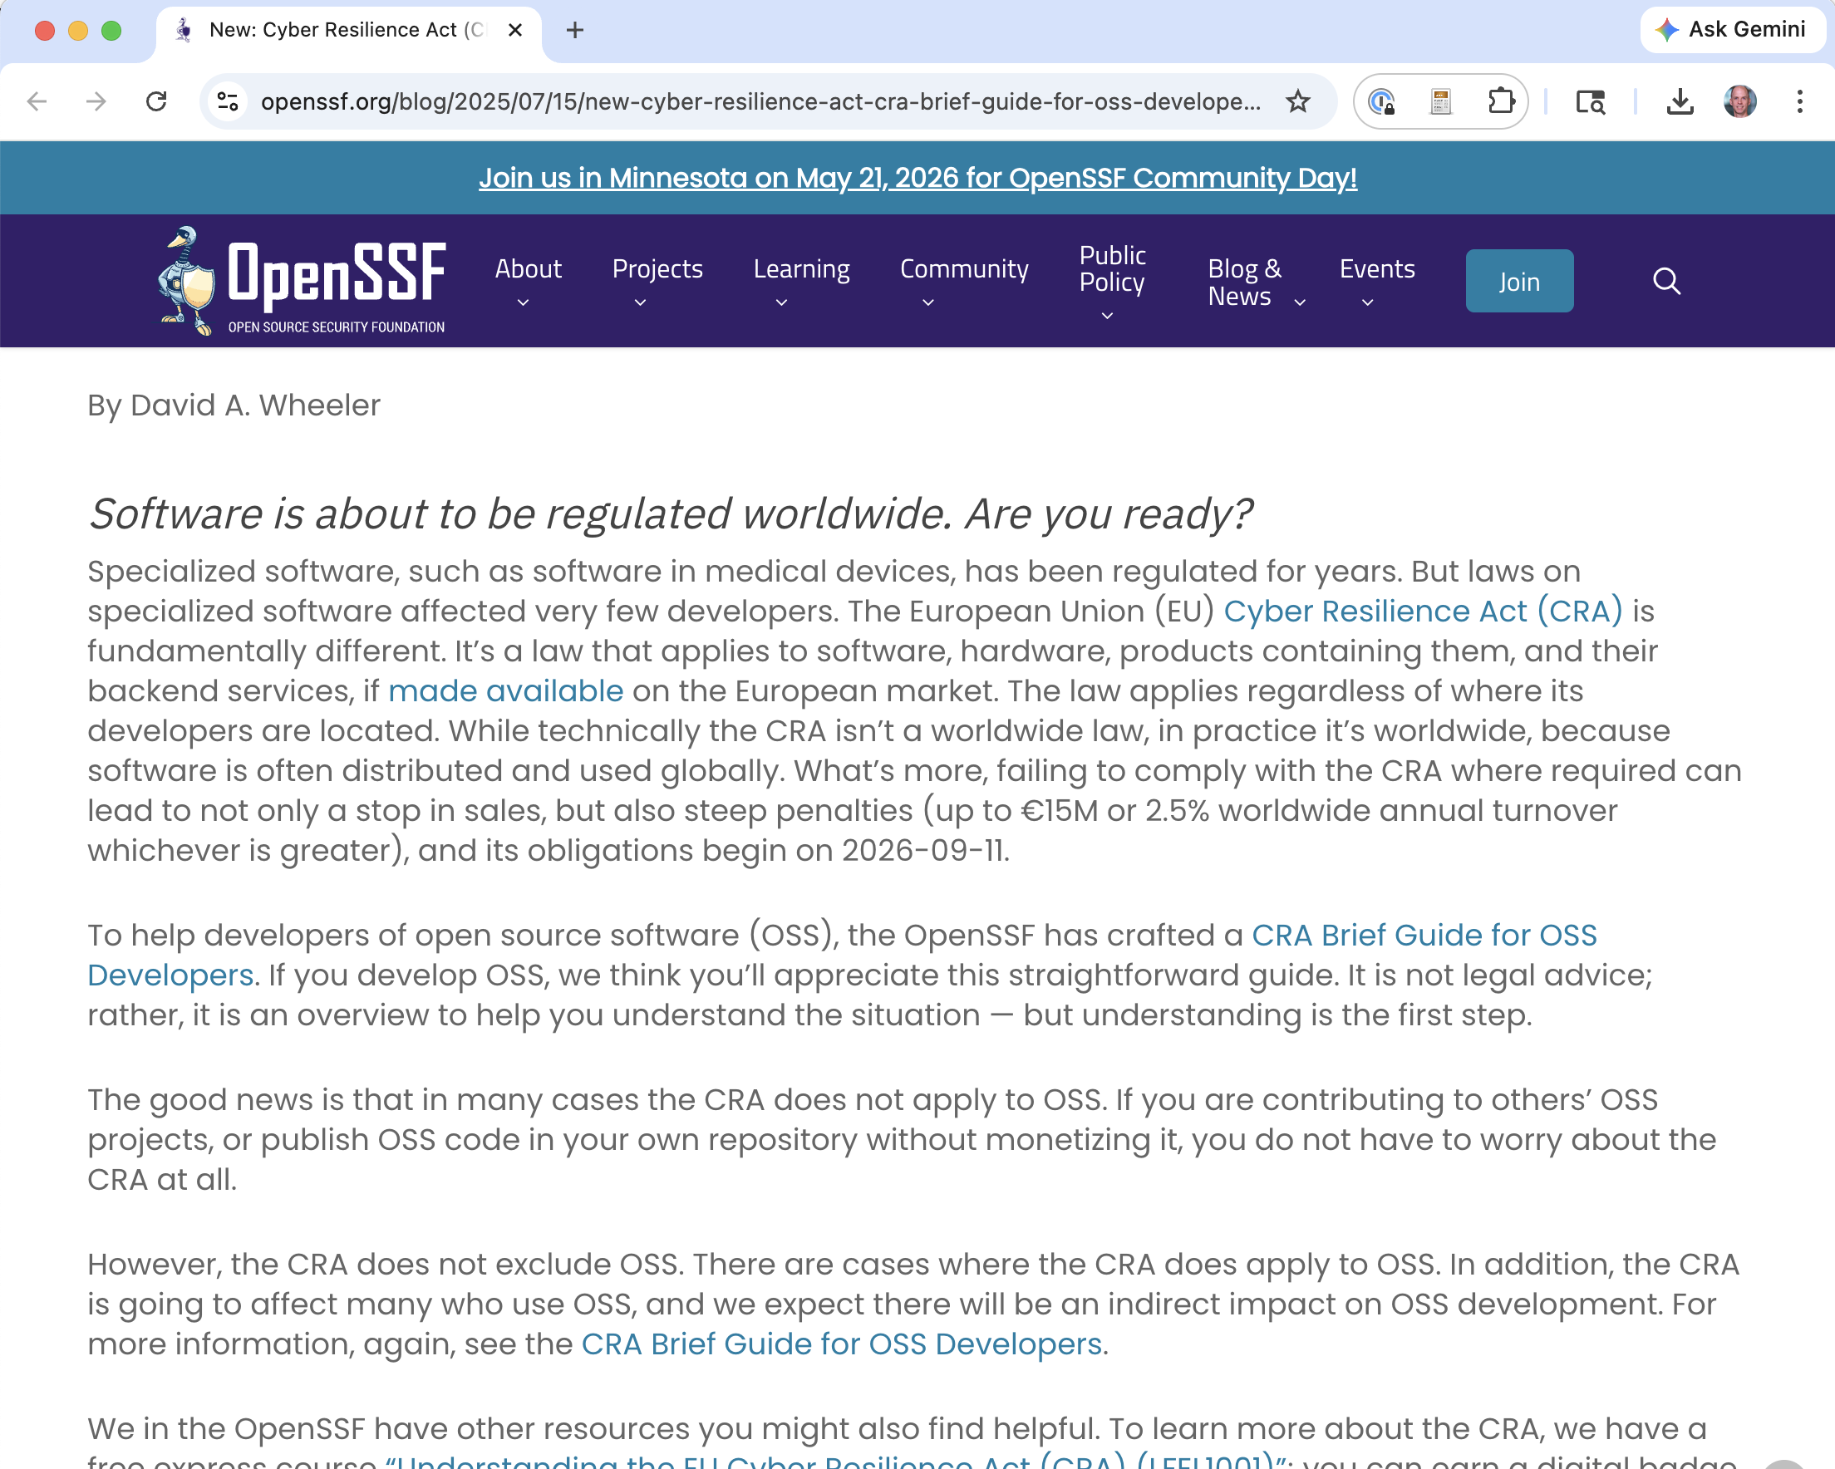
CRA: The Open Source Controversy
~76% of most software products is open source dependencies
First draft: OSS maintainers liable for commercial use of their code
Community pushback → revised:
Non-profit-motive OSS exempted
New “open source steward” category for foundations
Still unresolved: what happens when a critical library’s maintainer can’t comply?
Notes:
This is the single most concrete and alarming feature of CRA for software practitioners. The initial draft would have made open-source maintainers legally liable when commercial products depended on their libraries. The community response (Eclipse Foundation, Python Software Foundation, Linux Foundation, others) forced significant revisions.
The revised version carves out: - Software developed without a profit motive - “Open source stewards” (foundations) get a lighter regulatory regime than commercial manufacturers
But the core problem remains: a commercial product that depends on 2,000 OSS packages now has to verify all 2,000 meet CRA requirements (or pick alternatives that do). “Full supply chain compliance” is unprecedented in software.
Great discussion question: if you maintain a popular OSS library used by European commercial products, how do you respond? Options include stopping distribution in EU, requiring commercial licenses, or demanding indemnification from downstream users. Each has major knock-on effects.
Reference: https://orcwg.org/cra/

Slide 68
The Cybersecurity Act 2 (CSA2)
New element added 2026: high-risk supplier designation for countries posing non-technical risks.
Laws requiring vulnerability disclosure to that country’s authorities
Absence of judicial or democratic oversight
Credible indications of state-sponsored cyber activity
NIS2 entities prohibited from using components from designated suppliers. Phase-out required.
Fines up to 7% of worldwide turnover.
Notes:
CSA2 was proposed by the European Commission on January 20, 2026 (just a few months before this lecture). It explicitly names no countries but is widely understood to target Huawei and ZTE, and by extension Chinese suppliers more broadly.
The “non-technical risk” framing is novel and controversial. Traditional cybersecurity regulation assesses products technically — what vulnerabilities, what controls. CSA2 adds a legal/political assessment of the country of origin: what laws would compel disclosure of vulnerabilities to the government? What state-sponsored cyber operations have been observed?
The scope is broad: telecom, data centers, cloud, connected devices, social media. It extends well beyond 5G — the concrete new worry is Chinese-made solar inverters connecting to cloud servers in Europe’s energy grid.
References:
- https://www.insideprivacy.com/cybersecurity-2/european-commission-proposes-cybersecurity-act-2-new-eu-supply-chain-rules-and-certification-reforms/
- https://www.euronews.com/next/2026/01/20/brussels-pushes-for-stronger-cybersecurity-oversight-of-high-risk-technology-suppliers

Slide 69
CSA2: Cyber Regulation or Industrial Policy?
Huawei’s objection:
Restricting suppliers by country of origin rather than technical evidence violates EU principles of fairness, non-discrimination, and proportionality.
A real tension:
Could purely technical assessment reach the same conclusions? Maybe.
CSA2 explicitly chose a non-technical basis. That’s notable.
Notes:
This is a genuinely hard question. Are the technical risks of Chinese-manufactured network equipment distinguishable from ordinary supply-chain risk in a purely technical analysis? There’s a real literature arguing both ways.
The case for a technical basis: well-designed SBOMs, hardware attestation, and supply-chain integrity measures can, in principle, detect malicious modifications regardless of origin.
The case for a non-technical basis (the CSA2 position): the threat model includes legal compulsion under the supplier’s home-country law, which cannot be detected by inspection of the product. If country X can compel its manufacturers to add backdoors, a clean technical assessment today doesn’t rule out a dirty one tomorrow.
Discussion: which framing should prevail? Note that CSA2 is transparent about choosing the second framing — it is openly a geopolitical tool — which may be its biggest legitimacy strength (honest about what it is) and biggest legitimacy weakness (vulnerable to WTO challenge).

Slide 70
Will Industry Pushback Weaken CRA/CSA2?
US precedent: FCC Anti-Bot Code of Conduct (2013)
Attempted mandatory cybersecurity obligations on ISPs
Industry resistance: “we can’t kick customers offline”
Ended up voluntary → toothless
Similar dynamics now:
Telecom lobby: CSA2 proposals = “billions of euros” in costs
OSS community already forced CRA revisions
Notes:
Reference: FCC CSRIC III WG7 Report, March 2013.
The FCC example is instructive: the original Anti-Bot Code of Conduct was drafted as mandatory. It was watered down to voluntary after industry pushback — ISPs argued that involuntarily disconnecting customers was politically and legally difficult, and the code became a set of suggestions no one tracks. This is the American version of industry regulatory capture.
The EU dynamic is different but similar forces are at work. The CRA already yielded to OSS community pressure. CSA2 faces similar industry objections, plus geopolitical pushback from China. Whether the final form survives intact or gets carved up by exceptions is an open question.
Prediction: CRA will pass substantially intact but with slow, uneven enforcement concentrated in a few jurisdictions — much like GDPR. CSA2 will narrow significantly during the legislative process but retain its high-risk supplier core for strategically important categories.

Slide 71
Regulation: US vs. EU Divergence
US lighter-touch:
Cyber Trust Mark (voluntary labeling, 2024)
CIRCIA (reporting for critical infra)
No CRA equivalent
Open question: will EU horizontal regulation outperform US sectoral enforcement?
Notes:
The US has deliberately taken a lighter-touch approach. The Cyber Trust Mark is a voluntary labeling program for IoT devices that meet NIST criteria, modeled loosely on Energy Star. CIRCIA covers only critical infrastructure. There is no US equivalent to the CRA.
The transatlantic divergence is real and consequential. European products will have mandatory security baselines by 2027; US products will not. Firms selling in both markets will meet the EU bar, which effectively sets a global baseline through the Brussels Effect.
Whether EU regulation “outperforms” US enforcement depends on what you measure. Behavior change, yes (per DCMS). Breach frequency, unclear. Innovation and market entry, probably worse. Compliance costs, definitely higher.
This is another good research prompt for students interested in policy.

Slide 72
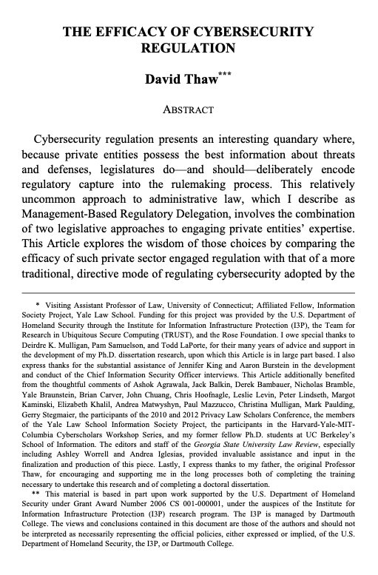
Thaw’s 2014 Idea: Blended Regulation
 | No concrete controls | Specifies concrete controls
No industry input | (rare in cyber) | State SBNs (directive)
Industry co-develops | HIPAA, GLBA (original), NIST CSF (MBRD) | GLBA 2023 revision (blended — Thaw’s ideal)
Empirical finding: Management-Based Regulatory Delegation (MBRD) > directive alone,
but a blend of the two beats either alone.
Notes:
Thaw’s “Efficacy of Cybersecurity Regulation” (Ga. St. U. L. Rev. 2014) is the deeper empirical treatment behind the Enlightened Capture result we just saw. Worth unpacking because it makes specific predictions we can now evaluate twelve years later.
His classification:
- Directive regulation: state breach notification laws (SBNs) specify exactly what must happen (notify within X days unless data was encrypted). The encryption safe harbor effectively mandates encryption without any industry rulemaking input — Thaw calls this “disclosure-based regulation that de facto achieves directive regulation.”
- Management-Based Regulatory Delegation (MBRD): HIPAA Security Rule, GLBA Safeguards, and FTC Section 5 enforcement. Regulators establish general goals; regulated entities develop individualized compliance plans with regulator input. The rulemaking process deliberately incorporates industry expertise.
His quantitative study of breach incidence (2000–2010) found:
1. MBRD-regulated industries prevented breaches better than directive-only industries
2. Directive alone had a perverse effect: “decreased reliance on technical professionals” — orgs did the minimum required (encrypt, get safe harbor) rather than maintaining real security programs. He calls this “locking the vault door and leaving the back window open.”
3. A blend of both performs best — directive rules create a floor, MBRD develops the expertise and adaptive capacity
His practitioner interviews with CISOs reinforced the quantitative findings: CISOs described HIPAA/GLBA compliance as engaging with technical complexity; they described SBN compliance as a narrow checkbox.
This is a testable framework. Twelve years later, how has it held up?

Slide 73
Twelve Years On: Thaw Partly Vindicated
✅ “Reasonableness impedes compliance”: LabMD (2018) — 11th Cir. vacated FTC order precisely because “reasonable” is unenforceable. Exactly Thaw’s prediction.
✅ Blended regulation works: 2023 GLBA revision adds specific directive mandates (MFA, encryption, Qualified Individual) on top of the existing MBRD structure. This is Thaw’s prescription, enacted.
✅ MBRD model expanded: NIST CSF 2.0 (2024), voluntary and industry-co-developed, is pure MBRD in Thaw’s sense.
Notes:
Take each in turn.
LabMD directly vindicates Thaw’s Section IV.C argument (“Unreasonable Deficiencies in ‘Reasonableness’”). He predicted that vague “reasonable security” mandates would impede compliance and enforcement. The 11th Circuit agreed, in a different form: it held the FTC’s order unenforceable for vagueness. LabMD is the case law confirmation of Thaw’s empirical claim.
GLBA 2023 is interesting because it’s exactly the blend Thaw recommended. The underlying MBRD structure — a designated Qualified Individual, a written security program, an individualized risk assessment — is preserved. The revision adds specific directive mandates (MFA, encryption in transit and at rest, pen testing) on top of MBRD. The result: regulators set a directive floor that’s concrete enough to be enforceable, while preserving the adaptive MBRD structure that encourages ongoing expertise. Whether it’s working in practice is early to say; effective June 2023 with staggered compliance.
NIST CSF is MBRD writ large: voluntary, industry-co-developed, built on risk management principles, explicitly designed to be tailored by each organization. Its adoption by federal agencies (post EO 14028, 2021) and its widespread use in procurement as a de facto standard suggest MBRD has institutional momentum.

Slide 74
Twelve Years On: Partly Overrun
⚠️ Horizontal regulation: GDPR and CRA bet against Thaw — economy-wide, prescriptive, limited industry-delegation. Evidence is mixed: DCMS shows governance uplift, but cookie theater, WHOIS harms, SME burdens support his caution.
⚠️ New disclosure mandates don’t fit cleanly: SEC 2023 and CIRCIA are information-forcing for different audiences (investors, government) — not the state SBN consumer-notification he studied.
⚠️ Personal liability for executives: Drizly CEO, SolarWinds/Brown. Thaw’s entity-level framework doesn’t speak to this.
Notes:
Where Thaw’s framework is strained or doesn’t fully apply in 2026:
Horizontal regulation: Thaw analyzed US sector-specific regimes. GDPR (2018) and CRA (2024) are bets on the opposite — economy-wide regulation with limited industry-delegation in the rulemaking process. His framework would predict this underperforms pure MBRD, and the GDPR evidence we reviewed is consistent with that: real behavioral improvements (DCMS), but also cookie-consent theater, WHOIS harms, and disproportionate SME burdens. CRA is the larger bet, not yet testable. Thaw’s framework pushes against horizontal regulation without being decisive — it’s possible the EU has found a new model (harmonized standards developed by CEN/CENELEC with industry input are a kind of MBRD), but we won’t know until the CRA standards settle.
Disclosure regulation has emerged as a distinct category Thaw didn’t fully separate. He treated state SBNs as “directive regulation dressed as disclosure.” But SEC 2023 cyber disclosure rules are genuinely information-forcing for investors, not consumers; CIRCIA is for government situational awareness. These don’t have the safe-harbor back-door that made SBNs de facto directive. Whether they achieve their own goals (Romanosky vs. Greenwood-Vaaler debate) is an open question — but they’re a new regulatory category that sits outside Thaw’s binary.
Personal liability is entirely new terrain. Drizly’s CEO consent order, CafePress’s CEO liability, SEC v. Brown — these target individuals, not entities, and create incentive structures Thaw’s 2014 framework doesn’t speak to. One hypothesis worth noting: personal liability may push CISOs toward box-ticking rather than MBRD-style genuine engagement, because they want defensible documentation they can show a court. That would be perverse relative to Thaw’s ideal.
Discussion prompt: if Thaw were writing this paper today, what would his ideal cybersecurity regulation look like given the 2026 landscape? My guess: MBRD structure + directive floor + genuine disclosure + CSRB-style institutional learning — but NOT personal executive liability, which may undermine the MBRD dynamic.

Slide 75
Part 5: Incident Reporting and the Cyber NTSB

Slide 76
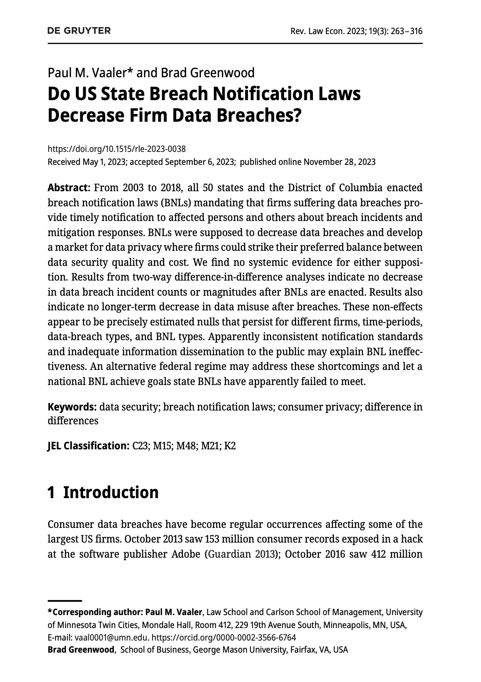
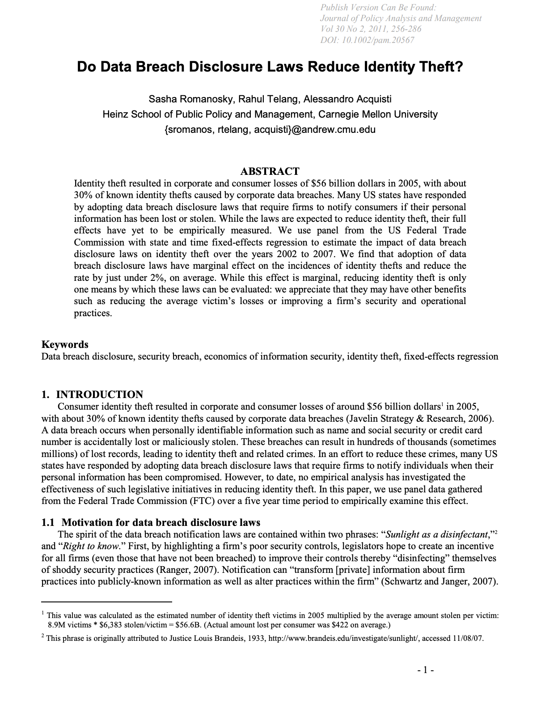
Do Breach Notification Laws Actually Help?
difference-in-differences → precisely estimated null effect (2023)
laws reduced ID theft by ~6.1% (2011)
Notes:
Romanosky, Telang & Acquisti (JPAM 2011): used state-level variation in adoption of breach notification laws to estimate their effect on identity theft. Found a ~6.1% reduction. Methodologically rigorous panel data analysis.
Greenwood & Vaaler (Rev. Law & Econ. 2023): broader dataset, difference-in-differences across all 50 states, longer panel. Finds precisely estimated null effects on firm-level breach outcomes.
The discrepancy is about what’s being measured (identity theft vs. firm breaches) and the panel (shorter early-period vs. longer later-period). Both defensible; neither wrong.

Slide 77
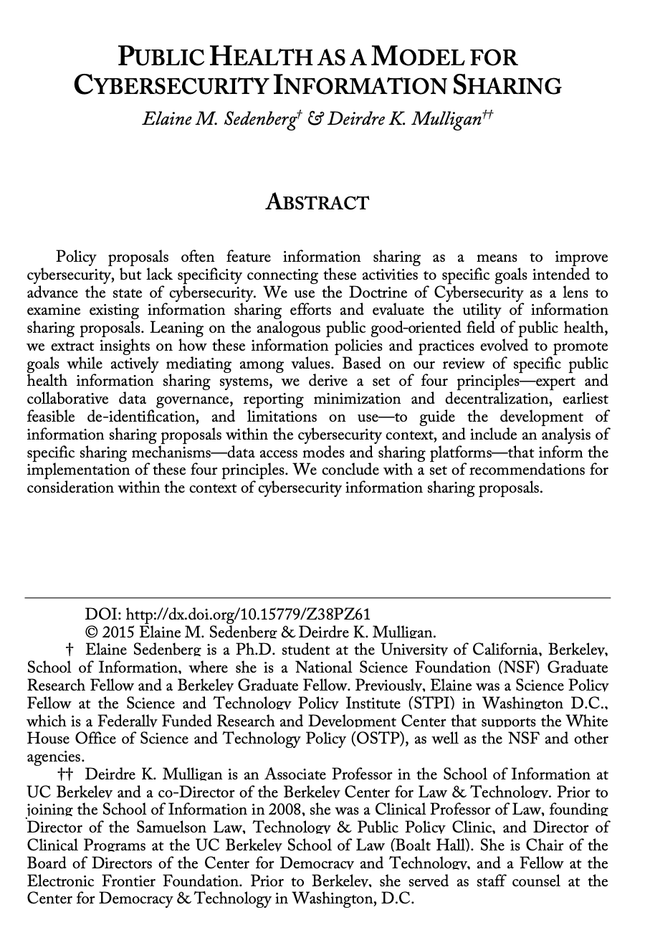
Reporting & Investigation: Public Health Analogy
Disease reporting → epidemiology → population-level interventions.
Could cyber incident reporting do the same?
Four principles from public health
Expert governance
Reporting minimization
De-identification
Use limitations
None of the current regimes (CIRCIA, SEC, CRA, NIS2) fully implement these principles
Notes:
Sedenberg & Mulligan is the strongest academic development of the public-health analogy. Their four principles are explicitly borrowed from the public health information-sharing regime: governance by subject-matter experts rather than general-purpose regulators; minimization of collected data to what’s needed for the analytic purpose; de-identification of reports; and legal limitations on how collected data can be used beyond the analytic purpose.
This is what a well-designed cyber incident reporting regime would look like. None of the current regimes (CIRCIA, SEC, CRA, NIS2) fully implement these principles. CIRCIA is the closest but falls short on anonymity and use limitations.
Reference: Sedenberg & Mulligan, “Public Health as a Model for Cybersecurity Information Sharing,” Berkeley Tech. L.J. 30:3 (2016).

Slide 78
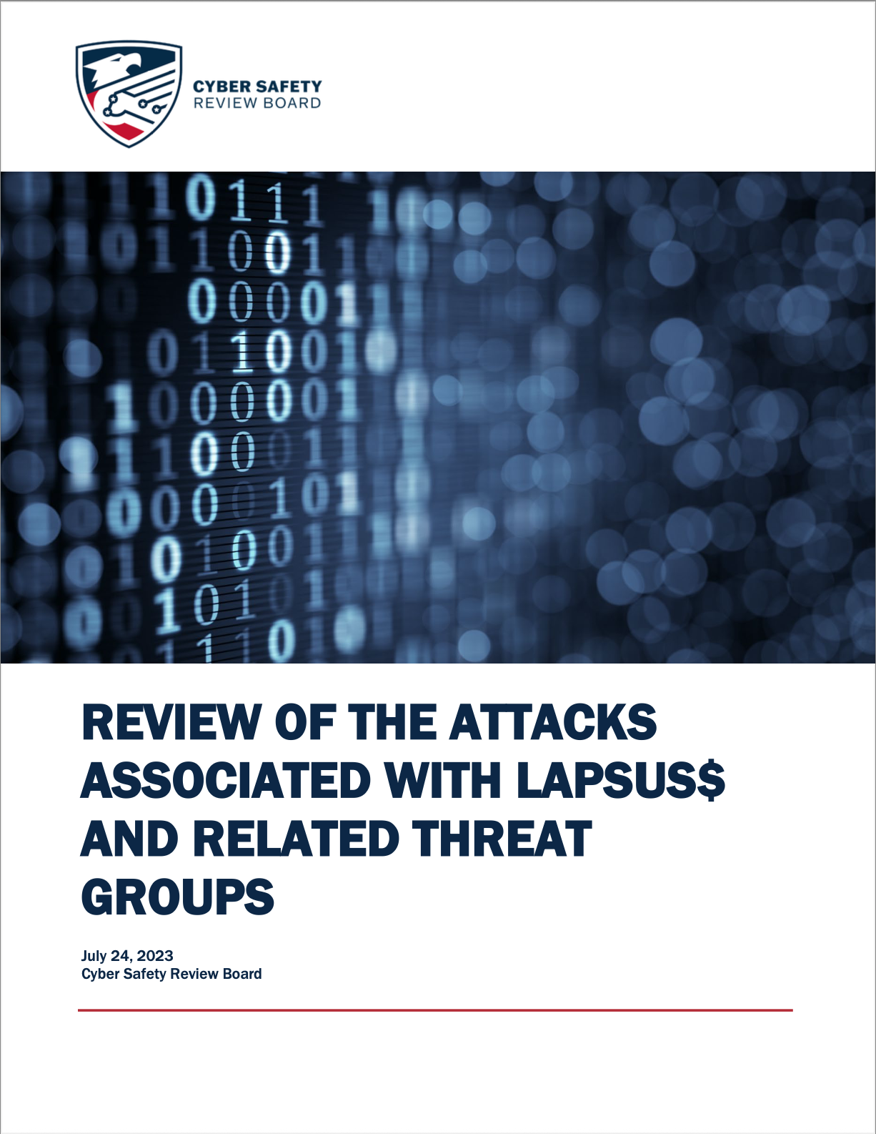
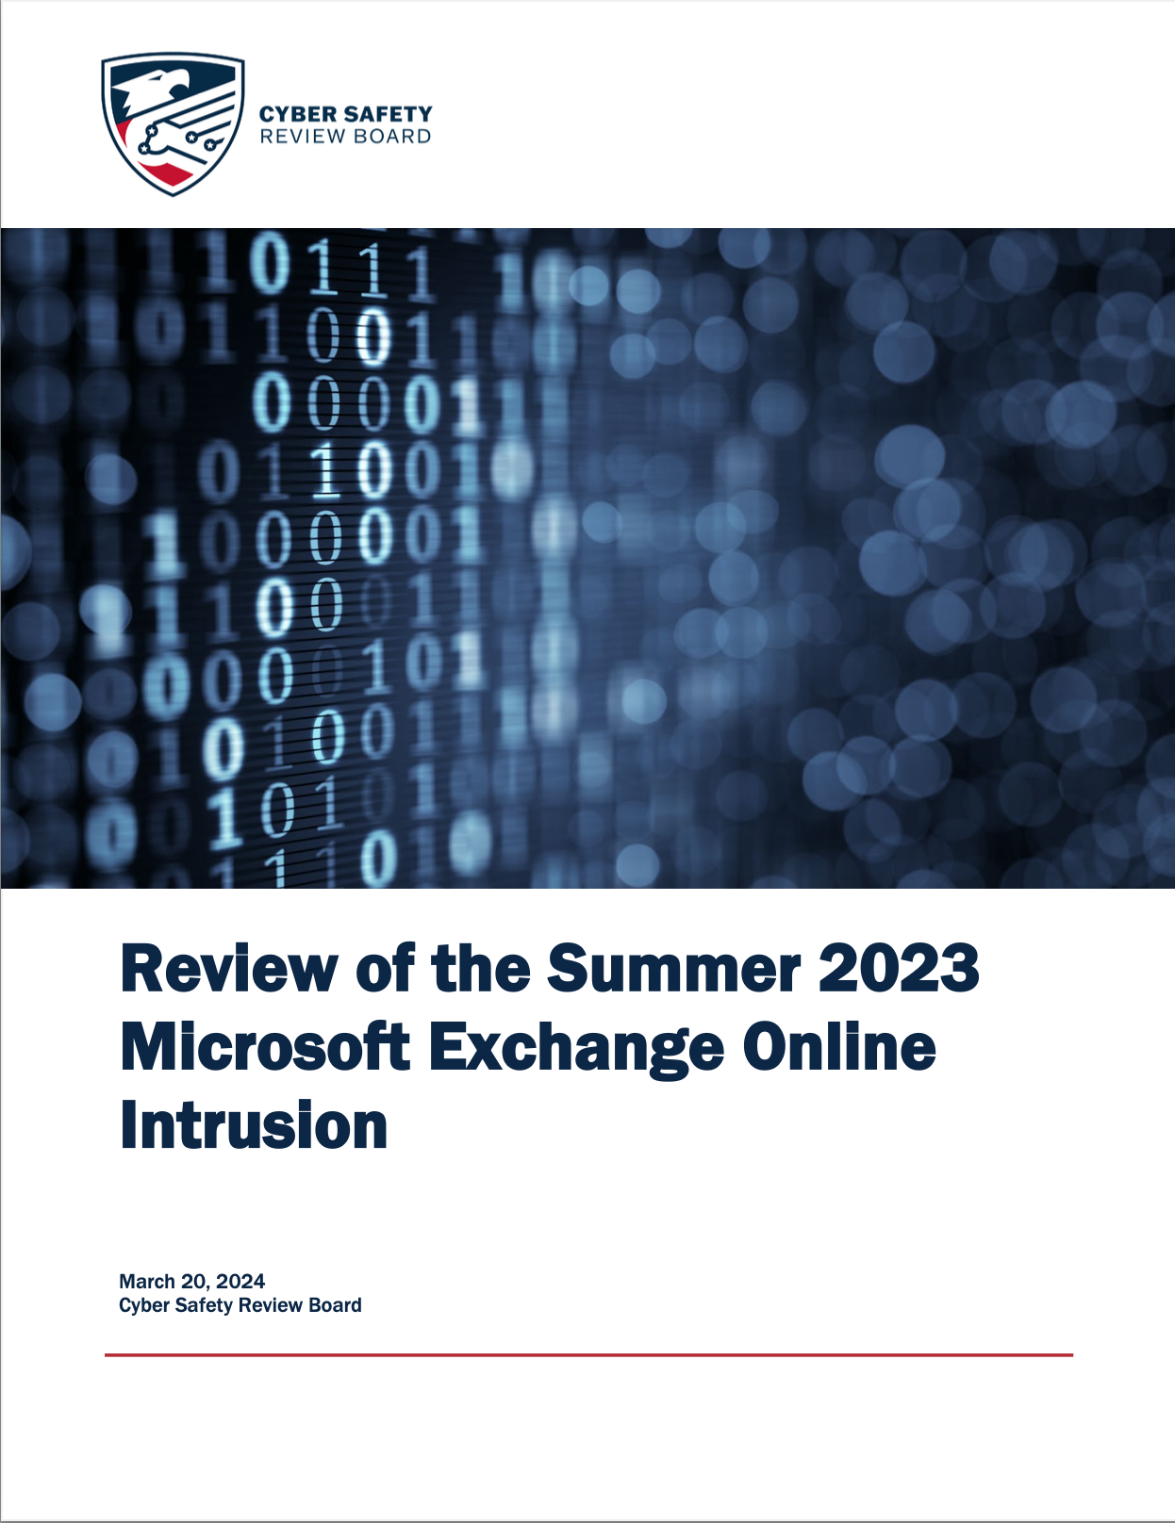
The Cyber Safety Review Board (CSRB)
Constituted 2021 by executive order. Modeled on the NTSB.
Investigated:
Lapsus$ group tactics
Microsoft Exchange / Storm-0558 intrusion
Notes:
The CSRB is the closest US analog to an aviation-model institutional learning body for cybersecurity. It was created by executive order under the Biden administration and operated from 2021 to early 2025. In that period it produced two major reports:
Lapsus$ (2023): The group of young attackers (mostly teenagers) that breached Microsoft, NVIDIA, Uber, and Rockstar Games. The CSRB report was notable for clearly naming inadequate MFA, SMS-based authentication, and social engineering as industry-wide systemic failures.
Microsoft Exchange / Storm-0558 (2024): Chinese state-sponsored intrusion that used forged Microsoft authentication tokens. The report was critical of Microsoft’s security culture and disclosure behavior.
The reports are public and worth reading — they are the closest thing to NTSB-style post-incident analysis that US cybersecurity has produced.
Reference: https://www.cisa.gov/resources-tools/groups/cyber-safety-review-board-csrb

Slide 79
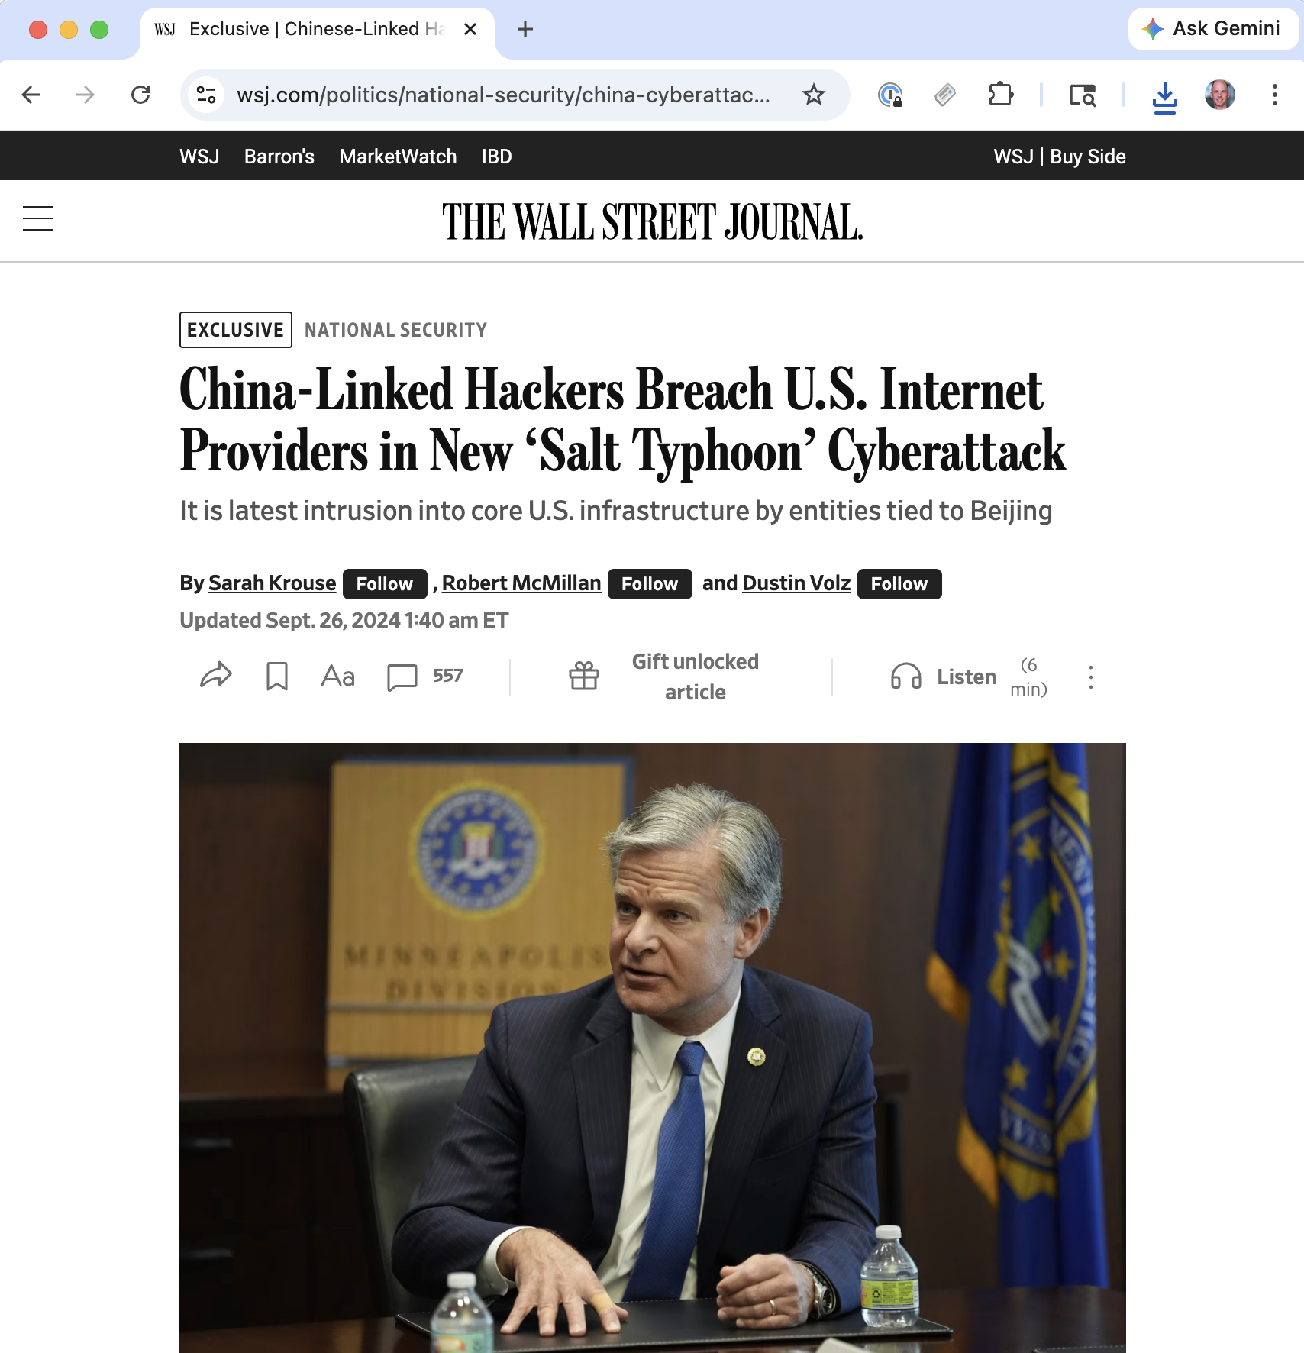
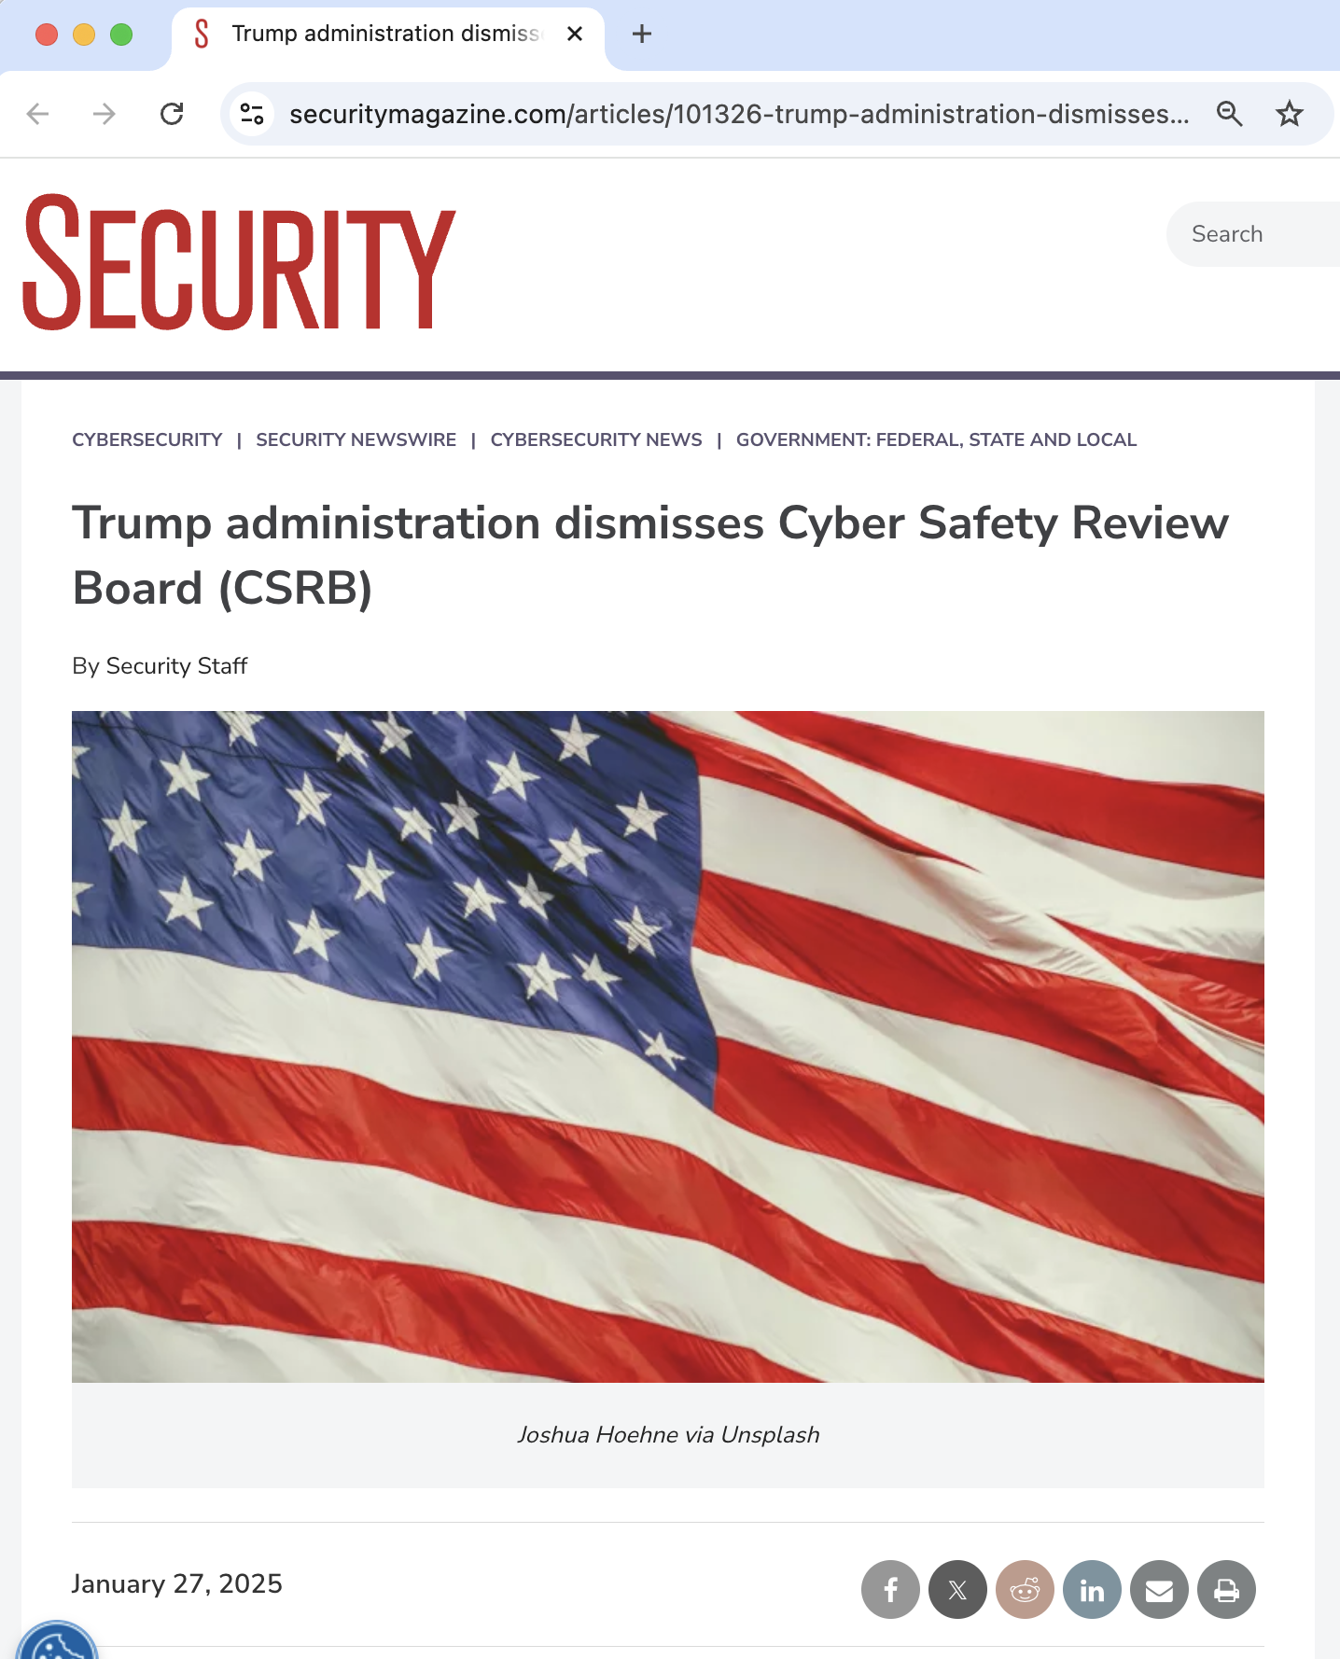
CSRB: Dormant Since January 2025

Slide 80
CSRB: Dormant Since January 2025
January 2025: Trump administration dismissed all advisory committee members at DHS, including CSRB
Halted ongoing investigation of Salt Typhoon (Chinese intrusions into US telecom)
Executive order establishing CSRB remains in place
DHS nominee Troy Edgar: will “reconstitute at the right time”
As of early 2026: no replacements
Notes:
This is the immediate situation as of April 2026. The CSRB has been dormant for over a year. Its most consequential investigation — Salt Typhoon, the Chinese campaign that compromised major US telecom providers — was halted.
The ACM US Technology Policy Committee (USTPC) has called for immediate reactivation and for Congress to give the board a permanent legislative foundation with subpoena authority. That hasn’t happened.
Reference: https://www.acm.org/public-policy/ustpc/policiesweb/csrb-2026
Practical implication for this class: the most recent major US telecom intrusion — arguably the most consequential cyber incident affecting US national security in years — will not produce a public NTSB-style report. Lessons from it exist only in classified channels.

Slide 81
CSRB: Structural Weaknesses
Even at its best, CSRB had none of what makes NTSB work.
Authority | NTSB | CSRB
Subpoena power | ✓ | ✗
Participant legal immunity (49 USC §1154) | ✓ | ✗
Independence from enforcement agency | ✓ | ✗
Statutory foundation | ✓ | ✗ (exec. order)
Anonymous near-miss channel (ASRS) | ✓ | ✗
Reports barred from litigation use | ✓ | ✗
Notes:
The NTSB can compel testimony, compel document production, and its investigations are explicitly protected from use in litigation or criminal proceedings (49 USC §1154). This combination of power-to-compel plus non-punitive-use is what makes the aviation safety system actually extract the truth from incidents.
The CSRB had none of this. It was constituted under an executive order, not a statute; its authority rested on voluntary cooperation. Microsoft’s cooperation with the Storm-0558 investigation was cited as exceptional — because they were not required to participate at all. Other firms’ cooperation levels varied.
This is a structural design flaw that was baked in at creation. An advisory board with no compulsion power can produce useful reports when participants choose to cooperate, but it cannot systematically extract lessons from incidents whose subjects prefer silence.

Slide 82

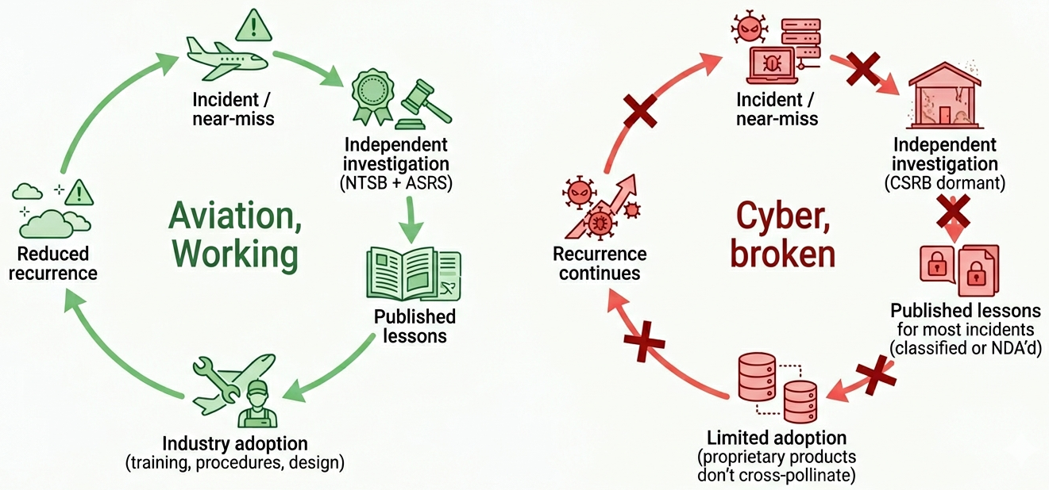
What Would a Real Cyber NTSB Need?
Workshop of 70+ experts:
Notes:
This is the authoritative policy paper on what a cyber NTSB would need. The workshop gathered 70+ experts from government, industry, and academia; the report identifies specific gaps in the CSRB design that prevent it from serving the function the NTSB serves in aviation.
The key findings: - The IT industry lacks independent investigation - Companies control incident narratives - Voluntary participation is insufficient - Aviation’s ASRS works because it’s non-punitive and anonymous, administered by NASA separately from the FAA, with legal protection against enforcement use
The CSRB as designed had none of these properties. The paper’s recommendation: statutory foundation, subpoena power, non-punitive reporting protections, and an anonymous near-miss channel. Implementing this would require Congress.
Reference: Knake, Shostack & Wheeler, “Learning from Cyber Incidents: Adapting Aviation Safety Models to Cybersecurity,” Belfer Center 2021.

Slide 83
What Would a Real Cyber NTSB Need?
Independent investigation body
Authority to compel cooperation (subpoena)
Non-punitive reporting protections (like ASRS)
Anonymous near-miss channel
Institutional memory and systematic analysis
Statutory foundation, not executive order
Notes:
The key findings:
- The IT industry lacks independent investigation
- Companies control incident narratives - Voluntary participation is insufficient
- Aviation’s ASRS works because it’s non-punitive and anonymous, administered by NASA separately from the FAA, with legal protection against enforcement use
The CSRB as designed had none of these properties. The paper’s recommendation: statutory foundation, subpoena power, non-punitive reporting protections, and an anonymous near-miss channel. Implementing this would require Congress.
Reference: Knake, Shostack & Wheeler, “Learning from Cyber Incidents: Adapting Aviation Safety Models to Cybersecurity,” Belfer Center 2021.

Slide 84
Beyond the CSRB: What Else?
Two parallel approaches worth noting:
Security Chaos Engineering (Shortridge & Rinehart, 2023): security is “something a system does, not something a system has” — borrows from SRE and resilience engineering
Cyber Public Health (Cybergreen; “Lessons for Cybersecurity from the American Public Health System,” 2024-5): epidemiological surveillance, population-level interventions, harm reduction
Both reframe security as resilience + institutional infrastructure, not prevention.
Notes:
If the NTSB model is about post-incident investigation, these two approaches are about what to do before and alongside incidents.
Security Chaos Engineering: actively test your system’s ability to tolerate failure. Shortridge & Rinehart’s argument is that prevention-only thinking produces brittle systems; resilience thinking produces systems that degrade gracefully. This is the software engineering analog of the aviation safety culture argument from Lecture 1.
Cyber Public Health: borrow methods from public health epidemiology. Population-level surveillance (not individual incidents); harm-reduction interventions (which often differ from the intuitive answers); cross-sector coordination.
Both are pre-paradigmatic. Neither has the institutional backing of, say, the CDC or NTSB. But both suggest that the answer to “compliance is theater” is not more prescription — it’s different institutions.
References: - Shortridge & Rinehart, Security Chaos Engineering (O’Reilly, 2023) - https://cybergreen.net/cyber-public-health/

Slide 85
Closing the Loop
Last time:
“Cybersecurity lacks the institutional learning infrastructure that aviation has.”
This time:
“Regulation alone won’t build it — regulation devolves into process compliance. Institutional learning requires different institutions.”
Notes:
This is the pedagogical thesis of the lecture. Regulation serves real purposes — FTC accountability is not theater — but it has systematic failure modes (process-over-outcomes, compliance theater, measurement gap) that make it poorly suited to the “build institutional learning” task.
The aviation analogy is the right framing: regulation exists (FAA), but the safety performance comes from the NTSB, ASRS, and the broader operational learning culture. Cybersecurity has the FTC equivalent; it is missing the NTSB equivalent.
Students should leave with this as the takeaway: the question is not “more regulation or less regulation” but “what kind of institution does each cybersecurity goal require?” Prevention through mandates, accountability through Section 5, transparency through disclosure, learning through NTSB-style bodies. Confusing these categories is how we end up with compliance theater.

Slide 86
A Third Mechanism
We’ve now seen two:
Risk-based investment: data problems, measurement problems
Regulation and compliance: compliance ≠ security, process-heavy
Next lecture: can insurance markets price what regulators can’t measure?
Notes:
The arc of the three-lecture sequence. Each mechanism is an attempt to compensate for the data and measurement gaps we’ve identified. Each has pathologies of its own. Insurance is the third: if firms can’t price their own risk internally and regulators can’t measure security to mandate outcomes, maybe a market actor with direct financial stakes can.
Reading for next time: Woods, “A Turning Point for Cyber Insurance,” CACM 2023. Short, accessible, captures the tradeoffs.

Slide 87
References
Equifax and FTC enforcement:
FTC v. Wyndham Worldwide, 799 F.3d 236 (3d Cir. 2015)
LabMD, Inc. v. FTC, 894 F.3d 1221 (11th Cir. 2018)
SEC v. SolarWinds, No. 1:23-cv-09518 (S.D.N.Y.)
FTC v. D-Link, No. 3:17-cv-00039 (N.D. Cal.)
US-GAO, “Actions Taken by Equifax and Federal Agencies,” GAO-18-559
Compliance critique / defense:
Kelly, “The Compliance Theatre,” CSAN 2025
Marotta & Madnick, “Compliance / Cybersecurity Interplay,” MIT CISL 2020
Thaw, “Enlightened Regulatory Capture,” Wash. L. Rev. 2014
Thaw, “The Efficacy of Cybersecurity Regulation,” Ga. St. U. L. Rev. 2014
EU regulation:
Cyber Resilience Act (Regulation 2024/2847)
EU Commission CSA2 Proposal, January 2026
UK DCMS, “Impact of GDPR on Cyber Security Outcomes,” 2020
Nouwens et al., “Dark Patterns after the GDPR,” CHI 2020
Utz et al., “(Un)informed Consent,” CCS 2020
Incident reporting / learning:
CIRCIA (2022)
SEC Cybersecurity Rules, 17 CFR 229.106 (2023)
Knake, Shostack & Wheeler, “Learning from Cyber Incidents,” Belfer 2021
Sedenberg & Mulligan, “Public Health as a Model…,” Berkeley Tech. L.J. 2016
Romanosky, Telang & Acquisti, JPAM 2011
Greenwood & Vaaler, Rev. L. & Econ. 2023
Tannenbaum & Rudawski, “SolarWinds Dismissed,” Harvard 2025
Wolff, “Harmonizing U.S. Cybersecurity Regulations,” SSRN 2024
GAO-25-108436, “Cybersecurity Regulations: Industry Perspectives,” 2025
Notes:
Full reference list. URLs are in the lecture outline document and in the optional readings slide.

Slide 88
Appendix: AI Regulation — Additional Detail

Slide 89
A New Frontier (Same Debates)
Earlier lecture: GenAI compresses attacker economics.
CVE-Bench: LLMs solve 13% of critical CVEs
AIxCC finals: 86% vulnerability ID on 54M LoC at $152/task
Anthropic: 500+ zero-days in well-audited open source
Hong Kong 2024 deepfake CFO fraud: $25M
Regulators are responding. Every debate from this lecture returns:
Horizontal vs. sectoral — Prescription vs. disclosure vs. learning
Measurement problem — Compliance theater
Notes:
These appendix slides are backup material. Use if time permits after Part 5’s two main slides, or for follow-up questions.
The AI/cyber intersection is significant — students saw this in the GenAI-reshapes-cybersecurity lecture (AI-security/part2-genai-reshapes-cybersecurity.md). AI capabilities lower the cost, raise the scale, and compress the skill barrier for known cyberattacks. Since this lecture is about cybersecurity regulation, the natural question is: what are regulators doing about AI, and does it address the cybersecurity dimension?
The punchline: AI regulation so far is mostly a faster, higher-stakes replay of the same debates we’ve had for cyber — with the same unresolved problems. Some new wrinkles (compute thresholds as proxy, international competition, rapid capability gain) but mostly familiar pathologies.

Slide 90
EU AI Act (Regulation 2024/1689)
Adopted June 2024; entered into force Aug 2024. Staged rollout:
Feb 2025: prohibited practices (social scoring, untargeted biometrics)
Aug 2025: governance + general-purpose AI (GPAI) obligations
Aug 2026 → Dec 2027 (delayed via Digital Omnibus, April 2026): high-risk systems
Risk-tiered horizontal regulation: prohibited / high-risk / limited-risk / minimal-risk
Fines up to €35M or 7% worldwide turnover.
Same architecture as GDPR and CRA.
Notes:
The AI Act is the EU’s third major horizontal regulation after GDPR (privacy) and CRA (product cyber). The pattern is clear: the EU is building a comprehensive regulatory framework across the entire digital economy via market-access-based horizontal laws.
The staged rollout mirrors CRA’s pattern: legislation passed quickly for political reasons, then implementation rules get dragged out as industry and Member States push back. The Digital Omnibus on AI (political agreement targeted April 28, 2026) is pushing high-risk obligations from Aug 2026 to Dec 2027 — echoing GDPR implementation delays. Only ~8 of 27 Member States had designated national competent authorities by the required date — again, GDPR-DPA understaffing redux.
Primary source: Regulation (EU) 2024/1689, EUR-Lex. Timeline: artificialintelligenceact.eu/implementation-timeline.

Slide 91
AI Act: Cyber-Relevant Provisions
GPAI with “systemic risk” (presumed at >10²⁵ FLOPs, Art. 51) owes under Art. 55:
Adversarial testing / red-teaming
“Adequate cybersecurity” for model + physical infrastructure
Serious incident reporting to the EU AI Office
Model evaluations, risk mitigation, documentation
Compliance path: the GPAI Code of Practice (July 2025, voluntary).
Notable: Meta refused to sign. Google, OpenAI signed with carve-outs.
Notes:
Article 55 is the most cybersecurity-relevant part of the Act. It targets the most powerful models (GPAI with systemic risk) and imposes outcome-based obligations: do adversarial testing, maintain adequate cybersecurity, report serious incidents. The 10²⁵ FLOPs threshold catches an order of magnitude more models than the US’s (now-revoked) 10²⁶ threshold.
“Adequate cybersecurity” has no defined technical floor — same structural problem as pre-2023 GLBA “reasonable” security. The LabMD vagueness problem from Part 3 will reappear when the first enforcement action comes.
The GPAI Code of Practice is the first real test of co-regulatory “Code of Practice” mechanics post-GDPR. Signatories get a presumption of compliance; non-signers have to demonstrate adequacy directly. Meta’s public refusal and Google/OpenAI’s partial signatures (with carve-outs around training-data transparency) are meaningful signals about industry’s appetite for this model.
Sources: Article 55 text; GPAI Code of Practice.

Slide 92
US: Regulatory Whiplash
Oct 2023: Biden EO 14110 — 10²⁶ FLOP reporting, mandatory red-teaming, NIST AI Safety Institute
Jan 2025: Trump rescinded EO 14110 (EO 14179 “Removing Barriers”)
June 2025: AI Safety Institute → CAISI (Center for AI Standards & Innovation) — mission shifted from pre-deployment safety to “standards”
May 2025: BIS AI Diffusion Rule rescinded (model-weight + chip export controls)
Dec 2025: FY2026 NDAA — DoD-specific AI requirements; DeepSeek/PRC model ban
Congress dropped proposed moratorium on state AI laws
Federal pre-deployment AI regulation is effectively paused. States and sectoral regulators fill the gap.
Notes:
The US AI regulation story is whiplash: Biden’s EO 14110 built out a pre-deployment safety infrastructure (10²⁶ FLOP reporting thresholds under the Defense Production Act, mandatory red-teaming, the US AI Safety Institute). Trump rescinded EO 14110 within days of taking office. AISI was rebranded CAISI in June 2025 with a redirected mission away from pre-deployment safety.
What survives federally: - Underlying chip export controls (October 2022 / October 2023 / December 2024 BIS rules) remain - DoD-specific requirements via NDAA (AI sandboxes by April 1 2026, cross-functional assessment, DeepSeek/High Flyer bans under Section 1532) - Sectoral regulation (HHS health data rule survives pending formal rulemaking; EEOC, CFPB guidance)
What’s explicitly NOT happening: Congress was pushed to preempt state AI laws in the FY2026 NDAA conference; the moratorium was dropped. Unlike the pre-2018 state-AG pattern in data privacy, Congress is not preempting. State regulators win this round.
Sources: EO 14179 “Removing Barriers”; AISI → CAISI rebrand (FedScoop); FY2026 NDAA AI/cyber (CRS).

Slide 93
California SB 53: Disclosure, Not Prescription
Sept 2024: Newsom vetoed SB 1047 — would have mandated safety plans + kill switches. Veto rationale: compute thresholds give “false sense of security.”
Sept 2025: Signed SB 53. Most provisions effective Jan 1, 2026.
Disclosure-only regime for frontier labs (>10²⁶ FLOPs):
Annual public safety framework
Pre-deployment transparency reports
Critical incident reporting to CalOES: 15 days; 24h for imminent danger
Whistleblower protections; civil penalties up to $1M / violation
~5–8 labs in scope. This is Category 2 — disclosure, not prescription.
Notes:
SB 53 is the most important US AI law currently in force. It’s the deliberate post-SB-1047 compromise: dropped the controversial kill-switch and safety-plan mandates, kept the disclosure pieces. Newsom’s veto rationale was explicit: compute thresholds give “false sense of security” and prescription is premature.
Map this back to Part 3’s Category 2 (disclosure). SB 53 doesn’t tell labs what safety measures to implement; it tells them to publicly describe what they do and to report critical incidents on tight timelines. It’s CIRCIA for frontier AI, scoped to a handful of labs.
In scope as of early 2026: OpenAI, Anthropic, Google DeepMind, Meta, Microsoft, xAI. Maybe Amazon if Olympus crosses the threshold.
The Q1/Q2 2026 compliance cycle will be the first real test of whether frontier labs produce meaningful safety-framework documents or boilerplate. Watch this closely — it’s the first major disclosure-regime test since the SEC cyber rules.
Sources: SB 53 text; Newsom signing statement.
Also worth mentioning: Colorado AI Act (SB 24-205) targets algorithmic discrimination in consequential decisions; originally effective Feb 2026, postponed to June 30, 2026. Civil-rights focused, not cyber-focused, but functionally presumes NIST AI RMF compliance.

Slide 94
The Same Debates Return
Debate | Cyber regulation | AI regulation
Horizontal vs. sectoral | EU CRA vs. US FTC §5 | EU AI Act vs. US state-by-state
Prescription vs. disclosure | GLBA vs. SEC 8-K | EU Art. 55 vs. CA SB 53
Measurement problem | Can’t measure security | Can’t measure safety; FLOPs are a proxy
Compliance theater | SOC 2 / PCI-DSS | GPAI Code self-declaration
Institutional learning | CSRB → dormant Jan 2025 | DHS AI Safety Board → dormant Jan 2025
Same pathologies. Moving faster.
Notes:
Every debate we’ve seen in the earlier parts of the lecture replays in AI regulation, with the same unresolved problems — and in some cases, sharper versions of those problems.
The measurement problem is particularly acute. Compute thresholds (10²⁵, 10²⁶ FLOPs) are widely acknowledged to be proxies. Inference-time scaling and algorithmic efficiency are already eroding them — a model trained with less compute today can match a larger model from two years ago. Red-teaming methodology is not standardized across labs. “Serious incident” has no agreed taxonomy for AI. There is no AI equivalent of CVE scoring or EPSS.
The institutional-learning parallel is striking: both the CSRB (cyber) and the DHS AI Safety and Security Board (AI) were disbanded by the same executive action in January 2025. The structural gap in US cybersecurity institutional learning (Part 6) also applies to AI — and was arguably widening even before the board was dismantled.
The compliance-theater risk is visible already: the GPAI Code of Practice’s safety chapter lets signatories self-declare which systemic risks they’ll evaluate. NYC Local Law 144 bias audits have been dominated by vendor-selected auditors and methodological heterogeneity — a textbook example Kelly would recognize.
Discussion prompt: does AI’s rapid capability gain make the measurement problem worse (technology outruns regulation) or better (capability is at least observable via benchmarks)?

Slide 95
AI + Cyber: The Immediate Stakes
Regime | Reaches AI-as-cyber-weapon?
EU AI Act, Art. 55 | Yes — systemic-risk GPAI must do adversarial testing
US federal | No, except chip export controls + DoD
CA SB 53 | Indirectly, via “critical safety incident” reporting
Product liability (CrowdStrike-style) | No
Who regulates AI systems that are themselves offensive cyber tools?
Dual-use foundation models: no jurisdiction owns this.
Notes:
The policy-relevant fact: AI capabilities are accelerating offensive cyber capability rapidly, and the regulatory infrastructure is fragmentary and partially dismantled.
A different regulatory asymmetry from the ones we’ve seen so far: - Breach regulation (FTC §5, GLBA): well-developed, case law accreted - Product regulation (CRA): coming online in EU, absent in US - Incident reporting (CIRCIA, SEC, CRA 24h): patchwork but developing - AI-as-cyber-tool regulation: nearly nonexistent federally; state-level experimentation only
The dual-use foundation model problem is the sharpest: the same model that writes legitimate security analysis also finds zero-days. Regulation that targets capabilities-as-published (benchmarks, evaluations) runs into the problem that the model is the same model — you either restrict access broadly or you don’t. The Carlini et al. paper (“LLMs unlock new paths to monetizing exploits,” arXiv:2505.11449) makes this concrete: the same capability that helps defense analysts helps attackers, and which use gets more value depends on deployment context, not model design.
Good research question for interested students: what would regulation of AI-as-cyber-tool actually look like? It’s not clear anyone has a good answer. The EU Art. 55 framework is closest — but even it punts on the technical floor for “adequate cybersecurity” and “systemic risk assessment.”

