Slide 1
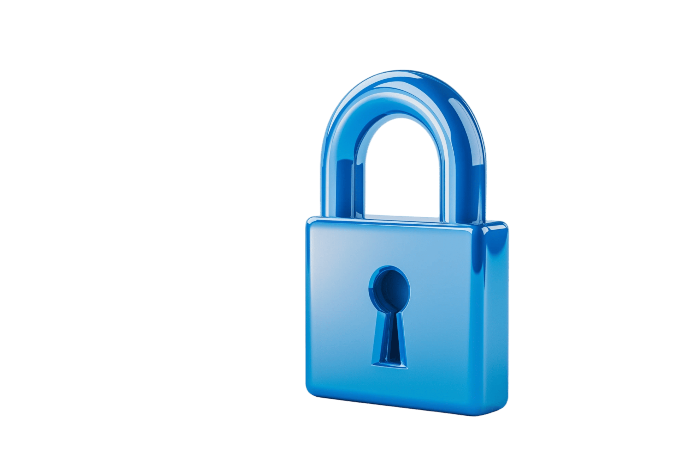

Secure Software Engineering and Management .
UPenn CIS 7000-010
Michael Hicks
Cybersecurity Risk Management

Slide 2
The Big Question
You are building and operating a cloud-hosted service with many customers and valuable data.
How do you decide what to spend on security — and on which security activities?
Notes:
This is fundamentally an economic question. We’ve seen Anderson’s argument that misaligned incentives distort security markets, and Grigg’s argument that the market rewards the appearance of security (silver bullets). Now we turn to: given these distortions, what’s the best a rational defender can do?
This lecture covers the theory and practice of cybersecurity risk management — what it promises, where it breaks down, and what actually happens in organizations.

Slide 3
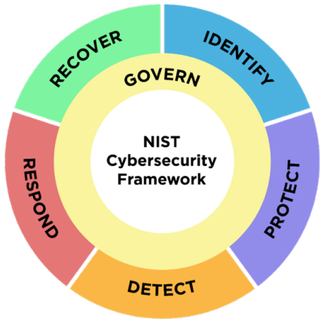
NIST CSF 2.0: What You Should Do
Notes:
IMAGE: The NIST CSF 2.0 wheel diagram — the iconic six-function wheel with Govern at center and Identify/Protect/Detect/Respond/Recover around it. Published by NIST and freely available. Much better than listing the functions as text. Source: https://www.nist.gov/cyberframework

Slide 4
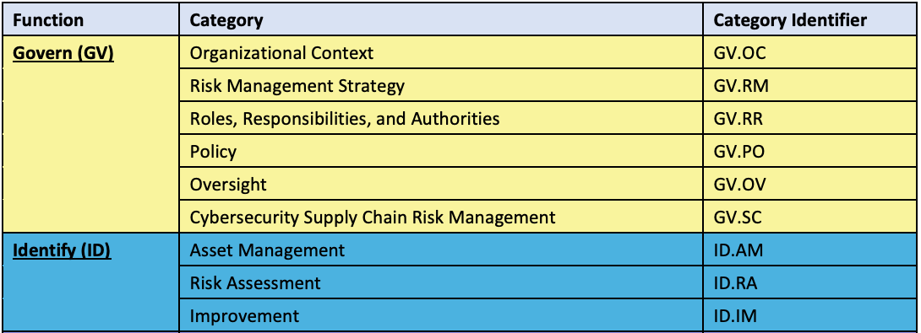
NIST CSF 2.0: What You Should Do
Notes:
IMAGE: The NIST CSF 2.0 wheel diagram — the iconic six-function wheel with Govern at center and Identify/Protect/Detect/Respond/Recover around it. Published by NIST and freely available. Much better than listing the functions as text. Source: https://www.nist.gov/cyberframework
Walk through the NIST CSF 2.0 ID.RA and GV.RM subcategories. The new “Govern” function (added in CSF 2.0, released Feb 2024) elevates cybersecurity governance to a top-level function, covering risk management strategy, organizational context, supply chain risk, roles/responsibilities, and policy. This reflects the post-SolarWinds, post-SEC-enforcement reality that boards and executives must own cyber risk.

Slide 5

NIST CSF 2.0: What You Should Do
Under Govern $→$ Risk Management (GV.RM):
GV.RM-02: Establish risk appetite and tolerance
GV.RM-06: Establish a standardized method for calculating and prioritizing risks
Under Identify $→$ Risk Assessment (ID.RA):
ID.RA-03: Identify and record threats
ID.RA-04: Identify potential impacts and likelihoods
ID.RA-05: Use these to prioritize risk responses
Notes:
IMAGE: The NIST CSF 2.0 wheel diagram — the iconic six-function wheel with Govern at center and Identify/Protect/Detect/Respond/Recover around it. Published by NIST and freely available. Much better than listing the functions as text. Source: https://www.nist.gov/cyberframework
Walk through the NIST CSF 2.0 ID.RA and GV.RM subcategories. The new “Govern” function (added in CSF 2.0, released Feb 2024) elevates cybersecurity governance to a top-level function, covering risk management strategy, organizational context, supply chain risk, roles/responsibilities, and policy. This reflects the post-SolarWinds, post-SEC-enforcement reality that boards and executives must own cyber risk.
The key observation: CSF tells you WHAT to do (estimate likelihoods, establish risk appetite, prioritize) but deliberately does not say HOW. It delegates methodology to SP 800-30 (risk assessment procedures) and SP 800-39 (risk management tiers). So it’s a taxonomy, not a methodology. Gordon-Loeb tells you HOW MUCH to invest — but only if you can estimate expected loss. CSF tells you what questions to ask — but not how to answer them. We need a method.

Slide 6
What We Know So Far
From earlier lectures:
Anderson: Misaligned incentives distort security markets
Grigg: The market rewards the appearance of security (“silver bullets”)
Herley & van Oorschot: Security as a scientific pursuit faces fundamental measurement challenges
Breen, Herley & Redmiles: Even estimating cybercrime victimization rates is surprisingly hard
Today: Given these problems, how do we make rational security investment decisions?
Notes:
Quick recap to connect to prior lectures. Students read Anderson’s “Why information security is hard” and Grigg’s “Market for Silver Bullets” in the economics lecture. The Herley & van Oorschot SoK and the Breen et al. cybercrime measurement paper were covered in the measurements unit. The key thread: security is economically distorted, scientifically immature, and hard to measure. Risk management is the practice of trying to make good decisions anyway.

Slide 7
Outline
The case for quantitative risk assessment
Why cyber risk is so hard to quantify
Giving it a shot!
Communicating risk

Slide 8
Part 1: The Case for Quantitative Risk Assessment

Slide 9
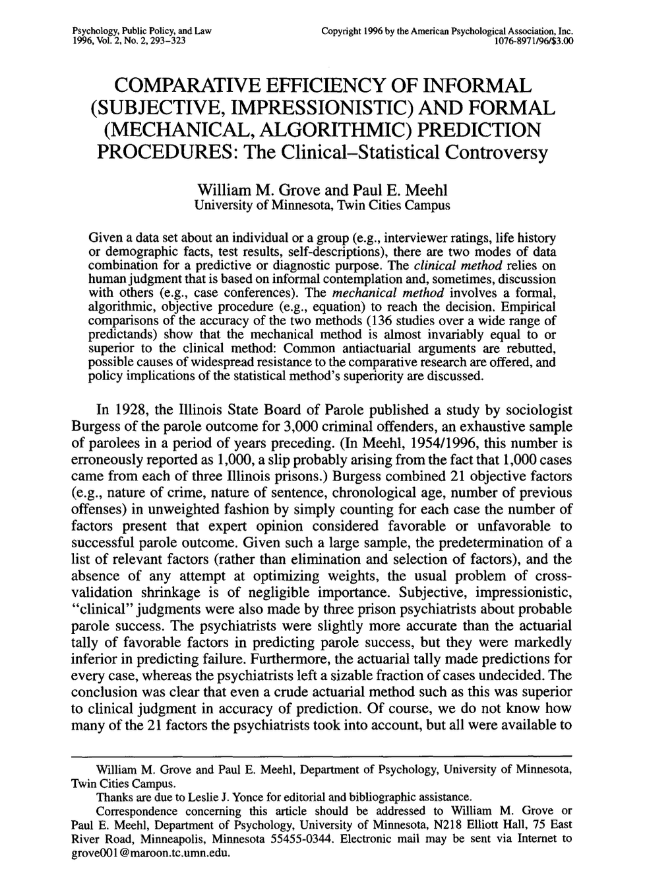
Clinical vs. Statistical Prediction
Across 136 studies in medicine, psychology, and other fields, mechanical/algorithmic prediction equals or beats expert judgment in virtually every case
Parole decisions
Medical diagnoses
Academic success predictions
Why should cybersecurity be exempt?
Notes:
This is the deep methodological argument for quantification. Paul Meehl’s work (starting in 1954, meta-analyzed by Grove & Meehl in 1996) showed that simple algorithms consistently outperform expert intuition for prediction tasks. The reason: humans are inconsistent, anchored by recent events, and overconfident. Algorithms are at least consistent. The cybersecurity implication: even a rough quantitative model (with acknowledged uncertainty) may produce better resource allocation than a CISO’s intuition informed by the last RSA keynote. This motivates everything that follows: we need a systematic method for assessing risk, not gut feel. The next question is what that method looks like — and whether the standard methods actually deliver.
Reference: Grove & Meehl, “Comparative Efficiency of Informal (Subjective, Impressionistic) and Formal (Mechanical, Algorithmic) Prediction Procedures.”

Slide 10
Why Quantify Risk?
“We need more security” is not actionable
“We face $2M in expected annual loss from ransomware; a $200K investment in backup testing reduces that by 60%” — that’s actionable
So we need an algorithm. What does one look like?
Notes:
The fundamental tension: security teams speak in threats and vulnerabilities; boards speak in dollars and risk appetite. Quantification is the bridge. Without it, security budgets are set by politics, fear of the last headline, or whatever the vendor is selling this quarter. The Meehl result says we should trust a systematic method over intuition. Now let’s look at the most common systematic method organizations use — the OWASP risk rating methodology — and see if it actually delivers.

Slide 11
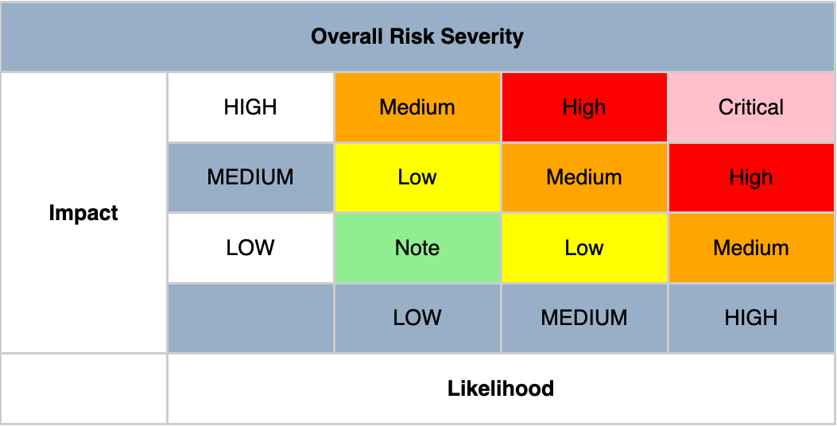
The OWASP Risk Rating Methodology (2010s)
A widely used approach: rate likelihood and impact on 0–9 scales, average them, plot on a heat map

Slide 12
The OWASP Risk Rating Methodology (2010s)
A widely used approach: rate likelihood and impact on 0–9 scales, average them, plot on a heat map.
Likelihood = average of 8 factors:
Threat agent: skill level, motive, opportunity, size
Vulnerability: ease of discovery, ease of exploit, awareness, intrusion detection
Impact = average of 4 factors:
Technical: confidentiality, integrity, availability, accountability
(Or business: financial, reputation, compliance, privacy)
Notes:
The OWASP Risk Rating Methodology is one of the most commonly referenced risk rating approaches in cybersecurity. It looks rigorous — 8 likelihood factors and 4+ impact factors, each scored 0-9. The scores are averaged within each group, then the averages are bucketed into LOW (0 to <3), MEDIUM (3 to <6), or HIGH (6-9), and combined on a 3x3 severity matrix. Let’s walk through it with a concrete scenario — the same ransomware scenario we’ll analyze quantitatively later.

Slide 13
Example: Ransomware Hits Our SaaS Company
Threat agent factors (0–9 each):
Average: (6 + 9 + 5 + 7) / 4 = 6.75
Factor | Score | Reasoning
Skill level | 6 | Ransomware-as-a-service lowers the bar
Motive | 9 | Direct financial gain
Opportunity | 5 | Need initial access (phishing, vuln)
Size | 7 | Large criminal ecosystem
Notes:
Walk through each factor, discussing the reasoning. The scores feel precise but are entirely subjective. Ask students: would you score “Skill level” as 6 or 7? What’s the actual difference? The point is that these feel like measurements but are really just opinions dressed up with numbers. Note that Ransomware-as-a-Service means low-skill attackers can deploy sophisticated ransomware, which complicates the “skill level” scoring — is it the skill of the malware author or the operator?

Slide 14

OWASP Example: Vulnerability
Vulnerability factors (0–9 each):
Average: (5 + 6 + 7 + 4) / 4 = 5.5
Overall likelihood = (6.75 + 5.5) / 2 = 6.125 $→$ HIGH
Factor | Score | Reasoning
Ease of discovery | 5 | Scanning tools find exposed services
Ease of exploit | 6 | Known CVEs, phishing kits available
Awareness | 7 | Ransomware is well-known
Intrusion detection | 4 | We have EDR, some logging
Notes:
Again, walk through each score. Note the subjectivity: “Intrusion detection = 4” — what makes it 4 and not 3 or 5? The OWASP scale says 1 = “active detection in application” and 9 = “not logged.” We have EDR and some logging, so… 4? 5? The choice between 4 and 5 seems trivial, but it shifts the average, which could shift the final bucket from MEDIUM to HIGH. This is the kind of false precision that Cox’s critique targets.

Slide 15

OWASP Example: Technical Impact
Technical impact factors (0–9 each):
Average: (7 + 9 + 9 + 3) / 4 = 7.0 $→$ HIGH
Factor | Score | Reasoning
Confidentiality | 7 | Data exfiltration before encryption
Integrity | 9 | All data encrypted
Availability | 9 | Service completely down
Accountability | 3 | Attackers usually identifiable as group
Notes:
The impact scoring has the same problems. “Confidentiality = 7” — is it 7 because data exfiltration is likely? But what if ransomware encrypts without exfiltrating? Then it might be 2. This single factor can swing the average by over a full point. And note that “Accountability = 3” (we can identify the ransomware group) lowers the overall impact score — but does the fact that you know who attacked you actually reduce the business impact? The factor is about traceability of the attacker, not about your losses. This is a design flaw in the methodology.

Slide 16

OWASP Result: The Heat Map
Risk Severity | LOW impact | MEDIUM impact | HIGH impact
HIGH likelihood | Medium | High | Critical
MEDIUM likelihood | Low | Medium | High
LOW likelihood | Note | Low | Medium
Our ransomware scenario: HIGH likelihood $×$ HIGH impact = Critical
So… now what?
Notes:
We’ve gone through 12 factors, assigned subjective scores to each, averaged them, bucketed the averages, and landed on “Critical.” But what does “Critical” actually tell us? It doesn’t tell us how much money we might lose. It doesn’t tell us how likely the attack is in probability terms. It doesn’t tell us how much to invest in prevention. It doesn’t let us compare this risk to BEC or data breach in any meaningful way — those might also be “Critical.” Every risk in the top-right corner of the matrix gets the same label, whether the expected loss is $100K or $100M.
And here’s the deeper problem: if we had scored “Intrusion detection” as 5 instead of 4, and “Accountability” as 5 instead of 3, our likelihood would have gone up slightly and our impact would have been… still HIGH. The buckets absorb variation. Information is destroyed. This is exactly what Cox proves mathematically.
The OWASP page itself acknowledges this criticism and points to NIST SP 800-30 and the Mozilla Risk Assessment framework as alternatives.

Slide 17
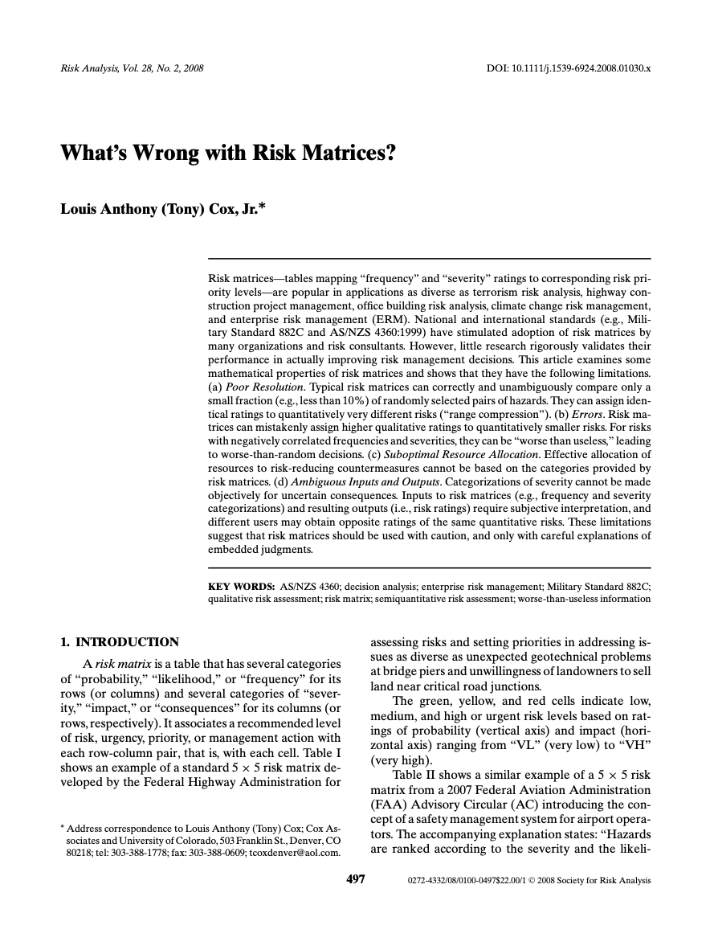
What’s Wrong with
Risk Matrices?
Correctly rank less than 10% of randomly selected hazard pairs
Can assign higher ratings to smaller risks
Can be “worse than useless” when frequency and severity are negatively correlated
Notes:
Cox proves these mathematically with straightforward proofs accessible to CS grad students. The core issue: ordinal scales destroy information. “High” likelihood times “Medium” impact = “High” risk. But “High” likelihood could mean 10% or 90%; “Medium” impact could mean $100K or $10M. The matrix compresses all of that into a single color. This means two risks in the same cell can differ by orders of magnitude in actual expected loss. Hubbard & Seiersen Ch. 5 (“Risk Matrices, Lie Factors, Misconceptions”) gives the cybersecurity-specific version of this critique — showing that 5x5 matrices can actually reverse the rank-ordering of risks.

Slide 18
Example 5x5 Risk Matrix
Score | Likelihood (annual) | Impact
1 Very Low | <1% | <$10K
2 Low | 1–5% | $10K–$100K
3 Medium | 5–20% | $100K–$1M
4 High | 20–50% | $1M–$10M
5 Very High | >50% | >$10M (unbounded!)
Inspired in part by
NIST 800-30
Risk score = Likelihood × Impact. “Critical” = score ≥ 20.
Each bucket spans ~5–10× in real values. Bucket 5 for impact has no upper bound at all. That’s where Cox’s reversal comes from.
Notes:
This slide exists to make the bucket widths concrete before we do the walkthrough. These ranges are typical of industry usage — NIST SP 800-30 Appendix H gives similar examples; OWASP’s scoring divides into 3 categories with similar ratios; NIST CSF 2.0 doesn’t prescribe specific ranges but SP 800-30 does.
Key observations to foreshadow:
Bucket widths are ~5–10×. Likelihood bucket 3 (5–20%) spans 4×. Bucket 4 (20–50%) spans 2.5×. Impact buckets each span 10× (a decade). These are standard. The ordinal labels (Medium, High, etc.) don’t capture the ratio.
Bucket 5 on impact is unbounded. It means “greater than $10M” — which covers a $10M incident and a $500M incident alike. The ordinal encoding drops all information about the tail. This is the single biggest source of the reversal we’ll see: a risk that should be rated much higher than one bucket above gets capped at “5.”
Likelihood bucket 5 is also unbounded on top (“>50%”), but probabilities max out at 100%, so the real range is at most 2×. Impact bucket 5’s real range can be 100× or more. That asymmetry is what multiplicative scoring can’t represent.
The ranges are defensible — that’s what makes this trap dangerous. These aren’t sloppy bucket definitions. They’re what you’d actually find in a well-run org using NIST guidance. The problem isn’t bucket choice; the problem is that ordinal × ordinal scoring is mathematically broken regardless of how the buckets are drawn.
Ask the class: how would you narrow the buckets to fix this? Answer: you can’t, really — narrower buckets still have the same structural problem, and the probability axis is bounded by 100% anyway. The only fix is to stop using ordinal scoring and estimate real numbers (McGeehan/Hubbard, Part 3). Which is where the lecture goes next.

Slide 19
Example of Cox’s Reversal
Our SaaS company assesses two risks.
Risk A — Major PII breach (Marriott-class event)
Analyst: Likelihood 3 (Medium), Impact 5 (Very High)
Cell: 3 × 5 = 15 → “High” (not Critical)
Risk B — Business Email Compromise (BEC) / O365 account takeover
Analyst: Likelihood 5 (Very High), Impact 4 (High)
Cell: 5 × 4 = 20 → Critical (upper-right)
Notes:
I Two realistic cyber risks for our SaaS company. The analyst’s reasoning is defensible:
Risk A (breach): “We handle a lot of PII but we’ve never had a breach. Likelihood is moderate; impact could be Marriott-level if it happens.” → Likelihood 3, Impact 5.
Risk B (BEC): “We see phishing attempts every week, someone will eventually click. A wire-fraud incident could easily cost $1M+.” → Likelihood 5, Impact 4.
The matrix reaches a clean conclusion: Risk B is Critical (score 20), Risk A is a step below (score 15). Spend on B first.

Slide 20
The Risk Matrix
 | I=1 | I=2 | I=3 | I=4 | I=5
L=5 | 5 | 10 | 15 | 20 ← B | 25
L=4 | 4 | 8 | 12 | 16 | 20
L=3 | 3 | 6 | 9 | 12 | 15 ← A
L=2 | 2 | 4 | 6 | 8 | 10
L=1 | 1 | 2 | 3 | 4 | 5
Bold cells = “Critical” (score ≥ 20).
B lands in the Critical corner.
A lands one cell below.
Risk A’s expected loss is ~87× larger than Risk B’s.
The matrix has the ranking reversed.
Risk | Actual likelihood | Actual impact | Expected annual loss
A (breach) | 15% (top of bucket 3) | $40M | $6,000,000
B (BEC) | 60% (bottom of bucket 5) | $115K | $69,000
Notes:
Important observation: A and B are one cell apart diagonally. B at (5,4), A at (3,5). If you slide A up one row (to L=4), A’s score becomes 20 and A would join the Critical corner. If you slide A up two rows (to L=5), A’s score becomes 25 — the highest possible score in the matrix. The matrix’s confidence about ranking A vs B is therefore highly sensitive to the likelihood bucket A lands in — and likelihood buckets span 4× ranges (5-20%, 20-50%).
Discussion prompt: imagine you’re the analyst presenting to the CISO. Looking at this matrix, how confident would you be that B is the bigger risk? The visual is very confident — B is red, A is not. That visual confidence is unearned.
Where the numbers come from:
Risk A: 15% annual probability is at the top of bucket 3 (5-20%). Impact of $40M is realistic for a mid-sized PII breach with CCPA class actions + state-AG multistate + notification + remediation + churn — Marriott’s 2024 multistate alone was $52M, and that doesn’t count private class actions or remediation.
Risk B: 60% annual probability — roughly “we’ll see at least one BEC attempt that gets through controls this year.” Conservative for a mid-sized SaaS. Impact of $115K is the Verizon DBIR 2025 median BEC loss.
Why the matrix reverses the ranking — three mechanisms, each doing some of the work:
Impact bucket 5 is unbounded on top. “Impact 5” means “>$10M.” A $10M ransomware and a $40M PII breach share the same ordinal score. A $100M breach does too. An infinite tail compresses into a single number, and Risk A loses its real magnitude the moment it’s bucketed.
Ordinal multiplication confounds the axes. Risk A is “moderate probability × enormous impact.” Risk B is “very high probability × moderate impact.” Multiplying 3×5 vs 5×4 yields 15 vs 20 — scores that are close and favor B. But a one-bucket step on the unbounded Impact axis (I=4 → I=5) can represent 10× in real values, while the same one-step move on Likelihood (L=4 → L=5) represents only ~2×. Multiplication treats them as equivalent.
Bucket-edge placement is invisible. Risk A’s 15% sits at the top of bucket 3; Risk B’s 60% sits at the bottom of bucket 5. Real probability ratio: 4×. Ordinal ratio: 5/3 ≈ 1.67×. The matrix can’t see where inside a bucket a risk actually lives.
This is Cox’s Lemma 1 concretized: when adjacent buckets span more than one order of magnitude of real values — which every cyber-relevant matrix does — ordinal × ordinal scoring can and does reverse the rank-ordering of expected losses.
Pedagogical punchline: one of these analyses is wrong about where to spend security dollars. It isn’t the arithmetic. The matrix says B is the Critical priority; a risk register with calibrated dollar estimates says A is ~87× more important. That’s a factor of nearly two orders of magnitude — the difference between a minor misallocation and a complete inversion of priorities.
Ask the class: could the analyst have caught this before doing the dollar estimates? Answer: not really. Within the matrix’s own logic, the scoring is reasonable. The failure is structural, not judgmental. This is exactly why Cox is emphatic that the tool is broken — not just the people using it.

Slide 21
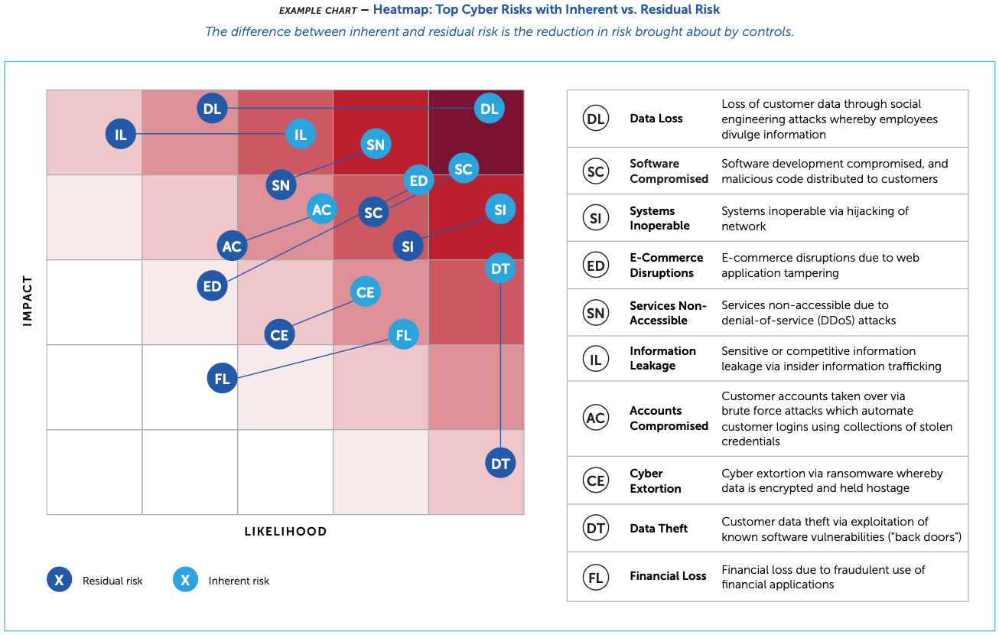
Exhibit A: CISOs Use Heatmaps Too
From an actual Fortune 1000 CISO board presentation (RSAC ESAF, 2022)
Our ransomware scenario landed on “Critical.” So did cyber extortion, data loss, and systems inoperable in this real board presentation. They’re all in the same red corner — are they the same risk?
Notes:
IMAGE: Screenshot the heatmap from ESAF-report.pdf page 20 (“Heatmap: Top Cyber Risks with Inherent vs. Residual Risk”). This replaces the placeholder image. The diagram shows risk bubbles (DL, SC, SI, etc.) on a likelihood-vs-impact grid with inherent and residual positions connected by arrows. Multiple risks cluster in the top-right red corner.
The ESAF report (page 20) shows an actual heatmap from a CISO board presentation, plotting risks like “Data Loss,” “Cyber Extortion,” “Systems Inoperable” on a likelihood-vs-impact grid, with inherent vs. residual risk positions. Multiple risks cluster in the top-right corner, all labeled Critical or High. But their actual expected losses could differ by orders of magnitude. The irony: even the most sophisticated CISOs at the world’s largest companies use the exact tool that Cox proves is mathematically broken. We just did the same thing with our ransomware scenario — 12 factors, careful scoring, and all we got was a color. Later in the lecture, we’ll assess the same scenario quantitatively and get a dollar figure we can actually act on.

Slide 22
We Need Something Better
The standard method (risk matrices) is mathematically broken
But CISOs at the world’s largest companies still use it
Why? And what should we use instead?
First: let’s understand why cyber risk is so hard to quantify.
Notes:
This is the bridge between Part 1 and Part 2. Part 1 established the need for quantification (Meehl) and showed that the standard approach (OWASP-style risk matrices) fails (Cox). Part 2 will explore the fundamental reasons why cyber risk resists quantification — the data problems, the comparison to other engineering domains, and the aviation paradox. Part 3 will then present what practitioners can actually do about it.

Slide 23
Part 2: Why Cyber Risk Is So Hard to Quantify

Slide 24
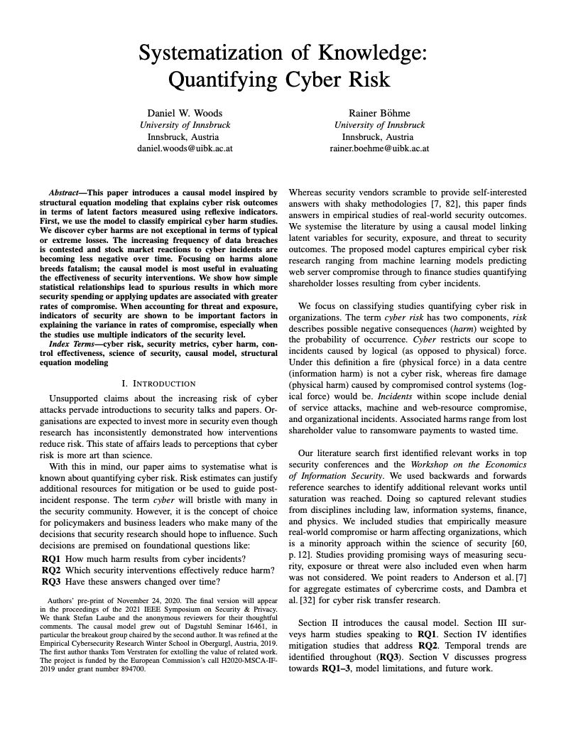
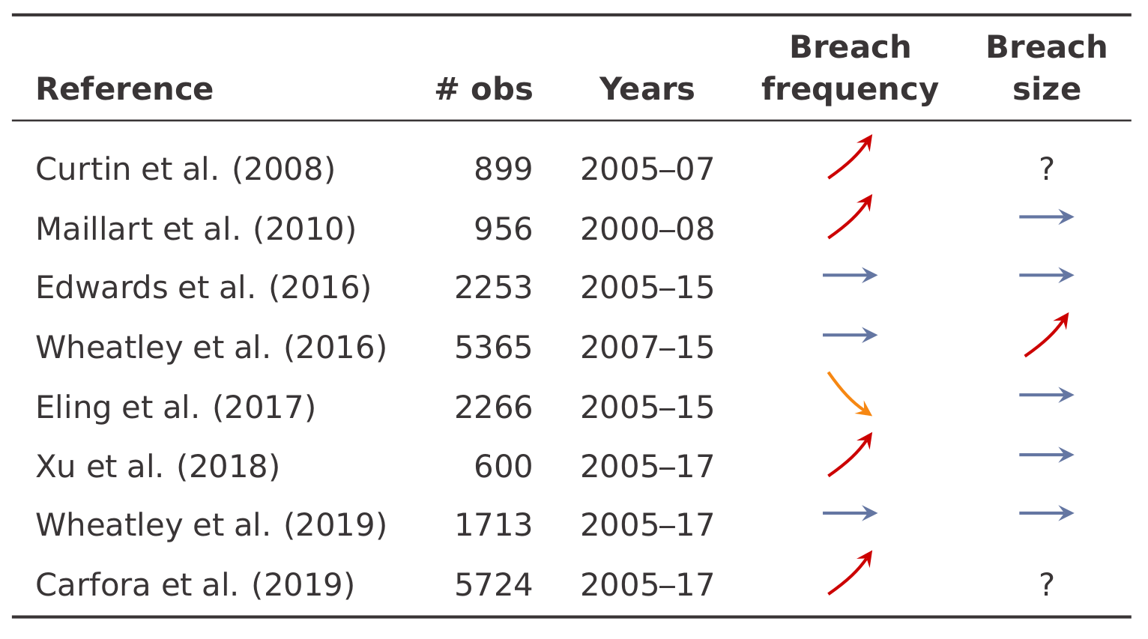
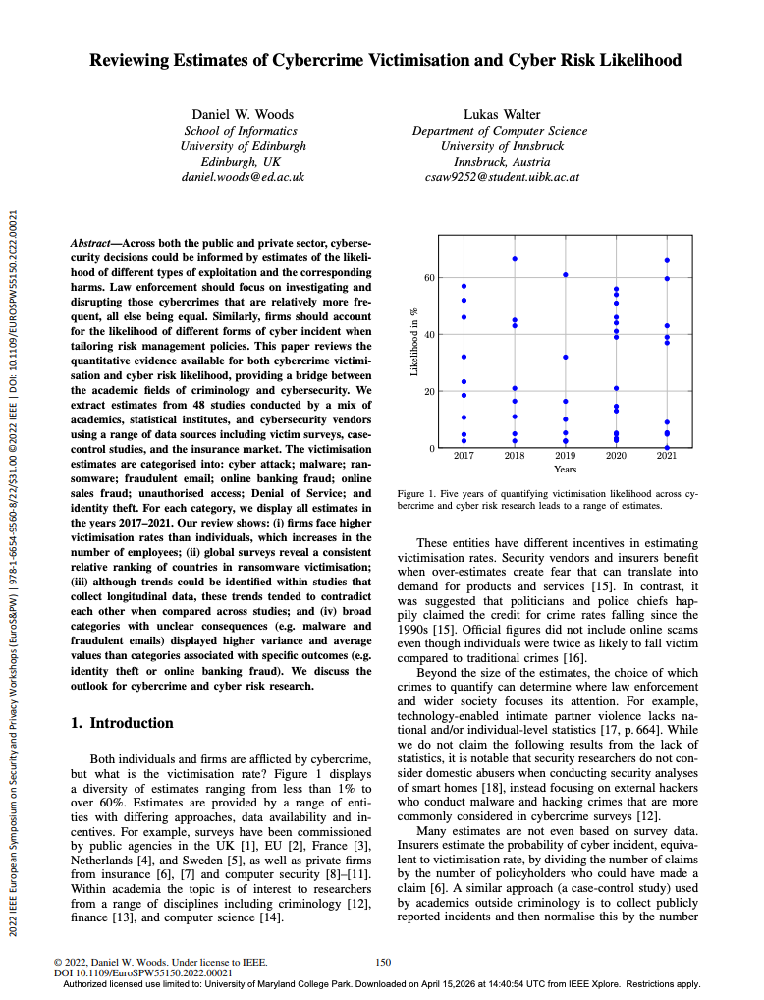
The Fundamental Data Problem
Different studies show unstable, contradictory trends
Measurement methodologies are incomparable across studies
We can’t even reliably estimate victimization rates
Notes:
IMAGE: Screenshot the first page of papers/woods-bohme-sok-2021.pdf.
This is the authoritative survey of the field’s data problems. Core message: the field of cyber risk quantification is in a pre-scientific state. Different researchers using different methodologies on different datasets reach different conclusions, and there’s no convergence. Woods’ separate paper “Reviewing Estimates of Cybercrime Victimisation and Cyber Risk Likelihood” (2022) makes the point even sharper: if you can’t tell what the victimization rate is, how do you know what your risk of being hacked is and thus what a reasonable investment might be? Summary at Woods’ project page: https://www.danielwoods.info/projects/quantify/

Slide 25
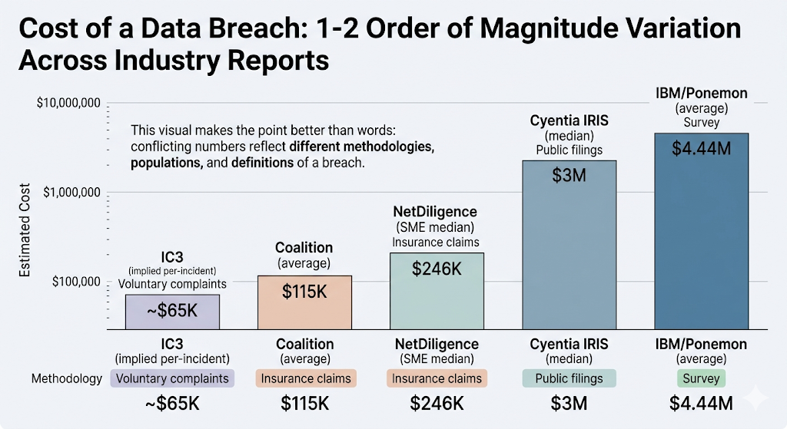
What Do Actual Cyber Losses Look Like?
Notes:
This is a crucial teaching point. Students are used to seeing “the average cost of a data breach is $4.88M” cited as fact. We’re about to show them why that number is essentially meaningless without context, and why different sources tell wildly different stories. Walk through the next several slides as a tour of the data landscape.

Slide 26
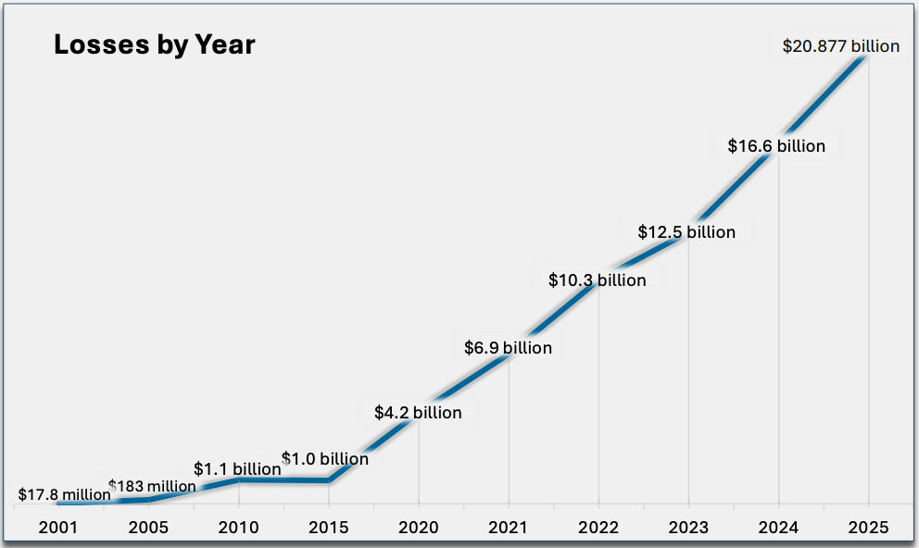
FBI IC3: The Floor Estimate
Notes:
The IC3 annual report is based on complaints filed to a government website. It’s widely understood to represent a small fraction of actual cybercrime. But is this because cybercrime is increasing or because reporting is increasing? Hard to tell. The ransomware figure ($12.5M) is laughably low because it only counts the ransom payment itself — no downtime, no remediation, no legal costs. Use this to illustrate how data collection methodology determines what you see.
Source: FBI IC3 2024 Annual Report (https://www.ic3.gov/AnnualReport/Reports/2025_IC3Report.pdf)

Slide 27
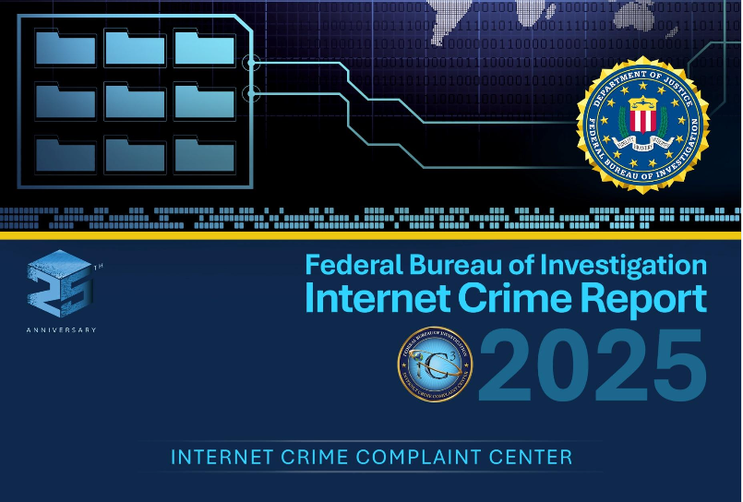
FBI IC3: The Floor Estimate
FBI Internet Crime Complaint Center, 2025:
Total reported losses: $20.9 billion
BEC alone: $3.05 billion
Ransomware: $32.3 million (!)
IC3 is voluntary self-reporting —
captures ~10–15% of actual incidents
excludes downtime, remediation, and lost business.
Notes:
The IC3 annual report is based on complaints filed to a government website. It’s widely understood to represent a small fraction of actual cybercrime. But is this because cybercrime is increasing or because reporting is increasing? Hard to tell. The ransomware figure ($12.5M) is laughably low because it only counts the ransom payment itself — no downtime, no remediation, no legal costs. Use this to illustrate how data collection methodology determines what you see.
BEC = Business Email Compromise
Source: FBI IC3 2024 Annual Report (https://www.ic3.gov/AnnualReport/Reports/2024_IC3Report.pdf)

Slide 28
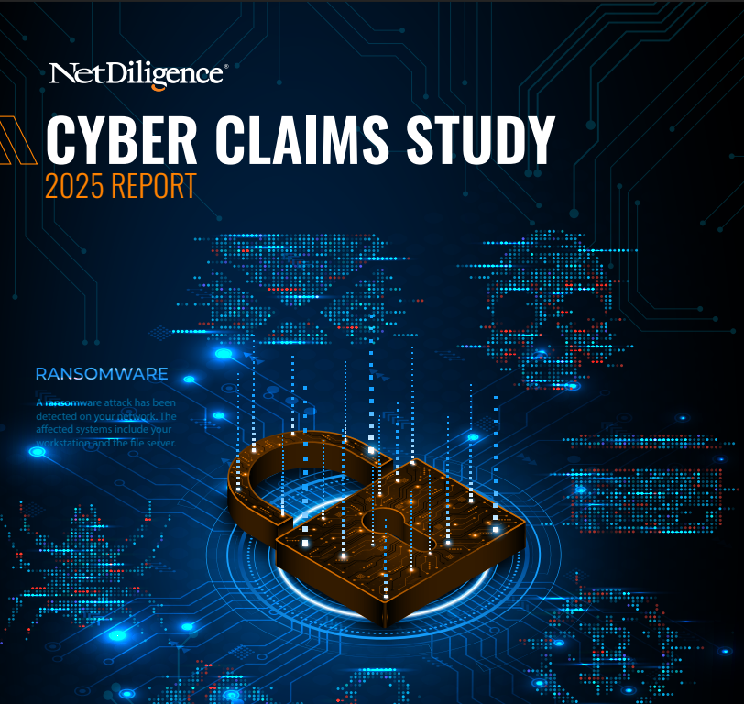
Insurance Claims: The Most Credible Source
Company size | Average incident cost | Insurance covered
SME (<$2B revenue) | $264,000 | 69%
Large (>$2B revenue) | $10.3 million | 27%
(10,402 actual insurance claims. 2020-2024)
Large companies = 2% of claims but >50% of total costs
Notes:
Insurance claims data is the most credible public source for actual verified business losses — these are adjudicated dollar amounts, not surveys or estimates. The NetDiligence study covers 10,402 claims from participating insurers over 2020-2024. Coalition’s 2025 report (from their own book of business) shows average claim = $115K, average ransomware loss = $292K. Key insight: 60% of claims came from BEC and funds transfer fraud, not ransomware. Ransomware gets the headlines, but BEC is the volume business of cybercrime.
Sources: NetDiligence Cyber Claims Study 2025; Coalition 2025 Cyber Claims Report.

Slide 29
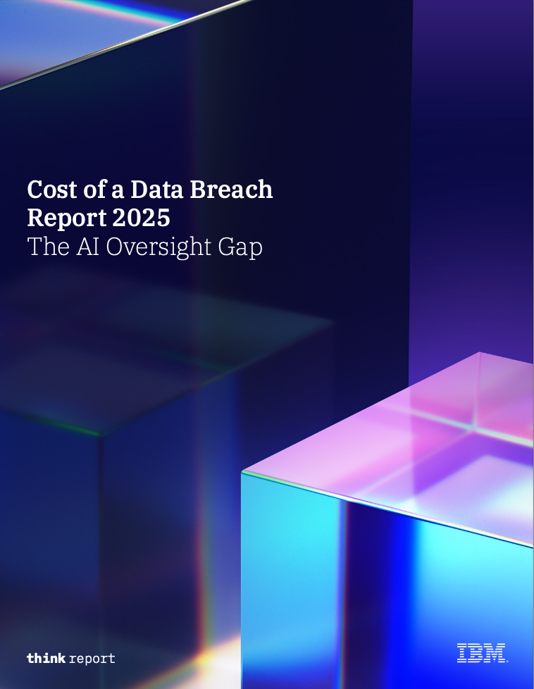

The Widely-Cited Number: $10M
IBM/Ponemon Cost of a Data Breach 2025
Notes:
The IBM/Ponemon report is the most widely cited and the least methodologically defensible of the major sources. Ponemon interviews ~3,470 executives and asks them to estimate costs using “activity-based costing.” These are subjective estimates, not verified financial data. The study caps at ~113,000 records, so mega-breaches (Change Healthcare, MOVEit) are excluded from the headline average. Cyentia Institute found that the per-record cost metric “simply doesn’t work — it underestimates small events and vastly overestimates large events.” This is a good teaching moment: the most-cited number in cybersecurity risk is the least reliable. Students should learn to ask “what’s the methodology?” before citing any statistic.

Slide 30
The Widely-Cited Number (Why It’s Weak)
IBM/Ponemon Cost of a Data Breach 2025:
Global average: $4.44 million
U.S. average: $10.22 million
Methodology problems:
Survey-based: executives estimate costs, not verified data
Excludes mega-breaches (>113K records)
Per-record cost model explains only 2–13% of variance
Sponsored by IBM, which sells security products
Notes:
The IBM/Ponemon report is the most widely cited and the least methodologically defensible of the major sources. Ponemon interviews ~3,470 executives and asks them to estimate costs using “activity-based costing.” These are subjective estimates, not verified financial data. The study caps at ~113,000 records, so mega-breaches (Change Healthcare, MOVEit) are excluded from the headline average. Cyentia Institute found that the per-record cost metric “simply doesn’t work — it underestimates small events and vastly overestimates large events.” This is a good teaching moment: the most-cited number in cybersecurity risk is the least reliable. Students should learn to ask “what’s the methodology?” before citing any statistic.

Slide 31
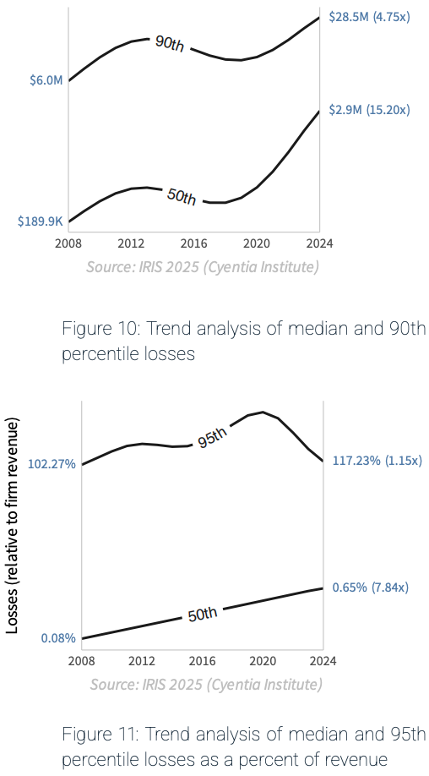
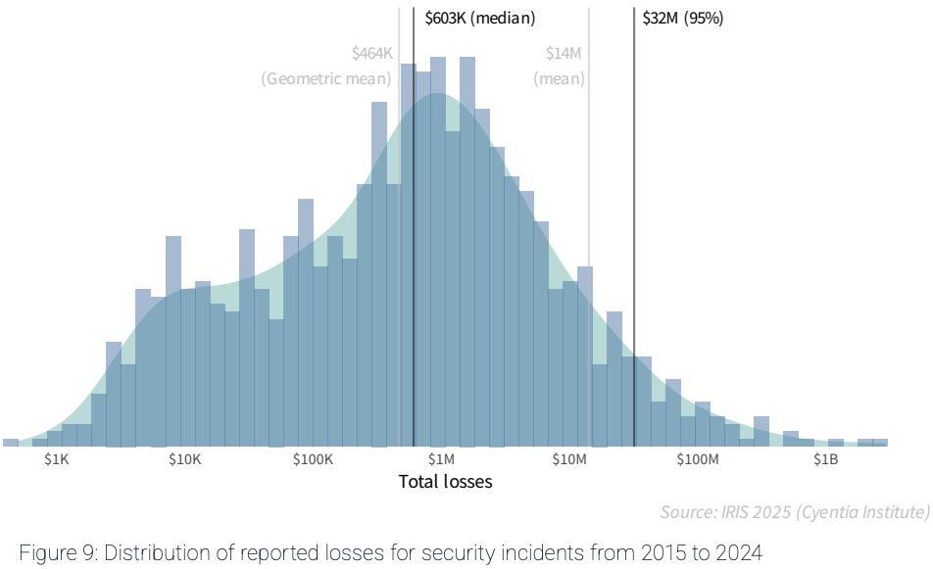
The Loss Distribution: Fat Tails
$2.9M in 2024
Cyentia IRIS 2025 (150,000+ incidents, 2008–2024)
Notes:
The Cyentia Institute IRIS reports are arguably the most methodologically rigorous public source on cyber loss distributions. They use verified, publicly reported financial data (SEC filings, litigation records, breach disclosures, FOIA requests) rather than surveys. Wade Baker (who created the Verizon DBIR) leads the team. The IRIS 2025 report covers 150,000+ incidents spanning 2008–2024, sponsored by CISA. Key findings beyond the headline numbers:
The annual probability of any firm experiencing an incident has almost quadrupled since 2008 (2.5% to 9.3%). But this varies dramatically by size: firms under $1B have seen probability more than double, while $100B+ megacorps have seen a 50% drop (Figure 7).
Losses relative to the victim’s annual revenue have grown nearly 8x over 15 years (Figure 11). The top 5% of loss events now exceed the affected firm’s entire annual revenue.
Loss trends differ sharply by incident type: ransomware median losses have ballooned 20-fold ($155K to $3.2M), while the top-tier system intrusion losses have actually dropped from $221M to $7.4M (Figure 15). This supports the need for threat-specific risk scenarios rather than generic “cyber risk” estimates.
Sector matters: professional services median losses are up 25x over 15 years; retail losses have actually decreased dramatically, likely due to PCI compliance and Chip-and-Pin adoption (Figure 12).
Compromising user credentials (Valid Accounts) remains the #1 intrusion technique, involved in 43–60% of all incidents over the past decade. Web app exploitation has surged from single-digit percentages to 38% (Figure 16).
Also note Romanosky (2016): analyzed 12,000+ events, found typical cost <$200K (0.4% of revenue). The IRIS 2025 data shows the landscape has shifted significantly since Romanosky’s dataset: median losses have risen 15-fold, and losses as a share of revenue have grown ~8x. The “rational underinvestment” argument may be weakening as tail risk grows.

Slide 32

Where Risk Quantification Works: Building Codes
Notes:
Ellingwood, “Probability-Based Load Criteria for Structural Design” (NBS Special Publication 577, 1980) is the foundational document behind modern US building codes. For a textbook treatment: Nowak & Collins, Reliability of Structures (McGraw-Hill, 2000), Chapter 2.
Load and Resistance Factor Design (LRFD)
Probabilistic models of wind, snow, loads, material strength
Calibrated against centuries of data and stable physical laws
Codified into safety factors in building codes (ASCE 7, AISC)
This works because: (a) the physics of materials and loads is stable and well-characterized, (b) failure modes are well-cataloged from centuries of building collapses, (c) there is abundant data — every windstorm, earthquake, and structural failure feeds back into the models, and (d) there is no adversary deliberately trying to make your building fall down. Civil engineering is the poster child for quantitative risk management done right.

Slide 33
Why Cybersecurity Breaks the Pattern
 | Structural engineering | Cybersecurity
Governing laws | Stable physics | No “physics” of attacker behavior
Adversary | Nature — no intent | Active, intelligent, adaptive
Failure modes | Catalogued from centuries | Constantly evolving
Historical data | Abundant, systematic | Sparse, proprietary
Landscape change | Codes evolve over decades | Every update changes the attack surface
Notes:
This table captures the core structural reasons why cybersecurity risk quantification is fundamentally harder than structural engineering risk. Hubbard & Seiersen, How to Measure Anything in Cybersecurity Risk (2016), Chapter 3 (“The Myth of the Unmeasurable”) directly makes this comparison — arguing that cyber is harder than traditional engineering domains but that the field’s fatalism about measurement is itself the problem. The question is not “can we measure?” but “can we measure well enough to make better decisions than we do now?”

Slide 34
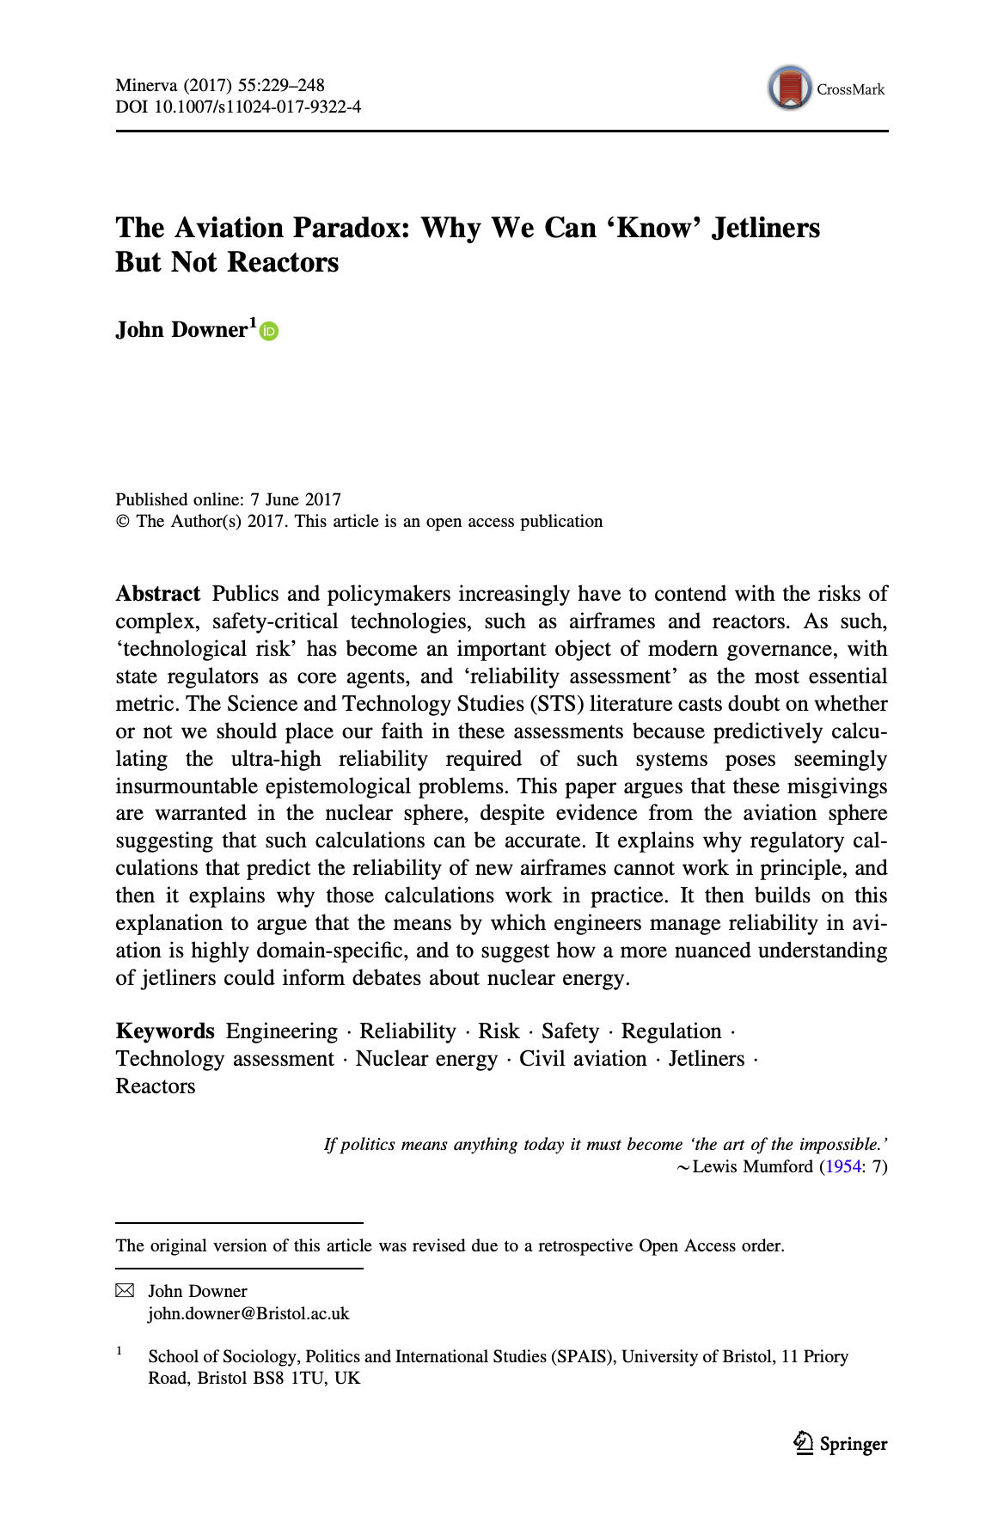

The Aviation Paradox
Downer (2017): Aviation’s safety record cannot be explained by the testing and modeling the industry credits
Can’t validate claims like 10$​^{−9}$ failures/flight hour — would need billions of test hours
Same problem applies to nuclear safety
Notes:
IMAGE: Screenshot the first page of Downer (2017) “The Aviation Paradox” from Minerva. Download manually from https://link.springer.com/article/10.1007/s11024-017-9331-4 (Penn library access) and save to papers/downer-2017.pdf. This is a required reading — showing the first page reinforces “you should have read this.” The Minerva journal is unfamiliar to CS students; showing it signals interdisciplinary work.
Also consider: a photo of a NASA ASRS reporting form or the ASRS website (https://asrs.arc.nasa.gov/) to make the reporting system concrete. Or a cockpit photo to set the aviation context.
John Downer’s key insight: even in domains with stable physics (unlike cyber), the quantitative risk models can’t be validated through empirical data when failure rates are extremely low. Aviation claims 10^-9 failures per flight hour, but you’d need billions of test flights to verify this statistically. Nuclear safety faces the same problem. So what actually makes aviation safe? It’s the institutional infrastructure: the ASRS (Aviation Safety Reporting System) enables non-punitive, anonymous near-miss reporting. Pilots and crews report errors and close calls without fear of punishment. NASA administers it, separate from the FAA. This creates a massive dataset of “what almost went wrong” that continuously improves the system.
Reference: Downer, “The Aviation Paradox: Why We Can ‘Know’ Jetliners But Not Reactors,” Minerva 55.2 (2017): 229-248.

Slide 35
Ultra-high reliability assessments
Reliability like security – a negative property.
  Forces it to be contextual: You have to define the circumstances under which you agree the bad thing can’t happen, and you have to carefully define the parameters of the bad thing
Predictive reliability assessment goal: 1B hours of failure-free service
Approach: Model-based analysis
  Assess individual components inductively
  Reason about their combined reliability deductively, using a model
Example: Redundant engines
  Single engine failure probability P, based on measurements
  Total engine failure of two engines = P²
    Assuming engine failures are independent
Notes:
Where did the “billion hours” level of reliability come from? Paper observes that this is basically “certainty”

Slide 36
Ultra-high reliability assessments, questioned
Epistemically dubious!
  “There is no way that experts should be able to deduce from tests and models that a yet-unrealized jetliner or reactor will be reliable to the extraordinary levels that they claim.”
  Why? We cannot observe the tech in action long enough, or draw on other prior evidence, to extrapolate to the hoped-for conclusion.
    1B hours is 114,000(ish) years! Long time to run to test directly
Nevertheless: “A stubbornly suicidal traveler would have to take a random airline flight every day for 19,000 years to stand a better-than-even chance of succumbing to a fatal crash.”

Slide 37
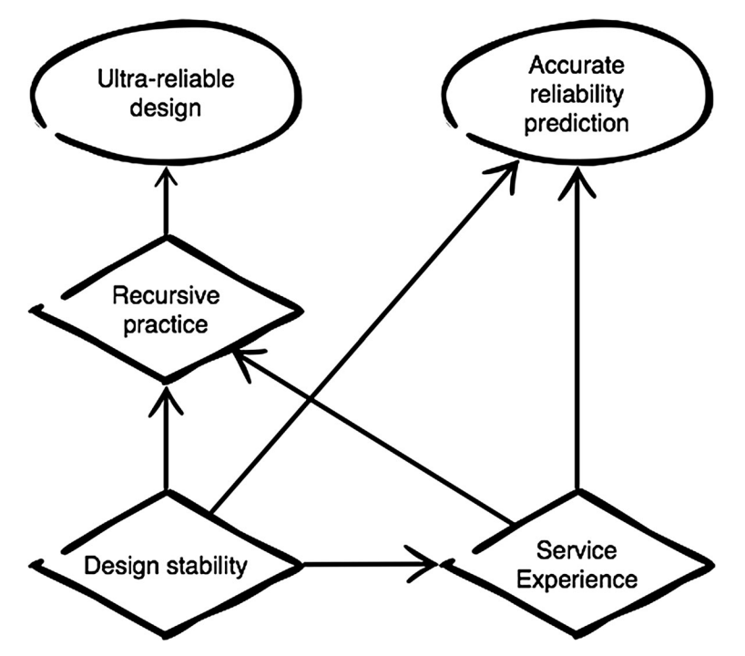
Why it works for (most) civil aviation
Notes:
Also: Military aviation is more risk-taking, and civil aviation learns from its failures (not successes!)
Does FAA acknowledge what it’s really doing?

Slide 38

But not the Concorde

Slide 39
But not the Concorde
1 catastrophic failure, July 25, 2000
Very different design
1354 mph cruising speed
‘Double delta’ wing shape
Unorthodox landing gear and a nose that moved
Special heat-resistant alloys
Only 14 planes in operation totaling 50,000 flights over 27 years
Notes:
1 failure in 175000 hours = 5700x below spec of 1 in 1B hours

Slide 40
And not Nuclear
Lessons are learned and improvements made, but do not generalize
Not enough reactors, not enough service time for each
Reactor designs broadly dissimilar

Slide 41

The Layered Implication
Civil engineering: Risk quantification works — stable physics, abundant data, no adversary
Aviation: Even with stable physics, safety depends on institutional culture, not just models (thus: doesn’t apply to nuclear reactors)
Cybersecurity: All of aviation’s modeling problems plus an adaptive adversary
$⇒$ We can’t rely on risk models alone. We also need institutional infrastructure for learning (more later).
Notes:
This is the synthesis slide. The argument builds in layers: structural engineering shows us what “risk quantification done right” looks like. Aviation shows us that even with stable physics, models aren’t enough — you need institutional learning. Cybersecurity faces both problems simultaneously, plus the unique challenge of an intelligent adversary. This frames the rest of the lecture: Parts 3-4 look at what practitioners actually do (spoiler: it’s more social than technical), and Part 5 asks whether we should invest more in institutional learning infrastructure.

Slide 42
Part 3: Trying to Quantify Risk

Slide 43
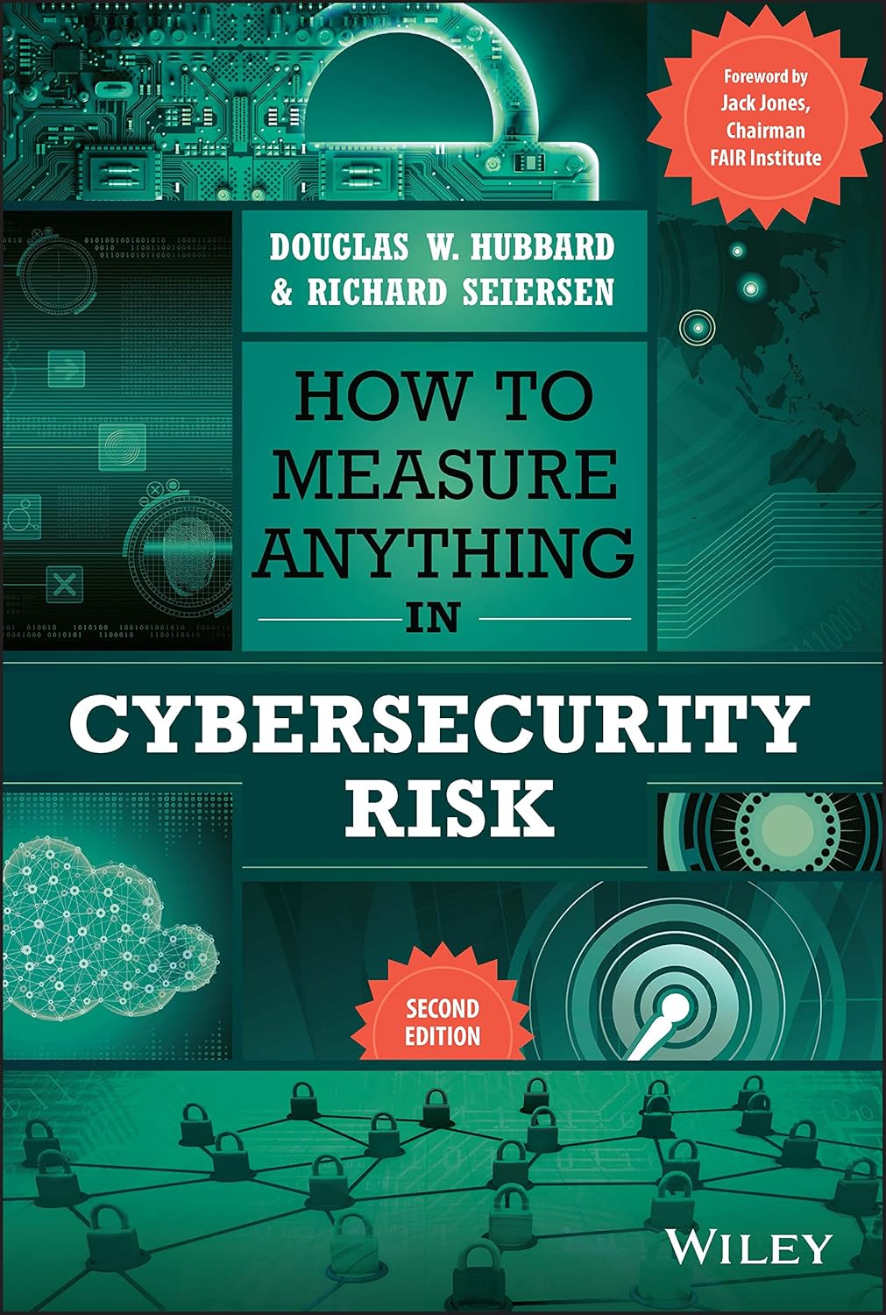
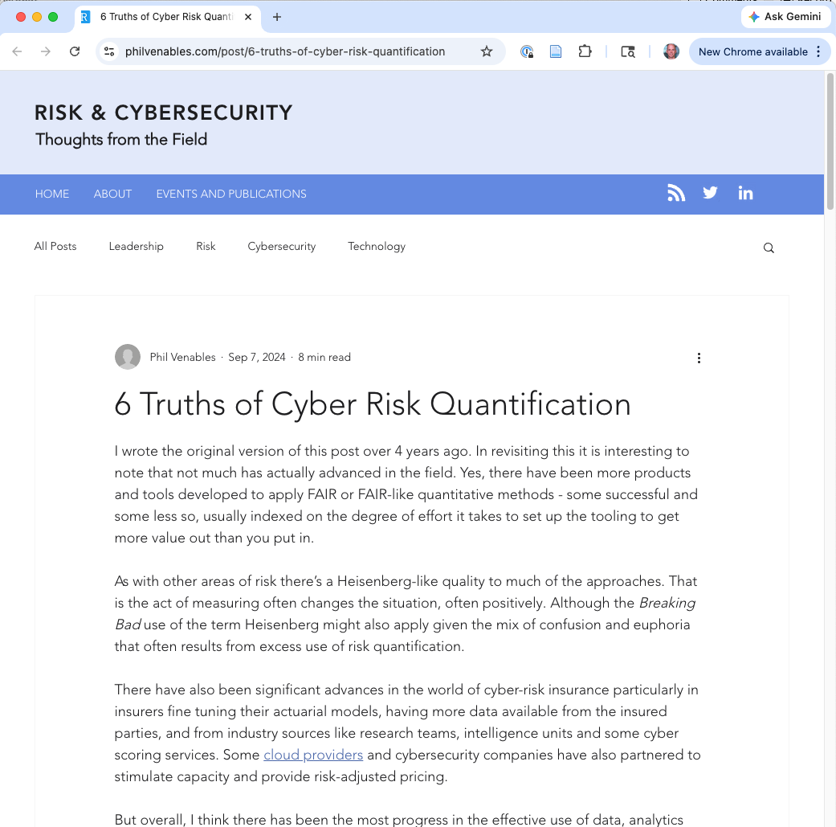

Hall of Fame 2017
Notes:
Phil Venables (Google Cloud CISO) on “6 Truths of Cyber Risk Quantification” 2024
Douglas Hubbard for the first book

Slide 44
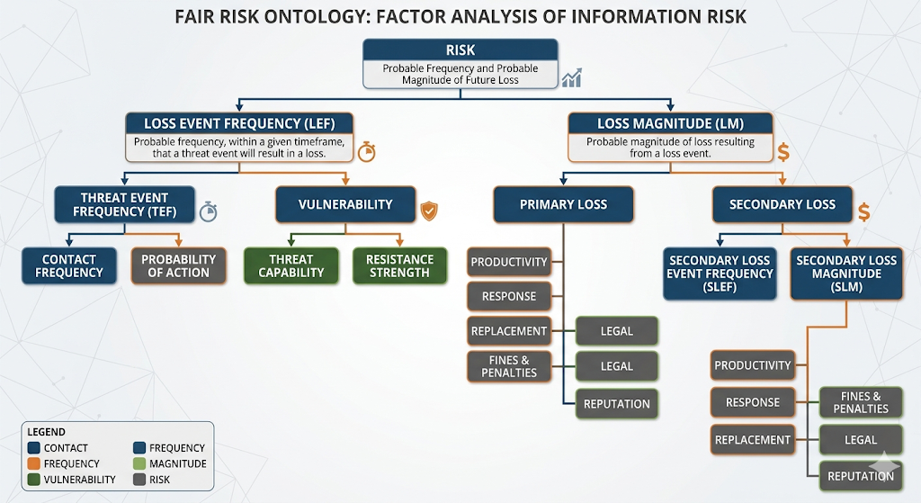
FAIR: The Prominent Quantitative Framework
Factor Analysis
of Information Risk
Uses Monte Carlo simulation to produce loss distributions in dollars
https://www.fairinstitute.org/
Notes:
IMAGE: The FAIR decomposition tree diagram. Risk decomposes into Loss Event Frequency and Loss Magnitude; LEF decomposes into Threat Event Frequency and Vulnerability; LM into Primary Loss and Secondary Loss; each of those decompose further. The standard FAIR ontology tree is widely reproduced — redraw it or screenshot from Open Group documentation (https://www.opengroup.org/certifications/openfair). Makes the decomposition concrete rather than a bullet list.
FAIR decomposes risk into measurable components. Loss Event Frequency breaks into Threat Event Frequency and Vulnerability (probability a threat event becomes a loss event). Loss Magnitude breaks into Primary Loss (direct costs) and Secondary Loss (response costs, reputation, legal). Analysts feed in ranges/distributions and run Monte Carlo simulations to get probability distributions of annual loss in dollar terms. It’s the most serious attempt at a quantitative risk framework specific to cybersecurity. The FAIR Institute has thousands of members. This is what many organizations turn to when they want to go beyond risk matrices.

Slide 45
FAIR: What’s Sound, What’s Missing
FAIR’s structure is sound:
Decompose risk into measurable sub-factors
Express inputs as ranges (not point estimates)
Aggregate via Monte Carlo to get loss distributions in dollars
The real critique is about inputs, not structure:
Hubbard: practitioners often feed FAIR uncalibrated gut estimates
Venables: the hard problem is communication and calibration, not quantification itself — FAIR works when done well
What FAIR needs: a discipline for producing calibrated inputs.
Notes:
The critique of FAIR is often misstated as “FAIR is wrong.” It isn’t. FAIR provides sound quantitative structure: decompose risk into Loss Event Frequency and Loss Magnitude, use ranges to express uncertainty, run Monte Carlo to propagate that uncertainty to an overall loss distribution. This is exactly what you’d want.
The problem is that FAIR’s outputs are only as good as its inputs. If you estimate “Threat Event Frequency” as “between 2 and 10 per year” with no base-rate data, you produce numbers that feel precise but aren’t actually calibrated against reality. Hubbard calls this the illusion of knowledge.
Phil Venables (CISO at Google Cloud) pushes back on the anti-quantification backlash. In “6 Truths of Cyber Risk Quantification” (2024), he argues that most complaints about risk quantification are actually complaints about how results are communicated and acted on, not about quantification itself. Venables is bullish on FAIR when it’s done with calibrated inputs.
So the narrative for the class is: FAIR is not the villain. The missing piece is a calibration discipline — a way to produce probability and cost estimates you can actually trust. That’s what McGeehan and Hubbard provide. The forecasting approach doesn’t replace FAIR; it supplies FAIR with credible numbers.

Slide 46
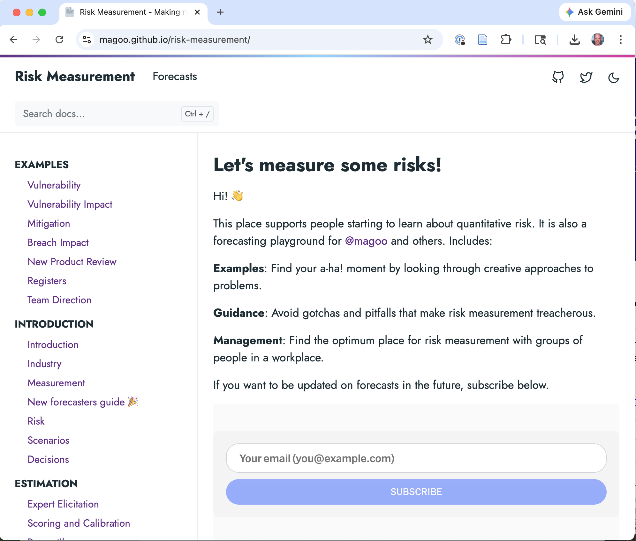
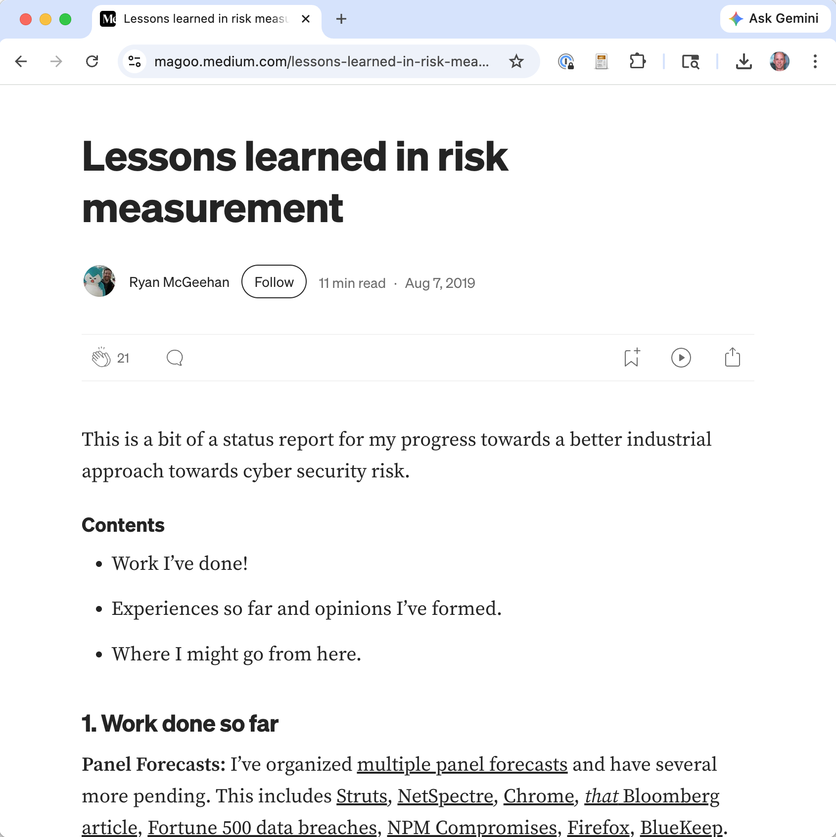
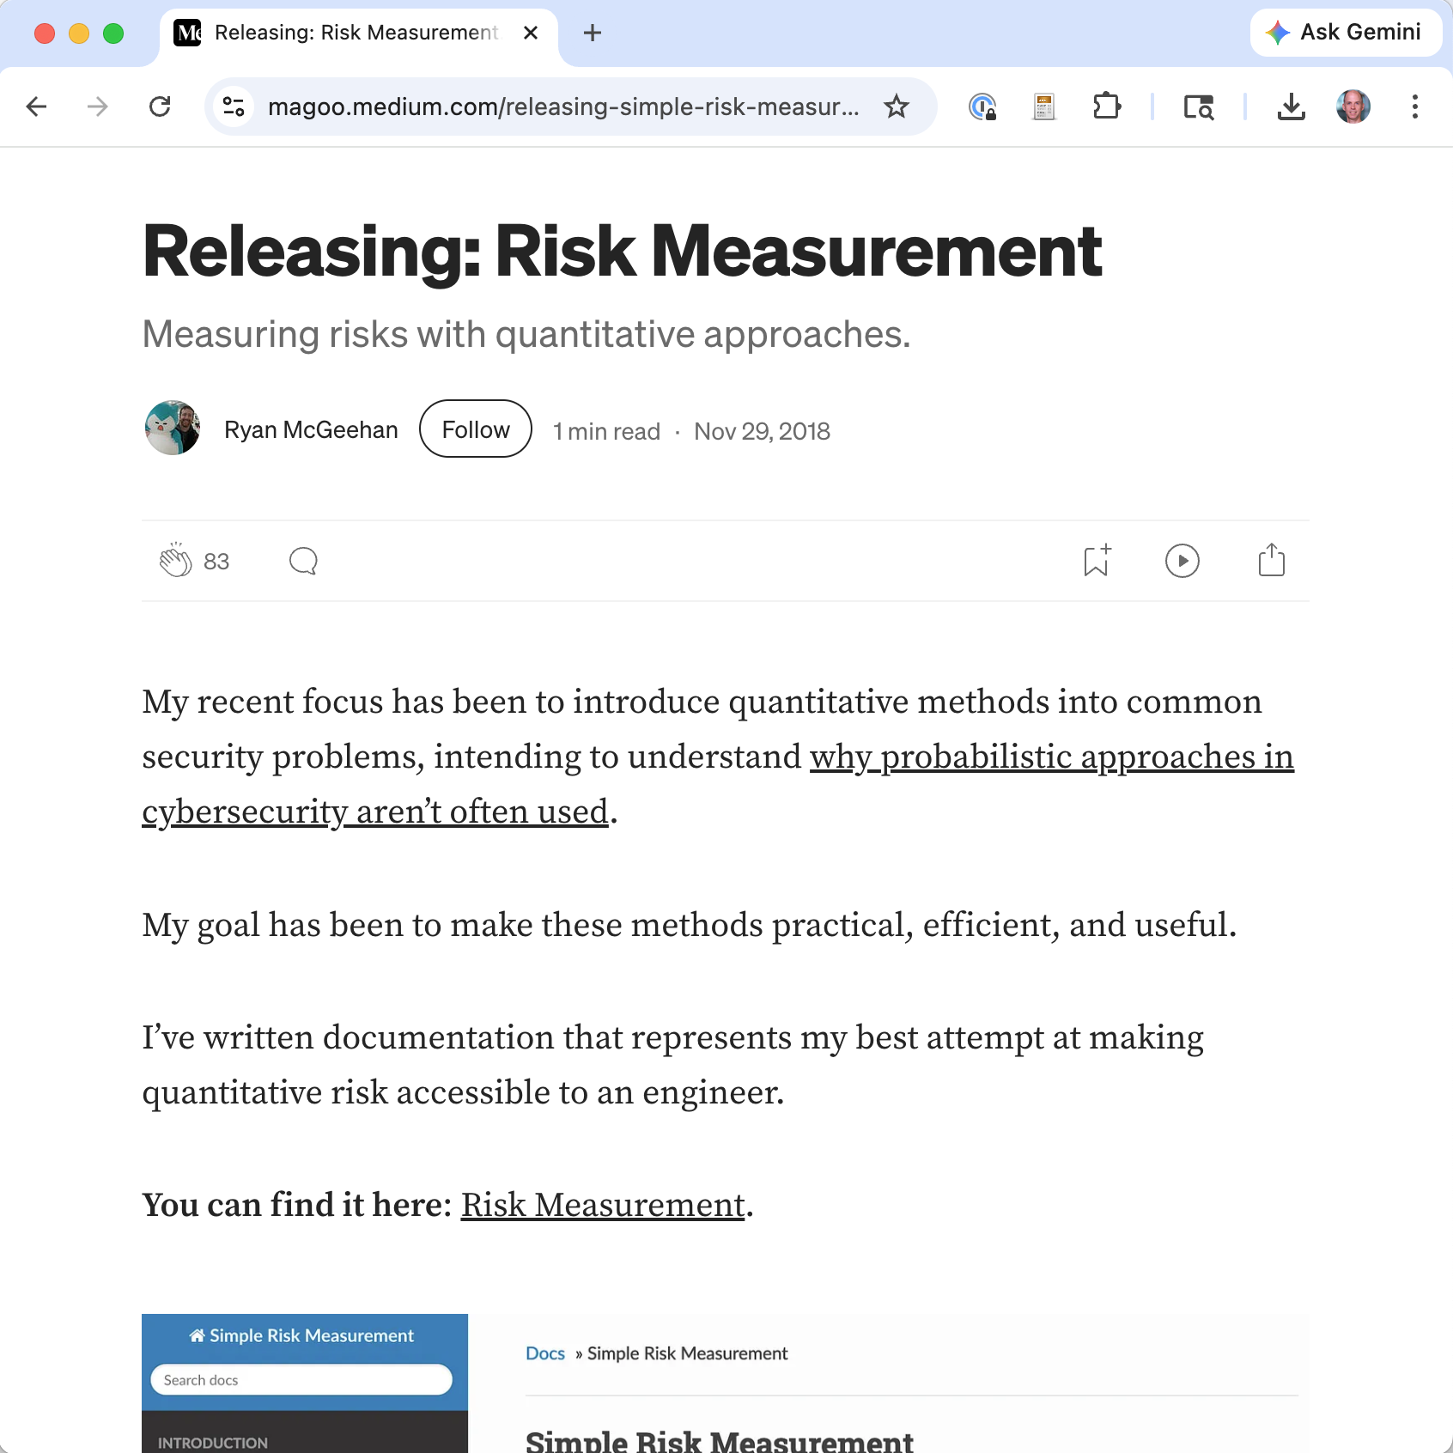

Slide 47
Forecasting: The Calibration Discipline FAIR Needs
Treat risk inputs as forecasts, not scores.
Instead of “ransomware = High risk,” commit to a specific falsifiable prediction:
Then attach:
A probability (Brier-scored after the timeframe)
Separately, a cost interval if it occurs (feeds FAIR/Gordon-Loeb)
Calibration is tracked over many forecasts, not one.
“A ransomware event causes >24h of downtime within the next 12 months”
Notes:
McGeehan’s Simple Risk Measurement methodology (https://magoo.github.io/risk-measurement/) lays out this approach. The core shift: from categorical labels to specific, falsifiable predictions scored against reality. This is directly informed by the superforecasting literature (Tetlock) and by Hubbard & Seiersen’s work. McGeehan’s forecasting panels at Facebook tracked calibration via Brier scores (averaging ~0.32, well above the 0.50 random baseline). Key posts: “Lessons Learned in Risk Measurement” and “Releasing: Simple Risk Measurement.”
Hubbard & Seiersen’s How to Measure Anything in Cybersecurity Risk provides the theoretical foundation. Ch. 6 (“Decomposing the Problem”) covers Fermi estimation applied to cyber risk; Ch. 3 (“The Illusion of Knowledge”) and Ch. 9 (“Calibrated Estimation”) cover overconfidence bias and training exercises for improving probability estimates. Ch. 9 has exercises students can try themselves. Hubbard explicitly argues that FAIR-style frameworks are sound but under-deliver because of calibration failures — and his book is essentially a manual for fixing that.
Emphasize: forecasting doesn’t replace FAIR. It supplies FAIR with the credible, scorable inputs it needs.

Slide 48

What Makes a Good Forecast?
A forecast is a structured, scorable commitment about a future event:
Scenario: An unambiguous statement of an undesirable future event, with a timeframe — the “impact” is built into the scenario itself (downtime, disclosure, lawsuit, etc.)
Probability: Your stated confidence the scenario will occur
Scoring plan: Judge the outcome after the timeframe using a Brier score (0-1, lower is better):
$$\text{Brier}=(\text{forecast}−\text{outcome})^{2}$$
Scoping note: Dollar costs and investment decisions come afterwards, when we act on forecasts we’re confident in.
Notes:
McGeehan’s framework is intentionally narrow. A “scenario” is a binary event that either happened or didn’t, and its qualitative impact is built into the definition — e.g., “>24h of downtime”, “disclosure to regulator”, “named in a lawsuit covered by a major newspaper”. The forecast is a probability attached to that binary event. Scoring (Brier) evaluates how accurate that probability was.
Dollar-cost estimation is a separate activity that happens downstream. McGeehan uses interval estimates (e.g., “90% CI: $10M–$100M settlement costs”) for various quantities including costs, but those intervals are not necessarily part of the forecast itself.
Keeping these steps distinct matters:
The forecast is a prediction about whether a defined event occurs (scored with Brier).
Later, the cost estimate is a conditional prediction about what damage the event would cause IF it occurs.
Expected loss (p × cost) combines the two to support ranking.
Gordon-Loeb or similar models use expected loss to bound investment.
Blurring these together (as risk matrices do) makes it impossible to score any individual step for accuracy.
Reference: McGeehan, Simple Risk Measurement, “Scenarios” and “Scoring and Calibration” sections.

Slide 49

Let’s Try It: Writing a Scenario (Step 1)
Bad scenario: “Ransomware hits our company” $←$ vague, no timeframe, no defined outcome
Good scenario:
Our mid-sized SaaS company (~$50M revenue, ~200 employees) publicly discloses a ransomware incident that causes >24 hours of service downtime within the next 12 months.
Unambiguous event: clear trigger (public disclosure + >24h downtime)
Timeframe: next 12 months
Judgment: Did we file a public disclosure? Was downtime >24h?
Notes:
Walk through what makes the good scenario testable. The bad version (“ransomware hits our company”) has at least three ambiguities: (1) Does a ransomware email that gets blocked count? Probably not, but the scenario doesn’t say. (2) When? Ever? This year? (3) What counts as “hits” — encryption of one laptop? Full network lockout?
The good version specifies: public disclosure (observable, binary), >24h downtime (measurable threshold), 12-month window (testable). After 12 months, anyone can check: did this happen or not?
Emphasize that the impact is qualitative and built into the scenario. We are NOT forecasting a dollar figure. We are forecasting a binary event defined to include a specific qualitative impact (“>24h downtime”). If we want to ask “what would that cost us?”, that’s a separate question we’ll get to after scoring.
McGeehan also recommends decomposing into sub-scenarios when useful. For example, you might break this into mutually exclusive branches: (a) ransomware with data exfiltration and public disclosure, (b) ransomware with encryption only and public disclosure, (c) ransomware contained before encryption with no disclosure. The probabilities of the sub-scenarios must sum to no more than the parent. This decomposition forces sharper thinking about what you’re actually worried about.

Slide 50
Step 2: Commit to a Probability
Before I show you any data:
Write down your estimate. What probability do you assign to this scenario?
This is your forecast. Own it.
Notes:
INTERACTIVE: Pause here. Have students write down a number on paper or type it privately. This is critical — if they see the data first, they’ll anchor on it and lose the calibration exercise. The whole point is to compare their intuitive estimate against what the data says, illustrating calibration (or lack thereof).
Emphasize: there is no “right” answer you’re supposed to guess. The probability is subjective — it’s your measure of belief given what you currently know. The question is whether your beliefs are well-calibrated, meaning that over many such forecasts, your stated probabilities match the frequency of outcomes. If you say “10%” and events like this actually happen 10% of the time, you’re well-calibrated. If they happen 1% of the time, you’re systematically overconfident.

Slide 51
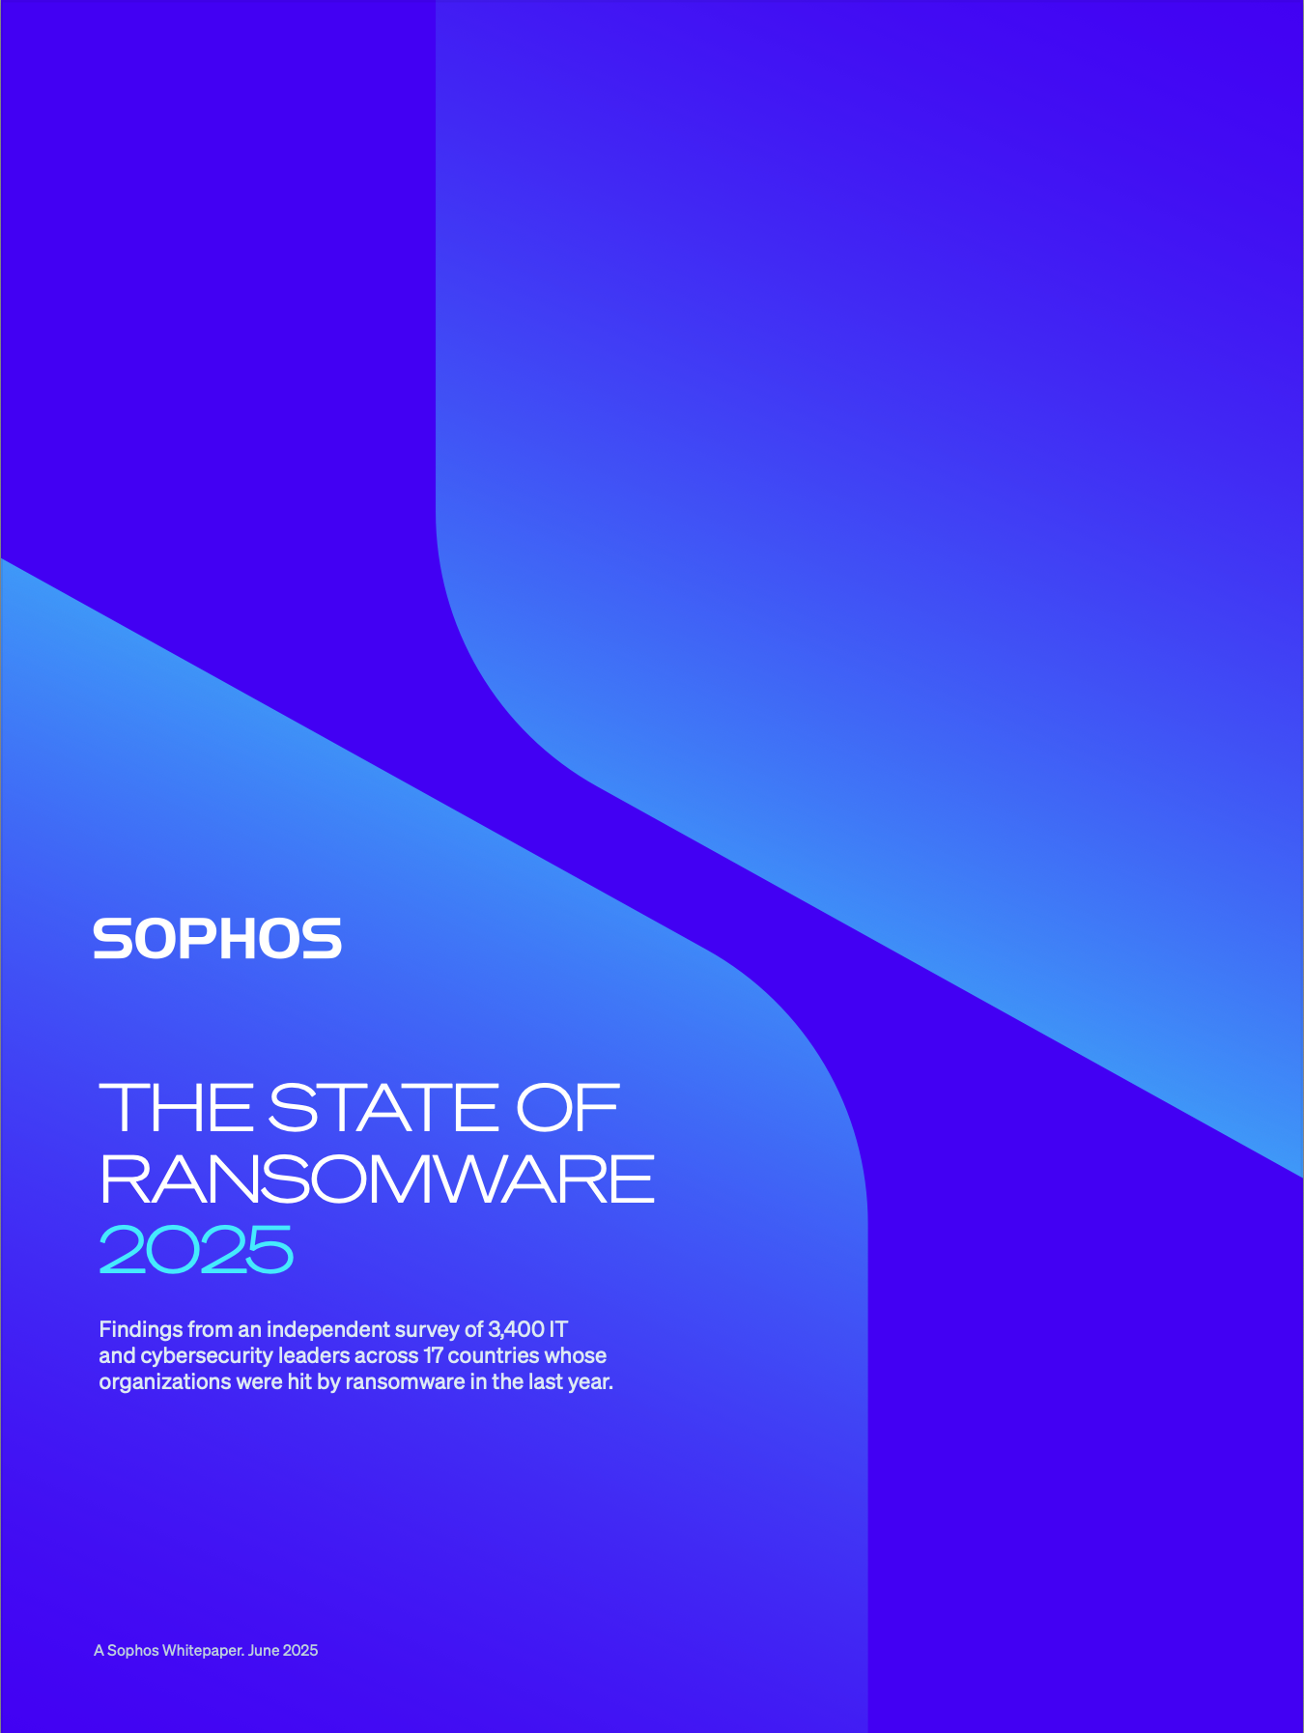
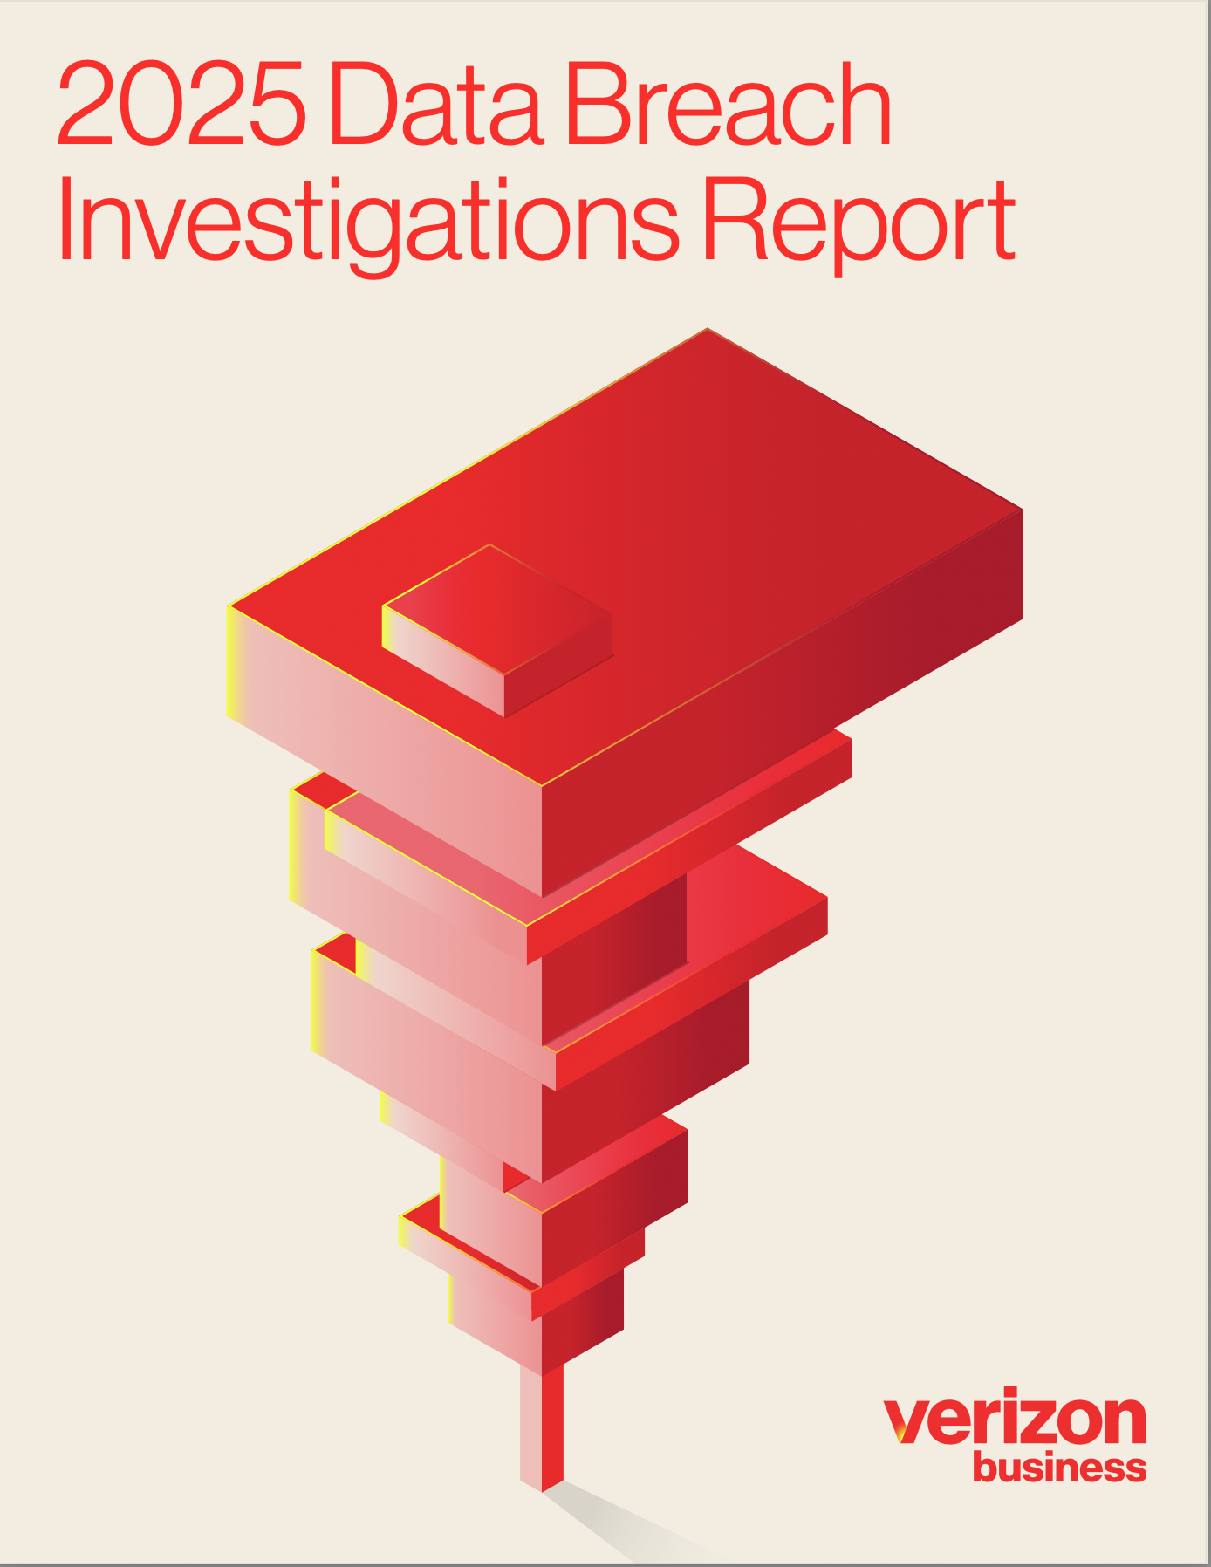
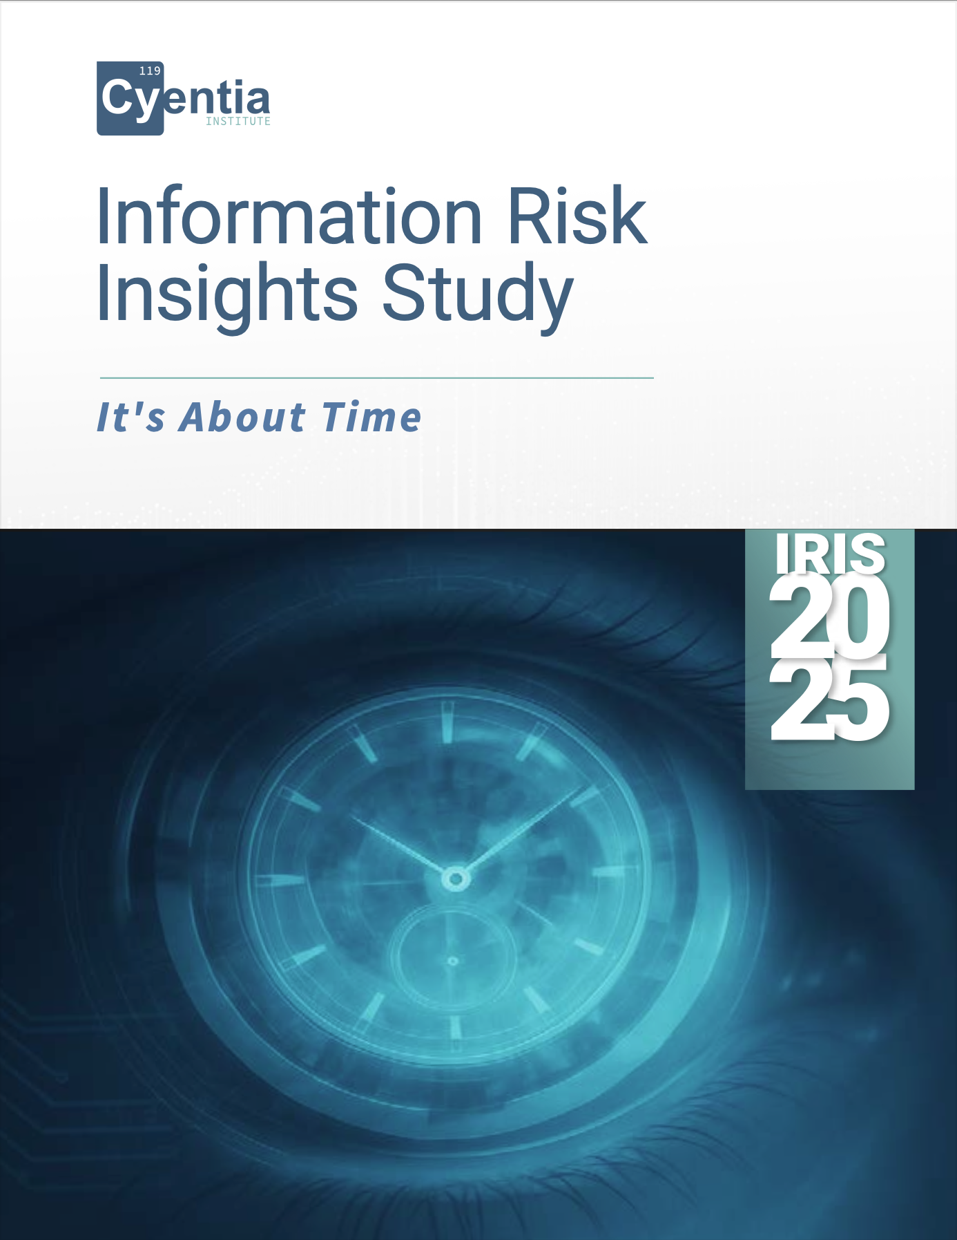
Notes:
Picture of headers of DBIR, Sophos, Coalition reports

Slide 52
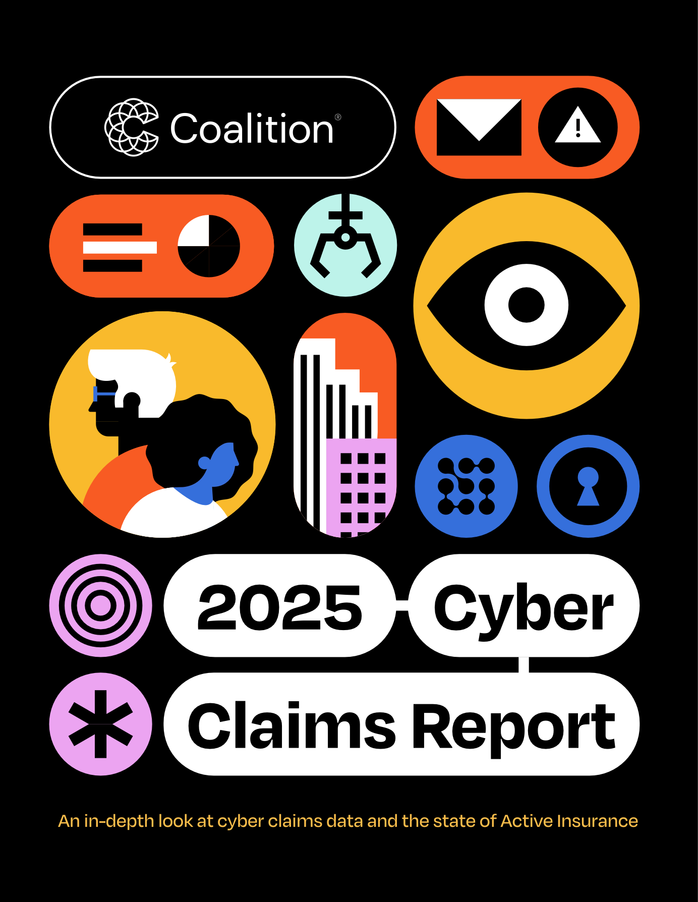
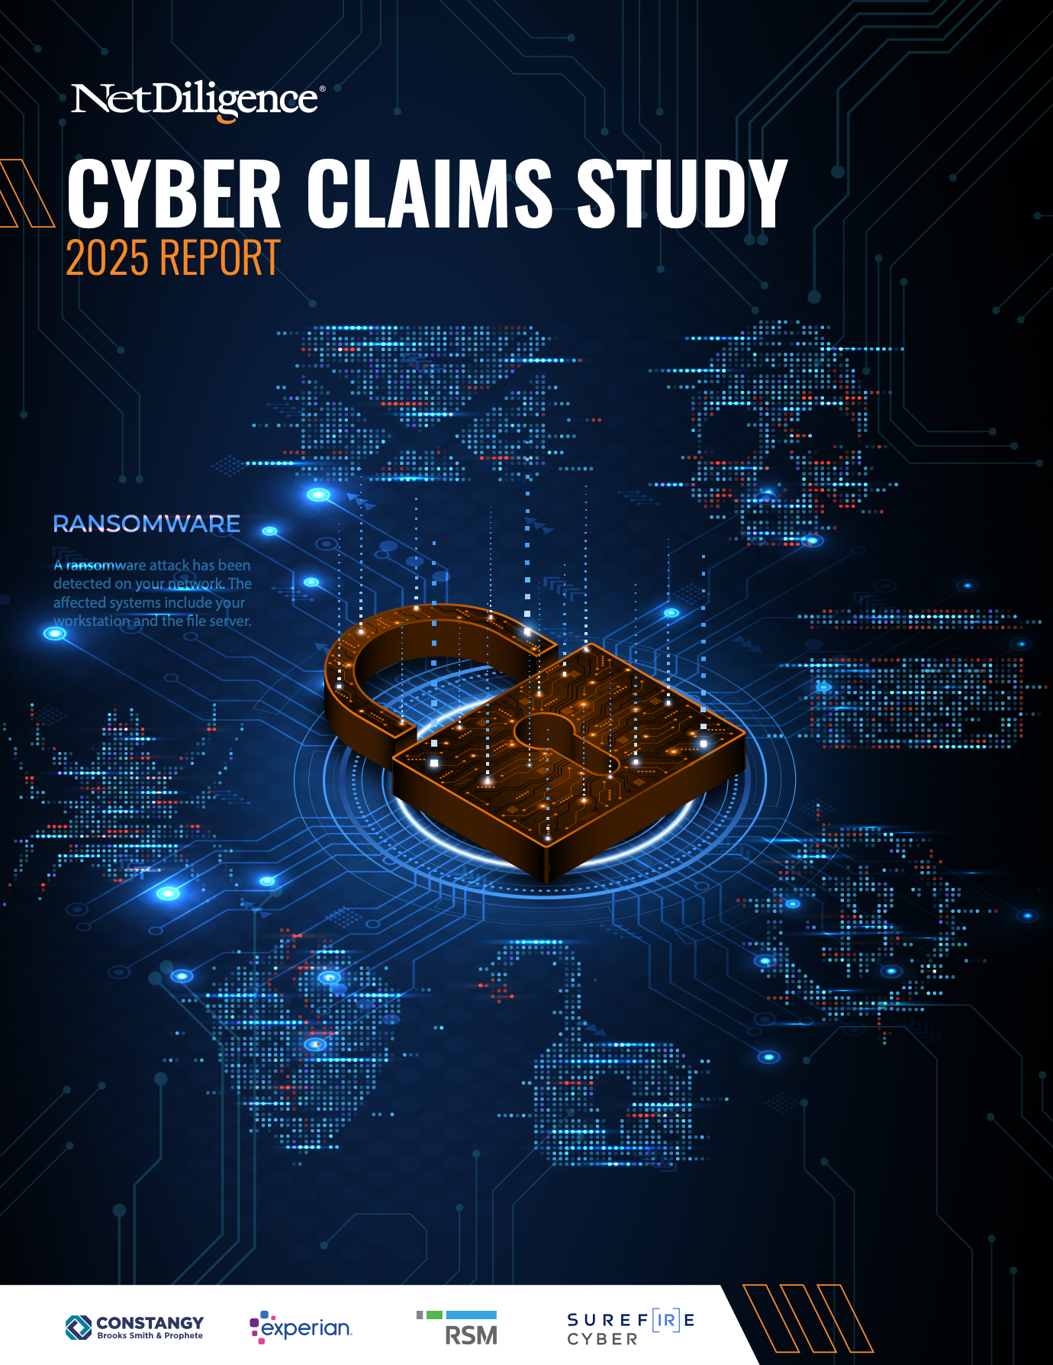

Slide 53

What the Data Says: Probability
Now let’s calibrate your probability estimate against available data:
Coalition 2025: Ransomware claims frequency = 0.31% of policyholders (industry avg ~4x higher $→$ ~1.1%)
Cyentia IRIS 2025: Overall incident probability ~9.3%; ransomware is ~30% of incidents $→$ ~3%
Verizon DBIR 2025: Ransomware in 44% of confirmed breaches; 88% among SMBs — but this is composition, not probability
Triangulating: roughly 1–5% for a mid-sized firm per year
Notes:
The 44% and 88% figures from DBIR refer to the fraction of CONFIRMED BREACHES that involve ransomware — not the fraction of all companies that get hit. The distinction matters enormously. Students who anchored on “44%” or “88%” to set their probability were using the wrong metric entirely. This is a very common mistake in cyber risk: confusing “X% of breaches involve ransomware” with “X% chance of ransomware.”
The Coalition 2025 report gives the most direct probability data: ransomware claims frequency among their policyholders is 0.31% (Figure 6.1). Coalition claims their policyholders experience 73% fewer claims than the industry average, so an industry-wide estimate might be ~1.1%. IRIS 2025 gives overall incident probability at ~9.3% (Figure 6); if ransomware is ~30% of incidents (Figure 2), that implies ~3%. Triangulating these gives a range of roughly 1–5%.
IRIS 2025 gives overall incident probability at ~9.3% (Figure 6); if ransomware is ~30% of incidents (Figure 2), that implies ~3%. Triangulating these gives a range of roughly 1–5%. Use ~3% as a reasonable classroom point estimate. Acknowledge this is rough — but it’s a number, not a color. Also note: Sophos 2025 only surveys organizations that were already hit by ransomware (n=3,400), so it cannot provide prevalence data.
Note: Sophos 2025 (State of Ransomware) only surveys organizations that were already hit by ransomware (n=3,400), so it cannot provide prevalence data. It’s useful later for impact estimation (what happens after you’re hit) but not for probability estimation.
Ask students: how did your estimate compare? If you said 20% or higher, you’re likely overconfident — possibly anchoring on the DBIR composition figures or on media salience. If you said <1%, you may be underweighting the base rate for a mid-sized firm.

Slide 54

Step 3: Score It
$$\text{Brier}=(\text{forecast}−\text{outcome})^{2}$$
After 12 months, check: did the scenario occur?
A single Brier score tells you little. Over many forecasts, your average Brier score reveals calibration: are your probabilities trustworthy?
Your forecast | Outcome | Brier score
3% | Did not occur (0) | (0.03 - 0)² = 0.0009
3% | Occurred (1) | (0.03 - 1)² = 0.9409
30% | Did not occur (0) | (0.30 - 0)² = 0.0900
Notes:
The Brier score for a single forecast is not very informative — a 3% forecast that doesn’t happen gets a great score (0.0009), but so does a 0% forecast (which would be miscalibrated). The value is in the aggregate. If you make 100 forecasts at 3%, roughly 3 should occur. If 10 occur, you’re systematically underestimating risk. If 0 occur, you may be overestimating.
This is where McGeehan’s framework connects to the calibration literature (Tetlock’s superforecasting, Hubbard’s calibration training). The goal is not to be right about any one forecast but to build a track record of well-calibrated probability estimates. Over time, this is what makes a risk program trustworthy: not that it predicted the last breach, but that its probabilities are reliable inputs to decision-making.
Practical note: in a real risk program, you’d maintain a risk register with dozens of scenarios, each with a probability forecast. Quarterly or annually, you’d score the ones whose timeframes have closed, compute average Brier scores, and identify where your team is systematically over- or under-confident. This is the “learning from incidents” process that Downer (the aviation paradox reading) argues is so difficult for cybersecurity.
At this point, the McGeehan-style forecast is complete. The next slides pivot to what we do with forecasts we’re confident in — starting to ask about cost and investment.
Reference: McGeehan, “Scoring and Calibration” section.

Slide 55
Now What?
We have a forecast:
~3% probability that a ransomware incident causes >24h downtime and public disclosure in the next 12 months.
The CISO’s next questions:
If it happens, what would it cost us?
What should we do to mitigate this risk?
Notes:
This is the pivot from forecast to risk management. The forecast itself answered a narrow question: will this event occur? That’s McGeehan’s scope. But a CISO needs to prioritize and allocate investment across many forecasts, which requires bringing in cost data and investment models.
Emphasize: each of these steps introduces new assumptions and new uncertainty. The forecast was just about event occurrence (scored by Brier against a binary outcome). Cost estimation is about dollar impact CONDITIONAL on occurrence. Expected loss multiplies two uncertain estimates. Gordon-Loeb applies a specific model with its own limitations. Be explicit about this stack of assumptions — don’t let the precision of the final dollar figure hide how much estimation has gone into it.
This is also why it matters to keep the forecast clean. If our 3% probability estimate has good calibration (we know because we score many forecasts), then we can trust it as an input to the dollar-cost conversation. If it were a gut feel, we’d be compounding unscored estimates.

Slide 56
What Would It Cost? (If It Occurs)
Don’t estimate a single cost. Estimate a range:
“I’m 90% confident that if this scenario occurs, our total direct losses will fall between $___ and $___.”
Direct losses = downtime revenue loss + forensics + legal + ransom (if paid) + notification
Write down your 90% confidence interval.
Notes:
Now that the forecast itself is done, we shift to cost estimation. McGeehan treats this as a separate activity using interval estimates (see “Intervals” page).
INTERACTIVE: Again, have students commit before showing data. Most will struggle with this — it’s cognitively harder than a point estimate. Common mistakes:
Ranges that are way too narrow (overconfidence). If your 90% CI is $200K–$400K, you’re saying there’s only a 10% chance the loss falls outside that range. Are you really that sure?
Anchoring on a single number and adding symmetric error bars. Real loss distributions are heavily right-skewed (fat tails), so the interval should be much wider on the upper end.
McGeehan’s framework calls these “interval estimates” — a range plus the probability that the outcome falls within it. The 90% CI means you’ve identified the 5th and 95th percentiles of your belief distribution. The remaining 10% covers the possibility that you’re wrong about the bounds.
Reference: McGeehan, “Intervals” section — “An interval estimate can be described as a range of values, plus the probability that an outcome will fall within them.”

Slide 57
What the Data Says: Cost
Source | What it measures | Amount
Coalition 2025 | Avg insurance claim (ransomware) | $292K
Sophos 2025 | Avg recovery cost (survey, excl. ransom) | $1.53M
Sophos 2025 | Avg recovery, 100–250 employees | $639K
Coalition 2025 | Avg business interruption loss | $102K
Coalition 2025 | Avg forensic vendor cost | $58K
DBIR 2025 | Median ransom payment (if paid) | $115K
Sophos 2025 | Median ransom payment (if paid) | $1M
A reasonable 90% CI for our scenario: $50K – $3M
Notes:
Walk through why sources differ so dramatically: - Coalition’s $292K is verified insurance claims data — what insurers actually paid out. It may undercount total impact (deductibles, uninsured losses, opportunity costs). - Sophos’s $1.53M is a survey-based self-reported estimate excluding ransom. It captures broader organizational impact but is subject to estimation error and reporting bias. For our scenario’s firm size (100–250 employees), Sophos reports $639K average recovery cost. - DBIR’s $115K median ransom payment vs. Sophos’s $1M median payment: different populations and data collection methods. DBIR aggregates from many contributors; Sophos surveys a selected panel. - 53% recover within one week (Sophos 2025 Chart 12), and only 10% take >1 month. 44–49% of victims pay the ransom (Coalition; Sophos). DBIR reports 64% don’t pay, meaning 36% do — likely a different population.
The suggested 90% CI of $50K–$3M is wide. That’s honest. The lower bound covers a quickly-contained incident (blocked before encryption, minimal downtime). The upper bound covers a multi-week outage with data exfiltration, legal costs, and regulatory exposure. A 90% CI should feel uncomfortably wide — if it doesn’t, you’re probably overconfident.
Compare to IBM’s $4.44M average: that’s a survey-based estimate across all company sizes, not verified claims data for mid-market firms.

Slide 58

So: Expected Annual Loss?
With probability $p$ and a 90% CI on cost $[L,H]$: Either
Use Monte Carlo simulation (FAIR) to estimate losses, or
Use the geometric mean for right-skewed distributions:
$$\text{Central} \text{cost}=\sqrt{L×H}=\sqrt{\$50\text{K}×\$3\text{M}}≈\$387\text{K}$$
$$\text{Annualized} \text{expected} \text{loss}=p×\text{central} \text{cost}=3\%×\$387\text{K}≈\$12\text{K}$$
Tail-weighted (95th percentile of cost): $3\%×\$3\text{M}=\$90\text{K}$ annualized
Notes:
Why geometric mean rather than arithmetic mean for the central estimate? Because loss distributions are log-normal (heavily right-skewed). The arithmetic mean of $50K and $3M is $1.525M, which is close to the upper bound — that’s not a “typical” outcome, it’s being pulled by the tail. The geometric mean ($387K) better represents the center of a log-normal distribution and is close to what we see in the insurance claims data ($292K Coalition, $603K IRIS pooled median).
Hubbard & Seiersen (Ch. 7–8) go further: if you have a 90% CI, you can fit a log-normal distribution and run a Monte Carlo simulation. For a classroom exercise, the geometric mean is a reasonable shortcut.
The annualized expected loss has a range: $12K (using the central estimate) to $90K (using the 95th percentile). This honestly represents the uncertainty that a single P × I calculation hides. A risk-neutral decision-maker uses the central estimate; a risk-averse one weights the tail more heavily. Which one your organization should be depends on its risk appetite and financial resilience.
Note: compare to BEC (Coalition: 0.44% frequency, $35K avg loss = ~$154/year annualized) or funds transfer fraud (0.44% frequency, $185K avg loss = ~$814/year annualized). BEC+FTF account for 60% of all Coalition claims but have lower per-event impact. Ransomware is less frequent but more severe — a classic fat-tail problem.
Key teaching point: this expected loss number is what goes on the risk register alongside other scenarios. A CISO doesn’t manage one risk at a time; they manage a portfolio. Expected annual loss is the currency that lets you compare ransomware against BEC against insider misuse on a common footing.

Slide 59
How Should We Mitigate the Risk?
“Risk = Likelihood * Impact” is a lie. Pick one:
  1/10,000 chance of losing $100,000 or 1/1 chance of losing $10
    … $20?
    … $100?
    … $1,000?
Risk is a distribution, not a point. Risk management is the practice of shaping that distribution
  Reducing likelihood by 10x has a different effect on the distribution than reducing impact by 10x
Cost of risk mitigation must be explicit

Slide 60
Shaping risk distribution
Starting with $1,000 …
… option to spend $100 to:
50% of losing $400
cut loss magnitude by half
cut loss probability by half
Mean final wealth is $800 in all three scenarios

Slide 61
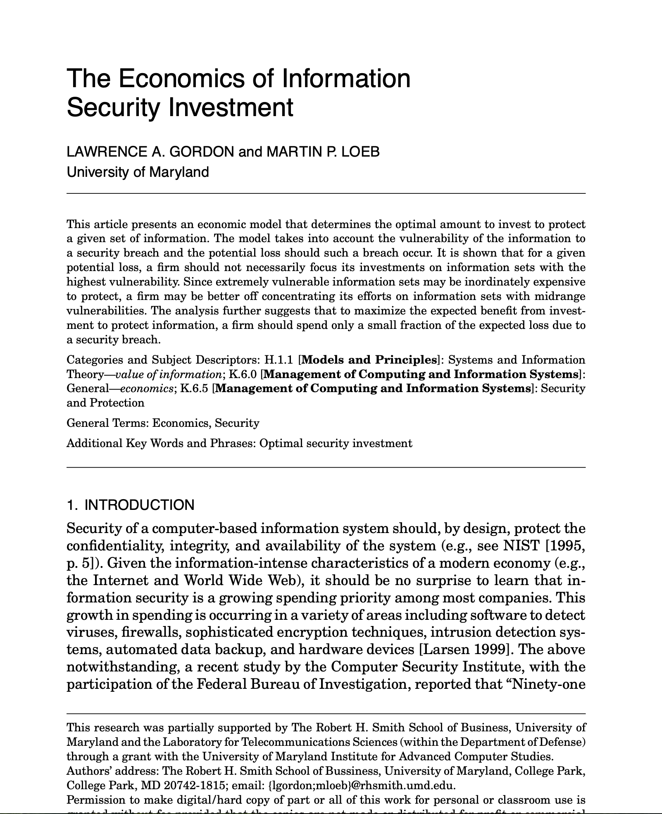

Framing the Problem: Security as Investment
Investment to reduce loss probability
Highly influential:
Cited > 2000 times
Notes:
Reference: Gordon & Loeb, “The Economics of Information Security Investment” (2002).

Slide 62
Cited Takeaway From This Paper
it's often not worth investing heavily to protect highly vulnerable information sets, because the marginal returns to reducing an already-high vulnerability diminish quickly.
The optimal investment amount z* could be well below the expected loss vL
  Theorem: If the breach probability function S(z,v) is either of class I or class II, then z∗ < (1/e) vL = .3679vL
  For class I, there are scenarios where z* < .25vL

Slide 63
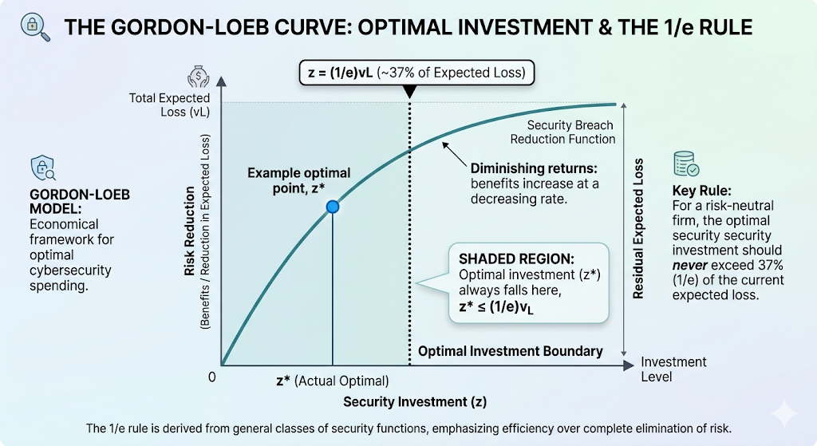
Notes:
IMAGE: (1) Screenshot the first page of papers/gordon-loeb-2002.pdf — classic, widely cited paper. (2) The placeholder Gordon-Loeb curve: draw a simple diminishing returns graph with security investment on x-axis, risk reduction on y-axis, and the optimal point at 1/e (~37%) of expected loss marked with a dotted line. This replaces the placeholder image on this slide.
Gordon & Loeb showed mathematically that the optimal investment in information security is at most 1/e (approximately 37%) of the expected loss from a breach. The intuition: spending more doesn’t always reduce risk proportionally, and at some point additional investment yields diminishing returns. This is the right framing for everything that follows in Part 3: security spending is an investment optimization problem, not a fear-driven purchasing decision. If we can estimate expected loss, we have a principled basis for how much to spend.
Limitations: single-period model, no attacker adaptation, treats vulnerabilities independently, and the “expected loss” figure is itself very hard to estimate (as Part 2 showed). But the framing is powerful: to make rational investment decisions, you need to estimate expected loss. So how do organizations actually do that?

Slide 64

The Investment Question: Defense
If we believe Gordon-Loeb: invest at most 37% of expected loss
Using the tail-weighted estimate ($90K):
$$37\%×\$90\text{K}=∼\$33\text{K}\text{/}\text{year}$$
Does that match what your company spends on:
Endpoint detection?
Backup testing?
Incident response retainer?
Are you over- or under-investing?
Notes:
$33K/year is not a lot of money — roughly one EDR license or one annual IR retainer. If your company is spending significantly more than that specifically on ransomware prevention, the model suggests you might be over-investing relative to the expected loss from this single threat. But remember: (1) controls like EDR protect against more than just ransomware, so you can’t attribute their full cost to this one scenario; (2) Gordon-Loeb is a single-period model that doesn’t account for attacker adaptation; (3) the model assumes risk-neutrality, and most organizations are (and should be) somewhat risk-averse, especially for tail events that could threaten the business.
The key insight is not the specific dollar figure but the discipline of the exercise: without numbers, there’s no way to ask “are we spending the right amount?” Even rough numbers with wide confidence intervals are better than colors on a heat map.

Slide 65
The Investment Question: Insurance?
Cyber insurance addresses the other part of risk: Reducing the impact
This affects the other part of the risk distribution
You (probably) want both
Notes:
$33K/year is not a lot of money — roughly one EDR license or one annual IR retainer. If your company is spending significantly more than that specifically on ransomware prevention, the model suggests you might be over-investing relative to the expected loss from this single threat. But remember: (1) controls like EDR protect against more than just ransomware, so you can’t attribute their full cost to this one scenario; (2) Gordon-Loeb is a single-period model that doesn’t account for attacker adaptation; (3) the model assumes risk-neutrality, and most organizations are (and should be) somewhat risk-averse, especially for tail events that could threaten the business.
The key insight is not the specific dollar figure but the discipline of the exercise: without numbers, there’s no way to ask “are we spending the right amount?” Even rough numbers with wide confidence intervals are better than colors on a heat map.

Slide 66
Whence the Data? Threat Intelligence
We just used base-rate data from DBIR, insurance claims reports (Coalition), incident probability modeling (IRIS 2025), and recovery surveys (Sophos). In practice, where does a CISO get this information?
ISACs (sector-specific sharing): ~25 sectors, e.g., FS-ISAC (financial), H-ISAC (health), REN-ISAC (higher ed — Penn is a member)
CISA: free alerts, IOC feeds, and the Known Exploited Vulnerabilities (KEV) catalog
Commercial threat intel (CrowdStrike, Mandiant, Recorded Future): $13.5B market
Notes:
This slide connects directly to the walkthrough we just did. We estimated ransomware probability using DBIR and insurance data. In a real organization, the security team would draw on threat intelligence to inform those estimates — and to update them as the landscape changes.
ISACs were created under Presidential Directive PDD-63 (1998). The National Council of ISACs coordinates ~25 of them. Members receive IOCs (indicators of compromise), alerts, vulnerability advisories, and peer collaboration forums. The value is less in any single feed and more in sector-specific context and peer relationships — knowing what’s hitting other universities right now.
REN-ISAC, housed at Indiana University, serves ~700 higher education and research institutions. Members (including Penn) receive curated threat indicator feeds for firewalls/IDS, a Daily Watch Report with education-sector situational awareness, and advisories on threats targeting universities (credential phishing, research IP theft). Notably affordable compared to commercial alternatives. Ask students: did you know Penn is part of this?
CISA’s Known Exploited Vulnerabilities (KEV) catalog is arguably its most impactful tool: it lists CVEs with confirmed in-the-wild exploitation, mandating federal remediation timelines. This gives any organization an evidence-based vulnerability prioritization input. A DHS OIG report found CISA’s broader AIS program underperforming on participation — quantity of shared data doesn’t equal quality.
Commercial threat intel is a $13.5B market (projected ~$37B by 2030). Vendors like CrowdStrike and Mandiant provide deeper, proprietary intelligence — adversary profiling, incident-response-derived TTPs, predictive analytics. Cost: six-to-seven figures annually.
IMAGE: Consider a diagram showing the threat intelligence ecosystem: CISA at center (free, government), ISACs in a ring (sector-specific, membership), commercial vendors in the outer ring (proprietary, expensive). Or show a screenshot of the CISA KEV catalog webpage.

Slide 67
The Threat Intel Gap
But most shared threat intelligence is tactical:
IOCs, signatures, patches — “what to defend against”
What the forecasting exercise needed was strategic:
Likelihood estimates, loss modeling — “how much to spend”
We had to go to insurance claims data and academic studies for that.
The CISA KEV catalog is a rare bridge: evidence-based vulnerability prioritization
Notes:
This is a key teaching point. The forecasting exercise we just did required probability estimates and cost data. Most threat intel feeds don’t provide that — they provide tactical information: here’s a new malware hash, here’s an IP to block, here’s a CVE to patch. Valuable for day-to-day defense, but doesn’t answer: what’s our probability of a ransomware event this year?
Translating tactical feeds into probability estimates is exactly the forecasting exercise we did — and few organizations do it systematically. The KEV catalog comes closest to bridging this gap: if a CVE is on the KEV list, the probability of exploitation is no longer speculative. But for the kind of strategic risk quantification we walked through, you need insurance claims data (Coalition, NetDiligence), incident probability modeling (Cyentia IRIS), recovery cost surveys (Sophos), breach composition data (DBIR), and academic research (Romanosky) — none of which come from traditional threat intel channels.
This is one more reason the forecasting approach is hard in practice: the data you need for strategic risk estimation and the data you get from threat intel are largely different things.

Slide 68
Why This Is Hard
Nobody wants to commit to numbers — executives push back on probabilities
Teams argue about estimates — but that’s the point! It surfaces hidden disagreements
Risk registers become compliance artifacts — quantitative models used to justify decisions already made
Notes:
The organizational friction is real. McGeehan writes honestly about the political challenges: getting executives to commit to numbers, handling disagreement about estimates, the discomfort of explicit prioritization. But the argument itself is valuable — a team that argues about whether ransomware probability is 5% or 15% is having a better conversation than a team that agrees it’s “High.” CISOs report that real risk management is mostly organizational politics, prioritization under uncertainty, and communication — not models. The gap between theoretical frameworks and operational reality is where most security failures live.

Slide 69
Part 4: Communicating Risk

Slide 70
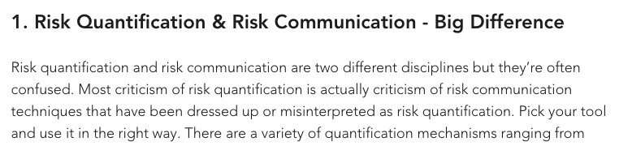
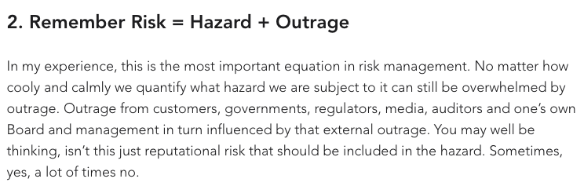
Notes:
Phil Venables (Google Cloud CISO) on “6 Truths of Cyber Risk Quantification” 2024
Douglas Hubbard for the first book

Slide 71

What CISOs Present to Boards
Surveyed Fortune 1000 CISOs on their actual board updates
All include:
Changes to the risk landscape
Maturity scores
Security initiatives progress
Significant incidents
Notes:
IMAGE: Consider showing two additional ESAF diagrams here or on subsequent slides: (1) ESAF-report.pdf page 17, “Appendix I: Examples of Tables of Contents for Board Updates” — shows 8 real board update outlines side by side, illustrating the range of what these presentations look like. (2) ESAF-report.pdf page 19, “Cyber Risk Management: Top 5 Risks and Countermeasures” — shows how CISOs actually present risk lists to boards (risk name, trend arrow, countermeasure effectiveness). Both are powerful real-world artifacts.
The RSAC Executive Security Action Forum surveyed eight CISOs from seven different industries, collecting actual board presentation materials. This is rare — board presentations are normally confidential. The report reveals what CISOs actually communicate. Key quote from Jerry Geisler (SVP/CISO, Walmart): “Where CISOs can lose credibility is to go in with an overly positive report. If you only show them a rose garden, you are going to leave them wondering if it’s really that good.”

Slide 72
Why They Present This Way: Hazard + Outrage
Boards respond to outrage, not expected value
A $300K ransomware incident that makes the news is “worse” than a $3M BEC loss nobody hears about
Notes:
IMAGE: Simple 2x2 diagram showing Hazard (low/high) vs. Outrage (low/high), with examples in each quadrant
IMAGE: The placeholder 2x2 Hazard+Outrage diagram. Four quadrants with cybersecurity examples: (1) High Hazard / Low Outrage: BEC — large aggregate losses, no headlines; (2) High Hazard / High Outrage: major ransomware attack on hospital — costly and terrifying; (3) Low Hazard / High Outrage: minor data breach that hits the front page — small actual loss, huge reputational damage; (4) Low Hazard / Low Outrage: routine phishing attempts — low cost, nobody notices. This replaces the placeholder image on this slide.
Venables, “Risk = Hazard + Outrage” (2021), draws on Peter Sandman’s risk communication framework. The insight: perceived risk = hazard (actual expected damage) + outrage (fear, unfamiliarity, dread, media attention). This explains why CISOs present narratives and risk landscapes rather than probability distributions: boards respond to stories and headlines, not expected values. A ransomware attack that makes the Wall Street Journal is “worse” politically than a larger BEC loss that stays quiet. This is also Grigg’s point: the market for silver bullets exists because reputation/signaling matters more than actual risk reduction. A CISO who buys a flashy AI-powered security tool gets credit; a CISO who improves backup testing does not.

Slide 73
What CISOs Don’t Present: Dollar Estimates
“The board updates in our sample did not present cyber risks quantified in financial terms”
— RSAC ESAF Report, p. 9
But wait — is the board presentation the whole story?
Notes:
At first glance this seems damning: Fortune 1000 CISOs don’t present quantified risk to boards. But we need to be careful about what this means. The next slide teases apart the nuance.

Slide 74
The Nuance: Communication vs. Analysis
Some organizations do quantitative work internally:
“Security teams use risk scoring systems internally to prioritize their efforts but do not find it useful to share those numbers with the board” (p. 8)
CISOs “do a detailed assessment each year on a severe-but-plausible risk scenario and quantify the financial losses… primarily for insurance purposes” (p. 9)
But many haven’t built the capability at all:
“Most CISOs who have evaluated building a capability to quantify cyber risk in dollar values found that the resources required would be prohibitive” (p. 9)
Notes:
This is the crucial distinction. There are two very different situations here:
Best case: the org does rigorous internal analysis (risk scoring, scenario quantification for insurance) and simplifies for board communication. The board gets heatmaps and narratives because that’s what boards can act on — but there’s real analysis underneath. This is defensible. Boards are not security experts; translating technical risk into business language is part of the CISO’s job. Quote from Catherine McCully (CISO, Procter & Gamble): “Think about how to translate it into layman’s terms. Will someone without cybersecurity expertise understand this?”
Worst case: the heatmap IS the analysis. There’s nothing quantitative underneath. The organization uses OWASP-style risk matrices internally, presents a simplified version to the board, and nobody at any level has estimated actual probabilities or dollar losses. The ESAF report suggests many organizations are in this camp — “most CISOs” found building actuarial capability “prohibitive.”
Quote from Chris Betz (CISO, Capital One): “Boards look at cyber risk in the context of the company’s overall culture. The cyber risk conversation depends on what the company values. If the company is driven by cost optimization, it’s about return on investment.” — Note the implication: the framing is driven by board culture, not by the underlying risk analysis.

Slide 75
What Boards Actually Want to Know
Is the risk landscape being monitored?
Are risks being analyzed and prioritized?
Is risk appetite being factored in?
Is the CISO providing adequate oversight?
The board’s primary concern: legal defensibility
“Board members need to be able to show that they were adequately overseeing cyber risk management”
Notes:
The ESAF report’s “Legal Defensibility” section (p. 7) is revealing: a primary driver of board engagement with cybersecurity is the threat of legal action against board members if an incident occurs. They need to demonstrate they were providing oversight. This means the board update is partly a legal artifact, not just a risk management tool. Quote from JR Williamson (SVP/CISO, Leidos): “When you talk about threats, what the board really wants to know is how prepared the company to deal with them — readiness, resiliency, and business continuity. Otherwise, you’re just admiring the problem.” Quote from Justin Acquaro (CISO, Evernorth): “Risk statements should be in terms of business impact. If you state the risk as ‘script injection,’ that means nothing to a board member. But if you say, ‘Our systems would be inoperable because of a cyber attack,’ that makes sense.”

Slide 76

Maturity Scores: Measuring Process, Not Outcomes
CISOs report maturity scores based on NIST CSF, ISO 27001, etc.
Limitation (from the CISOs themselves):
“Assessments using NIST CSF often don’t measure the efficacy of controls but rather assess if the controls are in place”
Having MFA deployed $≠$ MFA effectively controlling access
Notes:
The ESAF report (p. 11) captures this limitation. Maturity scores measure whether controls exist and whether processes are followed — not whether the controls actually reduce risk. This is exactly the compliance-vs-security tension: you can score well on a maturity assessment while being highly vulnerable. It’s the security equivalent of measuring whether a student attended class rather than whether they learned anything.
Some CISOs try to address this by incorporating quantitative results (pen test results, threat modeling outcomes) into their scoring. But the report notes this creates comparability problems — companies using customized methods can’t benchmark against peers.

Slide 77
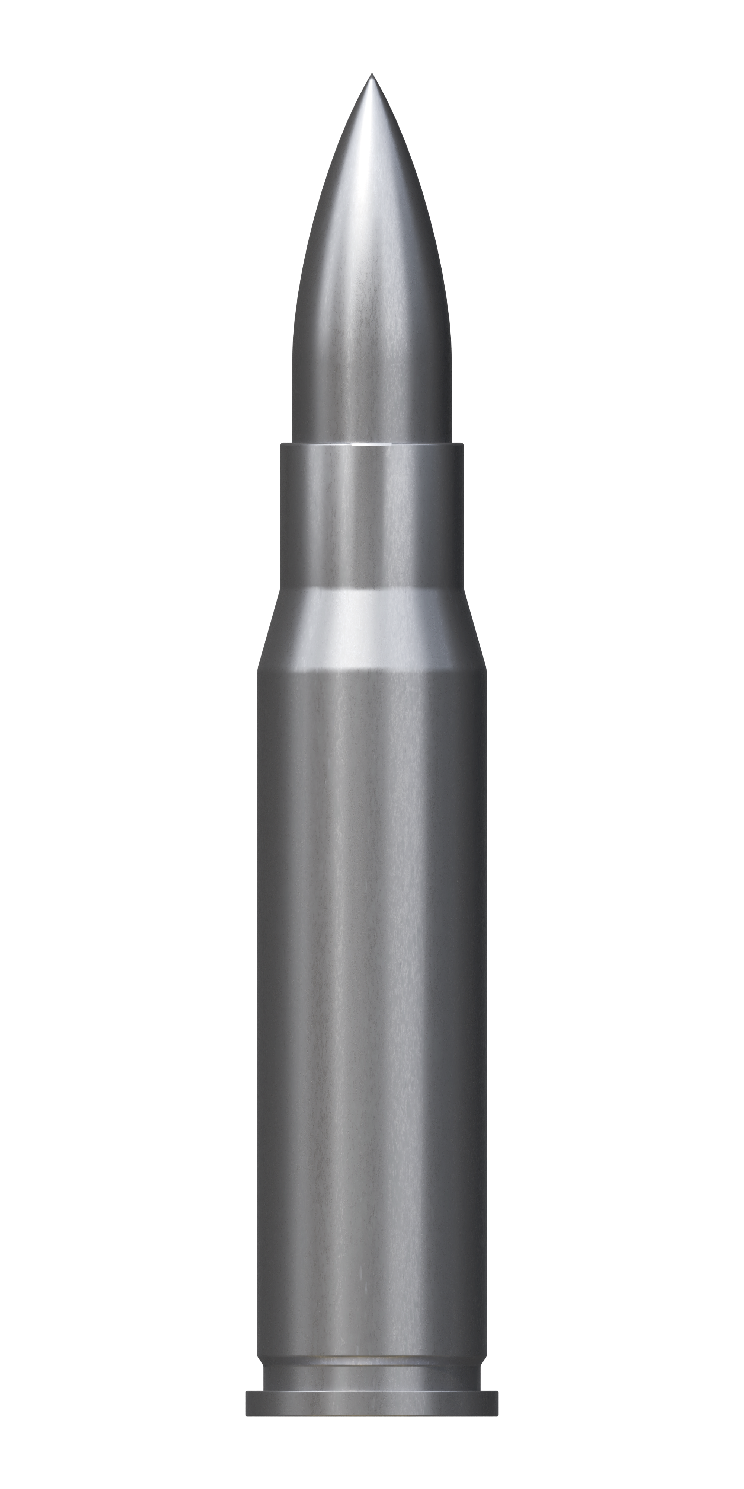
The Silver Bullets Connection
What boards see | What it measures | The worry
Risk heatmaps | Cox: broken by construction | Is there real analysis underneath?
Maturity scores | Process, not outcomes | Or is the heatmap all there is?
Compliance status | Checkbox, not efficacy
Security initiatives | Activity, not risk reduction
Simplifying for boards is fine — if there’s rigorous analysis underneath
Grigg’s silver bullets: the danger is when signaling replaces analysis, not just simplifies it
Notes:
This is the payoff slide connecting the ESAF findings back to Grigg’s “Market for Silver Bullets.” The parallel: just as the security market rewards products that signal security rather than deliver it, the CISO-board relationship rewards presentations that signal oversight rather than quantify risk.
The critical question is: what’s underneath the board presentation? If a CISO presents a heatmap to the board but has a calibrated risk register internally with P and $ columns, that’s fine — they’re translating for their audience. If the heatmap IS the deepest analysis the org does, that’s the silver bullets problem: the appearance of risk management substituting for actual risk management.
The ESAF report suggests both patterns exist, but the “prohibitive” finding on actuarial capability suggests many orgs are in the second camp. This isn’t because CISOs are incompetent — the ESAF participants are among the most sophisticated security leaders in the world. It’s because the institutional incentives (legal defensibility, board expectations, the difficulty of quantification) push toward signaling over substance. The question for students: is this inevitable, or could the forecasting approach from Part 3 bring quantitative rigor to more organizations at lower cost than full actuarial capability?

Slide 78
Discussion
Given everything we’ve discussed:
The data problems
The practitioner reality (social, not technical)
The competing pressures (compliance, signaling, cost)
The missing institutional infrastructure
Is quantitative cyber risk assessment genuinely achievable, or is it another “silver bullet”?
Notes:
Open discussion. Possible angles: - Is imperfect quantification still better than qualitative approaches? (Meehl’s answer: usually yes) - Does the ESAF report suggest CISOs have given up on quantification, or that they’ve made a rational choice given the constraints? - What would it take to build the institutional infrastructure for cybersecurity that aviation has? - Could insurance data (which insurers have a financial incentive to get right) become the actuarial foundation that the field lacks? - Is the forecasting approach (McGeehan/Hubbard) practical for most organizations, or only for well-resourced security teams?

Slide 79
Three Mechanisms, Three Limitations
Mechanism | Promise | Limitation
Risk models | Rational investment | Data problems, no stable physics
Regulation | Minimum standards | Compliance ≠ security
Insurance | Markets price risk | Same data limitations
Next lecture: Regulation and Compliance — do mandates help?
Guest lecture (Apr 23): Cyber Insurance — can markets price what regulators can’t measure?
Notes:
This is the arc of the three-lecture sequence. Today we’ve seen the limits of risk-based investment. Next lecture covers regulation and compliance — another attempt to compensate for the same underlying problems. The guest lecture on cyber insurance examines whether markets can do better. The overarching theme: cybersecurity lacks the institutional infrastructure (data collection, non-punitive reporting, systematic learning) that makes risk management work in other domains. All three mechanisms — risk models, regulation, and insurance — are imperfect attempts to fill that gap.

Slide 80
Readings for This Lecture
Required:
Downer, “The Aviation Paradox,” Minerva 2017
Romanosky, “Examining the Costs and Causes of Cyber Incidents,” J. Cybersecurity 2016
Optional:
Hubbard & Seiersen, How to Measure Anything in Cybersecurity Risk, 2nd ed. 2023 (esp. Chapters 5, 6, 9, 12)
Cox, “What’s Wrong with Risk Matrices?”, Risk Analysis 2008
Cyentia Institute, IRIS 2025: It’s About Time (papers/IRIS-2025.pdf)
Knake, Shostack & Wheeler, “Learning from Cyber Incidents,” Belfer Center 2021
Notes:
Downer is the primary reading — it’s accessible, well-written, and directly applicable. Students should come to the next lecture having read it. Romanosky provides the empirical grounding for the “rational underinvestment” argument. The optional readings are for students who want to go deeper: Hubbard & Seiersen is the best book on the quantitative approach; Cox is the mathematical foundation for the risk matrix critique; the IRIS 2025 report is the most comprehensive public analysis of cyber loss trends over time (150K+ incidents, 2008–2024); and the Belfer Center report explores the institutional learning question.

Slide 81
All References
Risk quantification:
Woods & Böhme, “SoK: Quantifying Cyber Risk,” IEEE S&P 2021
Woods, “Reviewing Estimates of Cybercrime Victimisation,” 2022
Gordon & Loeb, “Economics of Information Security Investment,” 2002
Grove & Meehl, “Comparative Efficiency of Prediction Procedures,” 1996
Cox, “What’s Wrong with Risk Matrices?”, 2008
Frameworks & practice:
NIST CSF 2.0 (2024)
OWASP Risk Rating Methodology
McGeehan, Simple Risk Measurement (magoo.github.io/risk-measurement)
Venables, “6 Truths of Cyber Risk Quantification,” 2024
Venables, “Risk = Hazard + Outrage,” 2021
Loss data:
FBI IC3 Annual Report 2024
NetDiligence Cyber Claims Study 2025
Coalition 2025 Cyber Claims Report
Cyentia IRIS 2025: It’s About Time
Verizon DBIR 2025
Romanosky, “Costs and Causes of Cyber Incidents,” 2016
IBM/Ponemon Cost of a Data Breach 2025
Safety & institutional learning:
Downer, “The Aviation Paradox,” 2017
Knake, Shostack & Wheeler, “Learning from Cyber Incidents,” 2021
RSAC ESAF, “What Top CISOs Include in Updates for the Board,” 2022
Hubbard & Seiersen, How to Measure Anything in Cybersecurity Risk, 2nd ed. 2023
Notes:
Full reference list for students who want to follow up on any topic covered in the lecture. All URLs are in the lecture outline document.

