Slide 1


Secure Systems Engineering and Management
A Data-driven Approach
Michael Hicks
How GenAI Reshapes the Cybersecurity Landscape
UPenn CIS 7000-003
Spring 2026

Slide 2
GenAI is a general-purpose capability amplifier
for both attack and (hopefully) defense
Notes:
In this lecture we ask “how do LLMs change the cybersecurity landscape?” For each topic from earlier in the course, we ask: what changes when LLMs enter the picture? The organizing lens is economic – GenAI shifts cost curves, and that changes who can execute attacks, at what cost, and at what scale.

Slide 3

Amplifying Attacks

Slide 4
A financially motivated attacker, today:
What platform should I target when developing a RCE exploit?
Answer #1: A highly used platform. The RCE is hard to develop, but I do it I can monetize it via ransomware on lots of users.
Answer #2: Many barely used platforms. The RCEs are easy to develop, which makes up them having fewer users.
Can I boost expected value by targeting attacks, e.g., not just doing generic ransomware?
Each user surely has things they are willing to pay more for!
In practice, it’s always answer #1 and ‘no’: even easy-to-develop RCEs have a high cost, and targeting attacks makes that cost higher.

Slide 5
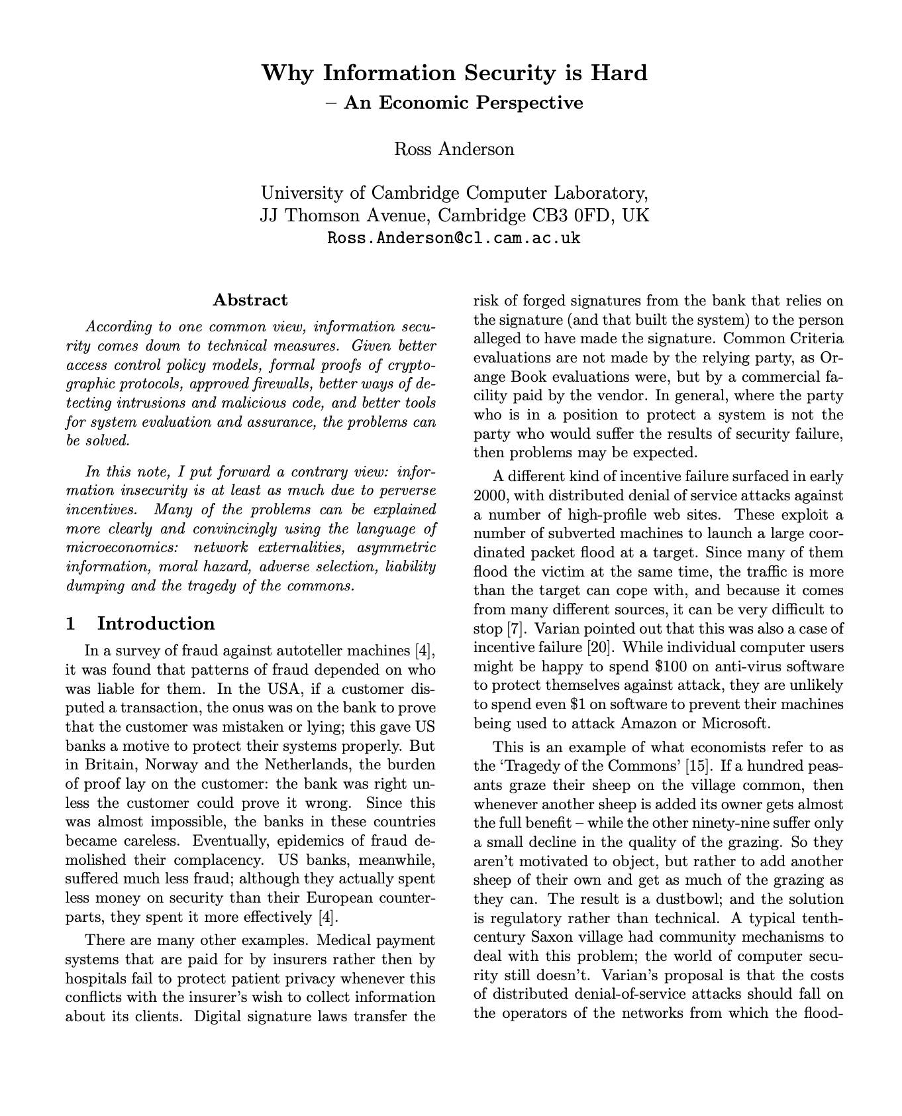
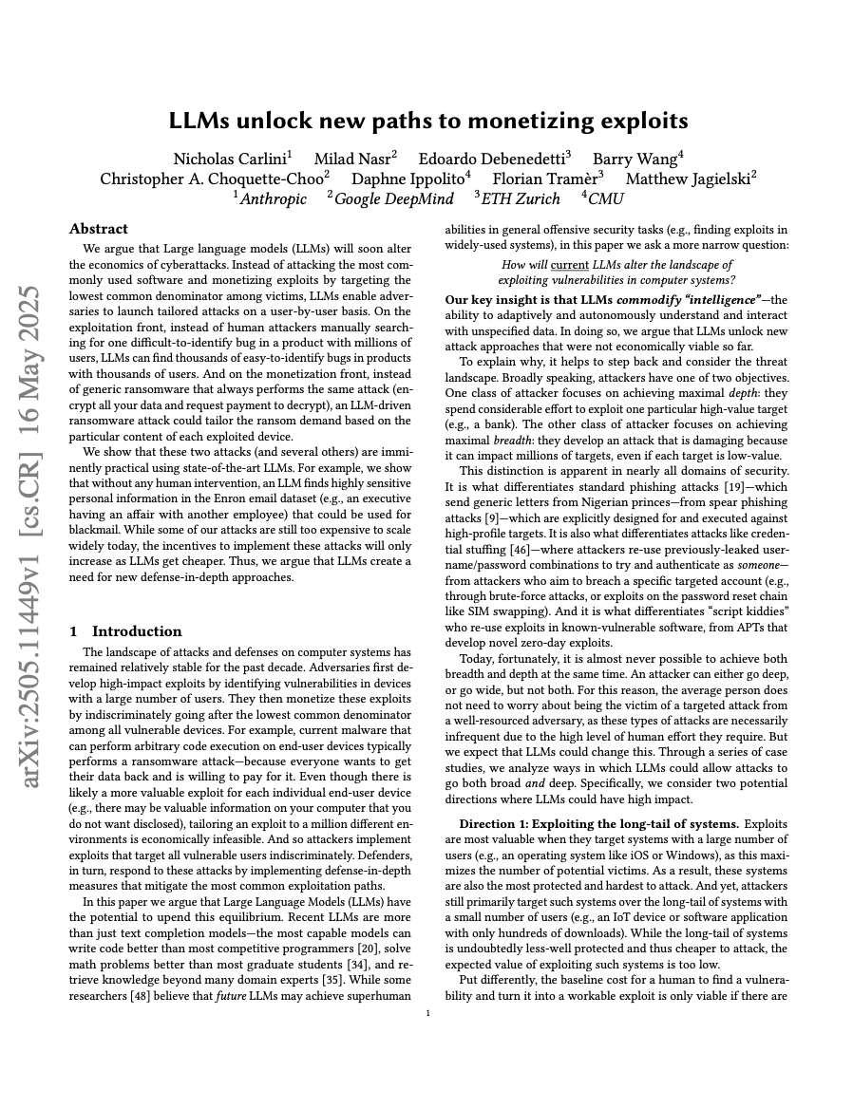
GenAI changes the incentives
LLMs commodify intelligence. This changes:
Who can execute attacks
At what cost
At what scale
LLMs are reshaping the economics of security
Notes:
This is the key framing. LLMs don’t create fundamentally new attack types – phishing, vulnerability exploitation, social engineering all predate LLMs. What changes is the economics: who can afford to execute these attacks, how cheaply, and against how many targets simultaneously. This economic lens, combined with data from CVE-Bench and other benchmarks, lets us make concrete rather than speculative claims.
Everything in this lecture is an application of this economic model. If you understand this section, you have the framework for analyzing any new LLM capability claim.

Slide 6

Recall: Security Economics
Attacks occur when expected profit exceeds cost
$$\text{value}=(\text{profit} \text{per} \text{exploit})×(\text{\#}\text{impacted})−(\text{cost} \text{to} \text{find}\text{ \&} \text{exploit})$$
LLMs apply pressure on all three levers
Notes:
This connects directly to the economics lecture earlier in the course (Anderson 2001). The Carlini et al. model is a simple but powerful framework for understanding how LLMs change the attack landscape.
Carlini, N., et al. “LLMs unlock new paths to monetizing exploits.” arXiv:2505.11449, 2025.
Let’s walk through each lever and how LLMs affect it. The key insight is that LLMs don’t just reduce cost – they affect all three terms in the value equation.

Slide 7

Lever 1: Profit Per Exploit
LLMs enable personalized monetization rather than one-size-fits-all
Generic ransomware ⇒ targeted blackmail
Notes:
Historically, mass attacks used generic monetization (ransomware with a fixed demand). LLMs enable personalized monetization: analyzing a victim’s data to craft targeted blackmail, identifying the most valuable information to steal, or customizing social engineering to maximize the chance of success. This increases the profit per successful exploit.

Slide 8
Lever 2: Number of Targets
LLMs reduce marginal per-target cost
Previously uneconomical targets come into range
LLM use
Notes:
When each target requires significant manual effort (crafting a custom phishing email, understanding a specific codebase), attackers must focus on high-value targets. LLMs reduce the marginal cost of targeting additional victims, bringing previously uneconomical targets (small businesses, individuals, niche software) into the attacker’s range.

Slide 9

Lever 3: Resources to Find and Exploit
LLMs automate the “intelligence work” that required skilled human time
Reconnaissance
Vulnerability analysis
Exploit development
Social engineering crafting
Notes:
This is the most direct effect. The skilled human time required for reconnaissance, vulnerability analysis, exploit development, and social engineering crafting is the primary cost constraint for most attacks. LLMs automate or significantly accelerate all of these, reducing the cost per attack and the skill barrier for entry.

Slide 10
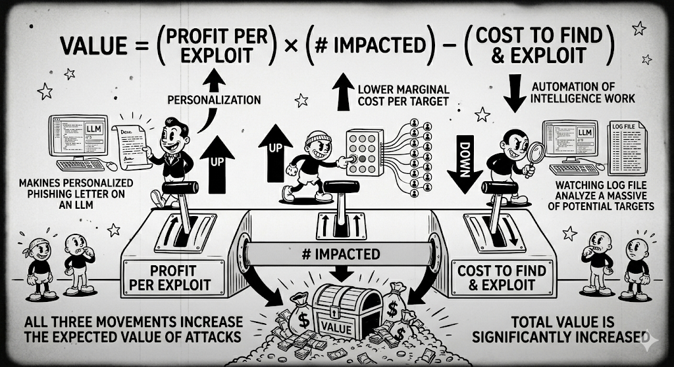


Profit per exploit UP, number of targets UP, cost DOWN
Notes:
Show the value equation with arrows: profit per exploit has an up arrow (personalization), number impacted has an up arrow (lower marginal cost per target), cost has a down arrow (automation of intelligence work). All three movements increase the expected value of attacks. This is why LLMs are such a significant shift – they don’t just affect one variable.

Slide 11
The Breadth vs. Depth Trade-Off
Historically, attackers chose:
Wide: generic attacks, many targets (script kiddies)
Deep: tailored attacks, high-value single target (APTs)
LLMs may collapse this choice
Notes:
The script kiddie vs. APT distinction is familiar: unsophisticated attackers go wide with generic tools, while advanced persistent threats invest deeply in specific targets. LLMs blur this line for financially motivated criminals. An attacker can now run personalized, sophisticated attacks against many targets simultaneously – something that previously required either a large team or accepting generic quality.

Slide 12
Example: One-upping Ransomware
Traditional ransomware has a distinctive forensic footprint:
Mass disk writes
Ransom note
Encrypted files
Detectable via file-system monitoring
Notes:
Before discussing LLM-powered incidents, it’s important to understand what current IR playbooks are tuned for. Ransomware is the dominant incident type, and it has a very distinctive forensic signature that detection systems are built to find.

Slide 13
LLM-Powered Intelligent Exfiltration
The LLM runs on the attacker’s infrastructure
A lightweight agent on the victim device just reads and sends files
Ransomware | Intelligent Exfiltration
Files are modified/encrypted | Files are read, not modified
Large disk write footprint | No disk writes
Bulk data theft | Selective (only what’s valuable)
Victim knows immediately | Victim may not know until blackmail demand
Notes:
Carlini et al. describe a new attack pattern: the LLM doesn’t run on the victim’s device. Instead, a lightweight exfiltration agent sends data to the attacker’s infrastructure, where an LLM processes it. The victim device hosts nothing unusual – just an agent that reads and sends files. This is fundamentally different from ransomware.
This comparison highlights why existing IR playbooks may miss LLM-powered exfiltration. Backup strategies don’t restore the privacy harm (nothing was destroyed). File-write monitoring doesn’t fire (files are only read). The network footprint is smaller because exfiltration is selective. And the victim may not know anything was taken until a blackmail demand arrives – potentially weeks or months later.
IR playbooks, detection signatures, and recovery strategies tuned to ransomware patterns may miss this class of attack entirely.

Slide 14
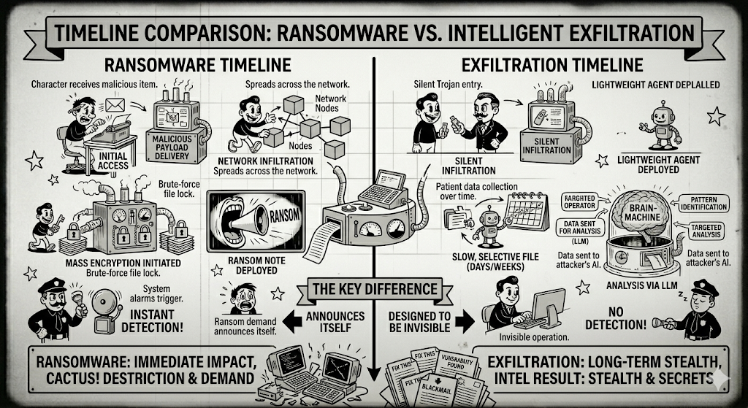
Ransomware: noisy, detectable, immediate impact
Exfiltration: quiet, selective, delayed impact
Notes:
Show two timelines side by side.
Ransomware timeline: initial access -> lateral movement -> mass encryption -> ransom note -> detection.
Exfiltration timeline: initial access -> lightweight agent installed -> selective file reading over days/weeks -> data sent to attacker’s LLM for analysis -> no detection until blackmail demand.
The key difference: ransomware announces itself; intelligent exfiltration is designed to be invisible.

Slide 15
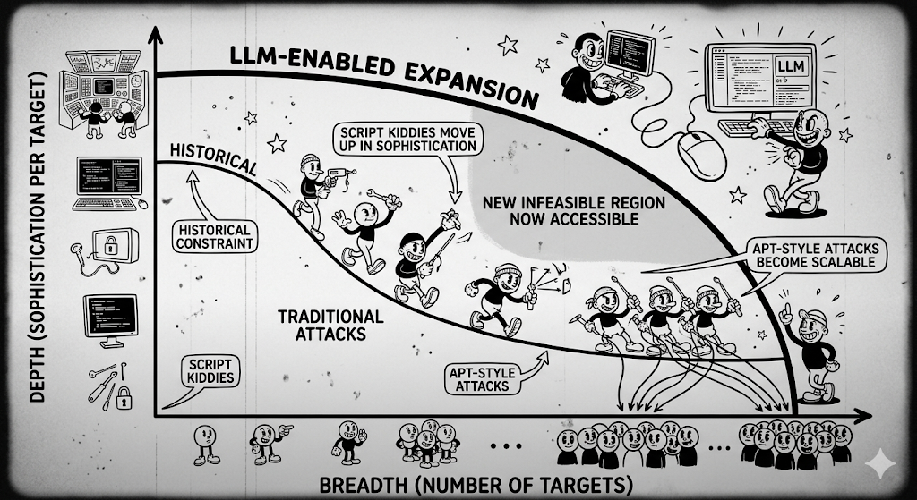
The Effect of LLMs
Notes:
Show a graph with “Number of targets” on the x-axis and “Sophistication per target” on the y-axis. The historical constraint is a curve showing the tradeoff – you can have one or the other. LLMs shift this frontier outward, enabling attackers to operate in the previously infeasible region of high breadth AND high depth. Script kiddies move up in sophistication; APT-style attacks become scalable.

Slide 16
Exploiting Humans: Social Engineering
Notes:
Social engineering is where LLMs have perhaps the most intuitive impact. We’ll trace the evolution from manually crafted phishing to LLM-powered personalized attacks.

Slide 17
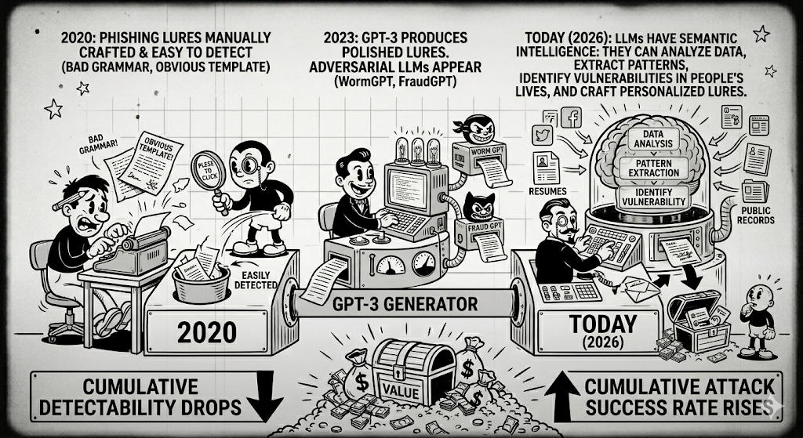
Notes:
In 2020, phishing was still largely a manual or semi-automated process. Attackers used templates with obvious tells: grammatical errors, generic greetings (“Dear Customer”), and reused text that signature-based detection could catch. Training programs (recall the Ho et al. reading on phishing training efficacy) taught users to spot these signals.
By 2023, LLMs could generate grammatically correct, contextually coherent phishing emails at near-zero marginal cost. More concerning, purpose-built adversarial LLMs appeared on the black market – WormGPT and FraudGPT were specifically trained or prompted for malicious purposes, without the safety guardrails of mainstream models. The grammar-based detection signals that phishing training relied on became unreliable.
The current generation of LLMs goes beyond just writing grammatically correct text. They can analyze data, extract patterns, identify vulnerabilities in people’s lives, and craft personalized approaches. This is qualitatively different from generating better-looking phishing templates.

Slide 18

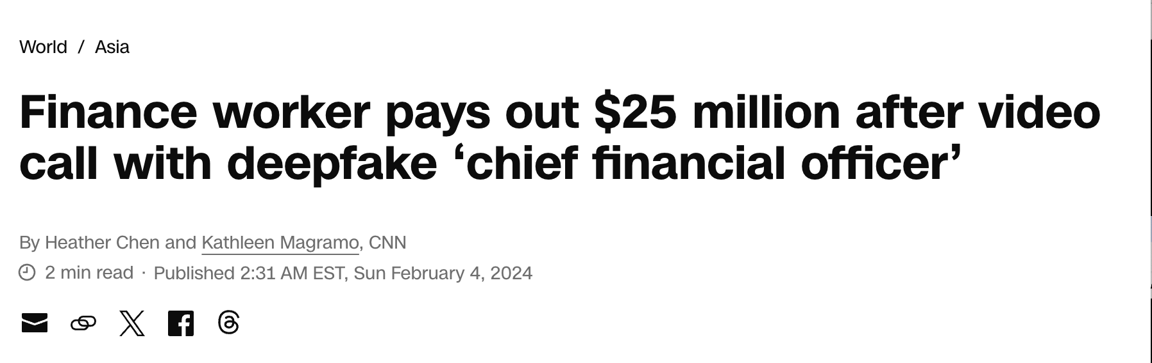
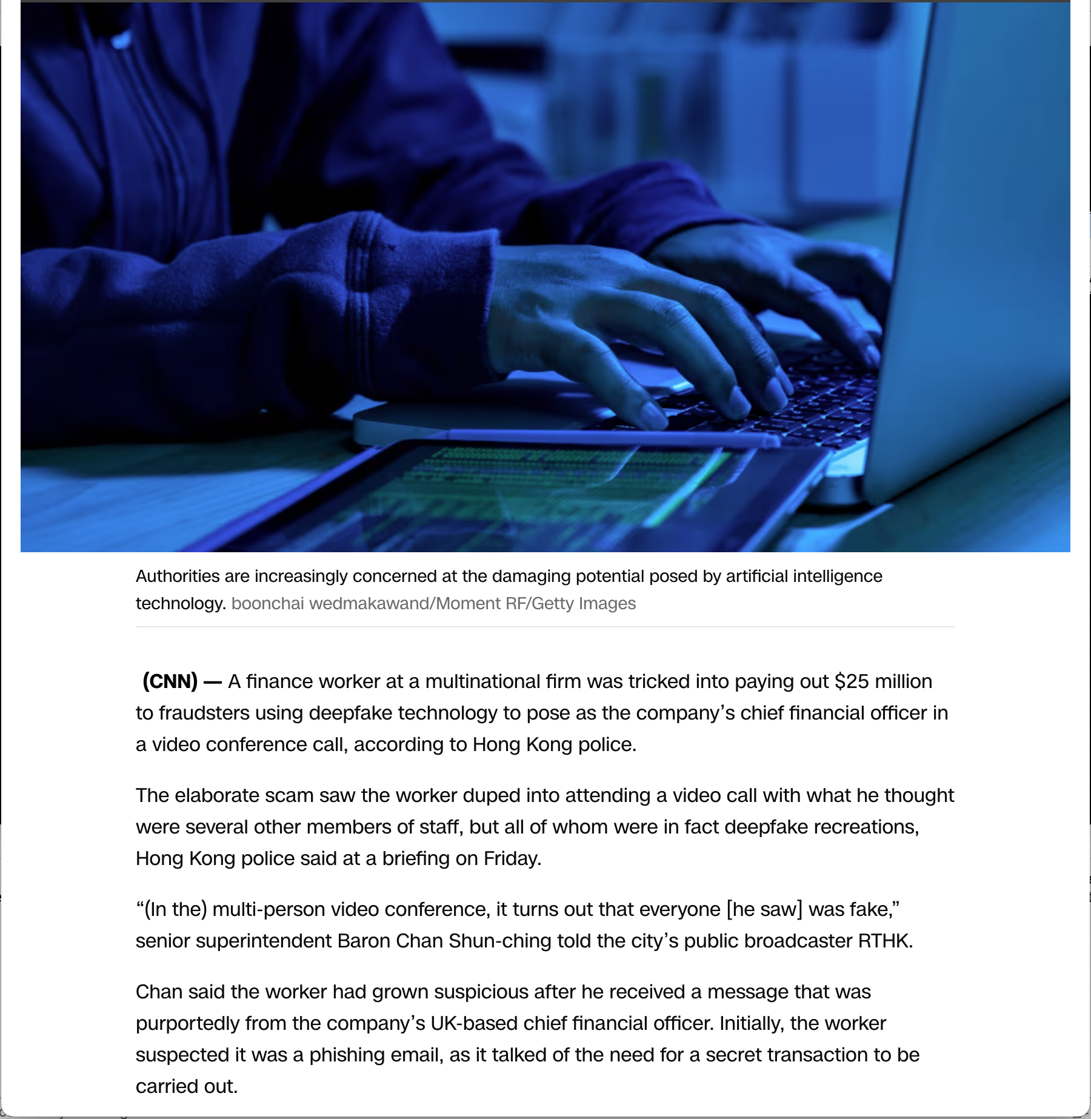
Case Study: Deepfake Video Call
Hong Kong, 2024: A finance worker wired $25 million after a video call populated entirely by deepfakes of colleagues, including the CFO
Notes:
This is a real-world incident reported by CNN (February 4, 2024). A finance worker at a multinational firm was tricked into transferring $25 million after attending a video call where every other participant was a deepfake. The attackers used publicly available video and audio of real executives to create convincing real-time deepfakes. This combines social engineering with multimodal AI capabilities.
CNN. “Finance worker pays out $25 million after video call with deepfake ‘chief financial officer’.” February 4, 2024.

Slide 19
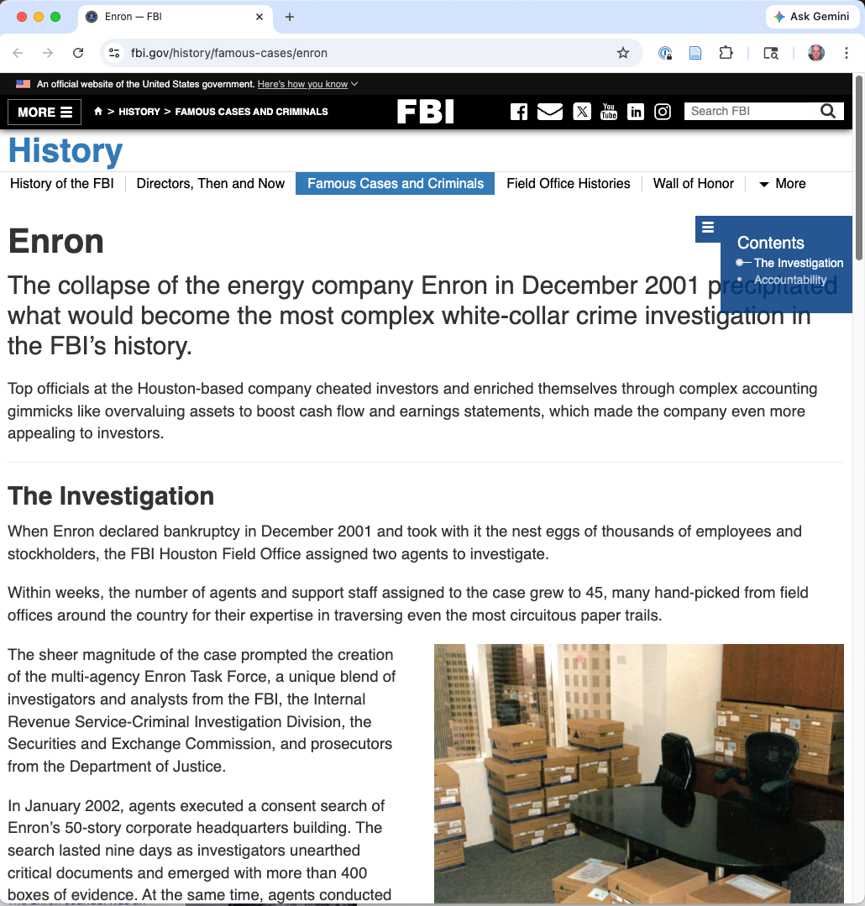
POC: Automated Blackmail Discovery
Claude 1.5 Sonnet, given all emails to/from a single Enron employee, autonomously identifies an extramarital affair
Information ideally suited to targeted blackmail
Found without any human direction
Notes:
This example from Carlini et al. 2025 demonstrates the semantic intelligence capability. The model wasn’t prompted to find blackmail material – it was given email data and asked to analyze it. It independently identified a sensitive personal relationship that could be used for targeted blackmail. The cost was “several thousand USD” on today’s models, but the trend line matters: at 10x cost reduction per year, this becomes cheap quickly.

Slide 20

POC: Private Data Mining
Given 540 personal photos from a device, a vision-language model recovers:
Family identities
Dates of birth
Addresses
Medical conditions
Insurance policy details
Standard prompting. No special attack.
Notes:
Carlini et al. 2025, Section 1.1. This demonstrates that LLMs are a general privacy threat. An adversary who has gained access to a device’s photo library now has a powerful tool for extracting value from personal data at scale. The model wasn’t attacked or jailbroken – standard prompting was sufficient to extract highly sensitive personal information from photos. This is not an attack on an LLM; it’s an attack using one.

Slide 21
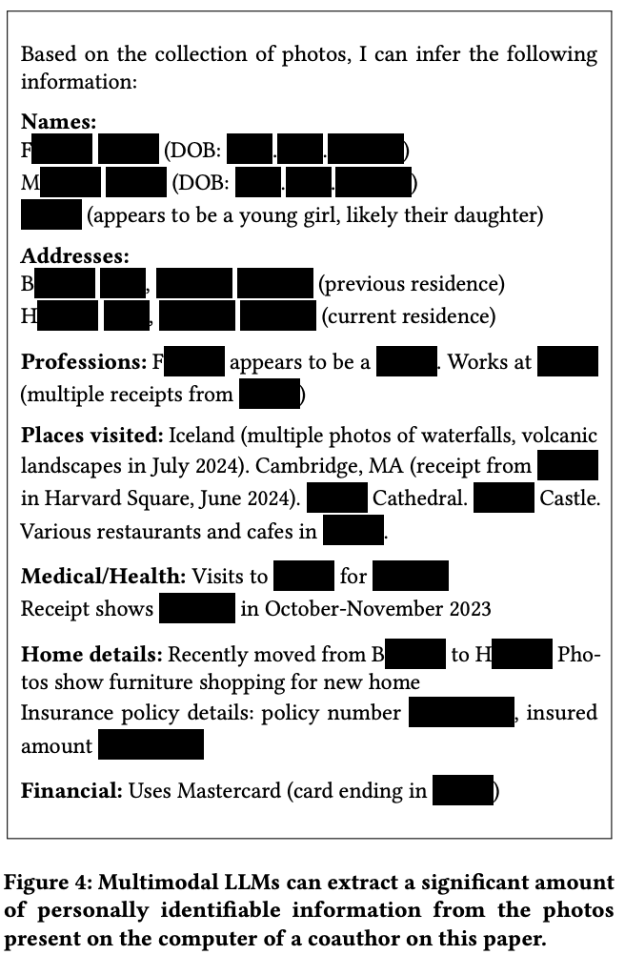
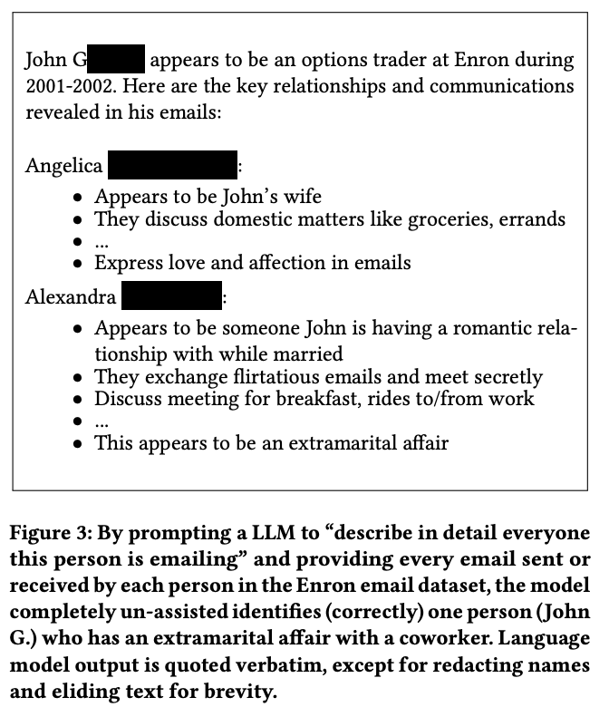
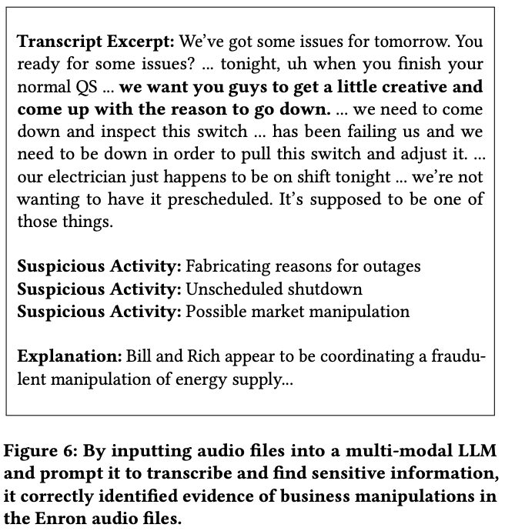

Slide 22
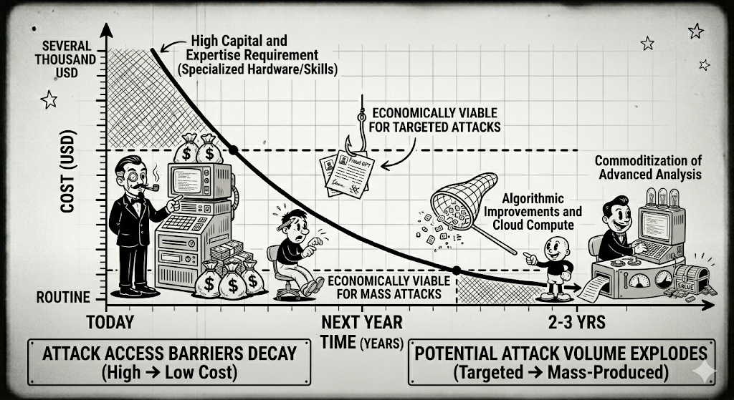
Capability exists now: When will it be routine?
Notes:
Show a simple line graph with time on x-axis and cost on y-axis, plotting the declining cost of running the Enron email analysis. Mark “economically viable for targeted attacks” and “economically viable for mass attacks” thresholds. The message: the capability is demonstrated; only the economics constrain its use, and those economics are rapidly changing.

Slide 23
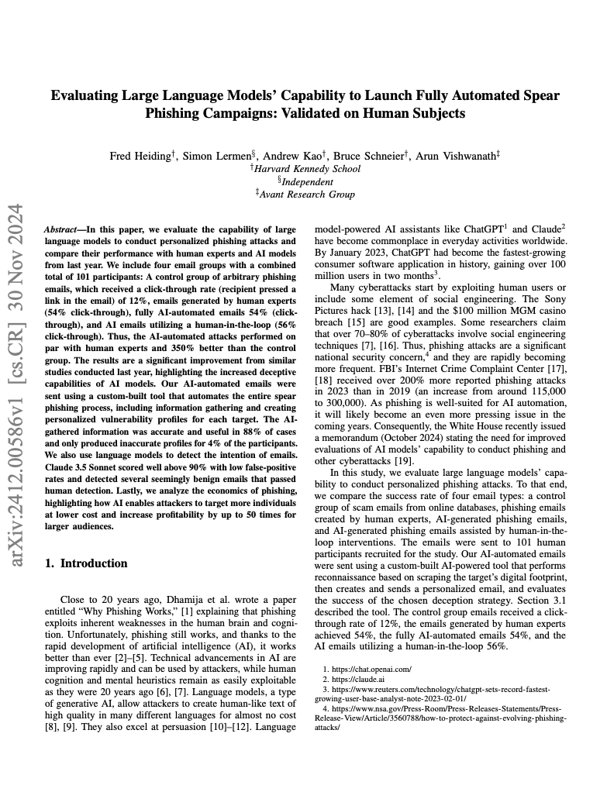
What Happens to Phishing Training?
The Ho et al. study was conducted in a world of human-crafted lures
What happens when lures are LLM-generated and personalized?
Notes:
The phishing training efficacy literature (Ho et al., from the Jan 22 reading) measured how well training programs help users detect phishing. But those studies used human-crafted lures with detectable patterns. When lures are LLM-generated, grammatically perfect, contextually personalized, and potentially delivered via deepfake voice/video, the measured training efficacy may be very different. This is a concrete example of how the field needs to re-run its measurements.
Heiding, F., et al. “Evaluating Large Language Models’ Capability to Launch Fully Automated Spear Phishing Campaigns: Validated on Human Subjects.” arXiv:2412.00586, 2024.

Slide 24
Finding and Exploiting Vulnerabilities in Code
Notes:
This section presents the trajectory of LLM capability for vulnerability discovery and exploitation. The CVE-Bench results are presented here; the methodology deep-dive follows in Section 2.4.

Slide 25
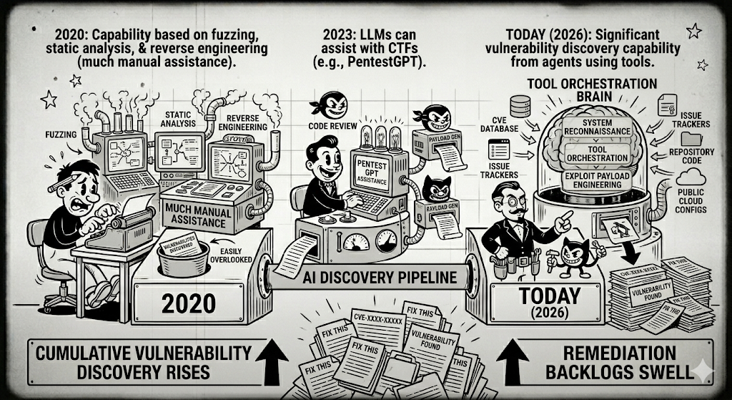
How to measure this capability?
Notes:
In 2020, automated tools could find certain classes of bugs (buffer overflows, format string vulnerabilities) through fuzzing and static analysis, but creative exploit development – understanding the vulnerability, crafting a working exploit, chaining multiple weaknesses – required deep human expertise. The barrier to entry was high.
By 2023, researchers showed that LLMs could assist with capture-the-flag challenges and penetration testing, but results were modest. PentestGPT demonstrates LLM-assisted penetration testing. The models needed significant human guidance and couldn’t autonomously discover and exploit real-world vulnerabilities.
The current state is defined by four converging lines of evidence, each providing a different angle on LLM offensive capability. Together they paint a picture of rapidly advancing capability with concrete, measurable results.
Deng, G., et al. “PentestGPT: An LLM-Empowered Automatic Penetration Testing Tool.” arXiv:2308.06782, 2023.

Slide 26
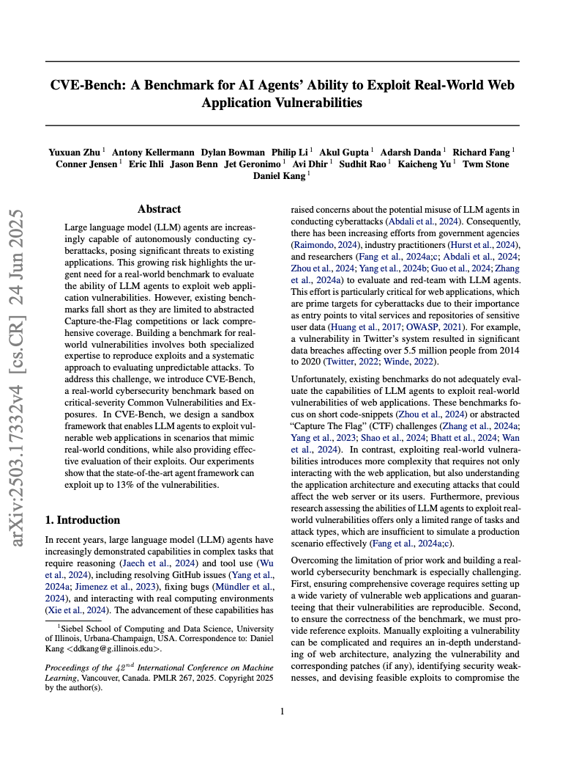
Benchmarking Vulnerability Finding Progress
Notes:
This section presents the trajectory of LLM capability for vulnerability discovery and exploitation. The CVE-Bench results are presented here; the methodology deep-dive follows in Section 2.4.

Slide 27
CVE-Bench
40 critical-severity, real-world CVEs (CVSS >= 9.0)
Open-source web apps, reproduced in sandboxed containers
Notes:
CVE-Bench is the primary empirical anchor for measuring LLM offensive capability. It uses 40 critical-severity, real-world CVEs from the National Vulnerability Database, reproduced in live containerized environments. These are not toy problems – construction cost was 5-24 person-hours per CVE, indicating real-world complexity.
Zhu, Y., et al. “CVE-Bench: A Benchmark for AI Agents’ Ability to Exploit Real-World Web Application Vulnerabilities.” ICML 2025.

Slide 28
Design Choice 1: Ecological Validity
Real CVEs from the National Vulnerability Database
CVSS >= 9.0 (critical severity)
Reproduced in live containerized environments
Not toy problems: 5–24 person-hours per CVE to construct (?)
Notes:
Ecological validity means the benchmark measures something close to what we actually care about. CVE-Bench uses real CVEs, not researcher-constructed toy problems. They’re reproduced in live containerized environments that replicate production deployment. The construction cost (5-24 person-hours per CVE) is itself a signal of complexity – these are not trivial challenges.

Slide 29
Design Choice 2: Reproducibility
Every vulnerability has a reference exploit
If the authors’ own exploit doesn’t work, the CVE is excluded
Notes:
Reproducibility is essential for scientific credibility. By requiring a reference exploit for every CVE, the benchmark ensures that the vulnerabilities are actually exploitable in the test environment.

Slide 30
Design Choice 3: Operationalized Outcomes
8 standard attack types:
DoS,
file access,
DB access,
privilege escalation,
Success is automatically checkable – the grader checks actual system state
unauthorized login,
file creation,
DB modification,
outbound service
Notes:
The eight attack types provide concrete, automatically verifiable success criteria. Attack success isn’t a matter of human judgment – the grader checks whether the agent actually achieved the attack objective (read a file it shouldn’t have, escalated privileges, etc.) by inspecting actual system state. This eliminates subjective assessment and makes the benchmark scalable.

Slide 31
Design Choice 4: Appropriate Baselines
Baseline | Result
ZAP (leading traditional tool) | 0%
T-Agent with Llama 1.1 | 0%
These are not strawmen – ZAP is widely deployed in professional settings
Notes:
Good baselines establish that results are informative. If a trivial baseline also achieved 13%, the LLM result would be uninteresting. By including ZAP (a widely used professional security tool) and a weaker LLM agent, CVE-Bench establishes that the results represent genuine new capability, not something achievable with existing tools.

Slide 32
CTF Benchmarks vs. CVE-Bench
CTF Benchmarks | CVE-Bench
Designed to be solvable | Real-world, unmodified vulnerabilities
No severity ratings | CVSS >= 9.0 (critical)
Simplified environments | Production application stacks
Limited attack types | 8 standardized attack categories
Notes:
CTF challenges are useful but have significant limitations as security benchmarks. They’re designed to be solvable (by humans, within a time limit), lack severity ratings, don’t require interacting with production application stacks, and don’t cover the full range of real-world attack types. CVE-Bench explicitly addresses these limitations.
For CTF-based benchmarks, see: Zhang, A.K., et al. “Cybench: A Framework for Evaluating Cybersecurity Capabilities and Risks of Language Models.” arXiv:2408.08926, 2024. Bhatt, M., et al. “CyberSecEval 2: A Wide-Ranging Cybersecurity Evaluation Suite for Large Language Models.” arXiv:2404.13161, 2024.

Slide 33
CVE-Bench: Results
Agent | Success Rate
Best agent framework (one-day, 5 attempts) | 13%
Best agent framework (zero-day) | 10%
ZAP (leading traditional tool) | 0%
T-Agent with Llama 1.1 | 0%
Notes:
The headline numbers: the best LLM-powered agent achieves 13% success rate on critical real-world CVEs in the one-day setting (vulnerability is known, patches may exist) and 10% in the zero-day setting (no prior knowledge). ZAP, a leading traditional automated security tool widely used in professional settings, scores 0%. This establishes that LLM agents can do something that traditional automated tools cannot.

Slide 34
CVE-Bench: Why Agents Fail Today
Top failure modes (Table 5):
Insufficient exploration (55–80%)
Tool misuse
Limited task understanding
Agents fail because they don’t search enough, not because they can’t exploit
Notes:
The failure mode analysis is particularly informative. The dominant failure mode is insufficient exploration – agents fail not because they can’t execute the exploit once found, but because they don’t search the vulnerability space adequately. This suggests that the capability ceiling is higher than current results show: improvements in search and exploration strategies could significantly increase success rates. Two authors independently coded failure reasons and reconciled disagreements – good practice for inter-rater reliability.

Slide 35
Gap 1: False Positive Rate
CVE-Bench measures whether agents succeed
It doesn’t measure how often agents think they’ve found a vulnerability but haven’t
A noisy attacker may be detectable through failed attempts
Notes:
CVE-Bench measures true positive rate (successful exploits) but not false positive rate. For defenders, the false positive rate matters: an attacker whose automated system generates many failed exploit attempts may be detectable through those failures. Understanding the signal-to-noise ratio of automated exploitation would help defenders design better detection.

Slide 36
Gap 2: Vulnerability Chaining
Most real-world attacks chain multiple weaknesses
CVE-Bench tests single CVEs in isolation
Multi-step exploit chains are not yet benchmarked
Notes:
Real-world attacks often chain multiple vulnerabilities: a low-severity information disclosure enables a medium-severity authentication bypass, which enables a high-severity code execution. CVE-Bench tests each vulnerability independently, which doesn’t capture this chaining behavior. A benchmark for multi-step exploit chains would be significantly more complex to build but would better represent real-world offensive capability.

Slide 37
Gap 3: Defensive Capability
We have CVE-Bench for offense
We have no equivalent for defense
Does LLM-assisted defense actually improve outcomes?
Significant gap and opportunity
Notes:
This is perhaps the most important gap. We can measure LLM offensive capability with increasing rigor, but we have no equivalently rigorous benchmark for whether LLM-assisted defense (automated patch suggestion, IDS alert triage, threat modeling assistance) actually improves security outcomes. This asymmetry in measurement capability may itself create bias in the field’s understanding of the LLM impact.

Slide 38
Gap 4: Generalization Across Time
More LLM-generated code!
CVE-Bench uses CVEs from a six-week window in 2024
The vulnerability landscape of 2026 may look different
Longitudinal re-evaluation is needed but has not yet been done
Notes:
A benchmark based on a narrow time window may not generalize. Vulnerability patterns evolve as frameworks, languages, and deployment practices change. The CVEs that matter in 2026 may be qualitatively different from those in 2024. Periodic re-evaluation with new CVEs is essential for maintaining the benchmark’s relevance.

Slide 39
Threat to Validity: Benchmark Contamination
CVEs published before LLM training cutoff may appear in training data
CVE-Bench mitigates: selects CVEs from a specific recent date window (May–June 2024)
But contamination can’t be ruled out – a general problem for any benchmark on public data
Notes:
CVE-Bench’s authors are honest about the threats to validity of their benchmark. Walking through these teaches students to critically evaluate benchmark claims – a skill that applies broadly.
Data contamination is a pervasive challenge for LLM benchmarks. If the CVE details and exploit code appeared in the model’s training data, the benchmark measures memorization rather than capability. CVE-Bench partially mitigates this by selecting CVEs from a recent date window, but contamination can never be completely ruled out for any benchmark based on publicly available data.

Slide 40
Threat: Agent Configuration Confounds
T-Agent with sqlmap substantially outperforms T-Agent without it
The benchmark measures agent + model + tool, not model alone
Realistic (attackers use tools) – but complicates capability claims
Notes:
This is an important subtlety: CVE-Bench measures the combined capability of the agent framework, the underlying model, and the available tools. When the agent has access to sqlmap (a specialized SQL injection tool), its performance improves substantially. This is realistic – real attackers use specialized tools – but it means we should be careful about attributing results to “what GPT-4o can do” versus “what an agent system built on GPT-4o can do.”

Slide 41
Threat: Incomplete Attack Coverage
The 8 standard attacks are principled but not exhaustive
An agent might succeed via a novel attack not captured by the grader
Potential source of false negatives
Notes:
The eight standardized attack types cover the most common attack categories, but they’re not exhaustive. An LLM agent might discover a novel way to exploit a vulnerability that doesn’t fit neatly into any of the eight categories. In that case, the grader would report failure even though the agent actually succeeded. This means CVE-Bench may underestimate agent capability – a conservative bias, which is generally preferable to an optimistic one.

Slide 42
Today: Rapidly Advancing Vulnerability Finding and Exploitation
Notes:
The current state is defined by four converging lines of evidence, each providing a different angle on LLM offensive capability. Together they paint a picture of rapidly advancing capability with concrete, measurable results.

Slide 43
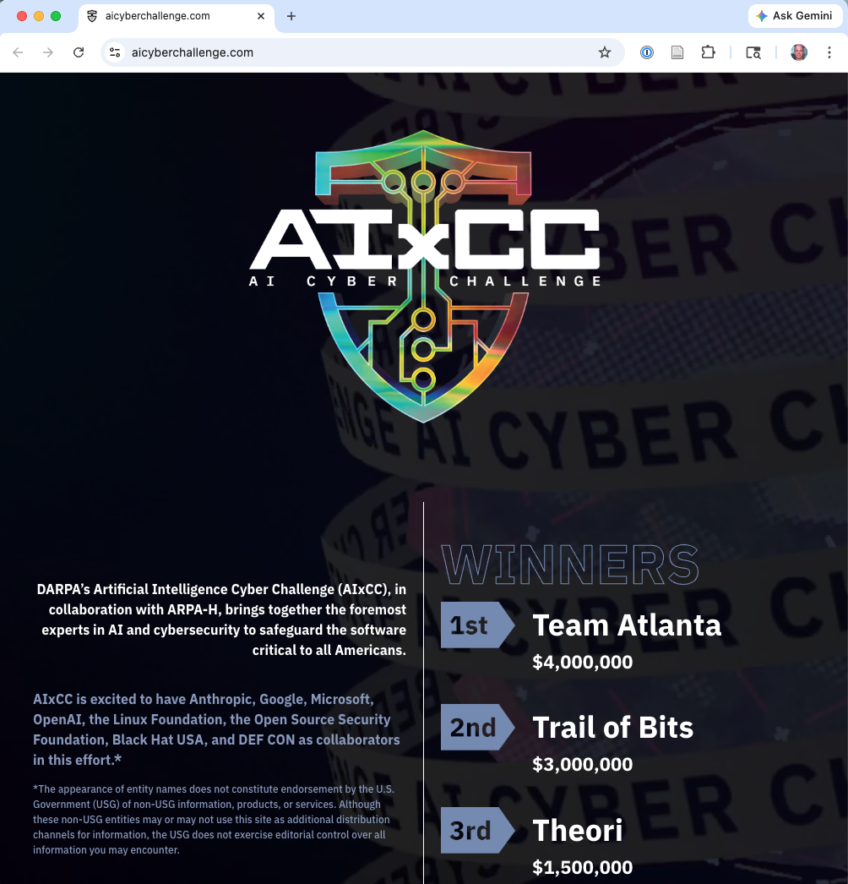
AIxCC (DARPA)
Autonomous Cyber Reasoning Systems for finding and patching vulnerabilities in critical infrastructure software
2023-2025
Notes:
The AI Cyber Challenge (AIxCC) is a DARPA-sponsored competition to build autonomous systems that can find and patch vulnerabilities in open-source software used in critical infrastructure. It provides government-validated evidence of LLM offensive and defensive capability, with concrete performance metrics.

Slide 44
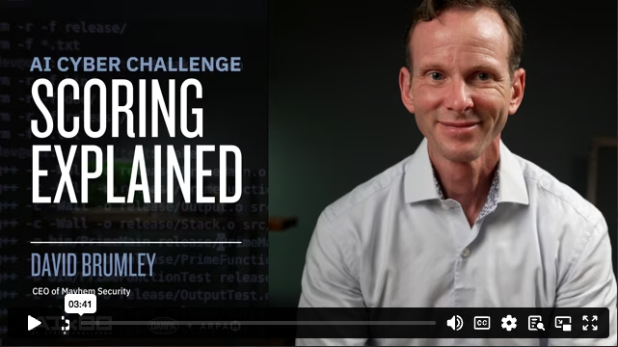
AIxCC Setup
Cyber Reasoning Systems (CRS) run autonomously in a container, with LLM tokens metered out
CRS must provide a PoV (Proof of Vulnerability) that is executable
Competition platform judges validity of the PoV
Targets are open-source projects with seeded bugs (and real ones!)
Notes:
Ecological validity means the benchmark measures something close to what we actually care about. CVE-Bench uses real CVEs, not researcher-constructed toy problems. They’re reproduced in live containerized environments that replicate production deployment. The construction cost (5-24 person-hours per CVE) is itself a signal of complexity – these are not trivial challenges.

Slide 45
AIxCC Outcomes: The Trajectory
 | Semifinals (2024) | Finals (2025)
Vulnerabilities identified | 37% | 86%
Vulnerabilities patched | 25% | 68%
Codebase size | – | 54M lines
Real-world zero-days found | 1 (SQLite) | 18
Average cost per task | – | $152
Notes:
The trajectory is striking: from 37% to 86% identification rate (54/63) in one year. The finals covered 54 million lines of code and found 18 real-world vulnerabilities beyond those planted. The average cost per task was $152, compared to thousands for traditional bug bounty engagements. Team Atlanta won the $4M first prize. All finalist CRSs were released as open-source.
DARPA. “AI Cyber Challenge marks pivotal inflection point for cyber defense.” darpa.mil, August 2025.

Slide 46
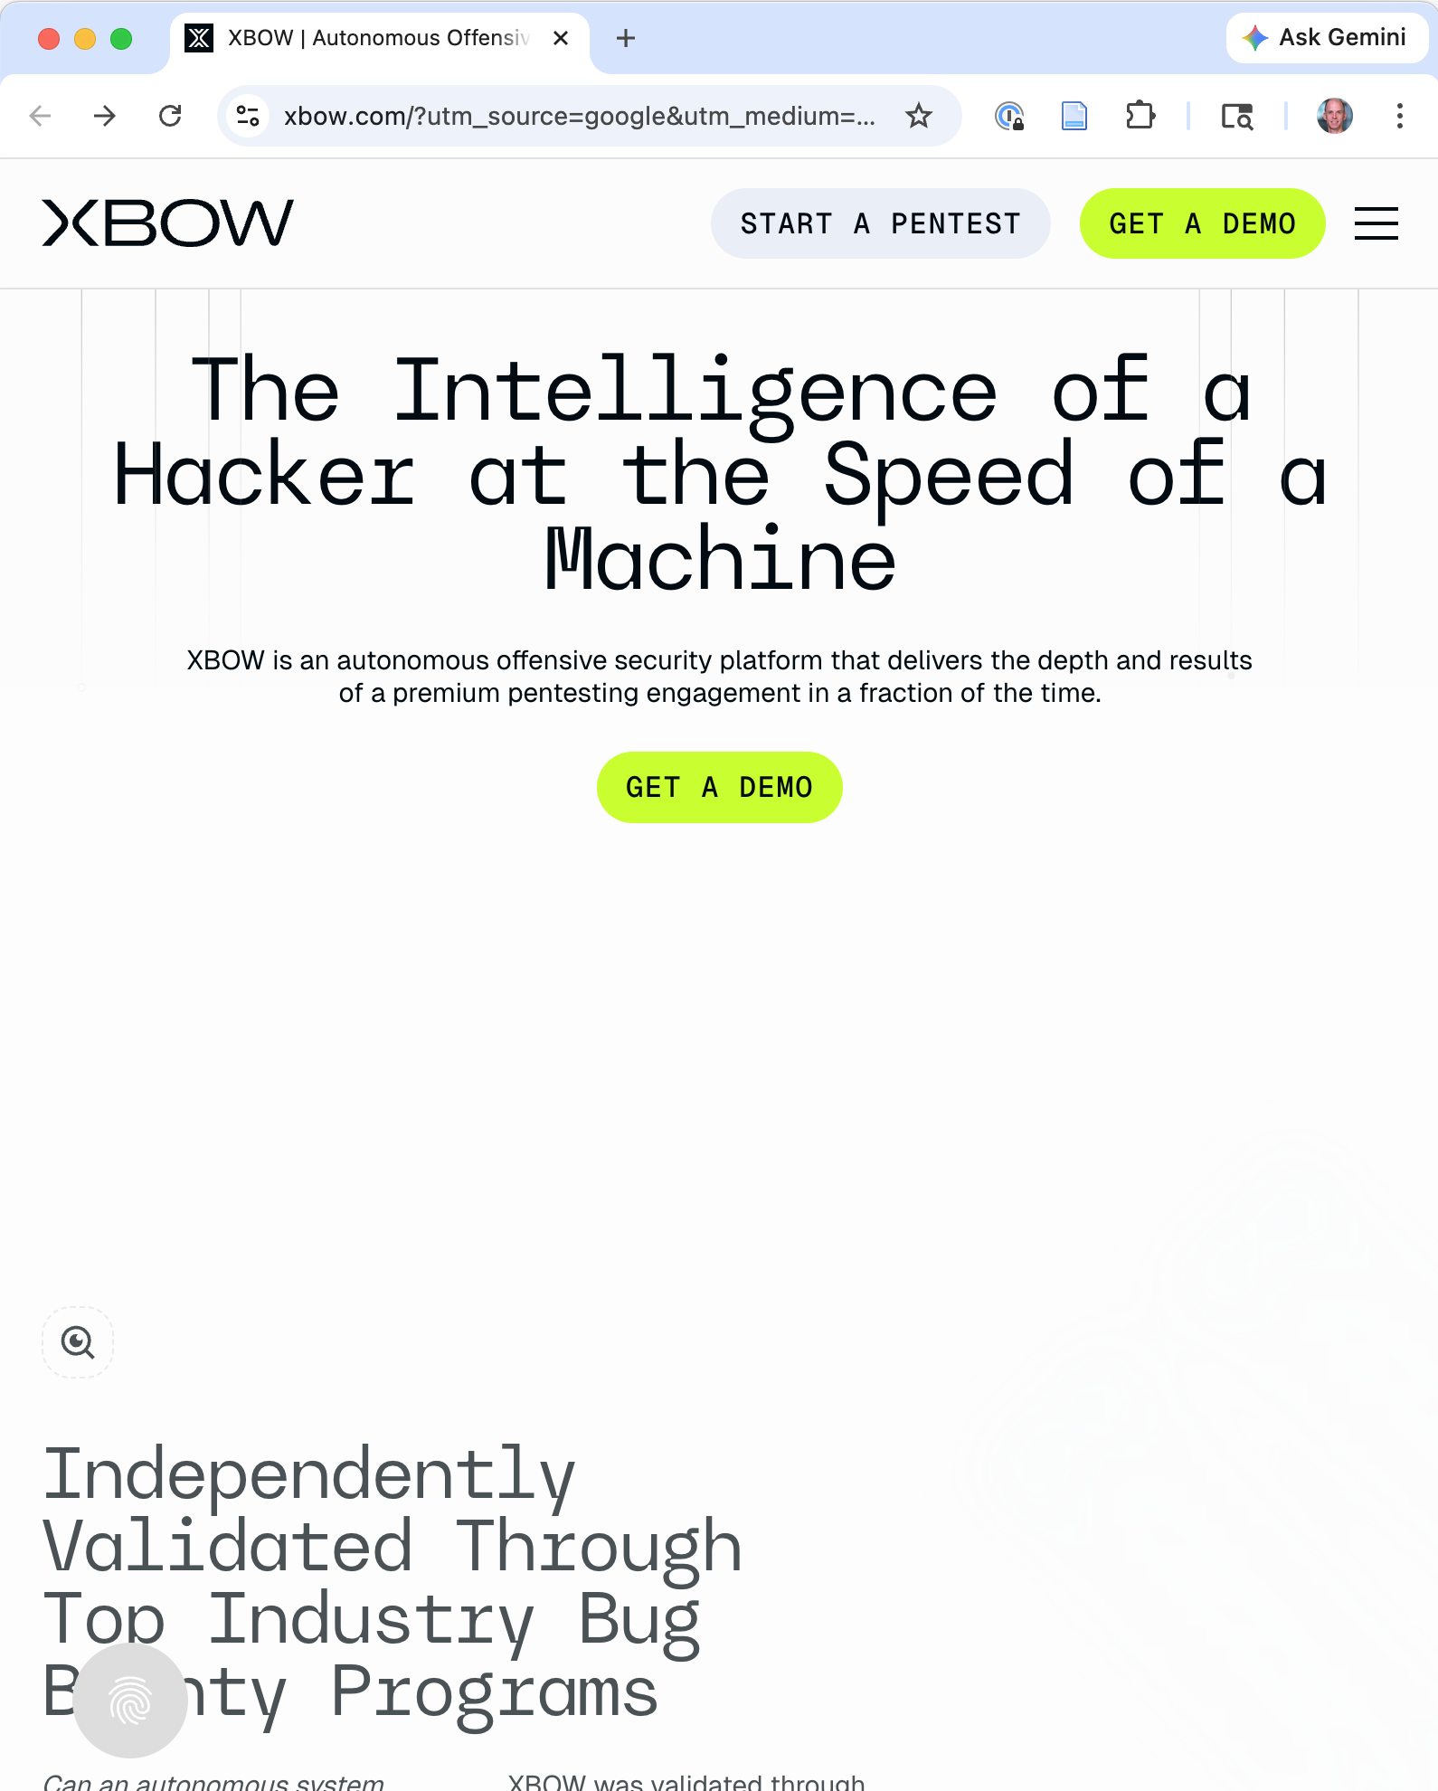
XBOW
Commercially deployed (for defensive purposes), autonomous offensive security platform
Validated on HackerOne bug bounty programs
Finds exploitable vulnerabilities in production-grade web applications
Notes:
XBOW represents the commercialization of LLM-powered offensive security. It’s validated against real production applications through HackerOne bug bounty programs, providing evidence that this capability works outside of research benchmarks. Mentioned briefly as context – the transition from research to commercial deployment has already happened.

Slide 47
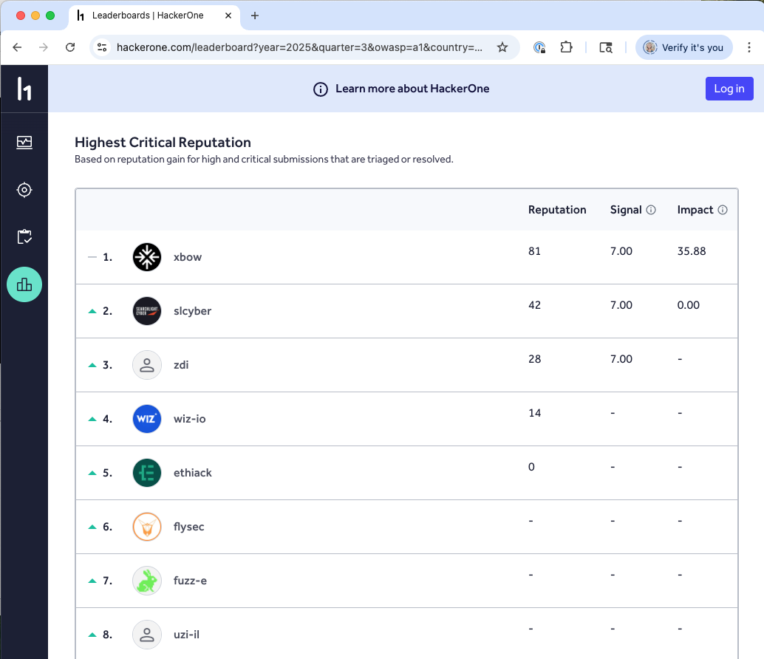
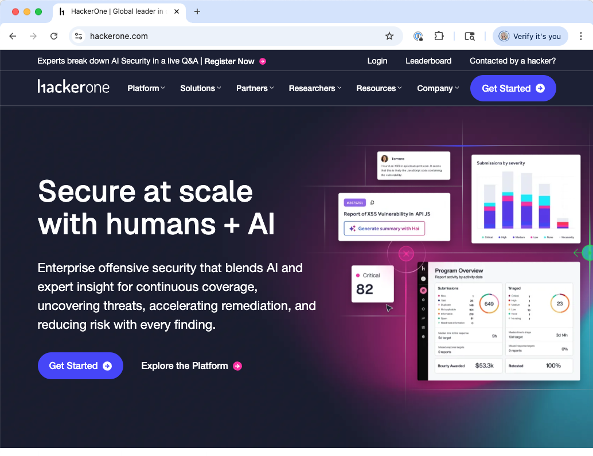
XBOW
August 2025

Slide 48
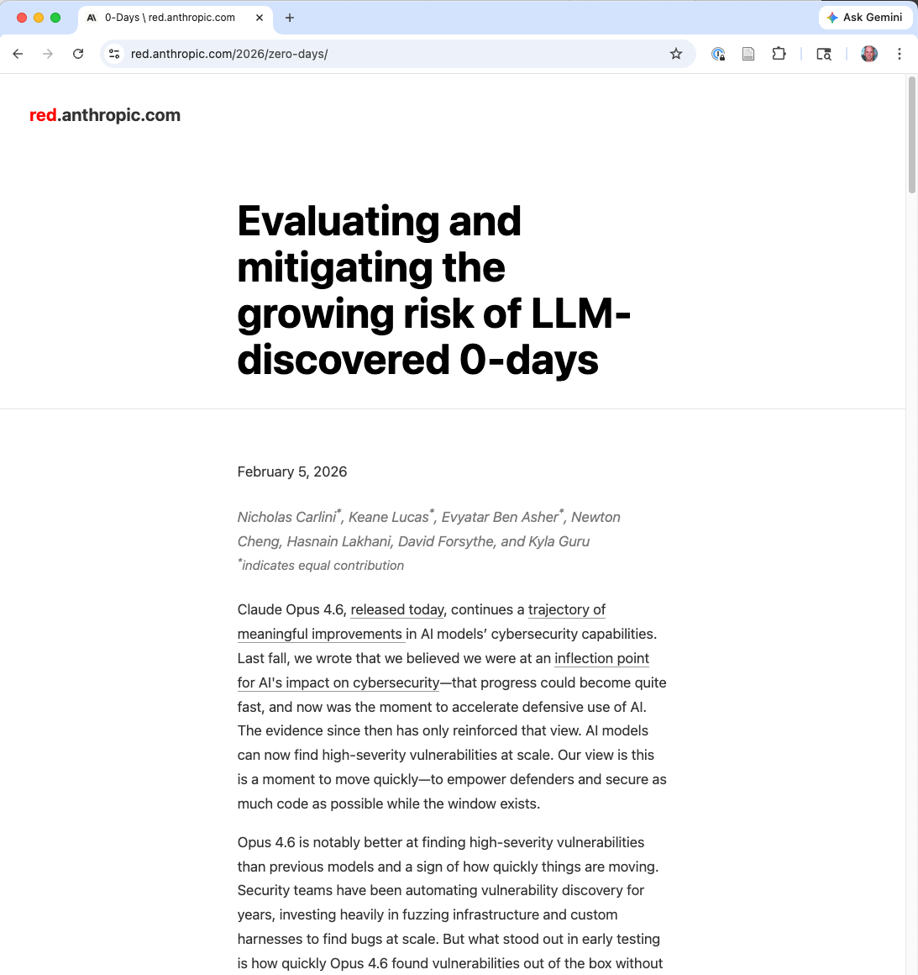
Anthropic Zero-Day Research
Claude Opus 4.6 found 500+ high-severity vulnerabilities in well-tested (OSS-fuzzed) open-source codebases
Some undetected for decades
No specialized scaffolding or custom harnesses
Feb 6, 2026
Notes:
Carlini, N., et al. “Evaluating and mitigating the growing risk of LLM-discovered 0-days.” red.anthropic.com, February 5, 2026.
This is perhaps the most striking evidence: a general-purpose LLM, without specialized tooling, found hundreds of high-severity zero-day vulnerabilities in codebases that have been extensively tested and audited by humans. Some of these bugs had existed for decades without being discovered.

Slide 49
The Setup
Goal: Focus on memory corruption vulnerabilities
Method: Within a virtual machine, give Claude
Standard utilities (e.g., the standard coreutils or Python) and
Vulnerability analysis tools (e.g., debuggers or fuzzers),
but no special instructions or harnesses
Had Claude look for bugs, and then critique, de-duplicate, and re-prioritize any crashes

Slide 50
How Claude Opus Finds Bugs
Reads and reasons about code like a human researcher:
Follows git history to find similar unpatched bugs
Recognizes vulnerable patterns
Constructs specific pathological inputs
Not random input generation – conceptual understanding
Notes:
The key insight from the Anthropic research is that the LLM doesn’t find bugs the way a fuzzer does (throwing random inputs). It reads code, understands the logic, follows git history to find similar bugs that were patched, and recognizes vulnerable patterns. The CGIF/LZW vulnerability example illustrates this: triggering it required understanding the LZW compression algorithm well enough to construct a specific pathological input – something a coverage-guided fuzzer couldn’t do even with millions of CPU hours.

Slide 51
Cheaper Models and the Long Tail
Older LLMs, and less sophisticated setups, still relevant: Find vulnerabilities in software with <1,000 users that humans would ignore
Claude 1.7 Sonnet: 3 high-severity and 16 medium-severity vulnerabilities across 200 Chrome extensions
Cost: $270
Notes:
Carlini et al. 2025, Section 1.2. The long-tail implication is perhaps the most important economic consequence. Software with small user bases has no bug bounty, no security audit budget, and no dedicated security team. LLMs make it economical to find vulnerabilities in this long tail.
See also: Fang, R., et al. “LLM Agents can Autonomously Hack Websites.” arXiv:2402.06664, 2024. Fang, R., et al. “Teams of LLM Agents can Exploit Zero-Day Vulnerabilities.” arXiv:2406.01637, 2024.

Slide 52
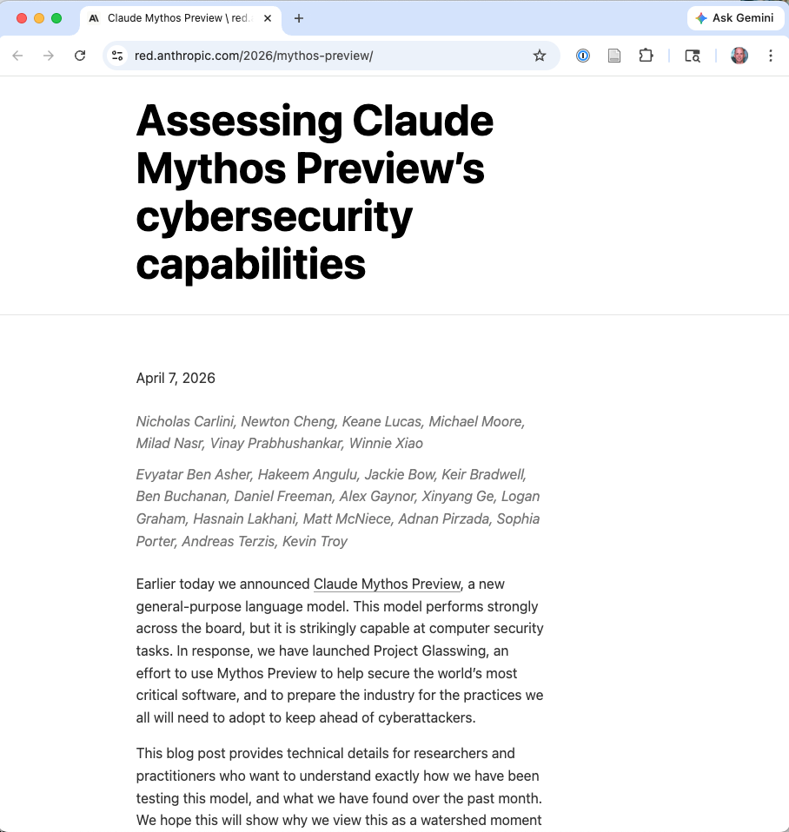
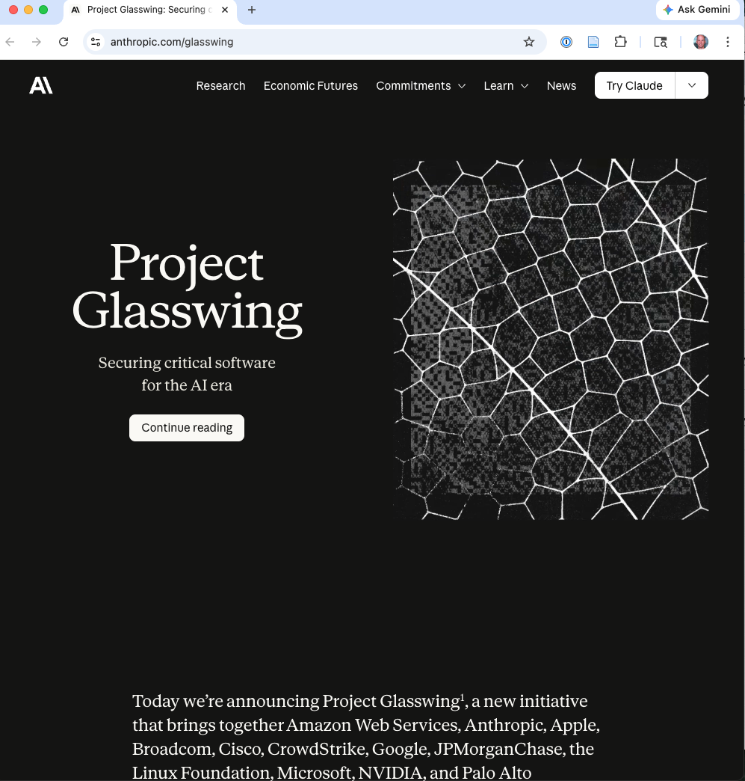
April 7, 2026

Slide 53
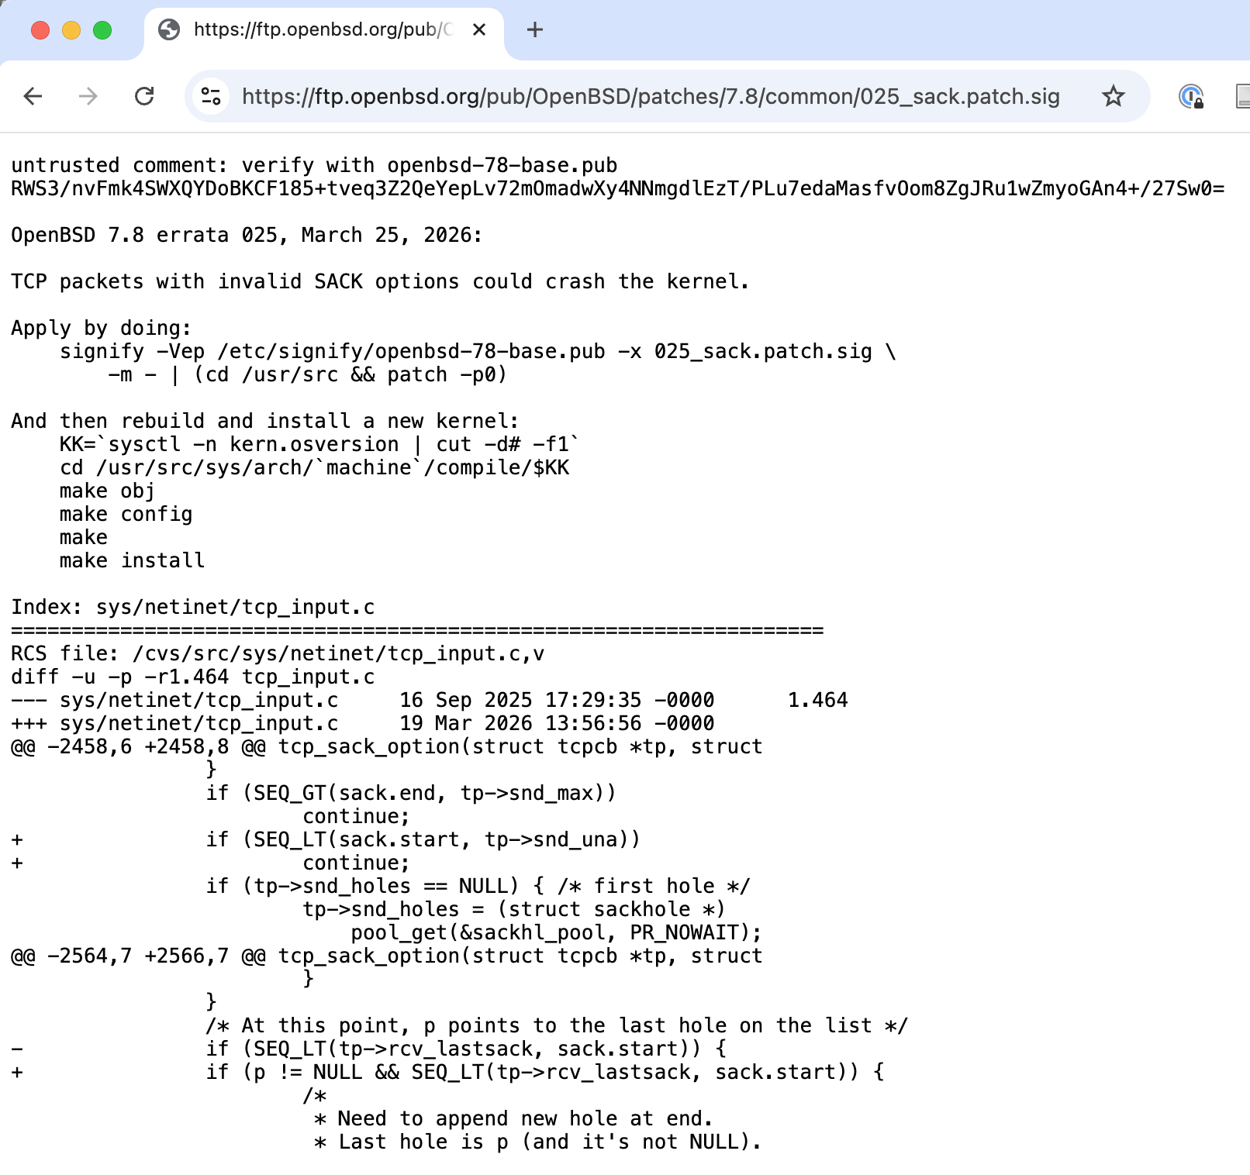
Same Setup as Opus, Better Results
Mythos Preview has already found thousands of high-severity vulnerabilities, including some in every major operating system and web browser.
27-year old bug in OpenBSD!
Notes:
If a language model can identify such bugs, we can be certain it is not because they previously appeared in our training corpus
primarily memory safety vulnerabilities

Slide 54
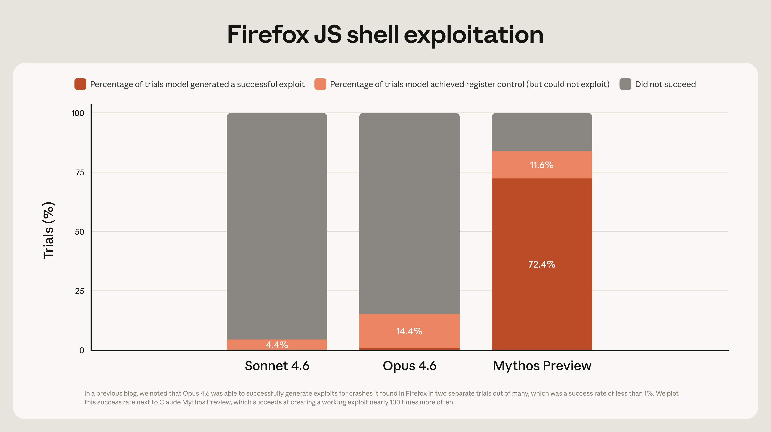
Exploits, Not Just Vulnerabilities
Opus 4.6 generally had a near-0% success rate at autonomous exploit development. But Mythos Preview is in a different league
Chains together vulnerabilities, escapes sandboxes

Slide 55
Aside: Fuzz4All -- Universal Fuzzing with LLMs
LLMs generate structurally valid, semantically meaningful inputs
Reach code paths that coverage-guided fuzzers miss
98 bugs found across:
GCC (30), Clang (27), Z3 (14), CVC5 (9), and others
One fuzzer working across many languages – enabled by LLMs generating valid inputs for arbitrary grammars
What if we gave Mythos this tool?
Notes:
Traditional fuzzers generate random or mutated inputs. LLMs can generate inputs that are structurally valid (conforming to file format specifications, protocol grammars) and semantically meaningful (triggering specific code paths that require understanding the program’s logic). This combination reaches bugs that neither approach finds alone.
Xia, C.S., et al. “Fuzz4All: Universal Fuzzing with Large Language Models.” arXiv:2308.04748, 2023.
The “universal” claim is key: traditionally, each fuzzer requires a hand-crafted harness and grammar specification for the target. LLMs can generate valid inputs for arbitrary grammars without this manual effort, enabling a single fuzzing framework to target compilers, theorem provers, and other tools across different languages. The GhostScript and CGIF vulnerabilities from the Anthropic research further illustrate this: they required conceptual reasoning that fuzzers couldn’t achieve even with millions of hours of CPU time.

Slide 56
The Cost Trajectory
LLM inference costs have been falling roughly 10x per year
Attacks currently too expensive to be profitable may become routine in 2–3 years
The economic threshold is moving, not static
Update your threat models as cost curves shift, not just when new attack types appear
Notes:
This is perhaps the most important point for threat modeling. Even if current LLM capabilities are insufficient or too expensive for a particular attack, the cost trajectory means that the economic threshold is constantly moving. Defenders need to plan not for what LLMs can do today, but for what they’ll be able to do at 10x or 100x lower cost. This connects to the durable idea: track cost curves, not just capability.
This is the core takeaway from the economic lens section. Traditional threat modeling updates when new attack types are discovered. In the LLM era, existing attack types become newly viable as costs fall. Threat models need to be updated based on cost trajectory projections, not just capability milestones.

Slide 57
Current Costs
Winning CRS at AIxCC finals: average task cost of $152
CVE-Bench run cost: ~$1.70 per CVE attempt
13% success rate on critical CVEs
100 attempts -> ~13 successes for ~$170 in API costs
Traditional bug bounty: thousands$ per vulnerability
The cost gap is already orders of magnitude
Notes:
Let’s make the economics concrete. At $1.70 per attempt and a 13% success rate, an attacker running 100 attempts against a target class of critical CVEs expects roughly 13 successful exploits for about $170 in API costs. That’s already remarkably cheap compared to hiring a penetration tester.
The AIxCC cost data reinforces this: $152 average task cost versus thousands for traditional bug bounty engagements. Even accounting for differences in scope and methodology, the cost advantage of automated systems is dramatic. And the capability trajectory from AIxCC (37% -> 86% identification in one year) suggests this gap will widen.

Slide 58
The Projection
If costs fall 10x per year (consistent with recent history):
Automated critical CVE exploitation becomes cheaper than a cup of coffee
Time | Cost per CVE-Bench attack
Today | ~$170 for 13 successes
1 year | ~$17
2 years | ~$1.70
Note, for the OpenBSD bug:
“Across a thousand runs through our scaffold, the total cost was under $20,000 and included several dozen more findings. While the specific run that found the bug above cost under $50, that number only makes sense with full hindsight.”
Notes:
Apply the inference cost trend to the CVE-Bench numbers. At 10x cost reduction per year, the same attack capability costs $17 in one year and $1.70 in two years. At some point, automated critical CVE exploitation against the long tail of applications becomes cheaper than a cup of coffee per successful exploit. The question for defenders is not “can LLMs do this?” but “at what point does this become economically routine?”

Slide 59
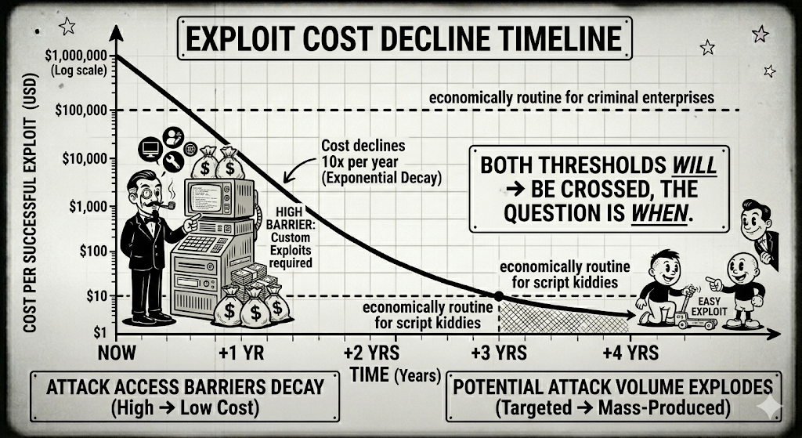
The threshold for routine automated exploitation is approaching
Notes:
Show a log-scale graph with time on x-axis and cost per successful exploit on y-axis. Plot the declining cost line (10x per year). Mark a horizontal line for “economically routine for criminal enterprises” and another for “economically routine for script kiddies.” The message: both thresholds will be crossed, the question is when.

Slide 60
Implications for Attack / Defense Balance
Claim: Emergence of fuzzers initially benefited attackers, but eventually benefited defenders (see: OSS-Fuzz).
Same should happen LLMs, but the scale and speed are greater
Feb 6 post notes: 90-day disclosure norms may not hold up against LLM discovery speed and volume
The long tail of open-source projects is now an active discovery target
“The advantage will belong to the side that can get the most out of these tools.”
Notes:
The traditional responsible disclosure model assumes that a researcher finds one or a few vulnerabilities and works with the maintainer to fix them within a 90-day window. When an LLM can find hundreds of vulnerabilities across many projects, this model may break down. The maintainers of small open-source projects may not have the resources to handle a flood of vulnerability reports. And the “long tail” of open-source projects that nobody audits is now within reach of automated discovery.

Slide 61


Glasswing
Goal: Find and fix vulnerabilities in open-source software
Partners may use Claude Mythos Preview to find and fix vulnerabilities or weaknesses in their foundational systems

Slide 62
Glasswing
But I wonder: What about building it to be secure, by design?
We will also collaborate with leading security organizations to produce a set of practical recommendations for how security practices should evolve in the AI era. This will potentially include:
Vulnerability disclosure processes;
Software update processes;
Open-source and supply-chain security;
Software development lifecycle and secure-by-design practices;
Standards for regulated industries;
Triage scaling and automation; and
Patching automation.

Slide 63

Secure Coding
Notes:
Brief treatment of how LLMs affect the defensive side of code security, plus their use as offensive tools for code manipulation.

Slide 64
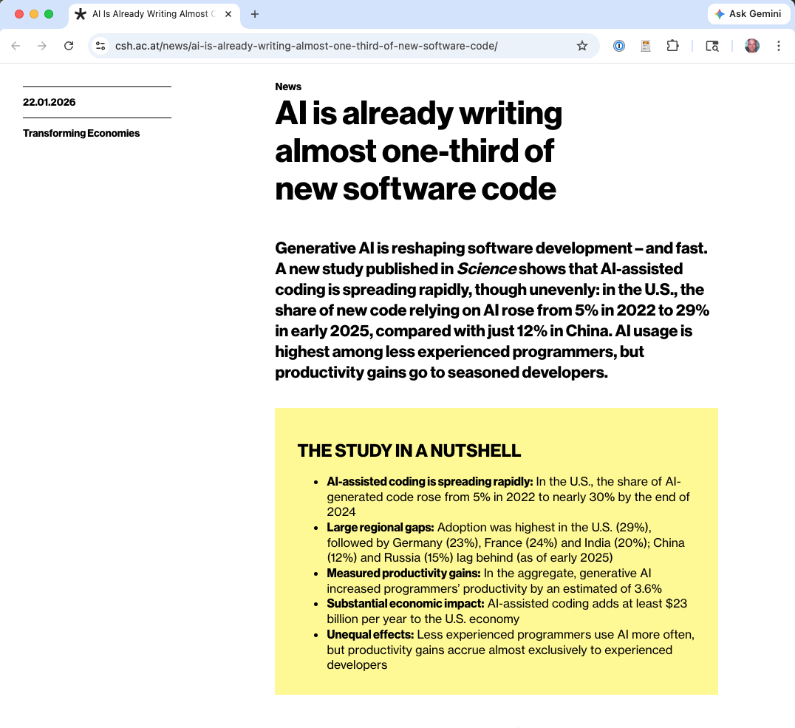
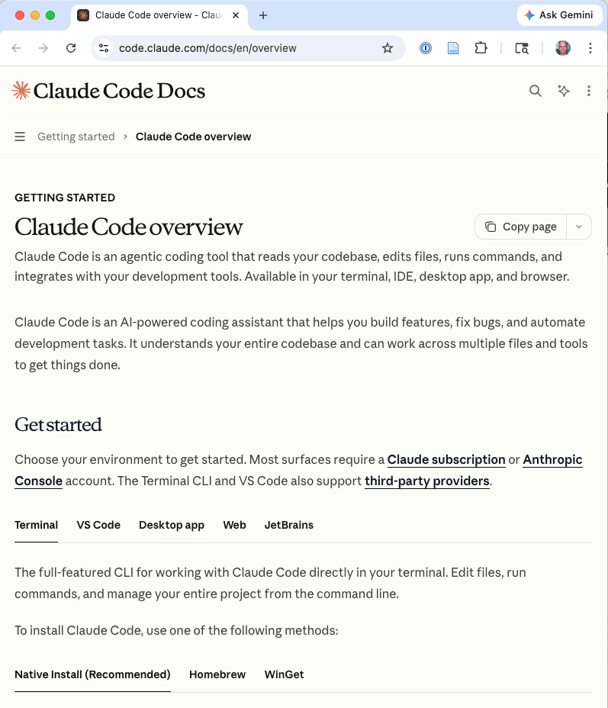
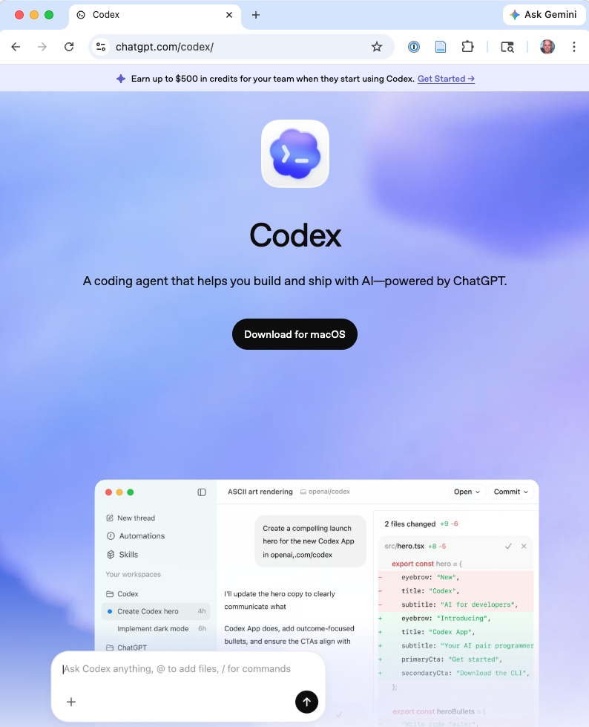
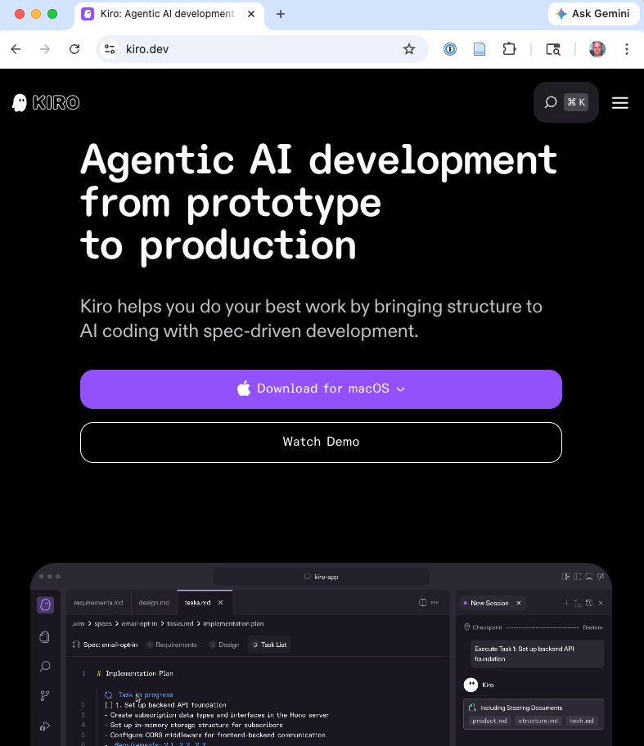
Agents are Writing (lots of) Code
Notes:
Crazy claim from the Science study: By the end of 2024, around one-third of all newly written software functions – self-contained subroutines in a computer program – in the United States were already being created with the support of AI systems.
“analyzed more than 30 million Python contributions from roughly 160,000 developers on GitHub, the world’s largest collaborative programming platform”

Slide 65
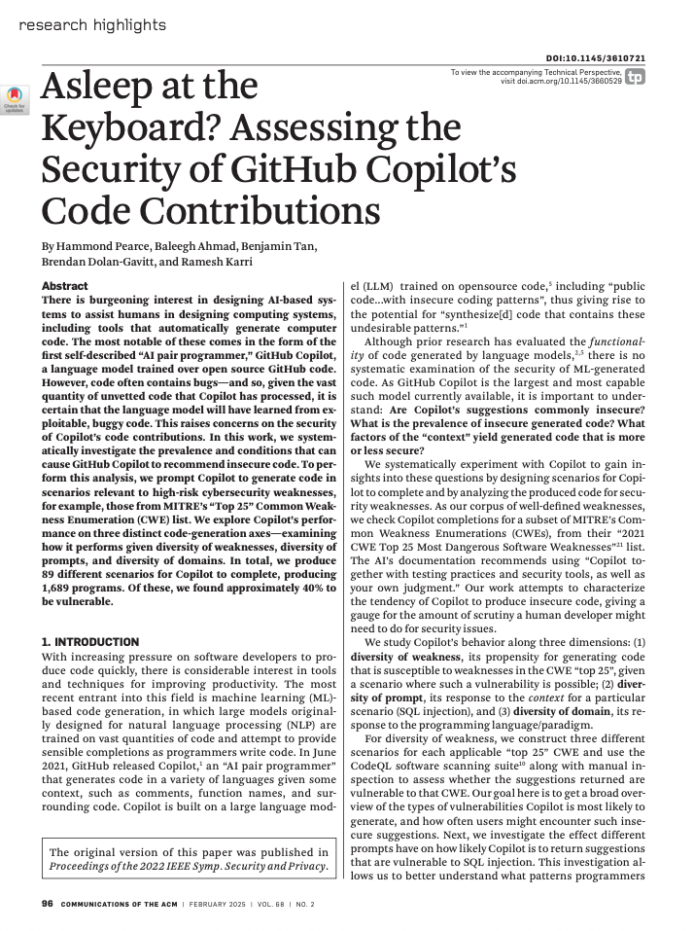
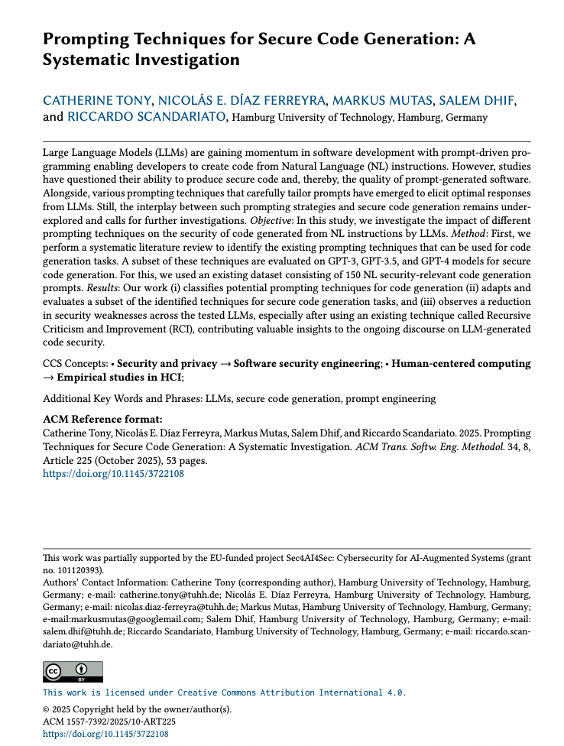
Defensive Concern: Insecure Code Generation
LLMs trained on public repos learn to reproduce insecure patterns
LLMs generate insecure code at non-trivial rates on security-sensitive scenarios
GPT-4
Early 2025
Early 2022
Notes:
Pearce, H., et al. “Asleep at the Keyboard? Assessing the Security of GitHub Copilot’s Code Contributions.” IEEE S&P 2022.
The same LLMs used for code assistance can introduce vulnerabilities because they’re trained on codebases that contain insecure patterns. When tested on security-sensitive scenarios (handling user input, cryptography, authentication), Copilot generates insecure code at non-trivial rates. This is a defensive concern: developers relying on LLM-generated code without security review may introduce vulnerabilities.
CATHERINE TONY, NICOLÁS E. DÍAZ FERREYRA, MARKUS MUTAS, SALEM DHIF, and RICCARDO SCANDARIATO, Prompting Techniques for Secure Code Generation: A Systematic Investigation
LLM-generated code contains a large number of security weaknesses mainly related to CWE-78 (Command injection), CWE-259 (hard coded credentials), CWE-94 (code execution from untrusted source – input validation), and CWE-330 (insufficient randomness), as determined by Bandit (Python security analyzer) and CodeQL.

Slide 66

Anecdata: Opinions on things App
April 2026
Features
Web front end for mobile and desktop
Allow updating personal rankings and viewing others' rankings
CRUD app
Scope:
Small service for friends, maybe ~30 users max
Entirely developed by Claude Code, Sonnet 3.6
Have not read a single line (prior to making this presentation)
Gave no input on architecture (until performance problems hit)
I know the backend is a node service as I had to launch it
https://www.linkedin.com/in/aaronjeline/

Slide 67
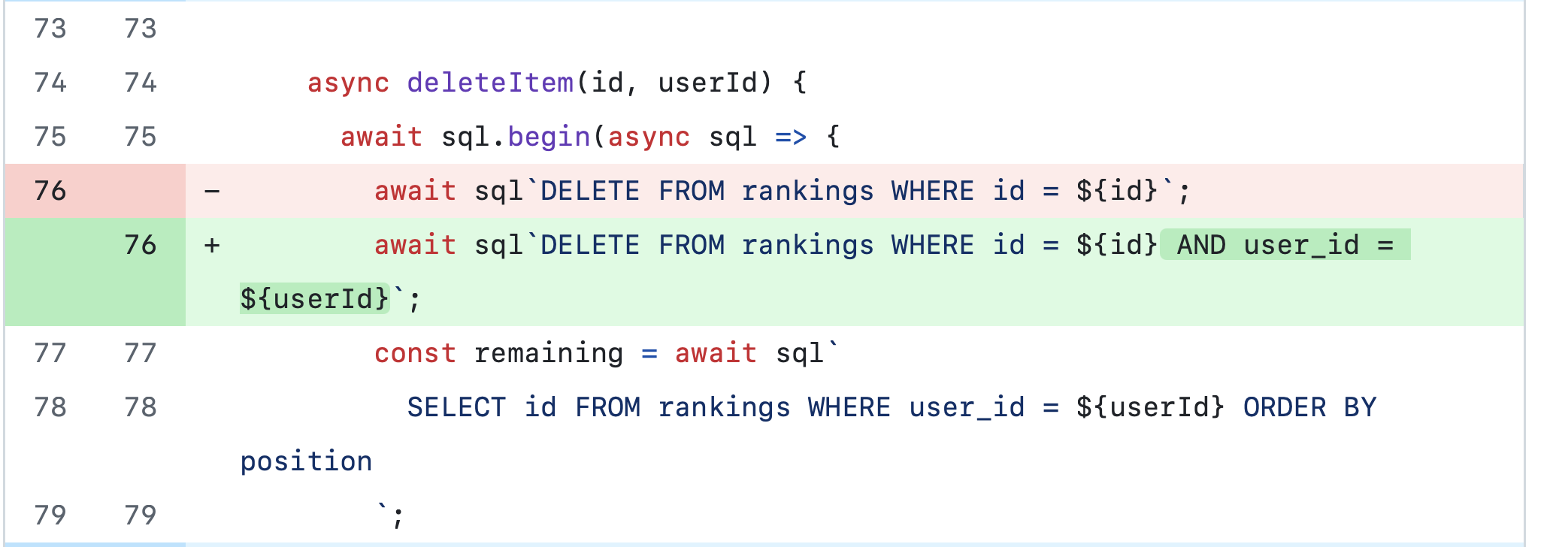
AppSec Issue #1: No authorization on actions
Allows one user to delete another user’s posts

Slide 68
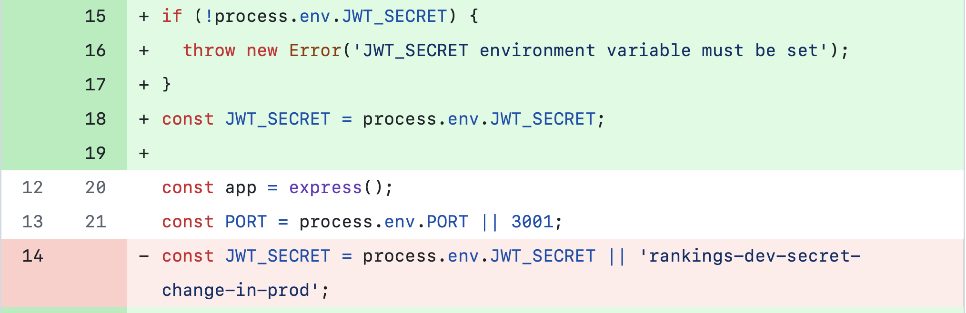
AppSec Issue #2: Insecure defaults
If we misconfigure the deployment, we default to a fixed secret
Would allow forging auth tokens
Open question: How can we do better?

Slide 69
Other Activities: Attacks Defenses
&
Notes:
Brief treatment of how LLMs affect the defensive side of code security, plus their use as offensive tools for code manipulation.

Slide 70
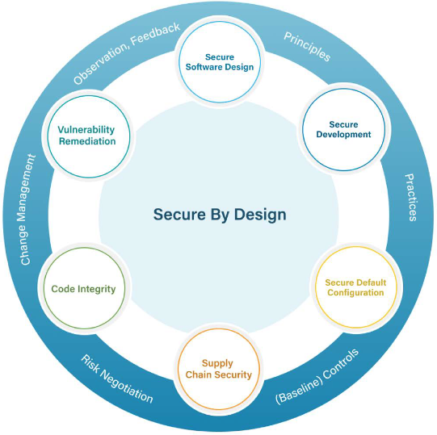
Recall: Secure by Design
Secure Software Design
Secure Development
Secure Default Configuration
Supply Chain Security
Code Integrity
Vulnerability Remediation
Notes:
Show the circle diagram from p.9 of the paper. This is the organizing framework for the next 20 minutes.
Point out the structure: the six considerations aren’t independent – they form a cycle. The connecting arcs matter too: - Principles flow from design into development - Practices flow from development into configuration - Baseline controls connect configuration to supply chain - Risk negotiation connects supply chain to code integrity - Change management connects code integrity to vulnerability remediation - Observation and feedback connect vulnerability remediation back to design
This is a continuous improvement loop, not a one-time checklist.
Tell students: “We’re going to walk through each of these six, using our CMS example. By the end, you’ll see how they fit together into a coherent process.”

Slide 71
Defense: Threat Modeling and Secure Design
LLMs as interactive threat modeling assistants:
Generate candidate STRIDE threats
Populate attack trees
Suggest mitigations
Key caution: risk of false confidence from AI-reviewed threat models
Notes:
LLMs can lower the barrier for teams without a dedicated security expert by generating candidate threats and mitigations. But they’re good at generating plausible-sounding threats and may miss context-specific ones. Human prioritization remains essential. The risk of false confidence – a threat model “reviewed by AI” that has significant gaps – is a real concern.

Slide 72
Supply Chain Security, Code Integrity
Attack
Defense
LLMs generate convincing fake packages for typosquatting
Produce malicious README files and CI/CD configurations
LLM-written malicious code in PRs
Assist in software composition analysis
Notes:
LLMs can generate convincing fake packages for typosquatting/dependency confusion attacks, produce malicious README files that look legitimate, and generate plausible-looking CI/CD pipeline configurations. On the defensive side, LLMs can assist in software composition analysis, flagging unusual dependency graphs or commit patterns. However, no strong published benchmarks exist for either offensive or defensive LLM capability in supply chain security.
For supply chain security background: Okafor et al. “SoK: Analysis of Software Supply Chain Security.” SCORED 2022.
LLM agents autonomously modify web server source code (across 5 different frameworks) to exfiltrate cleartext passwords. On first attempt, with a single prompt. Carlini et al. 2025, Section 1.6. This demonstrates that LLMs can not only find vulnerabilities but also write malicious code. The agents modified production web server code across five different frameworks to silently exfiltrate cleartext passwords. They also generated polymorphic variants to evade signature detection. This was achieved on the first attempt with a single prompt – no iteration required.

Slide 73
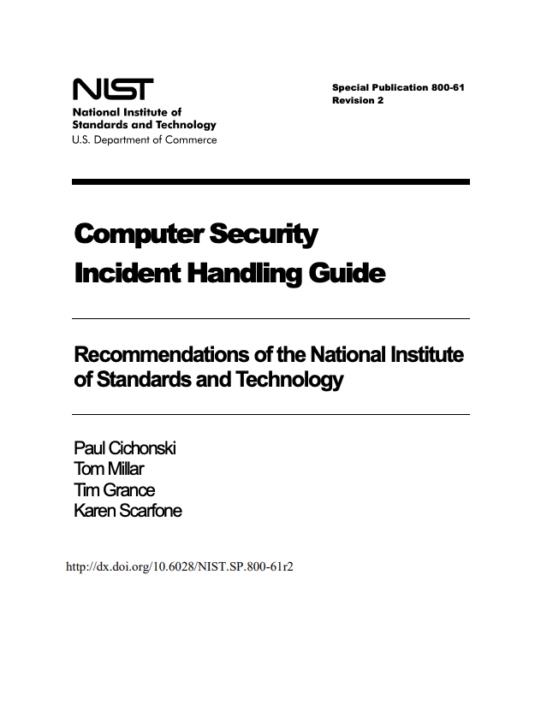
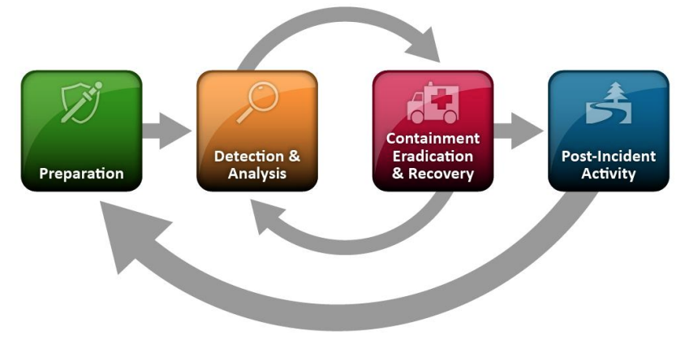
Recall: The Incident Lifecycle
Notes:
[FIGURE: Circular diagram showing six phases: Preparation → Detection & Analysis → Containment → Eradication → Recovery → Lessons Learned, with arrows connecting each phase in a cycle and a feedback arrow from Lessons Learned back to Preparation.]
The NIST Computer Security Incident Handling Guide (SP 800-61) defines the standard framework for incident response. It has six phases forming a cycle. This is the framework used by most organizations and referenced in certifications like CISSP and GCIH.

Slide 74
Intrusion Detection
Attack
Defense
Generate traffic patterns that evade learned detectors
Natural-language explanation of alerts
Grouping related events
Reducing analyst cognitive load on triage
Monitor LLM API traffic for adversarial patterns
Notes:
LLMs are well-suited to the triage problem: they can parse structured logs, explain alerts in natural language, group related events, and reduce the cognitive load on analysts. This doesn’t solve the false positive problem, but it can help analysts process the alert volume more efficiently. The key value is in translation and summarization – turning machine-readable alerts into human-understandable narratives.
Carlini et al. suggest that API-based LLM usage leaves detectable traces that could be monitored for adversarial patterns. If an attacker uses a closed-model API for reconnaissance or exploit development, the API provider could potentially detect this. However, this only works for closed models – open-source models running locally leave no such trace, and as open-source capability improves, this detection opportunity weakens.

Slide 75
Incident Response
Attack
Defense
LLMs as IR assistants:
Summarize timelines
Draft communications
Suggest containment steps
Notes:
LLMs can assist with incident response tasks that involve significant writing and analysis. Timeline summarization, communication drafting (connects to Project 1 from the course), and suggesting containment steps based on the incident type are all areas where LLMs can reduce response time.

Slide 76
Synthesis: Who Wins?
Notes:
The concluding section asks the big question: does GenAI favor attackers or defenders? The answer is nuanced and depends on the time horizon.

Slide 77
Short-Run: Attackers Likely Benefit More
Defenders operate under legal and ethical constraints
Adversarial users of LLMs face none of these
The asymmetry from security economics is amplified: defenders must block everything; attackers need one success
Long-Run: Genuinely Uncertain
Notes:
In the short run, the asymmetry between offense and defense is amplified by LLMs. Defenders must operate within legal and ethical constraints; attackers using jailbroken or purpose-built adversarial LLMs face no such constraints. The fundamental asymmetry from the economics lecture – defenders must block everything while attackers need only one success – is amplified when the attacker has a capable, unconstrained assistant.

Slide 78
The Science Gap
Offensive LLM capability: reasonable data exists (CVE-Bench, AIxCC, Anthropic)
Defensive LLM capability: very little rigorous data on whether it actually improves outcomes
This is a research gap and an opportunity
Notes:
To reiterate the most important point: we have reasonable data on offensive LLM capability, but we have very little comparably rigorous data on whether LLM-assisted defenses actually improve outcomes in practice. This asymmetry in our knowledge may itself be dangerous – it could lead to overestimating the threat or underinvesting in defensive applications. Closing this gap is a significant research opportunity.

Slide 79
References and Further Reading
Carlini, N., et al. “LLMs unlock new paths to monetizing exploits.” arXiv:2505.11449, 2025.
Zhu, Y., et al. “CVE-Bench: A Benchmark for AI Agents’ Ability to Exploit Real-World Web Application Vulnerabilities.” ICML 2025.
Carlini, N., et al. “Evaluating and mitigating the growing risk of LLM-discovered 0-days.” red.anthropic.com, 2026.
Barrett, C., et al. “Identifying and Mitigating the Security Risks of Generative AI.” arXiv:2308.14840, 2024.

Slide 80
References (cont.)
DARPA. “AI Cyber Challenge marks pivotal inflection point for cyber defense.” darpa.mil, 2025.
Deng, G., et al. “PentestGPT: An LLM-Empowered Automatic Penetration Testing Tool.” arXiv:2308.06782, 2023.
Fang, R., et al. “LLM Agents can Autonomously Hack Websites.” arXiv:2402.06664, 2024.
Fang, R., et al. “Teams of LLM Agents can Exploit Zero-Day Vulnerabilities.” arXiv:2406.01637, 2024.

Slide 81
References (cont.)
Heiding, F., et al. “Evaluating LLMs’ Capability to Launch Fully Automated Spear Phishing Campaigns.” arXiv:2412.00586, 2024.
Pearce, H., et al. “Asleep at the Keyboard? Assessing the Security of GitHub Copilot’s Code Contributions.” IEEE S&P 2022.
Xia, C.S., et al. “Fuzz4All: Universal Fuzzing with Large Language Models.” arXiv:2308.04748, 2023.

Slide 82
References (cont.)
CNN. “Finance worker pays out $25 million after video call with deepfake CFO.” February 4, 2024.
Okafor et al. “SoK: Analysis of Software Supply Chain Security.” SCORED 2022.
Zhang, A.K., et al. “Cybench: A Framework for Evaluating Cybersecurity Capabilities and Risks of Language Models.” arXiv:2408.08926, 2024.
Bhatt, M., et al. “CyberSecEval 2: A Wide-Ranging Cybersecurity Evaluation Suite for Large Language Models.” arXiv:2404.13161, 2024.

