Slide 1


Secure Systems Engineering and Management
A Data-driven Approach
Michael Hicks
A Science of Security
UPenn CIS 7000-003
Spring 2026

Slide 2
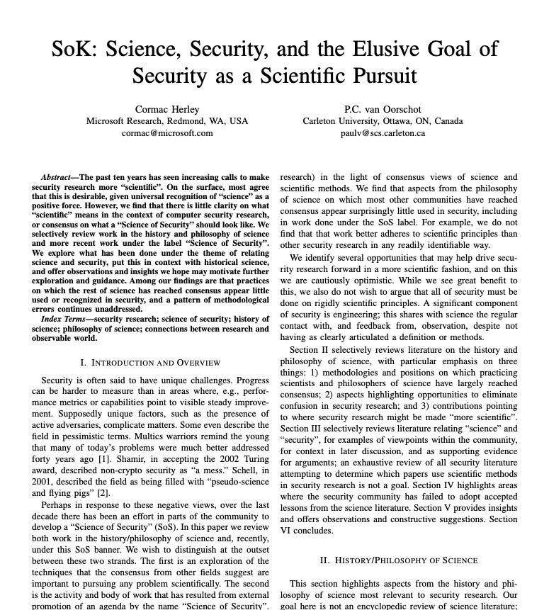
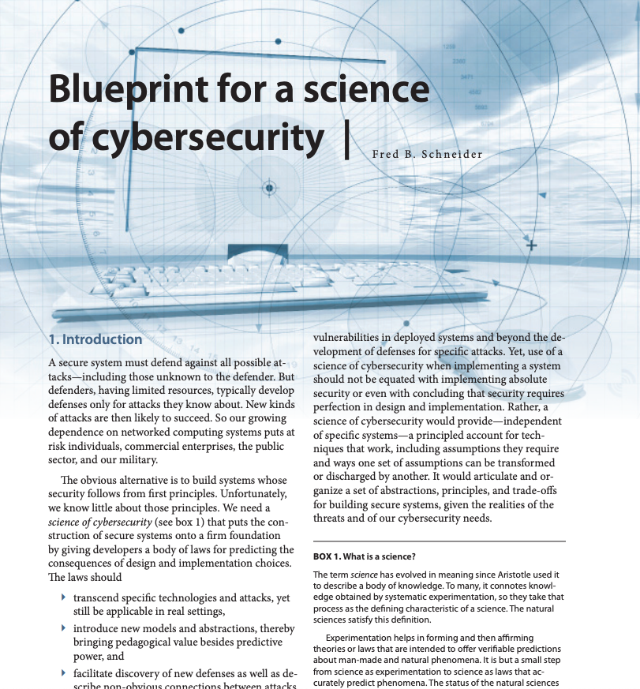
(optional)
Notes:
Herley paper in 2017
FB Schneider paper in 2012

Slide 3
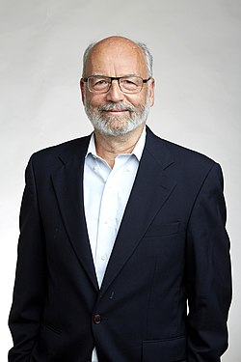
Can we escape the security mess?
“In 10 years non-crypto security will remain a mess.”
— Adi Shamir (co-inventor of RSA), in 2002
How to improve this state of affairs?
Maybe: Seek to develop cybersecurity science
Notes:
Shamir’s prediction: https://financialcryptography.com/mt/archives/000147.html
Key insight: Cryptography succeeded because it developed mathematical foundations—provable guarantees. But the systems, users, and policies surrounding crypto remained messy.

Slide 4
What is science?
Science is a
body of knowledge
Observation/question
Report conclusions
Research topic area
Science is a process
Analyze data
Hypothesis
Test with experiment

Slide 5
The opening question
“In what ways is cybersecurity (not) a science?”
Notes:
This question frames the entire session.
What would it take for security to be a science?
Physics has laws, chemistry has the periodic table… What does security have?
Draw out student intuitions:
- Do they think security IS a science? Why or why not?
- What makes something “scientific”?
- Have them consider: reproducibility, falsifiability, predictive power

Slide 6
What is the scientific process?
Induction: generalizing from observation, constructing or refining a consistent model
Observation/question
Report conclusions
Research topic area
Falsification: Confirming or refuting a prediction against reality
Deduction: making a prediction from the model
Analyze data
Hypothesis
Test with experiment
Notes:
Deductive statements are certain consequences of premises, induction is always subject to error.
So: Science is about falsification. Popper: “A theory which is not refutable by any conceivable event is non-scientific. Irrefutability is not a virtue of a theory (as people often think) but a vice” – true if the theory is meant to apply to the real world.
Marxist theory and Freudian analysis are non scientific – elastic enough to not be refutable. Religion and mathematics.
Thus, science progresses by finding errors.

Slide 7
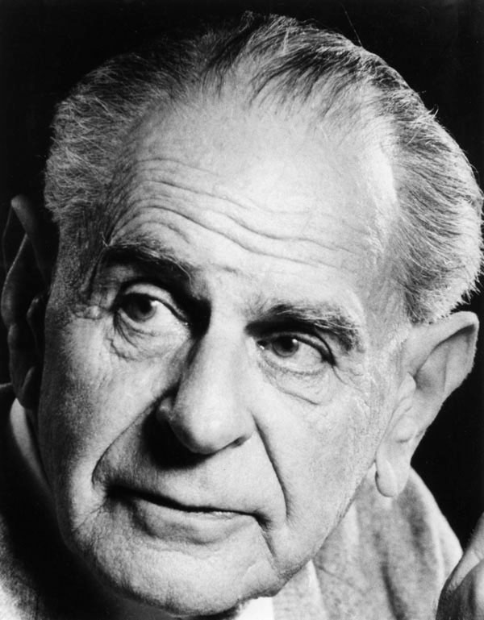
Karl Popper’s view: Falsifiability is critical
“A theory which is not refutable by any conceivable event is non-scientific. Irrefutability is not a virtue of a theory (as people often think) but a vice”
Notes:
Marxist theory and Freudian analysis are non scientific – elastic enough to not be refutable. Religion and mathematics.

Slide 8
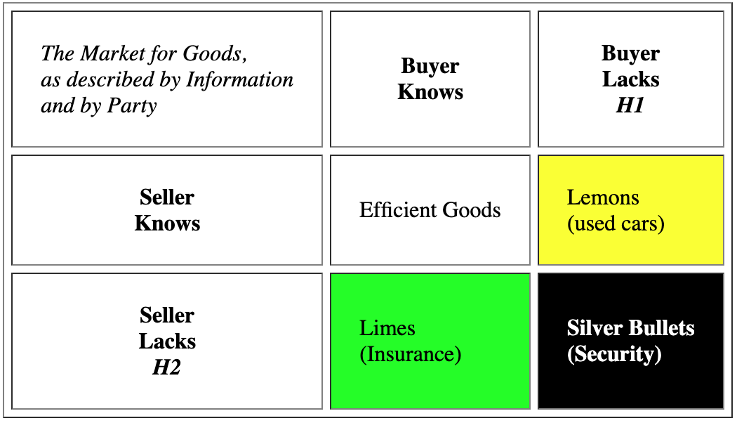
Context: Silver bullets, not lemons
2008
Extends Anderson:
Security is a good
Security is hard to assess
  Leads to information insufficiency on both sides
Lacks empirical basis, i.e., falsifiability
Notes:
Ian Grigg: Cryptographer, financial cryptography researcher at Systemics, Inc.
Paper draws on Nobel Prize economics: Akerlof (lemons), Spence (signaling), Rothschild & Stiglitz (insurance)
Market for Lemons: Seller knows quality, buyer doesn’t (used cars)
Market for Limes: Buyer knows their risk, seller doesn’t (insurance—high-risk buyers seek more coverage)
Market for Silver Bullets: Neither party has sufficient information (security)
Key insight: The seller of a security product genuinely doesn’t know if it will stop a real attacker. This isn’t information hiding—it’s information absence.

Slide 9
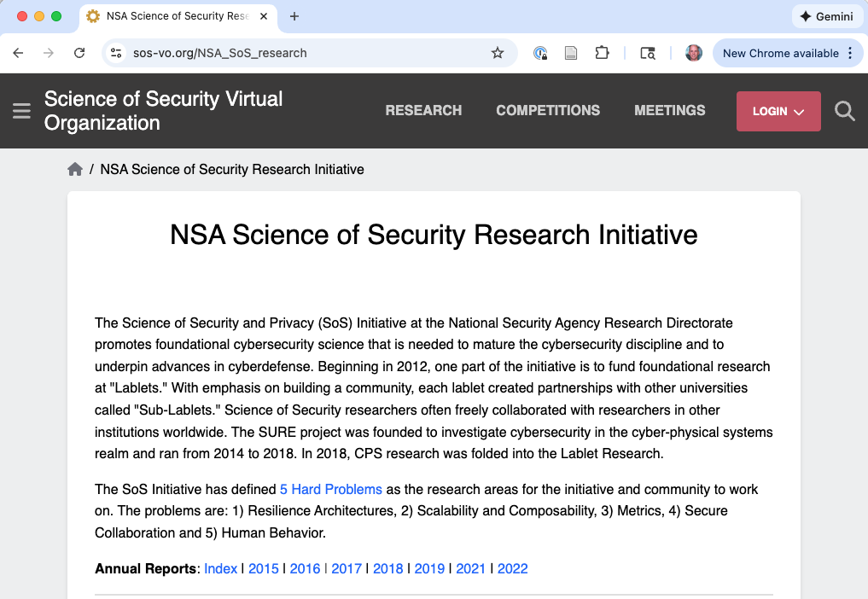
2012
Notes:
~2011-2012: NSA Science of Security Initiative
NSA Research Directorate establishes SoS Initiative
Goal: “Promote foundational cybersecurity science”
Creates Science of Security Virtual Organization (sos-vo.org)
Establishes paper competitions for rigorous research
November 2012: First SoS Community Meeting
150+ leaders from government, industry, academia
Spanning math, CS, behavioral science, economics, biology
Can you make something scientific by funding it? Or does the field need something more fundamental?

Slide 10
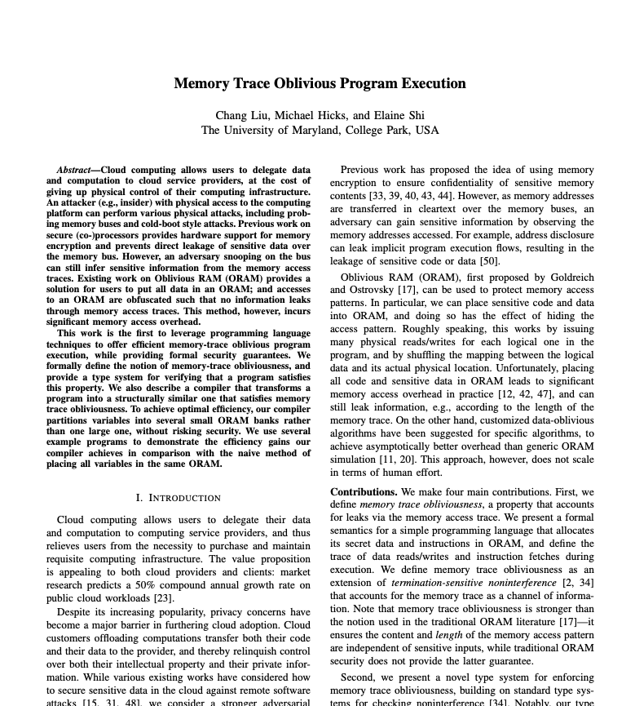
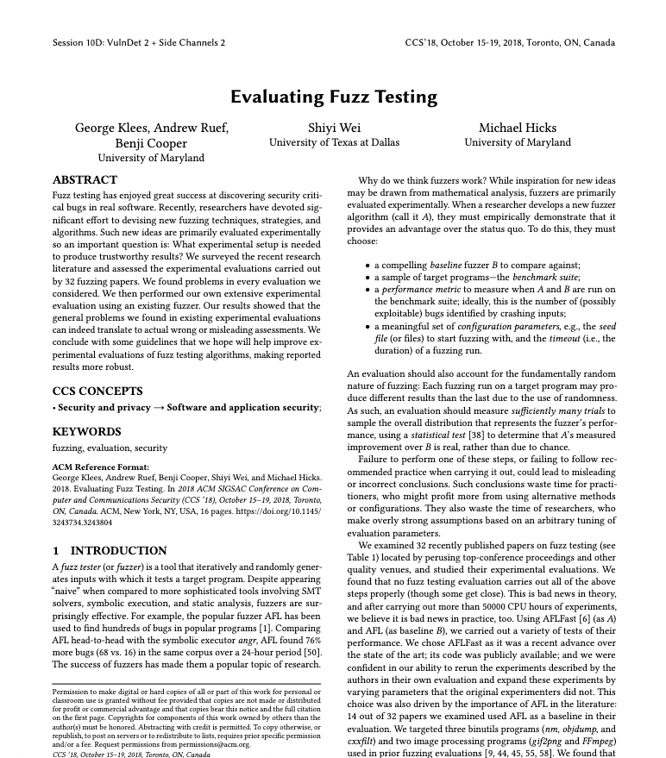
2013
2018
Notes:
NSA Best Scientific Cybersecurity paper competition winners!
The left one is not very scientific per Herley, but fits closer to the mold of Schneider
The right one is empirical through and through

Slide 11
Cybersecurity science
Why do we want or need this?
Science helps us understand reality; missing that for security
  Would like durable understanding – laws (like motion, entropy, etc.)
Science is successful, current cybersecurity practice is not
Sciences like physics, chemistry, medicine speak about nature
Security is about human-made systems – science of the artificial
Big part of the challenge!

Slide 12
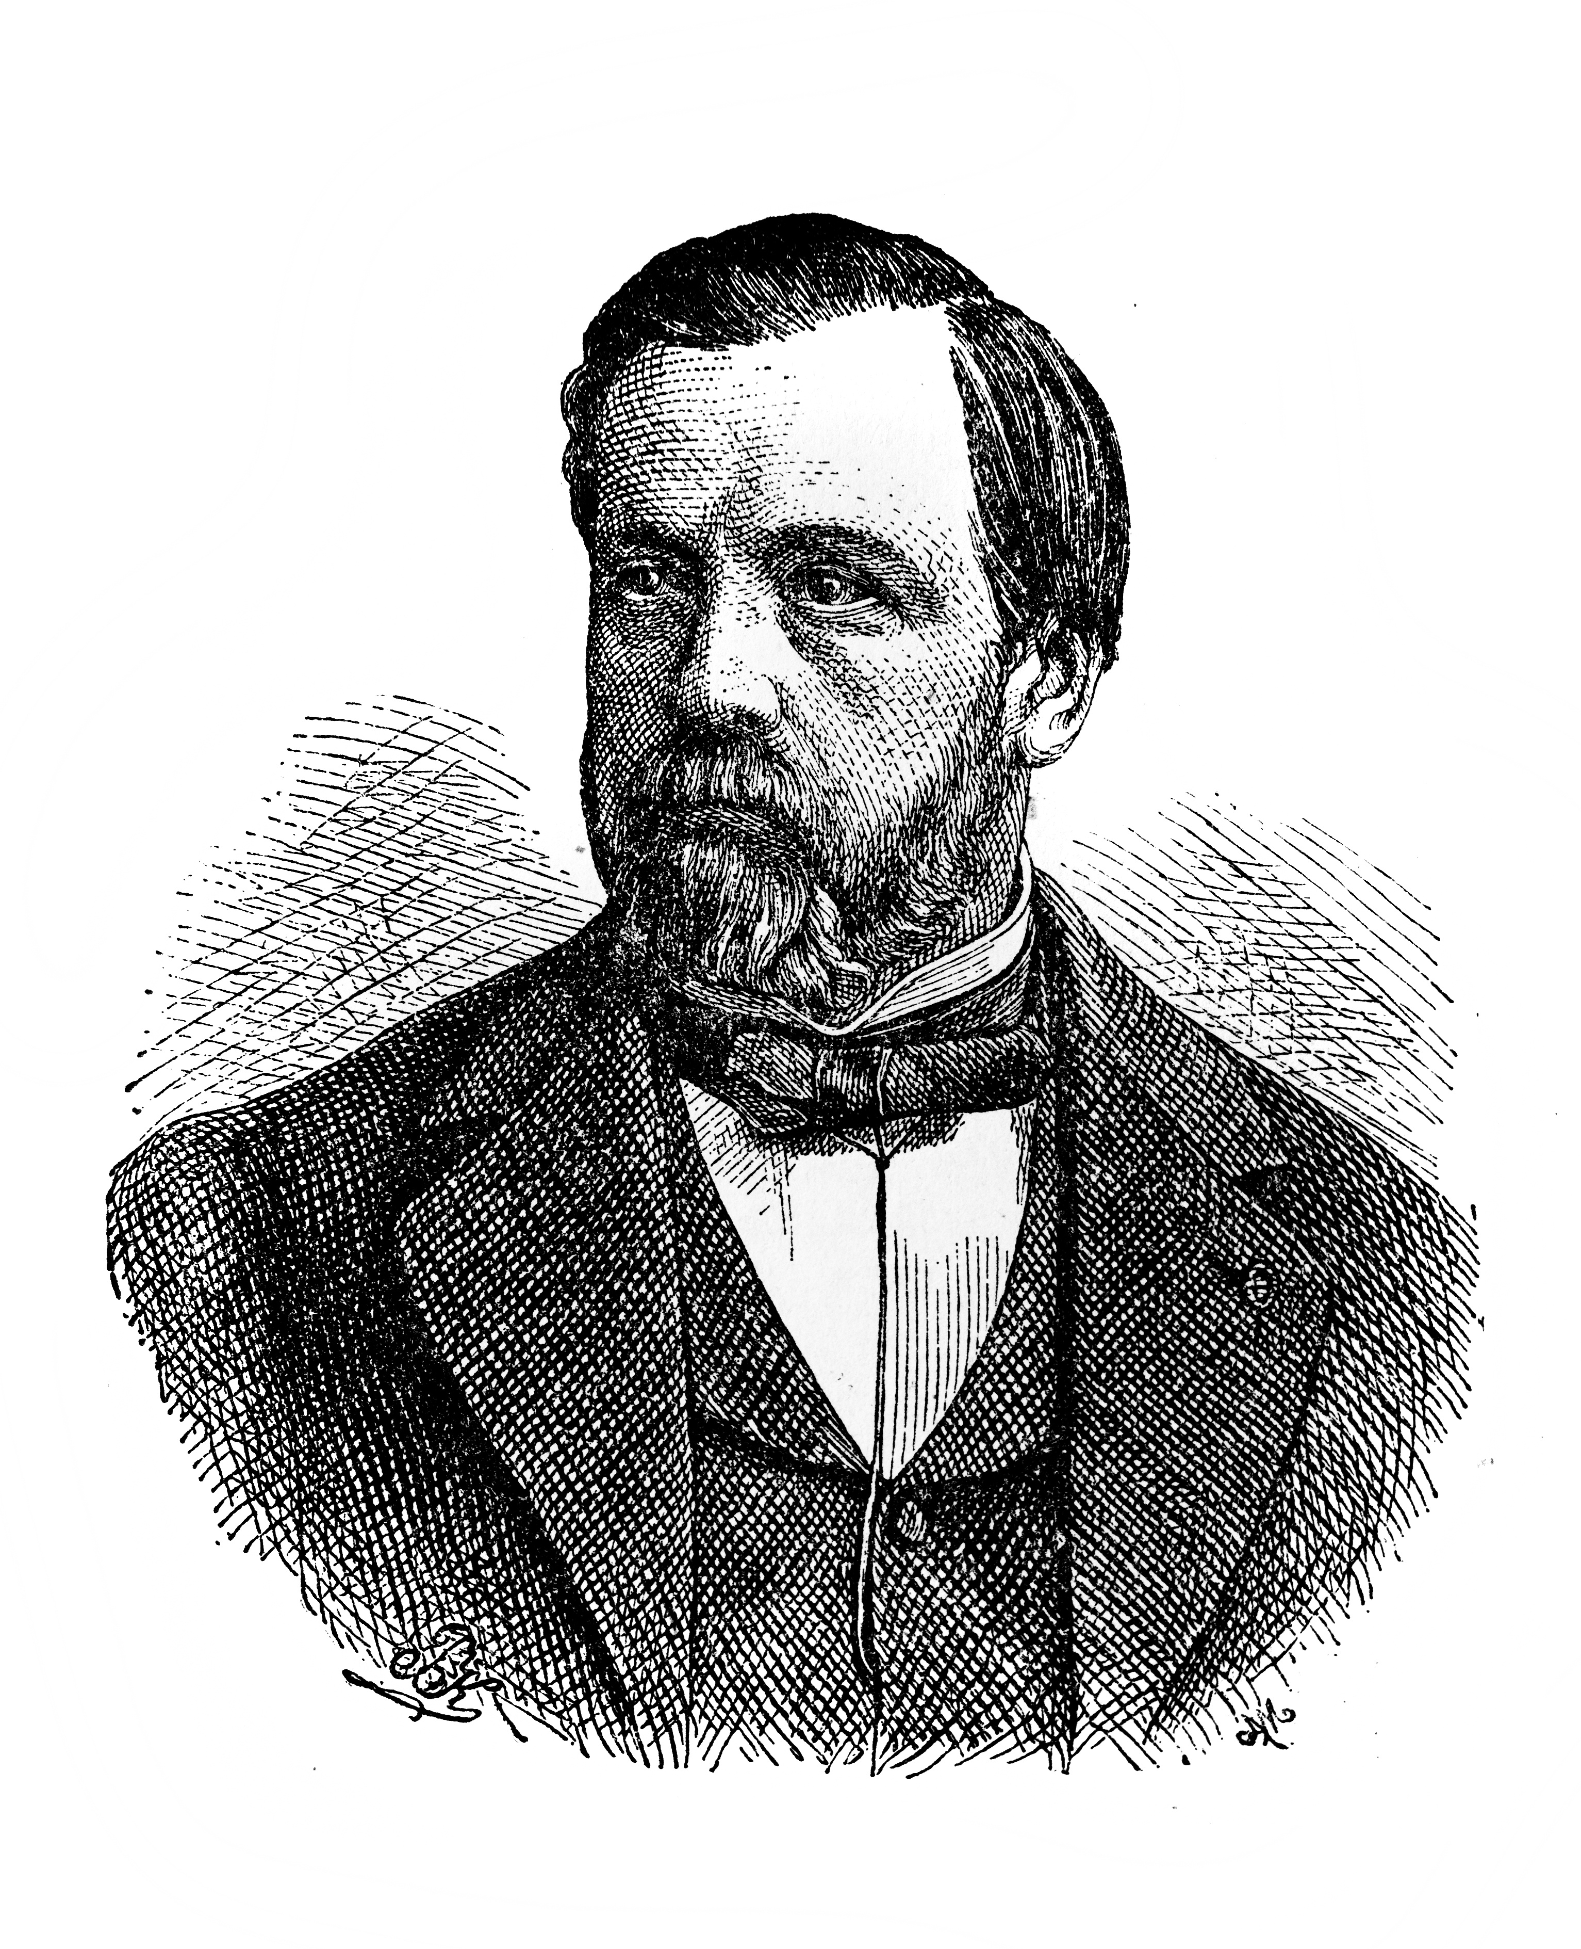
What is applied science?
the application of the scientific method for achieving practical goals, rather than purely for knowledge discovery, and
the use of accumulated scientific theories, knowledge, methods, and techniques to that end
What are the practical goals for security?
Louis Pasteur

Slide 13
Model: Cryptography
Schneider: “The field of cryptography comes close to exemplifying the kind of science base we seek.”
“Is cryptography scientific?”

Slide 14
Model: Cryptography
Schneider: “The field of cryptography comes close to exemplifying the kind of science base we seek.”
Krawczyk: “By its very nature, there is no (and cannot be) empirical evidence for the security of a design. Indeed, no concrete measurements or simulations can show that attacks against a cryptographic scheme are not feasible. The only way to do so is to develop a formal mathematical model and language in which to reason about such schemes”

Slide 15
The Fundamental Asymmetry
We can observe:
✅ Insecurity (attacks succeed, systems fail)
We cannot observe:
❌ Security (absence of attacks ≠ security)
This is not a temporary limitation.
It’s a fundamental asymmetry.
Notes:
This is the core insight that drives everything else.
Analogy: We can observe disease (symptoms, tests) but “health” is much harder to observe directly.
Same with security: we see breaches, but not “secure.”

Slide 16
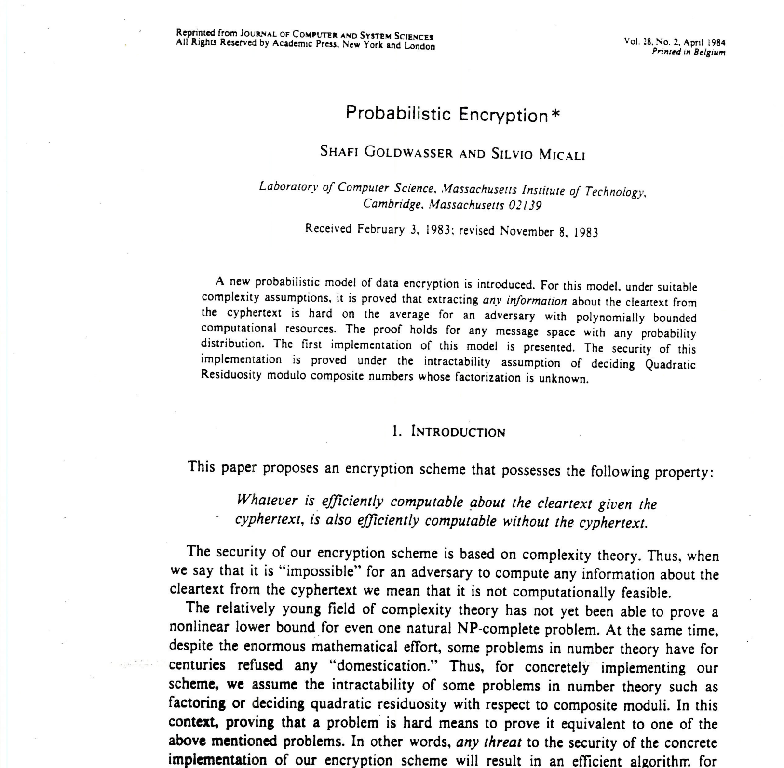
Provable security
Cryptography achieved what Schneider wants for all security:
  Formal security definitions (e.g., semantic security)
  Adversary models (what the attacker can do)
  Computational assumptions (e.g., factoring is hard)
  Reduction proofs showing: "break scheme → break assumption"
Result: Mathematically grounded confidence in cryptographic constructions
Notes:
Goldwasser & Micali (1982-84) introduced "semantic security" and the first provably secure public-key encryption.
This is THE example Schneider points to. Before this, crypto was like current security: ad hoc designs, broken repeatedly.
The methodology:
Define precisely what "secure" means (semantic security: ciphertext reveals nothing about plaintext)
Define the attacker's capabilities (chosen-plaintext, chosen-ciphertext, etc.)
State computational assumptions explicitly (factoring, discrete log, etc.)
PROVE via reduction: any attack on scheme → algorithm for breaking assumption
Key paper: Goldwasser & Micali, "Probabilistic Encryption," Journal of Computer and System Sciences, 1984.
This won them the Turing Award (2012).

Slide 17
Proofs are only as good as their assumptions
Component | Can Fail When…
Security definition | Doesn’t capture real attack goals
Attacker model | Real attackers have more capabilities
Computational assumption | Assumption turns out false
Reduction | Gap between model and implementation

Slide 18
Deduction vs. Induction
powerful
discovery…”
“Deduction in itself is quite powerless as a method of scientific
But with a useful model, you can deduce surprising and useful results
  Shannon's channel capacity theorem (1948)
  Gödel's incompleteness theorems (1931)
  Deductions from Euclidean geometry (e.g., Pythagorean theorem)
Schneider’s examples
  Execution monitoring
  Byzantine fault tolerance
Notes:
Shannon's channel capacity theorem (1948) — Claude Shannon proved that information can be transmitted reliably over a noisy channel up to a specific limit (the channel capacity), and that error-correcting codes exist that approach this limit. Engineers had assumed noise would always degrade signals proportionally—the existence of a sharp threshold was unexpected and revolutionized communications.
Gödel's incompleteness theorems (1931) — Kurt Gödel proved that any consistent formal system powerful enough to express arithmetic contains true statements it cannot prove, and cannot prove its own consistency. This demolished Hilbert's program to place all of mathematics on a secure, complete foundation. The philosophical implications—that mathematical truth outruns provability—remain profound and debated.

Slide 19
Schneider’s view: laws and principles
A science should provide first principles that allow developers to predict the consequences of design and implementation choices.
The Cryptography Analogy:
Cryptography developed laws — mathematical foundations
Information theory gives provable bounds
Question: Can we do the same for security broadly?
Notes:
Paper: https://www.cs.cornell.edu/fbs/publications/SoS.blueprint.pdf
Schneider distinguishes:
- Science: discovering laws about what’s possible
- Engineering: building artifacts using those laws
His vision is prescriptive—he’s saying what we SHOULD do.

Slide 20
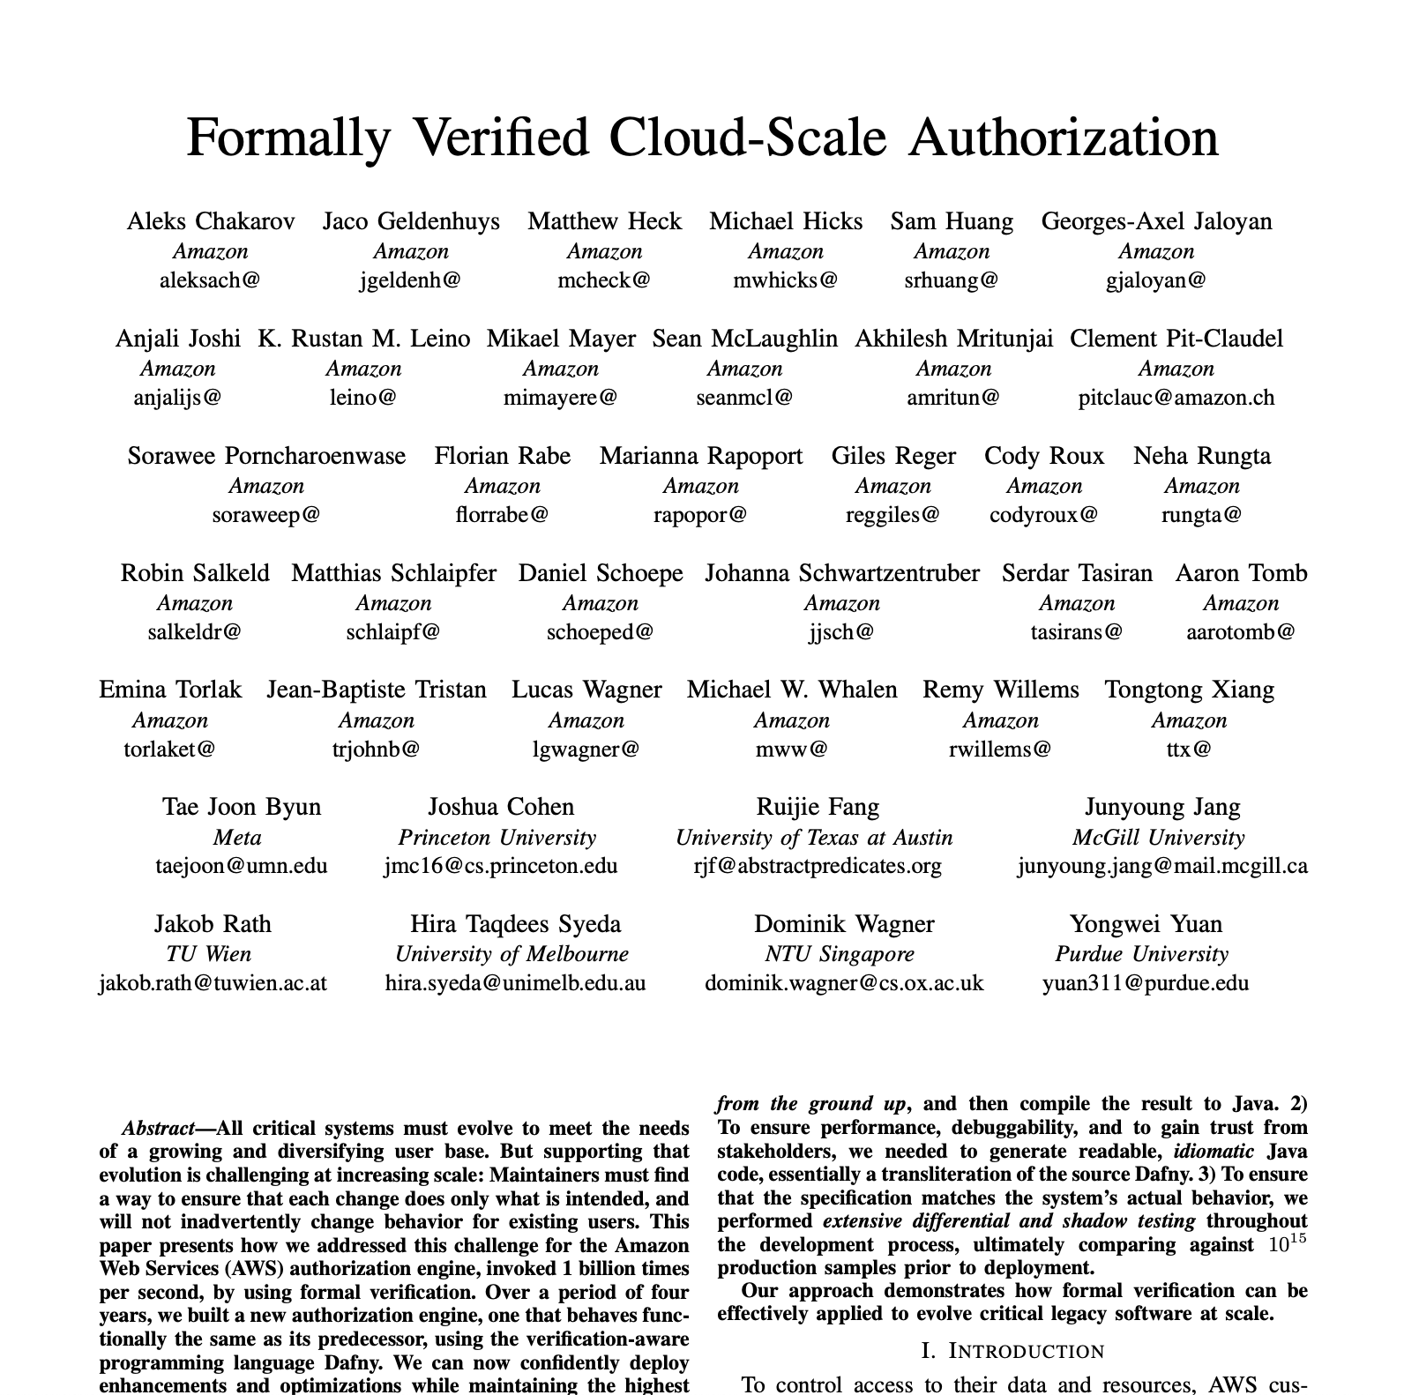
Formal methods
Formally verified replacement for existing AWS authorizer
  Deduction: the implementation matches the specification
  Induction: The specification does what we want it to do …
    defined by existing reality …
    confirmed by further deductions!

Slide 21
Key challenge: Specifying security
To know if a system is secure, we have to
Develop a model for it
Describe what the model should (and should not) do
Prove the model satisfies our description
Establish that the model, and its assumptions, represent reality
What do security specifications look like?
Schneider: Hyperproperties

Slide 22
Cybersecurity practice: Anti-patterns
Unfalsifiable claims
Confusing sufficient with necessary
Can never argue anything out
Implicit assumptions
Data sparsity

Slide 23
Unfalsifiable Claims
Claim: “You must do X to be secure”
To prove this wrong, you need:
Something that doesn’t do X
That is provably secure
But you can never prove something is secure.
Therefore: Necessity claims are unfalsifiable.
Notes:
This is Herley’s core logical argument.
Compare to Popper’s demarcation criterion: scientific claims must be falsifiable.
If security necessity claims are unfalsifiable, what does that make them?
(Herley’s Slide 18 asks provocatively: “Is Computer Security a Pseudo-Science?”)

Slide 24
Confusing Sufficient for Necessary
Sufficient: X is enough to achieve Y
Necessary: You can’t achieve Y without X
In security, we often confuse these:
“Avoiding password reuse is sufficient to counter some attacks”
Gets interpreted as: “Avoiding password reuse is necessary for security”
But it’s impossible to achieve across 100 accounts!
Notes:
From slide 22.
This is subtle but important. A measure being helpful (sufficient for some protection) doesn’t mean it’s required (necessary for any protection).
When we treat everything as necessary, we create impossible requirements.
ANIMATION SUGGESTION: Venn diagram showing sufficient vs necessary conditions

Slide 25
The Password Portfolio Impossibility
Standard advice:
Passwords should be random and strong (~40 bits)
Never reuse passwords across accounts
For N = 100 accounts:
N × log₂(S) + log₂(N!) = 4,000 + 524 = 4,524 random bits
Equivalent to memorizing:
1,361 digits of pi
Order of 17 shuffled card decks
Notes:
From Herley’s slides (Slide 4).
This isn’t just “burdensome”—it’s PROVABLY IMPOSSIBLE.
Yet these rules persisted for decades. 30 seconds of arithmetic would show they can’t work.
“Something broken upstream in our logic”
IMAGE SUGGESTION: Playing cards or pi digits visual

Slide 26
Implicit Assumptions
Morris & Thompson (1979): Password security paper
Made reasonable assumptions for 1979
Conclusions persisted long after assumptions changed
When assumptions are implicit:
Can’t assess if conclusions still hold
Can’t argue changed circumstances
Old advice becomes immune to critique
Notes:
From slide 24.
The Morris & Thompson paper is foundational—but the threat model has changed dramatically.
“Hard to argue that you’ve been assaulting assumptions if you can’t list them”

Slide 27
The One-Sided Ratchet
Science advances through self-correction:
Wrong ideas get falsified and abandoned.
In security:
✅ New attacks argue countermeasures IN
❌ Nothing argues countermeasures OUT
Result: A ratchet that only goes one direction
Requirements accumulate endlessly
Resources spread across ever more defenses
Old measures become “received wisdom”
Notes:
From slides 21, 23.
The ratchet metaphor is powerful. Draw it on the board if helpful.
Ask: Can anyone think of a security measure that was REMOVED due to evidence it wasn’t necessary?
(Password rotation requirements being relaxed is one possible example—discuss if raised)

Slide 28
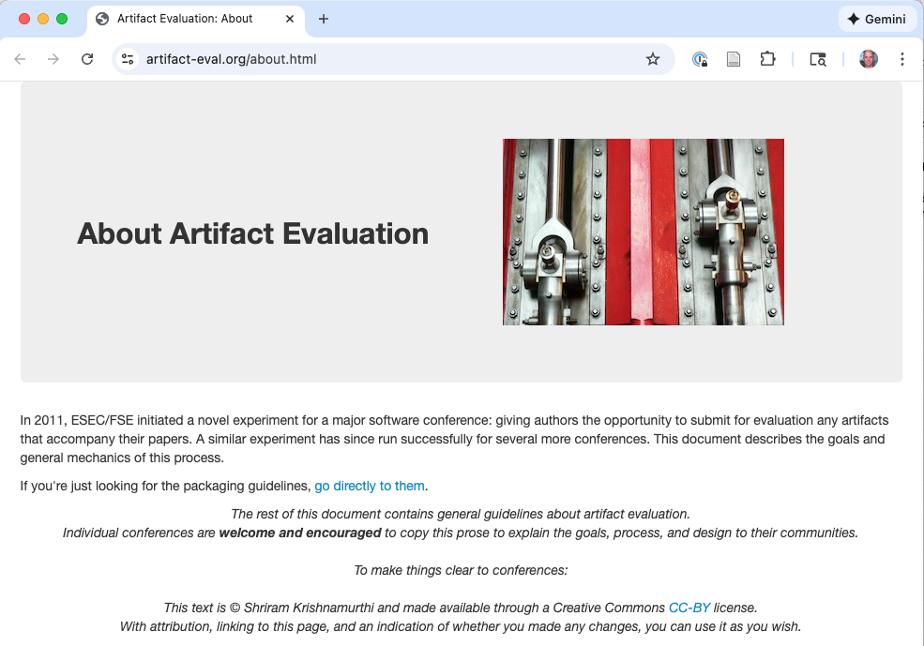

Slide 29
Data Sparsity Problem
Attack frequency varies enormously:
Password Guessing: 10⁻² to 10¹ per user
Spam: 10⁻⁵ to 10⁻³
Intrusion Detection: 10⁻⁷ to 10⁻⁵
DoS: 10⁻¹⁰ to 10⁻⁷
When data is sparse, iterative feedback is harder.
Obscuring/denying uncertainty is harmful.
Notes:
From slide 26.
This shows why empirical security is hard—different domains have vastly different data availability.
Password guessing: we have lots of data DoS attacks: extremely rare per organization
How do you do science with 10⁻¹⁰ frequency events?

Slide 30
Question 1: Does Breach Data Help?
Herley: Necessity claims are unfalsifiable.
But: Organizations have breach data. They know when they get compromised.
Discussion:
Does a breach falsify sufficiency or necessity?
What would an observation that falsifies “strong passwords are necessary” look like?
Can we distinguish “policy failed” from “user didn’t follow policy”?
Notes:
This is a key question for discussion.
Draw out: Breach data tells us about OUTCOMES, but not necessarily about which measures were necessary.
A breach tells us our defenses weren’t sufficient. But a NON-breach doesn’t tell us which measures were necessary vs. unnecessary.

Slide 31
Question 2: Comparing Visions
Schneider: We need first principles and formal methods—more rigor, better engineering.
Herley: The problem is unfalsifiable claims and lack of feedback.
Discussion:
Are these compatible or in conflict?
Which diagnosis is more compelling?
Does formal verification avoid unfalsifiability?
Notes:
This is about comparing the two papers directly.
Schneider: BUILD better systems Herley: KNOW if systems are better
These could be complementary—or they could be in tension.
Does proving a system correct avoid Herley’s concerns? Or does it just push the assumptions elsewhere?

Slide 32
Question 3: Has the Landscape Changed?
Since 2017:
Mandatory breach disclosure laws
Standardized breach cost reporting (IBM, Verizon DBIR)
Growth in empirical security research
Discussion:
Have these addressed Herley’s concerns?
Can we now argue countermeasures OUT?
Is reduced password rotation requirements an example of self-correction?
Notes:
This connects to Part 4 materials on recent developments.
The field HAS changed since 2017: - More data available - More empirical research - Some practices abandoned (e.g., frequent password rotation)
But has the FUNDAMENTAL problem been solved?

Slide 33
Question 4: Practical Takeaways
Scenario: A CISO asks: “Should we implement security measure X?”
Based on these papers:
What questions should they ask before deciding?
How can practitioners apply these insights?
What’s the role of threat modeling?
You can’t wait for perfect science.
Notes:
This grounds the theoretical discussion in practice.
Key practical question to ask: “What would convince me this is NOT necessary?”
Threat modeling: Does making assumptions explicit help? Or is it “turtles all the way down”?
Balance: Action under uncertainty vs. accumulating unfalsifiable requirements

Slide 34
OECD Measurement Initiative
2024: OECD Digital Economy Paper 366
“New Perspectives on Measuring Cybersecurity”
Proposes standardized measurement frameworks
“Cybersecurity uncertainty” as a concept
Addresses methodological challenges
Acknowledges: Fundamental measurement challenges remain
Notes:
This is a policy-level recognition that measurement is hard.
The OECD paper tries to standardize what we CAN measure, while acknowledging limits.

Slide 35
Academic Empirical Security Research
Growth of measurement-focused groups:
Stanford Empirical Security Research Group
ACM Internet Measurement Conference (IMC)
Empirical methods in S&P, USENIX Security
Examples of progress:
Password behavior across real populations
Certificate transparency log analysis
Longitudinal vulnerability/patching studies
Honeypot data on actual attack patterns
Notes:
Stanford ESRG: https://esrg.stanford.edu/
There’s now a substantial academic subfield doing empirical security research.
This is real progress—but does it solve Herley’s fundamental concerns?

