Slide 1


Secure Systems Engineering and Management
A Data-driven Approach
Michael Hicks
Recap
UPenn CIS 7000-003
Spring 2026

Slide 2

Course goals: You will be able to
Understand cybersecurity from a data-driven and economic perspective, learning to make decisions based on empirical evidence, following good science
Identify key vulnerabilities and threats, especially when considering the impact of humans, both when they are attack targets and when the play a role in ensuring a system’s security
Follow a well-designed process for secure systems construction, from threat modeling to building to testing to maintenance
Manage security operations – preventing, detecting, mitigating, and recovering from incidents – and gather data to improve future posture
Make risk-informed decisions: Assess designs and technologies according to how they mitigate security risk, while leveraging insurance and responding to regulation
Communicate effectively and with empathy to key stakeholders about security options and recommendations
All while taking a data-informed approach

Slide 3
Course goals: You will be able to
Understand cybersecurity from a data-driven and economic perspective, learning to make decisions based on empirical evidence, following good science
Identify key vulnerabilities and threats, especially when considering the impact of humans, both when they are attack targets and when the play a role in ensuring a system’s security
Follow a well-designed process for secure systems construction, from threat modeling to building to testing to maintenance
Manage security operations – preventing, detecting, mitigating, and recovering from incidents – and gather data to improve future posture
Make risk-informed decisions: Assess designs and technologies according to how they mitigate security risk, while leveraging insurance and responding to regulation
Communicate effectively and with empathy to key stakeholders about security options and recommendations
All while taking a data-informed approach

Slide 4
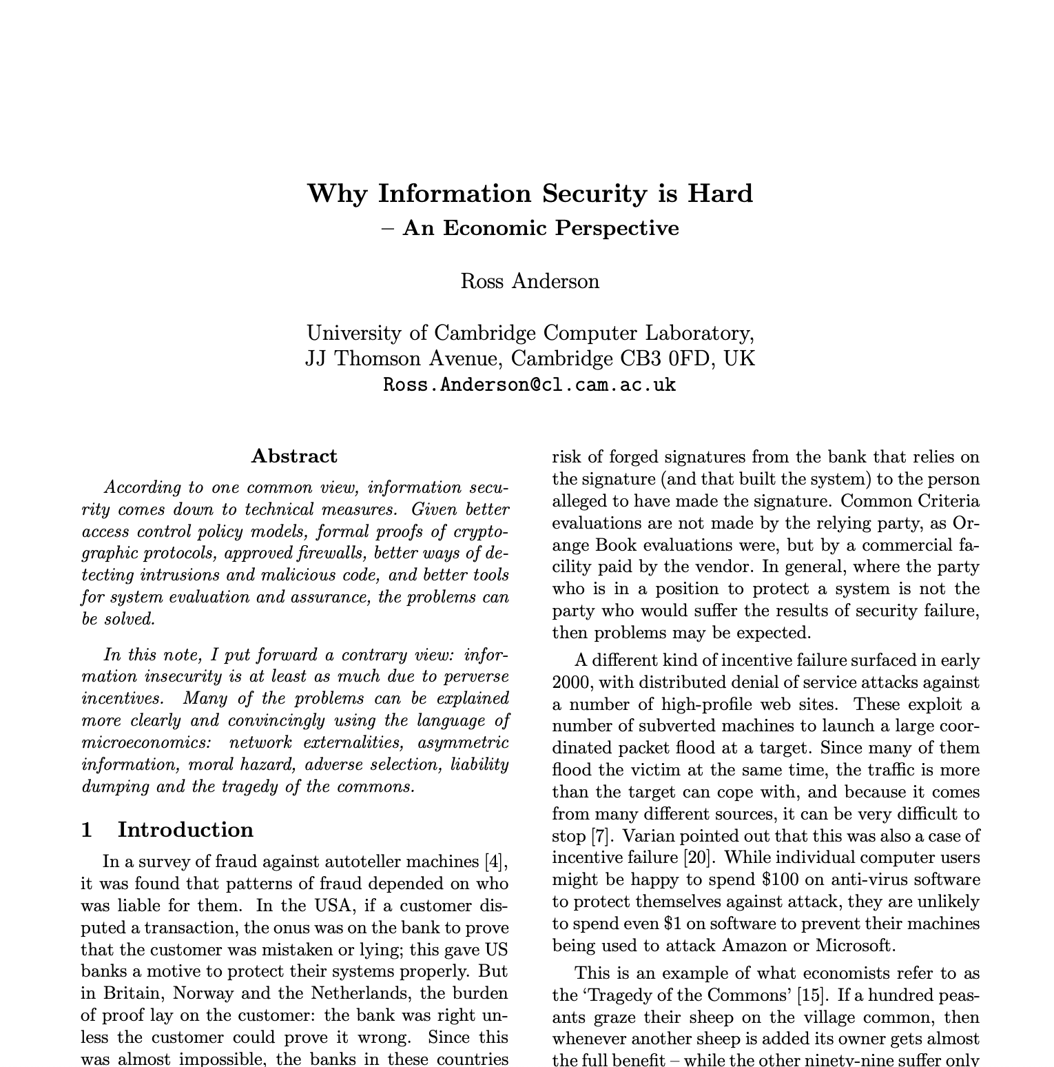
Why Information Security is Hard An Economic Perspective
Party best-placed to improve security should be incentivized to do so
Liability
Tragedy of the commons
First-mover and network externalities vs. security
3rd party evaluators paid by seller vs. direct user evaluation
Costs of attack vs. defense
“Even a very moderately resourced attacker can break anything that’s at all large and complex”
Market forces: end-user security vs. developer pain
“In an ideal world, the removal of perverse economic incentives to create insecure systems would depoliticize most issues.”

Slide 5
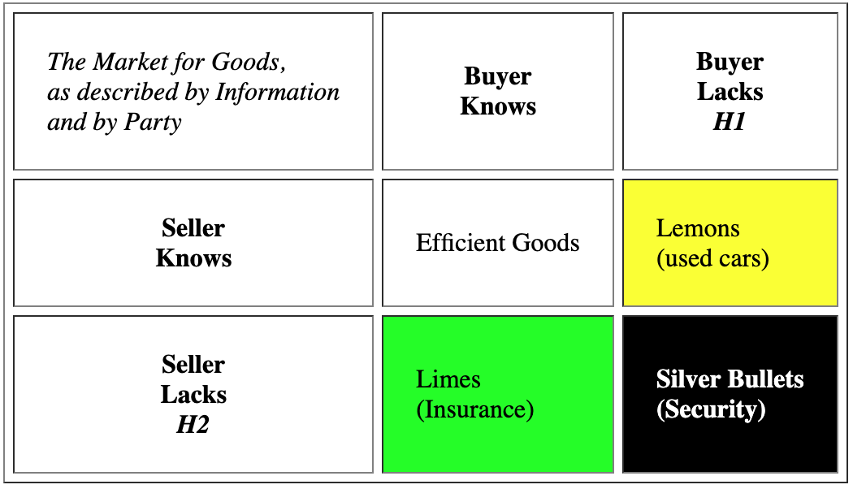
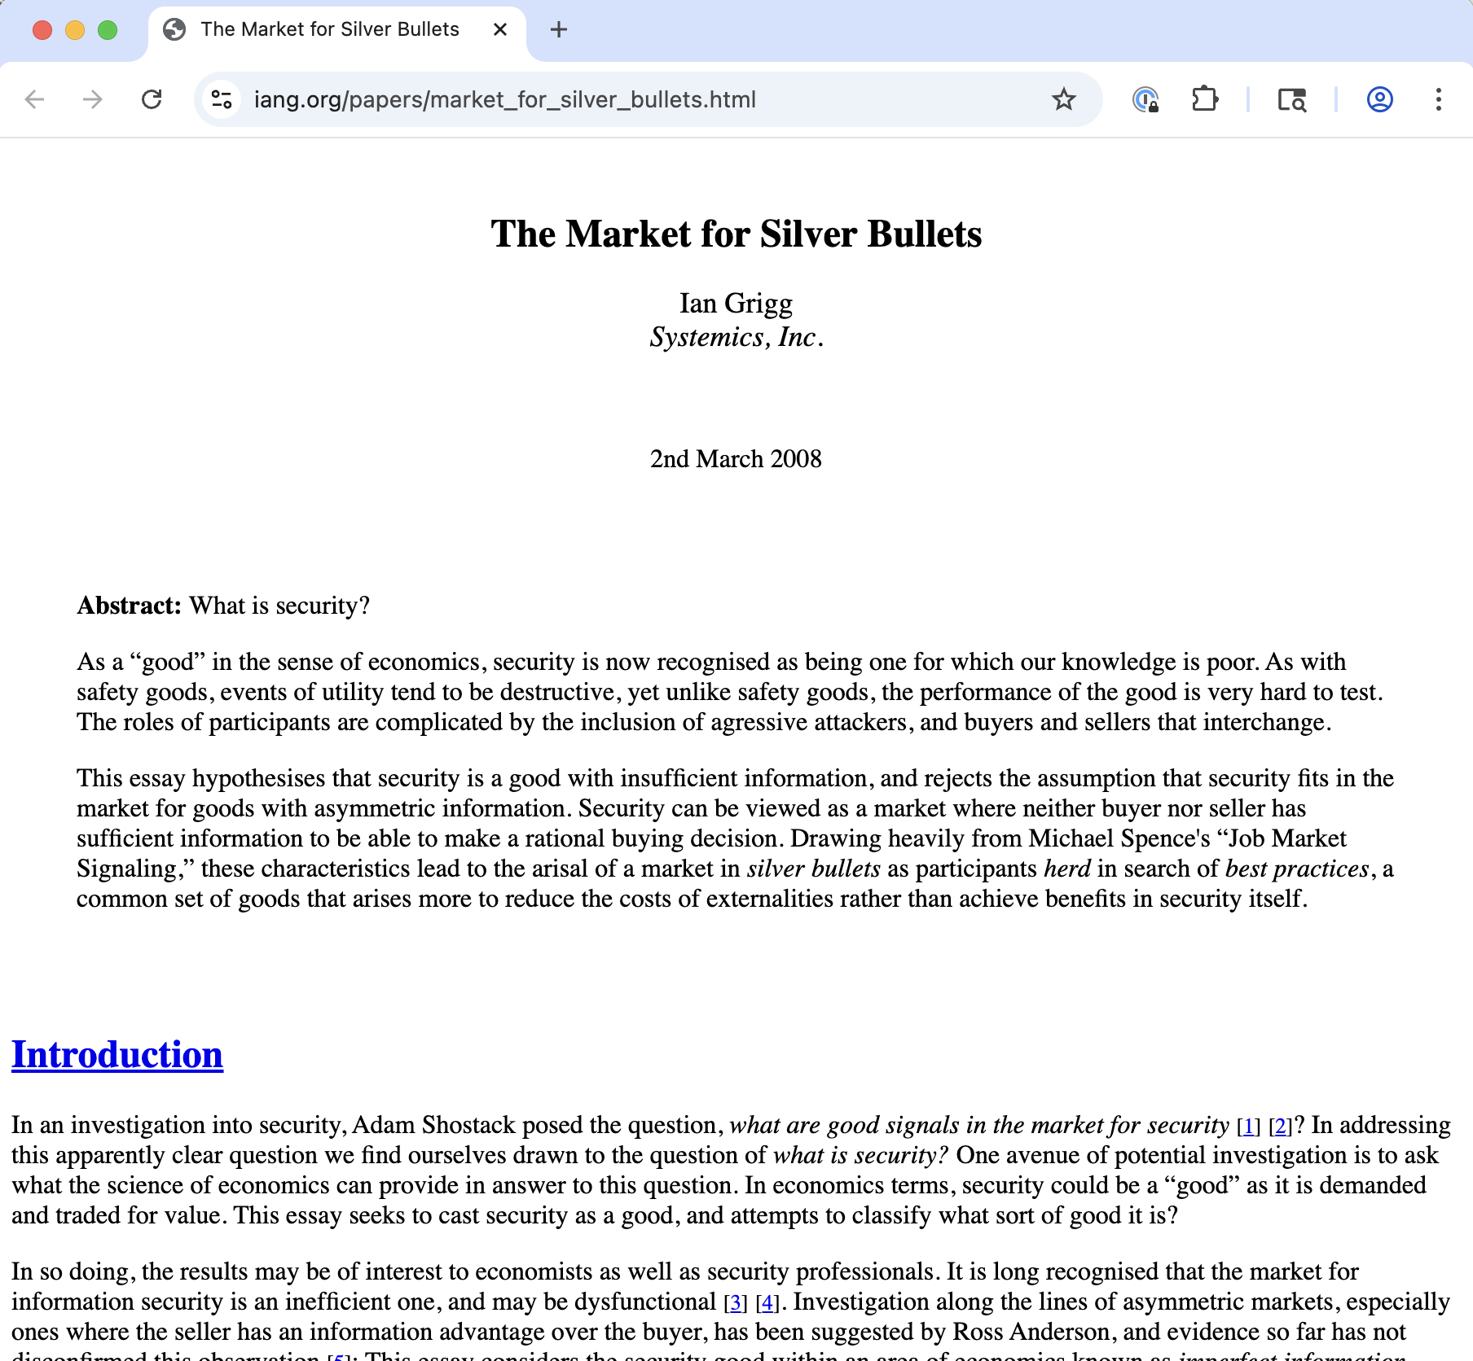
Silver Bullets, not Lemons
Extends Anderson:
Security is a good
Security is hard to assess
Leads to information insufficiency on both sides
Lacks empirical basis, i.e., falsifiability
Notes:
Ian Grigg: Cryptographer, financial cryptography researcher at Systemics, Inc.
Paper draws on Nobel Prize economics: Akerlof (lemons), Spence (signaling), Rothschild & Stiglitz (insurance)
Market for Lemons: Seller knows quality, buyer doesn’t (used cars)
Market for Limes: Buyer knows their risk, seller doesn’t (insurance—high-risk buyers seek more coverage)
Market for Silver Bullets: Neither party has sufficient information (security)
Key insight: The seller of a security product genuinely doesn’t know if it will stop a real attacker. This isn’t information hiding—it’s information absence.

Slide 6
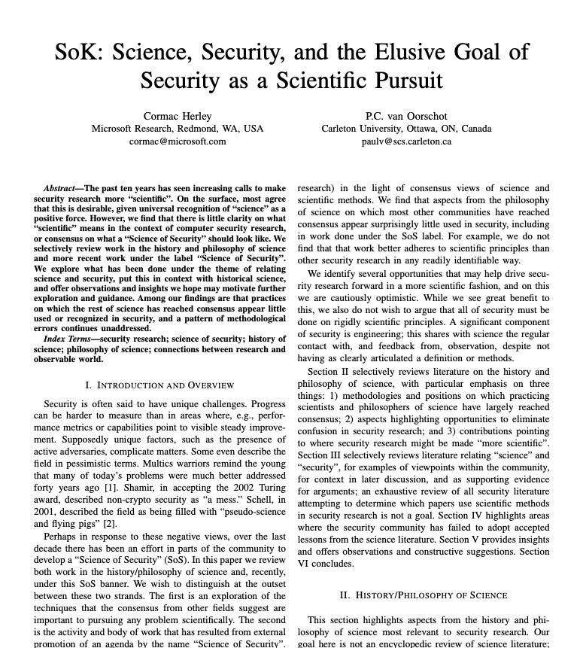
A Fundamental Asymmetry
We can observe:
✅ Insecurity (attacks succeed, systems fail)
We cannot observe:
❌ Security (absence of attacks ≠ security)
This is a fundamental asymmetry.
Notes:
This is the core insight that drives everything else.
Analogy: We can observe disease (symptoms, tests) but “health” is much harder to observe directly.
Same with security: we see breaches, but not “secure.”

Slide 7
Deduction vs. Induction
powerful
discovery…”
“Deduction in itself is quite powerless as a method of scientific
With a good model, you can deduce surprising and useful results
Shannon's channel capacity theorem (1948)
Gödel's incompleteness theorems (1931)
Deductions from Euclidean geometry (e.g., Pythagorean theorem)
Notes:
Shannon's channel capacity theorem (1948) — Claude Shannon proved that information can be transmitted reliably over a noisy channel up to a specific limit (the channel capacity), and that error-correcting codes exist that approach this limit. Engineers had assumed noise would always degrade signals proportionally—the existence of a sharp threshold was unexpected and revolutionized communications.
Gödel's incompleteness theorems (1931) — Kurt Gödel proved that any consistent formal system powerful enough to express arithmetic contains true statements it cannot prove, and cannot prove its own consistency. This demolished Hilbert's program to place all of mathematics on a secure, complete foundation. The philosophical implications—that mathematical truth outruns provability—remain profound and debated.

Slide 8
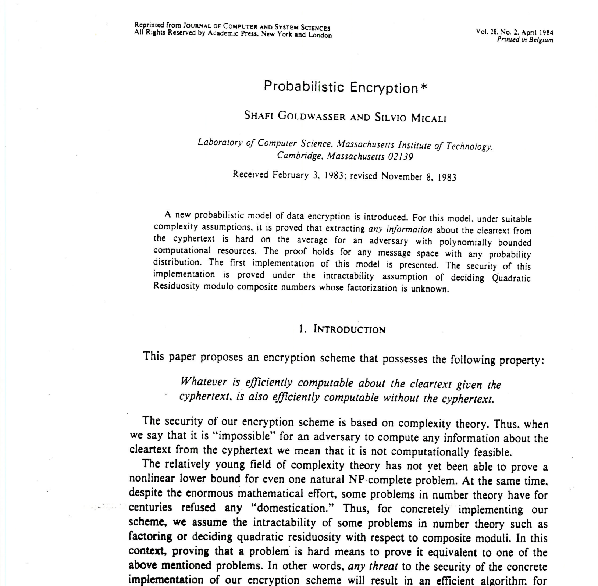
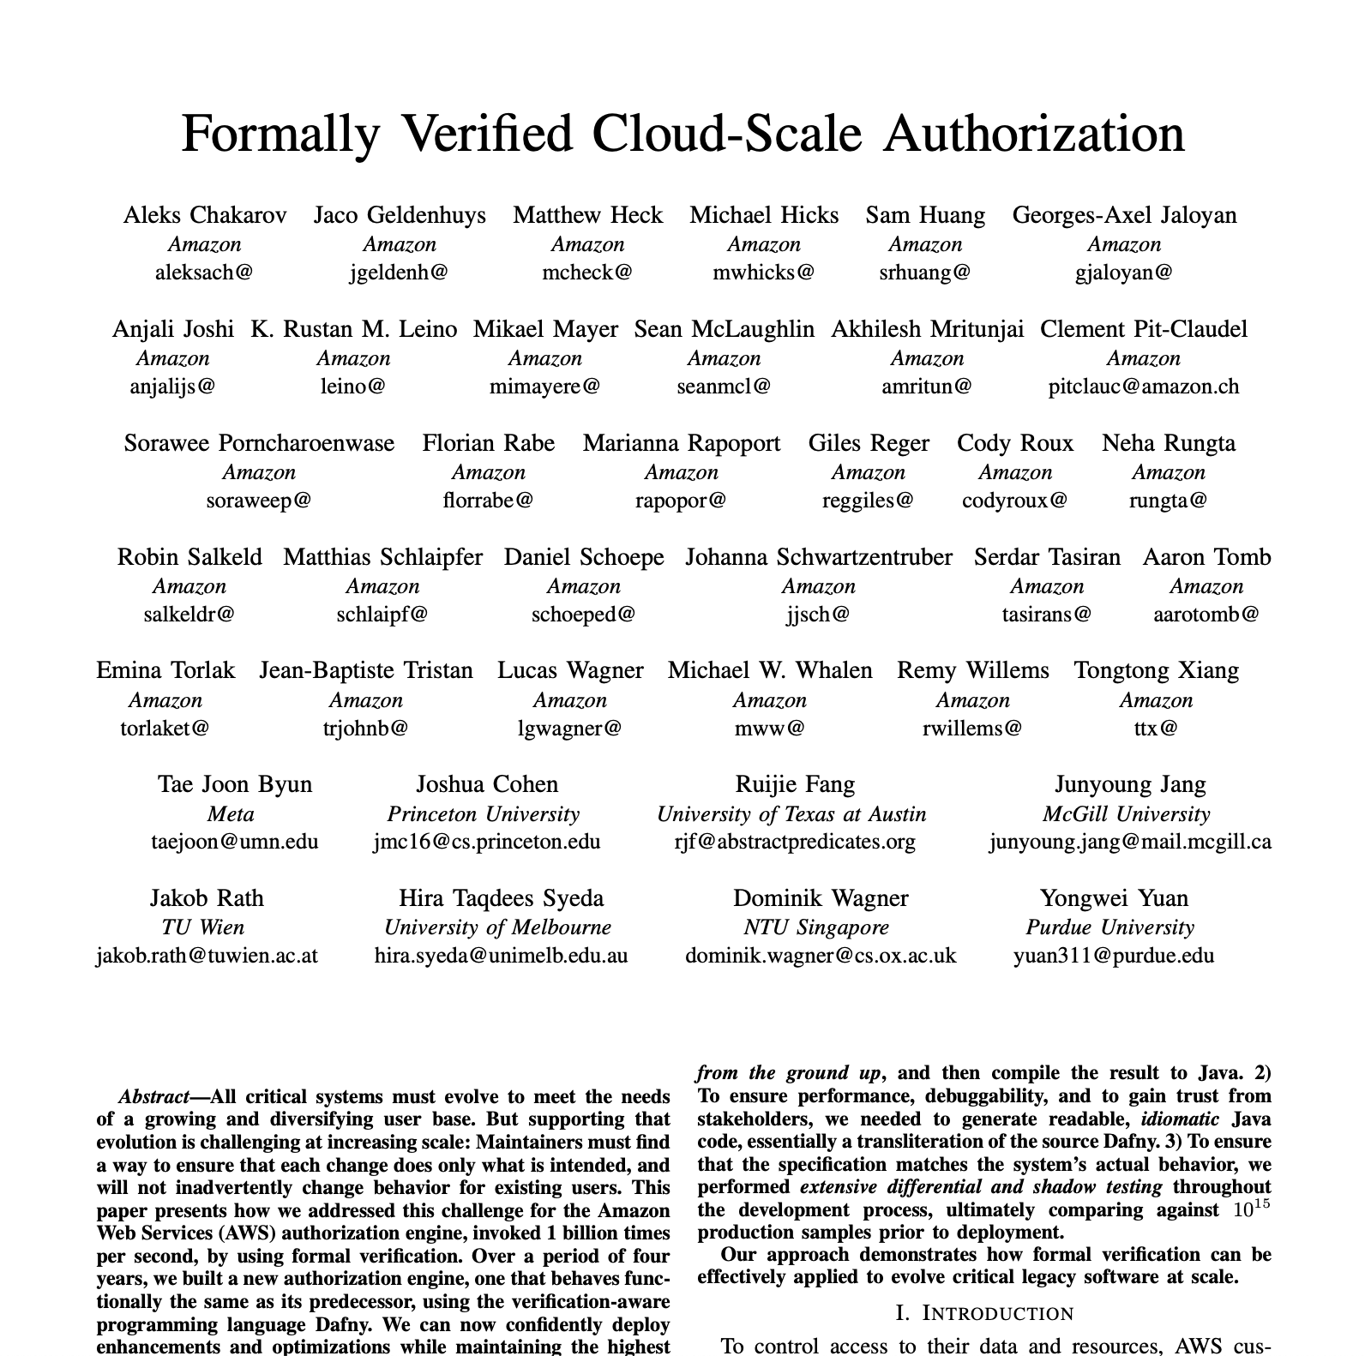
Key challenge: Specifying security
To know if a system is secure, we have to
Develop a model for it
Describe what the model should (and should not) do
Prove the model satisfies our description
Establish that the model, and its assumptions, represent reality
Fundamentally an empirical question

Slide 9
Evidence-based security
Analysis
What are the (still) successful vectors of attack?
Where is risk (still) greatest?
What interventions could be deployed cost-effectively?
Outcomes
Hosts compromised,
Vulnerabilities exploited,
Revenue lost, …
Intervention
Engineering,
Operations,
Policy,
Education, …

Slide 10
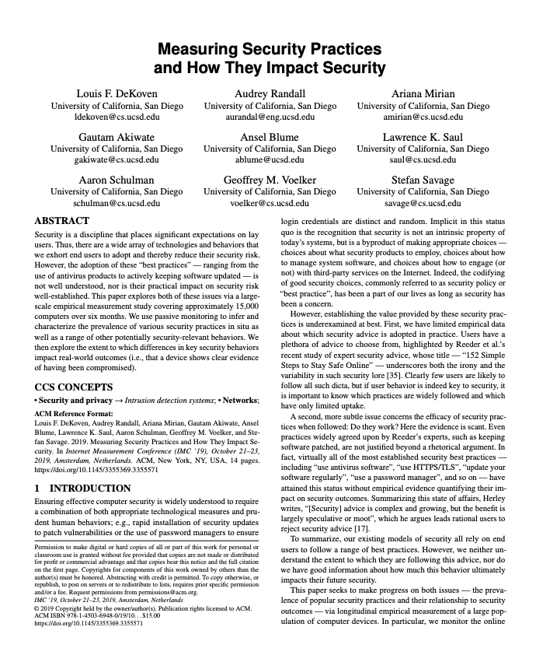
What to measure?
Outcomes
Hosts compromised,
Vulnerabilities exploited,
Revenue lost, …
Intervention
Engineering,
Operations,
Policy,
Education, …

Slide 11
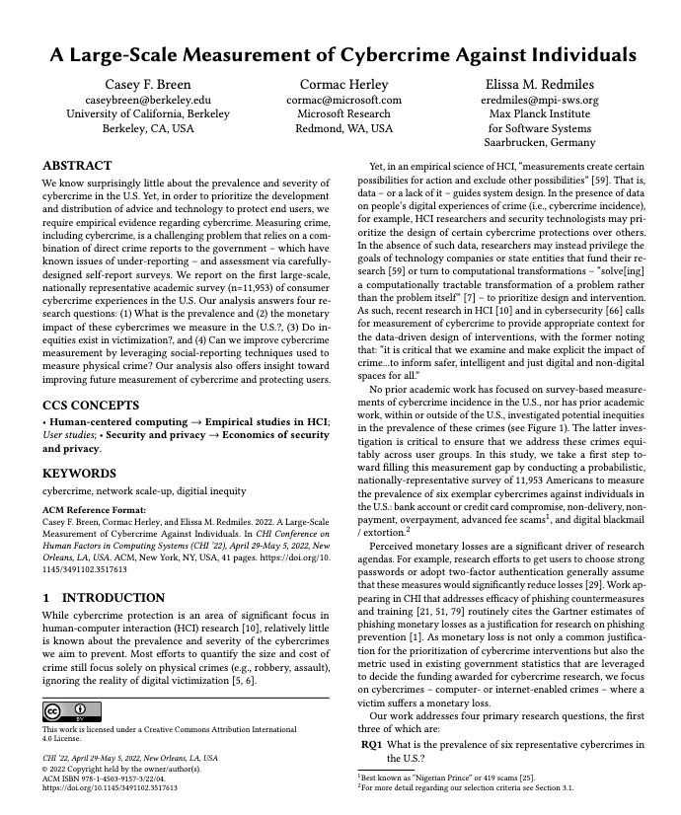
What to measure?
Outcomes
Hosts compromised,
Vulnerabilities exploited,
Revenue lost, …
Intervention
Engineering,
Operations,
Policy,
Education, …

Slide 12
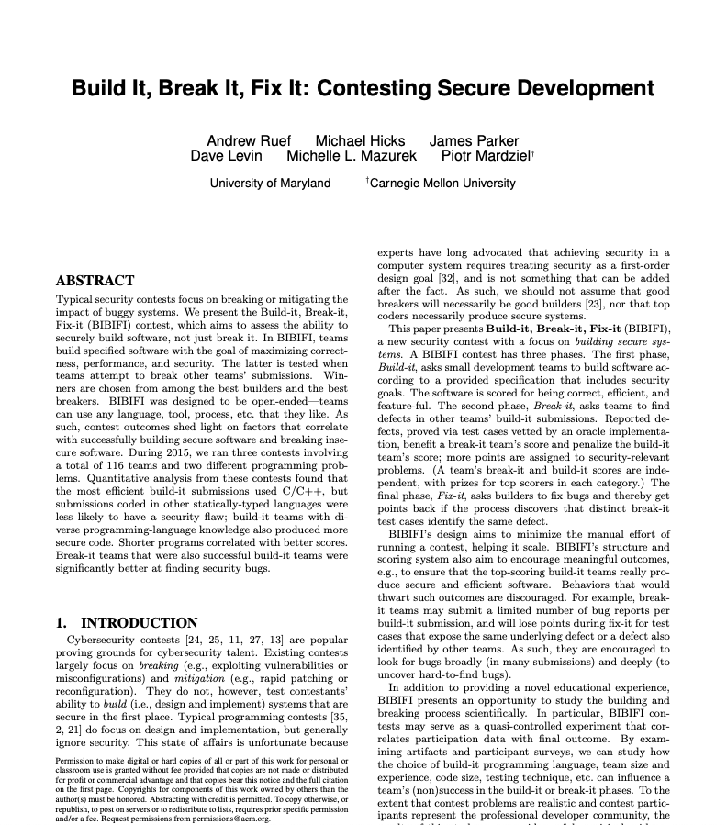
What to measure?
Outcomes
Hosts compromised,
Vulnerabilities exploited,
Revenue lost, …
Intervention
Engineering,
Operations,
Policy,
Education, …

Slide 13
How to analyze your data?
Hypothesis testing
Chi-square test of independence
Student’s t-test (parametric)
Mann-Whitney U test (non-parametric)
Effect sizes (Cohen’s d, Vargha-Delaney A)
Bootstrapped confidence intervals
Linear regression models
Categorical predictors (dummy coding)
Model comparison (likelihood-ratio tests)
Logistic regression for binary outcomes
Odds ratios and predicted probabilities

Slide 14
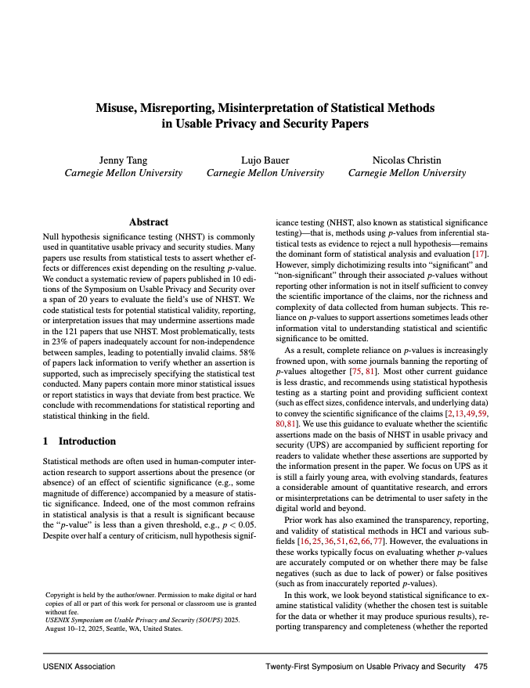
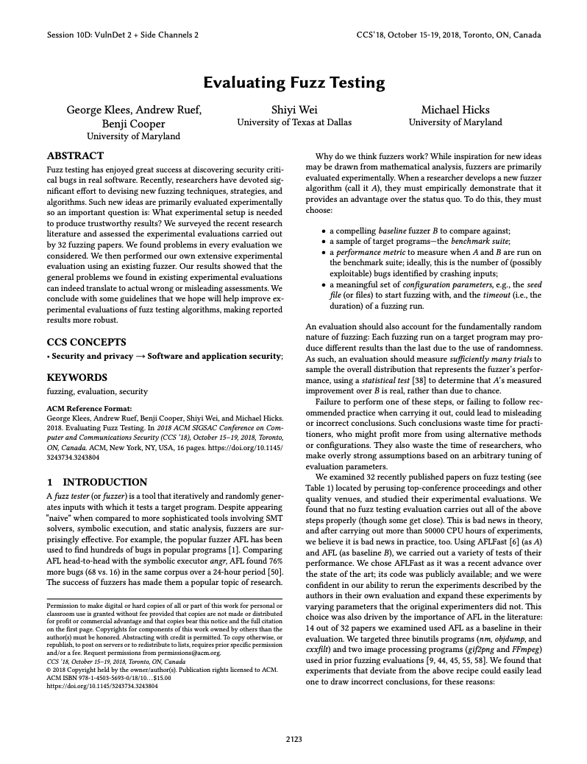
How to analyze your data? Beware!

Slide 15
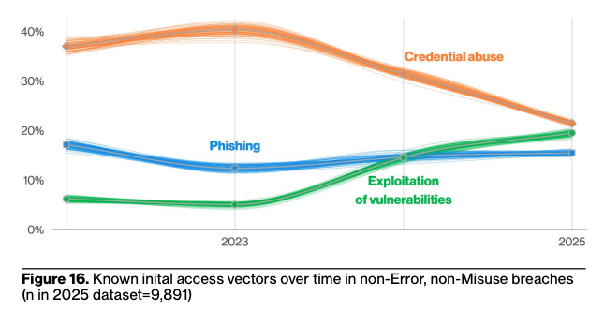
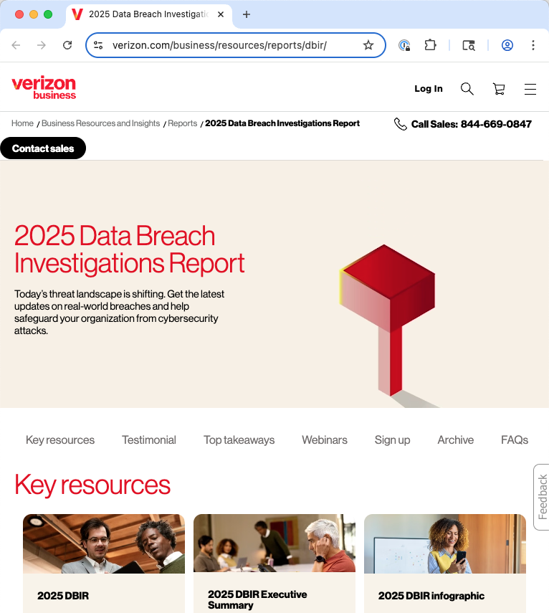
Looking at the data: Attack vectors
Source: 2025 Verizon Data Breach Investigations Report
Notes:
Still: Only 20% start with a vulnerability exploitation!

Slide 16
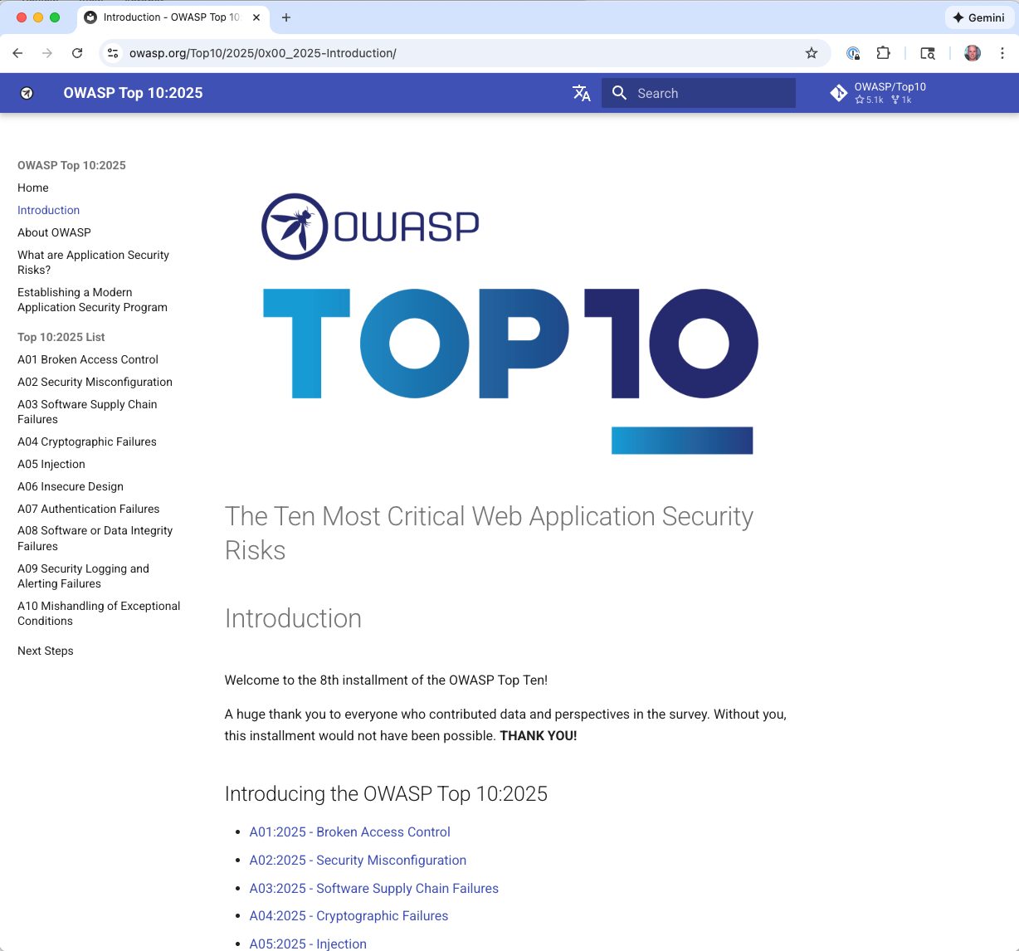

Attack methods
Vulnerability based: Exploiting design and implementation flaws
Social engineering-based: Exploiting the human
Notes:
Key attacks on the social engineering side:
Phishing
Insider attacks
Baiting (USB drive in parking lot)
Vishing and Smishing
Supply chain manipulation

Slide 17
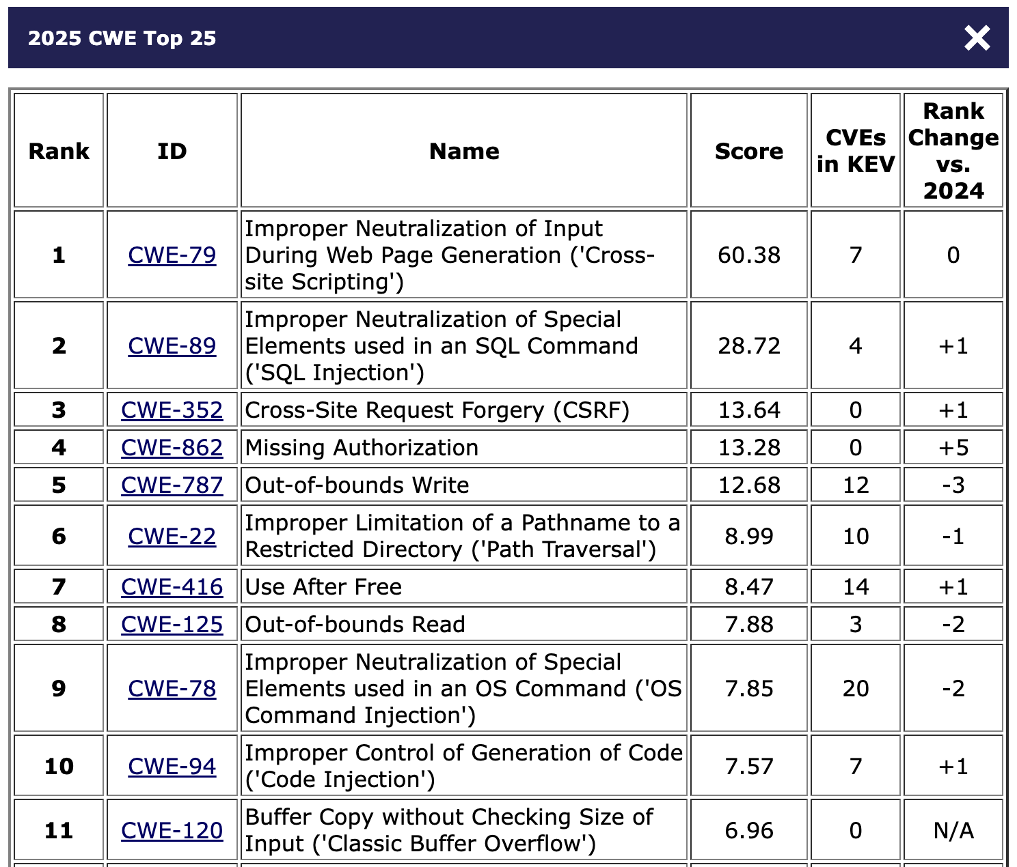
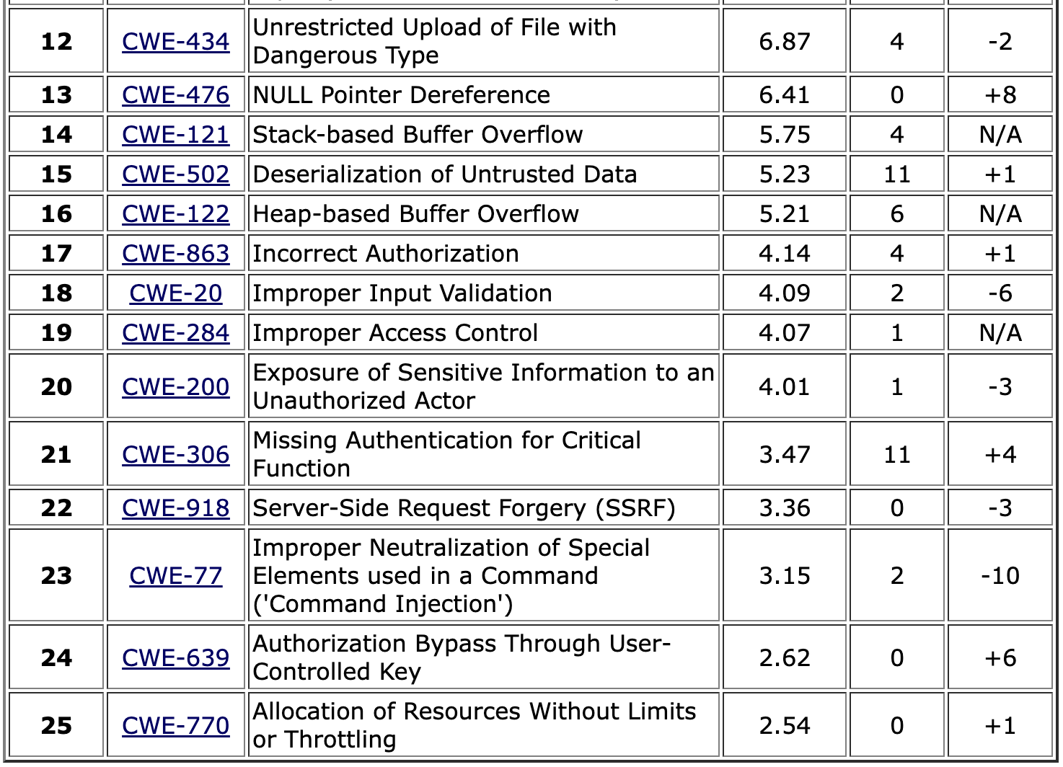
Data source: MITRE Top 25 CWEs
Notes:
This year’s dataset included 39,080 CVE Records for vulnerabilities published between June 1, 2024 and June 1, 2025.
Scores are based on product of Frequency (#CVEs) and Severity (CVSS); max score is 100
See https://www.first.org/cvss/v4.0/specification-document for CVSS
Note: CVSS scores are between 0 and 10
See https://www.cisa.gov/known-exploited-vulnerabilities-catalog for KEV

Slide 18
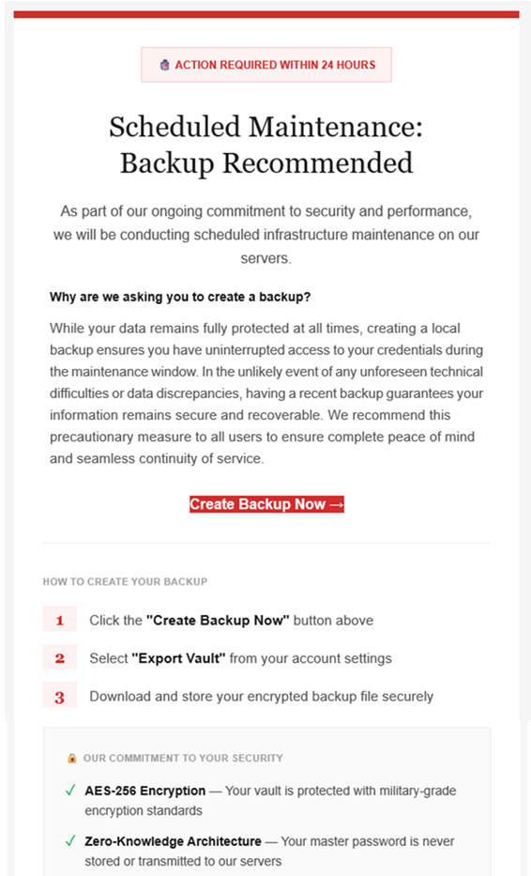
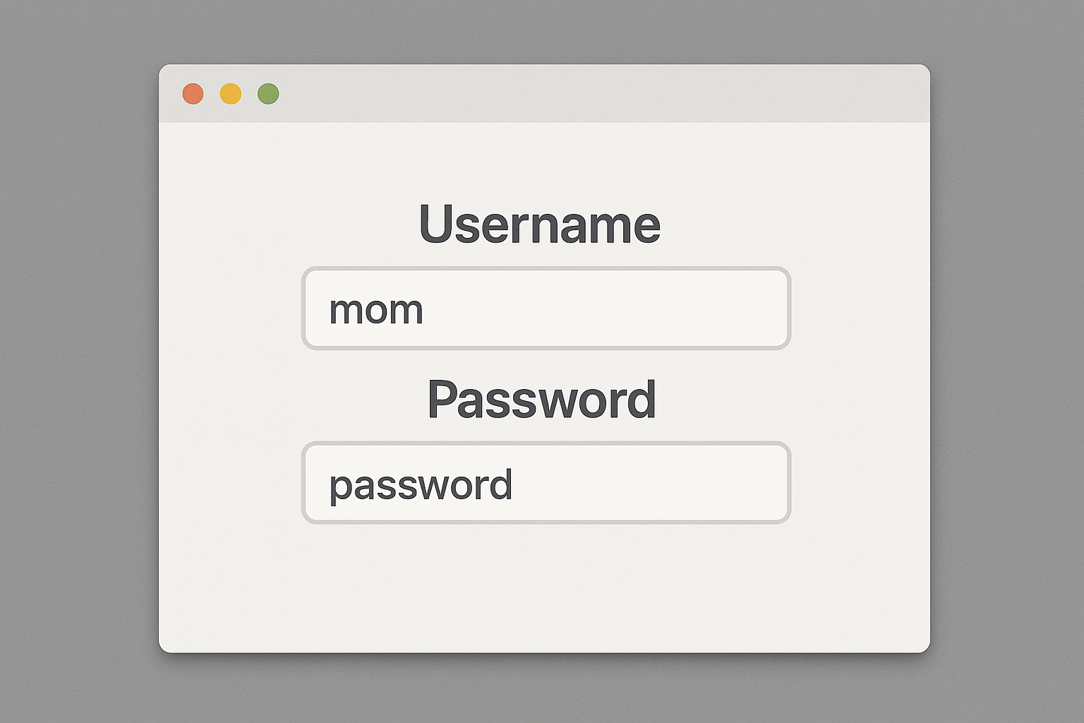
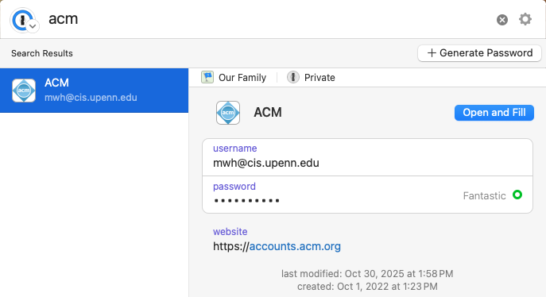
Humans in the loop
Do they know they are supposed to be doing something?
Do they understand what they are supposed to do?
Do they know how to do it?
Are they motivated to do it?
Are they capable of doing it?
Will they actually do it?

Slide 19
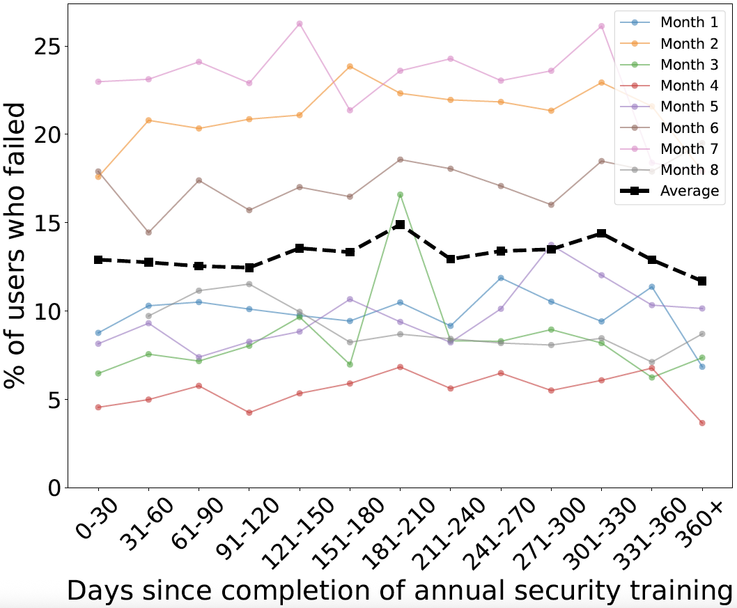
Data: Generic training benefits dubious
Can help address prevalent phishing attacks?
Evidence: Data and statistical models (GLME) find no association between:
how long ago a user completed training (KnowBe4) and
their likelihood of failing a phishing simulation
1 Month
1 Year
Source: Ho et al, “Understanding the efficacy of phishing training in practice.” S&P 2025.

Slide 20
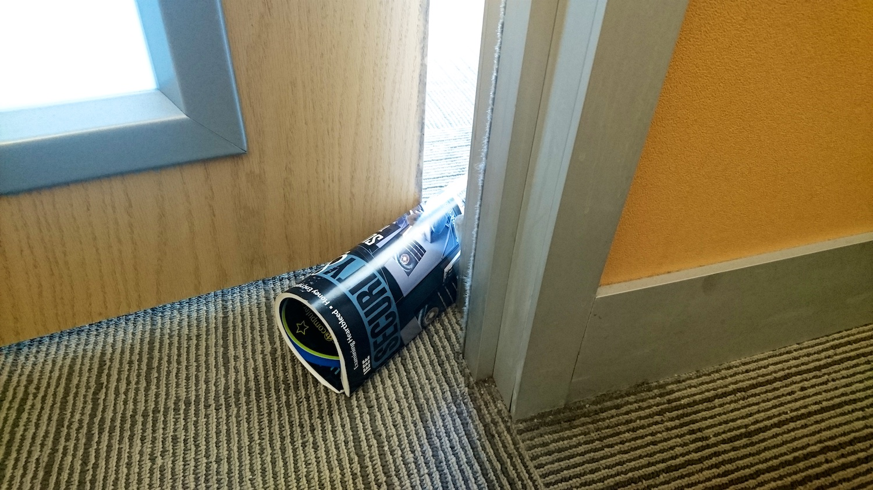
Remember: Convenience always wins

Slide 21
Course goals: You will be able to
Understand cybersecurity from a data-driven and economic perspective, learning to make decisions based on empirical evidence, following good science
Identify key vulnerabilities and threats, especially when considering the impact of humans, both when they are attack targets and when the play a role in ensuring a system’s security
Follow a well-designed process for secure systems construction, from threat modeling to building to testing to maintenance
Manage security operations – preventing, detecting, mitigating, and recovering from incidents – and gather data to improve future posture
Make risk-informed decisions: Assess designs and technologies according to how they mitigate security risk, while leveraging insurance and responding to regulation
Communicate effectively and with empathy to key stakeholders about security options and recommendations
All while taking a data-informed approach

Slide 22
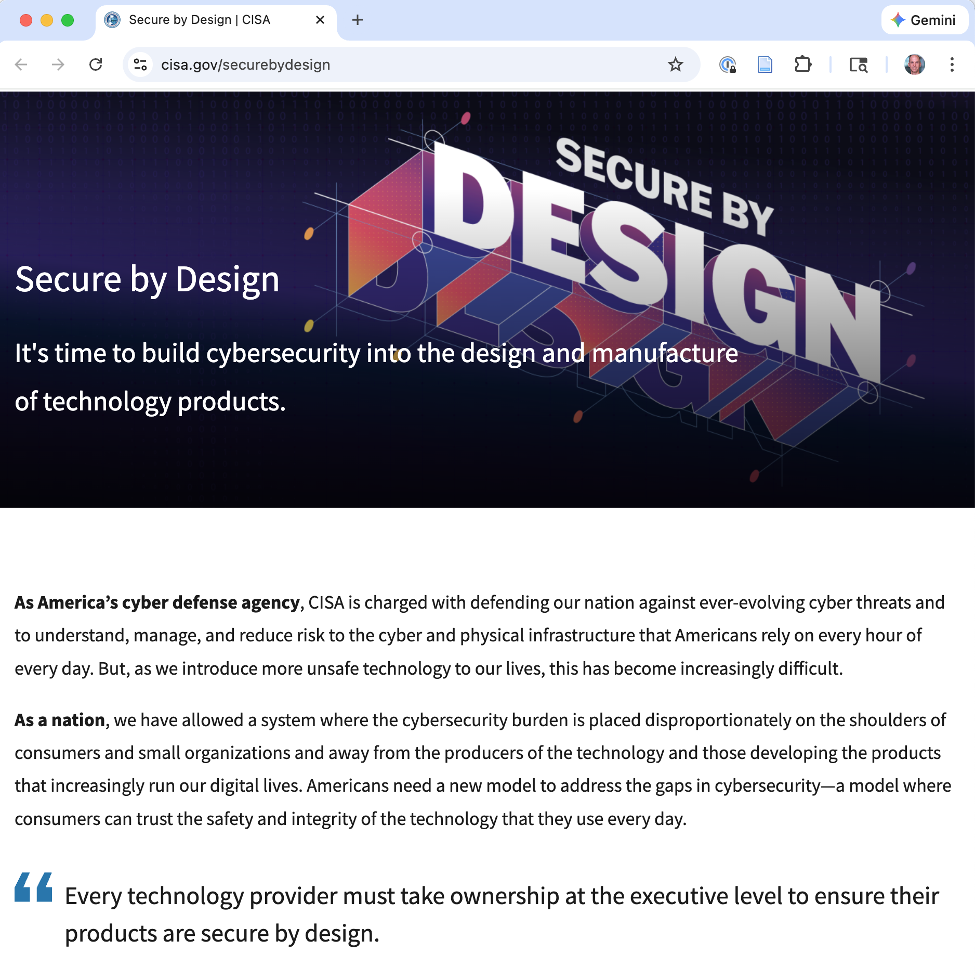
“prioritize the security of customers as a core business requirement” and “implement
Secure by Design principles to significantly decrease the number of exploitable flaws.”

Slide 23
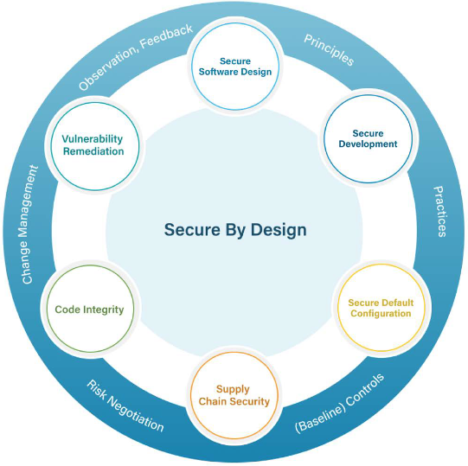
Six Considerations: Overview
Secure Software Design
Secure Development
Secure Default Configuration
Supply Chain Security
Code Integrity
Vulnerability Remediation
Notes:
Show the circle diagram from p.9 of the paper. This is the organizing framework for the next 20 minutes.
Point out the structure: the six considerations aren’t independent – they form a cycle. The connecting arcs matter too: - Principles flow from design into development - Practices flow from development into configuration - Baseline controls connect configuration to supply chain - Risk negotiation connects supply chain to code integrity - Change management connects code integrity to vulnerability remediation - Observation and feedback connect vulnerability remediation back to design
This is a continuous improvement loop, not a one-time checklist.
Tell students: “We’re going to walk through each of these six, using our CMS example. By the end, you’ll see how they fit together into a coherent process.”

Slide 24
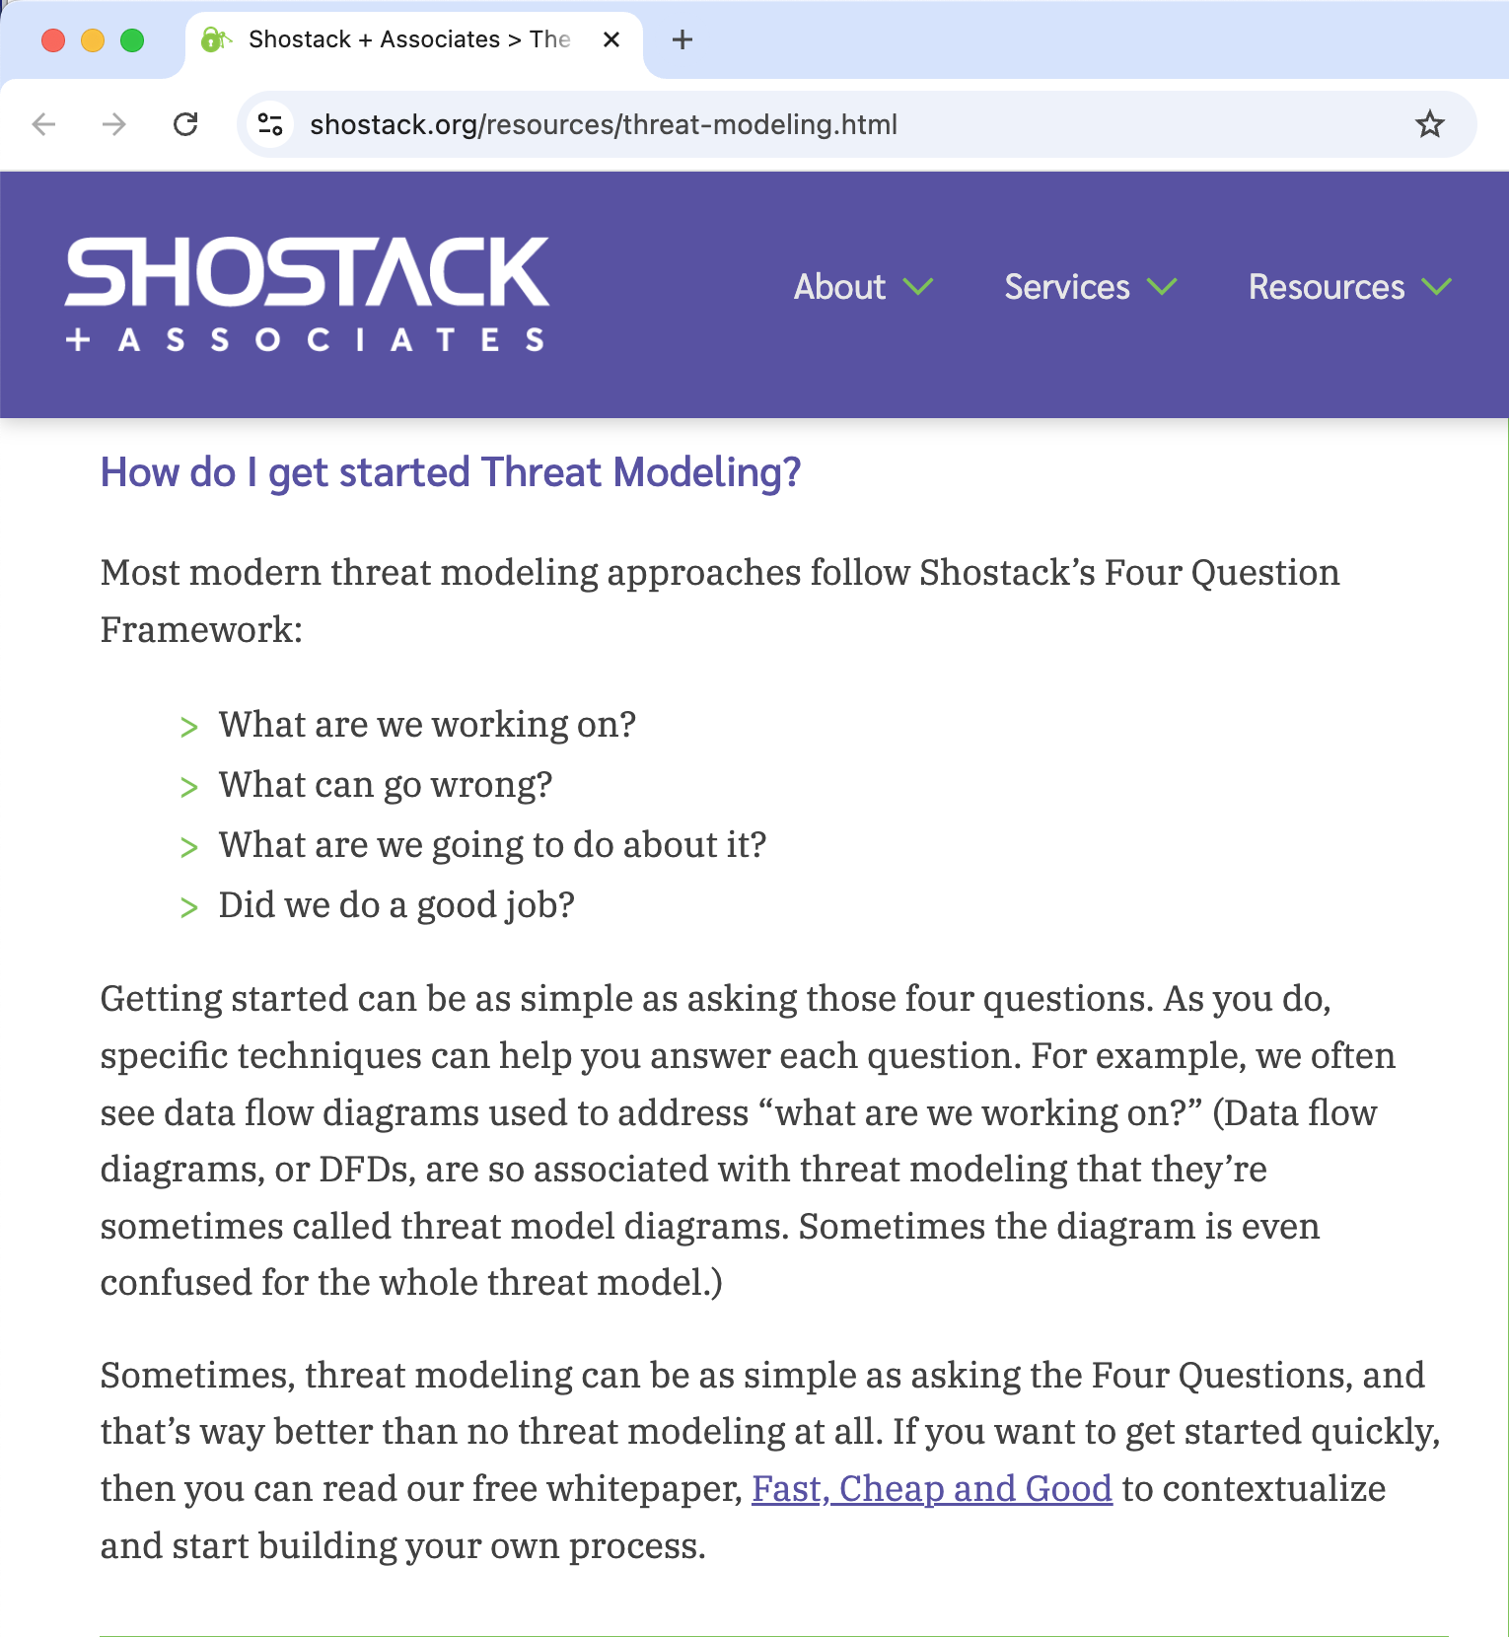
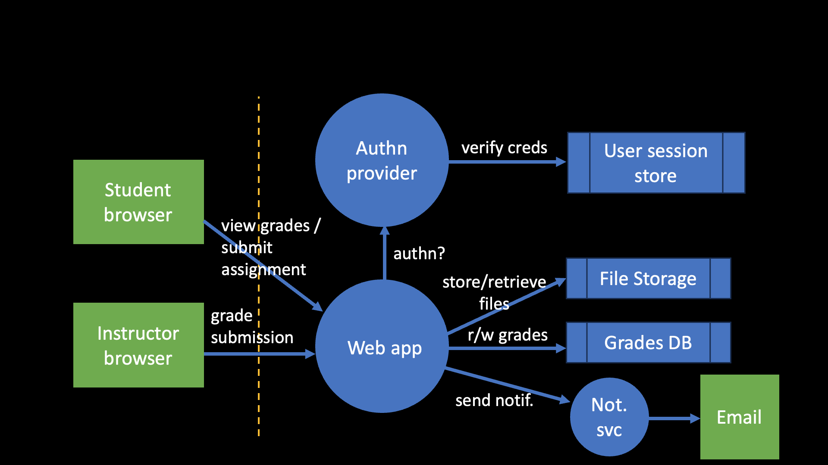
The Four Questions of Threat Modeling
Shostack’s four-question framework
What are we working on? Describe the system
What can go wrong? Identify threats
What are we going to do about it? Mitigate, accept, transfer, eliminate
Did we do a good job? Validate
Elevation of privilege
Tampering (SQL injection)
Spoofing

Slide 25
Secure Design: Properties, Principles, Controls
Principles and Controls
Confidentiality (by encryption)
Authentication – proving identity
Principles:
Do not expect expert users
Fail-safe defaults
Favor simplicity
Defend in depth (throughout)
Authorization
Integrity and Accountability
Trust with Reluctance (all)
Monitoring and Traceability
Putting it all together
Use community resources

Slide 26
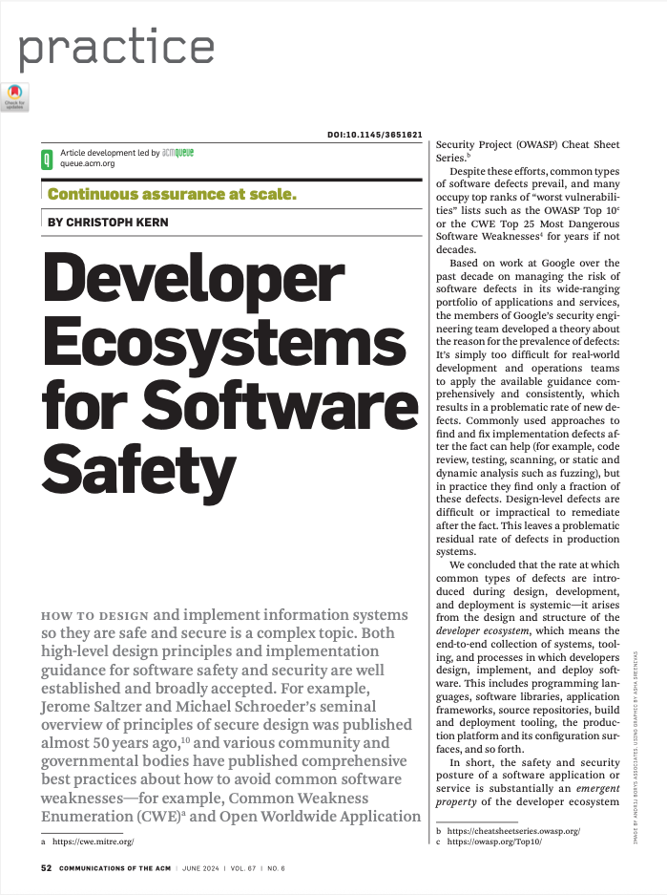
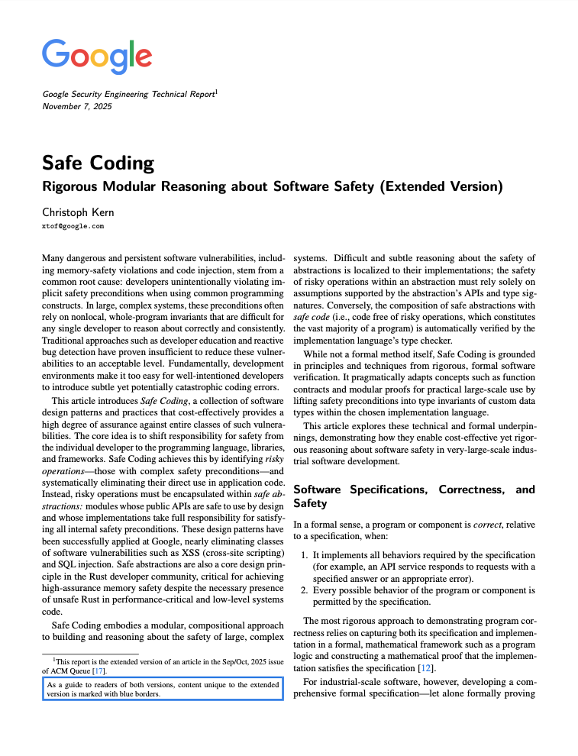
The Ecosystem Thesis
“The safety and security of a software application or service is substantially an emergent property of the developer ecosystem that produced it.”
To improve security, redesign the ecosystem, not just the guidance.
Programming languages, libraries, frameworks, build tooling, deployment infrastructure, configuration surfaces.
Notes:
This is the paper’s central thesis. The rate of defects isn’t a property of individual developers or individual applications – it’s a property of the ecosystem those developers work in. If the ecosystem makes it easy to introduce XSS, you will get XSS, no matter how many training courses you run.
This reframing has a powerful practical consequence: instead of trying to educate thousands of developers to avoid each vulnerability class, you can invest in the ecosystem once and benefit all applications built within it.
This is the “shift left” idea taken to its logical conclusion: shift security responsibility from individual application developers to the ecosystem designers.

Slide 27

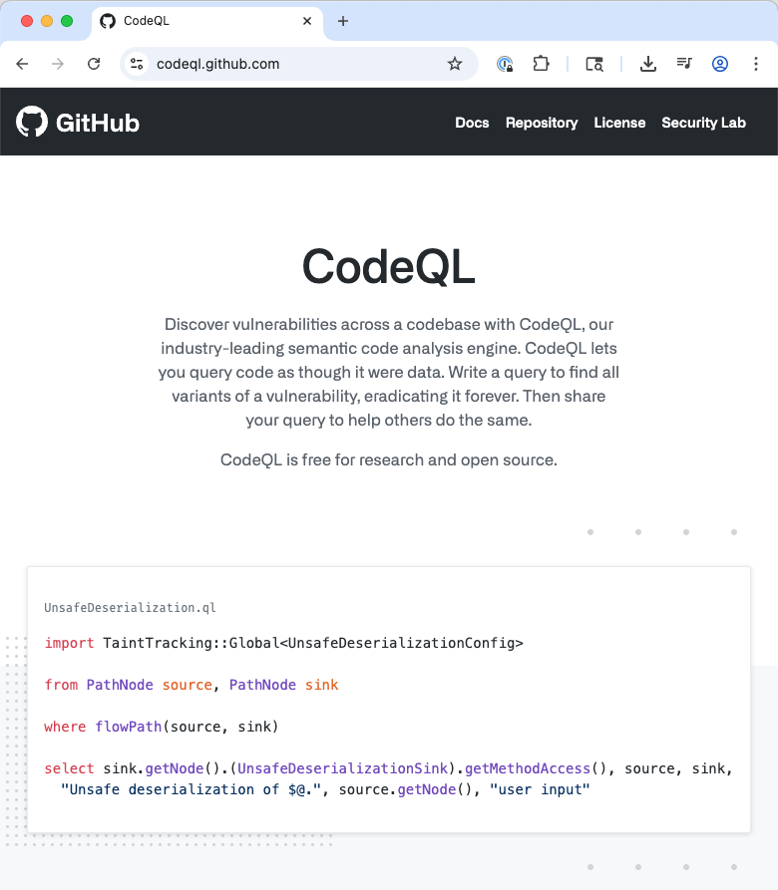
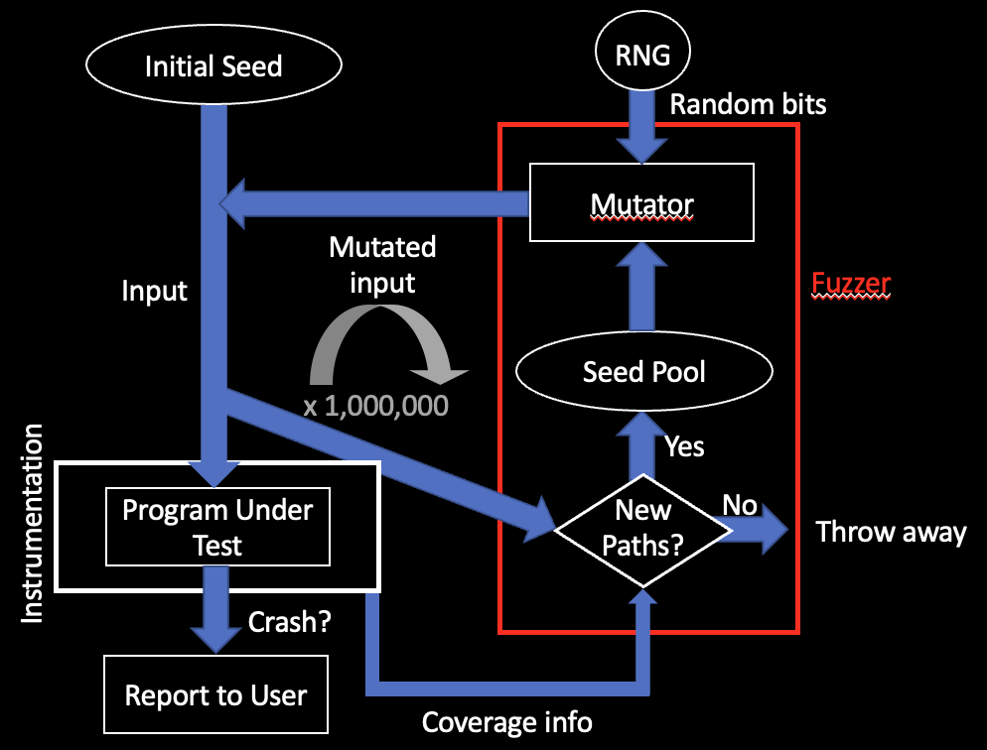


Secure Dev: Safe PLs, fuzzers, analyzers, …

Slide 28
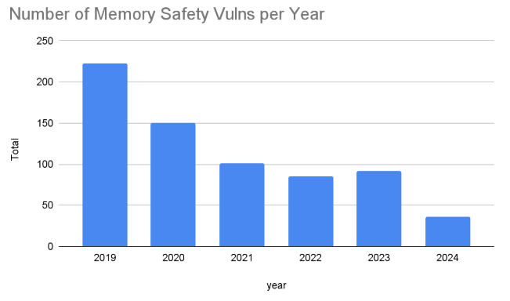
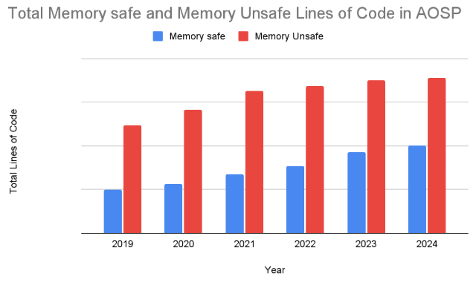
Data: Use of PL can prevent vulnerabilities
Android is writing most new code in Rust, and fixing vulns in its C/C++.
Result: A roughly exponential drop in vulnerabilities reported
Source: Google Security Blog

Slide 29
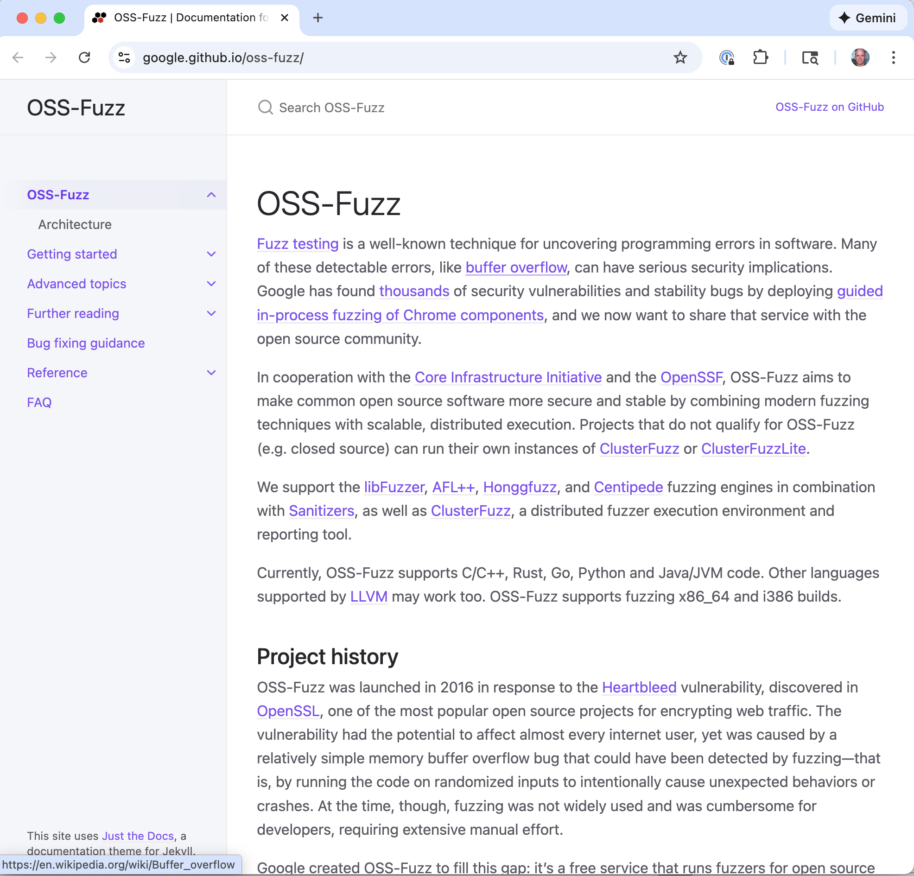
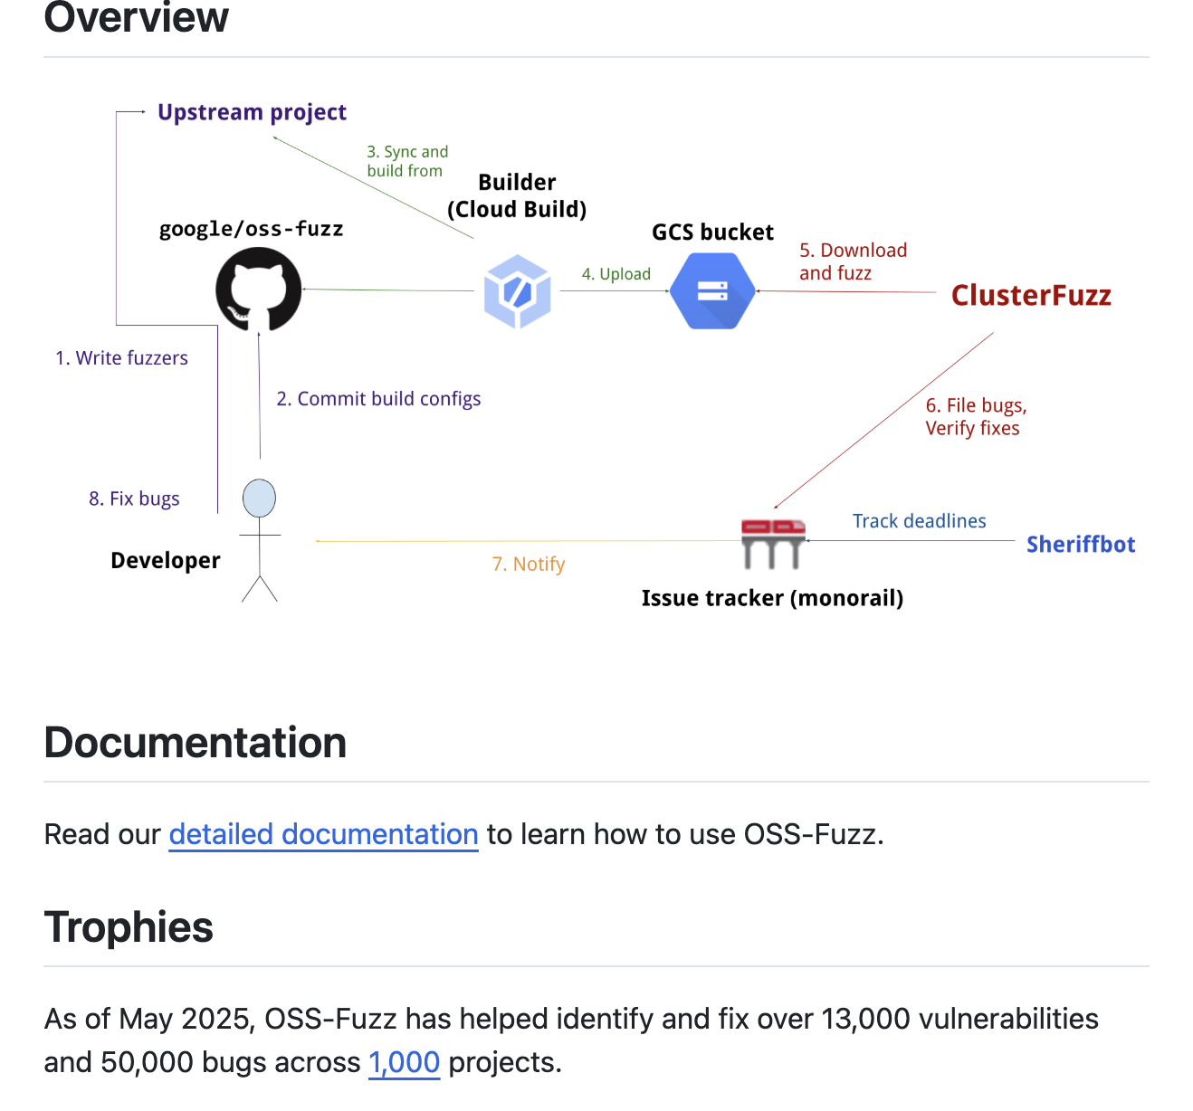
OSS-Fuzz

Slide 30
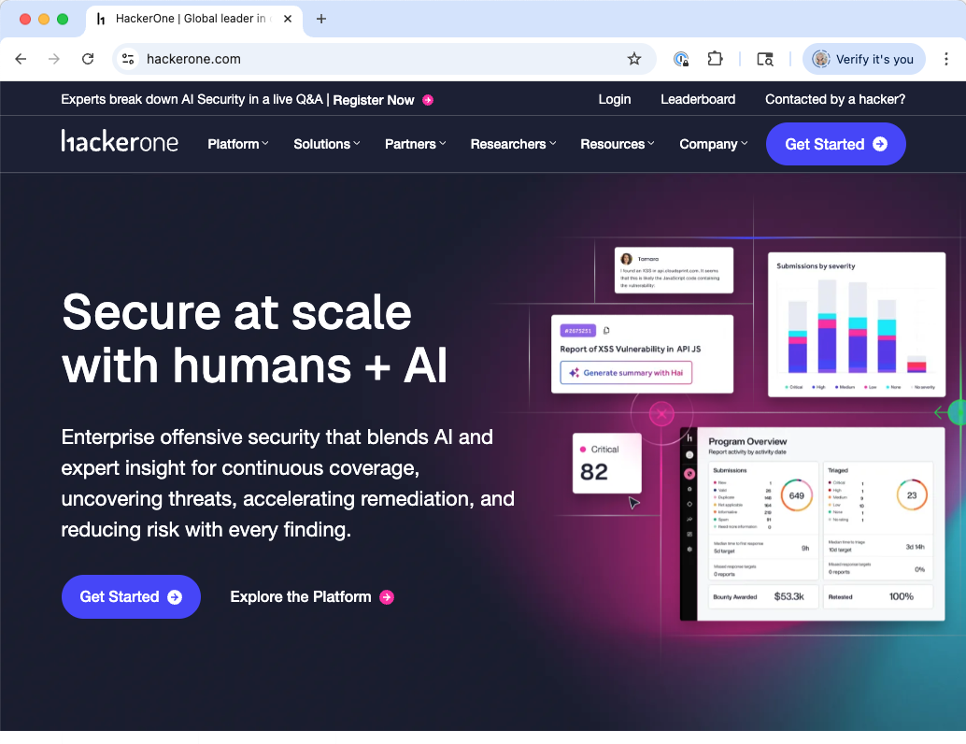
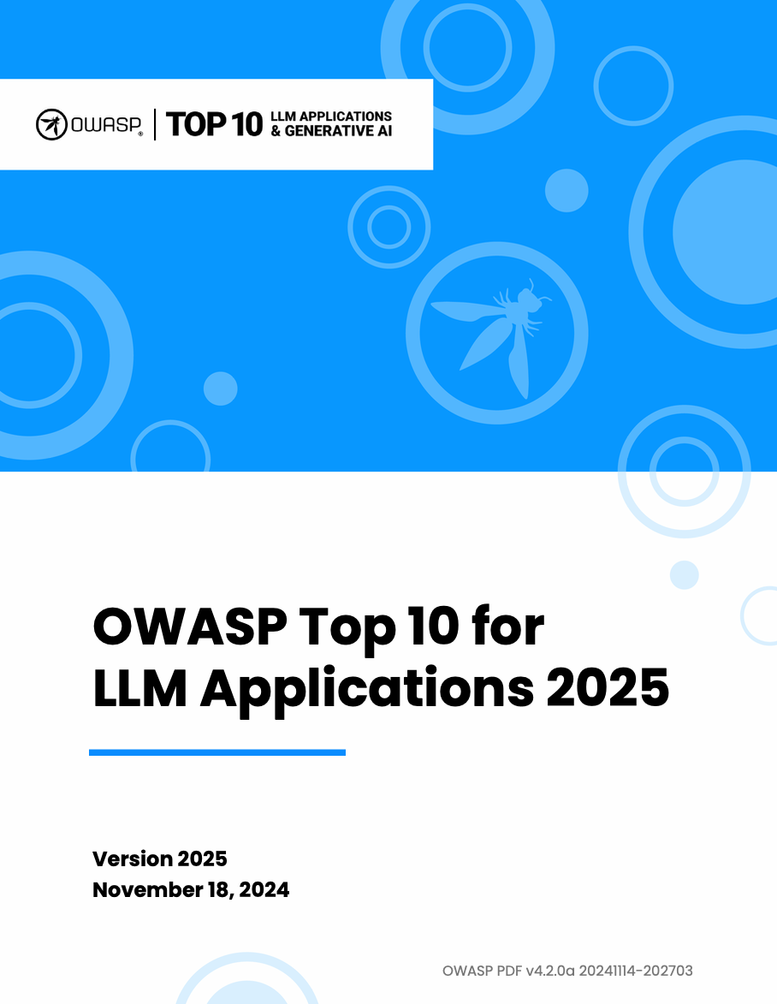
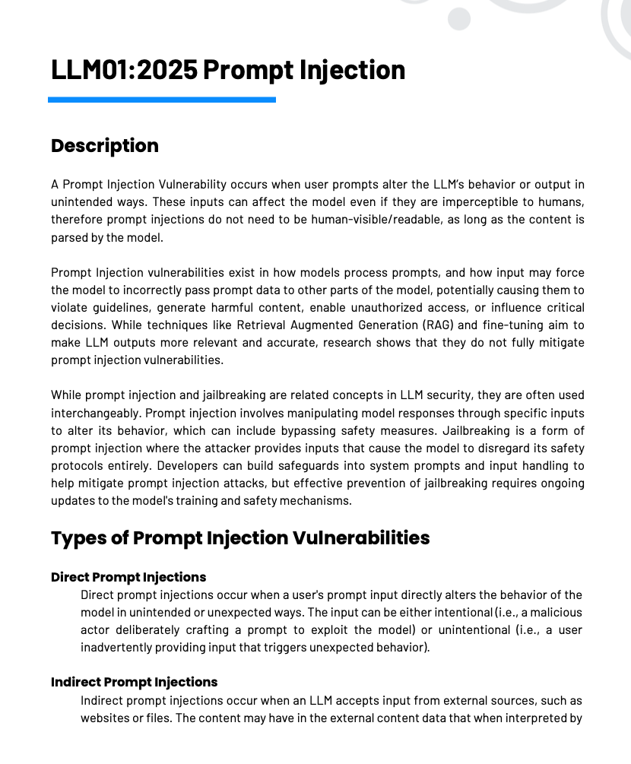
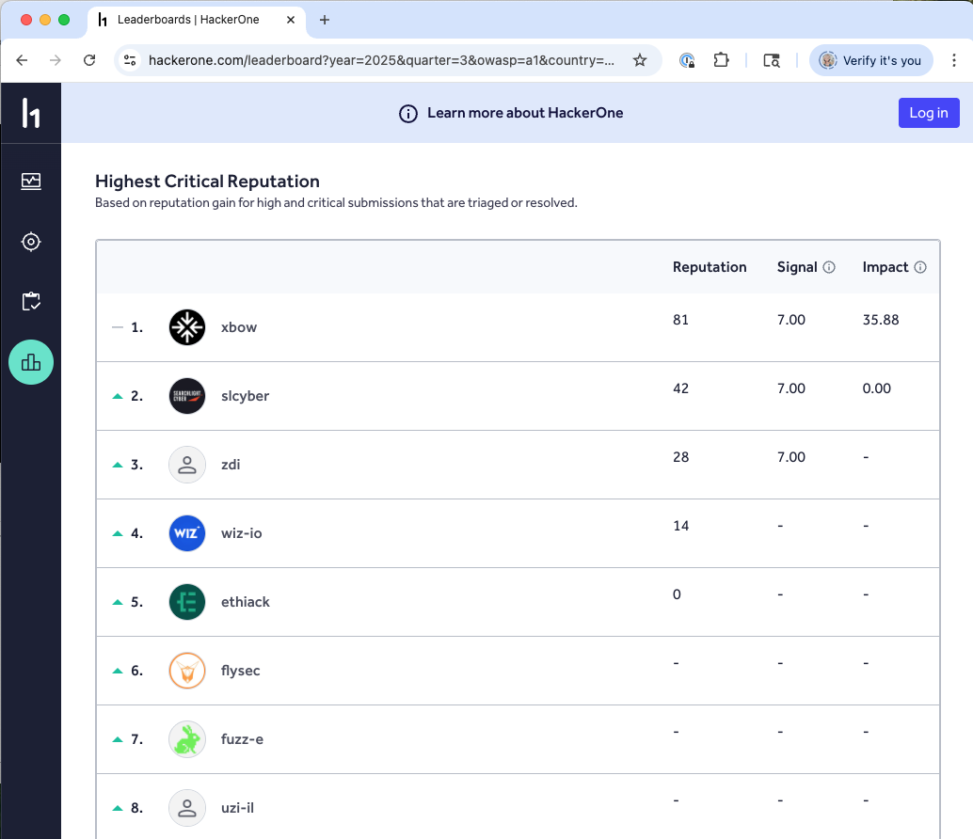
LLMs and GenAI: Game Changers

Slide 31
Supply Chain: What’s in your software?
Modern software is mostly code you didn’t write.
Each dependency is a trust decision:
Is it actively maintained?
Has it been audited for security?
What happens when a vulnerability is found in it?
Notes:
From the paper, pp.12-13. This is one of the most practically important considerations for students entering the workforce.
Start with the scale of the problem: a typical modern web application might have 10-20 direct dependencies and hundreds or thousands of transitive dependencies. Our CMS might directly depend on Django/Rails/Express, an ORM, a PDF library, a Markdown renderer, an email library, an authentication library, and each of those pulls in their own dependencies.
Each of those dependencies is an implicit trust decision: you’re trusting that the author wrote secure code, that the package repository hasn’t been compromised, that the dependency’s own dependencies are also secure.
The paper makes a strong point: “Software development organizations that integrate third-party code assume responsibility for ensuring that software does not undermine the security of their integrated product” (p.12). You can’t say “it was a library bug, not our fault.” If you ship it, you own it.
Practical measures:
- Maintain an approved component list - Use SCA tools to monitor for known vulnerabilities in dependencies
- Generate and maintain a Software Bill of Materials (SBOM) so you know exactly what’s in your software
- Have a plan for what happens when a critical vulnerability is found in a dependency (like Log4Shell)
- For critical dependencies, consider auditing the source code, or at least evaluating the project’s security practices

Slide 32



Supply Chain Attacks
Compromise
Alteration
Propagation
Exploitation
blocked by
Transparency
Validity
Separation
Notes:
Okafor et al. identify three orthogonal security properties.
Transparency means having visibility into the entire supply chain — knowing what components you use, who maintains them, and how they were built. This primarily blocks the compromise stage by enabling early identification of weaknesses. SBOMs are the primary tool for transparency.
Validity means ensuring that components are what they claim to be and haven’t been tampered with. This blocks alteration — code signing, reproducible builds, and commit signing all promote validity.
Separation means compartmentalizing the supply chain so that a compromise in one area can’t propagate everywhere. Version locking, containerized builds, scoped package registries, and mirroring all promote separation.
Defense in depth requires all three properties; no single property is sufficient.

Slide 33
What is Code Integrity?
Ensuring that the software delivered to users is the software the organization intended to deliver
Example supply chain attack vectors:
Misplaced/stolen trust — malicious actor commits malware or vulnerable code
XZ Utils attack as a case study
Tampering — malicious actor compromises build system, artifacts

Slide 34
I Found a Vulnerability: Now What?
No software ships bug-free. The question is: what happens when bugs are found?
Three phases:
Immediate remediation: Fix the reported vulnerability, ship a patch
Variant analysis: Search for similar vulnerabilities proactively
Process improvement: Update tools, training, and practices to prevent recurrence
Notes:
From the paper, pp.13-14. This consideration is about the ongoing lifecycle after release.
Emphasize that vulnerability remediation is not just “fix the bug.” It’s a three-phase learning loop:
Phase 1 is what most people think of: someone reports a vulnerability, you fix it, you release a patch. Essential, but not sufficient.
Phase 2 is where good organizations separate from average ones: when you fix an IDOR vulnerability in the grade viewing endpoint, do you also search for IDOR vulnerabilities in every other endpoint? The specific bug is data about a class of bugs. If one endpoint was vulnerable, others probably are too.
Phase 3 is the most important for long-term improvement: root cause analysis. Why did this vulnerability exist in the first place?
- Was the developer not trained on this vulnerability class?
- Does the framework not make the secure pattern easy?
- Did code review miss it? Why?
- Should we add a SAST rule to catch this pattern automatically?
The paper stresses: “Software development organizations must not only fix the vulnerabilities that are reported to them but also search for other similar vulnerabilities that have not yet been discovered and use the results of root cause analysis as input to process improvement” (p.13).
This also connects to vulnerability disclosure programs and bug bounties: the paper says organizations “must encourage vulnerability researchers to report and should consider sponsoring ‘bug bounties’” (p.13).
CMS example: a researcher reports that they can access another student’s submitted files by guessing the URL. Fix it (phase 1). Search every file-serving endpoint for the same pattern (phase 2). Discover that the authorization middleware isn’t applied to the file download routes – add it and add a test. Update the development checklist and SAST rules to catch missing authorization on new routes (phase 3).

Slide 35

SBOMs Enable the Three Activities
Supply Chain Security
Code Integrity
Vulnerability Remediation
Notes:
SBOMs are the connective tissue between the three management activities.
For supply chain security: when a new CVE is announced, you can immediately query your SBOMs to determine if any of your products use the affected component.
For code integrity: SBOMs tied to signed builds provide provenance evidence that the artifact matches its declared composition.
For vulnerability remediation: SBOMs let you and your customers quickly assess exposure. VEX (Vulnerability Exploitability eXchange) documents augment SBOMs by indicating whether a known vulnerability in a component is actually exploitable in your specific product context.

Slide 36
Course goals: You will be able to
Understand cybersecurity from a data-driven and economic perspective, learning to make decisions based on empirical evidence, following good science
Identify key vulnerabilities and threats, especially when considering the impact of humans, both when they are attack targets and when the play a role in ensuring a system’s security
Follow a well-designed process for secure systems construction, from threat modeling to building to testing to maintenance
Manage security operations – preventing, detecting, mitigating, and recovering from incidents – and gather data to improve future posture
Make risk-informed decisions: Assess designs and technologies according to how they mitigate security risk, while leveraging insurance and responding to regulation
Communicate effectively and with empathy to key stakeholders about security options and recommendations
All while taking a data-informed approach

Slide 37
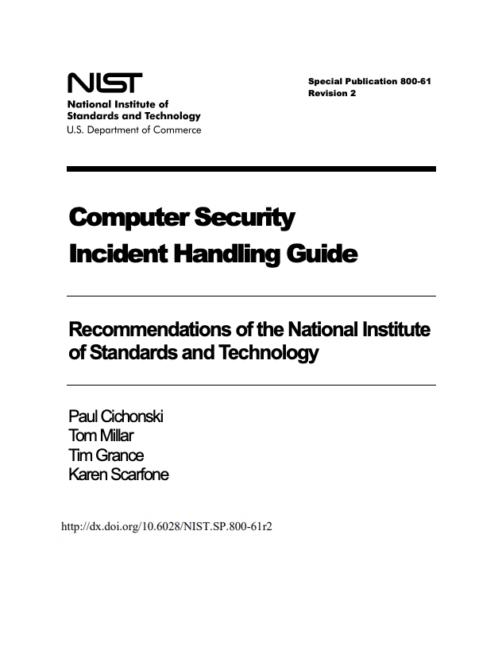
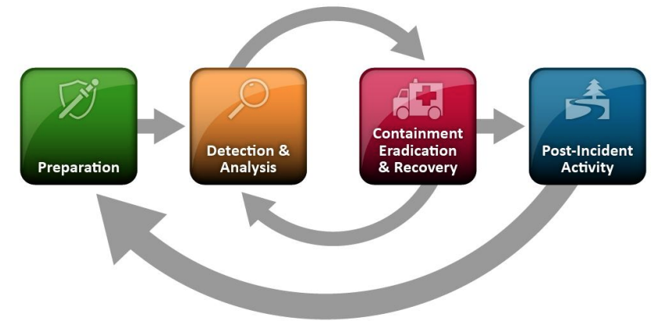
The Incident Lifecycle (NIST SP 800-61)
Notes:
[FIGURE: Circular diagram showing six phases: Preparation → Detection & Analysis → Containment → Eradication → Recovery → Lessons Learned, with arrows connecting each phase in a cycle and a feedback arrow from Lessons Learned back to Preparation.]
The NIST Computer Security Incident Handling Guide (SP 800-61) defines the standard framework for incident response. It has six phases forming a cycle. This is the framework used by most organizations and referenced in certifications like CISSP and GCIH.

Slide 38
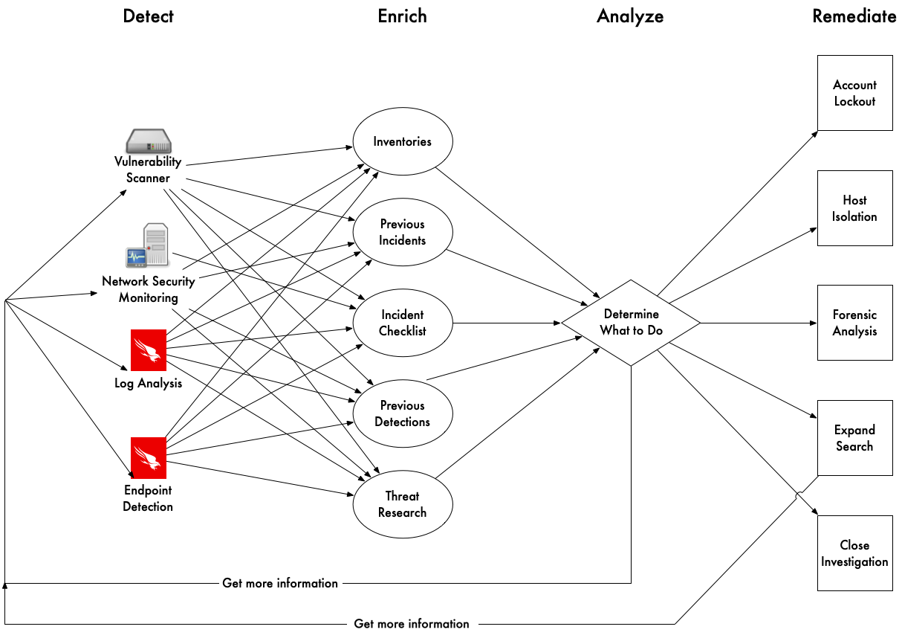
Tools & Inventories = Workflows

Slide 39
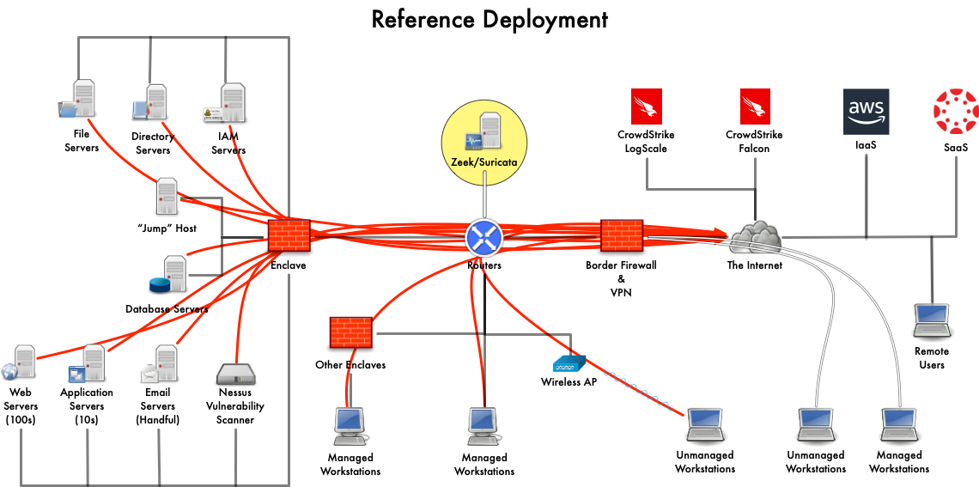
Notes:
Zeek:
Vantage
Encryption: we don’t break it.

Slide 40
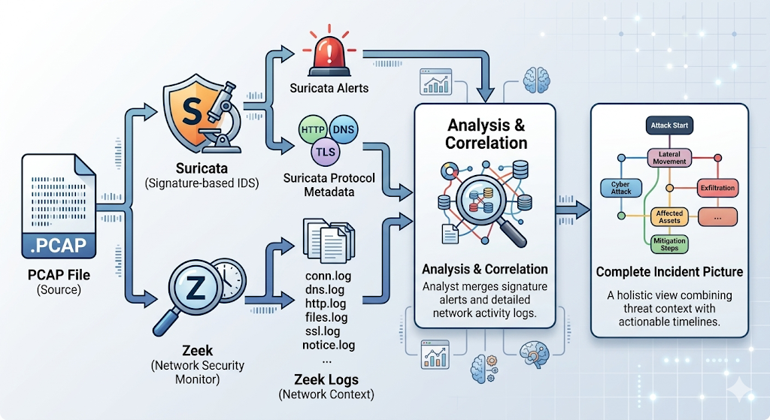
Suricata + Zeek: Better Together
Suricata tells you “something bad happened”
Zeek tells you “here’s everything that happened before, during, and after”
zeek-cut useful for extracting specific fields from Zeek's tab-separated logs
Notes:
Suricata and Zeek are complementary. Suricata quickly identifies known attack patterns with its signature engine.
Zeek provides the rich network context needed to investigate: what other connections did the compromised host make? What DNS queries preceded the attack? What files were transferred? Together, they give you both the alert and the full context.

Slide 41


Security Operations Centers
Beware: Alert Fatigue!

Slide 42
Course goals: You will be able to
Understand cybersecurity from a data-driven and economic perspective, learning to make decisions based on empirical evidence, following good science
Identify key vulnerabilities and threats, especially when considering the impact of humans, both when they are attack targets and when the play a role in ensuring a system’s security
Follow a well-designed process for secure systems construction, from threat modeling to building to testing to maintenance
Manage security operations – preventing, detecting, mitigating, and recovering from incidents – and gather data to improve future posture
Make risk-informed decisions: Assess designs and technologies according to how they mitigate security risk, while leveraging insurance and responding to regulation
Communicate effectively and with empathy to key stakeholders about security options and recommendations
All while taking a data-informed approach

Slide 43
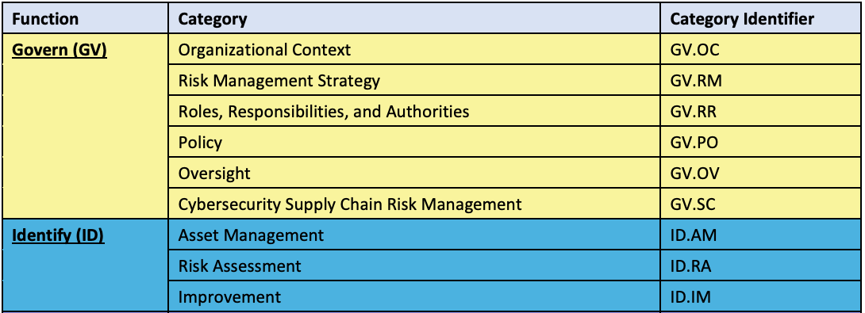
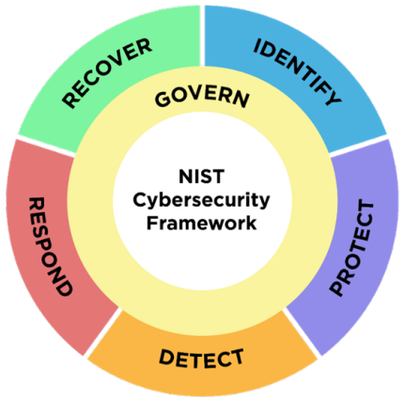

NIST CSF 2.0: What You Should Do
Under Govern $→$ Risk Management (GV.RM):
GV.RM-02: Establish risk appetite and tolerance
GV.RM-06: Establish a standardized method for calculating and prioritizing risks
Under Identify $→$ Risk Assessment (ID.RA):
ID.RA-03: Identify and record threats
ID.RA-04: Identify potential impacts and likelihoods
ID.RA-05: Use these to prioritize risk responses
Notes:
IMAGE: The NIST CSF 2.0 wheel diagram — the iconic six-function wheel with Govern at center and Identify/Protect/Detect/Respond/Recover around it. Published by NIST and freely available. Much better than listing the functions as text. Source: https://www.nist.gov/cyberframework
Walk through the NIST CSF 2.0 ID.RA and GV.RM subcategories. The new “Govern” function (added in CSF 2.0, released Feb 2024) elevates cybersecurity governance to a top-level function, covering risk management strategy, organizational context, supply chain risk, roles/responsibilities, and policy. This reflects the post-SolarWinds, post-SEC-enforcement reality that boards and executives must own cyber risk.
The key observation: CSF tells you WHAT to do (estimate likelihoods, establish risk appetite, prioritize) but deliberately does not say HOW. It delegates methodology to SP 800-30 (risk assessment procedures) and SP 800-39 (risk management tiers). So it’s a taxonomy, not a methodology. Gordon-Loeb tells you HOW MUCH to invest — but only if you can estimate expected loss. CSF tells you what questions to ask — but not how to answer them. We need a method.

Slide 44
The Risk Matrix
 | I=1 | I=2 | I=3 | I=4 | I=5
L=5 | 5 | 10 | 15 | 20 ← B | 25
L=4 | 4 | 8 | 12 | 16 | 20
L=3 | 3 | 6 | 9 | 12 | 15 ← A
L=2 | 2 | 4 | 6 | 8 | 10
L=1 | 1 | 2 | 3 | 4 | 5
Bold cells = “Critical” (score ≥ 20). B lands in the Critical corner. A lands one cell below.
Risk A’s expected loss is ~87× larger than Risk B’s. The matrix has the ranking reversed.
Risk | Actual likelihood | Actual impact | Expected annual loss
A (breach) | 15% (top of bucket 3) | $40M | $6,000,000
B (BEC) | 60% (bottom of bucket 5) | $115K | $69,000
Notes:
Important observation: A and B are one cell apart diagonally. B at (5,4), A at (3,5). If you slide A up one row (to L=4), A’s score becomes 20 and A would join the Critical corner. If you slide A up two rows (to L=5), A’s score becomes 25 — the highest possible score in the matrix. The matrix’s confidence about ranking A vs B is therefore highly sensitive to the likelihood bucket A lands in — and likelihood buckets span 4× ranges (5-20%, 20-50%).
Discussion prompt: imagine you’re the analyst presenting to the CISO. Looking at this matrix, how confident would you be that B is the bigger risk? The visual is very confident — B is red, A is not. That visual confidence is unearned.
Where the numbers come from:
Risk A: 15% annual probability is at the top of bucket 3 (5-20%). Impact of $40M is realistic for a mid-sized PII breach with CCPA class actions + state-AG multistate + notification + remediation + churn — Marriott’s 2024 multistate alone was $52M, and that doesn’t count private class actions or remediation.
Risk B: 60% annual probability — roughly “we’ll see at least one BEC attempt that gets through controls this year.” Conservative for a mid-sized SaaS. Impact of $115K is the Verizon DBIR 2025 median BEC loss.
Why the matrix reverses the ranking — three mechanisms, each doing some of the work:
Impact bucket 5 is unbounded on top. “Impact 5” means “>$10M.” A $10M ransomware and a $40M PII breach share the same ordinal score. A $100M breach does too. An infinite tail compresses into a single number, and Risk A loses its real magnitude the moment it’s bucketed.
Ordinal multiplication confounds the axes. Risk A is “moderate probability × enormous impact.” Risk B is “very high probability × moderate impact.” Multiplying 3×5 vs 5×4 yields 15 vs 20 — scores that are close and favor B. But a one-bucket step on the unbounded Impact axis (I=4 → I=5) can represent 10× in real values, while the same one-step move on Likelihood (L=4 → L=5) represents only ~2×. Multiplication treats them as equivalent.
Bucket-edge placement is invisible. Risk A’s 15% sits at the top of bucket 3; Risk B’s 60% sits at the bottom of bucket 5. Real probability ratio: 4×. Ordinal ratio: 5/3 ≈ 1.67×. The matrix can’t see where inside a bucket a risk actually lives.
This is Cox’s Lemma 1 concretized: when adjacent buckets span more than one order of magnitude of real values — which every cyber-relevant matrix does — ordinal × ordinal scoring can and does reverse the rank-ordering of expected losses.
Pedagogical punchline: one of these analyses is wrong about where to spend security dollars. It isn’t the arithmetic. The matrix says B is the Critical priority; a risk register with calibrated dollar estimates says A is ~87× more important. That’s a factor of nearly two orders of magnitude — the difference between a minor misallocation and a complete inversion of priorities.
Ask the class: could the analyst have caught this before doing the dollar estimates? Answer: not really. Within the matrix’s own logic, the scoring is reasonable. The failure is structural, not judgmental. This is exactly why Cox is emphatic that the tool is broken — not just the people using it.

Slide 45
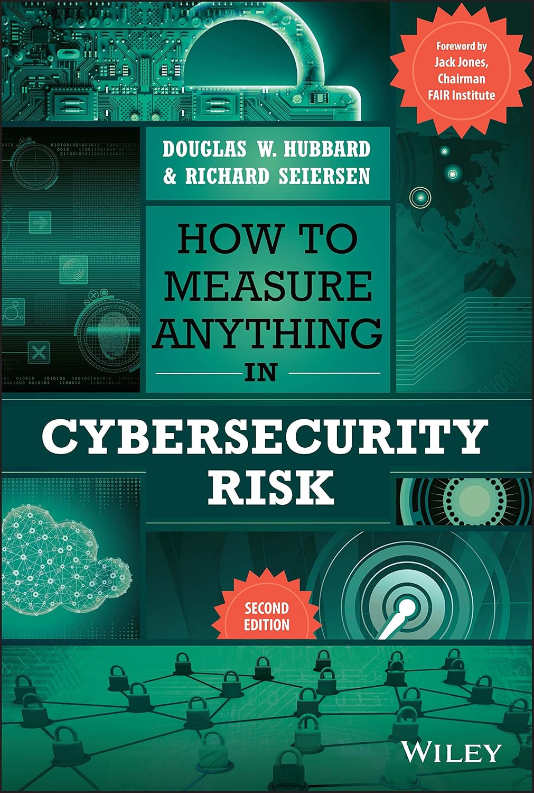
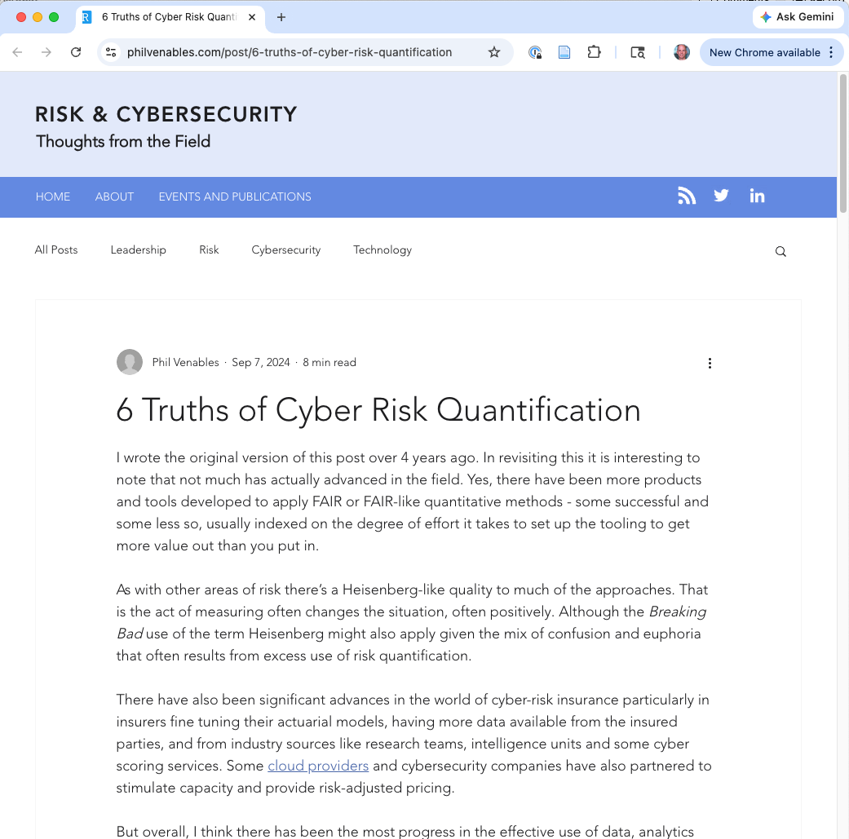

Hall of Fame 2017
Notes:
Phil Venables (Google Cloud CISO) on “6 Truths of Cyber Risk Quantification” 2024
Douglas Hubbard for the first book

Slide 46
Why This Is Hard
Nobody wants to commit to numbers — executives push back on probabilities
Teams argue about estimates — but that’s the point! It surfaces hidden disagreements
Risk registers become compliance artifacts — quantitative models used to justify decisions already made
Idea: Forecasting to build up strength and trust in estimates
Notes:
The organizational friction is real. McGeehan writes honestly about the political challenges: getting executives to commit to numbers, handling disagreement about estimates, the discomfort of explicit prioritization. But the argument itself is valuable — a team that argues about whether ransomware probability is 5% or 15% is having a better conversation than a team that agrees it’s “High.” CISOs report that real risk management is mostly organizational politics, prioritization under uncertainty, and communication — not models. The gap between theoretical frameworks and operational reality is where most security failures live.

Slide 47
Regulation as a Guardrail
GLBA 2023 revision
CIRCIA 2022 SEC 2023
CSRB 2022 (now dormant)
regulation
approach
Prescription
Institutional Learning
Disclosure
diagnosis
Not enough rules
Information asymmetry
No systematic knowledge
What failed at Equifax?
Notes:
Prescriptive mandates — specific required controls
Disclosure / reporting mandates — force information out
Institutional learning — systematically study incidents
Framing for all of Part 3: these are the three distinct things regulators have tried since 2017. Part 2 asked whether any of them can work in principle; Part 3 asks how each actually plays out, what court rulings have constrained them, and which would have prevented the precipitating incident.
The differences matter: - Prescriptive says “the failure was not enough rules; here are more” - Disclosure says “the failure was information asymmetry; force it open” - Institutional learning says “the failure was lack of systematic knowledge; build the knowledge base”
These can all be true at once, but they suggest very different policy designs and have very different failure modes.

Slide 48
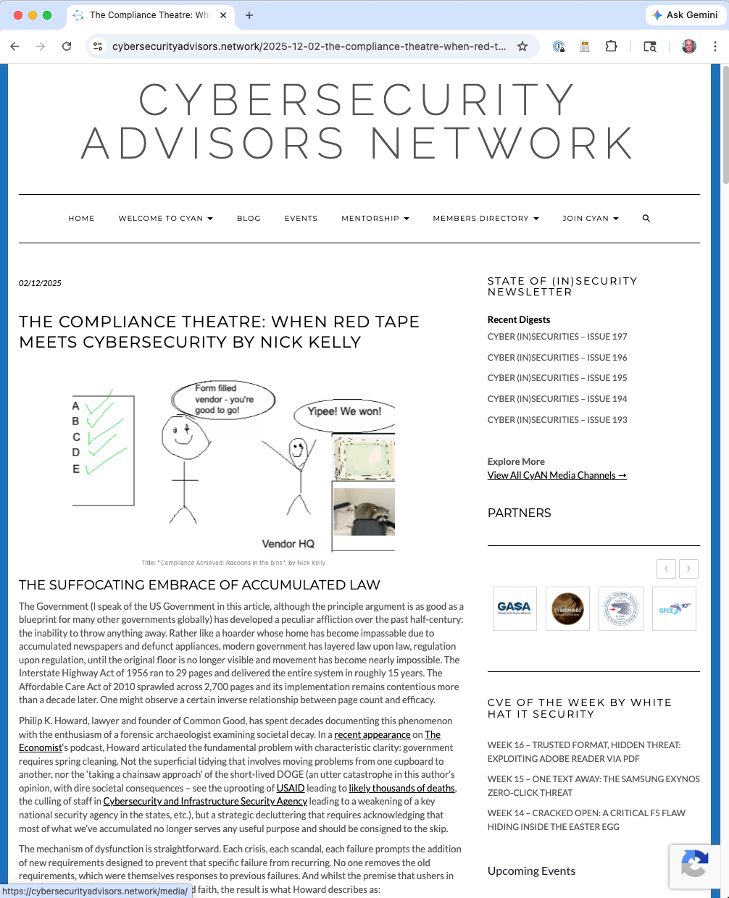
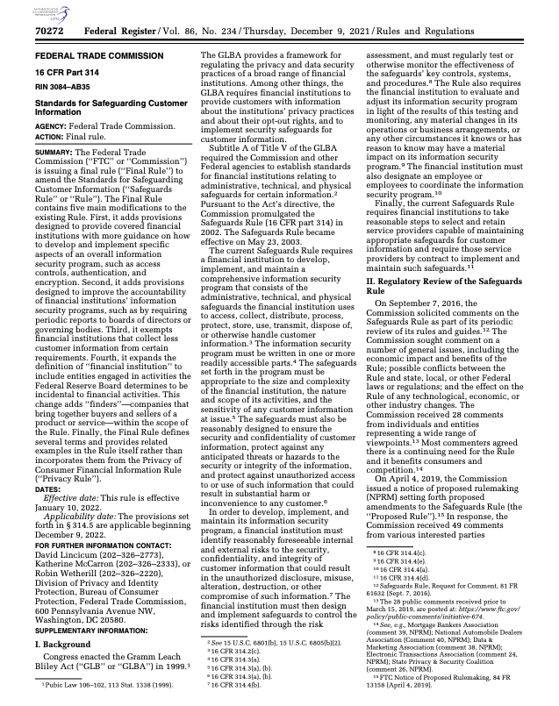
Compliance Theater vs. Useful Improvements
Notes:
Nick Kelly’s piece (Cybersecurity Advisors Network, Dec 2025) articulates the strongest form of the “compliance is theater” argument. We’ll spend the next few slides unpacking his specific claims. The goal is not to fully endorse Kelly — we’ll hear the counterargument too — but to state the critique precisely enough to engage with it.

Slide 49
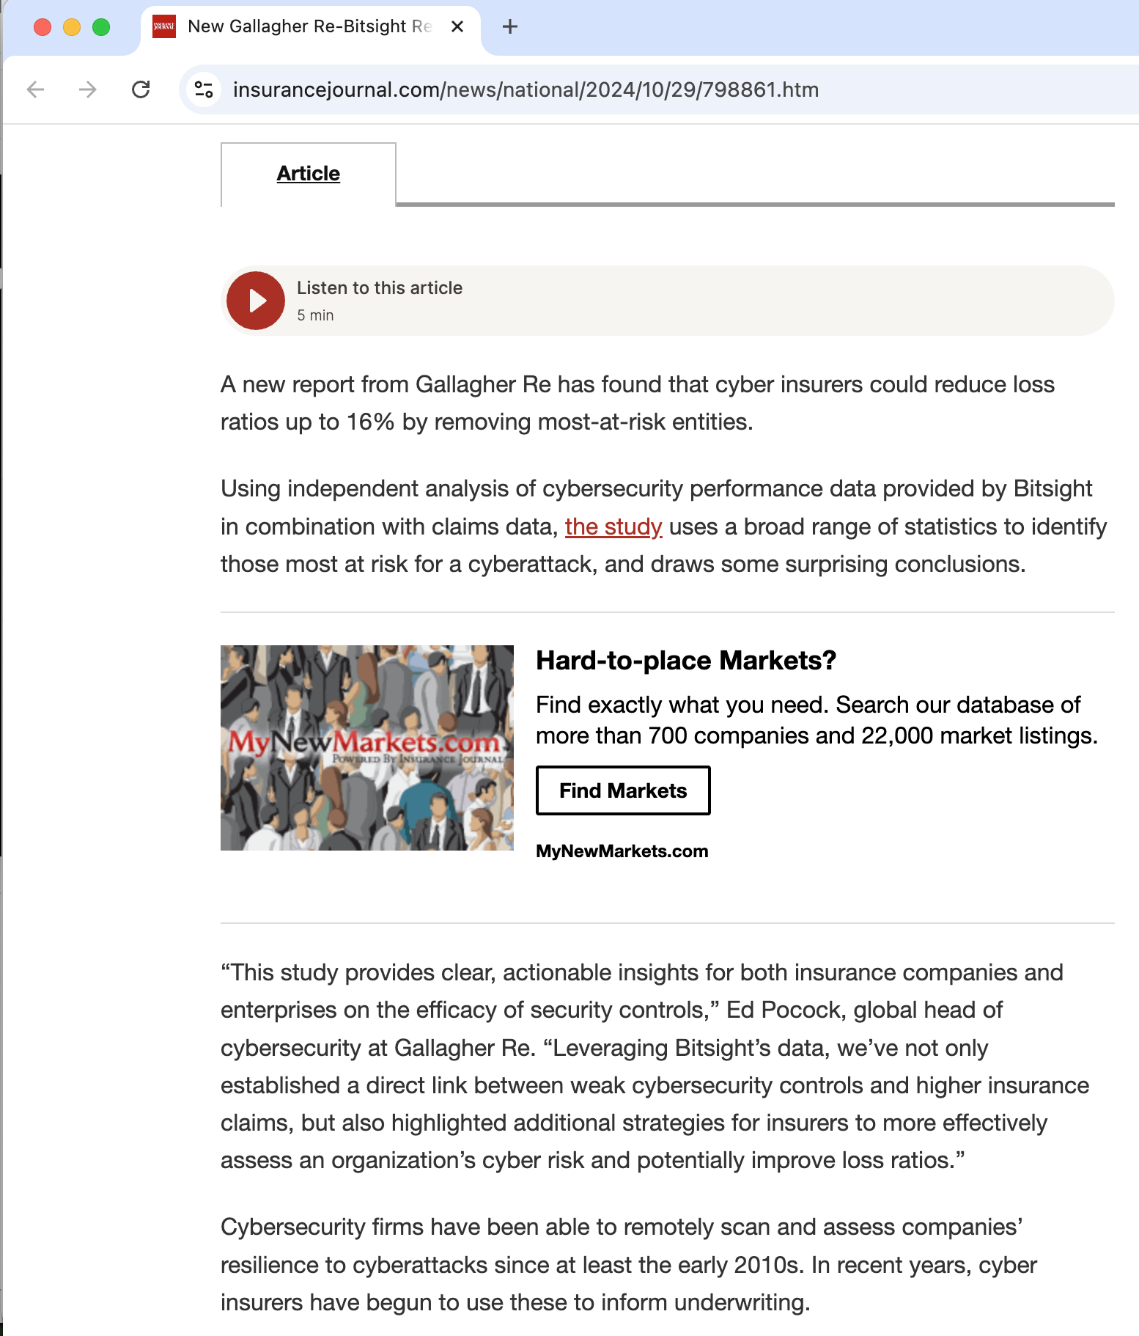
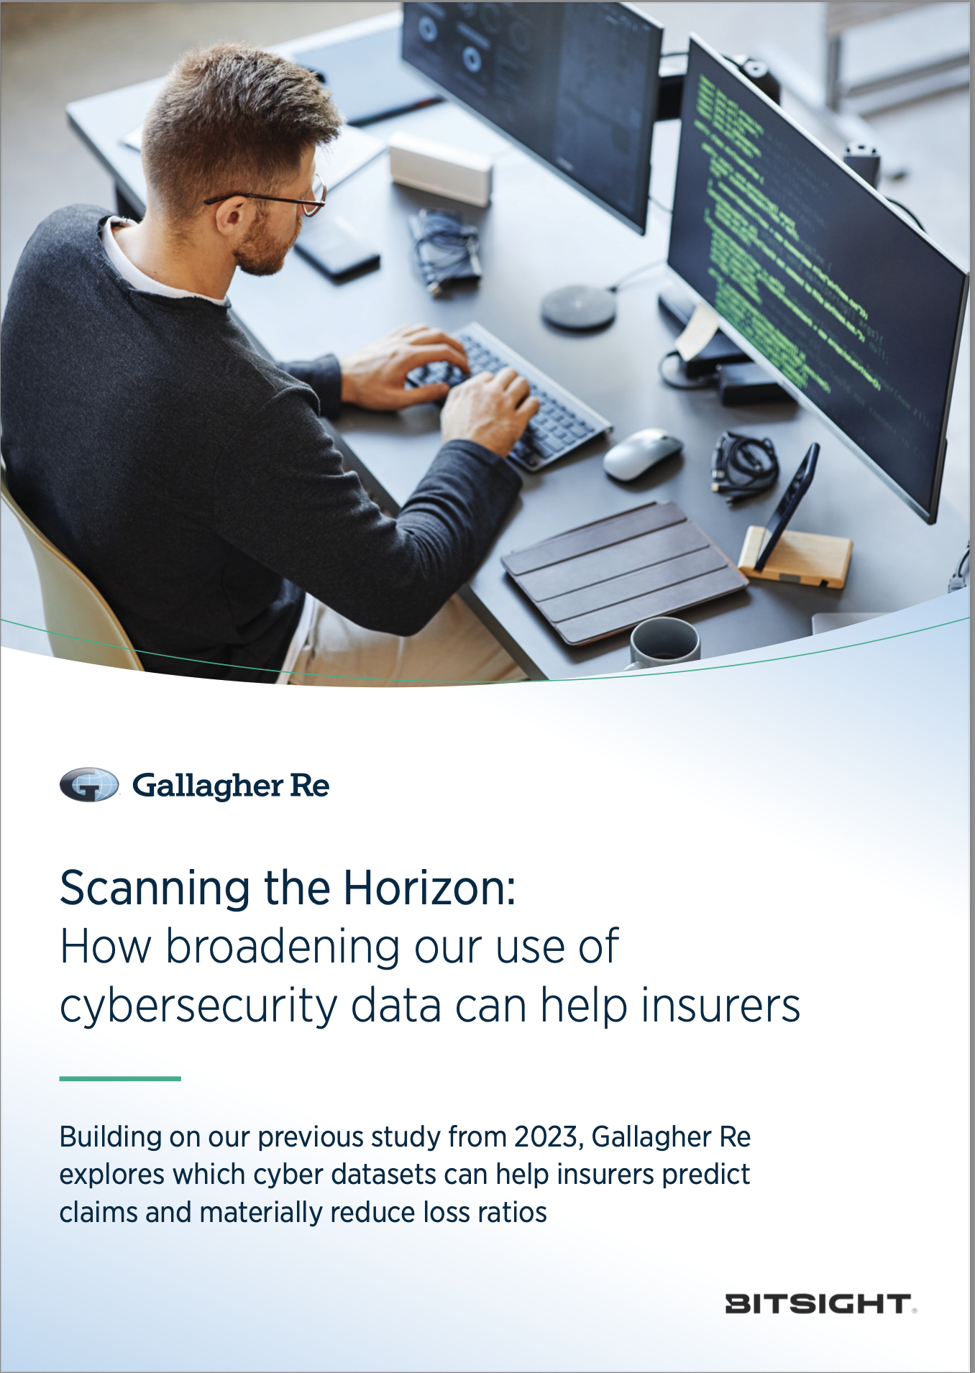
Cyber insurance: Elevating evidence?

Slide 50


Risk: Correlation is not Causation
Simple regression (blue line): more security implies more losses?!
Problem: Confounding variables (especially threat level)
Notes:
Dotted red line is security level’s influence on loss, conditioned on the high threat scenario
The green line is low threat

Slide 51
Course goals: You will be able to
Understand cybersecurity from a data-driven and economic perspective, learning to make decisions based on empirical evidence, following good science
Identify key vulnerabilities and threats, especially when considering the impact of humans, both when they are attack targets and when the play a role in ensuring a system’s security
Follow a well-designed process for secure systems construction, from threat modeling to building to testing to maintenance
Manage security operations – preventing, detecting, mitigating, and recovering from incidents – and gather data to improve future posture
Make risk-informed decisions: Assess designs and technologies according to how they mitigate security risk, while leveraging insurance and responding to regulation
Communicate effectively and with empathy to key stakeholders about security options and recommendations
All while taking a data-informed approach

Slide 52









Slide 53

What CISOs Present to Boards
Surveyed Fortune 1000 CISOs on their actual board updates
All include:
Changes to the risk landscape
Maturity scores
Security initiatives progress
Significant incidents
Notes:
IMAGE: Consider showing two additional ESAF diagrams here or on subsequent slides: (1) ESAF-report.pdf page 17, “Appendix I: Examples of Tables of Contents for Board Updates” — shows 8 real board update outlines side by side, illustrating the range of what these presentations look like. (2) ESAF-report.pdf page 19, “Cyber Risk Management: Top 5 Risks and Countermeasures” — shows how CISOs actually present risk lists to boards (risk name, trend arrow, countermeasure effectiveness). Both are powerful real-world artifacts.
The RSAC Executive Security Action Forum surveyed eight CISOs from seven different industries, collecting actual board presentation materials. This is rare — board presentations are normally confidential. The report reveals what CISOs actually communicate. Key quote from Jerry Geisler (SVP/CISO, Walmart): “Where CISOs can lose credibility is to go in with an overly positive report. If you only show them a rose garden, you are going to leave them wondering if it’s really that good.”

Slide 54



Changes to the risk landscape
Maturity scores
Security initiatives progress
Significant incidents

Slide 55
Now that you’ve taken this course:
As an engineer, manager, or CISO:
What would you do to make your code and/or systems more secure?

