Slide 1


Secure Systems Engineering and Management A Data-driven Approach
Cybersecurity Economics and Silver Bullets
Michael Hicks
UPenn CIS 7000-003, Spring 2026

Slide 2
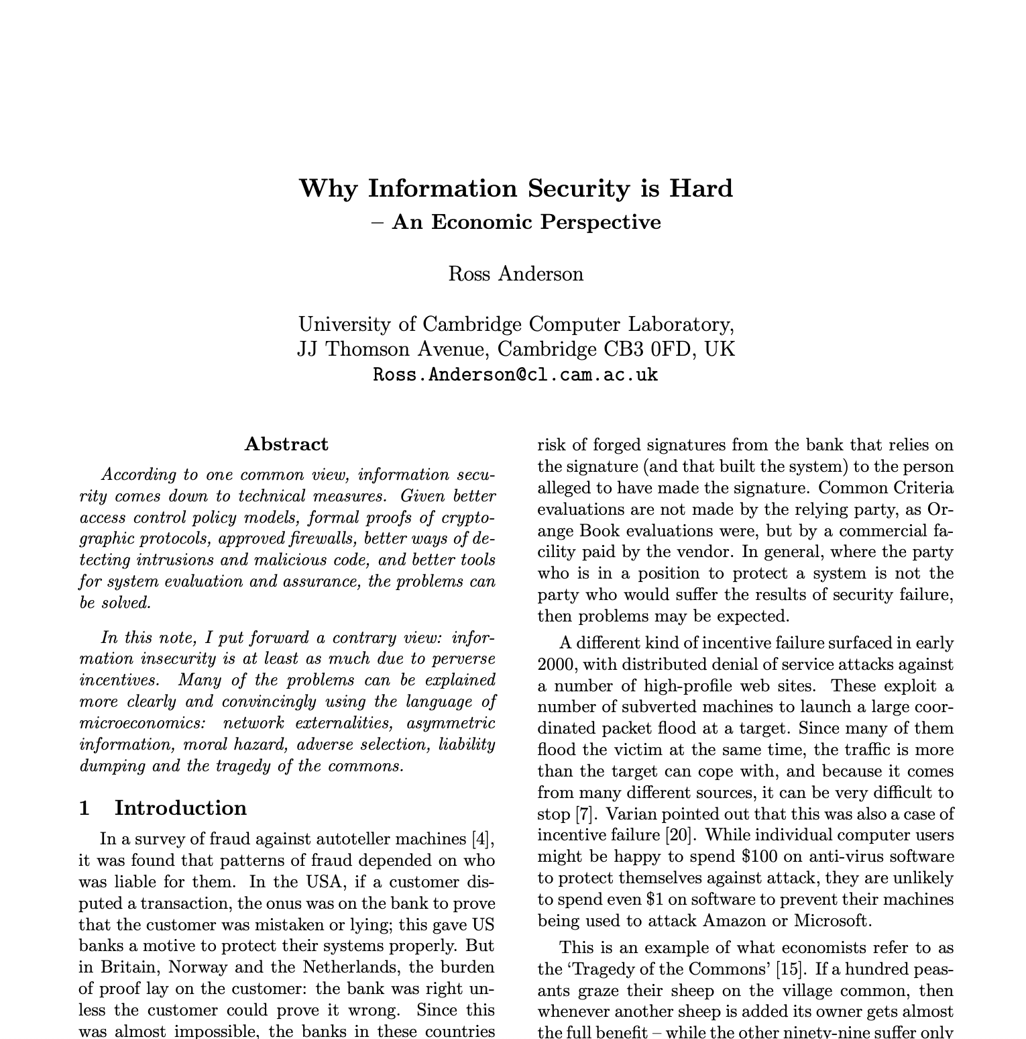
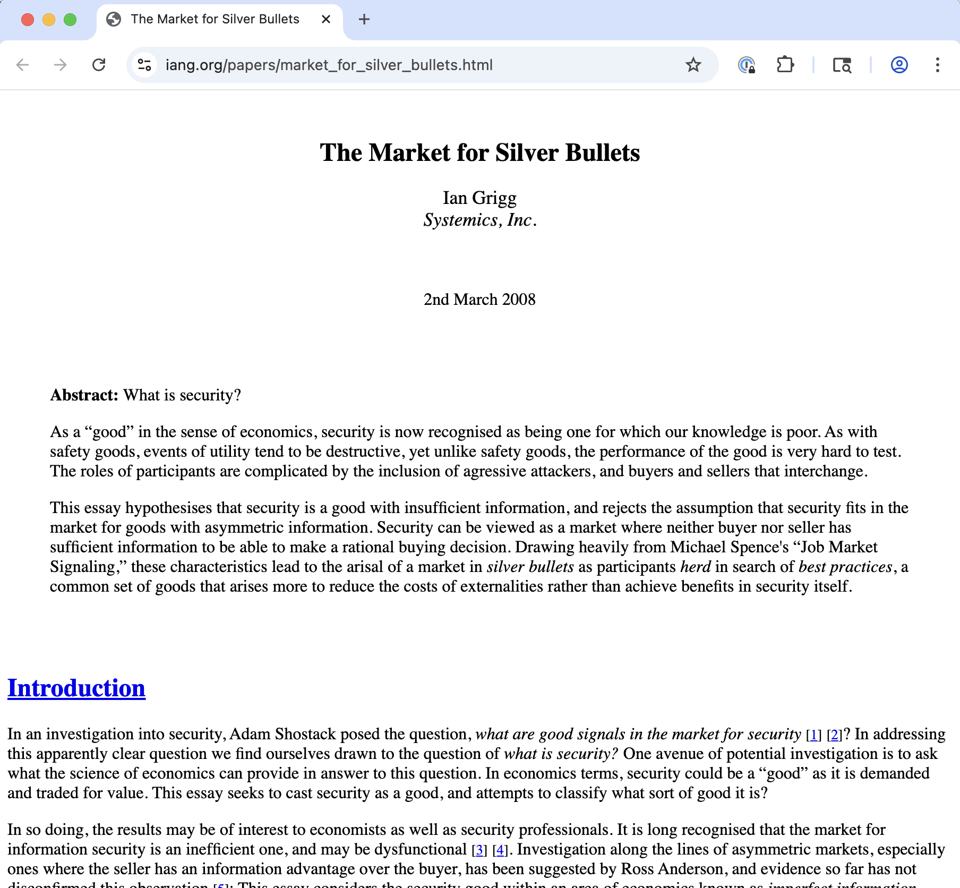
Readings

Slide 3

Readings
Essentially founded the field of security economics
Notes:
Published at ACSAC 2001
Context: Post-Y2K era, Microsoft under fire for security failures, pre-9/11 cyberattack awareness

Slide 4



Attack vs. Defense Asymmetry
Attacker (Paddy)
1,000 hours/year testing → finds 1 bug/year
Defender (Brian)
10,000,000 hours/year testing → finds 100,000 bugs/year
Probability Brian found Paddy’s bug: only 10%
Notes:
Target: Windows 2000 has 1,000,000 bugs, each with an MTBF of 1,000,000,000 hours
Paddy works for the Irish Republican Army
Break into the British Army’s computer to get the list of informers in Belfast
Brian is the army assurance guy
Reasonable: 35,000,000 line program like Windows 2000 to have 1,000,000 bugs
Anderson’s analogies:
1920s–30s air warfare: “Attack is simply easier than defense”
Wild West: “Men in black hats can strike anywhere, while the men in white hats have to defend everywhere”
16th–17th century piracy: Until great powers denied pirates safe haven, piracy was “just too easy”
“Thermodynamics” favors attackers—defenders must protect everything, attackers need find only one vulnerability
Today: Has technology changed this equation?
Looking ahead: Does generative AI change this calculus?
56% of executives believe attackers will have the AI advantage over the next two years. We’ll discuss.

Slide 5
Perverse Incentives
Concept | Definition | Security Example
Network externalities | Value increases with adoption | Platform vendors prioritize developer ecosystem over security; winner-take-all dynamics favor speed over safety
Asymmetric information | One party knows more than another | Buyers cannot assess security quality before purchase (“market for lemons”)
Moral hazard | Risk-taking when costs fall on others | Those who make security decisions don’t bear the costs of breaches
Adverse selection | Bad products drive out good | Secure products cost more but look identical to insecure ones
Liability dumping | Shifting responsibility to others | Vendors disclaim responsibility via EULAs; costs externalized to users
Tragedy of the commons | Shared resources degraded by individual use | Insecure systems impose costs on others (spam relays, botnets)
Key insight:
“Information insecurity is at least as much due to perverse incentives” as technical weaknesses.
I.e., economic, not (only) technical

Slide 6



Microsoft Case Study—The Trustworthy Computing Transformation
1990s–2000s: Network effects drove Windows dominance
“Applications barrier to entry”—security secondary to developer ecosystem
Code Red, Nimda, SQL Slammer (2001–2003) prompted transformation
Bill Gates’s “Trustworthy Computing” memo (January 15, 2002)
Result: Security Development Lifecycle (SDL), Windows XP SP2, monthly Patch Tuesday
Notes:
Question: Did market pressure or technical capability drive this change?

Slide 7
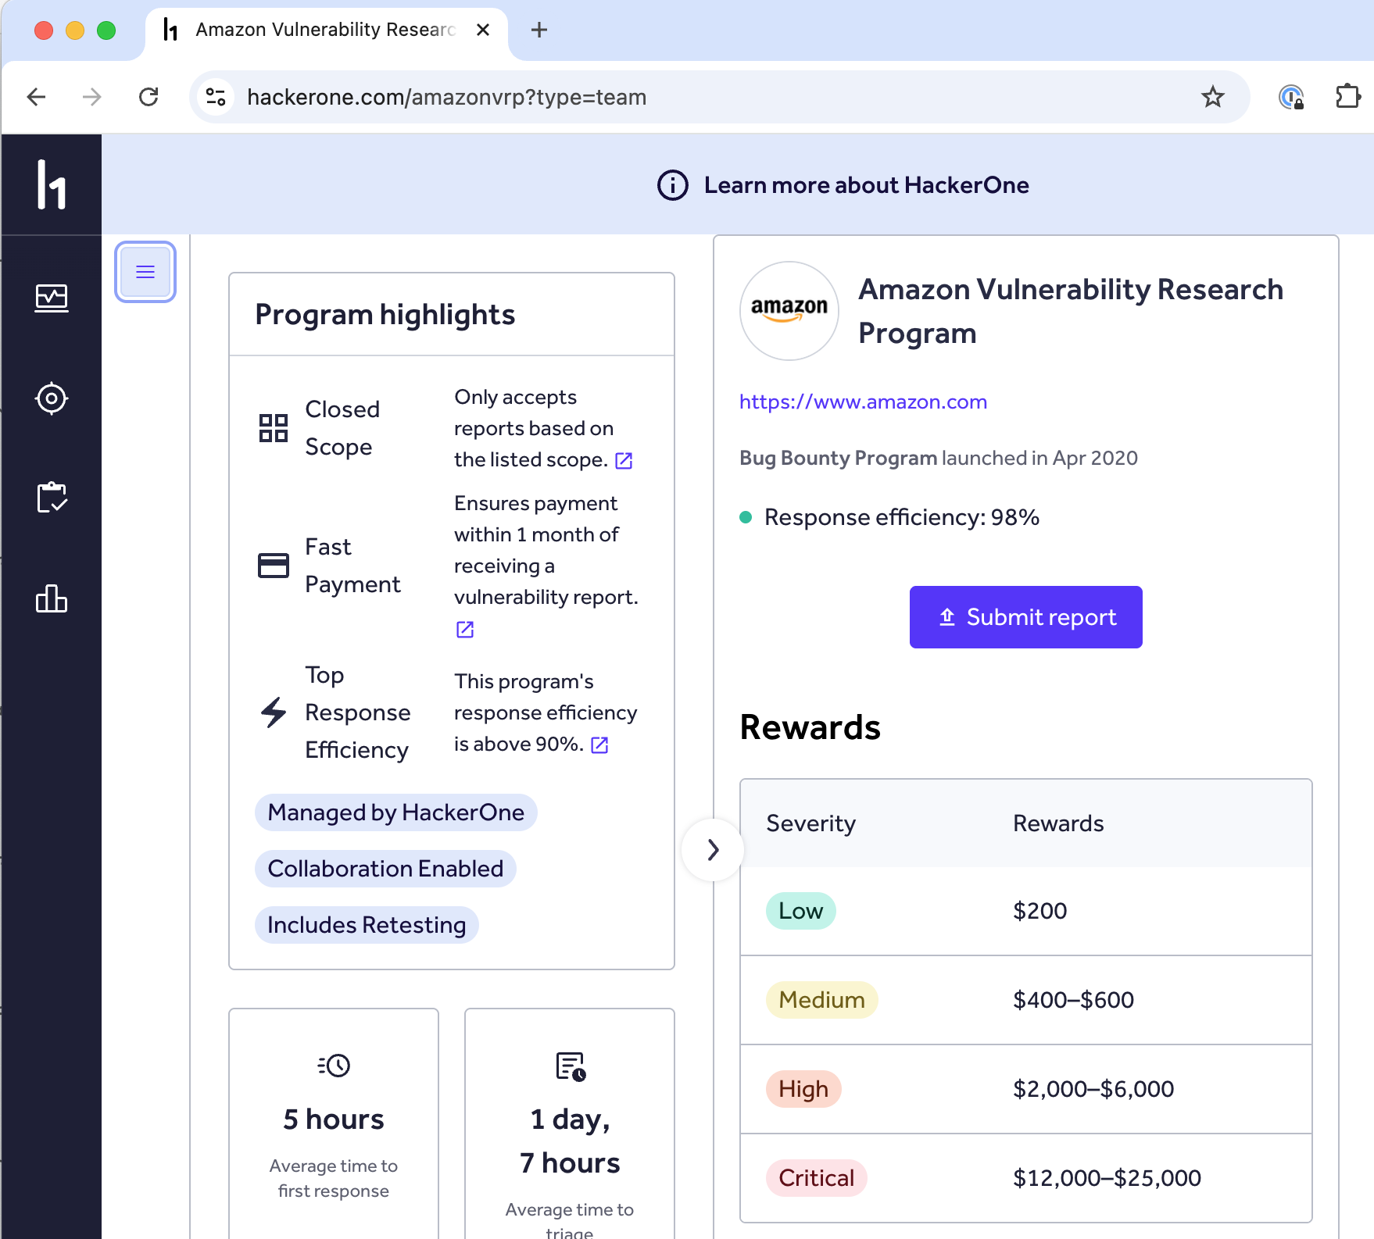

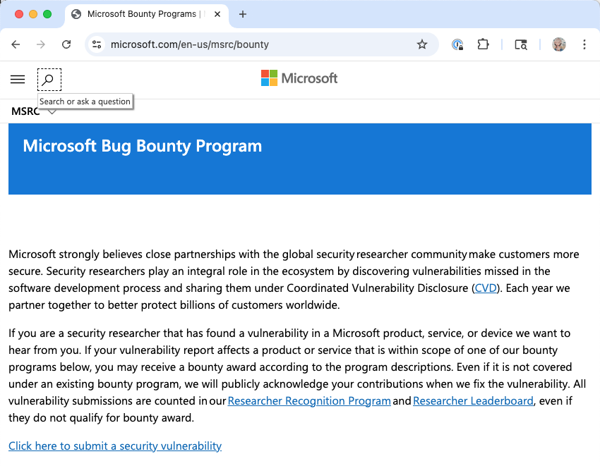
What has changed for the better?
Breach disclosure laws (California SB 1386 in 2002, GDPR in 2018) increased transparency
Bug bounty programs address some information asymmetry
CISA Secure by Design initiative (2023–2024) pushing vendor accountability
Notes:
Positive developments (detail): - California SB 1386 (2002) — first breach notification law; now all 50 states have similar laws
Microsoft’s transformation: Trustworthy Computing initiative led to SDL, dramatically reduced Windows vulnerabilities
Bug bounty programs: Mozilla pioneered (2004); now standard at major tech companies
CISA Secure by Design Pledge (May 2024): 194+ signatories; Fortinet year-in-review

Slide 8
What economic problems have persisted?
Problem | 2001 Status | 2026 Status
Network externalities | Microsoft dominance | Cloud platform dominance + AI model concentration
Asymmetric information | Can’t evaluate security | Still can’t evaluate security (now includes AI-generated code)
Moral hazard | Vendors don’t bear costs | CrowdStrike: $5.4B damage, ~$0 liability
Liability dumping | EULAs disclaim all | EULAs still disclaim all (though EU CRA may change this)
Tragedy of commons | Spam relays, worms | Botnets, cryptomining, DDoS-for-hire, AI-generated phishing
Notes:
Problems that persist (detail): - 83% of organizations report being affected by cybersecurity breaches, yet only 32% report revenue loss (CSIS/McAfee 2017) - Cloud concentration risk: AWS, Azure, GCP control vast majority of enterprise infrastructure
CrowdStrike’s 18% endpoint market share created single point of failure (CSA analysis). CrowdStrike 2024 outage: $5.4B Fortune 500 losses, but liability capped at “fees paid” (CNN analysis)
AWS outage Oct 20-21, 2025 – 3500 companies, 17M+ outage reports across 60 countries, https://www.ookla.com/articles/aws-outage-q4-2025
Software liability remains limited—vendors still disclaim via EULAs
Network effects stronger than ever (cloud monocultures)
9 July 2024, the American cybersecurity company CrowdStrike distributed a faulty update to its Falcon Sensor security software that caused widespread problems with Microsoft Windows computers running the software. As a result, roughly 8.5 million systems crashed and were unable to properly restart^{[1]} in what has been called the largest outage in the history of information technology^{[2]} and "historic in scale".
The CRA entered into force on 10 December 2024. The main obligations introduced by the Act will apply from 11 December 2027, with reporting obligations to apply as of 11 September 2026.

Slide 9
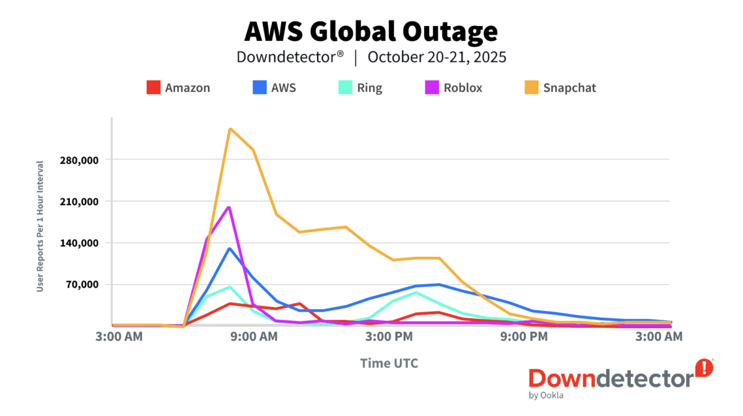

Slide 10
Generative AI as Accelerant and Amplifier
Anderson/Grigg Concept | How GenAI Amplifies It
Attack-defense asymmetry | AI enables personalized attacks at scale; defenders slowed by compliance
Information insufficiency | Neither AI vendor nor developer knows if generated code is secure
Herding | Everyone adopting same AI models creates new monocultures
Network externalities | AI model market is winner-take-all; concentration → systemic risk
Liability dumping | Who’s responsible for AI-generated vulnerabilities?
Plus: New attack surfaces
Prompt injection
Training data poisoning
Supply chain attacks via AI coding assistants
What will AI risks stabilize at?
Notes:
How GenAI amplifies attacker capabilities:
Phishing attacks surged 1,265% since ChatGPT launch (Accenture)
- LLM-generated phishing emails achieve 54% click-through rate vs. 12% for human-written (CrowdStrike/Arxiv)
- Deepfake incidents up 19% in Q1 2025 alone vs. all of 2024
- $25.6M deepfake fraud at Arup: AI-generated video call impersonated CFO
New attack surfaces unique to GenAI:
Prompt injection (#1 OWASP LLM risk)
- Training data poisoning
- Supply chain attacks via AI coding assistants
GenAI introduces new dimensions—40–62% of AI-generated code contains security vulnerabilities, and AI coding tools are now used by 97% of developers.
How GenAI could help defenders: - AI-powered threat detection and anomaly identification - Automated code review and vulnerability scanning - Natural language interfaces for security operations
The adoption asymmetry problem: > “Adversaries are moving faster and experimenting freely with new tools, while defenders are often slowed by bureaucracy, legacy processes and risk aversion.” — WEF 2025

Slide 11
Discussion Questions
Anderson argues platform vendors prioritize developer convenience over security. Is this still true?
Disclaiming liability: Should software be treated like other engineered products (bridges, aircraft)?
Does modern evidence still suggest that defenders are inherently disadvantaged?
Does generative AI tilt the balance toward attackers or defenders, or both equally?
Will voluntary pledges or liability shifts actually change vendor behavior?
Notes:
# Anderson argues platform vendors prioritize developer convenience over security. Is this still true?
Consider:
- Apple's [App Store model](https://developer.apple.com/app-store/review/guidelines/) (curated but restrictive)
- Cloud platforms ([AWS shared responsibility model](https://aws.amazon.com/compliance/shared-responsibility-model/))
- The rise of SaaS and API-first architectures
# Should software be treated like other engineered products (bridges, aircraft)?
The paper describes how software vendors disclaim liability via EULAs. The [CrowdStrike outage](https://en.wikipedia.org/wiki/2024_CrowdStrike-related_IT_outages) caused $5.4B in losses but their liability was capped at "fees paid."
Consider:
- What would change if strict liability applied to software?
- How would this affect open-source software? (See [EU CRA concerns](https://en.wikipedia.org/wiki/Cyber_Resilience_Act#Open_source_concerns))
- Is the [EU Cyber Resilience Act](https://digital-strategy.ec.europa.eu/en/policies/cyber-resilience-act) the right approach?
# Does modern evidence still suggest that defenders are inherently disadvantaged?
Consider:
- [Zero trust architecture](https://www.nist.gov/publications/zero-trust-architecture)
- AI-assisted threat detection
- Threat intelligence sharing ([ISACs](https://www.nationalisacs.org/), [CERTs](https://www.cisa.gov/uscert))
- Automated patching and DevSecOps
# Does generative AI tilt the balance toward attackers or defenders, or both equally?
Anderson's "Paddy vs. Brian" thought experiment assumed human effort on both sides. GenAI changes this equation.
Consider the **attacker advantages**:
- AI can generate [personalized phishing at scale](https://www.crowdstrike.com/en-us/blog/ai-vs-ai-cybersecurity-arms-race/)—converging mass attacks with spear-phishing precision
- [WormGPT and FraudGPT](https://deepstrike.io/blog/ai-cybersecurity-threats-2025) offer "crime as a service" on dark web forums
- Deepfakes enable social engineering that bypasses voice/video verification ([Arup $25.6M fraud](https://deepstrike.io/blog/ai-cybersecurity-threats-2025))
- Attackers face no compliance constraints or approval processes
Consider the **defender advantages**:
- AI can analyze logs and detect anomalies faster than humans
- Automated threat hunting and incident response
- [Bain analysis](https://www.bain.com/insights/generative-ai-and-cybersecurity-strengthening-both-defenses-and-threats-tech-report-2023/) shows threat identification is the current "hot spot" for defensive GenAI
Consider the **adoption asymmetry**:
- [56% of executives](https://www.accenture.com/content/dam/accenture/final/accenture-com/document-2/Accenture-Cybersecurity-In-The-Generative-AI-Era.pdf) believe attackers will have the advantage over the next two years
- Defenders face procurement cycles, compliance requirements, and risk aversion
- Is this a temporary "chaos phase" or a permanent shift? ([XBOW analysis](https://xbow.com/blog/the-chaos-phase-ai-cybersecurity-threats-2025))
# Will voluntary pledges or liability shifts actually change vendor behavior?
Anderson suggested government might need to intervene in security markets.
Consider:
- [194+ companies signed CISA's Secure by Design pledge](https://www.cisa.gov/securebydesign/pledge)—what accountability exists?
- The [EU CRA](https://digital-strategy.ec.europa.eu/en/policies/cyber-resilience-act) imposes fines up to €15M or 2.5% of global revenue but relies on self-certification
- California SB 1386 did change disclosure behavior—what made it effective?

Slide 12

Readings
Cryptographer and economist
Essay published in 2008

Slide 13
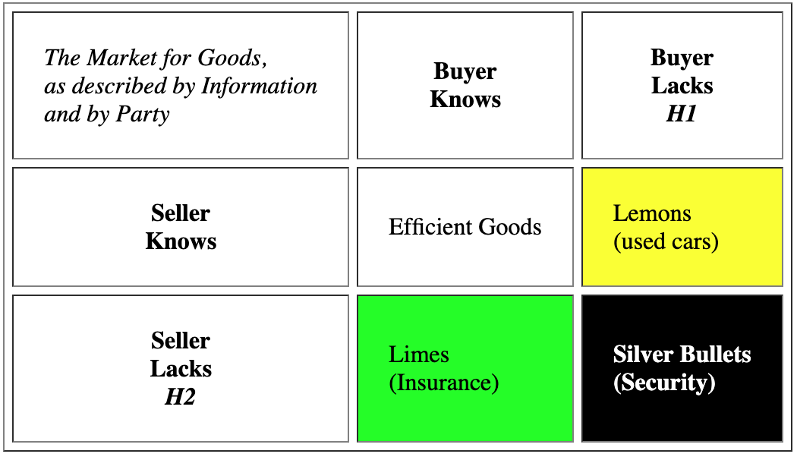
Silver bullets, not lemons
Extends Anderson:
Security is a good
Security is hard to assess
Leads to information insufficiency on both sides
Notes:
Ian Grigg: Cryptographer, financial cryptography researcher at Systemics, Inc.
Paper draws on Nobel Prize economics: Akerlof (lemons), Spence (signaling), Rothschild & Stiglitz (insurance)
Market for Lemons: Seller knows quality, buyer doesn’t (used cars)
Market for Limes: Buyer knows their risk, seller doesn’t (insurance—high-risk buyers seek more coverage)
Market for Silver Bullets: Neither party has sufficient information (security)
Key insight: The seller of a security product genuinely doesn’t know if it will stop a real attacker. This isn’t information hiding—it’s information absence.

Slide 14

Why Security Can’t Be Tested
Problem | Explanation
Active attacker | Unlike safety testing, attackers deliberately bypass standardized tests
Burglar alarm paradox | You can test that it beeps, not that it stops burglars
Statistical invalidity | Each attack is unique; past defense doesn’t predict future success
Destructive testing | Real tests are expensive and may cause the harm you’re trying to prevent
“You’re proposing to build a box with a light on top of it. The light is supposed to go off when you carry the box into a room that has a Unicorn in it. How do you show that it works?”
Notes:
Gene Spafford’s thought experiment
The tragedy of security: We cannot distinguish competence from luck.

Slide 15

Herding and Best Practices
TGT after 2013 breach
Ordinary costs
Extraordinary costs
Herding emerges
Fingerpointing
Rational response: Do what everyone else does
Best practices emerge
Nash equilibrium
Notes:
Ordinary costs: Direct losses from a breach (money stolen, data lost)
Extraordinary costs: Blame, lawsuits, reputation damage, stock price drops
Observation: Extraordinary costs often exceed ordinary costs
How herding emerges:
Fingerpointing: After a breach, competitors differentiate themselves by blaming the victim
Rational response: Use the same tools as everyone else → can’t be singled out
Best practices emerge: Not because they’re optimal, but because they minimize fingerpointing risk
Nash equilibrium: Once established, deviating from best practices is costly—even if deviation would improve security
Result: “Best practices” is a herding equilibrium that naturally converges toward loss as attackers evolve faster than the herd can adapt.

Slide 16
Today: Still herding
Compliance frameworks as “best practices”
SOC 2, ISO 27001, NIST CSF, PCI-DSS
Security vendor consolidation creating monoculture risk

Slide 17
Today: Still pointing fingers
Post-CrowdStrike outage
Delta hired David Boies to sue rather than examining their own resilience
Delta and CrowdStrike sued each other (October 2024)—blame-shifting over root cause analysis
The newest silver bullet: “AI-powered security”
Notes:
AI-powered security—but who can verify it works? The silver bullet problem may be intensifying.

Slide 18
Discussion Questions
Do you agree that sellers of security products genuinely don’t know if their products work against real attackers?
Herding claim: “Best practices” minimize fingerpointing, not cybersecurity risk; can you identify examples where this is true?
Do you think it’s (still) true that reputational and legal costs of a breach often exceed the direct costs?
Is AI-assisted coding the ultimate silver bullet scenario, where neither buyer nor seller knows if the output is secure?
Grigg suggests that transparency, liability reform, and better metrics could break the silver bullet equilibrium. Which interventions are most promising today?
Notes:
### 1. On Information Insufficiency
Grigg argues that sellers of security products genuinely don't know if their products work against real attackers.
**Do you agree? Can vendors ever know their product's true effectiveness?**
Consider:
- Vendors with their own threat intelligence (CrowdStrike, [Mandiant](https://www.mandiant.com/))
- Products tested against known malware families
- The gap between lab testing and real-world attacks
### 2. On Herding and Best Practices
Grigg describes "best practices" as a Nash equilibrium that emerges to minimize fingerpointing risk rather than maximize security.
**Can you identify examples of security "best practices" that persist despite evidence they don't work?**
Consider:
- Password complexity requirements vs. length + breach checking ([NIST SP 800-63B](https://pages.nist.gov/800-63-3/sp800-63b.html) changed guidance in 2017)
- Periodic password rotation (now [discouraged by NIST](https://pages.nist.gov/800-63-3/sp800-63b.html#memsecretver))
- Security awareness training (click-rate metrics vs. actual behavior change)
- Checkbox compliance (SOC 2, PCI-DSS)
**What would it take to shift the equilibrium?**
### 3. On Extraordinary vs. Ordinary Costs
Grigg argues that the reputational and legal costs of a breach often exceed the direct costs, which drives herding behavior.
**Is this still true? Has breach fatigue changed the calculation?**
Consider:
- [Equifax breach (2017)](https://en.wikipedia.org/wiki/2017_Equifax_data_breach): $700M settlement, stock recovered within 2 years
- [Target breach (2013)](https://en.wikipedia.org/wiki/Target_Corporation#2013_security_breach): CEO fired, but company thrived
- [Capital One breach (2019)](https://en.wikipedia.org/wiki/2019_Capital_One_data_breach): $80M fine, minimal long-term impact
- [CrowdStrike outage (2024)](https://en.wikipedia.org/wiki/2024_CrowdStrike-related_IT_outages): Stock dropped 45% initially, but has since recovered
### 4. 🔮 On AI-Generated Code and the Silver Bullet Problem
[97% of developers](https://www.veracode.com/blog/ai-generated-code-security-risks/) now use AI coding tools, yet [40–62% of AI-generated code contains security vulnerabilities](https://cset.georgetown.edu/publication/cybersecurity-risks-of-ai-generated-code/).
**Is AI-assisted coding the ultimate silver bullet scenario—where neither buyer nor seller knows if the output is secure?**
Consider the **information problem**:
- Developers can't fully audit AI-generated code at scale
- AI vendors can't guarantee security of outputs
- Models trained on public code that includes insecure patterns
- "It compiles" ≠ "It's secure"
Consider the **monoculture risk**:
- If everyone uses the same 2–3 code generation models, do systemic vulnerabilities emerge?
- A flaw in training data or model behavior could propagate across the entire software ecosystem
- Analogous to [CrowdStrike's 18% market share](https://cloudsecurityalliance.org/blog/2025/07/03/what-we-can-learn-from-the-2024-crowdstrike-outage) creating single point of failure
Consider **new attack vectors**:
- [Prompt injection](https://genai.owasp.org/llmrisk/llm01-prompt-injection/) ranked #1 on OWASP Top 10 for LLMs
- [Indirect prompt injection in AI coding assistants](https://www.aikido.dev/blog/promptpwnd-github-actions-ai-agents) enables supply chain attacks
- [Data poisoning of training sets](https://sombrainc.com/blog/llm-security-risks-2026): 5 malicious documents among millions achieved 90% attack success rate
- Attackers can embed instructions in code comments, documentation, or public repos that AI assistants will read
**Who bears liability for AI-generated vulnerabilities?**
- The AI vendor?
- The developer who accepted the code?
- The organization that deployed it?
### 5. On Escaping Silver Bullets
Grigg suggests that transparency, liability reform, and better metrics could break the silver bullet equilibrium.
**Which interventions are most promising today?**
Consider:
- [CISA Secure by Design](https://www.cisa.gov/securebydesign) + software liability proposals
- [SEC cyber disclosure rules (2023)](https://www.sec.gov/news/press-release/2023-139)
- Breach notification laws (now in all 50 states + [federal proposals](https://www.congress.gov/bill/118th-congress/senate-bill/3180))
- Cyber insurance requirements driving standards

Slide 19
The Role of Regulation
Both authors suggest market failures require intervention
What forms of intervention have been tried?
Disclosure requirements (SB 1386, GDPR, SEC rules)
Standards and frameworks (NIST CSF, ISO 27001)
Voluntary commitments (CISA Secure by Design Pledge)
Liability reform (EU Cyber Resilience Act)
What has worked?

Slide 20
Key Takeaways
Security failures are economic, not (just) technical. Better firewalls won’t solve misaligned incentives.
Markets don’t self-correct because neither buyers nor sellers have sufficient information to make rational decisions.
“Best practices” can be a trap—they emerge from herding dynamics, not effectiveness evidence.
Attack-defense asymmetry is structural, not incidental. Defenders face thermodynamic disadvantage.
Intervention may be necessary but must be designed carefully to avoid regulatory capture and new herding equilibria.
The CrowdStrike outage is a case study in every concept from both papers: network externalities, liability dumping, herding, and the gap between ordinary and extraordinary costs.
🔮 Generative AI amplifies existing economic problems—it doesn’t create new categories, but intensifies attack-defense asymmetry, information insufficiency, and monoculture risk. The security economics framework from 2001 and 2008 remains essential for understanding AI-era challenges.

Slide 21
Backups

Slide 22
The Data-Driven Approach
This course is about data-driven security management.
How do these economic analyses inform a data-driven approach?
Consider: - What metrics escape the signaling trap? - How do you measure security rather than compliance? - Can economic incentives be aligned through measurement? - How do you measure the security of AI-generated code at scale?

Slide 23
Anderson: Contemporary References
CSIS/McAfee, “Tilting the Playing Field: How Misaligned Incentives Work Against Cybersecurity” (2017) — Survey of 800 companies showing structural disadvantages for defenders
CrowdStrike outage — Wikipedia overview; CNN cost analysis (July 2024)
Jen Easterly at Black Hat 2024: “We don’t have a cybersecurity problem, we have a software quality problem” — InsideCyberSecurity coverage
EU Cyber Resilience Act (entered force December 2024) — First major software liability legislation; official EU page; Wikipedia summary
CSET Georgetown, “Cybersecurity Risks of AI-Generated Code” (November 2024) — Analysis showing ~50% of AI-generated code contains security-relevant bugs
World Economic Forum, “Enhancing Cybersecurity Before the Attackers in an AGI World” (October 2025) — On AI amplifying attacker-defender asymmetry

Slide 24
Evaluation and Certification Economics
Anderson’s critique of Common Criteria: “vendor-funded evaluation”
Evaluator incentive: get paid by the vendor seeking certification
Modern parallels: SOC 2 audits, penetration testing as compliance checkbox
Question: When does third-party evaluation create real accountability?

Slide 25
The Intelligence Agency Dilemma
Anderson’s scenario: A US agency discovers a Windows exploit.
Report to Microsoft → protect 250M Americans
Keep quiet → conduct operations against 400M Europeans + 100M Japanese
Credit asymmetry: Operations against foreigners get recognized; defense failures stay hidden
Modern parallel: NSA’s Equation Group tools leaked (2016–2017); debate over Vulnerability Equities Process

Slide 26
What Changed Since 2001—Extended Analysis
Positive developments (detail): - California SB 1386 (2002) — first breach notification law; now all 50 states have similar laws - Microsoft’s transformation: Trustworthy Computing initiative led to SDL, dramatically reduced Windows vulnerabilities - Bug bounty programs: Mozilla pioneered (2004); now standard at major tech companies - CISA Secure by Design Pledge (May 2024): 194+ signatories; Fortinet year-in-review
Problems that persist (detail): - 83% of organizations report being affected by cybersecurity breaches, yet only 32% report revenue loss (CSIS/McAfee 2017) - Cloud concentration risk: AWS, Azure, GCP control vast majority of enterprise infrastructure - CrowdStrike’s 18% endpoint market share created single point of failure (CSA analysis)

Slide 27
GenAI and the Attack-Defense Arms Race
How GenAI amplifies attacker capabilities: - Phishing attacks surged 1,265% since ChatGPT launch (Accenture) - LLM-generated phishing emails achieve 54% click-through rate vs. 12% for human-written (CrowdStrike/Arxiv) - Deepfake incidents up 19% in Q1 2025 alone vs. all of 2024 - $25.6M deepfake fraud at Arup: AI-generated video call impersonated CFO
How GenAI could help defenders: - AI-powered threat detection and anomaly identification - Automated code review and vulnerability scanning - Natural language interfaces for security operations
The adoption asymmetry problem: > “Adversaries are moving faster and experimenting freely with new tools, while defenders are often slowed by bureaucracy, legacy processes and risk aversion.” — WEF 2025

Slide 28
Contemporary References: Silver Bullets
Ross Haleliuk & Mayank Dhiman, “Cybersecurity is Not a Market for Lemons. It is a Market for Silver Bullets” (Venture in Security, June 2024)
ESPROFILER, “Herding the Cyber Security Market” (2024)
Cloud Security Alliance, “What We Can Learn from the 2024 CrowdStrike Outage” (July 2025)
Delta vs. CrowdStrike litigation: CNN coverage (July 2024); CNBC lawsuit filing (October 2024)
OWASP, Top 10 for LLM Applications 2025 — Prompt injection ranked #1 risk
Cloud Security Alliance, “Understanding Security Risks in AI-Generated Code” (July 2025)

Slide 29
The Barings-Visa Paradox
Barings Bank: One breach (Nick Leeson, 1995) → complete collapse
Visa: Millions of fraud events per year → comparatively stable and profitable
Insight: Frequent small failures generate data that enables learning and adaptation; rare catastrophic failures provide no feedback until it’s too late.
Application: - Is it better to have many small breaches or gamble on having none? - How does this relate to chaos engineering and resilience testing?

Slide 30
Signaling vs. Substance
Drawing from Spence’s job market signaling: - Education signals productivity but may not cause it - Security certifications signal diligence but may not indicate actual security
Signal | What It Actually Measures
SOC 2 Type II | Auditor found documented controls exist
ISO 27001 | Management system is in place
Penetration test | Specific testers didn’t find vulnerabilities in limited scope
Bug bounty | Researchers found bugs you’re willing to pay for
Question: Which signals, if any, correlate with actual security outcomes?

Slide 31
Breaking the Equilibrium
Grigg’s suggestions for escaping silver bullet markets:
Replace signals with metrics: Develop actual measures of security (ongoing research challenge)
Rebalance costs: Make direct costs exceed extraordinary costs (liability reform)
Reduce fingerpointing: Professional norms, information sharing agreements
Sunlight: Remove secrecy that enables regulatory capture and herding
Incentivize the attacker: Bug bounties, exploit markets—pay for information about real vulnerabilities
Question: Which of these has been tried? Which has worked?

Slide 32
Modern Silver Bullets and Herding—Extended Analysis
Silver bullets persist: - “AI-powered” security tools with unverifiable claims - “Zero-day protection” promises that can’t be tested until it’s too late - “Next-generation” firewalls, “advanced” threat protection—marketing as signaling
Herding examples: - MITRE ATT&CK evaluations gamed by vendors claiming “100% coverage” (ESPROFILER analysis) - Everyone buying the same Gartner Magic Quadrant leaders - CrowdStrike’s 18% market share created single point of failure
Breach response patterns: - Equifax breach (2017): $700M settlement, stock recovered within 2 years - Target breach (2013): CEO fired, but company thrived - Capital One breach (2019): $80M fine, minimal long-term impact

Slide 33
GenAI Code Generation—A New Silver Bullet Problem?
The scale of AI-assisted development: - 97% of developers have used AI coding tools (GitHub 2024 survey) - “Vibe coding”—trusting AI to handle implementation without careful review
The security reality: - 40–62% of AI-generated code contains security vulnerabilities (CSET Georgetown, November 2024) - Common issues: SQL injection, missing input validation, insecure defaults - Models trained on public repos that contain both secure and insecure patterns
Why this is a silver bullet problem: - Neither the AI vendor nor the developer knows if the generated code is secure - “It compiles and passes tests” ≠ “It’s secure” - Information insufficiency on both sides—classic Grigg scenario
Supply chain amplification: - AI-generated code enters open-source libraries - Vulnerabilities propagate to downstream consumers - Prompt injection in GitHub Actions enables supply chain attacks through AI coding assistants

