Slide 1


Secure Systems Engineering and Management
A Data-driven Approach
Michael Hicks
Exploiting the Human
UPenn CIS 7000-003
Spring 2026

Slide 2



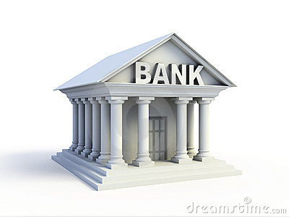
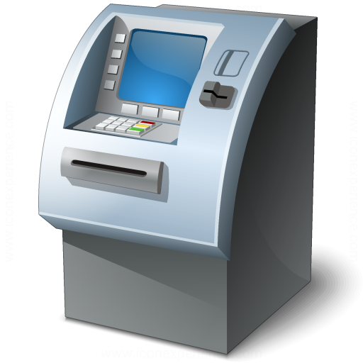
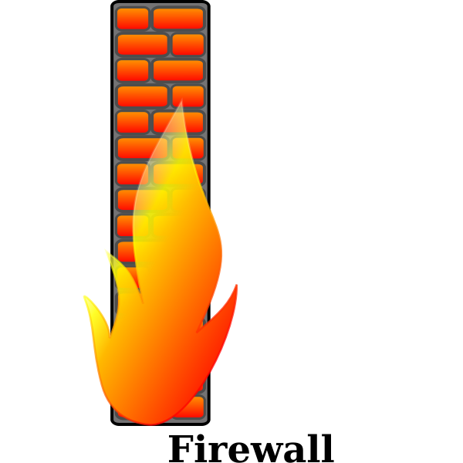




Operators
Builders
Attackers
Users
Cyber Builders

Slide 3
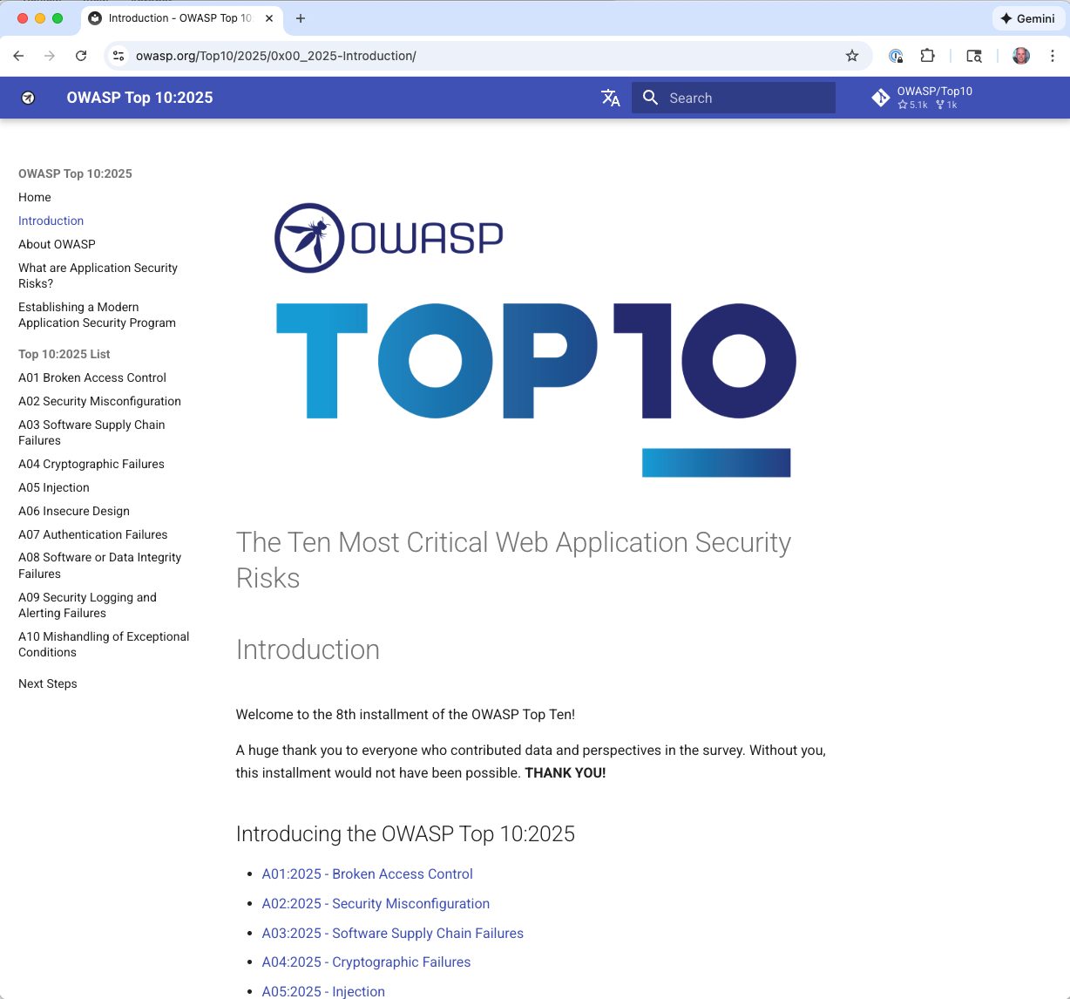
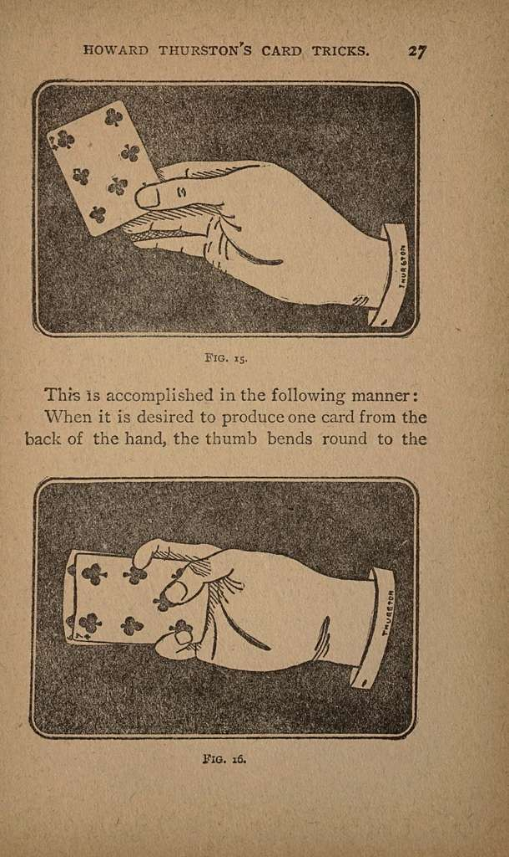
Attackers
' methods
Vulnerability based: Exploiting design and implementation flaws
Social engineering-based: Exploiting the human
Notes:
Key attacks on the social engineering side:
Phishing
Insider attacks
Baiting (USB drive in parking lot)
Vishing and Smishing
Supply chain manipulation

Slide 4
Attackers
' methods
Social engineering-based: Exploiting the human
Users
Notes:
Key attacks on the social engineering side:
Phishing
Insider attacks
Baiting (USB drive in parking lot)
Vishing and Smishing
Supply chain manipulation

Slide 5
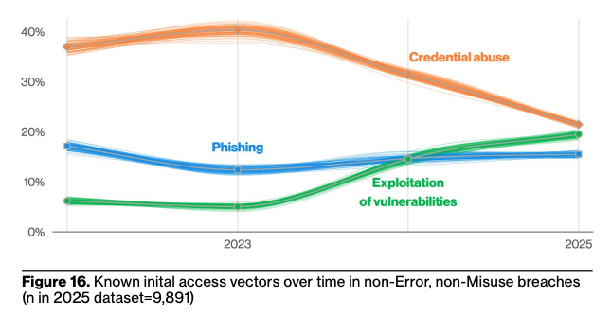
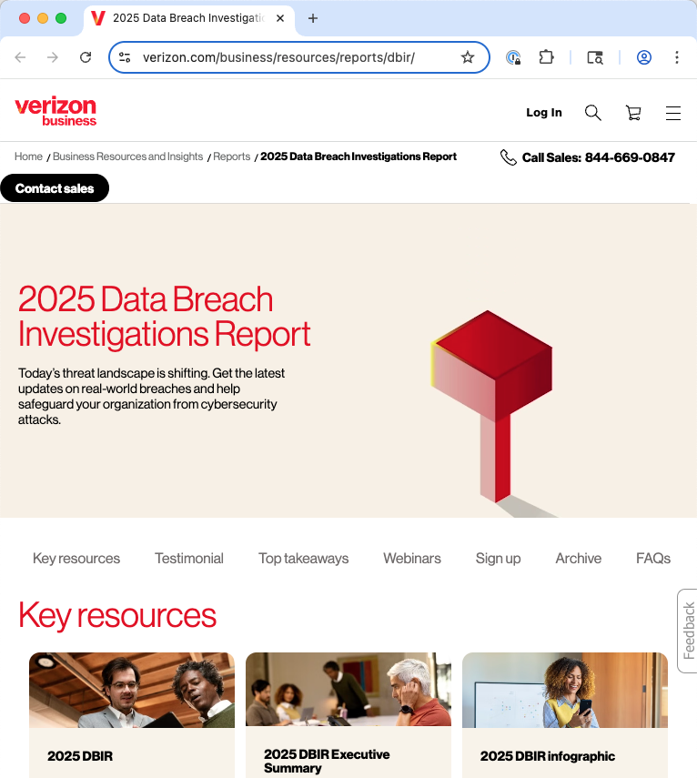
Top attack vectors
Source: 2025 Verizon Data Breach Investigations Report
Notes:
Still: Only 20% start with a vulnerability exploitation!

Slide 6
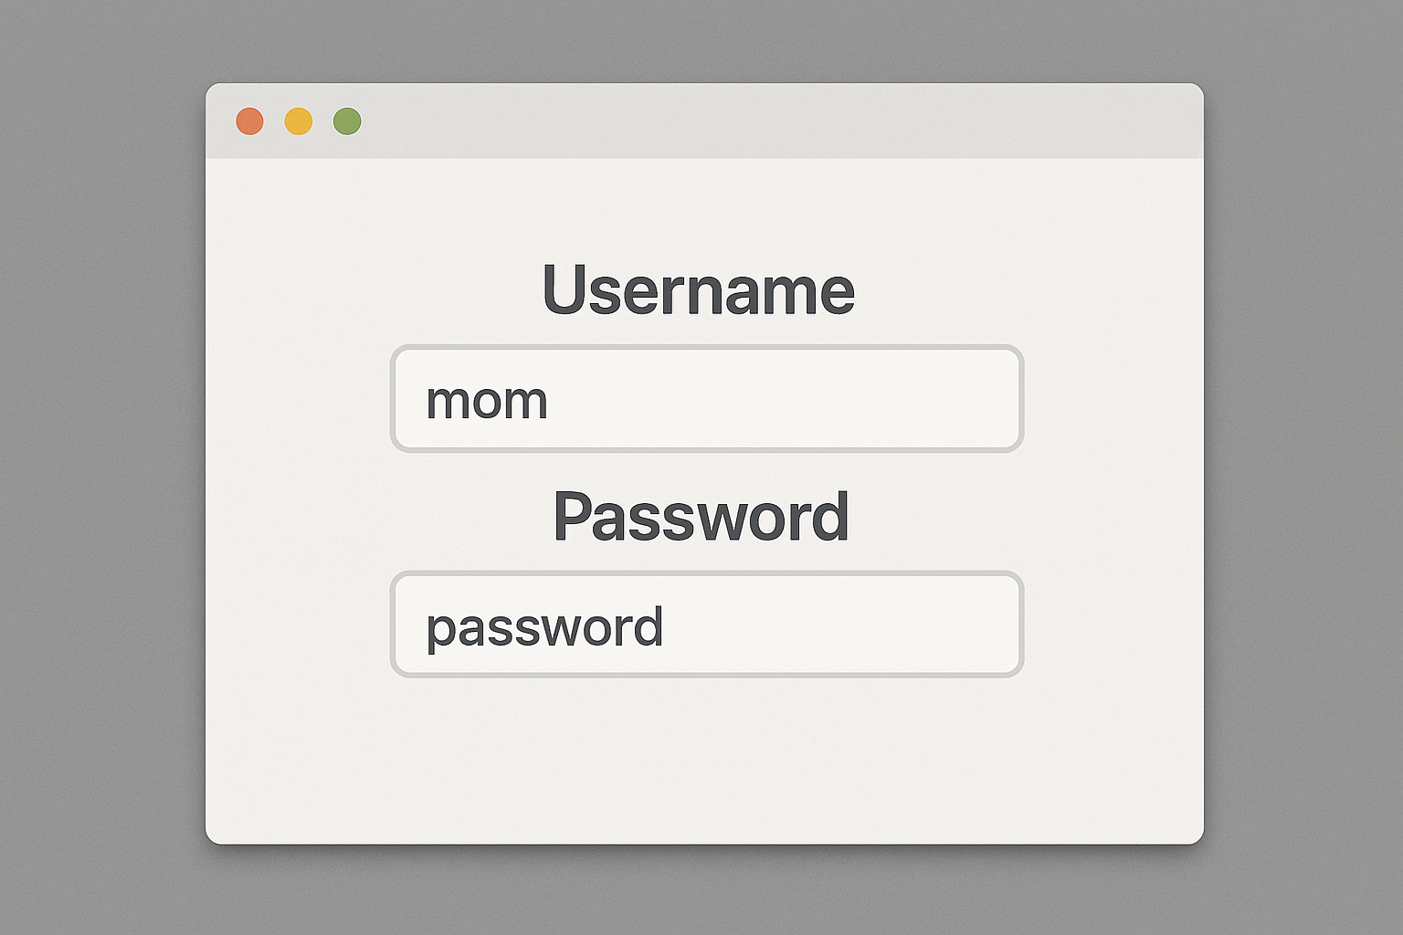
Credential abuse
Unauthorized use of stolen, leaked, or otherwise compromised login credentials (usernames and passwords). Acquired by:
Phishing – tricking users into entering credentials on fake pages
Data breaches – credentials stolen from one service and sold or leaked
Credential stuffing – using breached username/password pairs from one site to try logging into other sites, exploiting password reuse
Brute forcing – systematically guessing weak or common passwords
Infostealers – malware that harvests saved passwords from browsers or password managers
Purchasing on dark web markets – credentials are actively traded commodities

Slide 7
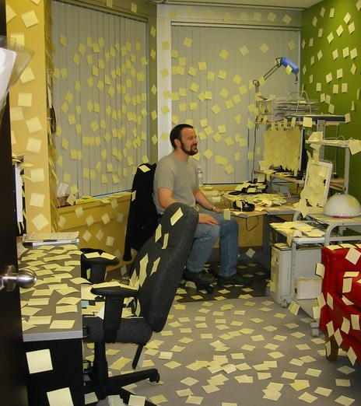
Are you capable of remembering a unique strong password for every account you have?

Slide 8
Passwords
Goal: easy to remember but hard to guess
Turns out to be wrong in many cases!
Hard to guess = Hard to remember!
Compounding problem: repeated password use
Password cracking tools train on released data to quickly guess common passwords
John the Ripper, http://www.openwall.com/john/
Project Rainbow, http://project-rainbowcrack.com/
many more …
Top 10 worst passwords of 2023: 123456789 Qwerty Password 12345 Qwerty123 1q2w3e 12345678 111111 1234567890
https://wesecureapp.com/blog/worlds-worst-passwords-is-it-time-to-change-yours/

Slide 9

Hypothesis: Password reuse is common, improves chances of breach
How would we know if this is true?
Do an experimental study!
Find a good source of data
Consider what you’d find in that data if the hypothesis were true
Ideally: Very unlikely to be another explanation
Analyze the data, report the results
Consider consequences of the outcome; do follow-on work

Slide 10

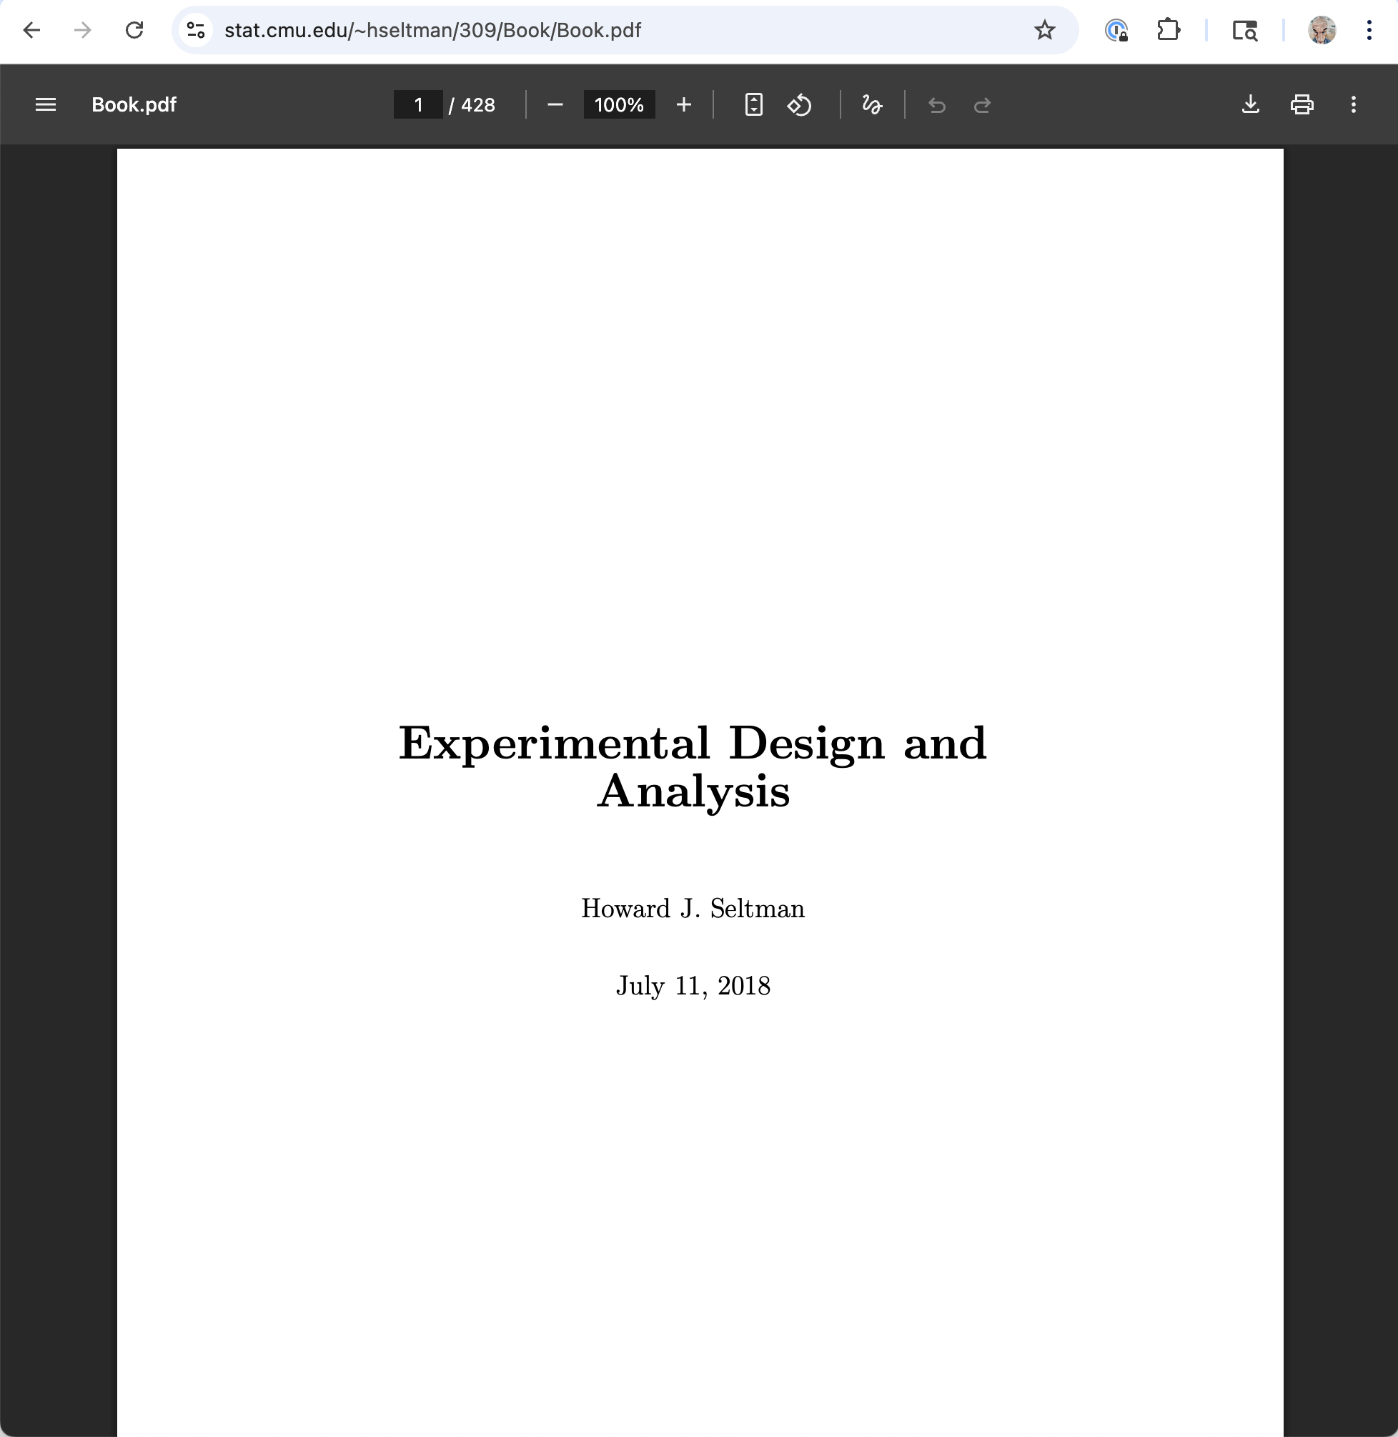
Analysis
Qualitative analysis (text responses)
Quantitative analysis (numeric, Boolean data)
These free books linked from course webpage
Notes:
we coded responses to the seven questions about attacker models, as well as all password pairs where participants’ perceptions differed statistically significantly from the guess numbers we calculated. One member of the research team first read through all responses to a question and proposed codes that would capture common themes. This researcher then coded all responses and updated the codebook when necessary. A second coder used the annotated codebook to independently code the data. Intercoder agreement ranged from 85.0% to 91.4% per question, while Krippendorff’s α ranged from 0.80 to 0.88. The coders met, discussed discrepancies, and agreed on the final codes.

Slide 11
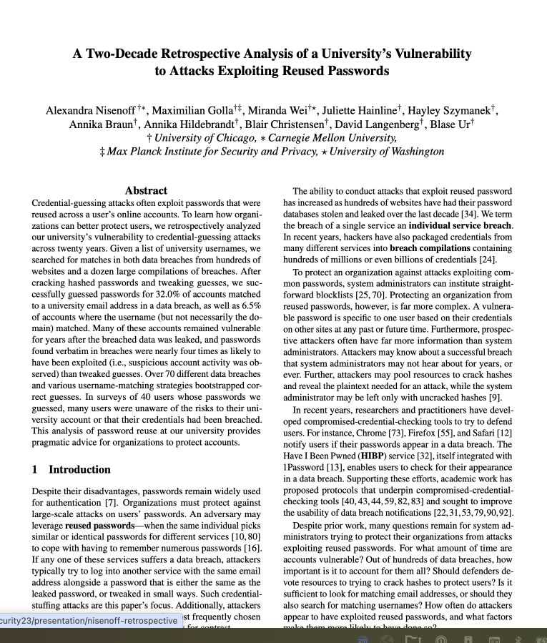
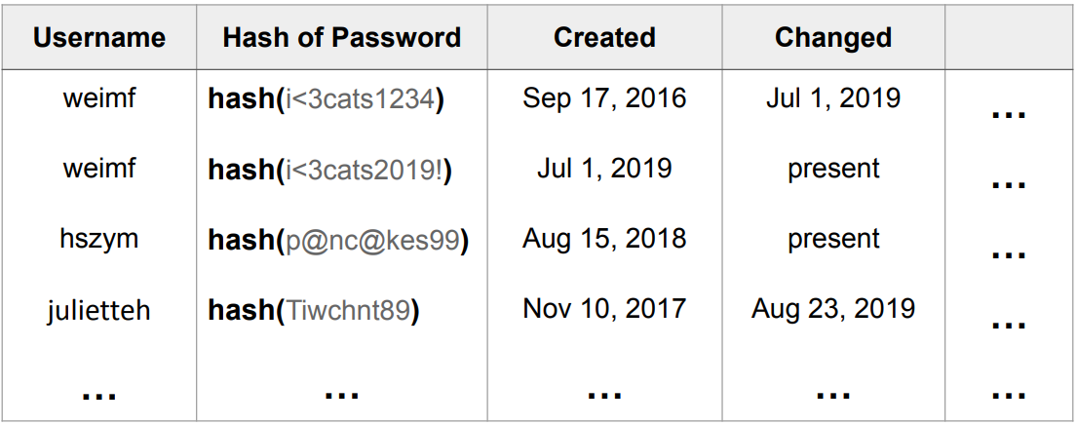
Research study on password reuse
Approach:
Find credentials in leaked data
Generate guesses against university accounts
Using normal cracking, but also variations of leaked passwords for similar accounts
Check against historical password database:
Ask: Cracking easier with cross-account data?
https://www.usenix.org/conference/usenixsecurity23/presentation/nisenoff-retrospective
Notes:
Talk video and PDF of slides at Ways that the study leveraged the historical password database
Ethics concerns
Technical challenges
What the study might have missed or overstated (limitations)
Other inferences to draw from results
Recommendations, and relevance today

Slide 12
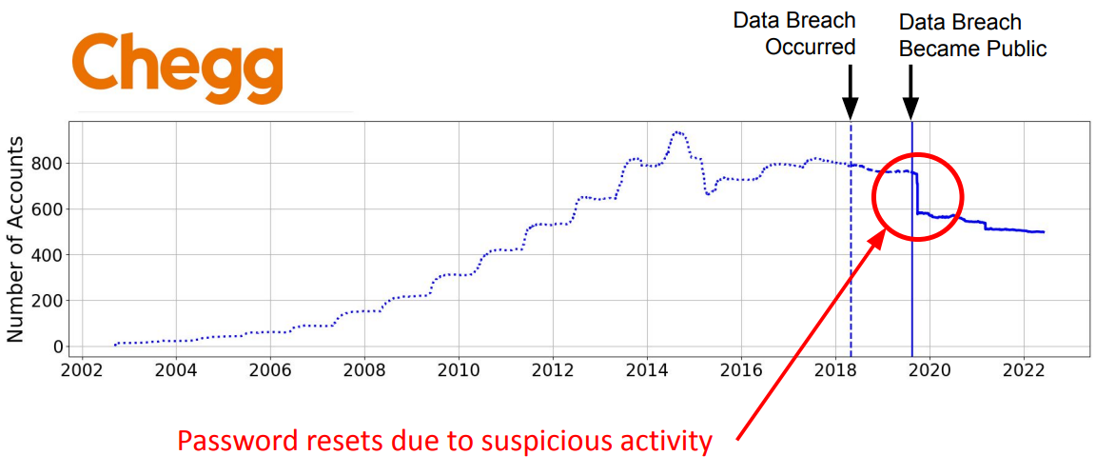
Results
Guessed 32% of passwords in historical DB by leveraging reuse
As compared to 6.5% without considering reuse
35.5% of valid guesses were for current passwords
Of those guessed by reuse
54.7% were verbatim reuse, vs. 45.3% based on tweaks
Vulnerability is real
Some historical observed exploits coincided with data breaches
Passwords were vulnerable for long after a breach (median of 5 years)
Notes:
Talk video and PDF of slides at https://www.usenix.org/conference/usenixsecurity23/presentation/nisenoff-retrospective
Ways that the study leveraged the historical password database
Ethics concerns
Technical challenges
What the study might have missed or overstated (limitations)
Other inferences to draw from results
Recommendations, and relevance today

Slide 13

The human “threat”
Malicious humans
Clueless humans
Unmotivated humans
Humans constrained by human limitations
Thanks to Lorrie Cranor for this and some of the following slides

Slide 14
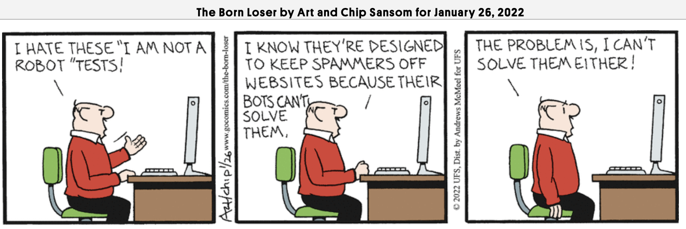

Slide 15
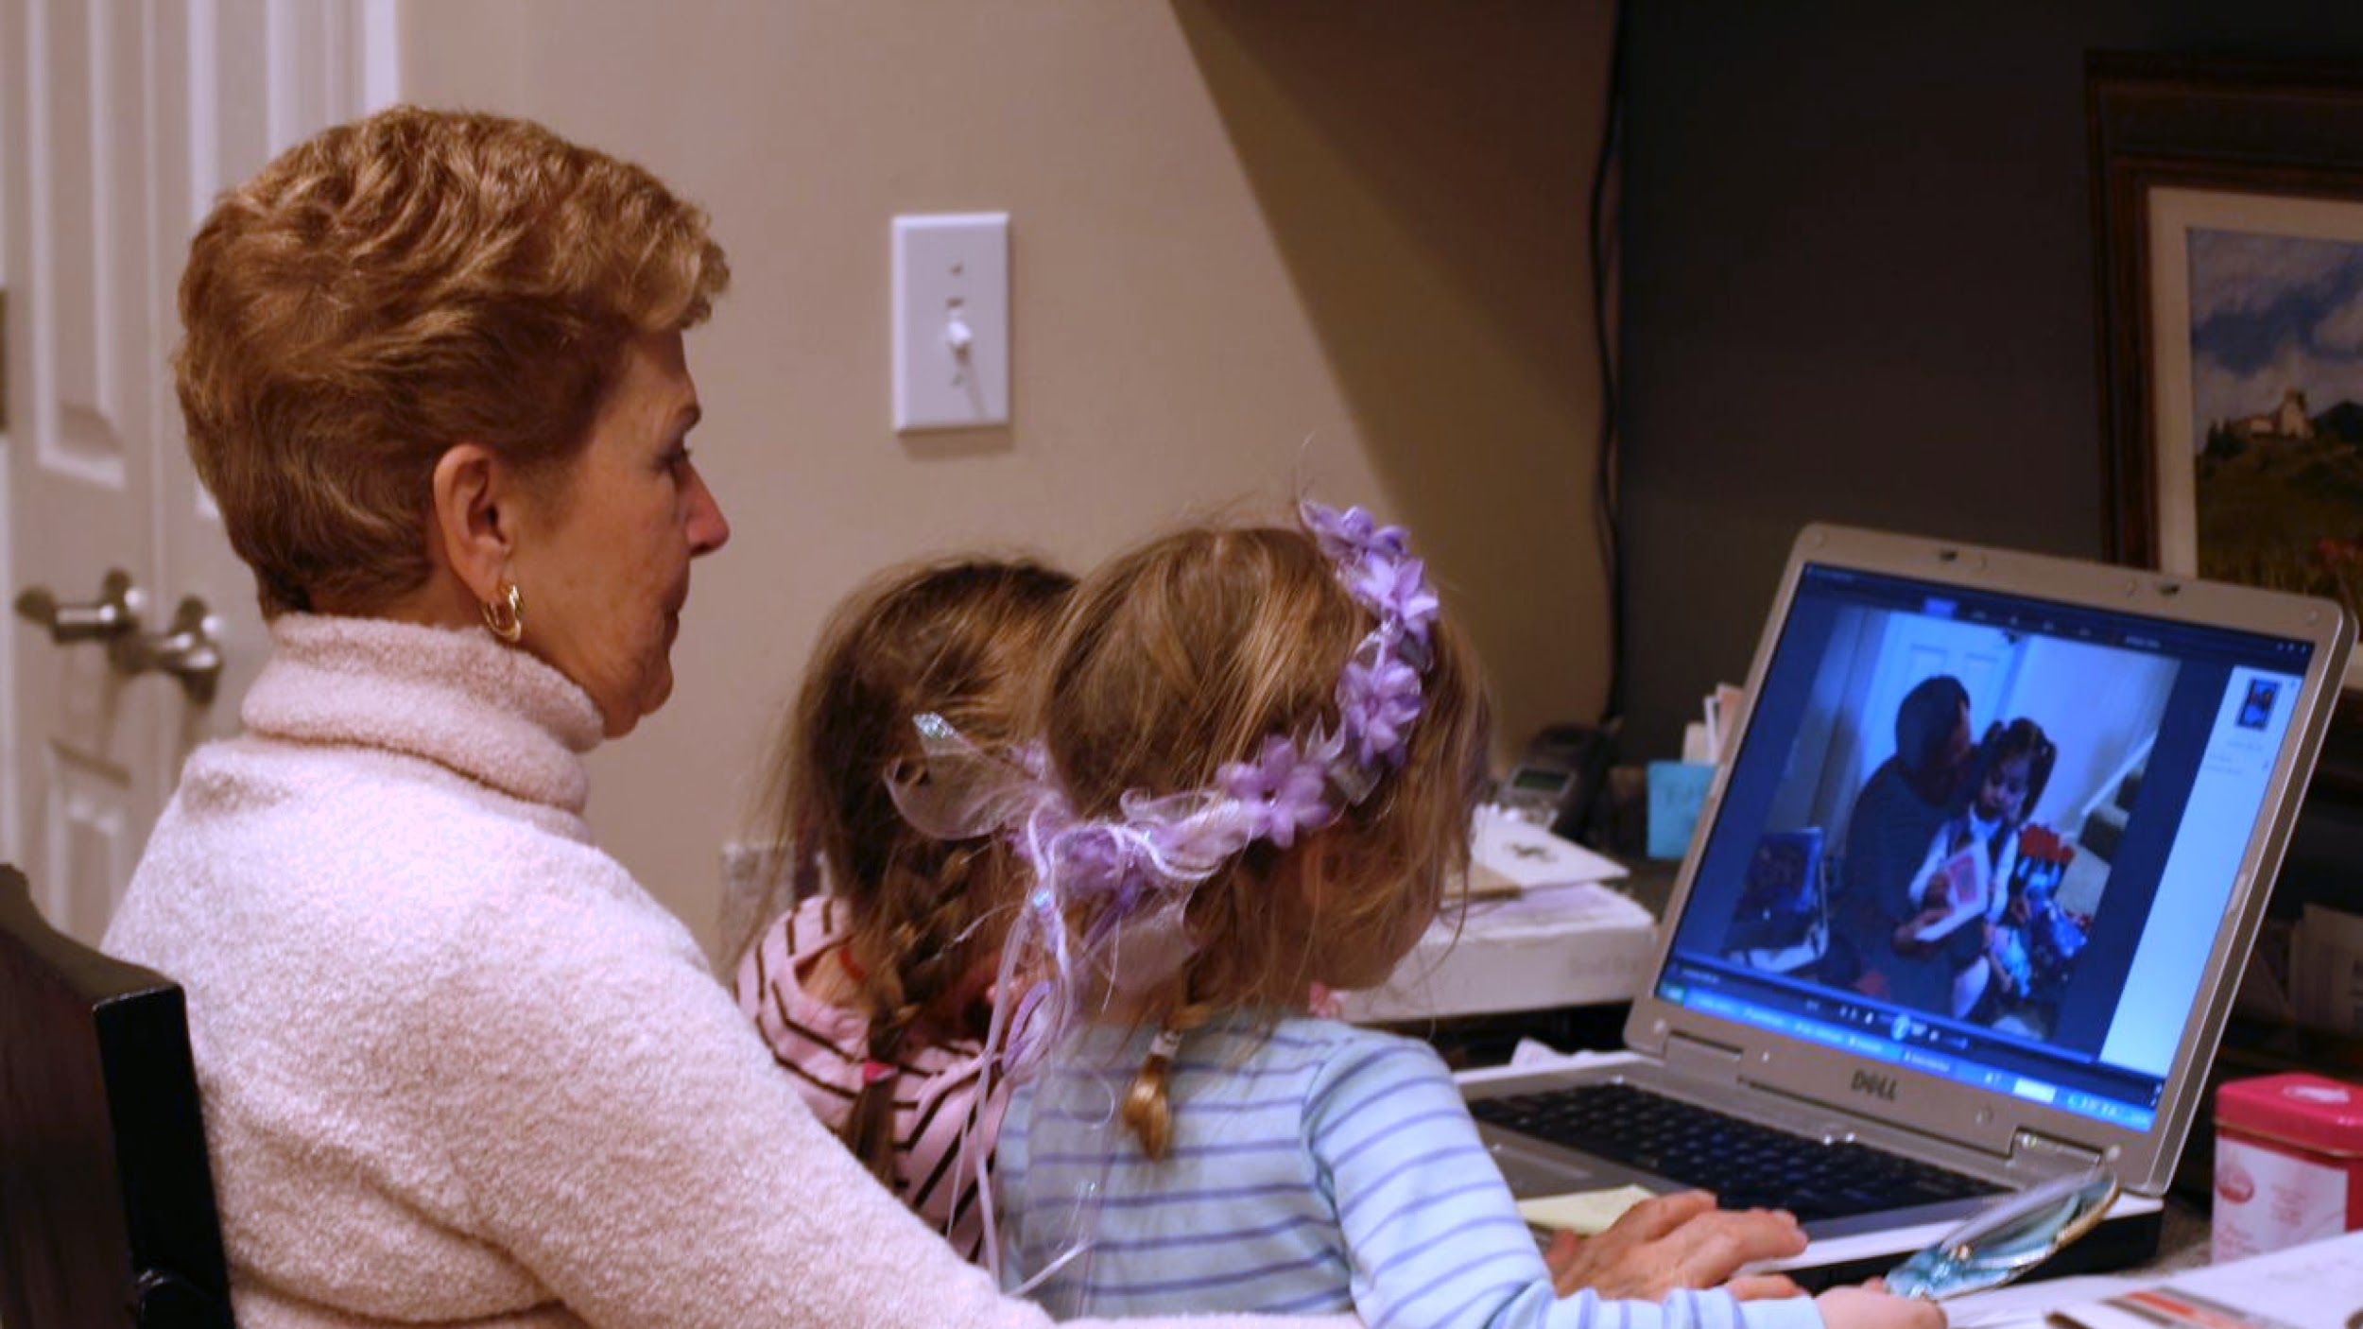
Security is a secondary task

Slide 16
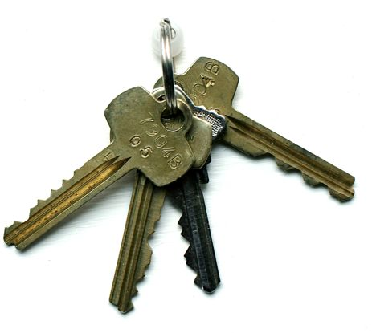
Concerns may not be aligned
Keep the bad guys out
Don’t lock me out!
Security Expert
User

Slide 17
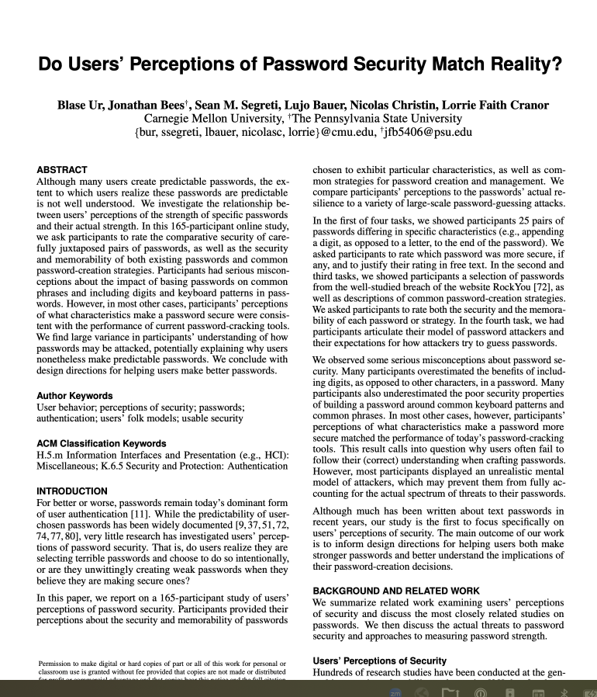
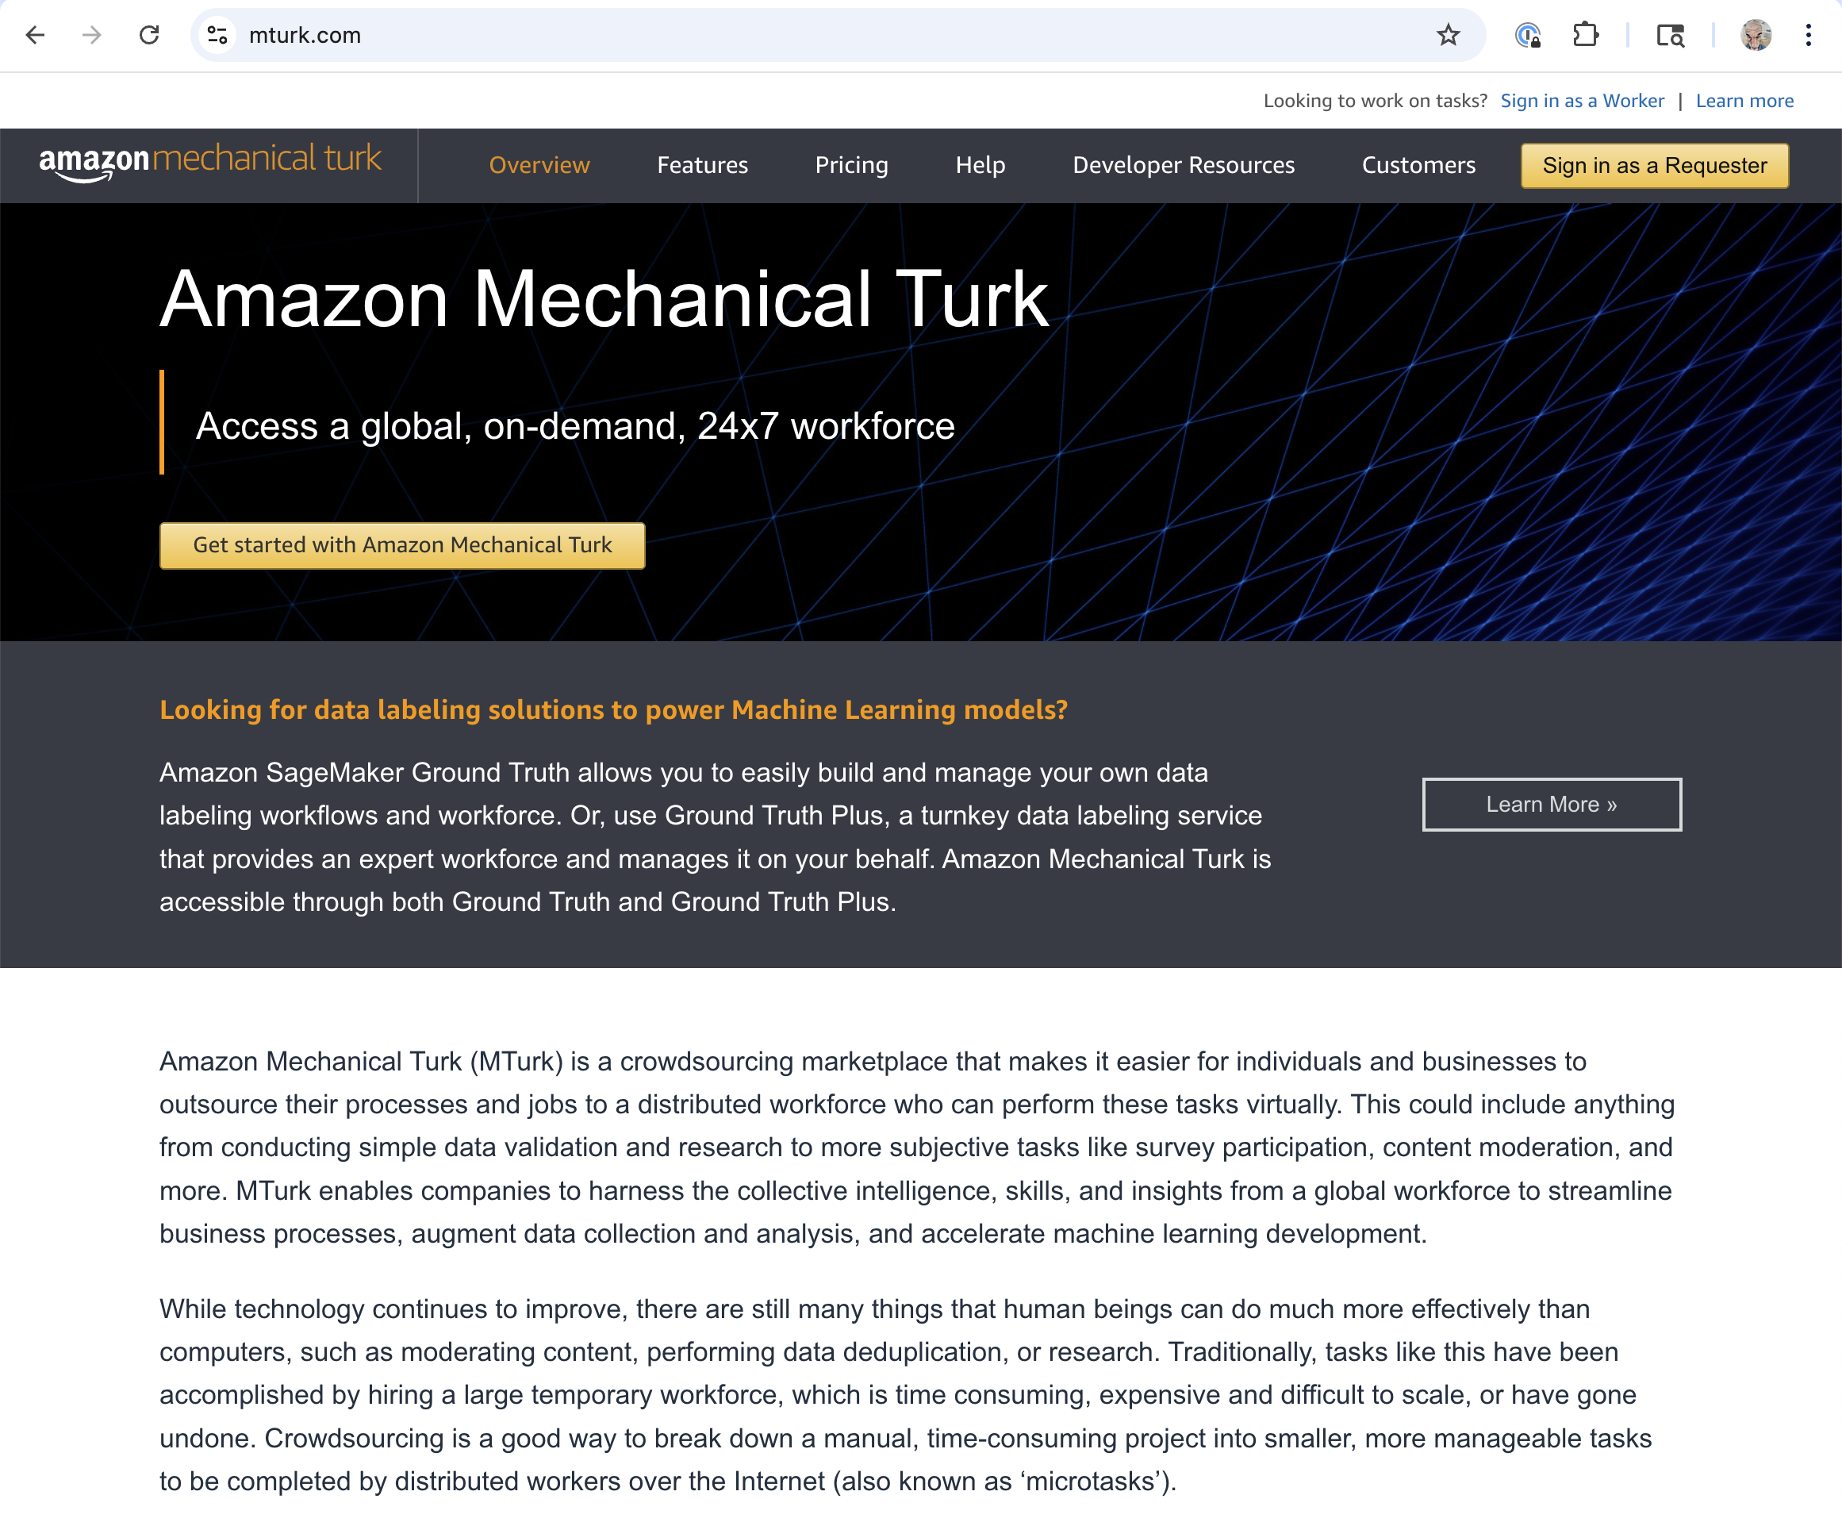
Password security: Perception vs. reality
Password predictability in 2016 (and today?) is high. Maybe:
Users unwittingly select predictable passwords because they misunderstand what makes a password guessable
Users prioritize memorability, or some other feature, over predictability
Let’s test these hypotheses experimentally!
Give participants a small set of technical exercises and free-response questions
Analyze results (e.g., with password cracking tools)

Slide 18
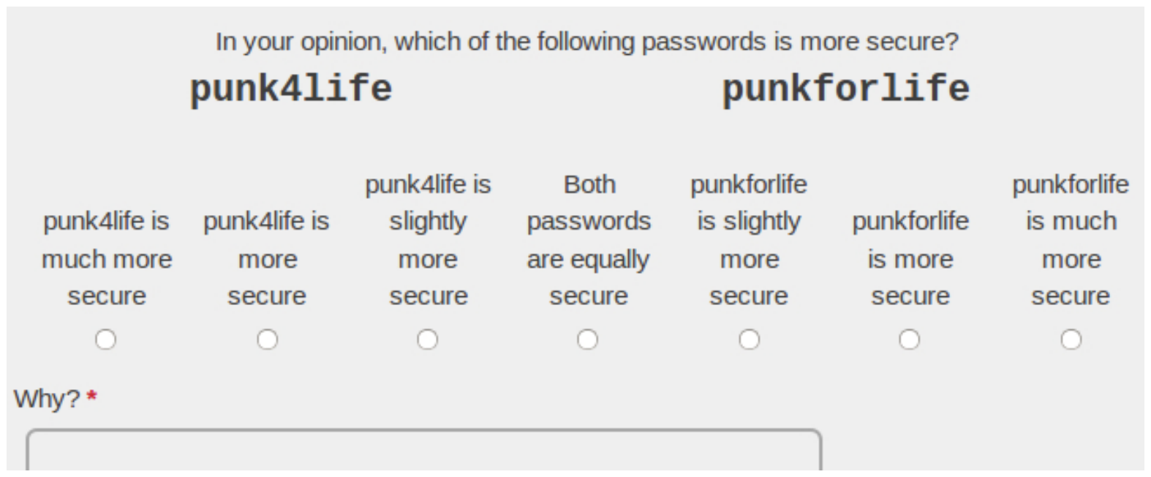
Example question type: Comparison
25 kinds of difference, users saw one of three password pairs per category (25 x 3 = 75 total pairs)
Password pairs selected randomly/systematically from RockYou dataset (real-world PW DB that was leaked)
26th category is an attention check: Show the same password
Presented in randomized order, and randomized left/right position

Slide 19
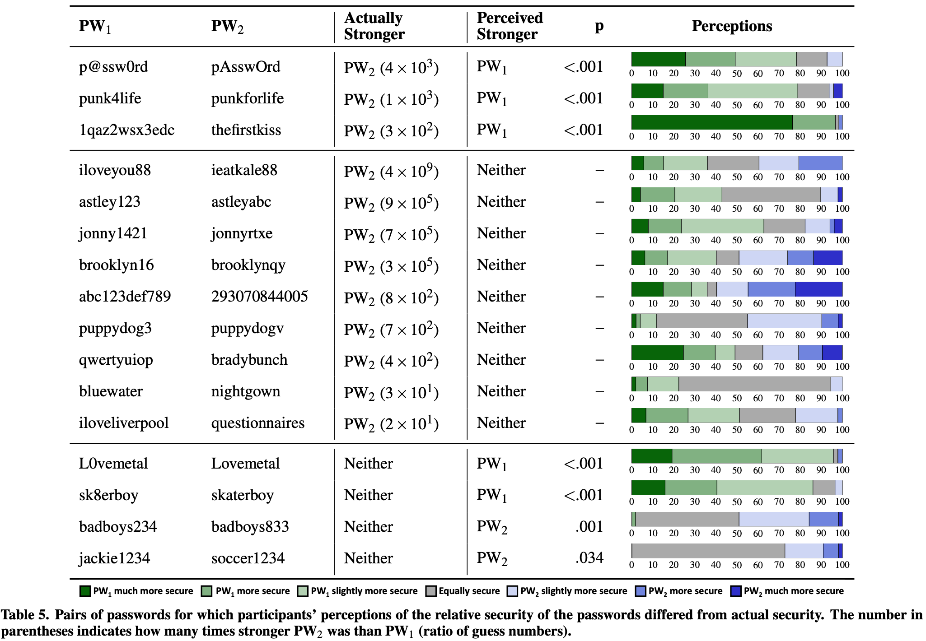
Results: Comparison
16 pairs (21%) were not consistent
Misconceptions:
adding digits inherently makes a password more secure than using only letters
substituting digits or symbols for letters makes a password more secure
overestimated the security of keyboard patterns
misjudged the popularity of particular words and phrases

Slide 20
Other results
79% of comparison pairs were correct!
Capitalizing the middle of words is better than capitalizing just the beginning
Putting digits and symbols in the middle is better than at the end
Dictionary words are better than common first names
…
Users' incomplete understanding of the scale of potential attacks seems to be a root cause of bad passwords
1/3 of participants: secure if can withstand several dozen guesses
Others: password must withstand quadrillions of guesses or more

Slide 21
Password strength meter
Gives user feedback on the strength of the password
Intended to measure guessability
Research shows that these can work, but the design must be stringent
Ur et al, “How does your password measure up? The effect of strength meters on password creation”, Proc. USENIX Security Symposium, 2012.
Some password requirements now debunked – people use odd characters in a predictable way!
password
P@ssw0rd!

Slide 22




Password manager
A password manager (PM) stores a database of passwords, indexed by site
Encrypted by a single, master password chosen (and remembered) by the user, used as a key
PM can generate complicated per-site passwords
Hard to guess, hard to remember, but the latter doesn’t matter!
Benefits
Only a single password for user to remember
User’s password at any given site is hard to guess
Compromise of password at one site does not permit immediate compromise at other sites
But:
Must still protect and remember strong master password

Slide 23
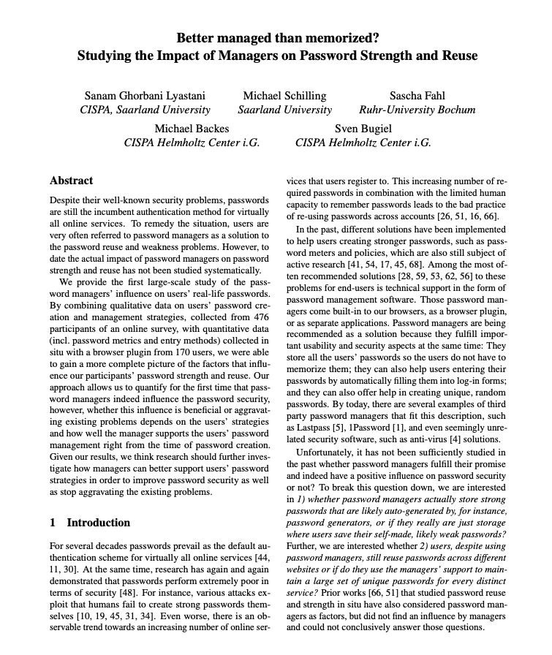
Impact of password managers on security
RQ: Impact of password managers on password strength and reuse?
Data collected: Survey on Mechanical Turk, then data collection from some of these about password management using a Chrome plugin
Plugin used for four days
Data analysis: Correlate factors against measures of password strength and occurrences of reuse
Factors include how exactly password managers were used or not used
Allows relating to baselines, identifying key aspects of success

Slide 24
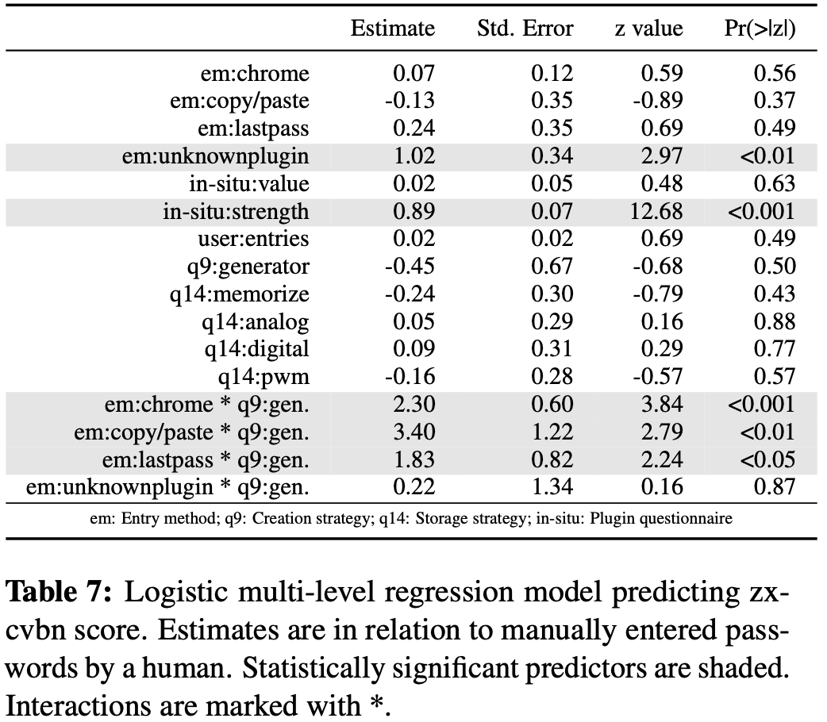
Modeling strength
Creation strategy + EM significant together, but not individually
So: using a PM only leads to significant improvement in password strength when users also employ supporting techniques for password creation
Self-reported password strength was a significant predictor of the measured password strength
Ordinal
Notes:
Did a correlation analysis to figure out which factors to drop, up front
In three steps we included a) entry methods, self-reported value, and strength; b) the number of individually submitted passwords per participant, the creation and storage strategy of the user; in a final step c) the interaction between creation strategy and detected entry method (two-way interaction).
we computed the model fit and used log likelihood model fit comparison (AIC?) to check whether the new, more complex model fit the data significantly better than the previous one. Kept the best one.
For zxcvbn, the ordinal model with all predictors and also the mentioned interaction described our data best

Slide 25
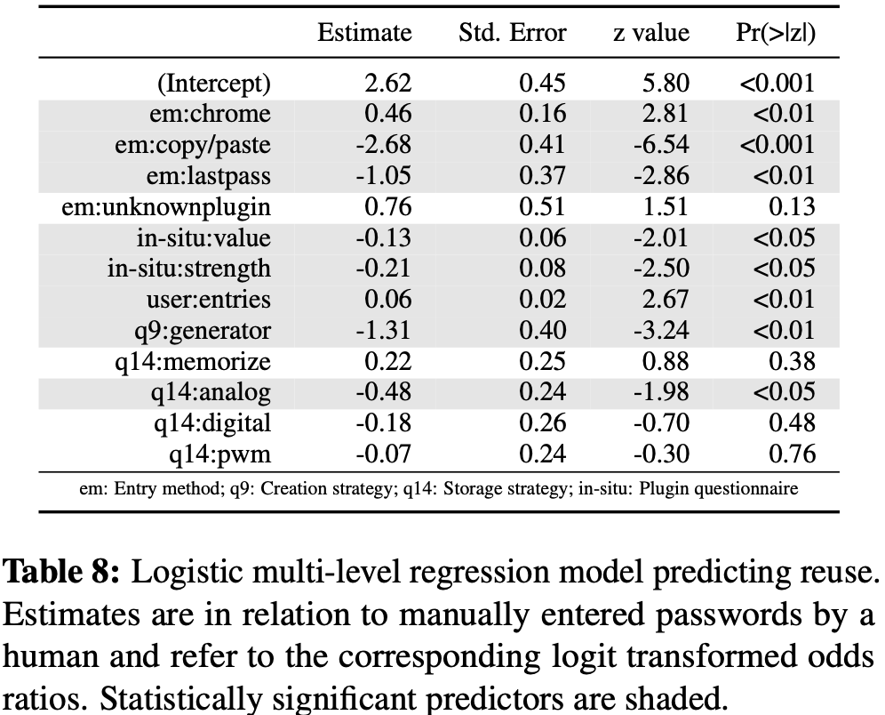
Modeling reuse
Reuse was significantly influenced by the entry method of the password
Odds for reuse were 2.85 times lower by LastPass, 14.29 times lower if C&P
odds for reuse were 1.65 times higher by Chrome auto-fill
Creation by alg: odds of non-reuse 3.70 times higher
Notes:
For password reuse a logistical model with all predictors but without interactions described our data best.
Paper reported odds ratios but these are not shown in the table. Not obvious how to compute them from the numbers reported in the table either. Sigh.

Slide 26
Summary of PM study results
Users that rely on technical support for password creation had both stronger and more unique passwords
Even if entered through other channels than a manager
Chrome’s auto-fill option increased password reuse – more than 80% of Chrome auto-filled passwords were reused
Chrome at the time did not have password generation enabled by default

Slide 27
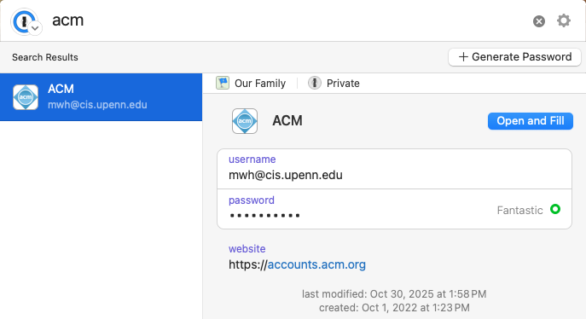
Better together
Password manager
One security decision, not many
Password meter
Users can explore ramifications of various choices by visualizing quality and reasoning of password
Do not permit poor choices (or reduce the chances of them) by enforcing a minimum score
Best: Let PM generate password
We’ll see some studies that show this later

Slide 28
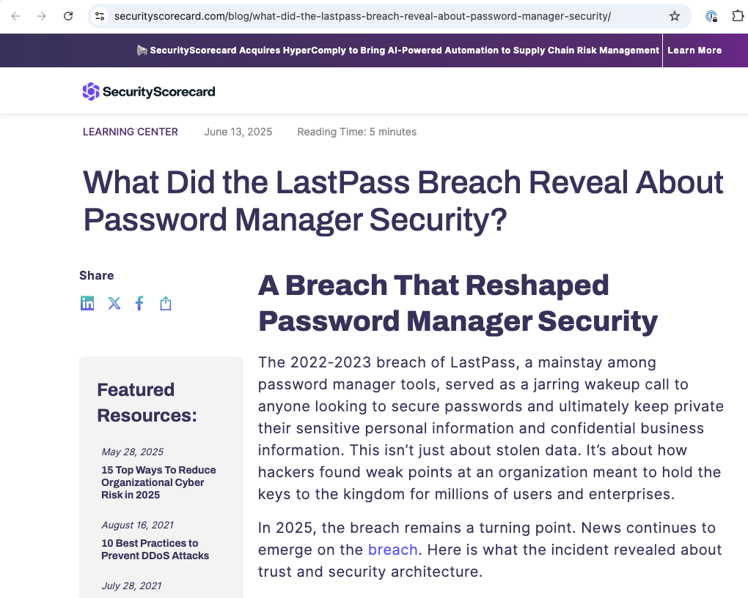
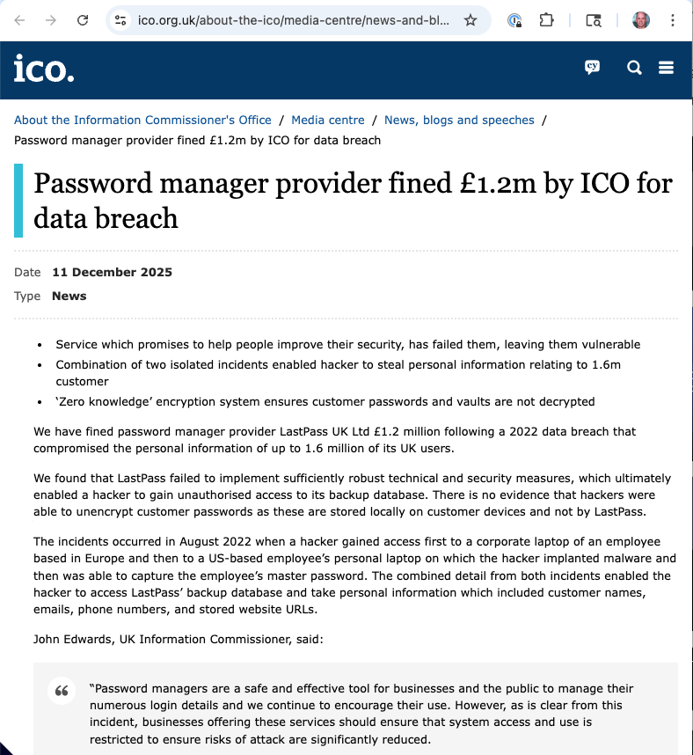
PM Risk: Central point of failure?

Slide 29
Understand humans in the loop
Do they know they are supposed to be doing something?
Do they understand what they are supposed to do?
Do they know how to do it?
Are they motivated to do it?
Are they capable of doing it?
Will they actually do it?

Slide 30
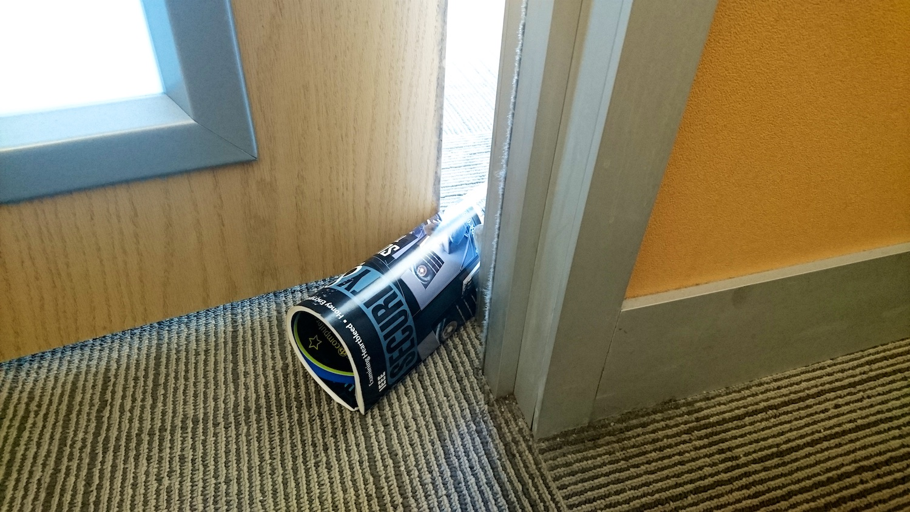
Remember: Convenience always wins

Slide 31

Given a choice between dancing pigs and security, users will pick dancing pigs every time. – Ed Felton
Notes:
https://www.clipartmax.com/download/m2i8G6H7b1Z5b1Z5_dancing-pig-png-by-clipartcotttage-clip-art-dancing-pig/

Slide 32
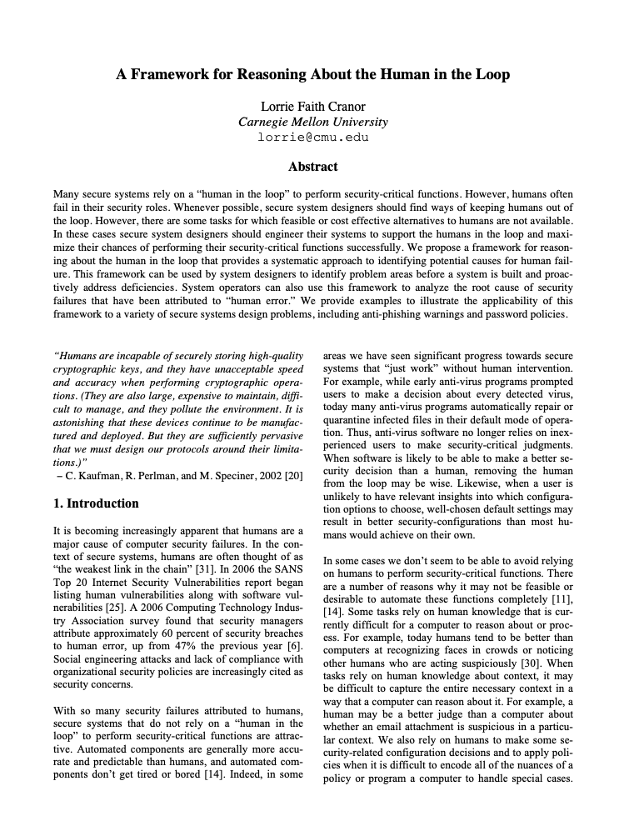

Human-in-the-loop framework
Based on Communication-Human Information Processing Model (C-HIP) from Warnings Science
Models human interaction with secure systems
Can help identify human threats
We will look at this a bit later
L. Cranor. A Framework for Reasoning About the Human In the Loop. Usability, Psychology and Security 2008. http://www.usenix.org/events/upsec08/tech/full_papers/cranor/cranor.pdf

Slide 33
Top attack vectors
Source: 2025 Verizon Data Breach Investigations Report
Notes:
Still: Only 20% start with a vulnerability exploitation!

Slide 34
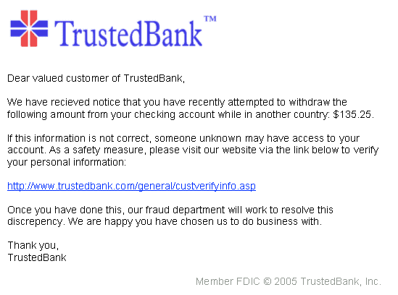
Phishing
User is tricked into thinking that a site or e-mail is legitimate
Real logos, plausible circumstances
But actually: It is a scam
May stoke fear, sense of urgency
Engages lizard brain!
User persuaded to install malware or perform other harmful actions
By clicking a link or engaging in a communication
Or by opening an attachment

Slide 35
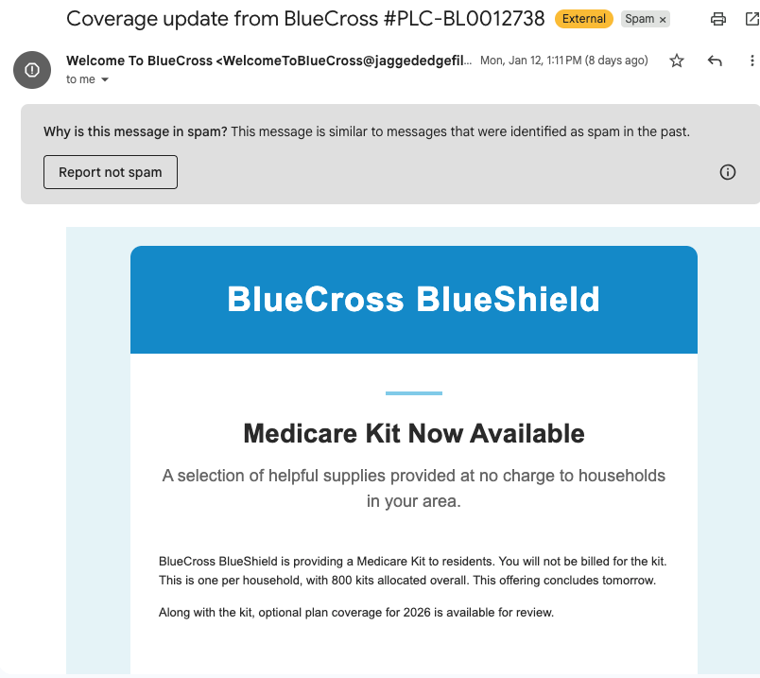
Phishing mitigation: Automated detection
Machine learning: Looks similar to other phishing emails

Slide 36
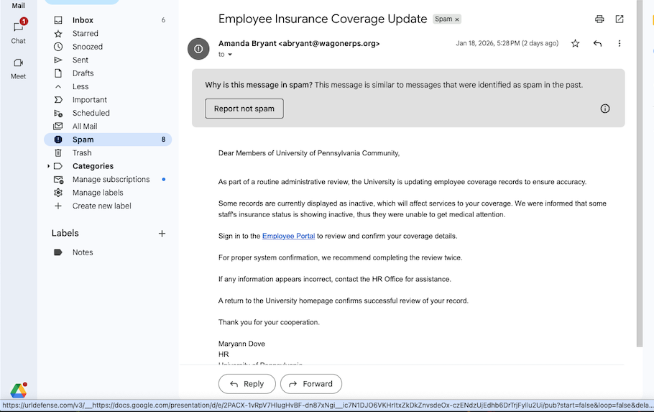
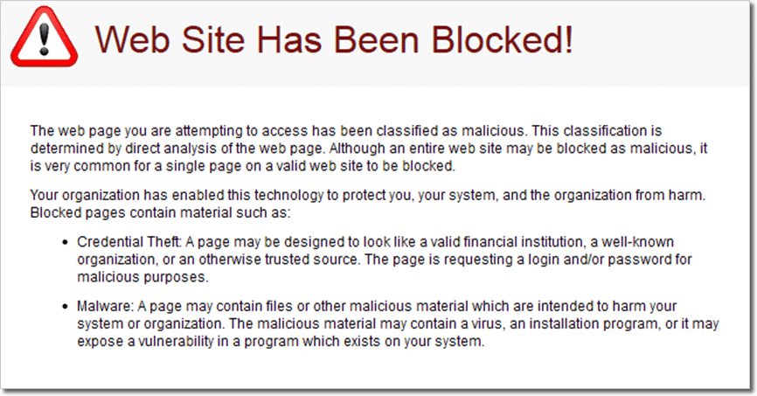
Phishing mitigation: Link-based protection
Wraps link with redirect to security gatewau; will block clicks on bad links

Slide 37
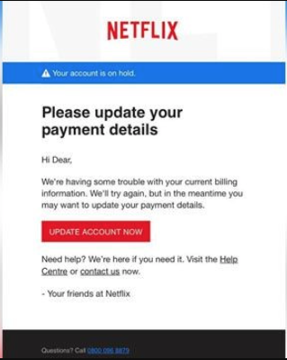
Mitigation by training: Spot “bad smells”
Text content phishy
The email has a generic greeting
The email says your account is on hold because of a billing problem
The email invites you to click on a link to update your payment details
Link URL (hover over it) not to netflix.com
Netflix.com.ru not the same thing!
Email might be similarly bogus
.bit.ly links suspicious
https://consumer.ftc.gov/articles/how-recognize-avoid-phishing-scams

Slide 38
Spear phishing
Email is highly customized to the recipient
Think: Email sent to CEO, CIO, etc.
Contextually valid, appears to be from someone they know, etc.
Expensive to produce, but the hope for the attacker is a big payoff
Several of the previous mitigations won’t work
No generic greeting, topic, etc.
Won’t look like prior phishing attempts
More onus on the human to spot the deception

Slide 39
No perfect defense
Failure: Site or e-mail not (really) authenticated
Internet e-mail and web protocols not originally designed for remote authentication
Solution is hard to deploy
Use hard-to-fake notions of identity, like public key cryptography. But which system? How to upgrade gradually?

Slide 40
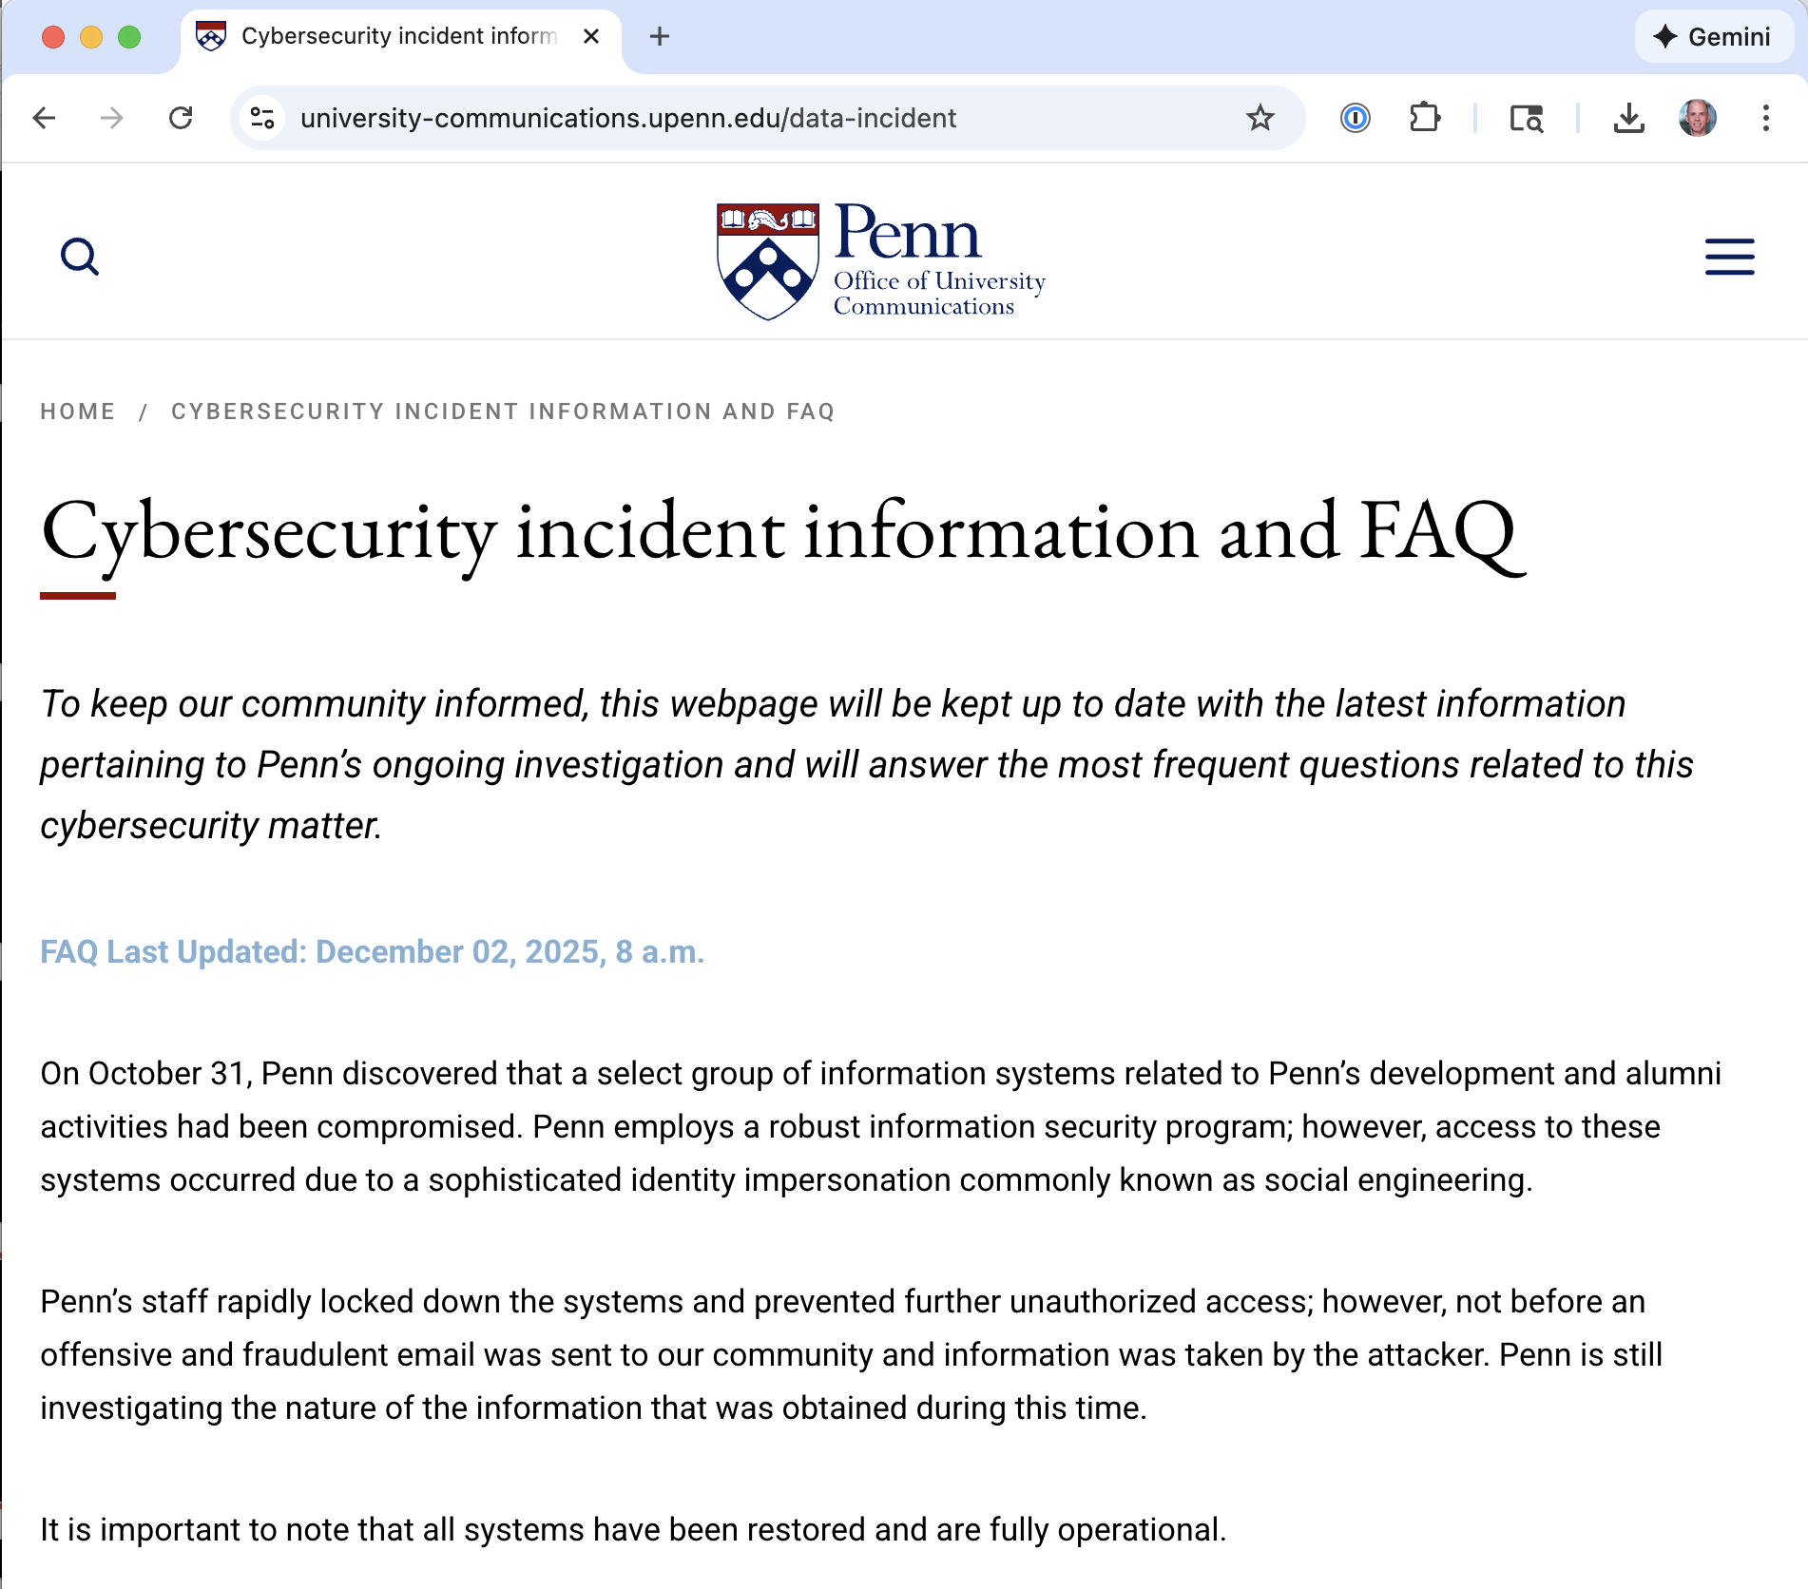
Social engineering
Social engineering is a type of psychological attack
Misleads target into doing something the attacker wants
Phishing is a kind of social engineering attack
Vectors: Phone call, text message, etc.
Signs
They are creating a sense of urgency
They are asking for information they should already have
The situation is too good to be true
Defense: contact claimed source directly (bank, gov’t agency, etc.)

Slide 41
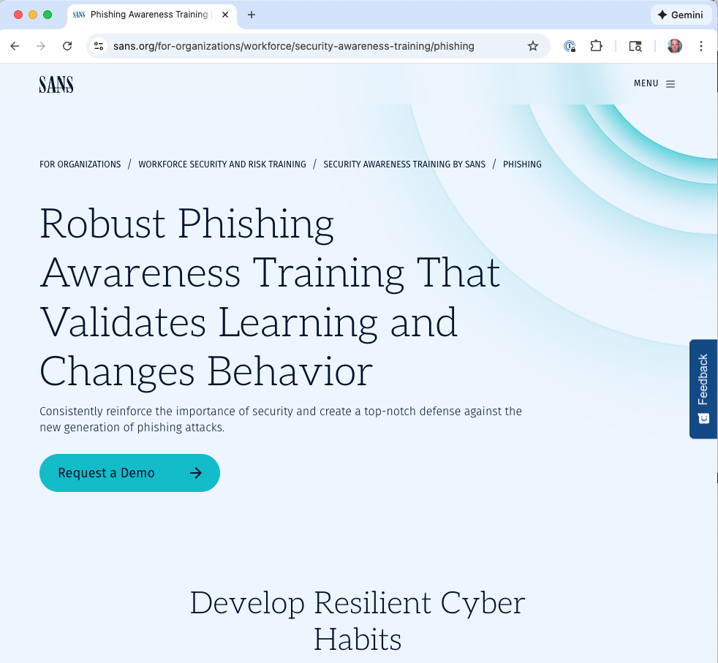
“Protect yourself” training: Does it work?

Slide 42
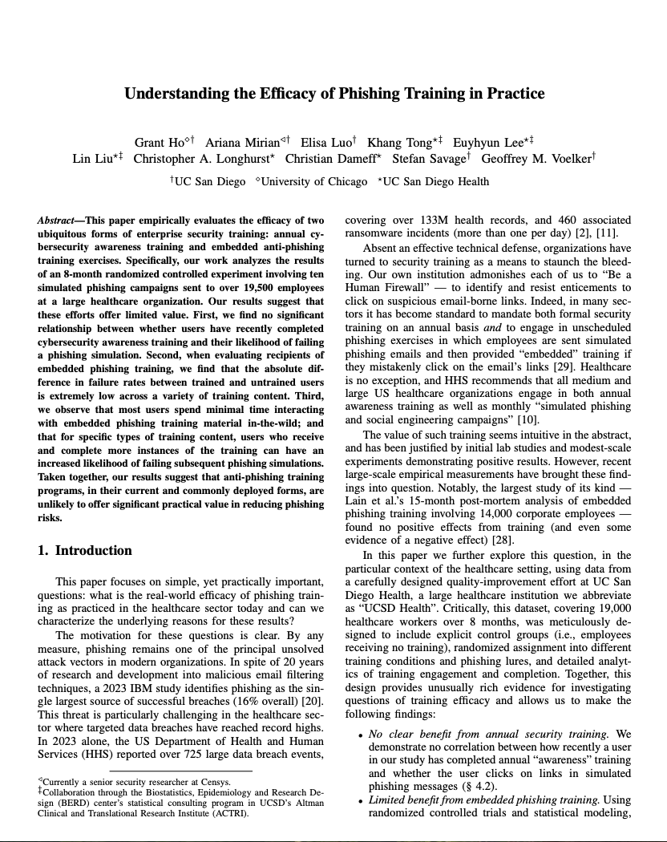
Reading

Slide 43
Key research questions
How well do common trainings protect against phishing attacks?
Annual security awareness training & Embedded phishing training
Do different forms and styles of training have varying levels of anti-phishing protection?
Interactive vs. Static material, Generic vs. Contextualized content, etc.
What underlying practical factors decrease training’s efficacy?
These slides are based on ones provided by Grant Ho – thanks!

Slide 44
Study Design: Real-world RCT at UCSD Health
UCSD Health: existing embedded phishing training -> controlled experiment
19,500+ employees: anonymized statistics (IRB & QI approval)
8 months: 10 different phishing emails of varying sophistication
Clicking on the embedded phishing link = “failed” simulation
Randomly partitioned all users into 5 training groups
1 control group: no training (“404 not found page”)
2 static training groups: generic vs. customized educational page
2 interactive training groups: generic & customized content
Statistical analysis of results w/ GLME models to control for confounders

Slide 45
Result: Embedded Phishing Training has Minimal Benefit
Phishing Lure | Control | Generic Static | Context. Static | Generic Interactive | Context. Interactive
Login Account | 3.44% | 1.14% | 1.27% | 0.97% | 1.13%
Outlook Pwd | 1.62% | 1.72% | 2.41% | 1.85% | 1.52%
John Davis | 9.56% | 7.01% | 6.38% | 6.4% | 7.45%
Docusign | 11.06% | 9.98% | 10.2% | 10.05% | 9.75%
OneDrive Medical | 9.89% | 9.37% | 8.54% | 9.25% | 9.16%
Open Enroll | 9.02% | 6.67% | 6.68% | 7.01% | 6.76%
Vacation Policy | 31.02% | 30.58% | 31.99% | 30.58% | 29.85%
Traffic Ticket | 20.39% | 20.07% | 16.37% | 17.25% | 19.37%
Building Evac | 11.67% | 8.25% | 8.4% | 8.55% | 9.32%
Dress Code | 29.96% | 27.01% | 27.41% | 26.98% | 26.88%
Overall, training yielded only a 1.7% average improvement over control group
See paper for additional analysis & statistical models

Slide 46
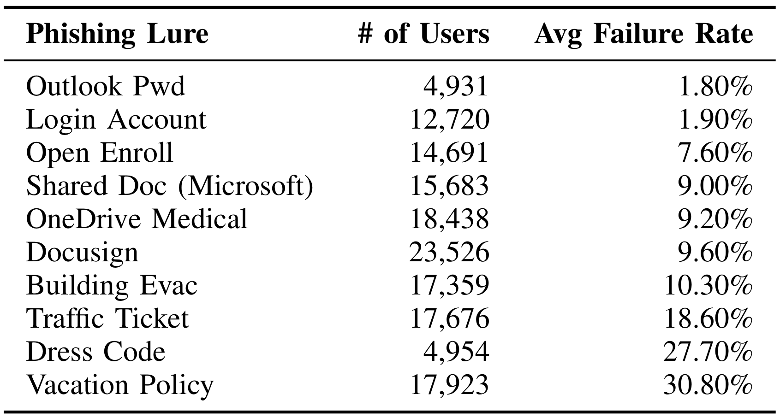
Phishing Lure Efficacy Varies & Far Outstrips Protection
The phishing lure used (chosen by attacker) ultimately dictates the attack outcome:
1.7% improvement from training vs. 30.8% clickthrough rate from specific lures

Slide 47
Limited Engagement w/ Embedded Training
User statistics across training for all simulated phishing emails:
< 25% | complete & acknowledge the training
> 33% | immediately close the training website
> 75% | spend < 1 minute on the training website
Paper has many additional results & further analysis:
Outcomes for users w/ substantial training engagement, premised on inefficient training delivery, impact of training material design, etc.

Slide 48
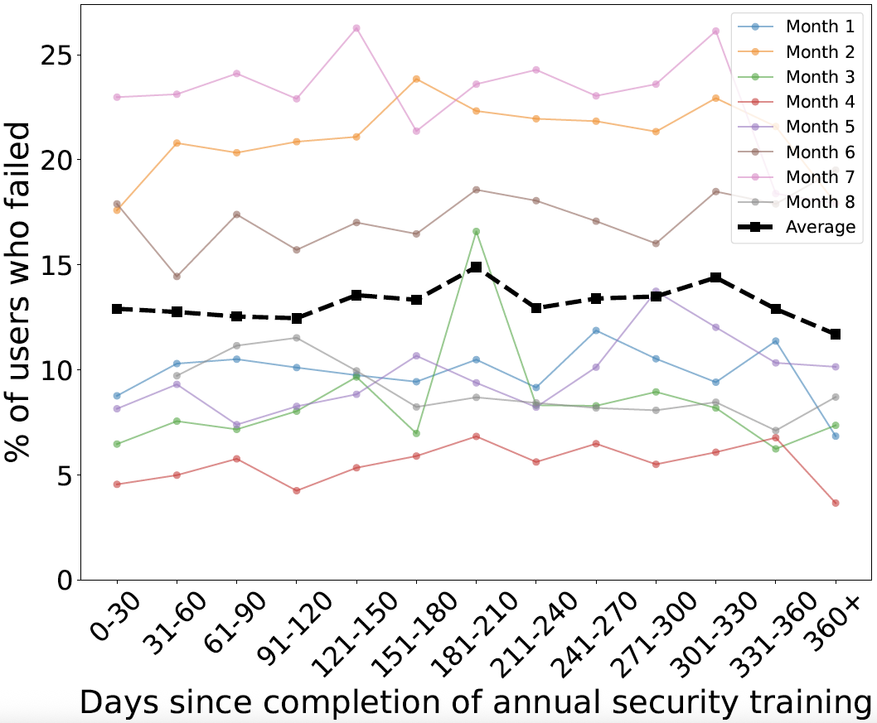
Annual Awareness Training has Minimal Benefit
Mandatory annual security awareness training made by a leading vendor (KnowBe4)
Data and statistical models (GLME) find no association between:
how long ago a user completed training and
their likelihood of failing a phishing simulation
1 Month
1 Year

Slide 49
Summary and reflection
Minimal anti-phishing benefits from common security training
Embedded phishing training & Annual cybersecurity awareness training
19.5k employees: 8-months of in-situ, randomized controlled experiments
Study limitations: one institution, one type of phishing action
But results consistent with prior large-scale studies
Realistically, phishing training will continue… so what should we do?
Whatever it is, we should evaluate it rigorously & empirically in-the-wild: go beyond marketing claims

