Slide 1


Secure Systems Engineering and Management
A Data-driven Approach
Michael Hicks
Introduction
UPenn CIS 7000-003
Spring 2026

Slide 2
How would you answer this question?
In the last decade, has the security of computer systems, generally,
improved,
declined, or
stayed the same?

Slide 3
To answer it, we need data
Cybersecurity is improving if costs due to attacks are going down
Direct costs of the attack (e.g., lost or stolen assets)
Indirect costs of the attack (e.g., costs of downtime, recovery)
Should also consider costs of defenses
Extra personnel and equipment, introduced inefficiencies (slower logins, dealing with false alarms, etc.)

Slide 4
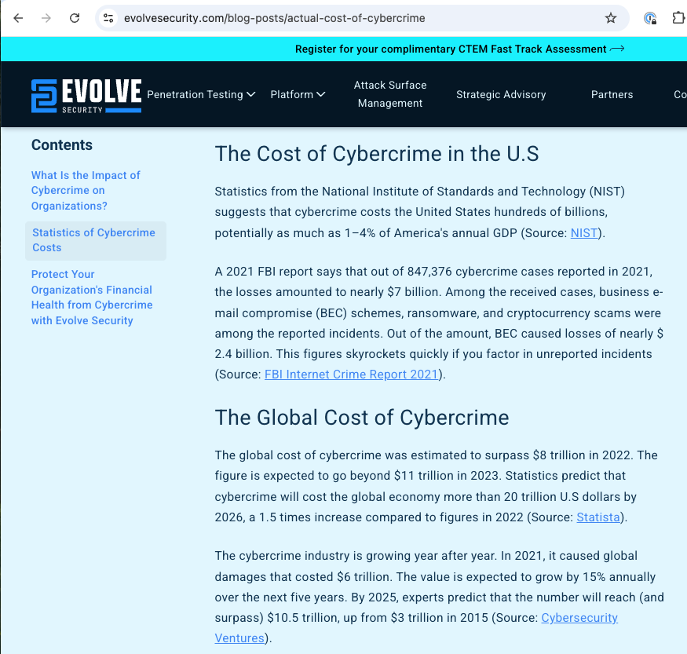
Cybercrime $$: Overall estimate
“It is estimated that the cost of cybercrime will grow from an annual sum of $3 trillion in 2015 to $6 trillion in 2021” – cited 2016 report by Cybersecurity Ventures
Evolve Security blog post (written 2023) agrees with those numbers, estimates $20 trillion cost by 2026

Slide 5
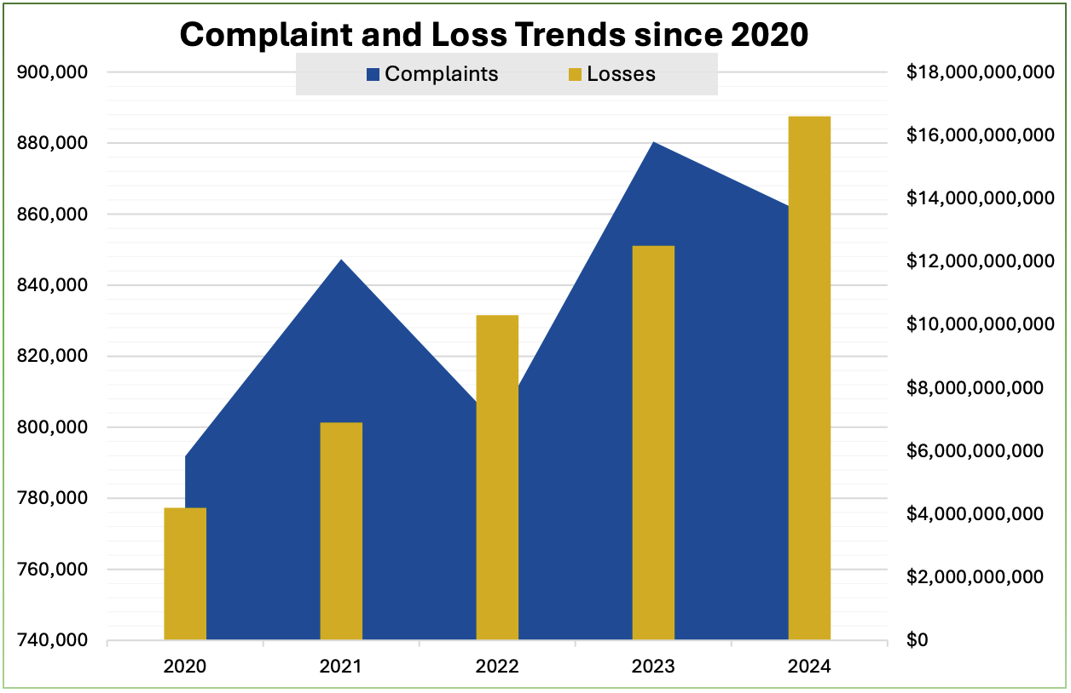
Cybercrime $$: FBI IC3 direct data
Increasing cumulative cost
Generally increasing number of incidents
Varying trend on cost per incident
Notes:
Probably need to normalize this according to GDP. US GDP grows at ~2.5% per year, but $13B in 2023 to $16.8B in 2024 was a 29.2% increase.

Slide 6
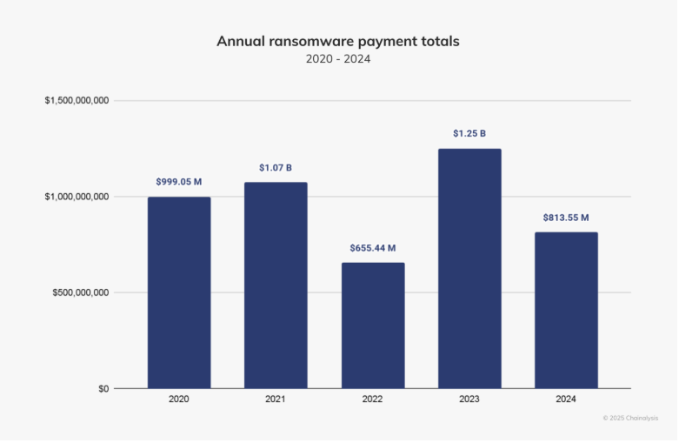
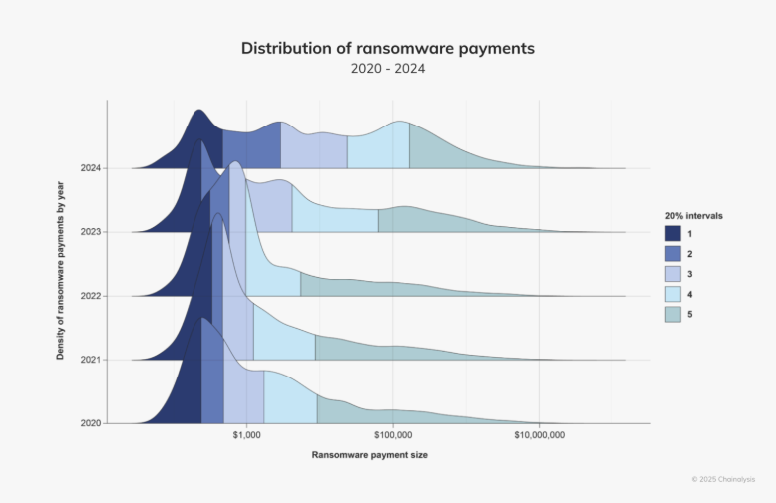
Costs of cyber attacks: Ransomware
Increasing number of incidents but reduced total inmpact
Source: Chainanalysis 2025 report
Notes:
Cytentia report: Roughly 30% of all publicly reported security incidents from 2019 through 2023 involved ransomware, earning it a #2 ranking for frequency. Ransomware also ranks #1 for financial impact,
companies are reporting 6.5 times more incidents each quarter, a typical firm is 3.7 times more likely to have an incident, median losses per incident are 15.2 times higher, and median losses relative to a firm’s revenue are nearly eight times higher

Slide 7

How should we protect ourselves?
Prioritize vectors of attack based on risk
Work backwards from an attack chain: Consider methods that break a link
Example: Dev tools to address vulnerabilities
Example: Patch 3p vulnerabilities quickly
Example: Train users to avoid the phish
Assess against direct and indirect measures of effectiveness
Local: Experiments, proofs, arguments
Global: Prevalence of types of exploitation

Slide 8
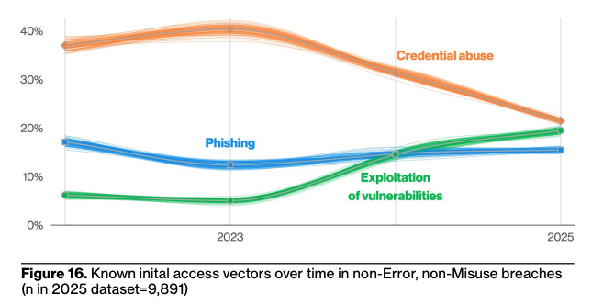
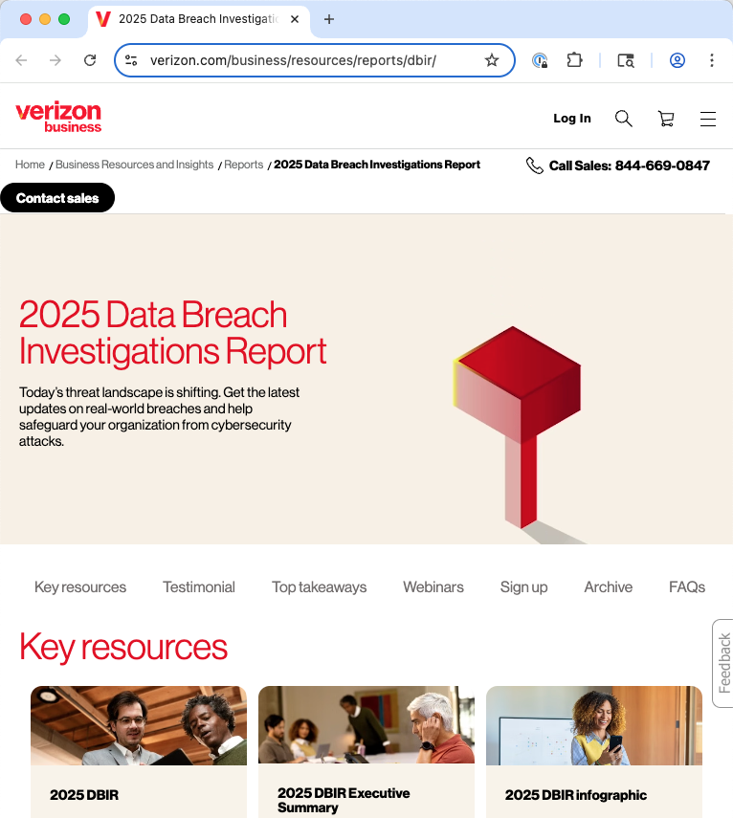
Consider attack vectors in data breaches
Source: 2025 Verizon Data Breach Investigations Report
Notes:
Still: Only 20% start with a vulnerability exploitation!

Slide 9
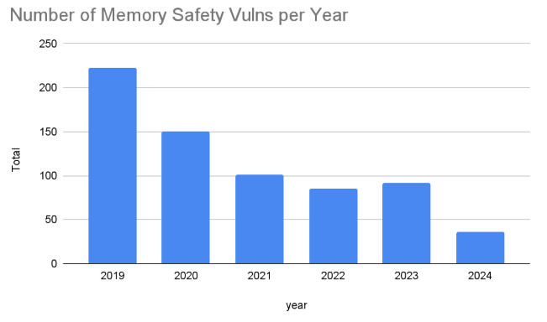
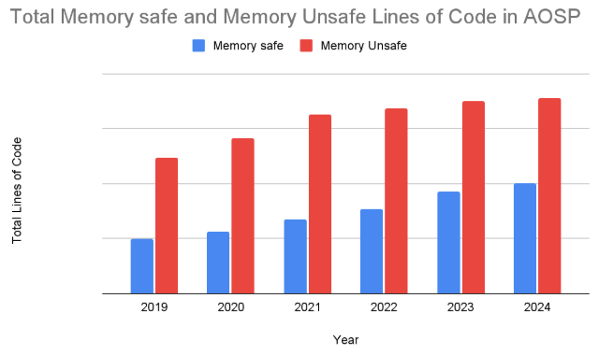
Method: Use PL that prevents vulnerabilities
Android is writing most new code in Rust, and fixing vulns in its C/C++.
Resuilt: A roughly exponential drop in vulnerabilities reported
Source: Google Security Blog

Slide 10
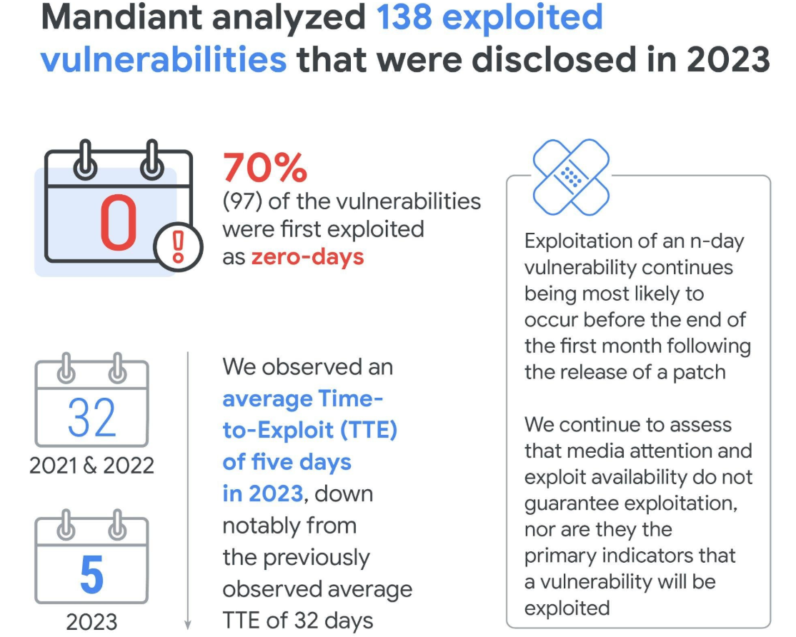
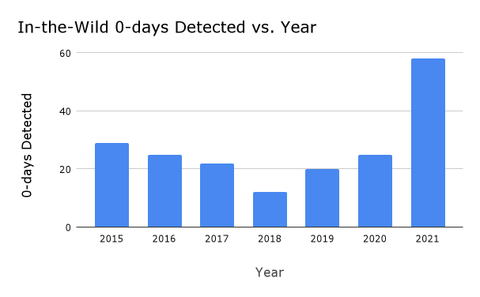
Method: Patch bugs faster
So: Attackers cannot keep exploiting the same vulnerabilities year after year
Source: Mandiant 2024 Threat Intelligence Report
Evidence: Adversaries shifting to greater use of 0-day vulnerabilities
and exploiting them sooner
Source: Google Project Zero

Slide 11
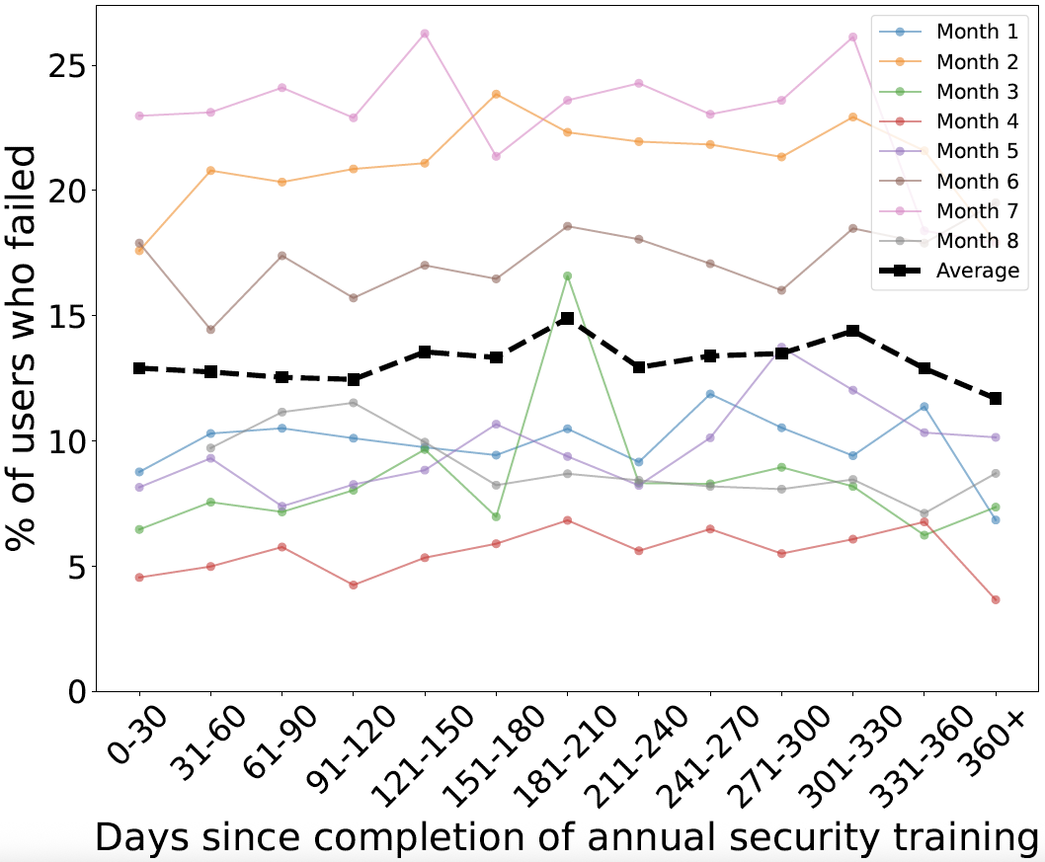
Method: Annual security awareness training
Can help address prevalent phishing attacks?
Evidence: Data and statistical models (GLME) find no association between:
how long ago a user completed training (KnowBe4) and
their likelihood of failing a phishing simulation
1 Month
1 Year
Source: Ho et al, “Understanding the efficacy of phishing training in practice.” S&P 2025.

Slide 12
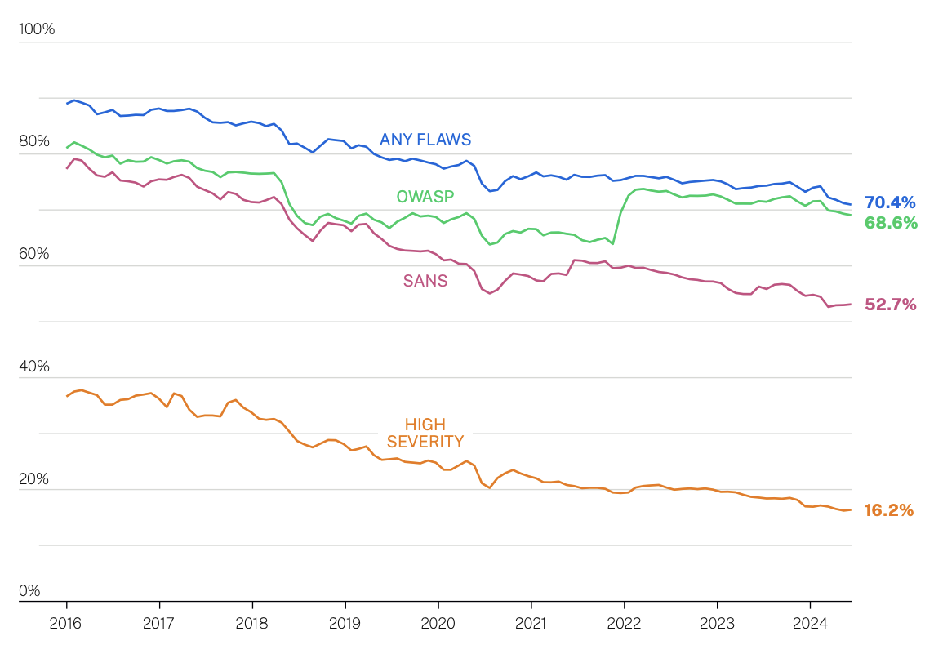
Vulnerability prevalence, resolution
Cobalt (pen testing co.):
The proportion of serious findings in pentests has declined from 20% to 11% over 10 years
Since 2017, the median time to resolve serious vulnerabilities has decreased from 112 days down to 37 days
Source: Veracode 2025 Annual Report on the State of Application Security
Notes:
30 percent reductions in the number of applications with high-severity flaws and in software without a “flaw in an open-source library when they are first scanned.”
Cobalt: However, this progress appears to have plateaued. When we look at the rate for serious findings being resolved in each calendar year, it remains stuck at just 55%.

Slide 13
Evidence-based security
Analysis
What are the (still) successful vectors of attack?
Where is risk (still) greatest?
What interventions could be deployed cost-effectively?
If it’s working, we should see:
A decline in successful attacks, according to a consistent data collection system
Updated best practices to remove demonstrably ineﬀective techniques, like password rotation
Outcomes
Data breached,
Vulnerabilities exploited,
Revenue lost,
…
Intervention
Engineering,
Operations,
Policy,
Education, …

Slide 14
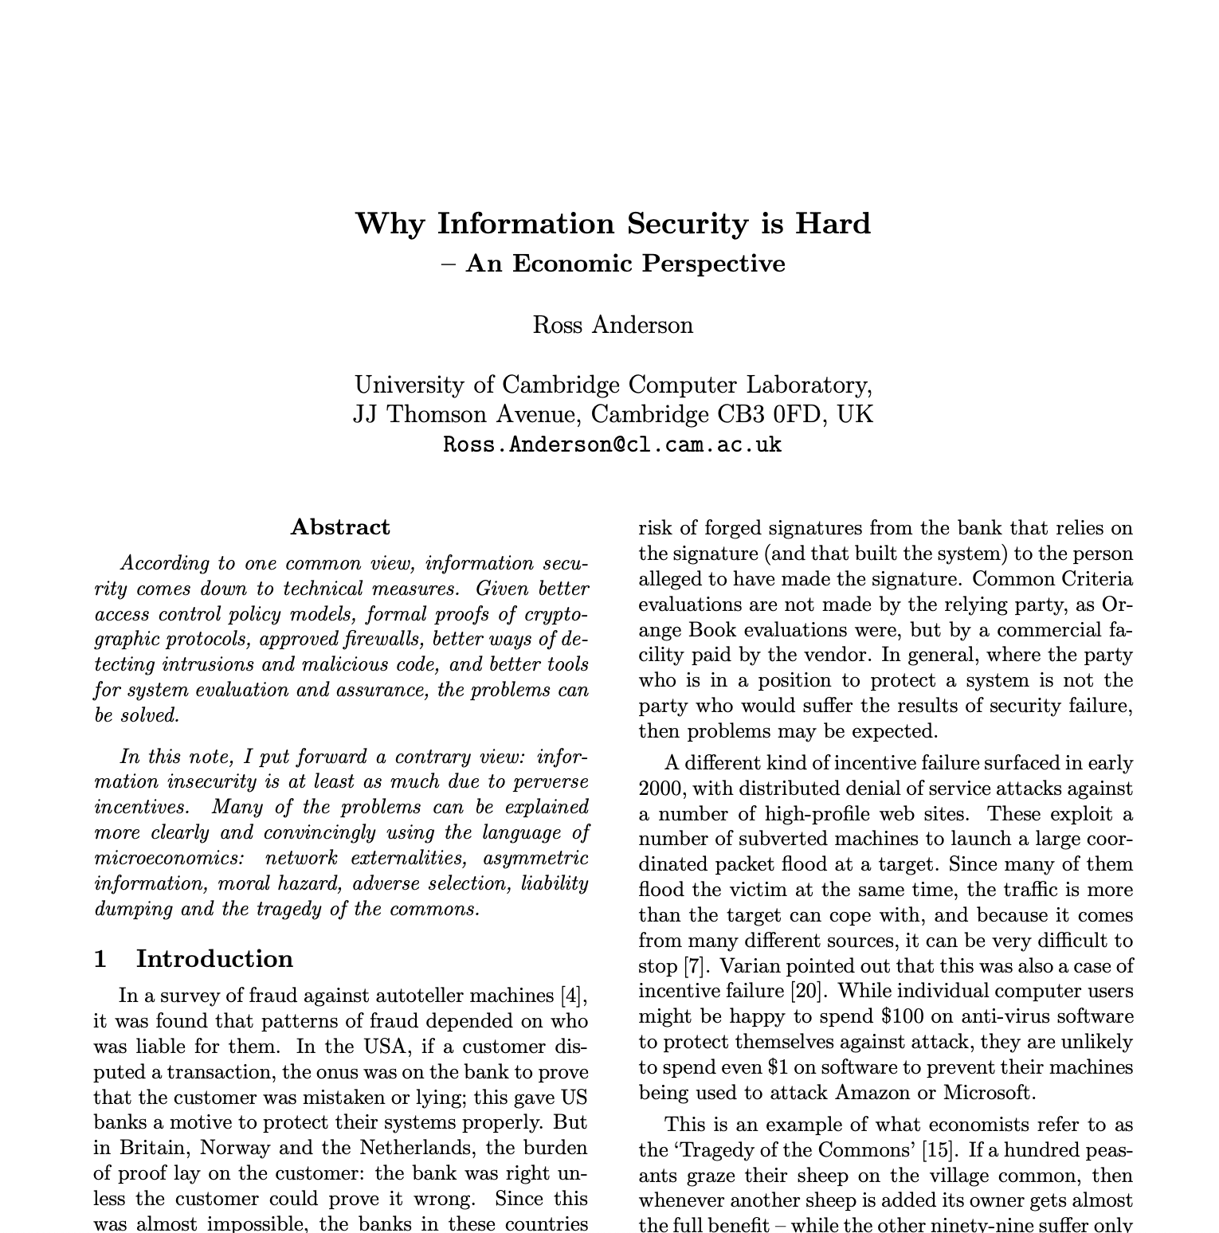
Why Information Security is Hard An Economic Perspective
Party best-placed to improve security should be incentivized to do so
Liability
Tragedy of the commons
First-mover and network externalities vs. security
3rd party evaluators paid by seller vs. direct user evaluation
Costs of attack vs. defense
“Even a very moderately resourced attacker can break anything that’s at all large and complex”
Market forces: end-user security vs. developer pain
“In an ideal world, the removal of perverse economic incentives to create insecure systems would depoliticize most issues.”

Slide 15

Course goals: You will be able to
Understand cybersecurity from a data-driven and economic perspective, learning to make decisions based on empirical evidence, following good science
Identify key vulnerabilities and threats, especially when considering the impact of humans, both when they are attack targets and when the play a role in ensuring a system’s security
Follow a well-designed process for secure systems construction, from threat modeling to building to testing to maintenance
Manage security operations – preventing, detecting, mitigating, and recovering from incidents – and gather data to improve future posture
Make risk-informed decisions: Assess designs and technologies according to how they mitigate security risk, while leveraging insurance and responding to regulation
Communicate effectively and with empathy to key stakeholders about security options and recommendations
All while taking a data-informed approach

Slide 16
Schedule
Today – 12 Feb (weeks 1-6)
17 Feb – 24 Mar (weeks 6-10)
Threat review: vulnerabilities and social engineering
Speaking and writing well
Empirical cybersecurity
Economics of cybersecurity
Cybersecurity as a scientific pursuit
Measuring and analyzing security
Secure software development
Threat modeling
Secure system design
Programming (memory safety!)
Pen testing (fuzzing)
Supply chain, patching, vulnerability remediation

Slide 17
Schedule
17 Feb – 24 Mar (weeks 6-10)
26 Mar – 28 Apr (weeks 10-14)
Secure software development
Threat modeling
Secure system design
Programming (memory safety!)
Pen testing (fuzzing)
Supply chain, patching, vulnerability remediation
Security operations
Incident detection and response
Management
Making risk informed decisions
The role and activities of the CISO
Cyber regulation and insurance
Bonus content week 10 (and throughout): Impact of AI/ML on security

Slide 18
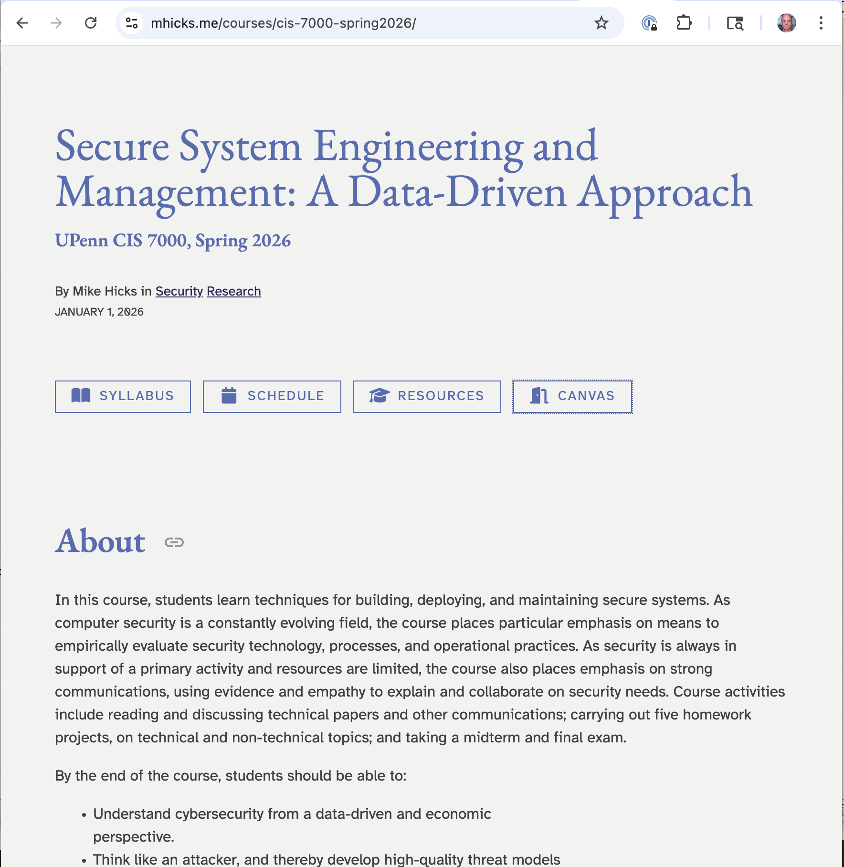
Main WWW site
https://mhicks.me/courses/cis-7000-spring2026/

Slide 19
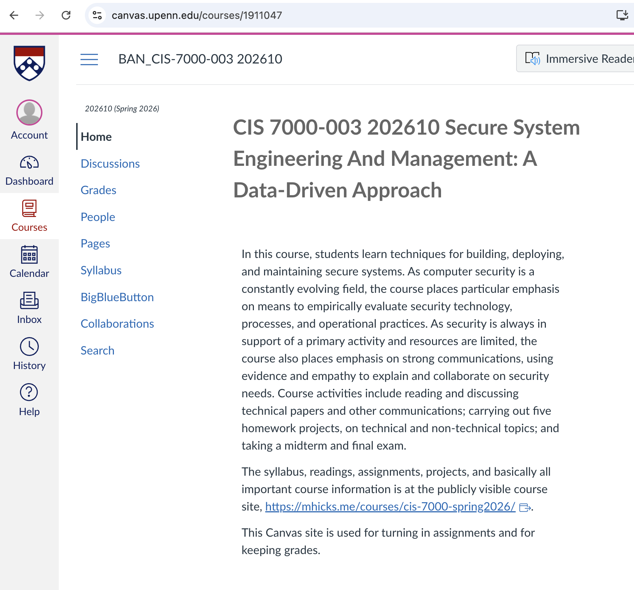
Canvas site
https://canvas.upenn.edu/courses/1911047

Slide 20
Graded activities
Read and critically review research papers, other sources
Discuss them, and course topics generally, in class
Do 5 (solo) projects
Communication
Data analysis
Threat modeling
Fuzzing
SecOps
Take 2 exams (midterm and final)

Slide 21


Read papers: Question, understand, improve
Good practice for the future!

Slide 22
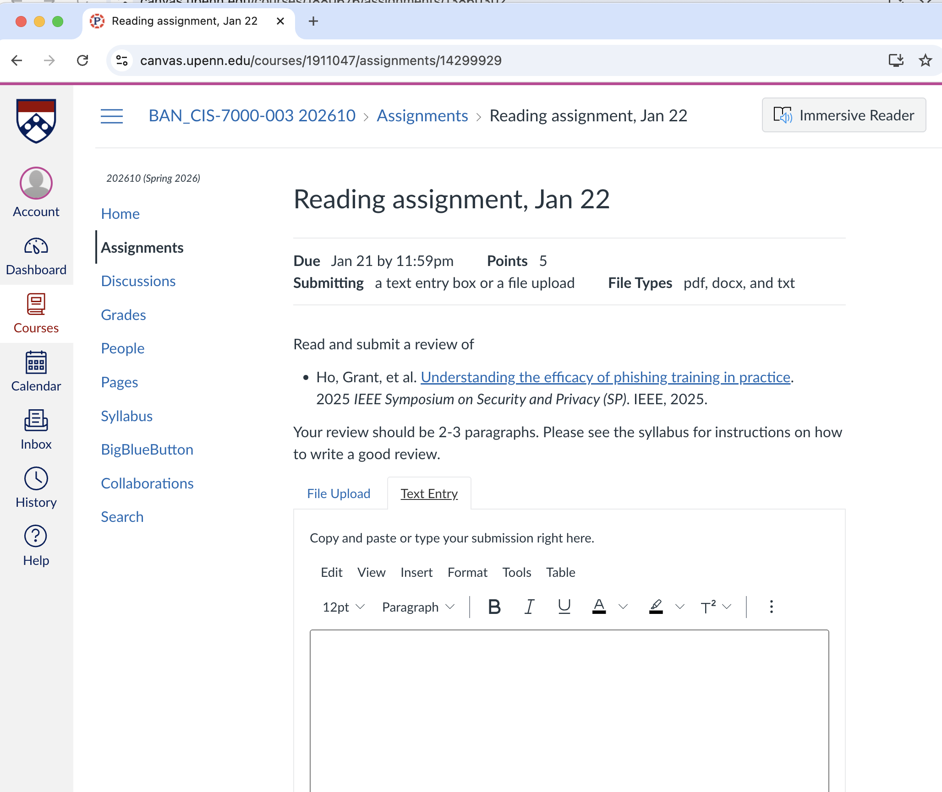
Class prep
Read the paper(s). Submit a 2-3 paragraph review the day before

Slide 23

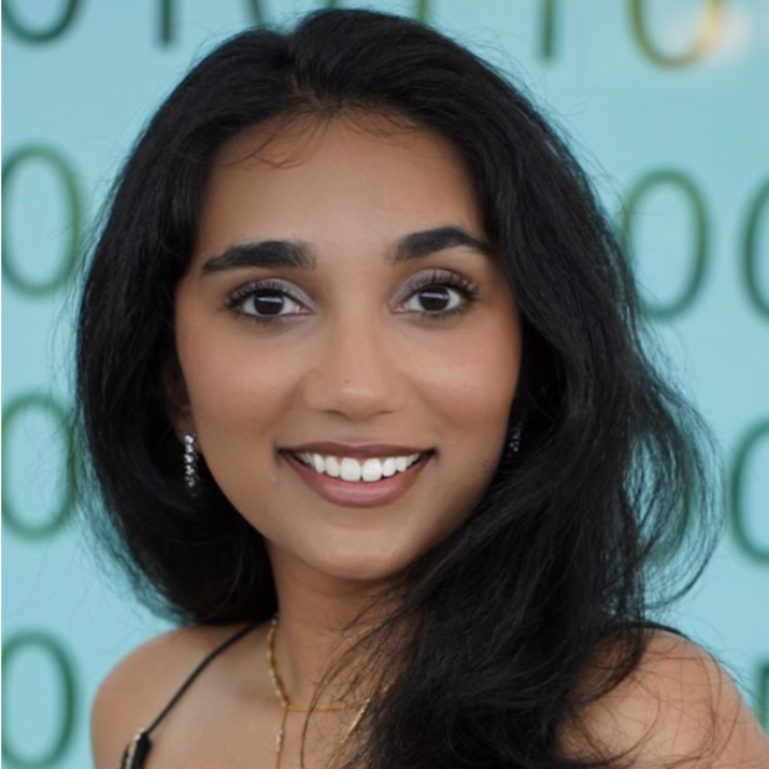
Personnel
Professor in CIS
Director of Schlein Center for Cybersecurity
Teaching assistant
PhD student in CIS, focus on cybersecurity

Slide 24

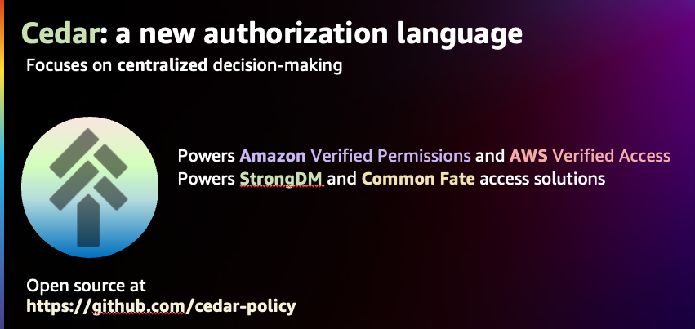

About me
Prof (2002-present): Research in Software Security, Programming Languages, Software Engineering, Usability, Cryptography
Startup (2018-2021): Building tools for secure software development
Binary analysis
Migration to memory-safe C
AWS (2022-2025)
Cedar authorization language
Fuzzing/automated test generation
Formal/mechanized proofs of security

Slide 25
Course overview

Slide 26




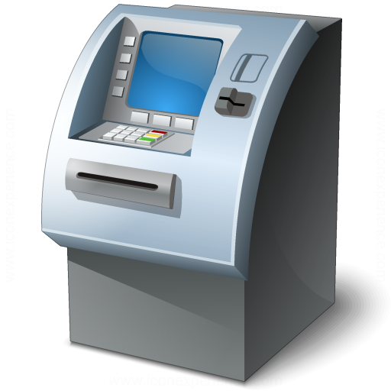
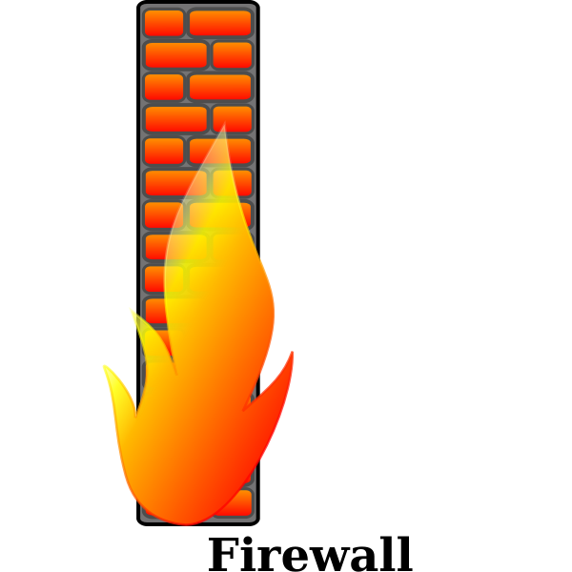




Operators
Builders
Attackers
Assets
System
Users
Cyber Builders

Slide 27
Operators
Users
directly affect
Attackers
contract services
mutually influence
Builders
Cyber Builders

Slide 28
Operators
contract services
Insurers
Users
Regulators
mutually influence
directly affect
Attackers
contract services
Builders
Cyber Builders
Consider:
Relationships induce incentives
(Cyber)builders are users and operators too!

Slide 29
Attackers
Overwhelming reason for attacks: Cybercrime
But also: national-state activities, such as espionage and cyber-war
Value proposition: Is the expected cost of developing and carrying out the attack worth the expected reward?
Costs and benefits are both monetary and non-monetary
As the world has become more cyber-enabled, the rewards have increased
But defenses have made carrying out attacks much harder, too!

Slide 30
Ukraine power grid attack (2015)
In the Ukraine power grid cyber attack,
spear-fishing emails,
an exploit kit targeting vulnerabilities,
the KillDisk, a destructive data-wiping utility, and
an SSH backdoor to maintain persistent access,
were used in tandem to successfully break into the system.
In the second step of the same attack, malicious firmware developed based on domain knowledge collected from the distribution management system and was tested by the simulated power grid system,
was uploaded to the system and to attack the ICS components.

Slide 31
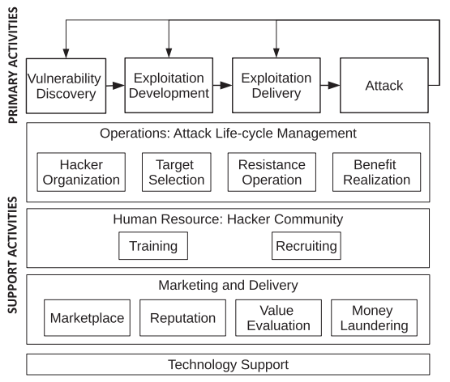
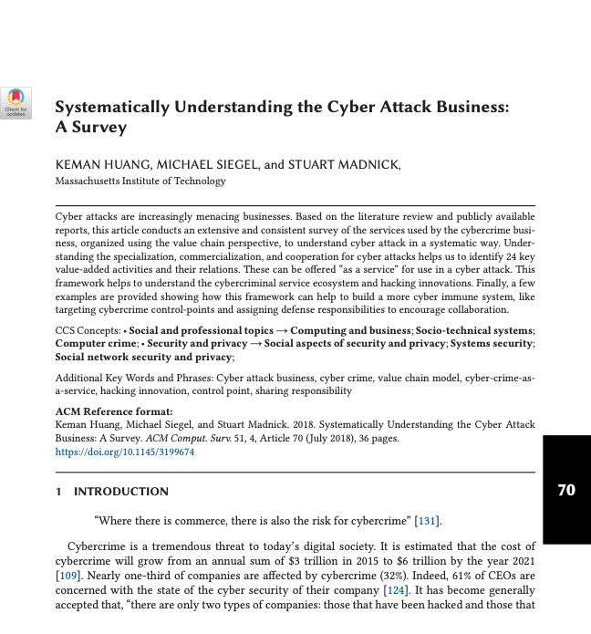
Cybercriminal Value Chain Model
Notes:
Primary:
Vulnerability: Technical (memory corruption) and operational (phishing)
Exploit development: Creation of exploit kits/packs for exploiting the vulnerability on a target. Includes “social engineering toolkit” via Metasploit!
Exploit delivery: Physical infection, electronic contact (email, SMS), drive-by-download (don’t click the link!), software distribution (corrupted install or patch; more clever: supply chain hack in open source)
Attack: The affectation of the target system. Purpose: digital gains (espionage, app theft, botnet, mule), direct monetary gains (harm competitor, ransomware 88% successful against healthcare institutions), psych gains (trophy hack)
Support: Goal is to gain greater benefit with less cost
Cyber attack ops:
- Target selection based on value prop – see next slide
- Hacker org – Hierarchy (state sponsored) vs. Aggregate (like Anonymous), and many others
- Benefit realization – basically, bitcoin via BTC-E (95% of ransomware, shut down in 2017). DDOS: with proof of participation. Black markets.
- Resistance ops: Being able to hide your tracks, recover from takedown
Human Resource
- Hacker training: two-way resources! (bug bounties etc) Also Anonymous had own school; nation states
- Hacker recruiting: same as legit recruiting! Social networks
Marketing and delivery
- Marketplace – used to find experts to fill needed skills, offer services
- Reputation – challenge! Need to earn trust (not LE or double dealer)
- Value evaluation – pricing, e.g., zero-day vs. one-day, **
- Money laundering
Tech support: IRC, Tor, Bitcoin, tools for VD and EK production, etc.
** In May, Neutrino became the primary EK distributing CryptXXX ransomware, initiating [rather: due to] a significant decline in Angler EK activity [since Angler was taken down]. As demand for Neutrino EK increased, the developers chose to increase the price of the EK from $880 per week on a shared server and $3500 per month on a dedicated server to $7000 on a dedicated server, discontinuing the shared server option

Slide 32
Operators
Builders
Attackers
Assets
System
Users
Cyber Builders

Slide 33
Operators
Builders
Attackers
Assets
System
Users
Cyber Builders

Slide 34
Builders
Operators
Attackers
Users
Cyber Builders

Slide 35
Builders
Operators
Attackers
Users
Cyber Builders
Notes:
Kinds of attackers
-

Slide 36
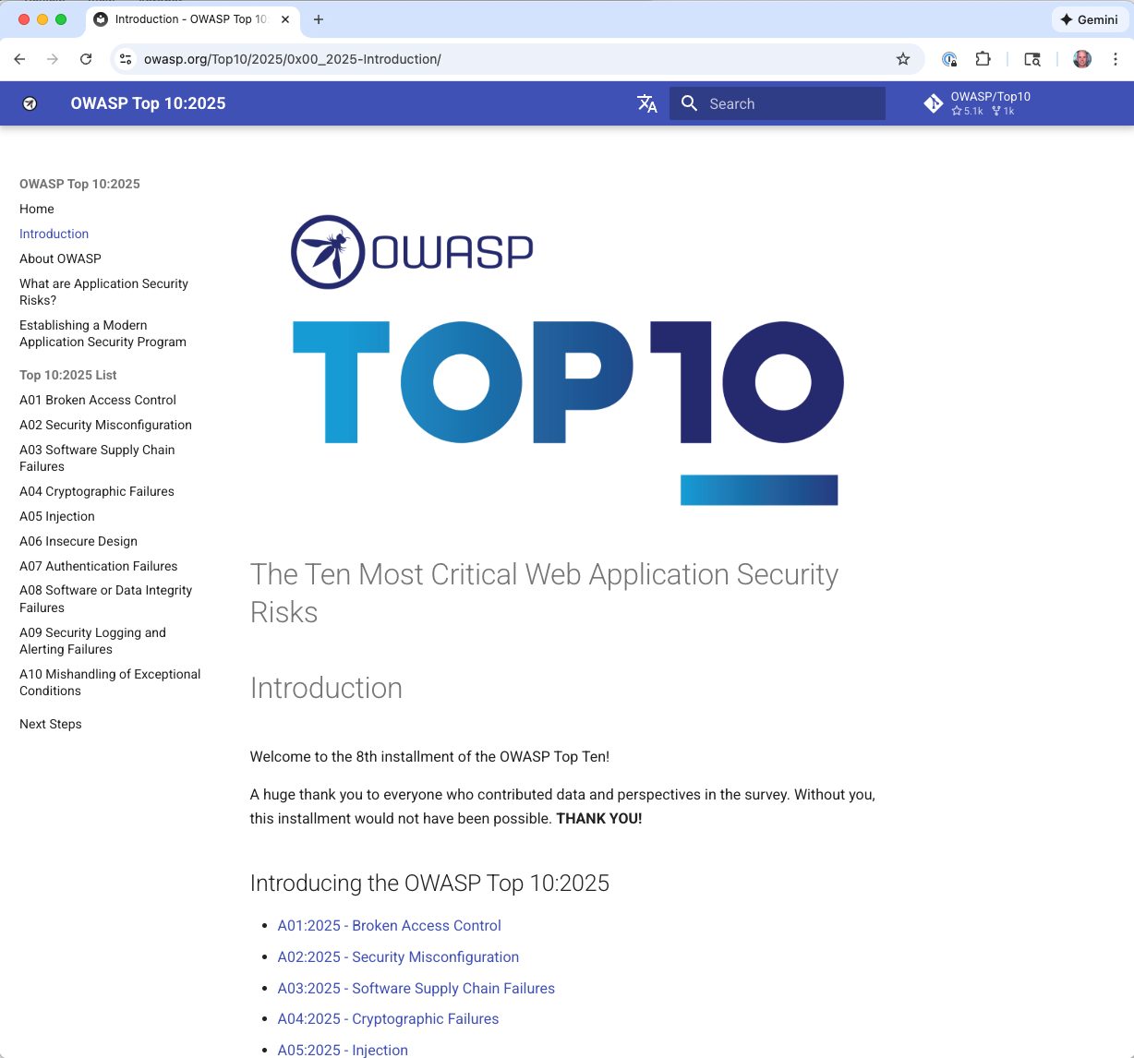

Attack methods
Vulnerability based: Exploiting design and implementation flaws
Social engineering-based: Exploiting the human
Notes:
Key attacks on the social engineering side:
Phishing
Insider attacks
Baiting (USB drive in parking lot)
Vishing and Smishing
Supply chain manipulation

Slide 37
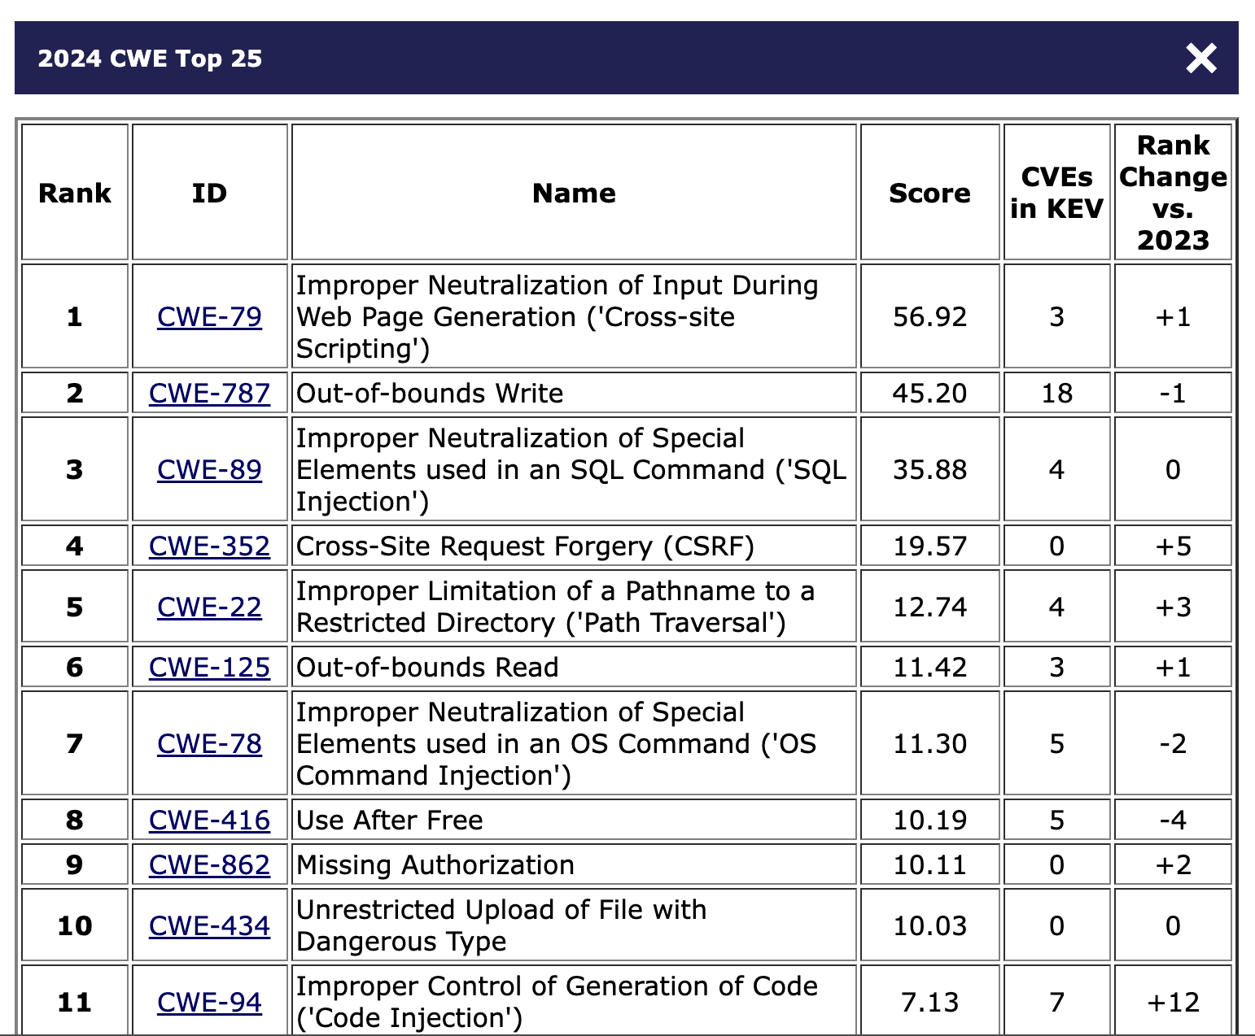
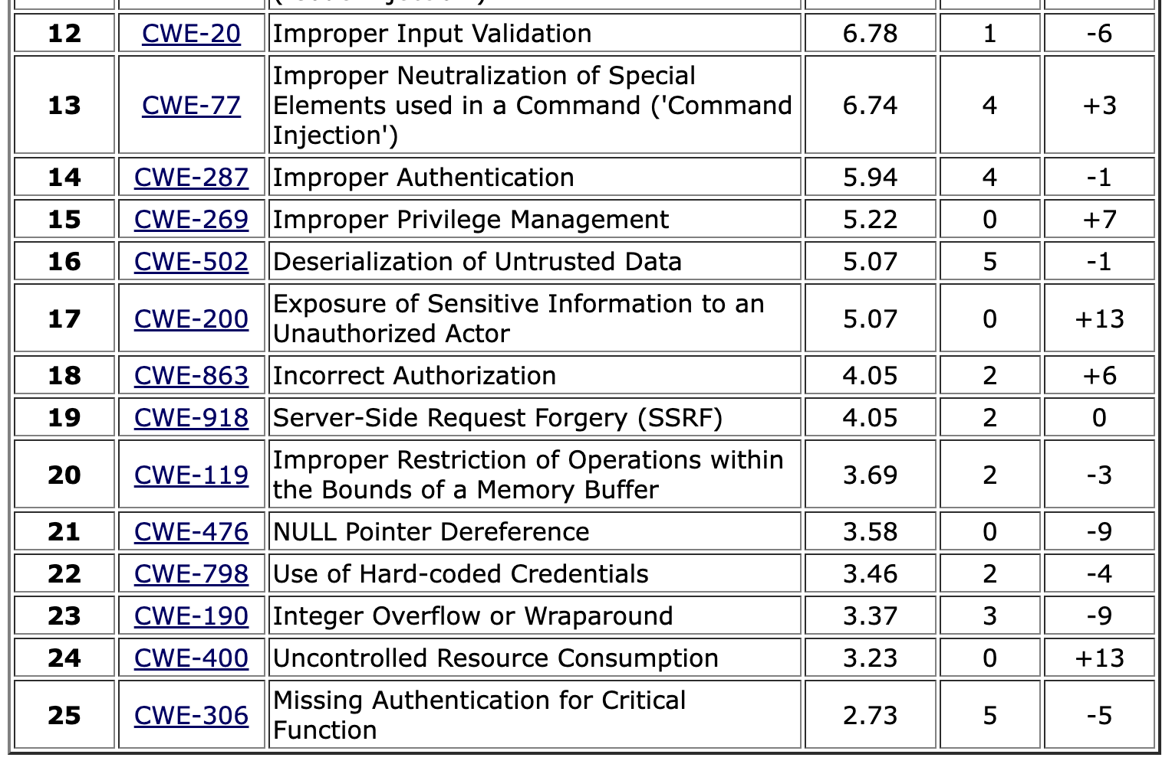
MITRE Top 25 Common Weakness Enumeration
Classic memory-safety vulnerabilities
Notes:
This year’s dataset included 31,770 CVE Records for vulnerabilities published between June 1, 2023 and June 1, 2024. Data was initially pulled on July 30, 2024, to share with CNA community partners for review. Data was pulled again on November 4, 2024, to ensure the most up to date CVE Records information was used in the Top 25 list calculations.
https://cwe.mitre.org/top25/archive/2024/2024_methodology.html
Note: CVSS scores are between 0 and 10
Beyond Trust CVEs
https://nvd.nist.gov/vuln/detail/cve-2024-12356 (Command Injection, 9.8 CVSS) to BeyondTrust Privileged Remote Access (PRA)
https://nvd.nist.gov/vuln/detail/CVE-2024-12686 (Command Injection 7/2 CVSS) BeyondTrust Privileged Remote Access (PRA) and Remote Support (RS) OS Command Injection Vulnerability

Slide 38
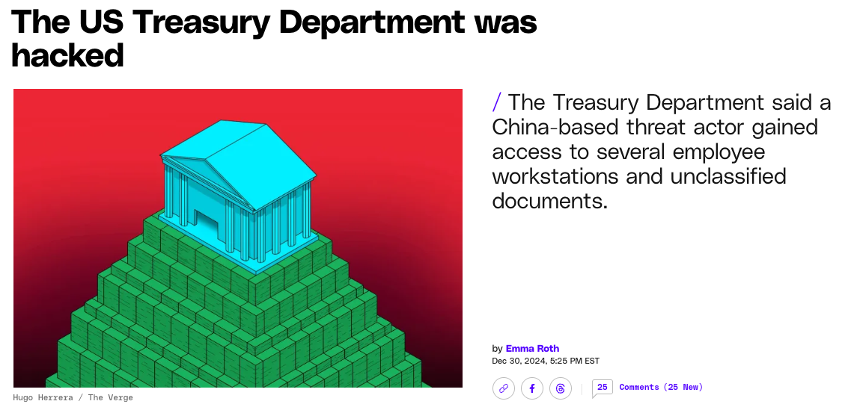
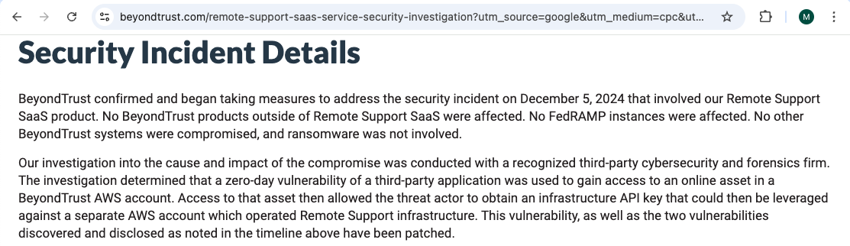
… “gain access to an online asset in a BeyondTrust AWS account. Access to that asset then allowed the threat actor to obtain an infrastructure API key …” which was used to operate the Remote Support infrastructure
Notes:
a zero-day vulnerability of a third-party application was used to gain access to an online asset in a BeyondTrust AWS account. Access to that asset then allowed the threat actor to obtain an infrastructure API key that could then be leveraged against a separate AWS account which operated Remote Support infrastructure.

Slide 39
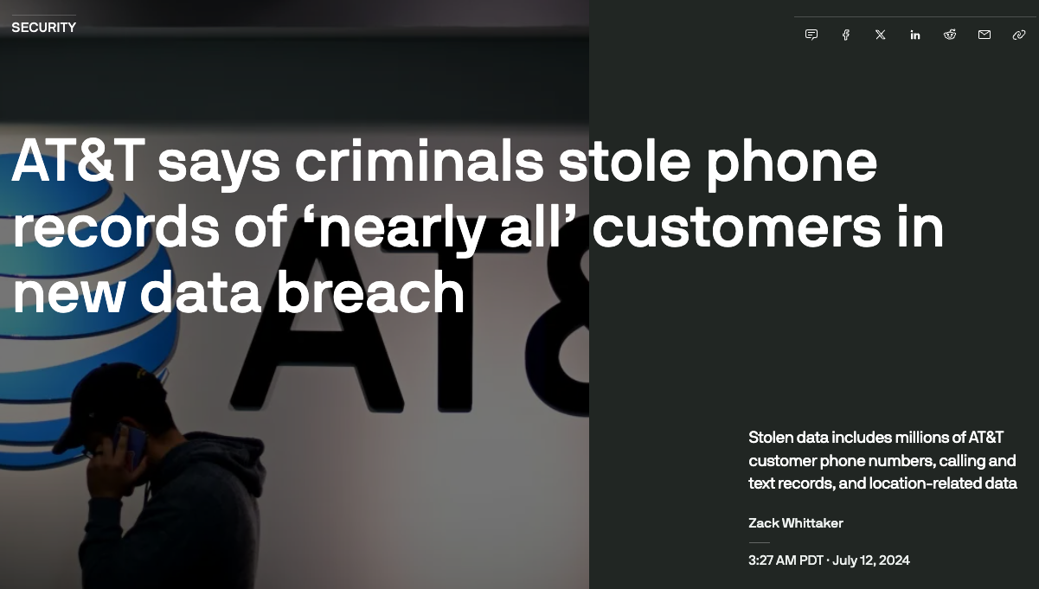
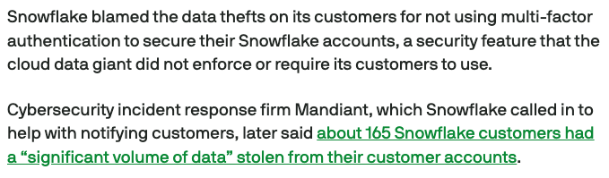
“Snowflake blamed the data thefts on its customers for not using multi-factor authentication to secure their snowflake accounts, … did not require its customers to use”

Slide 40
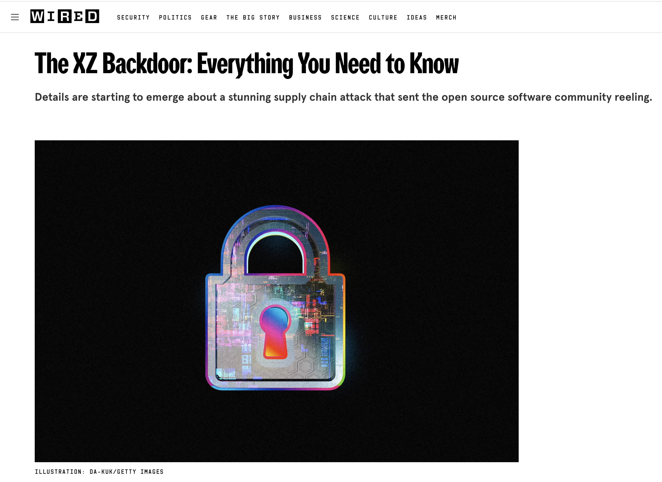
“This might be the best executed supply chain attack we've seen described in the open, and it's a nightmare scenario: malicious, competent, authorized upstream in a widely used library"
Notes:
Insider threat blow by blow https://boehs.org/node/everything-i-know-about-the-xz-backdoor

Slide 41
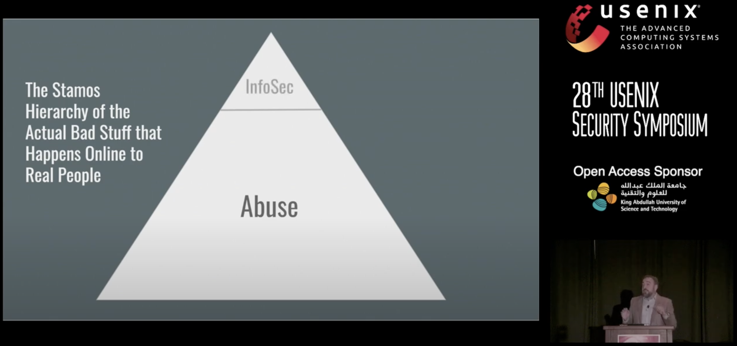
The big picture
https://www.usenix.org/conference/usenixsecurity19/presentation/stamos

Slide 42
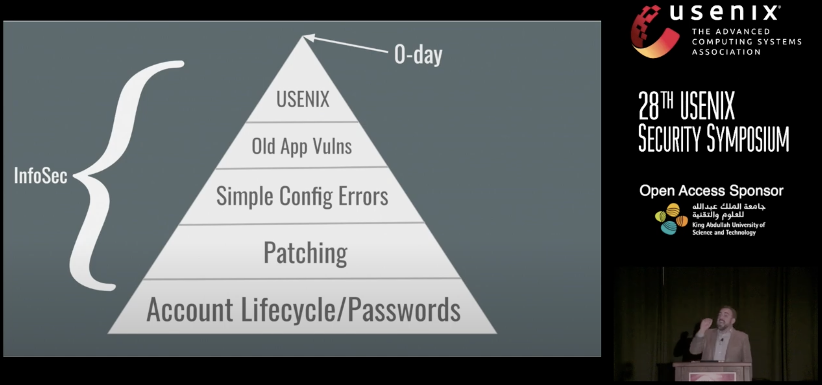
The big picture
https://www.usenix.org/conference/usenixsecurity19/presentation/stamos

Slide 43
Builders
Operators
Users
Cyber Builders
(also provides tools for Builders)

Slide 44
Builders
Create bespoke (first-party) software and services …
Developers within a bank, e.g., Capitol One
… and commodity (third party) software or services
Software: Android OS, Linux, Google Chrome, Microsoft Word, …
Services: AWS, Azure, Workday, Google Suite, …
Responsible for the product, and its security
Often rely on collaborating dev and security engineering teams

Slide 45
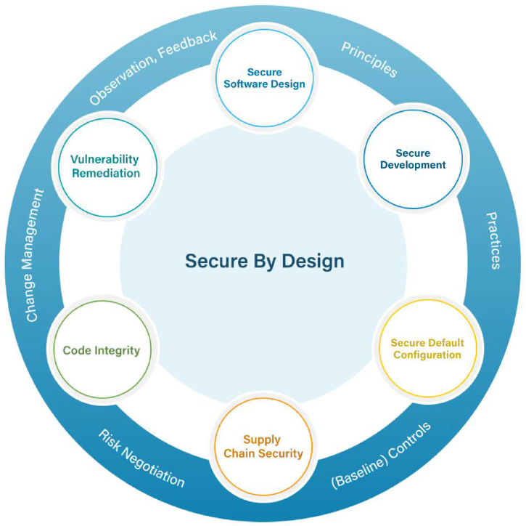
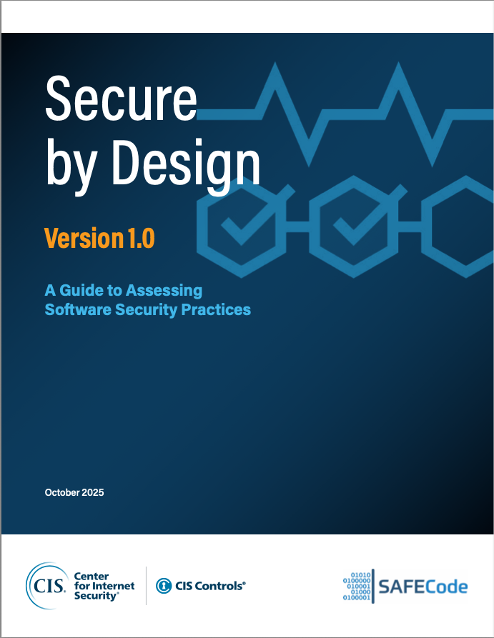
Builders
Threat modeling
Secure architectural design

Slide 46
Builders
Threat modeling
Secure architectural design
Secure programming
Security testing (e.g., fuzzing)

Slide 47
Builders
Threat modeling
Secure architectural design
Secure programming
Security testing (e.g., fuzzing)
Secure deployment and management

Slide 48
Builders
Operators
Users
Cyber Builders
(also provides tools for Builders)

Slide 49
Users
Target (direct or indirect) of attackers
Participant in system security
Setting passwords, setting a security policy, not clicking phishing links, …
… but not necessarily motivated or capable
May share or reuse passwords, set over-permissive policies, click suspicious links, ignore security training, …

Slide 50
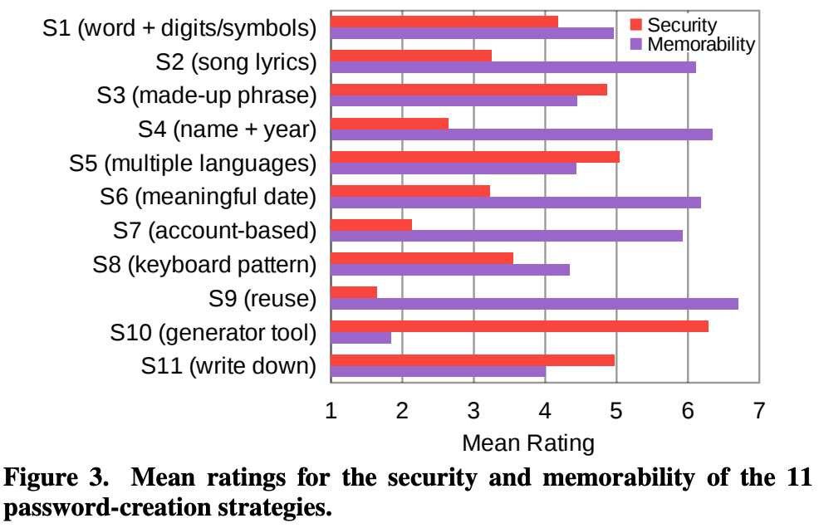
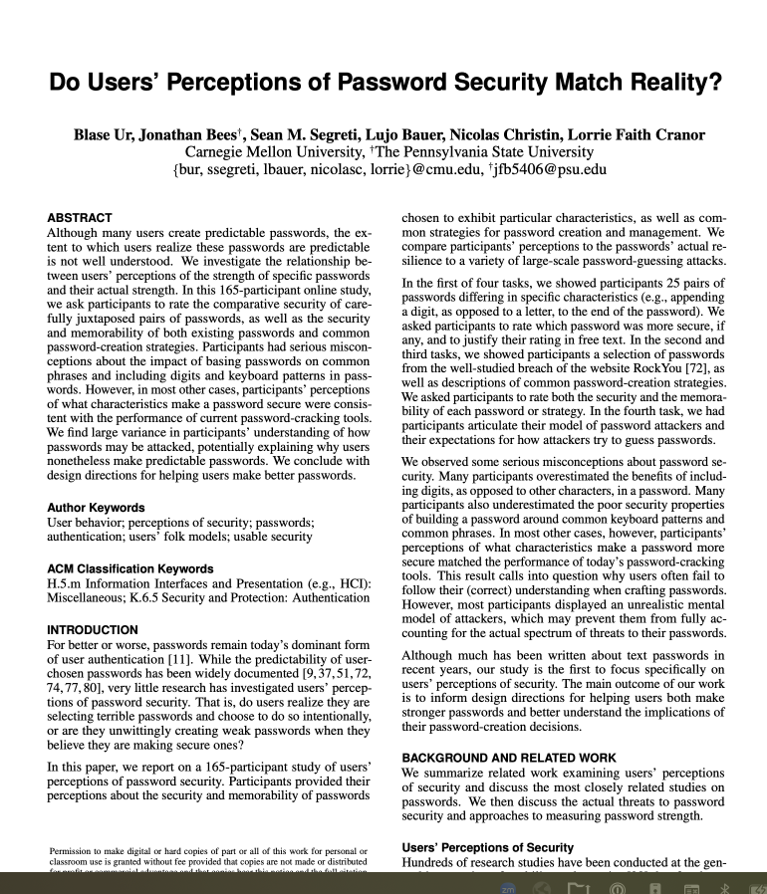
Passwords: Security v. memorability

Slide 51
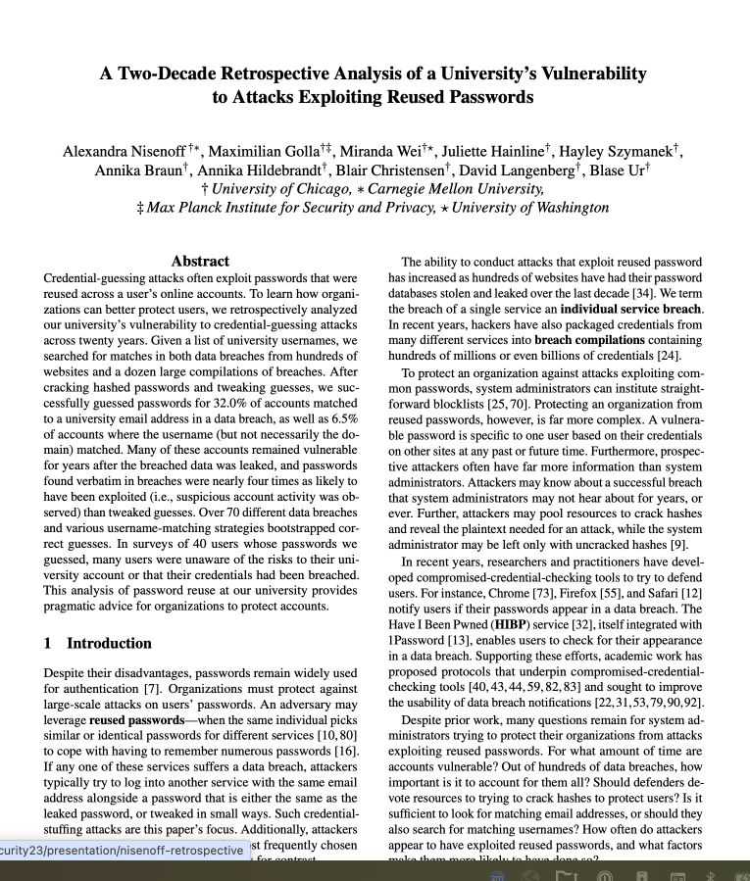
Password reuse: Vector of attack
Guessed 32% of passwords in historical DB by leveraging reuse
As compared to 6.5% without considering reuse
35.5% of valid guesses were for current passwords
Of those guessed by reuse
54.7% were verbatim reuse, vs. 45.3% based on tweaks
Vulnerability is real
Some historical observed exploits seemed to coincide with data breaches
Passwords were vulnerable for long after a breach (median of 5 years)

Slide 52
Builders
Operators
Users
Cyber Builders
(also provides tools for Builders)

Slide 53
Operators
Manage and operate systems for a user community
Examples: Companies that have an online presence, nonprofits such as universities and social services, and on-line service providers like Workday
In addition to core services/systems they may provide, they maintain internal network, email, personnel and financial records, etc.
Ultimately responsible for cybersecurity: prevention, detection, mitigation, response, recovery
Many technologies for these. Challenge: How to decide which to use in an evidence-based manner?
Notes:
Users are internal and external

Slide 54
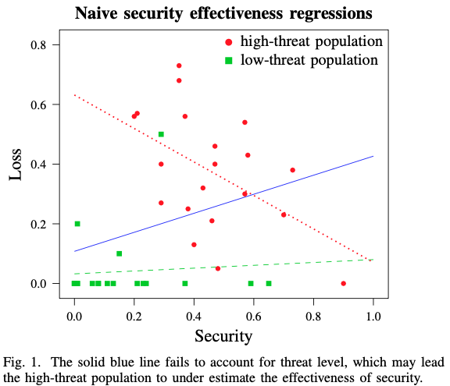
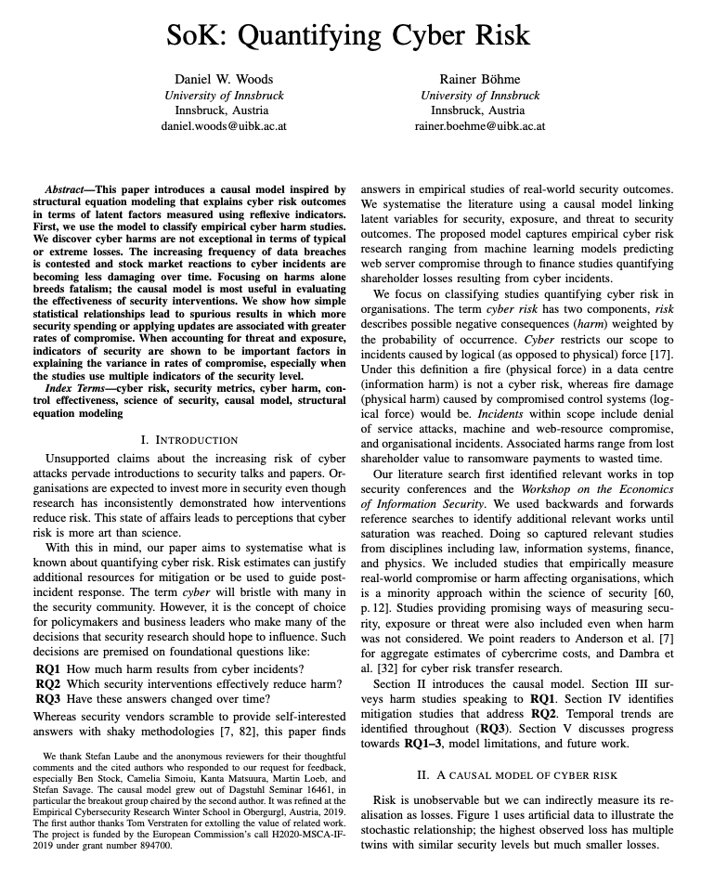
A naïve model relating loss to security level
Simple regression (blue line): more security implies more losses?!
Problem: Confounding variables (especially threat level)
Notes:
Dotted red line is security level’s influence on loss, conditioned on the high threat scenario
The green line is low threat

Slide 55
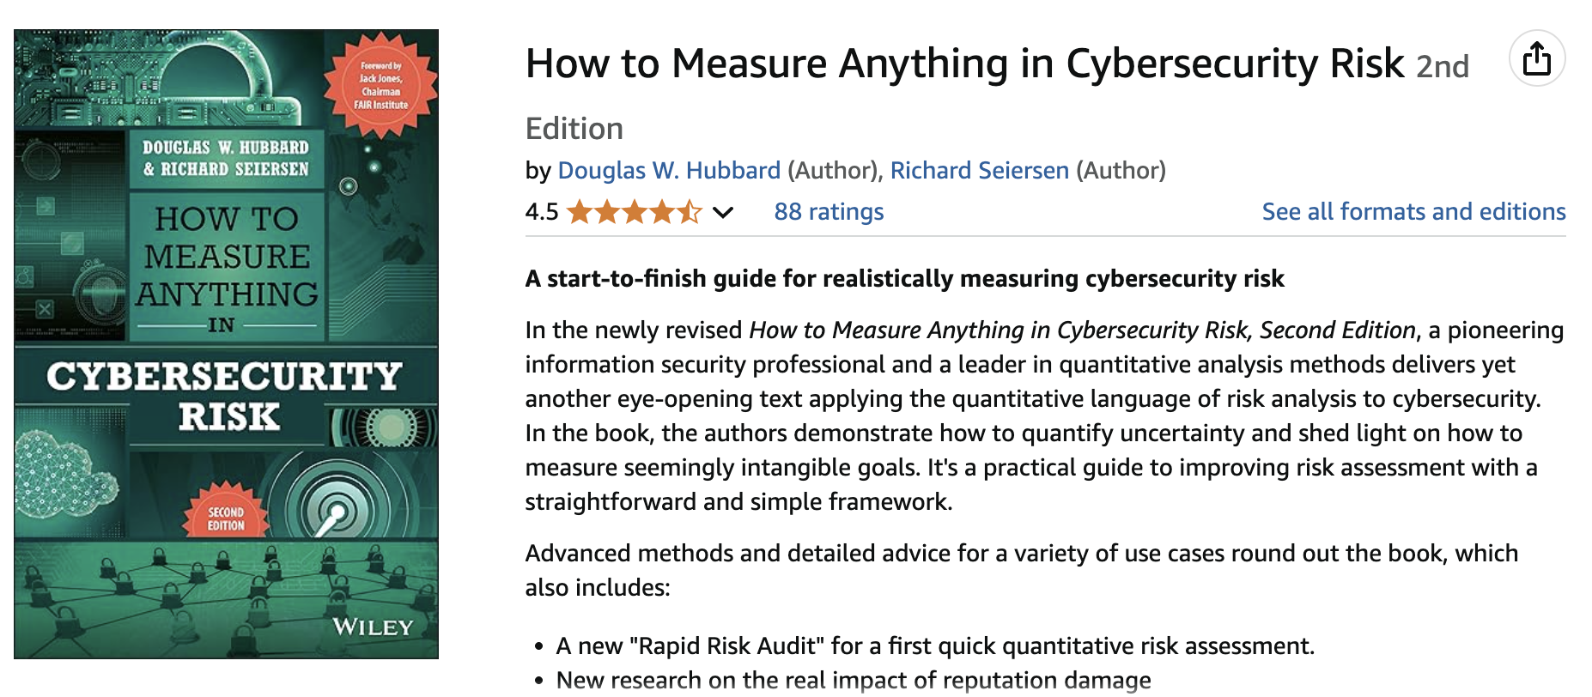

Slide 56
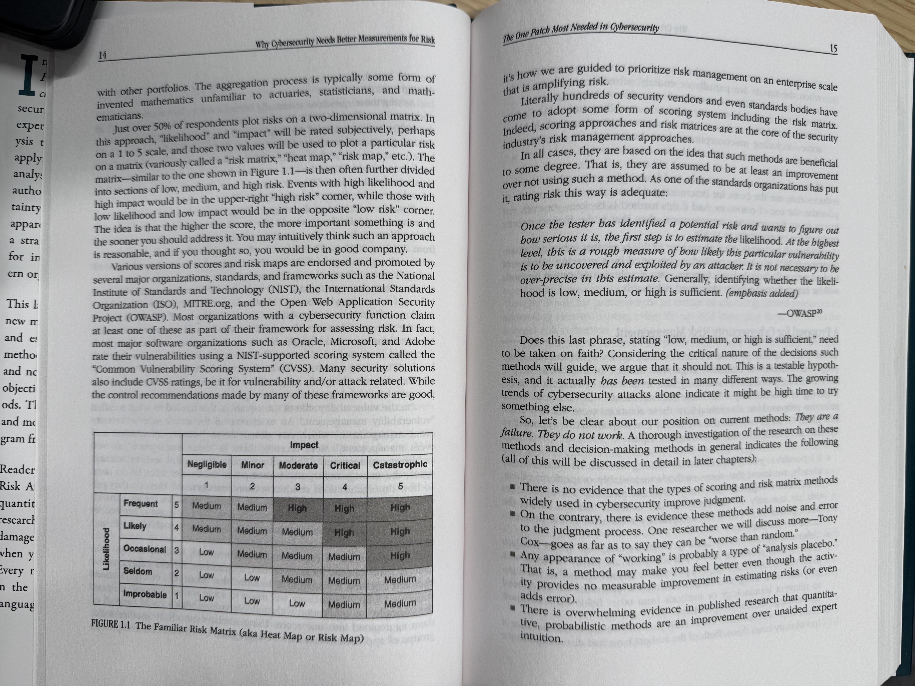

Slide 57
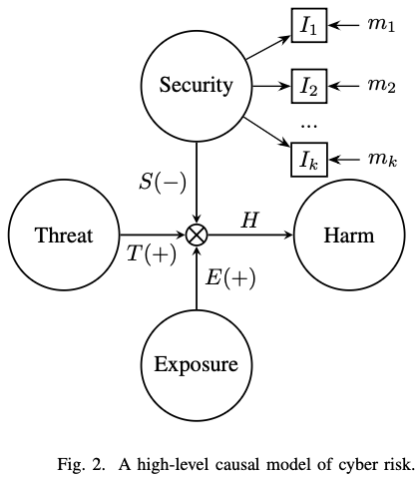
A simple causal model of cyber risk
Threat: The motivation, capability and activity of adversaries
Harm: Negative consequences resulting from compromise
Exposure amplifies E(+) the relationship between Threat and Harm
Security moderates S(−) the relationship between Threat and Harm
Security has reflexive indicators I₁, I₂, … I_{k}, which have corresponding measurements m₁, m₂, … m_{k}
Notes:
Why Latent Variables?
Single indicators are insufficient (e.g., security budget, certifications)
Reflexive indicators I₁, I₂, ..., Iₖ measure underlying constructs
Example: Multiple mismanagement symptoms better predict compromise

Slide 58
Builders
Operators
Users
Cyber Builders
(also provides tools for Builders)

Slide 59
Cyber Builders
Build products and services to enhance cybersecurity
Usability is extremely important: May reduce security benefits to increase it!
Customer: Operators
Firewalls, EDR (Endpoint Detection and Response), email security, pen testing services, threat intelligence, …
Customer: Users
Password managers, antivirus, cloud-hosted encrypted backups, …
Customer: Builders
Code management, dependency tracking, code analysis, automated testing, …
Customer: Attacker (!!)
Use builder services (code analysis), learn from defenses (malware scans)

Slide 60
For Operators: Key technologies and activities
Preventing and detecting attacks
Antivirus
Firewalls
Host-based intrusion detection/prevention (HIDS/HIPS)
Endpoint detection and response (EDR)
Security Information and Event Management (SIEM)
Mitigating effects of an attack
Containerization, cloud backups, MAC
Threat intelligence: leverage security researchers, CERTs and ISACs, media/journalists
Notes:
Example EDR: Crowdstrike Falcon, Sentinel One

Slide 61
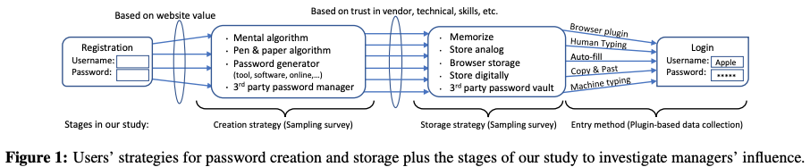
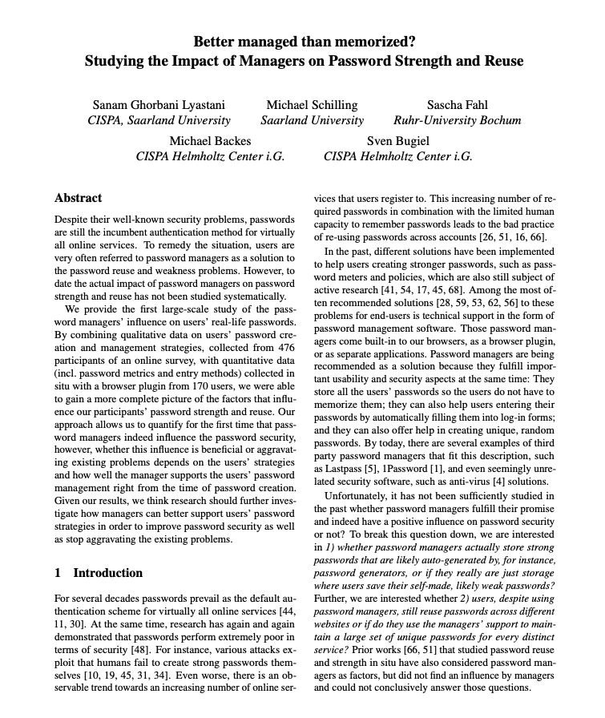
For Users: Password managers
Password creation – with algorithm, by hand, using service, ...
Password storage – memorized, in file, in service, …
Password entry – typed, cut&paste, auto-filled, …

Slide 62
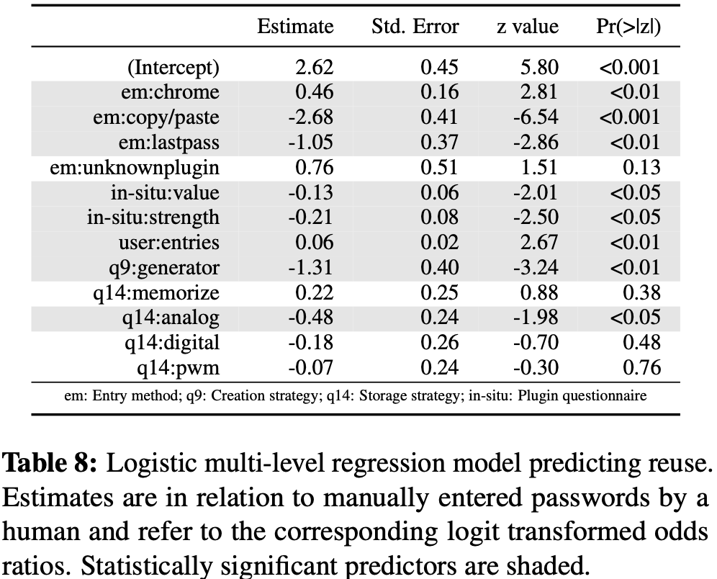
Study: Password managers may not help!
Reuse was significantly influenced by the entry method of the password
Odds for reuse were 2.85 times lower by LastPass, 14.29 times lower if C&P
odds for reuse were 1.65 times higher by Chrome auto-fill
Creation by alg: odds of non-reuse 3.70 times higher
More passwords → greater odds of reuse
Higher-value website → lower odds of reuse
Notes:
For password reuse a logistical model with all predictors but without interactions described our data best.
Paper reported odds ratios but these are not shown in the table. Not obvious how to compute them from the numbers reported in the table either. Sigh.

Slide 63

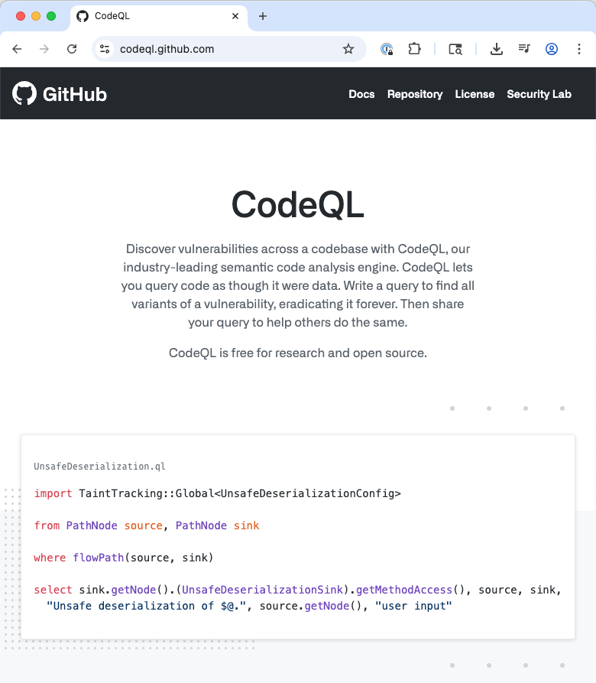
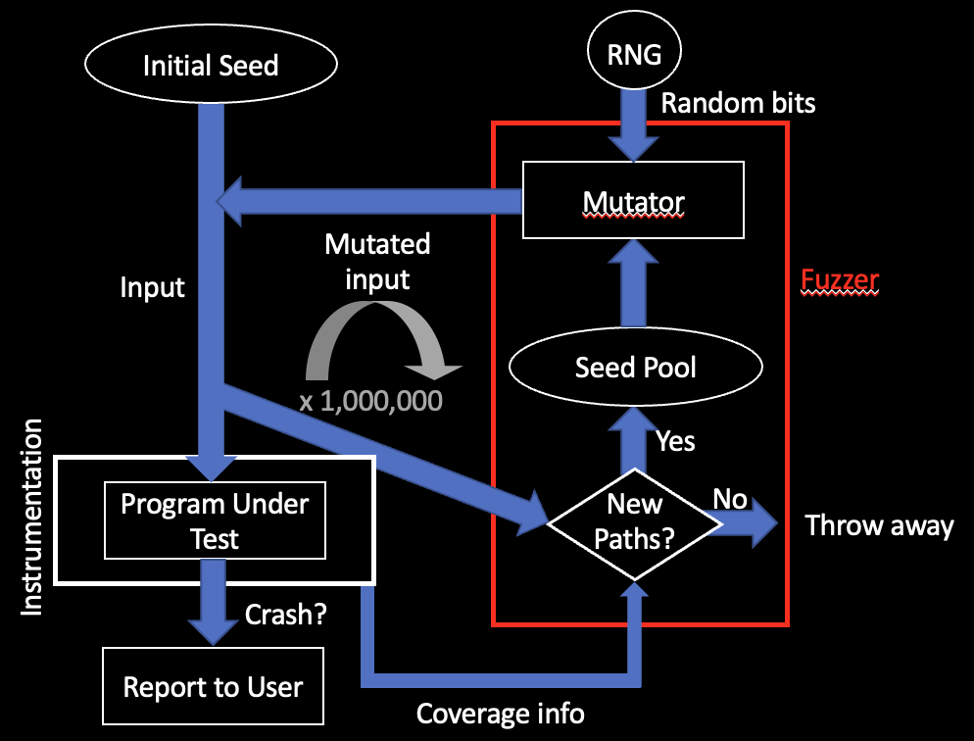


For Builders: Safe PLs, fuzzers, analyzers, …

Slide 64
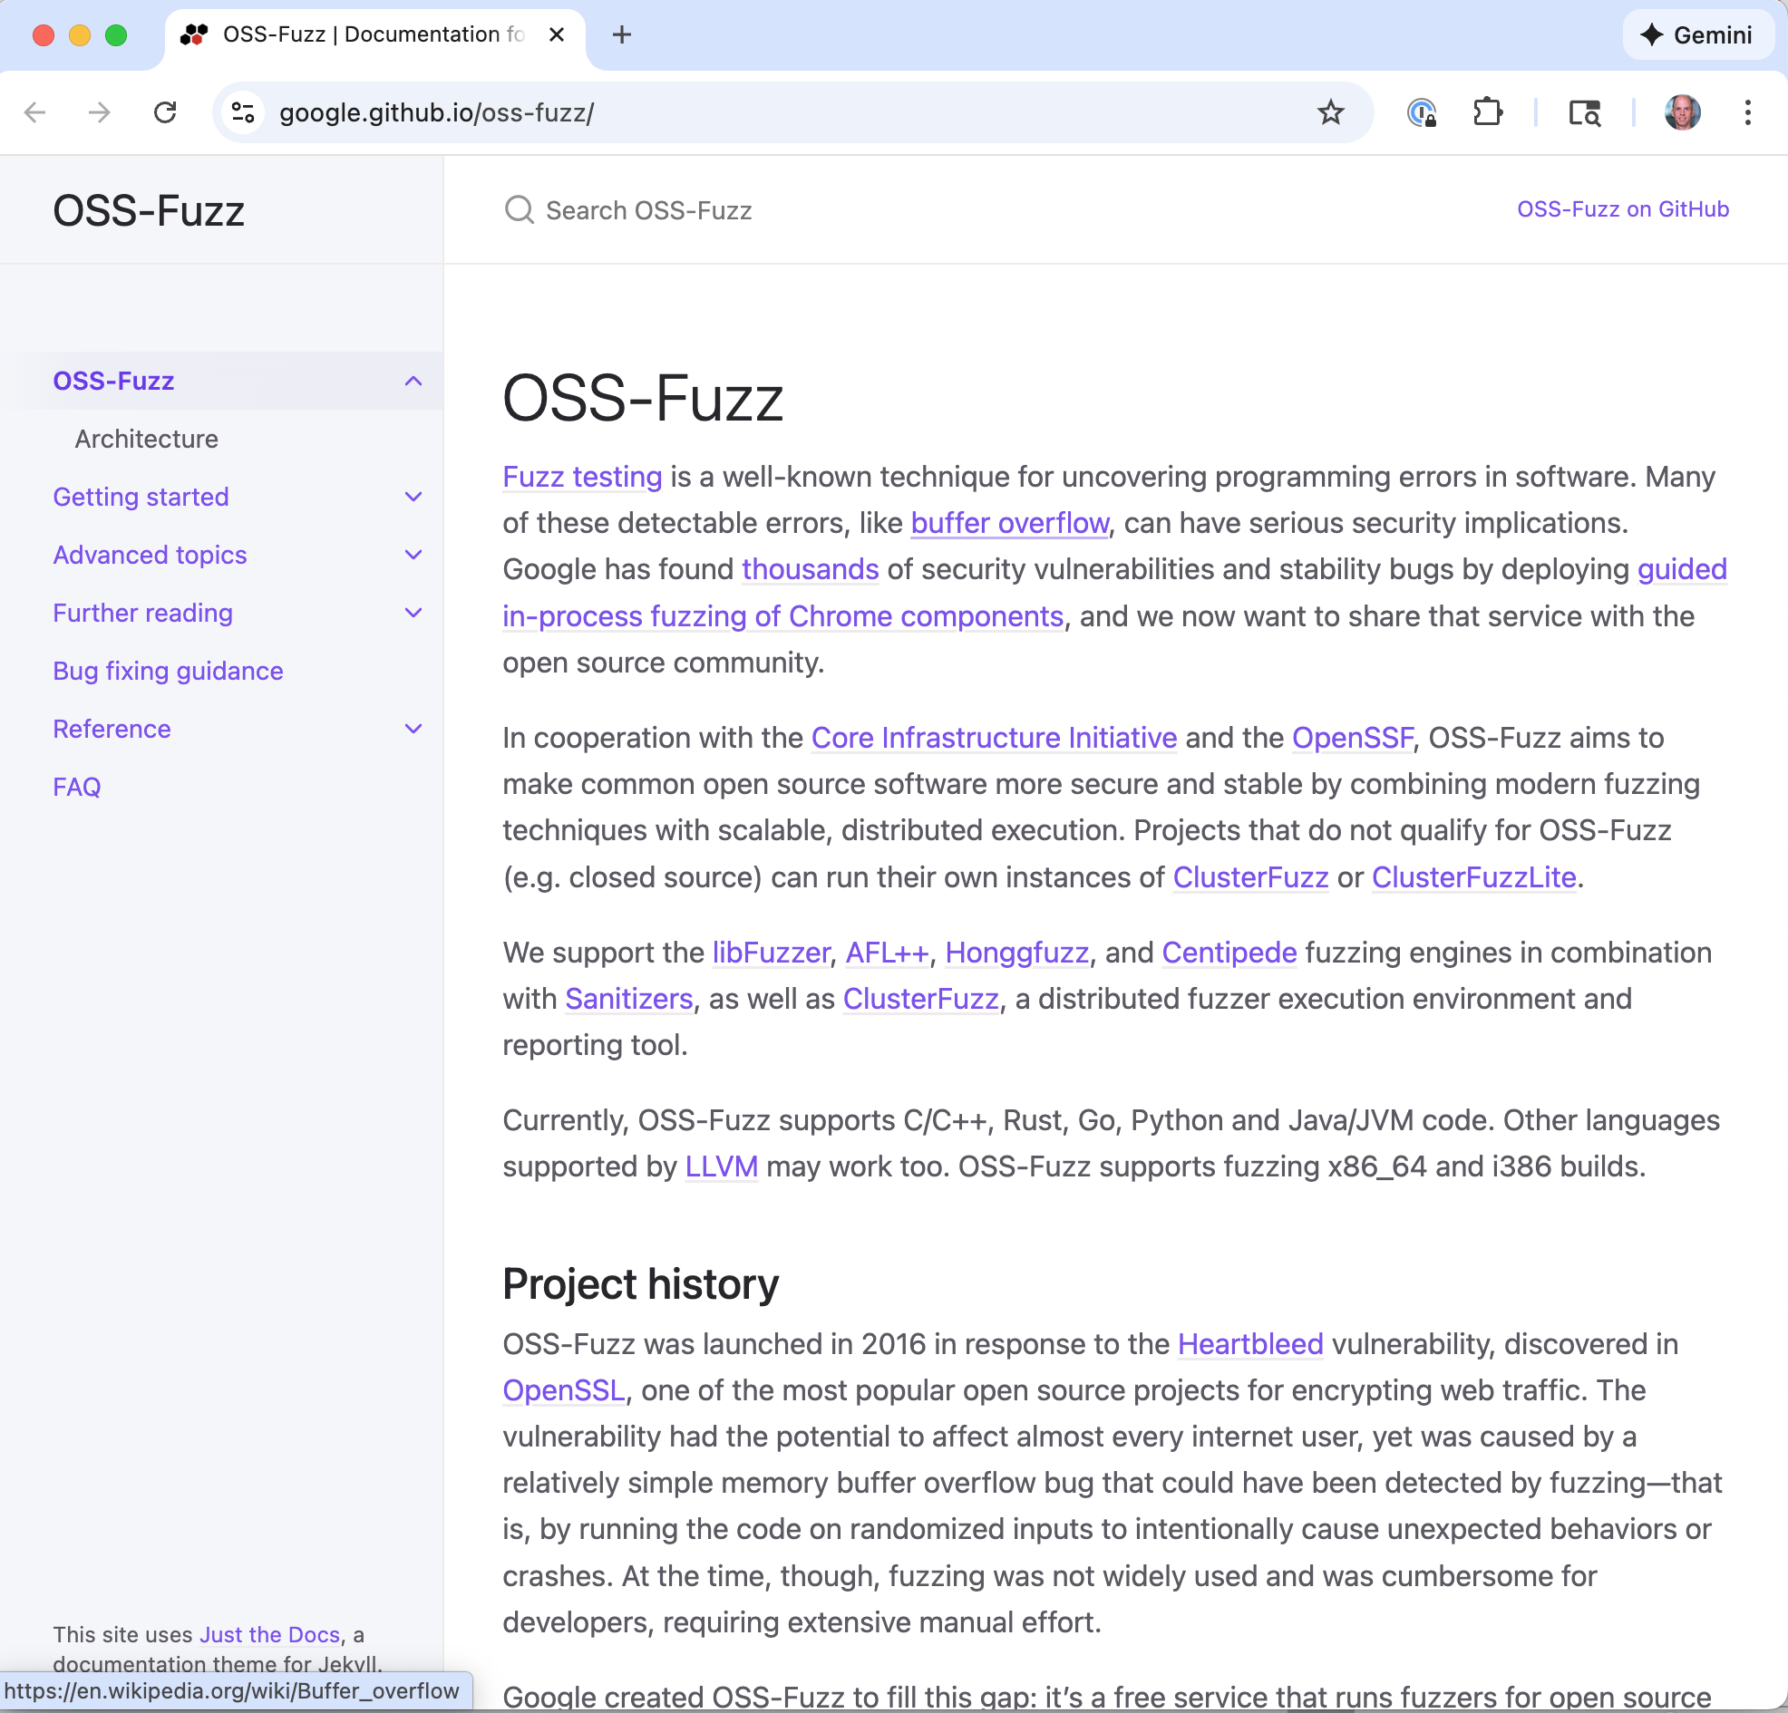
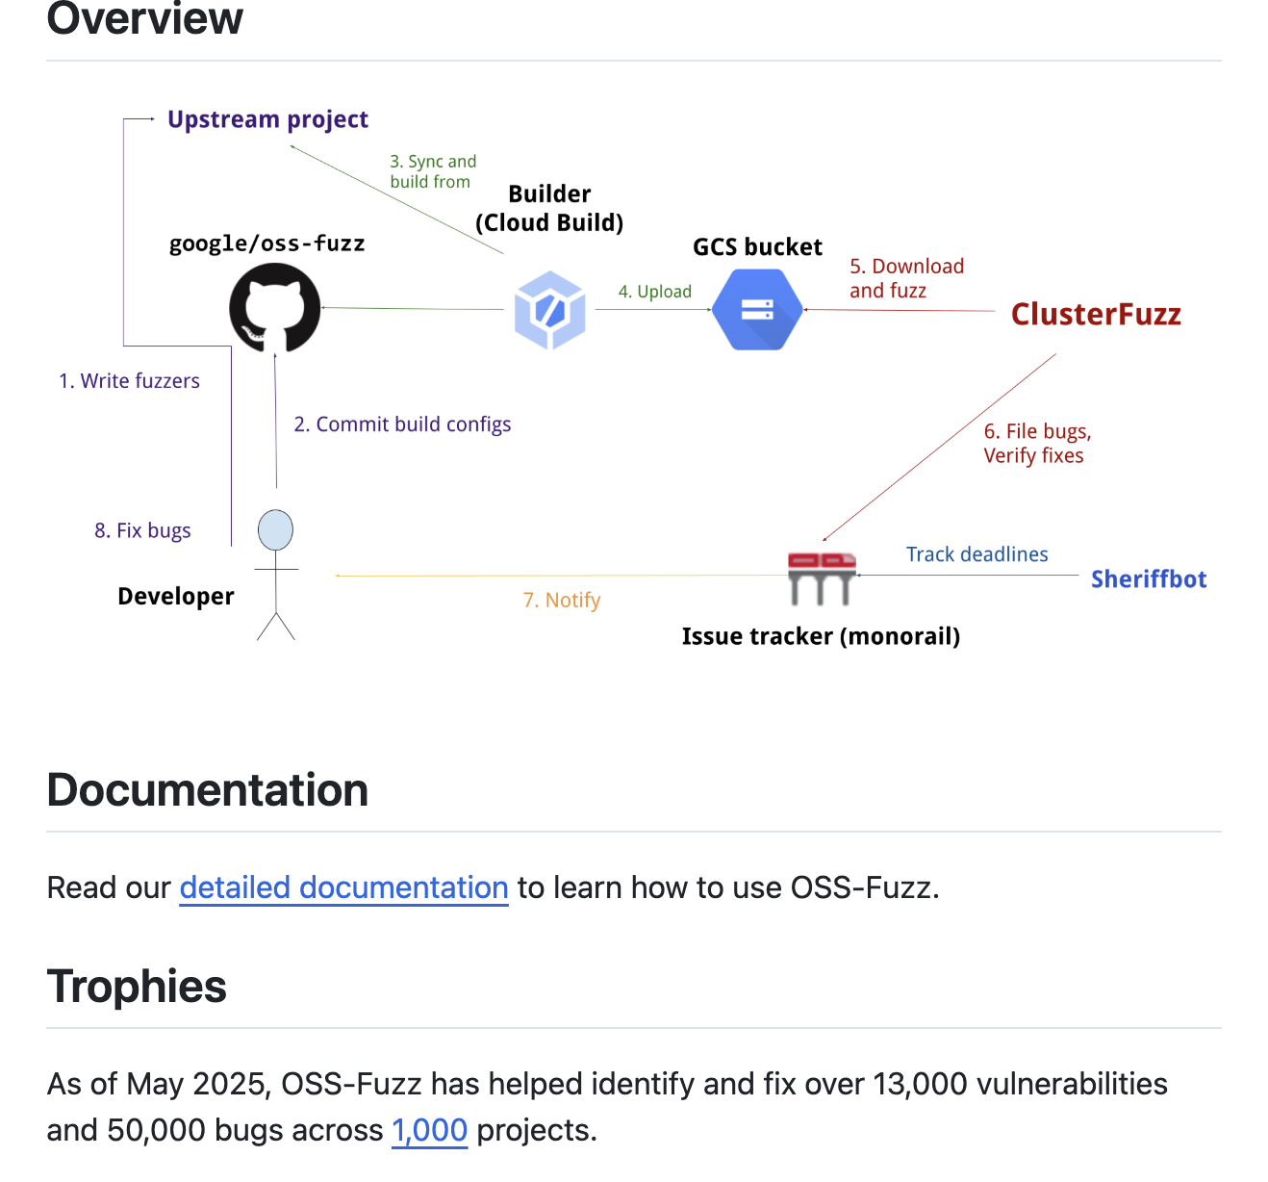
OSS-Fuzz

Slide 65
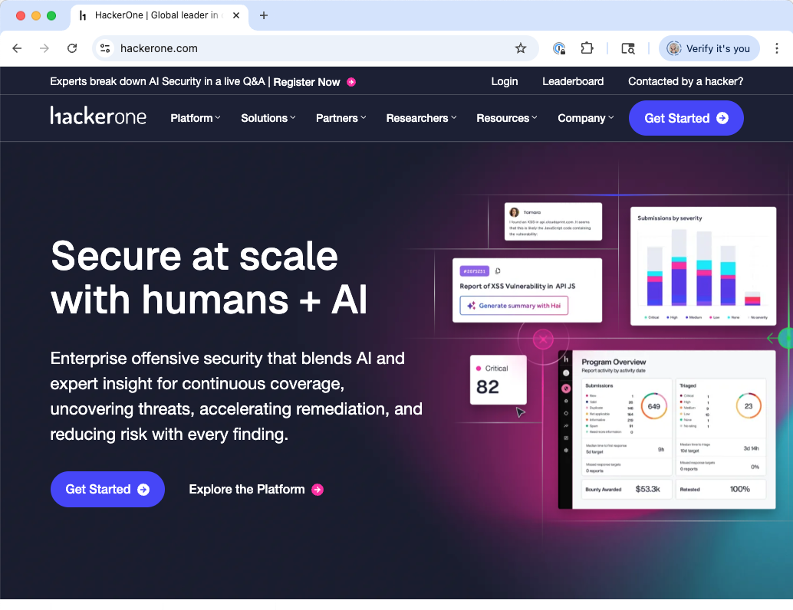

LLMs and GenAI: Game changers

Slide 66
A financially motivated attacker, today:
What platform should I target when developing a RCE exploit?
Answer #1: A highly used platform. The RCE is hard to develop, but I do it I can monetize it via ransomware on lots of users.
Answer #2: Many barely used platforms. The RCEs are easy to develop, which makes up them having fewer users.
Can I boost expected value by targeting attacks, e.g., not just doing generic ransomware?
Each user surely has things they are willing to pay more for!
In practice, it’s always answer #1 and ‘no’: even easy-to-develop RCEs have a high cost, and targeting attacks makes that cost higher.

Slide 67

Value proposition to attacker, with LLMs
value = (profit per exploit) * (number impacted)
- (cost to find vulnerability + cost to develop attack)
So, can we use LLMs to do any of the following?
Increase expected profit
Increase the number of expected users
Decrease the cost to find a vulnerability
Decrease the cost to develop an attack with it

Slide 68
Operators
contract services
Insurers
Users
Regulators
mutually influence
directly affect
Attackers
contract services
Builders
Cyber Builders
Notes
Relationships induce incentives
(Cyber)builders are users and operators too!

Slide 69
,
Regulators
Insurers
Governance organizations define and enforce the rules of the game
Government regulators (FTC, SEC, CISA, EU regulatory bodies …)
Standards organizations (NIST, ISO, OWASP, …)
Laws: HIPAA, FERPA, PCI, …
Insurance and financial intermediaries help manage cyber risk (effectively setting rules of their own)
Cyber insurance providers (Chubb, etc.)
Credit rating agencies
Investment firms (which may take into account cybersecurity posture)

Slide 70


Cyber insurance: Elevating evidence?

Slide 71


Bug bounty programs
Google has one, Microsoft too, and so does Amazon (via HackerOne)
Notes:
What are these programs? Pay “security researchers” for bugs

Slide 72



2024 Google rewards
Much bigger than in 2013!
$6.5M in 2019 for 461 researchers = $14,100 per person
$11.8M in 2024 for 660 researchers = $16,939 per person
In early 2013, $1,000 - $3,133.7 (max) paid per vulnerability per Finifter et al, “An Empirical Study of Vulnerability Rewards Programs,” USENIX 2013.

Slide 73


Android and devices
Awarded over $3.3 million total
8% decrease in the total submissions
2% increase in the number of critical and high vulnerabilities

Slide 74

Readings for next week
Plus: “How to Read a Paper?”

