Slide 1


Secure Systems Engineering and Management
A Data-driven Approach
Michael Hicks
Secure Design:
Principles and Controls (part 2)
Controlling Access, Limiting Damage, Detecting Attacks
UPenn CIS 7000-003
Spring 2026

Slide 2
From Threats to Mitigations
We enumerate threats against our security objectives using STRIDE.
For each threat, we propose a response: a control and implementation guidance.
These two lectures build the technical vocabulary and the design thinking for that.
Notes:
Connect to where students are: they’ve done the SbD lecture, learned threat modeling with STRIDE, and are working on their own threat models (GlucoGuard). These lectures answer the next question: once you’ve found a threat, what do you actually build to stop it?
Recall the four response strategies: mitigate, eliminate, transfer, accept. Most of our time focuses on mitigation through design – the controls you build into the system.

Slide 3
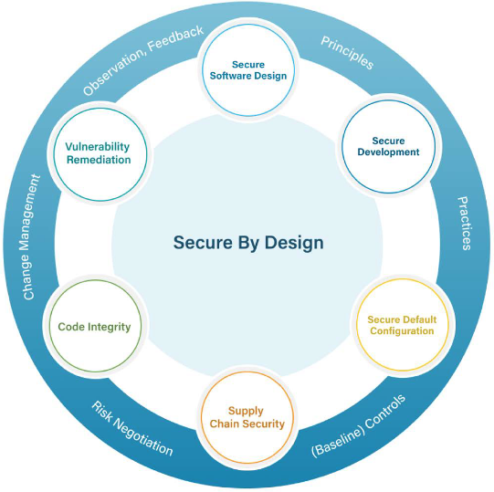
Recall: Security Objectives
Requirement | Definition
Confidentiality | Protect information from unauthorized disclosure
Integrity | Protect information from unauthorized modification
Availability | Provide access when required
Accountability | Non-repudiation via permanent audit records
Requirements expressed in terms offered by these features
Feature | Intent
Authentication | Reliably identifying users
Authorization | Granting access based on roles and rights
Notes:
These are the fundamental security requirements from the paper (p.9). Every system needs to think about all four, but the relative priority depends on the system.
For our CMS:
- Confidentiality is critical: student grades, FERPA-protected records, personal information. A breach here has legal consequences.
- Integrity is critical: if grades can be tampered with, the academic system breaks down. This includes both malicious tampering (a student changing their grade) and accidental corruption.
- Availability matters especially at peak times: during registration, exam periods, assignment deadlines. A system that goes down during finals week has real consequences.
- Accountability is essential: if a grade is changed, there must be an immutable record of who changed it and when. This protects both students and instructors.
For a different system – say, a hospital monitoring system – availability might dominate (lives depend on it). For a voting system, integrity is paramount. The priorities shape everything that follows.

Slide 4









Security Principles Underlying Controls
Prevention
Harm reduction
Detection &
recovery
Eliminate defects entirely
Limit damage from unknown defects
Identify attacks and undo damage
Notes:
“Harm reduction” is what other frameworks sometimes call “mitigation at the design level.” We use a different word to avoid confusion with threat-level mitigation (the response to a specific threat in a threat model).
As we go through topics, we’ll tag each with its category so students can see how the categories work together.

Slide 5
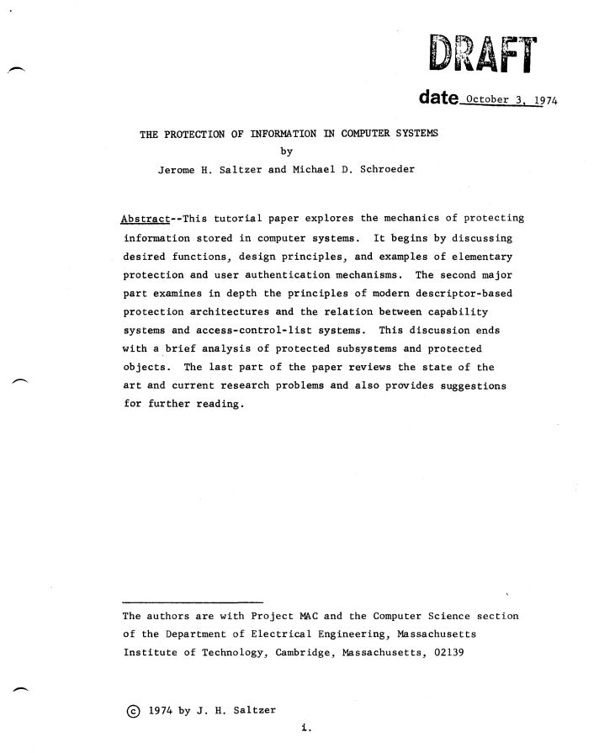
Secure Design Principles
Favor simplicity
Use fail-safe defaults
Do not expect expert users
Trust with reluctance
  Small trusted computing base
  Grant least privilege
  Compartmentalize
  Promote privacy
Defend in depth
Use community resources
Monitor and trace
Economy of mechanism
Fail-safe defaults
Psychological acceptability
(several S&S principles)
  Least common mechanism
  Least privilege
  Least privilege (again)
  (modern addition)
Separation of privilege
Open design
Compromise recording
Notes:
This is our reorganization of Saltzer & Schroeder’s 1975 principles plus modern additions. Post this slide or hand it out – students will reference it throughout both lectures and when working on their threat models.
The table shows how the classical S&S principles map to our three categories. Some principles span categories (e.g., “trust with reluctance” is both prevention and harm reduction).

Slide 6
Outline
Last time (part 1)
Confidentiality (by encryption)
Authentication – proving identity
Four principles:
  Do not expect expert users
  Fail-safe defaults
  Favor simplicity
  Defend in depth (throughout)
Techniques
TLS, BLE security, AES-GCM, key management
Argon2id, MFA, IdPs, mTLS
Password managers, FIDO2
Secure defaults, break glass, graceful degradation
Minimal APIs, boring technology
Today (part 2)
Authorization
Integrity and Accountability
Remaining principles:
  Trust with Reluctance (all)
  Monitoring and Traceability
  Putting it all together
  Use community resources

Slide 7
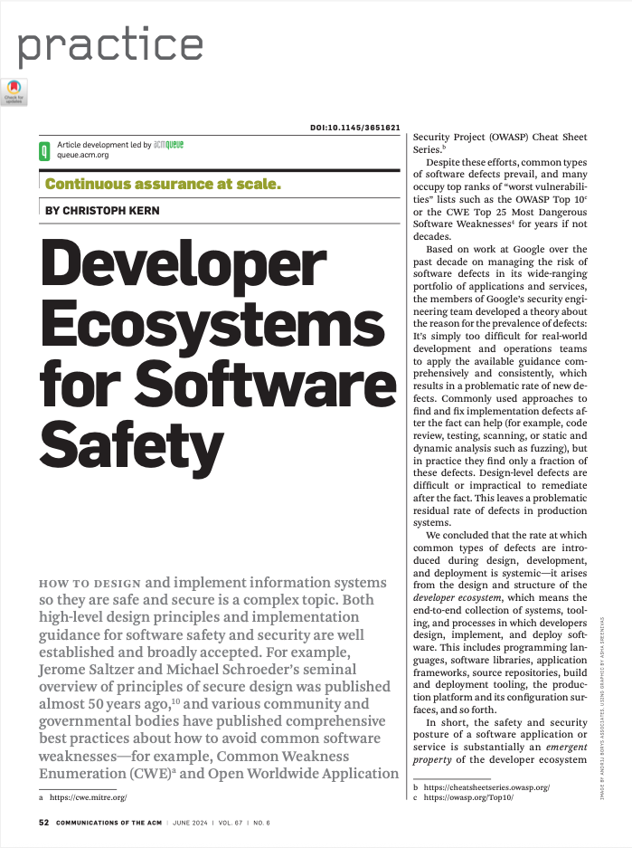
Interlude

Slide 8
Why Guidance Alone Doesn’t Work
“It’s simply too difficult for real-world dev and ops teams to apply the available guidance comprehensively and consistently.”
Two reasons
Developer vigilance doesn’t scale
After-the-fact tools are incomplete
Do not expect expert users
Notes:
This connects directly to the “Don’t expect expert users” principle from Lecture 1 – but applied to developers. Developers are also users of the security ecosystem. Expecting them to consistently apply complex, context-dependent rules across a large codebase doesn’t work, even when they understand the rules.
When a codebase has hundreds of places where an untrusted string could reach a SQL query, expecting developers to get it right every single time is unreasonable.
Kern gives a vivid example: a developer fixing a memory leak in C++ adds a deallocation statement, not realizing that code elsewhere in the program still holds a pointer to the object. The developer followed the rule (“free memory when done”) correctly in their local context, but introduced a use-after-free vulnerability because of implicit assumptions connecting distant parts of the codebase.
Static analysis, fuzzing, and code review find only a fraction of defects. They can’t reduce the rate at which new defects are introduced.
The after-the-fact tools point is important: SAST and DAST can help, but they are “computationally intensive and too slow to apply after a code change is written but before it is committed.” They can catch some bugs, but they cannot change the rate at which bugs are created.

Slide 9
The Ecosystem Thesis
“The safety and security of a software application or service is substantially an emergent property of the developer ecosystem that produced it.”
Programming languages, libraries, frameworks, build tooling, deployment infrastructure, configuration surfaces.
To improve security, redesign the ecosystem, not just the guidance.
Notes:
This is the paper’s central thesis. The rate of defects isn’t a property of individual developers or individual applications – it’s a property of the ecosystem those developers work in. If the ecosystem makes it easy to introduce XSS, you will get XSS, no matter how many training courses you run.
This reframing has a powerful practical consequence: instead of trying to educate thousands of developers to avoid each vulnerability class, you can invest in the ecosystem once and benefit all applications built within it.
This is the “shift left” idea taken to its logical conclusion: shift security responsibility from individual application developers to the ecosystem designers.

Slide 10
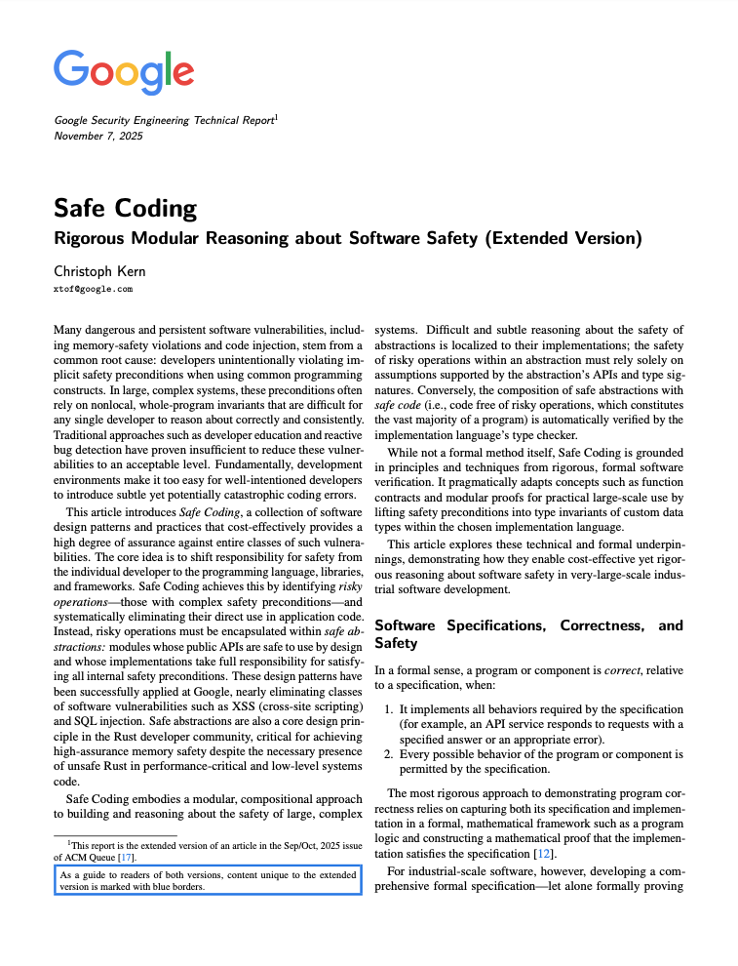
Strategy 1: Safe Coding
Make the ecosystem prevent entire classes of bugs through language design, type systems, and safe abstractions.
Notes:
Walk through each row:
Memory safety: C/C++ places the onus on developers to ensure every pointer dereference is valid and in-bounds. When millions of lines of code are written in such a language, there will be defects. Memory-safe languages remove this burden entirely – Java and Go use garbage collection; Rust uses ownership and lifetime types checked at compile time.
SQL injection: The traditional advice is “use parameterized queries.” But an API that accepts a plain String for SQL allows the developer to concatenate user input directly. Kern’s approach: the API for Google’s Spanner database accepts only values of type TrustedSqlString, which can only be constructed from trusted query fragments and parameter binding. Arbitrary strings cannot be passed – “the TrustedSqlString builder API simply has no append method that accepts arbitrary String-typed values.”
XSS: Instead of teaching developers to escape untrusted input in every context (HTML, JavaScript, CSS, URL – each with different rules), use a template system that auto-escapes by default, and a SafeHtml type that can only be created through safe builder APIs.
The pattern: replace a rule developers must follow with a mechanism that makes violation impossible (or at least detectable at compile/build time).

Slide 11
Strategy 1: Safe Coding
Defect Class | Guidance Approach | Safe Coding Approach
Memory corruption | “Don’t access freed memory” (SEI CERT) | Use a memory-safe language (Rust, Go, Java)
SQL injection | “Always use parameterized queries” (OWASP) | API accepts only TrustedSqlString, not String
XSS | “Always escape untrusted input” (OWASP) | Template system auto-escapes; SafeHtml type enforced
From “developers must remember”
to “the compiler/ framework enforces.”
Notes:
Walk through each row:
Memory safety: C/C++ places the onus on developers to ensure every pointer dereference is valid and in-bounds. When millions of lines of code are written in such a language, there will be defects. Memory-safe languages remove this burden entirely – Java and Go use garbage collection; Rust uses ownership and lifetime types checked at compile time.
SQL injection: The traditional advice is “use parameterized queries.” But an API that accepts a plain String for SQL allows the developer to concatenate user input directly. Kern’s approach: the API for Google’s Spanner database accepts only values of type TrustedSqlString, which can only be constructed from trusted query fragments and parameter binding. Arbitrary strings cannot be passed – “the TrustedSqlString builder API simply has no append method that accepts arbitrary String-typed values.”
XSS: Instead of teaching developers to escape untrusted input in every context (HTML, JavaScript, CSS, URL – each with different rules), use a template system that auto-escapes by default, and a SafeHtml type that can only be created through safe builder APIs.
The pattern: replace a rule developers must follow with a mechanism that makes violation impossible (or at least detectable at compile/build time).

Slide 12
The Results: Near-Zero Defect Rates
At Google, Safe Coding eliminated XSS and SQL injection as practical concerns:
Before: Tens of XSS vulnerabilities per year in each large web app. After: Residual XSS across all framework-based applications in the “low single digits”
SQL injection: “essentially a nonissue” in the Google internal codebase
Notes:
How? A small team of security engineers maintains Safe Coding libraries, framework components, and conformance checks – serving many thousands of web application developers.
This is the existence proof that the approach works. The numbers are striking: not just a reduction, but near-elimination of vulnerability classes that have been in the OWASP/CWE top lists for decades.
The cost model is important: a small team builds and maintains the safe ecosystem, and the benefit scales across all applications. This is far more efficient than training every developer and reviewing every application.
The Google Photos web frontend, for example, has never had any XSS vulnerability reported over its entire lifetime.
Note: this doesn’t mean zero residual risk. Some “legacy” applications that predate the framework, or use components not yet refactored to conform to the safe-types discipline, still have a small residual rate. But the trajectory is clear.

Slide 13
Strategy 2: Securing Application Archetypes
Many applications share a common architecture – a software archetype:
“Web frontend + microservices + SQL database”
“Mobile app + API server + backend services”
The threat models for each archetype substantially overlap.
Develop controls in the framework.
Which transport protocol?
How to authenticate/authorize requests?
How to encrypt data at rest?
How to handle sessions?
Notes:
This is the second key strategy. Instead of each product team developing its own threat model from scratch and designing its own mitigations, you identify common architectural patterns and build frameworks that address the common threats.
For example, the safety and security design of almost any web application must consider: protecting network traffic (TLS), authenticating and authorizing requests, protecting data confidentiality and integrity, and deleting user data when required. These considerations are common to the archetype, not specific to any one app.
At Google, frameworks and platforms encode these decisions. Application developers build on the framework and inherit its security properties. Security experts focus their limited bandwidth on the framework, where improvements benefit hundreds of applications.
This also enables rapid deployment of new mitigations: when a new attack class emerges, the framework team can roll out a fix to all framework-based applications, often without any involvement from the individual application teams.
Ask the class: “Think about the CMS and payment app examples. What aspects of their threat models are common to all web applications? What aspects are specific to the CMS or payment app?”

Slide 14
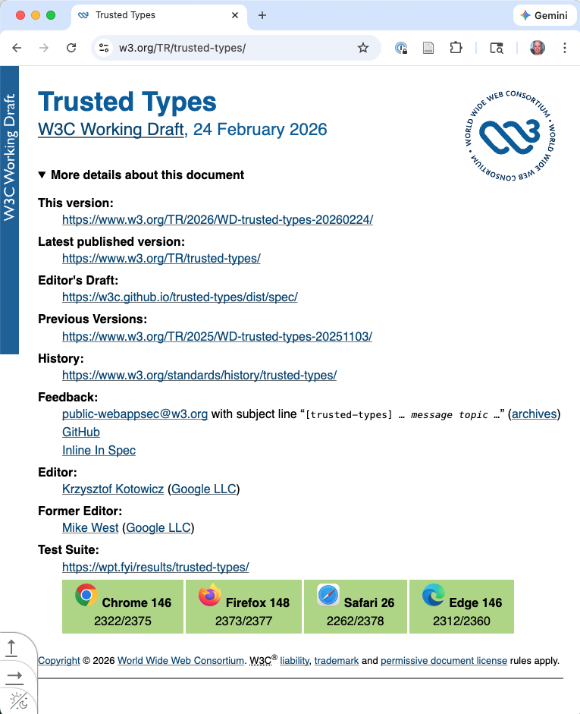
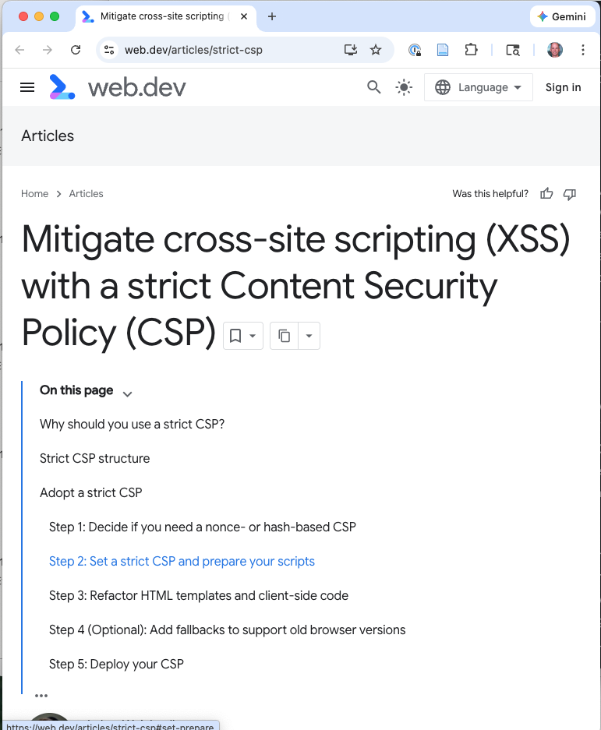
Scaling Security Through Frameworks: Evidence
The result: Thousands of applications. Near-zero residual XSS.
Framework-Level Action | Scale
Services newly enforcing Trusted Types (XSS prevention) | 176
JS builds with safe-coding conformance checks on all transitive dependencies | 1,079
Legacy DOM XSS sink assignments removed | 438
Services enforcing strict Content Security Policy | 900+
Adoption on tier-0 services (Gmail, Docs, Meet, Photos, …) | >75%
Notes:
These numbers come from Google’s “A Recipe for Scaling Security” blog post. They illustrate the leverage of the archetype/framework approach: a small security team can achieve these numbers because the security properties are built into the framework, not into each application.
Trusted Types is a W3C browser API (referenced in Kern’s paper as reference 7) that enforces type safety at the DOM level: the browser itself rejects plain strings passed to dangerous DOM APIs like innerHTML, requiring Trusted Types instead. This is Safe Coding enforced by the browser platform.
Content Security Policy (CSP) with nonces prevents inline script injection – even if an attacker manages to inject HTML, the browser won’t execute scripts that don’t have the correct nonce.
The key insight for students: these are not application-level decisions. They’re framework-level and platform-level decisions that benefit every application built on that framework. This is Kern’s archetype approach in action.
Source: “A Recipe for Scaling Security,” Google Bug Hunters blog (bughunters.google.com/blog/5896512897417216).

Slide 15
Outline
Today (part 2)
Authorization
Integrity and Accountability
Remaining principles:
  Trust with Reluctance
  Monitoring and Traceability
  Putting it all together
  Use community resources
As we go, consider:
Rather than expecting every developer to get this right, how would you build an ecosystem that makes the wrong thing impossible?
Notes:
This slide sets up the through-line for the rest of the lecture. Every topic we cover has both a “guidance” version (what developers should do) and an “ecosystem” version (how the framework/platform can enforce it). We’ll cover both, using Kern’s framing to understand why the ecosystem approach is often more effective.
Students should be thinking about this for their GlucoGuard projects: for each mitigation they propose, is it something that depends on individual developer vigilance, or is it enforced by the architecture?

Slide 16
Authorization – Controlling Access

Slide 17
From Authentication to Authorization
Last time: Authentication – protecting data and proving identity.
Today: Authorization – once you know who someone is, what should they be allowed to do?
Primary STRIDE threat: Elevation of Privilege
Notes:
This is the bridge from Lecture 1. Authentication is the prerequisite; authorization is where the security policy is actually enforced.
CMS authorization problem: students, TAs, instructors, admins – each with different permissions, scoped to different courses and sections.
Payment app: users can only operate on their own accounts; support staff can view but not transfer; no one can exceed daily limits.
Getting authorization wrong: a student sees every other student’s grades (FERPA violation); a payment app user transfers money from someone else’s account.

Slide 18


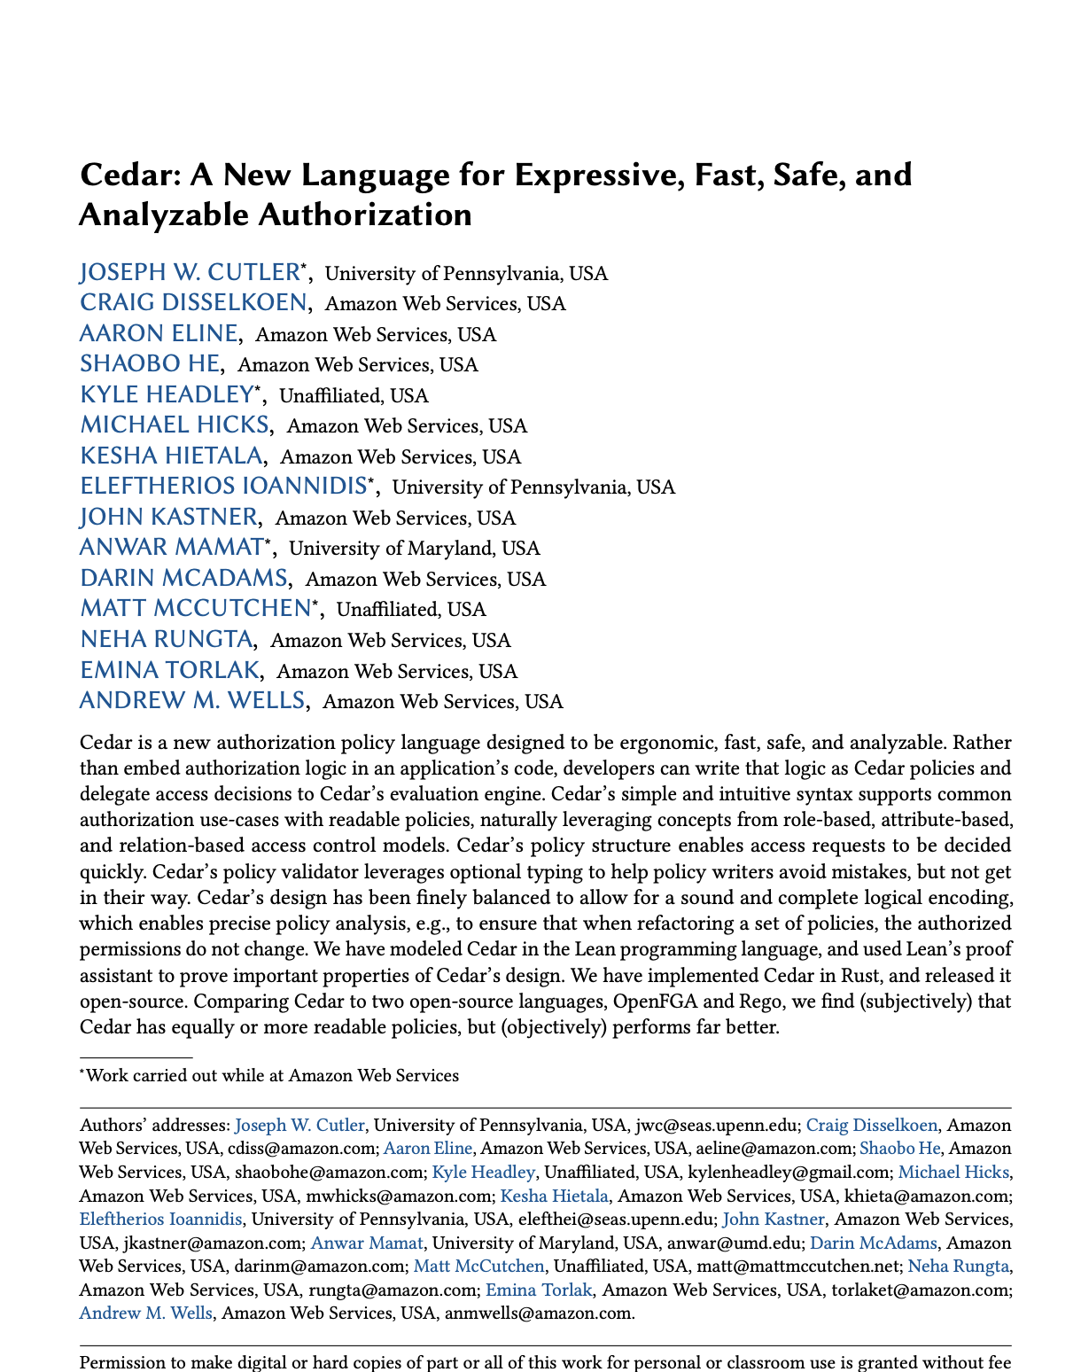
Cedar: A Modern Authorization Policy Language
Used in 30+ Amazon services and applications
and by Cloudflare, Cloudinary, MongoDB, Salesforce, StrongDM
Part of the
Open source at https://github.com/cedar-policy
4M
Downloads
1,400+
Stars
Notes:
Cedar was developed by AWS and is used in Amazon Verified Permissions. It’s open-source and has been formally verified (its authorization engine has been proven correct using automated reasoning tools).
Key benefits of an explicit policy language: policies are auditable (a reviewer can read them), testable (you can write unit tests for policies), and separate from application code (changing a policy doesn’t require a code deploy). The authorization logic becomes part of the trusted computing base, and Cedar keeps that piece simple and inspectable.
Cedar isn’t the only option (Open Policy Agent/Rego, Casbin, etc.), but the pattern is the important thing: make authorization logic explicit and centralized, not scattered across route handlers.

Slide 19
Role-Based Access Control (RBAC)
permit (
principal in Role::"admin",
action, // all actions
resource);
permit (
principal in Role::"TA",
action == Action::"SetGrade",
resource);
TA
in: transitive membership
admin
instructor
👱🏼‍♀️
🧔🏽‍♂️
👩🏽‍🦳
🧑🏻‍🦱
emma
andrew
kesha
aaron
Notes:
Assign permissions to roles, assign roles to users.
CMS roles: student, TA, instructor, admin
RBAC is a good starting point and is sufficient for many simple applications. But real-world authorization often depends on the relationship between the user and the specific resource being accessed, not just the user’s role.
But notice: a TA shouldn’t see grades for all sections, only their assigned one.
Pure RBAC doesn’t capture relationships.
This limitation is what leads to attribute-based and relationship-based access control models.

Slide 20
Attribute-Based Access Control (ABAC)
permit (
principal in Role::"admin",
action, // all actions
resource);
permit (
principal in Role::"TA",
action == Action::"SetGrade",
resource)
when {
context.now <
resource.course.freezeDate
};
TA
admin
instructor
👱🏼‍♀️
🧔🏽‍♂️
👩🏽‍🦳
🧑🏻‍🦱
emma
andrew
kesha
aaron
instructor:
User::"aaron"
TAs: [ …
User::"kesha” ]
freezeDate: …
course:
Course::"CIS7000"
dueDate:
29-March-2026
Course::
"CIS7000"
Assignment::
"Project1"

Slide 21
Relationship-Based Access Control (ReBAC)
permit (
principal in Role::"admin",
action, // all actions
resource);
permit (
principal in Role::"TA",
action == Action::"SetGrade",
resource)
when {
context.now <
resource.course.freezeDate
}
when {
principal in
resource.course.Tas
|| principal ==
resource.course.instructor
}
TA
admin
instructor
👱🏼‍♀️
🧔🏽‍♂️
👩🏽‍🦳
🧑🏻‍🦱
emma
andrew
kesha
aaron
instructor:
User::"aaron"
TAs: [ …
User::"kesha” ]
freezeDate: …
course:
Course::"CIS7000"
dueDate:
29-March-2026
Course::
"CIS7000"
Assignment::
"Project1"
Notes:
ReBAC (Relationship-Based Access Control) specifically focuses on relationships between entities. These relationships are not captured by roles alone – they depend on the specific resource being accessed.
The distinction matters because it changes how you think about policy: instead of “TAs can grade” (role-based), you get “TAs can grade submissions in sections they’re assigned to” (relationship-based). The latter is what you actually want, and expressing it requires knowing the relationship between the TA and the section.
Google’s Zanzibar system (used for Google Drive, YouTube, etc.) is a large-scale ReBAC system.

Slide 22
Cedar: CMS Examples
TA can view and grade submissions for their assigned section:
permit (
principal is User,
action in [Action::"ViewGrades", Action::"GradeSubmission"],
resource is Section
) when {
principal in resource.assigned_TAs
};
Instructor can manage grades for their courses:
permit (
principal in Role::"Instructor",
action in [Action::"ViewGrades", Action::"EditGrades",
Action::"ManageTAs"],
resource is Course
) when {
principal in resource.instructors
};
Notes:
Walk through the first policy: “A user (principal) is permitted to view grades or grade submissions (actions) on a section (resource) when the principal is in the list of assigned TAs for that section.”
Notice how the relationship is expressed naturally: principal in resource.assigned_TAs. This is ReBAC – the decision depends on the relationship between the user and the specific section.
The second policy shows role + relationship: the principal must be in the Instructor role AND be in the list of instructors for the specific course. This is separation of privilege: two conditions must hold.

Slide 23
Cedar: Payment App Examples
User can transfer from accounts they own, subject to daily limit:
permit (
principal is User,
action == Action::"Transfer",
resource is Account
) when {
principal == resource.owner &&
context.amount <= principal.daily_limit
};
Support staff can view but not transfer:
permit (
principal in Role::"Support",
action == Action::"ViewTransaction",
resource is Transaction
);
forbid (
principal in Role::"Support",
action == Action::"Transfer",
resource is Account
);
Notes:
The transfer policy combines relationship-based access (principal == resource.owner) with attribute-based constraints (context.amount <= principal.daily_limit). This is ABAC and ReBAC working together.
The support staff example shows Cedar’s forbid construct. Even if some other policy might permit a support agent to transfer (perhaps through a role inheritance), this explicit forbid blocks it. In Cedar, any forbid overrides any permit – this is the fail-safe default at work.
The explicitness is the key benefit: a security reviewer can read these policies and understand exactly who can do what. Compare this to authorization logic scattered across dozens of route handlers in application code, where understanding the full policy requires reading thousands of lines.

Slide 24

Delegation and Consent
Sometimes a user must grant another access:
Payment app: user authorizes a financial
advisor to view transactions
CMS: instructor delegates grading to a TA
Delegated access should be:
Scoped – only this section/account
Time-bounded – only this semester
Revocable – grantor can remove it
Audited – logged
Design question: What if the delegating user’s own access is revoked?
→ Cascading revocation.
Notes:
Delegation introduces transitive trust: if Alice delegates to Bob, and Alice’s access is revoked, Bob’s delegated access must also be revoked. Failing to cascade revocation is a common authorization bug.
OAuth 2.0 scopes are a practical implementation of delegated, scoped access: when you authorize a third-party app to access your Google account, you grant specific scopes (read email, manage calendar) for a limited time, and you can revoke the grant at any time.
For the CMS: when a TA is delegated grading authority by an instructor, and that instructor is removed from the course, the TA’s delegated authority must also be removed. This requires the system to track the delegation chain.

Slide 25
Complete Mediation
S&S: Every access to every object must be checked
Example failure: Insecure Direct Object Reference (IDOR)
CMS: /api/students/1042/grades – change 1042 to 1043 and see someone else’s grades
Payment app: /api/accounts/5678/balance – change the account ID
Notes:
Complete mediation is one of the most violated principles in practice. It’s easy to add an authorization check to the “main” endpoint and forget the export endpoint, the bulk-download endpoint, the admin API, the GraphQL query, the WebSocket channel.
IDOR (Insecure Direct Object Reference) is consistently in the OWASP Top 10 and is one of the most commonly reported vulnerabilities in bug bounty programs. The pattern is simple: the application uses a user-controlled identifier (student ID, account number, file name) to look up a resource without verifying that the requesting user is authorized to access that specific resource.
Mitigation: use indirect references (map a per-session opaque token to the actual resource ID) or, more commonly, add an authorization check on every single data access that verifies the requesting user’s relationship to the resource.

Slide 26
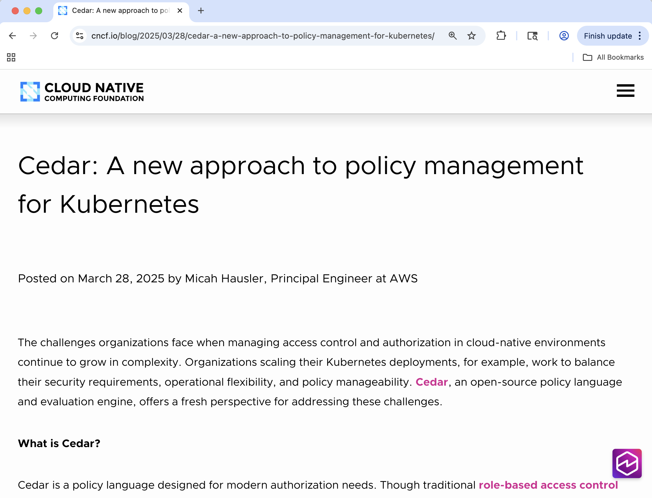
Ecosystem Assistance
Risk: With 50 route handlers, each implementing its own authorization check, real chance to get it wrong.
With platform help: One policy engine, enforced on every request by the infrastructure. Developers write declarative policies; Kubernetes enforces them.
Notes:
This is a good moment to connect Kern’s archetype idea to something concrete. Cedar on its own is a policy language — you still need something to evaluate the policies on every request. That “something” is the platform.
Kubernetes now supports Cedar as an authorization webhook (see cedarpolicy.com/blog/cedar-for-kubernetes).

Slide 27
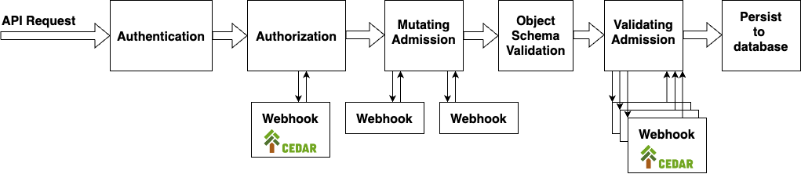
Ecosystem Assistance
https://www.cedarpolicy.com/blog/cedar-for-kubernetes
Notes:
Every API request to the Kubernetes API server — creating a pod, reading a secret, scaling a deployment — passes through the authorization layer. Cedar policies are evaluated by the webhook before the request is allowed. No application code is involved in the authorization decision.
This is Kern’s archetype approach: authorization is a concern common to all applications running on the cluster. Instead of each application implementing its own authorization checks, the platform handles it. Security experts write and maintain the Cedar policies; application teams don’t need to think about authorization enforcement at all.
The TCB shrinks from scattered application code to the Kubernetes API server + the Cedar webhook — a much smaller surface to audit and verify.
The same pattern applies to our CMS and payment app examples: if both run on Kubernetes, they inherit the platform’s authorization enforcement without writing any authorization code themselves.
Ask: “Which approach would you trust more for your GlucoGuard project? Training every developer to check permissions, or having the platform enforce policies on every request?”

Slide 28



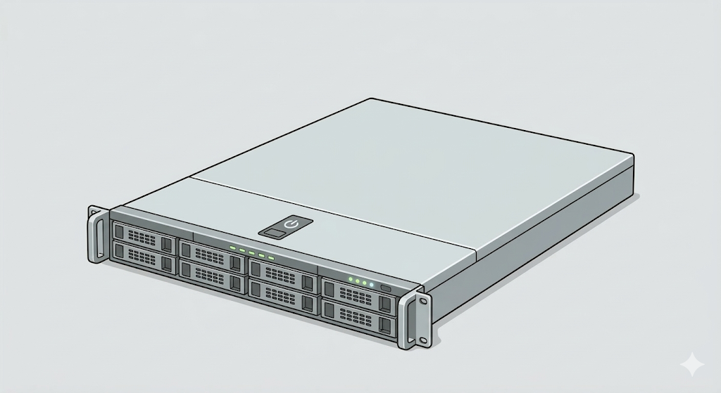

Server-Side Enforcement
Authorization must be enforced on the server, not just in the client UI.
Notes:
This is one of the most commonly violated security principles. Many web applications enforce authorization by hiding or disabling UI elements – not showing the “delete” button if the user isn’t an admin, for example. But anyone with browser developer tools or a tool like curl can call the API endpoint directly.
Client-side enforcement is a usability feature (don’t confuse users with buttons they can’t use) but it is NOT a security feature. Every authorization decision must be made on the server, where the attacker cannot bypass it.

Slide 29
Server-Side Enforcement
Authorization must be enforced on the server, not just in the client UI.
Rule: the UI is for usability; the server is for security.
Notes:
This is one of the most commonly violated security principles. Many web applications enforce authorization by hiding or disabling UI elements – not showing the “delete” button if the user isn’t an admin, for example. But anyone with browser developer tools or a tool like curl can call the API endpoint directly.
Client-side enforcement is a usability feature (don’t confuse users with buttons they can’t use) but it is NOT a security feature. Every authorization decision must be made on the server, where the attacker cannot bypass it.

Slide 30
Fail-safe Defaults and Least Privilege in Authorization
Fail-safe defaults: The default is no access.
CMS: a new instructor has access to zero courses until assigned
Payment app: a new support agent can view no accounts until configured
If the authorization service errors → result is deny, not allow
Least privilege: Each user, component, and API key gets the minimum permissions needed.
CMS: notification service can send emails but can’t read grades
Payment app: push notification service has no access to bank credentials
This limits blast radius when (not if) a component is compromised
Notes:
These two principles work together: fail-safe defaults means you start with nothing and grant explicitly; least privilege means you grant the minimum necessary.
Category: Prevention (fail-safe defaults), Harm reduction (least privilege).
The “when, not if” framing is important. Least privilege is not about preventing compromise – it’s about limiting the damage when compromise happens. If the notification service is compromised, the attacker can spam emails but can’t read grades or modify records. If the analytics pipeline is compromised, the attacker sees anonymized data, not bank account numbers.

Slide 31
Integrity and Accountability

Slide 32
Data Integrity: Input Validation
Every piece of data crossing a trust boundary must be validated
Validate using allowlists, not denylists:
Payment app: Transfer amount must be positive, within balance, below daily limit, at most two decimal places. Reject everything else.
CMS: Allowlist of upload types (.pdf, .docx, .zip) rather than blocklist of dangerous ones (.exe, .bat, .js).
Notes:
Input validation is one of the most fundamental security practices. Every piece of data that crosses a trust boundary – from the user’s browser to the server, from the server to the database, from an external API to your service – must be validated.
The allowlist vs. denylist distinction is critical and maps directly to the fail-safe defaults principle. If you enumerate what’s forbidden, you will miss something. If you enumerate what’s permitted, anything you miss is denied by default.
CMS trust boundaries: student browser → web app (file uploads, form submissions), web app → database (queries), external integrations (plagiarism API, LTI plugins).
Payment app trust boundaries: user device → server (transfer requests), server → bank API (financial instructions).

Slide 33
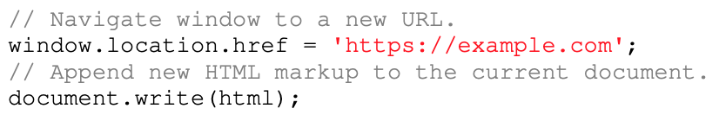
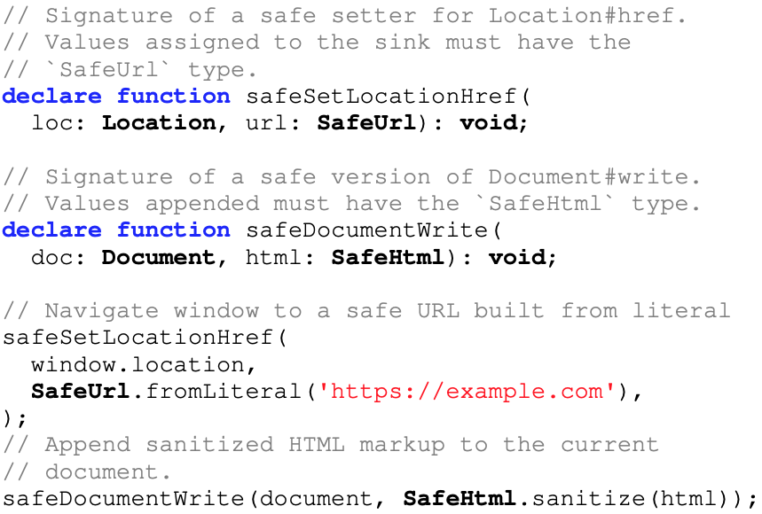
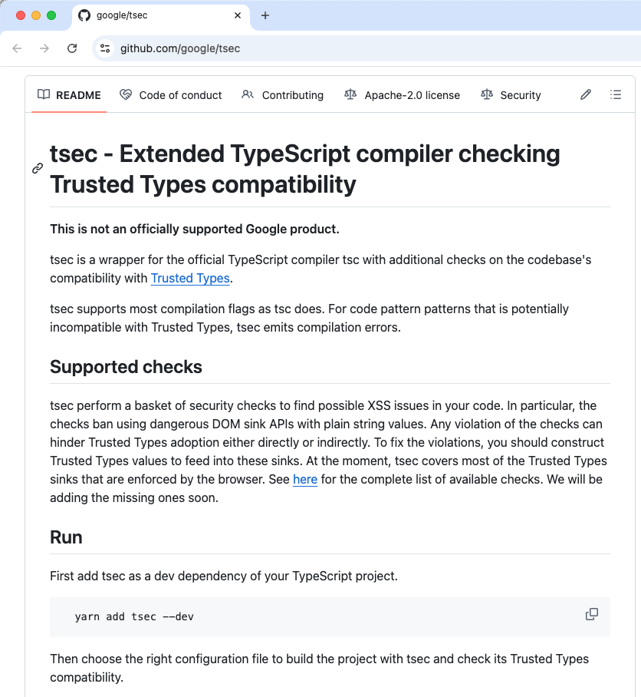
Input Validation in Google Safe Coding
Type error! Requires SafeURL
Type error! Requires SafeHTML
Ok! A literal is a SafeURL
Ok! Surely-sanitized SafeHTML
Notes:
Source: github.com/google/safevalues (TypeScript).
https://storage.googleapis.com/gweb-research2023-media/pubtools/5955.pdf

Slide 34
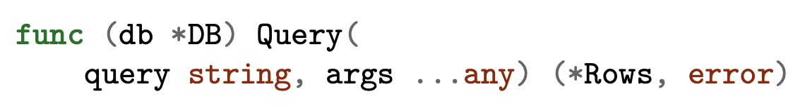
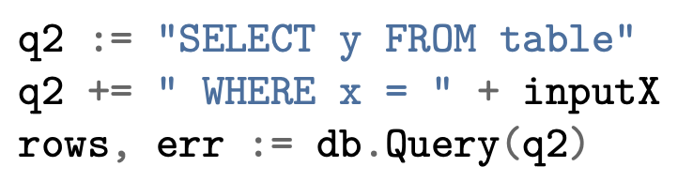
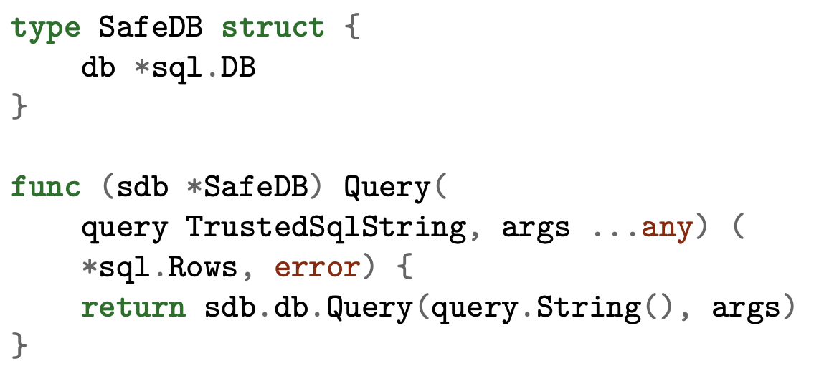
Safe Coding: Parameterized Queries
Risk! Potential SQL injection
Trustworthy wrapper type (e.g., via prep. statements)
Underlying DB call as usual
Notes:
The Java PreparedStatement example is the standard OWASP recommendation. The ? placeholder ensures that username is always treated as a data value, never as SQL code. Even if the username contains SQL metacharacters, they’re escaped by the database driver.
The problem: Java’s JDBC API still allows the unsafe version. Nothing prevents a developer from using string concatenation instead of parameterized queries. The “guidance” approach depends on developers remembering to use PreparedStatement every time.
Kern’s Safe Coding approach goes further: at Google, the Spanner database API accepts only TrustedSqlString values, not plain String. A TrustedSqlString can only be constructed from trusted query fragments (string constants in the source code) and parameter binding. There is no append(String) method – you literally cannot concatenate user input into a query.
This is the difference between “developers should use parameterized queries” and “the API makes non-parameterized queries impossible.” The former is guidance; the latter is ecosystem design.
Reference: OWASP Query Parameterization Cheat Sheet (cheatsheetseries.owasp.org).

Slide 35
Communicated Message Authentication
Beyond encryption, messages need integrity protection: did this data arrive unmodified?
HMAC (Hash-based Message Authentication Code):
Sender and receiver share a secret key
Sender computes HMAC(key, message) and appends it
Receiver recomputes and verifies
Detects any modification
Authenticated encryption (AES-GCM): integrity is built in.
Payment app: transfer instructions to bank API should be authenticated
CMS: webhook callbacks from integrations should include HMAC signatures
Primary STRIDE threat: Tampering
Notes:
If you’re already using encryption, use authenticated encryption (AES-GCM) and you get integrity for free. HMAC is for situations where you need integrity without encryption, or as an additional layer.
The payment app example is critical: a transfer instruction from the server to the bank API must be authenticated so the bank can verify it wasn’t modified in transit. Without message authentication, an attacker who can intercept the communication (even if encrypted) might be able to modify it in ways that change the recipient or amount.
CMS: webhook callbacks from integrations (e.g., plagiarism detection service sends a callback when analysis is complete) should include an HMAC signature so the CMS can verify the callback is genuine and unmodified.

Slide 36

Audit Logging: The Repudiation Threat
STRIDE threat: Repudiation
CMS: an instructor changes a grade. Later there’s a complaint. Without an audit trail, it’s one person’s word against another’s.
Payment app: a user initiates a $500 transfer, then claims “I never authorized that.”
What to log:
Authentication attempts (success and failure)
Authorization decisions (especially denials)
Data modifications
Configuration changes
Notes:
Audit logging serves three purposes: non-repudiation (proving who did what), security investigation (reconstructing what happened during an incident), and regulatory compliance (FERPA for the CMS, financial regulations for the payment app, HIPAA for health data).
CMS: every grade change (who, when, old value, new value), every file access, every role assignment.
Payment app: every transfer (initiator, amount, recipient, timestamp, IP, device fingerprint), every login, every linked-account change.
➔ Overlap with monitoring & detection

Slide 37
Audit Log Properties
Property | Why It Matters
Append-only / write-once | Attacker who compromises system can’t erase their tracks
Timestamped | Reliable clock source for ordering events
Stored separately | Compromise of app server doesn’t compromise logs
Minimal sensitive data | Log “User #1234 transferred $500 to #5678” – don’t log bank account numbers
Designing for observability:
Include correlation IDs (request IDs, trace IDs) so events from different services for the same user action can be linked
Notes:
The separation of log storage from the monitored system is crucial. If an attacker compromises the application server and the logs are stored on the same server, the attacker can delete evidence of their activity. Logs should be shipped to a separate, hardened logging infrastructure (e.g., a SIEM) in near-real-time.
Correlation IDs: in a distributed system, a single user action (e.g., "transfer $500") may touch the authentication service, the authorization service, the payment processor, the notification service, and the database. Without correlation IDs, reconstructing what happened during an incident requires manually matching timestamps and user IDs across multiple log sources.
The "minimal sensitive data" point: audit logs themselves become a target. If the audit log contains bank account numbers, an attacker who compromises the logging infrastructure gets financial data. Log enough to reconstruct events, but not so much that the log itself becomes a sensitive data store.

Slide 38
Trust with Reluctance

Slide 39

The Umbrella Principle
Whole-system security depends on the secure operation of its parts. Those parts are trusted.
Improve security by reducing the need for trust:
use a small trusted computing base,
minimize transitive trust,
reduce privilege with compartmentalization,
promote privacy, and
validate inputs as being well-formed
Later in course: authenticating code and data
Notes:
“Trust with reluctance” is a family of related principles all pointing in the same direction: minimize what you depend on, minimize what you assume, and verify what you can.
If you use third-party code, how do you know what it does?
If you are not a crypto expert, why do you think you can design your own crypto algorithm?

Slide 40
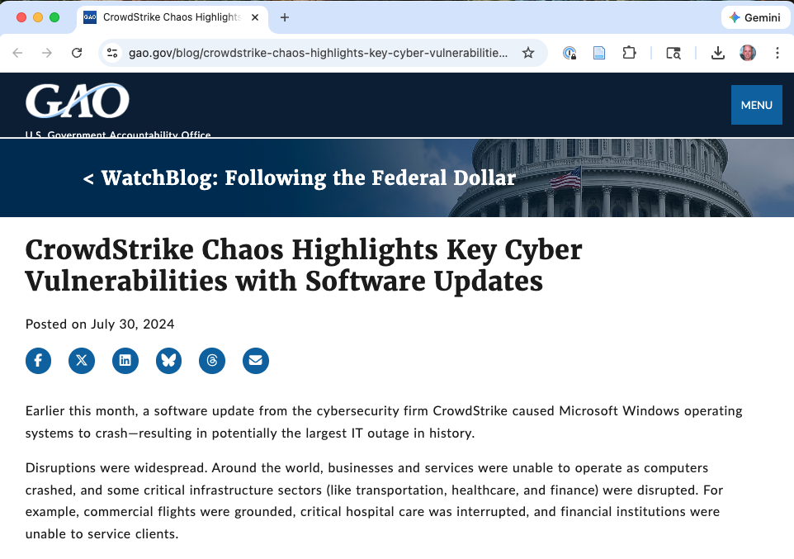
Small Trusted Computing Base (TCB)
The TCB comprises the system components that must work correctly for security to hold.
Keep it small (and simple) to reduce susceptibility to compromise.
The security software paradox: Security tools (firewalls, IDSes, antivirus) are part of the TCB. But as they grow in complexity, they become vulnerable themselves.
Notes:
The TCB concept is the formalization of the simplicity principle applied to security. It asks: what are the specific components that must be correct for the security guarantees to hold? Those components are the TCB, and everything else is outside it.
The smaller the TCB, the easier it is to verify, audit, and test.
This is the simplicity principle from Lecture 1 applied to the security-critical core.
The security software paradox (documented by DARPA) is worth highlighting: we add security tools to improve security, but each tool adds code that must itself be secure. An exploit in a SIEM tool can give an attacker access to all the logs. An exploit in a firewall can give access to all network traffic. This is why the TCB should be as small as possible, even for security tools themselves.

Slide 41
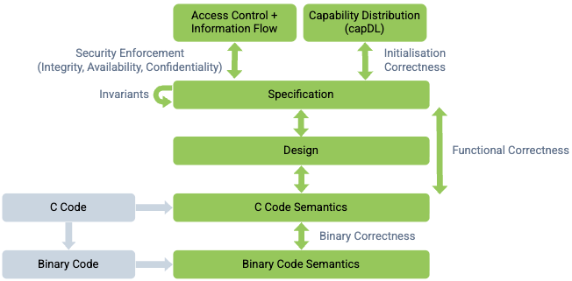
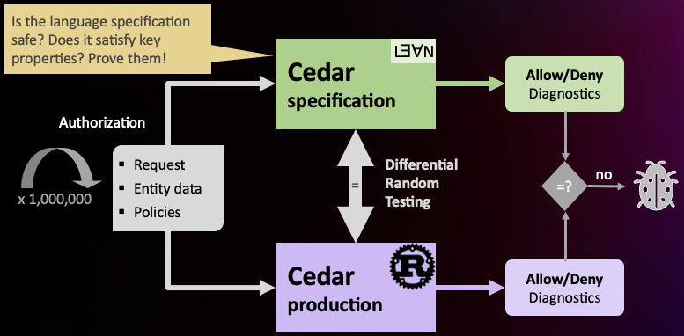
Examples: seL4 and Cedar
seL4 security proof structure
Cedar verification-guided development
Notes:
seL4 is a microkernel
A compromise in an OS device driver compromises security overall.
Microkernels (seL4, QNX) move drivers outside the kernel
that has been formally verified – mathematically proven correct.
Its entire kernel is about 10,000 lines of C. Compare that to the Linux kernel at 30+ million lines. The smaller codebase makes formal verification feasible.
Cedar benefits to TCB
Lean model
Simple design, small code
Policies centralized, easier to review – including by analysis

Slide 42
Ecosystem Lens: Frameworks as the TCB
Kern’s archetype frameworks are a deliberate TCB design:
Security experts build and maintain the framework (the TCB)
Application developers build on top of it (outside the TCB)
Improving the framework improves all applications built on it.
But: If the framework has a bug, all applications are affected.
A small, well-scrutinized codebase is far less likely to have bugs than thousands of ad-hoc implementations.
Notes:
This slide makes explicit the connection between the TCB concept and Kern’s ecosystem approach. The framework IS the trusted computing base for the security properties it provides. Just as a microkernel is a small, verifiable TCB for OS-level security, a security framework is a small, verifiable TCB for application-level security.
The “leverage” point is worth emphasizing: when Google’s security team finds and fixes a vulnerability in a framework component, the fix deploys to all applications using that framework, often automatically. Compare this to finding a vulnerability pattern and then hunting for every instance across thousands of independent applications.
Kern notes that “future security improvements and mitigations for novel attacks and defect classes can often be deployed swiftly, scalably, and efficiently, taking advantage of the well-defined structure of frameworks-based applications.”
This is the same argument for using identity providers (from Lecture 1): Auth0 maintaining your auth stack is better than you maintaining it yourself, because their TCB is smaller and more scrutinized than your ad-hoc implementation.

Slide 43
Ecosystem Lens: Safe Deployment
Zero Touch Prod: Every change to a production environment is made by trusted automation, prevalidated by conformance checks, or through an audited break-glass mechanism.
Safe Proxies: Trusted systems interposed between human engineers and production that:
Validate the safety of requested actions
Impose mandatory auditing and multiparty authorization
Rate-limit potentially destructive actions
Notes:
This is compartmentalization and separation of privilege applied to the deployment and operations environment, not just the application architecture.
Kern describes a common scenario: an SRE setting up a production environment with hundreds of devices, each with its own configuration surface. A typo in a command-line argument can expose an internal service to the public internet. The response: treat deployment environments as a developer ecosystem and apply the same Safe Coding principles.
Config-as-code: store the entire configuration in version-controlled files, apply changes through automation with conformance checks, require two-person review. This is analogous to our earlier discussion of code signing and authenticated updates.
Safe Proxies: mediate all interactions between humans and production. An engineer can’t directly SSH into a production server and run commands – they must go through a proxy that validates, logs, and potentially requires a second approver. This is separation of privilege at the operational level.
Connect to the “break glass” mechanisms from Lecture 1: Zero Touch Prod allows break-glass for emergencies, but the break-glass event is itself logged and audited after the fact.

Slide 44
Config-as-Code: Safe Coding for Deployment
Framework-as-TCB includes the production environment: Engineers may not make direct changes to deployment; offered a limited API
The unreliable way: An engineer configures a firewall through a CLI or web UI. Changes take effect immediately, including mistakes
The safer way: A Kubernetes NetworkPolicy, checked into version control, and enforced by the platform

Slide 45
Config-as-Code: Safe Coding for Deployment
# payment-api-network-policy.yaml
apiVersion: networking.k8s.io/v1
kind: NetworkPolicy
metadata:
name: payment-api-policy
namespace: production
spec:
podSelector:
matchLabels:
app: payment-api
policyTypes:
- Ingress
ingress:
- from:
- podSelector:
matchLabels:
app: frontend
ports:
- port: 443
Policy (like Cedar) is declarative (what, not how)
only the frontend can reach payment-api
HTTPS only
Notes:
This is a real Kubernetes NetworkPolicy. By default, Kubernetes pods have no network isolation – any pod can talk to any other pod. A NetworkPolicy declares allowed traffic; everything else is denied (fail-safe default).
This example says: only pods labeled app: frontend can send traffic to pods labeled app: payment-api, and only on port 443. All other ingress traffic is blocked by the platform.
The connection to Kern’s config-as-code principle: this YAML file lives in the same repository as the application code. Changes go through code review, CI checks, and version control – just like source code. An engineer can’t accidentally open up the payment API to the internet by typing the wrong command in a CLI, because the configuration is declarative and reviewed.
Kern describes the problem this solves: production environments with hundreds of devices, each with its own configuration UI and language. An SRE making changes through a CLI can make a typo that exposes an internal service. Config-as-code prevents this by requiring all changes to go through the same review pipeline as code.
Kubernetes also supports admission controllers (like OPA/Gatekeeper, or even Cedar – see cedarpolicy.com/blog/cedar-for-kubernetes) that can enforce conformance checks on configurations before they’re applied. For example: “No service in the production namespace may accept ingress from outside the cluster without a security review label.”
This is the same pattern as Safe Coding: instead of “engineers should be careful with configuration” (guidance), the platform structurally prevents unsafe configurations from being deployed (ecosystem).

Slide 46
Transitive Trust
If you trust component A, and A trusts component B, then you implicitly trust B. This trust can be misplaced.
Classic example: An email client delegates to a full-featured editor (vi, emacs) for composing messages, but editor provides shell access.
Better: Use a restricted editor, or sandbox the editor so shell escape runs with reduced privileges.
Notes:
Transitive trust is subtle and often overlooked. Every dependency in your system creates a trust chain. If your application trusts a library, and that library trusts another library, you implicitly trust the entire chain.
Applied to our examples:
CMS: the CMS sends student submissions to a plagiarism detection service. If that service is compromised, the attacker gains access to every submitted document. Mitigation: send only text content (not the full file with metadata), use a scoped API key, audit what data the service receives.
Payment app: a third-party push notification SDK runs inside the app process with access to whatever the app has in memory. If the SDK is compromised or exfiltrating data, it can access authentication tokens. Mitigation: compartmentalize the SDK, minimize in-memory data.
General: for every third-party component in your DFD, ask: what am I trusting this with? What’s the blast radius if it’s compromised?

Slide 47
Transitive Trust in Our Examples
System | Third-party Component | What You’re Trusting It With | If Compromised
CMS | Plagiarism detection | Every student submission | Document exfiltration
CMS | LTI plugin | User session, course data | Account takeover
Payment app | Push notification SDK | In-memory auth tokens | Token theft
Payment app | Analytics library | Transaction metadata | Privacy breach
For every third-party component in your DFD:
What am I trusting this with? What’s the blast radius if it’s compromised?
Notes:
This table is a useful exercise for students to apply to their own threat models. For each third-party component, explicitly enumerate what data and capabilities it has access to, and what happens if it's compromised.
Mitigations follow a pattern:
- Send the minimum data necessary (data minimization)
- Use scoped API keys (least privilege)
- Audit what data the component receives (monitoring)
- Compartmentalize the component so compromise doesn't spread (sandboxing)

Slide 48
Authenticating Code and Data
When your system depends on external code or data – firmware updates, plugins, configuration – verify that what you receive is what you expect.
Code signing: Developer signs software with a private key (held in an HSM); recipient verifies with the corresponding public key before running.
Examples:
CMS: browser extensions/plugins signed by their developer
Payment app: app store code signing ensures users get the genuine app
Any system receiving firmware/software updates over a network
If the signature check fails → reject.
Notes:
This generalizes: any system that accepts updates, plugins, or configuration from an external source needs a mechanism to verify authenticity and integrity before applying them.
For systems that receive firmware or software updates over a network (like the GlucoGuard pump), code signing is essential. An attacker who compromises the update channel can own every device if updates aren’t verified.
The key must be stored in an HSM (Hardware Security Module) to prevent extraction. If the signing key is compromised, the attacker can sign malicious updates that will pass verification.

Slide 49
Separation of Privilege
S&S: Require multiple conditions to be satisfied before granting access to critical actions. Don’t make any single credential or factor sufficient.
Payment app:
Authentication (password) + authorization (you own the account) + confirmation (PIN/biometric for this specific transaction)
No single compromised factor is sufficient
CMS:
Changing a final grade could require the instructor’s action + a department-level counter-signature
This is broader than MFA: separation of privilege applies to authorization decisions, not just identity verification.
Notes:
Separation of privilege is related to but distinct from multi-factor authentication. MFA applies multiple factors to verify identity. Separation of privilege applies multiple conditions to authorize actions.
For example, in the payment app, even if the attacker has the user’s password AND their session token, they still need the transaction-specific PIN or biometric. This is separation of privilege at the transaction level.
For the CMS grade change example: requiring both the instructor and a department counter-signature means that a compromised instructor account alone cannot change final grades. This is separation of privilege at the authorization level.

Slide 50
Compartmentalization and Sandboxing
Isolate components in compartments so that compromise of one doesn’t give access to others.
Mechanism | Granularity | Example
Process isolation | Per-component | Chrome: each tab in a separate process
seccomp-bpf (Linux) | Per-syscall | Restrict process to read, write, exit only
Containers / VMs | Per-service | Microservice isolation
Mobile sandboxing | Per-app | iOS/Android sandbox each app by default
Notes:
Process isolation: Chrome runs each tab in a separate process. Exploiting a vulnerability in one tab's renderer doesn't give access to another tab's data or the browser's master process. This is one of the most impactful security decisions in modern browser architecture.
Seccomp-bpf: restrict a process to a policy-specific set of system calls. A compartmentalized process can read, write, and exit, but cannot open new files, make network connections, or execute programs. Used by Chrome, OpenSSH, and vsftpd.
Example: isolating a document renderer. Fork a new process, open the file, exec the renderer, then call seccomp-bpf to lock it down. The renderer can process the content but can't reach the network or filesystem.

Slide 51
Compartmentalization in Our Examples
CMS: Server-side PDF renderer (for grade reports) runs in a sandbox. A malicious PDF exploiting a renderer vulnerability can’t access the grades DB.
This is the confused deputy problem (again!): the renderer runs with the server’s privileges but processes untrusted input.
Payment app: Payment processing and social feed run in separate containers with separate DB credentials. SQL injection in the social feed does not expose financial data.
Notes:
The confused deputy problem from the SbD lecture: a program (the PDF renderer) acts on behalf of a user but with its own elevated privileges. If the user can trick the program into misusing those privileges (via a malicious PDF), the user gains access they shouldn’t have.
Sandboxing solves this by removing the elevated privileges. The renderer runs in a restricted environment where even if it’s exploited, the attacker can’t reach anything valuable.
For the payment app: the social feed is a lower-security component (it displays transaction descriptions and emojis). The payment processing service handles financial data. Compromising the social feed should not give access to bank credentials or transfer capabilities. Separate containers with separate database credentials enforce this boundary.

Slide 52
Promote Privacy
Restrict the flow of sensitive data as much as possible, reducing the trust surface.
Data minimization:
Don’t collect data you
don’t need
Don’t store it longer
than you need
Don’t transmit it to
components that don’t need it
System | What the component receives | What it should receive
CMS → Plagiarism service | Student name, email, ID, submission | Text content with anon ID only
Payment app → Analytics | Full transaction details | Aggregated statistics only
Notes:
This is least privilege applied to data, not just to operations.
CMS: does the plagiarism detection service need the student's name, email, and student ID? Or just the text content with an opaque identifier? Send the minimum. If the plagiarism service is compromised, the attacker gets anonymized text, not PII.
Payment app: does the analytics pipeline need full transaction details? Or just aggregated statistics? The less data you share, the less damage a compromise can cause.

Slide 53
Restricting Data Views: Least Privilege Again
Example: A student admission system receives sensitive letters of recommendation as PDFs.
Typical design: Reviewers download PDFs to local machines → compromise of those machines leaks private information
Better: PDFs viewable only in a secure browser viewer; no data downloaded to the client
Payment app: Customer support agents investigating a dispute:
Default: show masked data (****1234)
Full access: requires supervisor override + audit log entry
Notes:
The admission system example illustrates how data access patterns create risk. Even if the central system is well-secured, allowing downloads to reviewer laptops creates hundreds of copies on devices with varying security postures.
For the payment app, the question is: what’s the minimum information the support agent needs to resolve the dispute? Usually a masked account number and transaction details are sufficient. Full access (unmasked bank account numbers, SSN) should require a supervisor override, be logged, and be reviewed.
This connects to the principle of data minimization: even within your own organization, restrict who can see what to the minimum necessary.

Slide 54
Input Validation as Trust Minimization
Input validation is a form of trust with reluctance: trust a subsystem only under specific circumstances.
Trust a function’s parameters only if they’re within expected range (e.g., buffer length)
Trust a web form field only if it contains no code-interpretable strings (XSS, injection)
Trust a serialized object only if it contains no executable content (deserialization attacks)
Apply at every trust boundary in the DFD.
Notes:
Input validation ties together several concepts: - It’s the fail-safe defaults principle applied to data (define what IS valid, reject everything else) - It’s trust with reluctance (don’t trust input until validated) - It’s complete mediation (validate every input, every time)
The trust boundary language is important: students should be able to look at their DFD, identify every trust boundary, and ask “what validation happens when data crosses this boundary?”
For the GlucoGuard project: what happens when the cloud platform sends a configuration change to the pump via the app? What validation should the pump perform before applying a new insulin delivery rate? This is where input validation becomes a safety concern, not just a security concern.

Slide 55
Monitoring and Traceability

Slide 56

Designing for Detection
If you are attacked, how will you know?
Once you learn, how will you discern the cause?
Software must be designed from the start to produce operational telemetry.
Notes:
Many systems are designed with logging as an afterthought – developers add console.log statements during debugging and call it monitoring. Real monitoring requires intentional design: deciding what events to emit, what format to use, how to aggregate and correlate, and what patterns to alert on.
The shift from “we’ll add monitoring later” to “monitoring is a design requirement” is analogous to the shift from “we’ll add security later” to “security by design.” Both are much harder to retrofit than to build in from the start.

Slide 57
Detecting Attacks in Progress
These patterns are not detectable from a single log line. They require aggregation and correlation.
Payment app anomalies:
Many small transfers to new accounts
Transfers at unusual hours from unusual locations
Sudden spikes in failed login attempts
Transfers just under reporting thresholds ($9,999 instead of $10,000)
CMS anomalies:
A single account downloading every student’s submission
Repeated authorization failures (probing for IDOR)
Grade changes outside normal grading periods
Notes:
The key insight: individual events look normal. A single login from a new IP isn’t suspicious. A single transfer isn’t suspicious. A single authorization failure isn’t suspicious. But a login from a new IP at 3am, followed by adding a new bank account, followed by three transfers just under the reporting threshold – that pattern is highly suspicious.
This is why monitoring must be a design-level concern: the system needs to emit events in a format that enables correlation, with correlation IDs that link related events across services, and with enough context (IP, device, timestamp, geolocation) to detect patterns.

Slide 58
Log Aggregation and Correlation
In a distributed system, evidence is spread across multiple services. A single attack may touch auth, payment, notifications, etc.
Correlation example:
User X’s session created at 3:42am from an IP in a new country
→ three transfers totaling $9,999
→ push notifications silenced
Design implication: Include correlation IDs in every log entry.
Notes:
Log aggregation tools (Splunk, ELK stack, cloud logging services) collect logs from all components into a single searchable store. But aggregation alone isn’t enough – you need correlation.
Correlation connects related events across services. The example shows a pattern that’s invisible if you look at any single service’s logs: the auth service sees a login, the payment service sees transfers, the notification service sees a configuration change. Only by correlating all three do you see the attack pattern.
Design implication: every log entry should include a correlation ID (request ID, trace ID) that connects events from different services for the same user action. This is a design decision that must be made early – retrofitting correlation IDs into an existing system is painful.

Slide 59
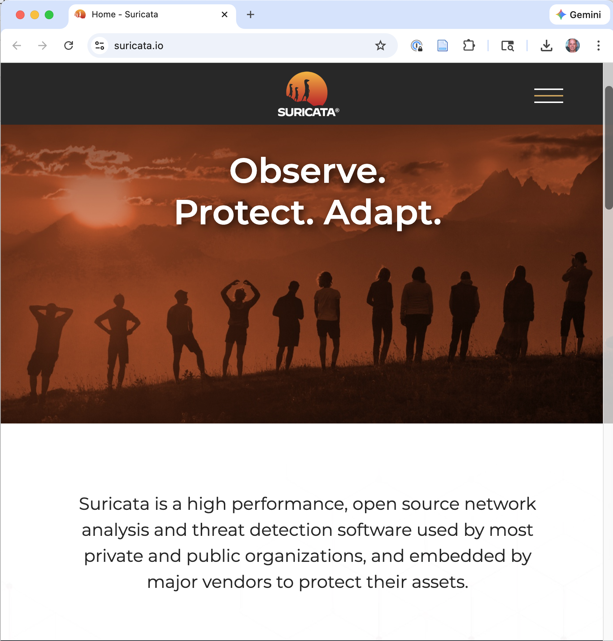
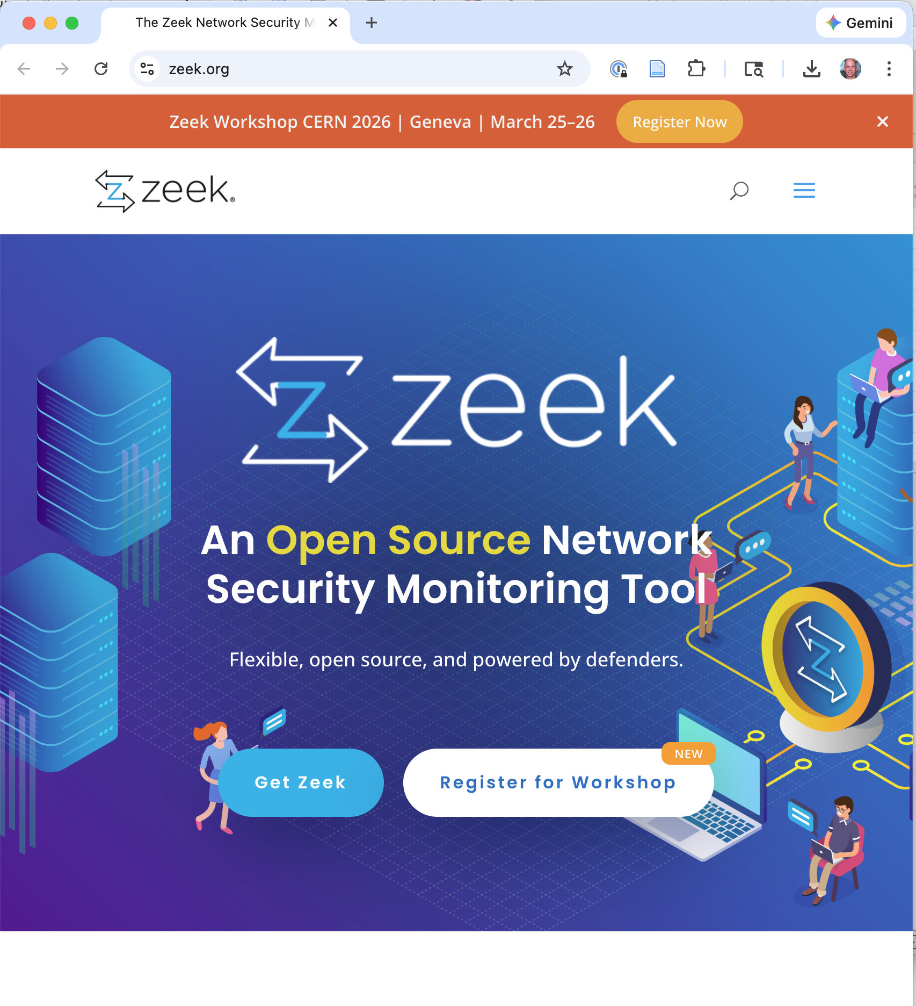
Intrusion Detection and Log Analysis

Slide 60
Pulling It Together

Slide 61
From Threat List to Architecture
Individual threats often converge on the same mechanism.
A security architecture is not “for threat X, do Y” repeated 20 times. It’s a coherent design where mechanisms serve multiple purposes.
CMS convergence:
Spoofing of student identity + elevation of privilege to instructor + information disclosure of grades → centralized, relationship-based access control with server-side enforcement and complete mediation
Payment app convergence:
Tampering with transfer amount + spoofing of sender + disclosure of bank credentials → authenticated encryption in transit, per-transaction re-authentication, encrypted credential storage with KMS
Notes:
**Kern's archetype insight:** Much of this convergence is *common across all applications of a given type*. The framework can encode the shared architecture; the team focuses on what's unique to their application.
This is the synthesis step that students need for their GlucoGuard project. The threat model produces individual threats with individual mitigations. The security architecture summary consolidates overlapping mitigations into a coherent design.
The architecture summary tells the story of how the system works securely, not a laundry list of individual fixes. A reader should come away understanding the overall security posture, not just a list of threats and responses.

Slide 62
The Principles as a Design Review Checklist
Principle | Review Question
Favor simplicity | Is the security-critical code path as simple as possible?
Fail-safe defaults | Does the system deny by default? Are defaults secure?
Don’t expect expert users | Does security depend on unreliable user behavior?
Small TCB | What must be correct, for security? Is that set minimal?
Least privilege | Does every component have minimum access needed?
Compartmentalization | If component X is compromised, what else is exposed?
Promote privacy | Are we collecting/storing/sending more data than needed?
Notes:
This table (continued on the next slide) is a practical tool students can use when reviewing their security architectures. For each principle, ask the review question. If the answer reveals a gap, that’s a design issue to address.
This is also useful for the GlucoGuard project’s Security Architecture Summary section: after enumerating threats and mitigations, use this checklist to verify the architecture is complete.

Slide 63
Design Review Checklist (continued)
Principle | Review Question
Complete mediation | Is every access checked, every time, at the server?
Separation of privilege | Does any critical action depend on a single condition?
Open design | Does security depend on obscurity, or on keys and controls?
Defense in depth | If one layer fails, does another independent layer catch it?
Monitor and trace | If attacked, will we know? Can we reconstruct what happened?
Notes:
The defense in depth question is the meta-check: for every security mechanism, ask “what if this fails?” If the answer is “then the system is fully compromised,” you’re missing a layer.
Open design: this doesn’t mean publishing your source code (though it can). It means your security shouldn’t depend on attackers not knowing how your system works. If learning your architecture would break your security, your security is insufficient.

Slide 64
Three Categories as a Completeness Check
Category | Have we addressed it?
Prevention | Eliminating classes of flaws (type-safe languages, vetted crypto, input validation, simple design)
Harm Reduction | Containing damage from unknown flaws (least privilege, compartmentalization, privacy, separation of privilege)
Detection & Recovery | Knowing when something goes wrong (audit logging, monitoring, correlation, alerting)
If any category is empty, the architecture has a gap.
Notes:
This is a simple but powerful completeness check. A common failure mode is an architecture that’s strong on prevention (good crypto, good input validation) but has no detection capability – so when prevention inevitably fails, the team doesn’t know about it until the breach is in the news.
Another common failure mode: strong prevention and detection, but no harm reduction. If a single compromised component gives access to everything, the detection just tells you how bad the damage is.

Slide 65
Part 2 Summary
For each mitigation, ask: does this depend on individual developer vigilance, or is it enforced by the ecosystem?
Topic | Key Techniques | Principles
Authorization | RBAC, ABAC/ReBAC, Cedar, server-side enforcement | Complete mediation, Least privilege
Integrity | Input validation (allowlists), HMAC, authenticated encryption | Fail-safe defaults, Trust w/ reluctance
Accountability | Audit logging, correlation IDs | Monitor and trace
Trust minimization | Small TCB, transitive trust analysis, code signing | Trust w/ reluctance, Simplicity
Compartment-alization | Process isolation, seccomp-bpf, containers | Separation of privilege
Privacy | Data minimization, restricted views | Promote privacy
Architecture | Convergence of mitigations | Defense in depth
Notes:
The key takeaway across both lectures: secure design is not a list of techniques to apply mechanically. It’s a way of thinking about systems – asking “what can go wrong?” at every level, and applying principles to guide the design of mitigations.
For the GlucoGuard project: students should now be able to take their STRIDE threats and propose concrete mitigations grounded in these principles, then consolidate those mitigations into a coherent security architecture.
The design review checklist is a practical tool they can use to verify completeness.

Slide 66
Quick-Reference: Secure Design Techniques
Technique | Principle(s) | CMS | Payment App
TLS / HTTPS | Open design, DiD | Grades in transit | Transfer instructions
AES-GCM at rest | DiD, Privacy | Student records (FERPA) | Bank account numbers
Argon2id | DiD, Fail-safe | Account passwords | Account passwords
IdP / SSO | Trust w/ reluctance | University SSO (SAML) | Auth0/Okta for MFA
mTLS | Trust w/ reluctance | LTI plugin integration | Server ↔ bank API
Cedar policies | Simplicity, Small TCB | TA scoped to section | User-owns-account
Compartmentalization | Compartmentalize | PDF renderer sandboxed | Payment ≠ social feed
Audit logging | Monitor and trace | Grade change history | Transfer evidence
Notes:
This is a reference table for students to use when working on their threat models. For each technique, they can see which principle(s) it implements and how it applies to familiar examples.
Additional techniques not shown here for space (but covered in the lectures): BLE security, application-layer encryption, key management (KMS), password manager support, FIDO2/WebAuthn, code signing, input validation (allowlists), HMAC, data minimization, rate limiting, graceful degradation, correlation IDs, “break glass” mechanisms.

Slide 67
References
Kern, C. “Developer Ecosystems for Software Safety.” Communications of the ACM 67, no. 6 (June 2024): 52–60.
Saltzer, J.H. & Schroeder, M.D. “The Protection of Information in Computer Systems” (1975)
CIS/SAFECode, “Secure by Design: Guide to Assessing Software Security Practices” (2025)
Cedar Policy Language – https://www.cedarpolicy.com/
Schneier, B. “Attack Trees” (Dr. Dobb’s Journal, 1999)
OWASP Authorization Cheat Sheet
OWASP Input Validation Cheat Sheet
Anderson, J.P. “Computer Security Technology Planning Study” (1972) – the reference monitor concept
NIST SP 800-218: Secure Software Development Framework (SSDF)
Notes:
Additional references:
Kern’s paper references several related works worth exploring:
Adkins, H. et al. Building Secure and Reliable Systems (O’Reilly, 2020) – covers Safe Proxies, Zero Touch Prod, and other Google practices.
Wang, P., Bangert, J., and Kern, C. “If it’s not secure, it should not compile” (ICSE 2021) – details on preventing DOM-based XSS through API hardening.
Kern, C. “Securing the Tangled Web” (Commun. ACM 57, Sept. 2014) – earlier paper on Safe Coding for web security.
Open-source Safe Coding implementations: github.com/google/safevalues (TypeScript), github.com/google/safehtml (Go).
For Cedar specifically: “Cedar: A New Language for Expressive, Fast, Safe, and Analyzable Authorization” (OOPSLA 2024).
For compartmentalization: Provos, N. “Improving Host Security with System Call Policies” (USENIX Security ’03) – the original seccomp paper.
For the TCB concept: Department of Defense “Trusted Computer System Evaluation Criteria” (Orange Book, 1985) – where TCB was formally defined.
For input validation: OWASP Testing Guide, Chapter on Input Validation Testing.

